Slide 1

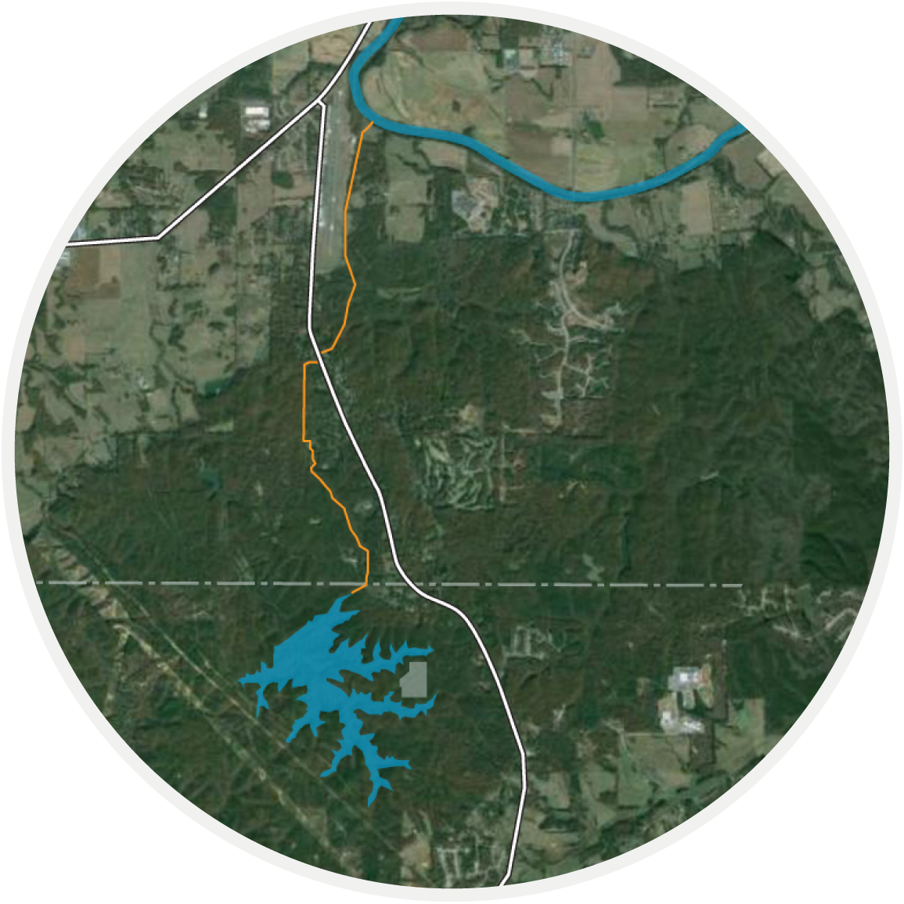
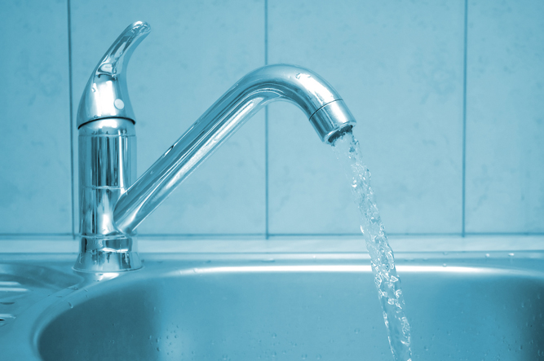
Richland Creek Water Supply Program
Status Update
Paulding County, Georgia
Board of Commissioners Work Session
January 26, 2016
Notes:
Speaker: Mark

Slide 2

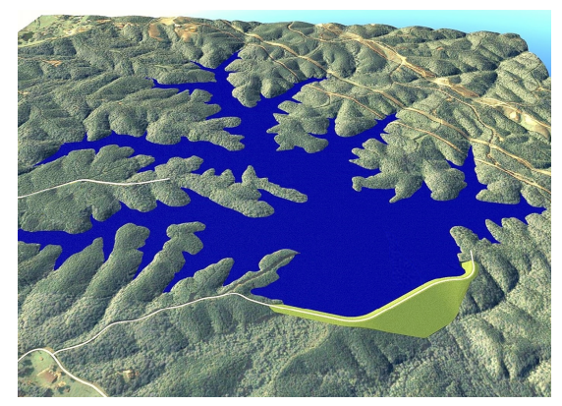
Update on Reservoir
        Design
        Received comments back from Safe Dams
        Conducted peer review (Schnabel Engineering)
        Contractor Procurement
        RFQ for Prequalification of Dam Contractor, Grout Injection, Slurry Wall due 01/29/16
        Bidding among prequalified contractors will take place in May
        RFP issued for tree harvesting on 01/21/16 (due 02/19/16)
        Construction
        Installation of USGS Monitoring Station during week of 01/25/16
        Tree clearing will begin in March
        Selected dam contractor will begin construction in July
Notes:
Speaker: Kelly

Slide 3
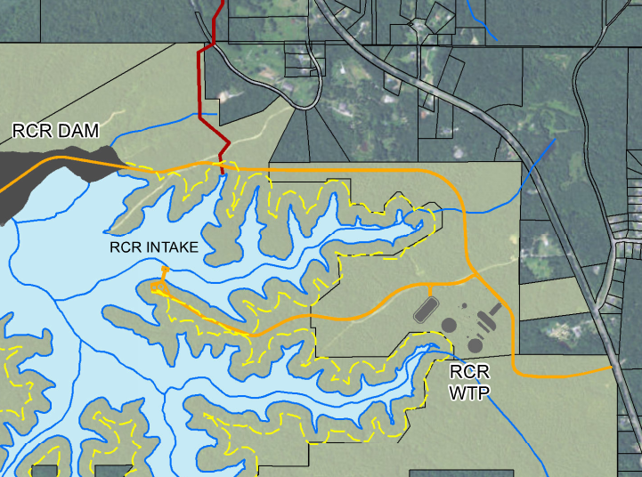
Update on 61 Entrance Road
        Design
        Design is complete
        GDOT permitting is ongoing
        Contractor Procurement
        RFP advertising for 61 Intersection Improvements, Road, and Site Grading Package issued on 01/21/16 and is due on 02/19/16
        Will go to WSAB and Commission in February
        Construction
        Selected contractor will begin construction in March and be complete in August
Notes:
Speaker: Kelly

Slide 4
Update on WTPs and Pump Stations
        Design
        Design will be at 100% in mid February
        EPD Drinking Water Program Permitting is being initiated
        Contractor Procurement
        CMAR has issued 17 RFQs for specialty packages (sitework, concrete, HVAC, Electrical, etc.) with Qualifications Packages due 01/29/2016
        CMAR Contractor will receive bids in May
        GMP
        CMAR Contractor to submit GMP in May for approval.
        Will go to WSAB and Commission in May / June
        Construction
        Construction will begin in late August
Notes:
Speaker: Kelly

Slide 5
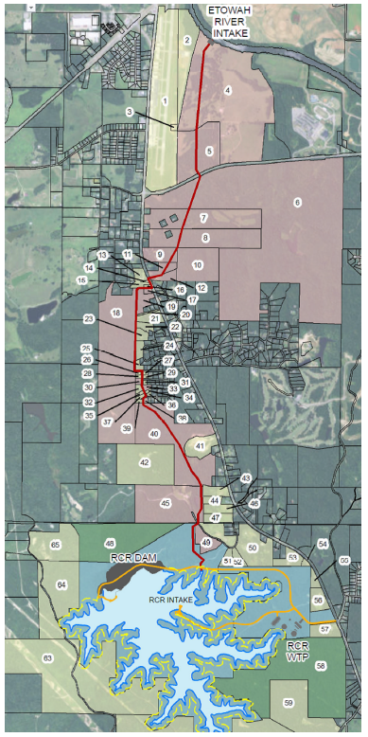
Update on Raw Water Pipeline
        Design
        Met with Bartow County to provide update
        Beginning process of easement acquisition
        Design is at 30% and will begin to advance
        Construction
        Construction will begin in Late 2016 and will be complete in late 2017 / early 2018.
Notes:
Speaker: Kelly

Slide 6
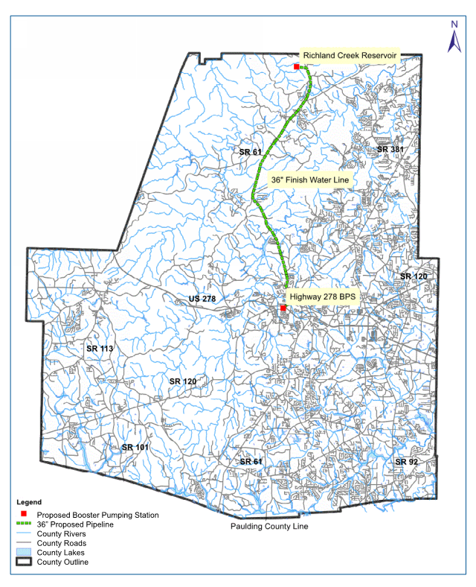
Update on Finished Water Pipeline and BPS
        Design
        Issued RFP for Design Engineer – Due 01/29/15
        Recommendation to W&S Advisory Board and Commission in February
        Design will take approximately 10 months
        Construction
        Contractor Procurement in early 2017
        Construction will begin in March of 2017 and be complete in March 2019
Notes:
Speaker: Kelly

Slide 7
Program Cost
Project Element | Cost
Reservoir | $ 70,300,000
WTPs and Pump Stations | $ 98,800,000
Raw Water Pipeline | $ 9,400,000
Finished Water Pipeline and BPS | $ 36,500,000
Total Program | $ 215,000,000
        Costs shown include design /CM, construction, easements, mitigation, and program management
Notes:
Speaker: Kelly

Slide 8
Cost $215,000,000
GEFA has provided
  $2,800,600 3.13%
  $29,100,000 1.82%
  $21,600,000 1.40%
  $ 6,000,000 2.03%
  $ 8,206,000 2.03%
  $15,000,000 0.00% No payback required
  $82,706,600

Slide 9
Remaining $132,293,400
We are in discussion with USDA to provide some low interest funding for this project and they are interested
How much can they provide?
What are the advantages to USDA funding?
  Lower the amount of Capitalized Interest
  Lower repayment Interest Rate
  Repayment Term 40 years rather than 30 years

Slide 10
USDA Funding -CAUTION
What are the disadvantages?
  Federal $$’s always come with strings attached
  The cost of meeting federal requirements can sometimes outweigh the advantages
  USDA REQUIRES the “Full Faith and Credit” backing for these $$’s
    This requirement can only be met if we establish a Water Authority and the County enters into an Agreement with the Authority to back the bonds with the “Full Faith and Credit of the County”

Slide 11
USDA - Advantage
Extending the repayment 10 years
    Savings of approximately $1,000,000 annually
Capitalized interest expense
  Only pay interest as we draw the funds down
  Traditional bonds we will capitalize interest on entire bond issue beginning day after the bond sale.

Slide 12
What if we don’t qualify for USDA?
We go to market and issue Revenue Bonds
Revenue Bonds are backed with a revenue source.
  Revenue Source – Water and Sewer Fees

Slide 13
Current Financial Market Ratings
Revenue
  Moody’s Aa3
  Standard & Poor’s AA
General Obligation
  Moody’s A2
  Standard & Poor’s AA-stable

Slide 14
Revenue Bond
What revenue stream will be used for repayment?
  Water and Sewer Revenues
  Revenues are measured by Coverage Ratios

Slide 15
Coverage Ratios
Rate Covenants are of particular interest to Revenue Bonds
  Basically, they are a pledge by the issuer to keep user fees and charges at a level to provide:
    Debt Service Payments
    Adequate Insurance
    Operation and Maintenance for Facility
    Adequate Reserves for Debt RePayment
    Capital Projects

Slide 16
Coverage Ratios
Water and Sewer Department
Last Ten Fiscal Years
 |  |  |  |  |  | Net Revenue
Fiscal |  | Operating |  | Operating |  | Available for |  | Debt Service Requirements (2)
Year |  | Revenues |  | Expenses (1) |  | Debt Services |  | Principal |  | Interest |  | Total |  | Coverage
2006 |  | 17,790,621 |  | 10,261,848 |  | 7,528,773 |  | 1,645,000 |  | 1,989,618 |  | 3,634,618 |  | 2.07
2007 |  | 20,180,090 |  | 11,780,024 |  | 8,400,066 |  | 1,770,000 |  | 1,961,707 |  | 3,731,707 |  | 2.25
2008 |  | 19,002,271 |  | 12,222,465 |  | 6,779,806 |  | 1,855,000 |  | 1,909,311 |  | 3,764,311 |  | 1.80
2009 |  | 20,304,005 |  | 13,727,385 |  | 6,576,620 |  | 1,940,000 |  | 1,997,191 |  | 3,937,191 |  | 1.67
2010 |  | 21,814,247 |  | 15,276,639 |  | 6,537,608 |  | 2,340,000 |  | 1,751,813 |  | 4,091,813 |  | 1.60
2011 |  | 23,486,640 |  | 16,135,691 |  | 7,350,949 |  | 2,860,000 |  | 2,003,118 |  | 4,863,118 |  | 1.51
2012 |  | 24,829,896 |  | 16,961,111 |  | 7,868,785 |  | 3,000,000 |  | 1,883,644 |  | 4,883,644 |  | 1.61
2013 |  | 25,296,030 |  | 17,938,024 |  | 7,358,006 |  | 3,130,000 |  | 1,746,914 |  | 4,876,914 |  | 1.51
2014 |  | 26,046,079 |  | 18,174,022 |  | 7,872,057 |  | 3,285,000 |  | 1,495,281 |  | 4,780,281 |  | 1.65
2015 |  | 27,812,318 |  | 19,835,391 |  | 7,976,927 |  | 3,455,000 |  | 1,369,619 |  | 4,824,619 |  | 1.65
 |  | (1) Total operating expenses exclusive of depreciation.
 |  | (2) Includes principal and interest of revenue bonds only. It does not include the GEFA loans
 |  | reported in the Water and Sewer Department.

Slide 17
Rate Impacts
Rate Increases | 2016 | 2017 | 2018 | 2019 | 2020 | 2021
Total Water | 4.0% | 8.75% | 8.75% | 8.75% | 8.75% | 8.75%
CCMWA Increase | 4.0% | 4.0% | 4.0% | 4.0% | 4.0% | 4.0%
Additional Increase | - | 4.75% | 4.75% | 4.75% | 4.75% | 4.75%
Sewer | 4.0% | 4.0% | 4.0% | 4.0% | 4.0% | 4.0%
Current annual increases from CCMWA are 4%
Additional 4.75% will be needed in near term to implement Richland Creek Project
Following implementation the County will not have the ongoing 4% increase

Slide 18
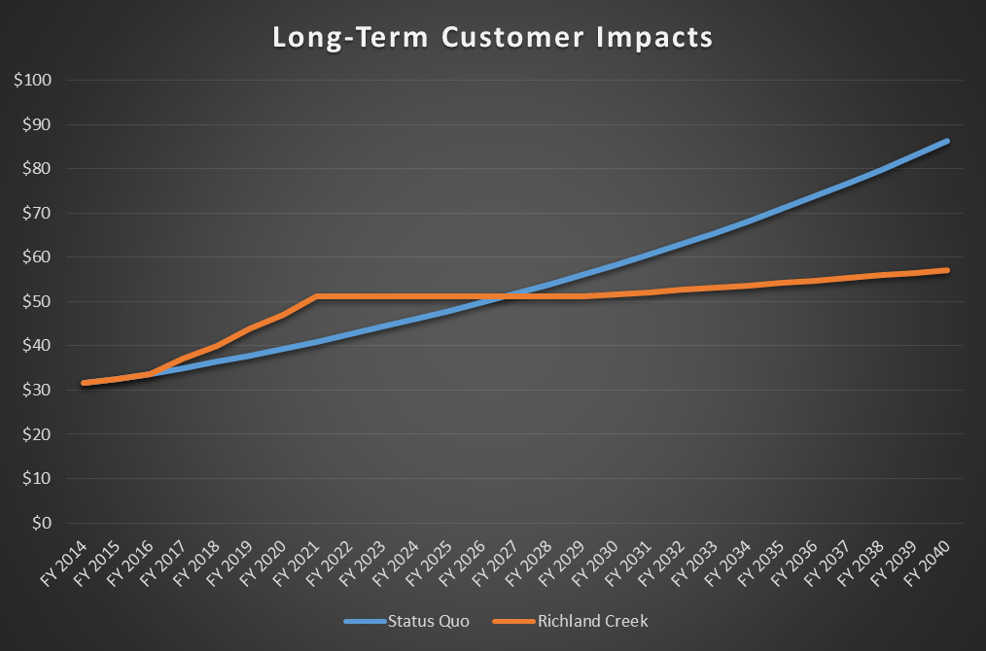
Long-Term Rate Forecast
Average monthly water bill for a customer using 4kgal per month

Slide 19
Potential Concerns for Rating
Debt is large for 42,000 customer system
  We are minimizing this risk with the 5 year rate increase being proposed to Board
  Extensive financial analysis has been conducted to ensure that we are able to meet all obligations of Water & Sewer System
  Current debt will be paid off in 2024
  County is committed to reviewing and updating the financial model to ensure obligations can be met

Slide 20
Double – Barreled Bond
Allows the Revenue Bonds to be backed by “Full Faith and Credit of County” via GO Bonds
Provides additional security for the bond holders – This extra layer of security would be an attempt to keep the County from experiencing a “downgrade” due to the size of the debt.

Slide 21
Double – Barreled Bond
The only way to use this type of security is through the establishment of an Authority and an agreement between the Authority and the Board of Commissioners to back or secure the bonds with the “Full Faith and Credit of the County”

Slide 22
Long-Term County Savings
    Over $100 Million in long term savings for the County
    Security of having your own water supply source

Slide 23
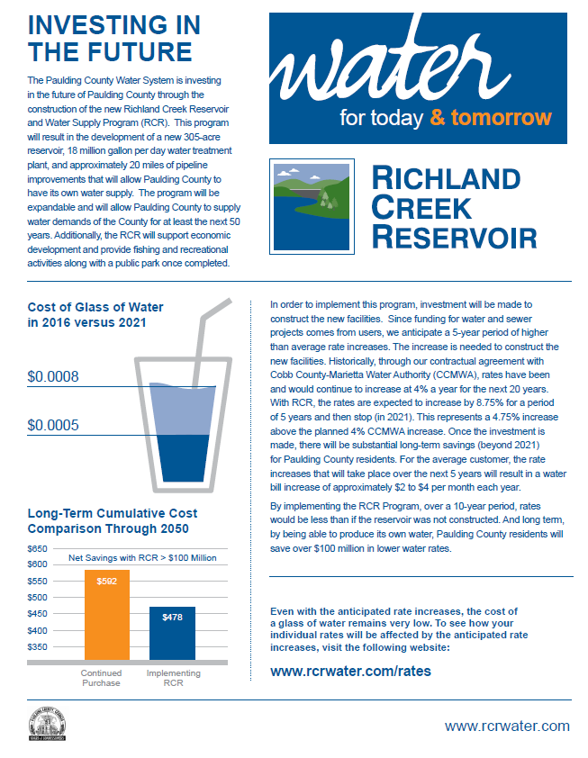
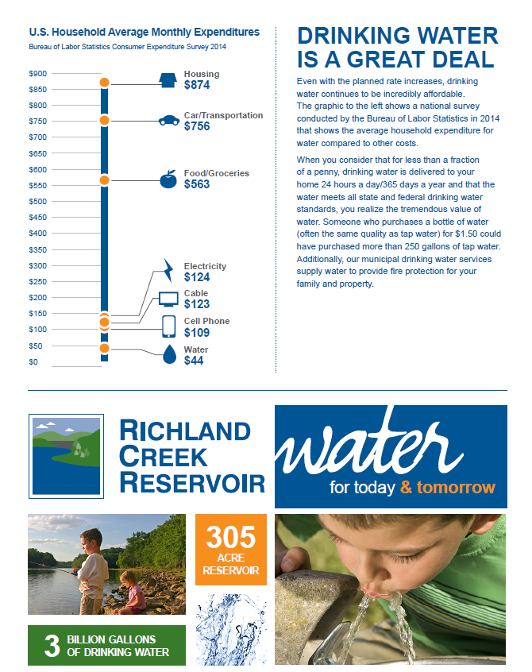
Bill Insert

Slide 24
Questions

