Slide 1
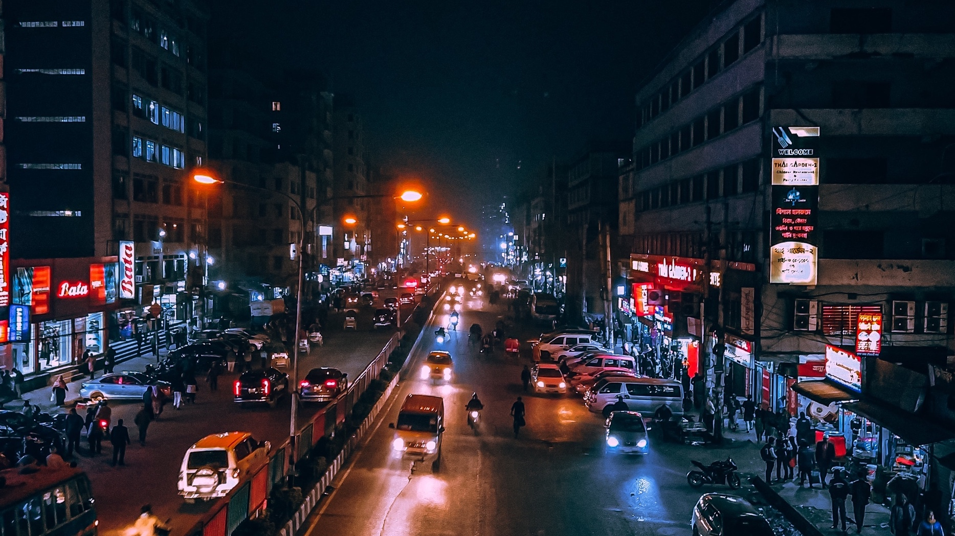
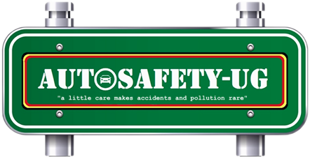
Autosafety – Uganda,
Tackling Africa’s Road Transport Emissions
from the Source.

Slide 2
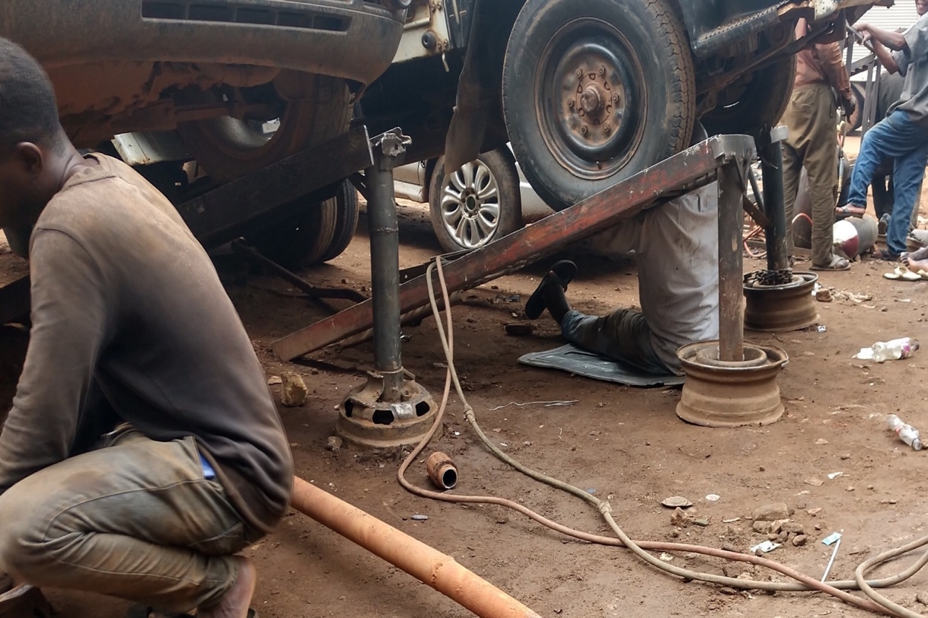
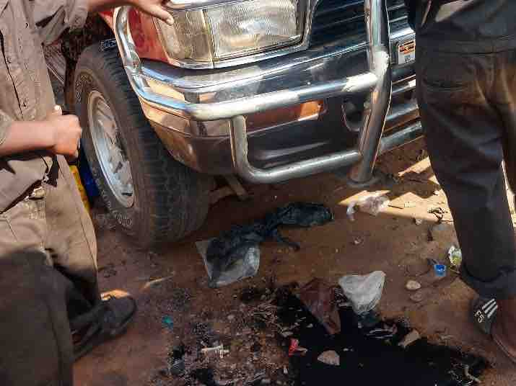
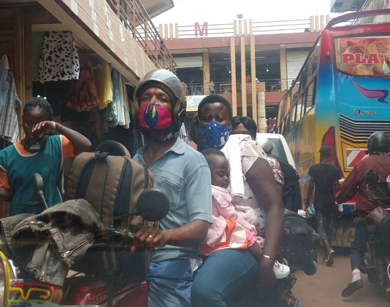
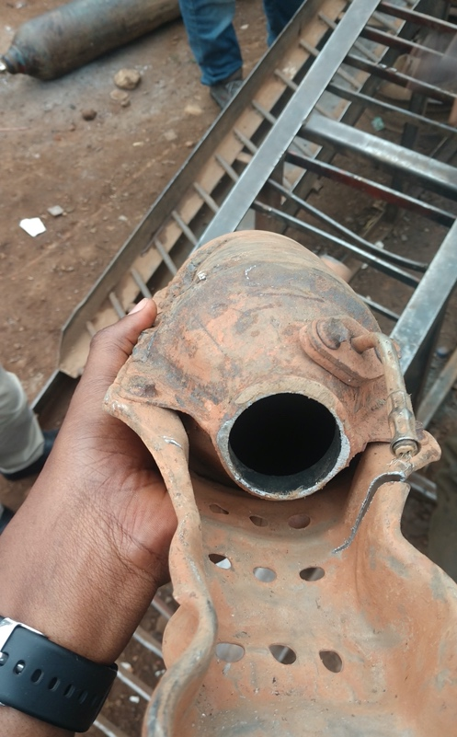
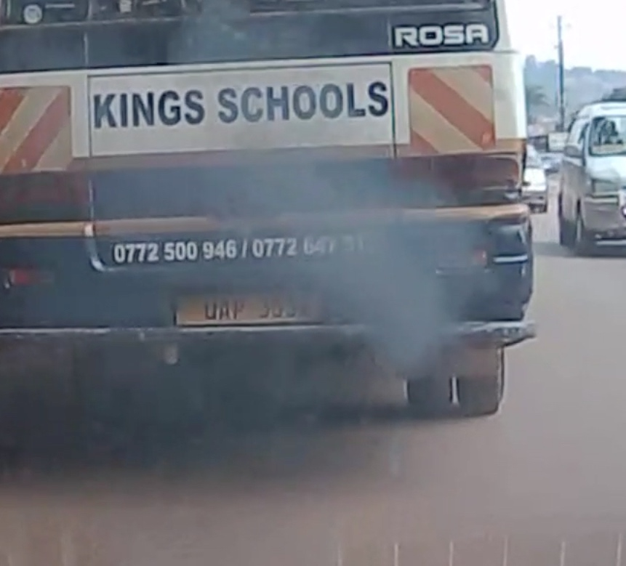
Problem: Old cars, Poor Maintenance, No data, Regulatory/Policy Gaps…
About 2 million vehicles in Uganda, average age 15yrs+.
90% used imports, exposed to poor maintenance practices & underdeveloped infrastructure amidst weak regulations – posing long-term negative impacts on the environment and public health.
Vast majority of vehicle maintenance & repairs done in makeshift settings; no skills, inappropriate tools – highly compromising emission controls & safety
Lack of citizen awareness on eco-friendly motoring and green mobility alternatives.
Domination of the underregulated informal sector

Slide 3
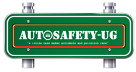
Our Intervention Framework…….
Government
Safety, emission standards, and regulations, transport infrastructure
Research to inform policy on transport pollution control
Universities, training institutions,
NGOs….
Research on safer & cleaner technologies
Skilling & Support
Local
Mechanics
Manufacturers & transport-related businesses
Citizen awareness on the health & ecological impacts of air pollution & guidance on green mobility alternatives
Maintenance and inspection
Commercial access to motorised transportation
Citizens, Child related services and urban commuters

Slide 4
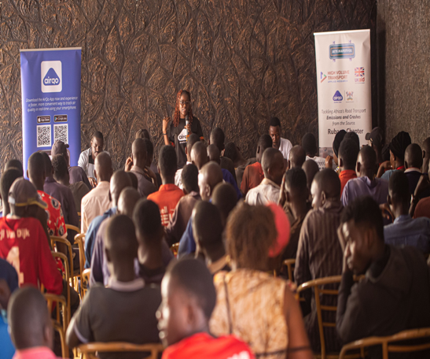
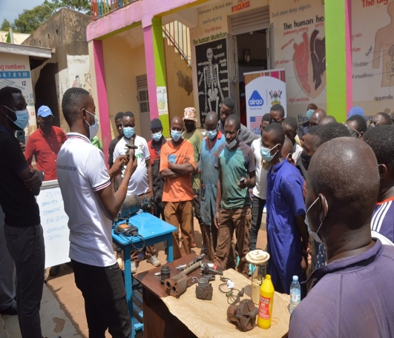
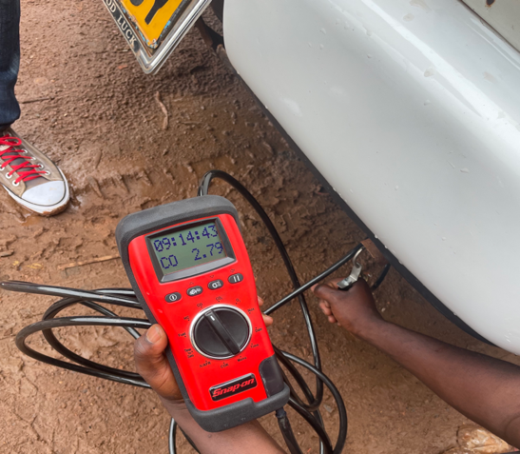
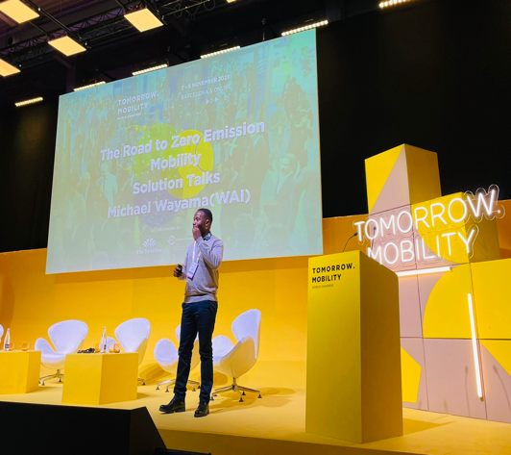
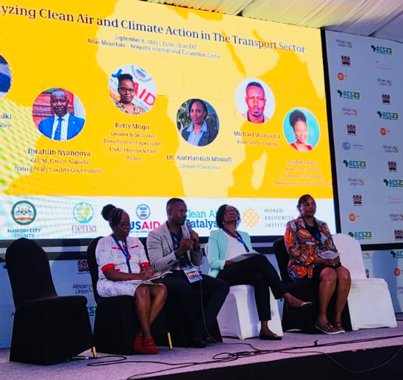
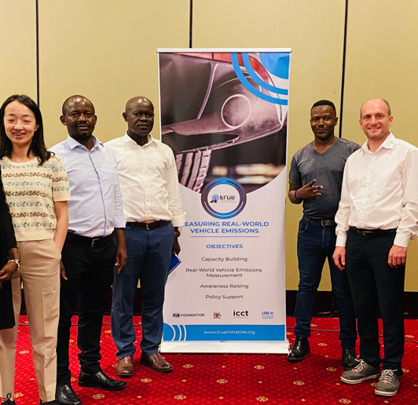
Progress and Achievements……
Engaged communities on road transport-induced pollution & trained over 1000 mechanics since 2022
Collecting & analyzing vehicular emissions data that’s already contributing to policy reform & fostering related projects
Achieved a proof of concept on EV retrofitting, for a potential circular economy while saving the environment
Participated in various climate action related events local & international like ATRC 2024, GMSHF 2024, CITA RAG Africa 2024, Kampala Car free day 2024, Africa Climate Week 2023, SCEWC 2023, Africa conference on air pollution 2023…….
Fostered the implementation of Africa’s first emissions testing project in Kampala by UNEP, ICCT & FIA Foundation
Received training on Environmental friendly recycling for ELVs
Won 2 prestigious international innovation awards for decarbonizing transport in Africa

Slide 5
Plans for 2025……
Amidst resource challenges, our vision for 2025 is quite broad…..
We aim to enhance our collaboration with partners such as AirQo and the Ministry of Works and Transport (MoWT) while identifying new opportunities for projects in environmental stewardship.
Scale vehicular emissions testing to support policy reforms & improve public health by targeting pollutants like CO, which seems to be having less attention yet a major problem.
Used oil recycling; to generate some revenue while addressing environmental concerns related to poor waste management in Uganda’s auto industry; UNHCR already identified as a partner.
Training up to 500 more mechanics, overall target is 5000 in the next 3-5yrs.
EV Retrofitting: With further developments set for 2025, we aim to convert public transport & school vans to electric, reducing their carbon footprint while contributing to the circular economy.

