Slide 1
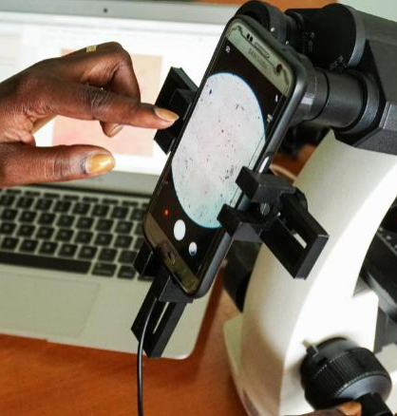
Advancing Sustainable Funding for Clean Air: The Role of AI in Health
Nakasi Rose, PhD
Head, Makerere AI Health Lab.
PI-Ocular project
December 11, 2024

Slide 2
Ocular Key Milestones and Achievements
AI-Driven Solutions
Hardware Innovations
Complementary SURVEILLANCE Systems
:
Capacity Building and Skills Development:
Cross-Sector Collaboration
An Android app was created to assist with malaria, TB and cervical diagnosis. Using AI-driven object detection.
Dev’t Microscopy teaching aid
Designed, tested, and refined 3D-printed adapters that attach smartphones to conventional microscopes
machine learning framework to digitize and automate disease surveillance,
Conducted extensive training programs for medical technicians and pathologists .
We engaged 2 Master’s students
approvals from the Ministry of Health, ethical review boards.
Community engagement

Slide 3
The Importance of Clean Air
Global Health Implications
• Clean air as a fundamental human right.
• Impact of air quality on health: respiratory diseases, cardiovascular diseases, and overall mortality.
• Link to AI in Health
• How poor air quality exacerbates diseases that AI can help diagnose.
.
.

Slide 4
project collaborations PLAN
PARTNER | PURPOSE | ACTIVITY
Academic Institutions | Leverage expertise in AI, healthcare, and diagnostics. | Conduct joint AI in health research, refine AI models, and provide internships and training for students.
Healthcare Providers | Validate tools and train workers in real-world settings. | Conduct pilot studies, train personnel, and integrate tools into healthcare workflows.
Government | Align with national health priorities | Develop informing digital health and AI framework that informs policy development and integration of AI into the healthcare system
Technology Companies and initiatives | Build collaborations to advance research in building sustainable AI models with interlinkages between air quality and its associated impact in healthcare | Build collaborative roadmap to enhance AI and associated technologies
International dev’t Organisations | Access global health networks, funding, and expertise. | Share best practices, co-host conferences, and apply for grants.
Community Based and Media Organisations | Build trust and raise awareness. | Conduct awareness campaigns, address patient concerns, and share insights through different dissemination channels

Slide 5
Project Future Plans
Tuberculosis is a chronic disease infection and is directly associated with both climatic and air quality factors, we intend to further collaborate with Air Quality initiatives that will further strengthen building of robust disease surveillance models
To leverage AI for improving health outcomes and promoting clean air initiatives.
Foster collaborations with environmental scientists and public health officials.
Expand research on air quality and its health impacts.
Continue optimizing AI models for improved accuracy and diagnostic and surveillance efficiency, with a particular focus on TB and cervical cancer.
Scale up deployment to more healthcare facilities, particularly in rural and underserved regions, to improve access to timely and accurate diagnostics and disease surveillance.
Enhance mobile and desktop applications with user-driven updates to streamline clinical workflows and improve functionality.
.

Slide 6
The Intersection of AI, Health, and Clean Air
How AI in Health Contribute to Clean Air Initiatives
Early disease detection and surveillance reduces healthcare burdens, allowing for more resources to be allocated to clean air initiatives.
• AI models predicting disease outbreaks can inform air quality management policies.
Case Studies
• Examples of successful AI applications improving health outcomes while promoting clean air.
•

Slide 7
Funding Models for Sustainability
Public-Private Partnerships
• Collaborations between government bodies and private sectors for funding sustainable health and air quality initiatives.
Grants and Donations
• Seeking funding from international health organizations, NGOs, and philanthropic foundations.
Investment in Technology
• Attracting venture capital focused on health tech and environmental sustainability.
•

Slide 8
Areas Requiring Funding
• AI Microscopy Diagnostics Development
•Equipment upgrades for AI microscopy tools.
•Research grants for developing algorithms for disease detection.
•Research on Air Quality and Health
•Studies linking air quality to the prevalence of diseases.
•Community health initiatives focusing on air pollution.
•Public Awareness Campaigns
•Educational programs on the health impacts of air pollution.
•Tools for community engagement and participation.
•

Slide 9
•
Expected Outcomes of Funding
• Enhanced Diagnostic Capabilities
• Improved accuracy and speed in diagnosing diseases like Malaria, Tuberculosis, and Cancer.
• Better Health Outcomes
• Reduction in disease prevalence linked to poor air quality.
• Informed Policy Making
• Data-driven decisions on air quality management.

Slide 10
Key takeaways
• The critical link between clean air and health.
• Investing in AI health diagnostics is not just a health imperative but also a step towards achieving clean air and a healthier future.

