Slide 1

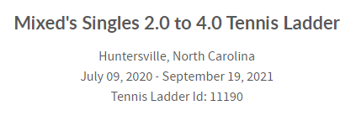
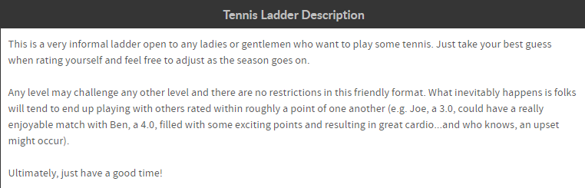
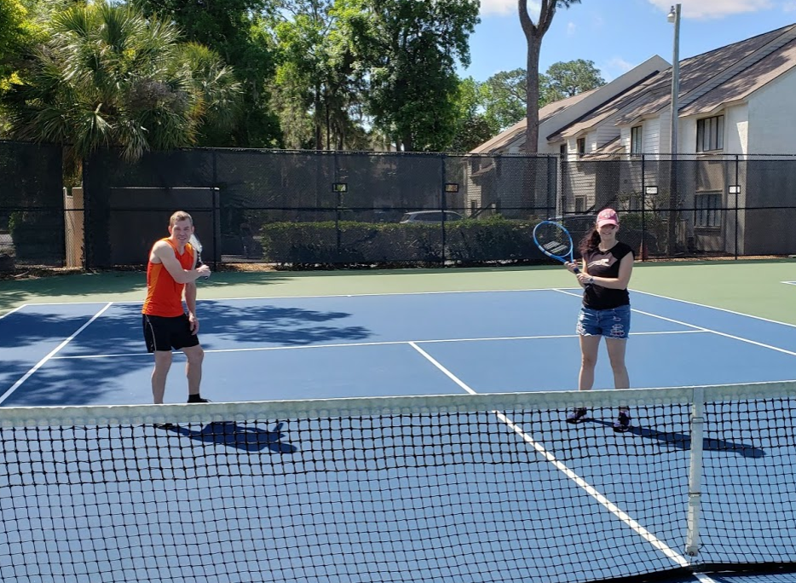

Lkn open Tennis ladder
Ladies and gentlemen of all skill levels
100% Free. No sign up fees
Prizes will be awarded
How do I register for this ladder?
You can go directly to the ladder's registration page to sign up (link below).
https://www.globaltennisnetwork.com/tennis-leagues/leagues/tennis-ladder-page/registerPage/11190-mixed-s-singles-2-0-to-4-0-tennis-ladder

