Slide 1


Our Fleet

Slide 2
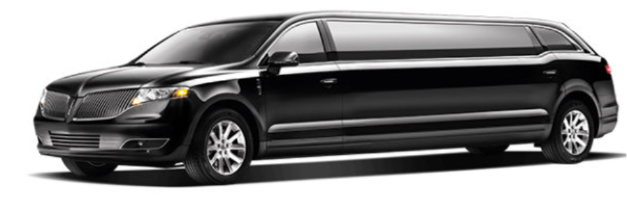
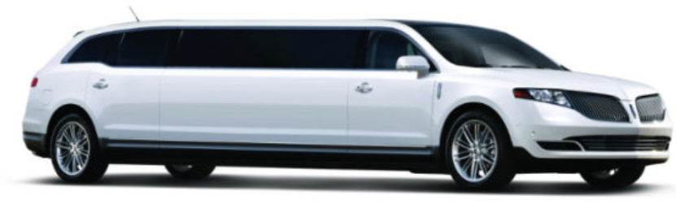
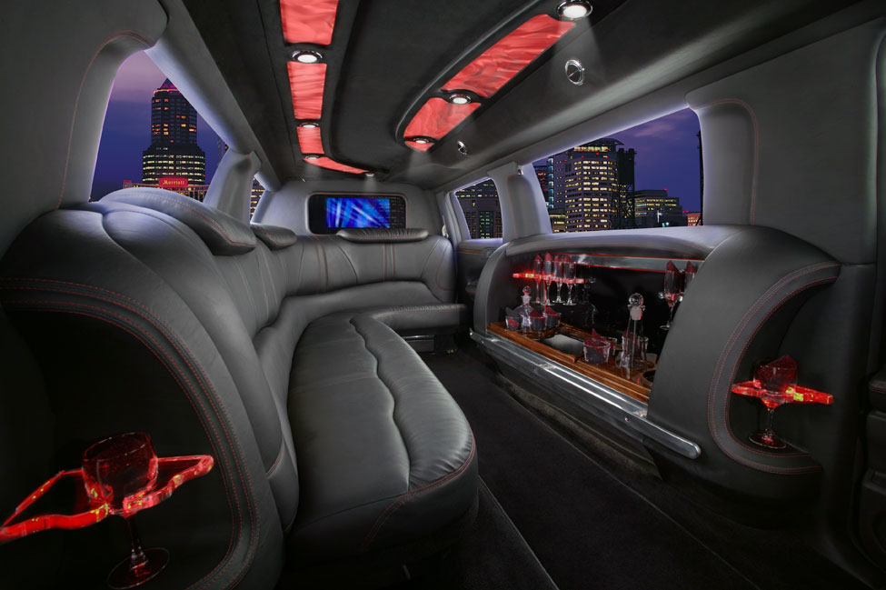
Lincoln MKT Stretch Limo
10 Passengers
Black Leather Interior
Heated Seats
DVD Player
WI-FI
I-Phone Charger
Laptop Desk

Slide 3
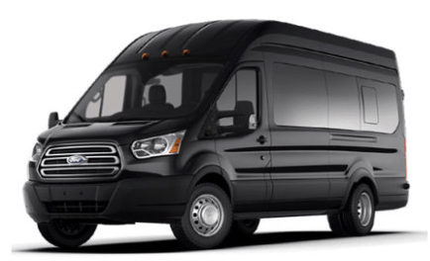
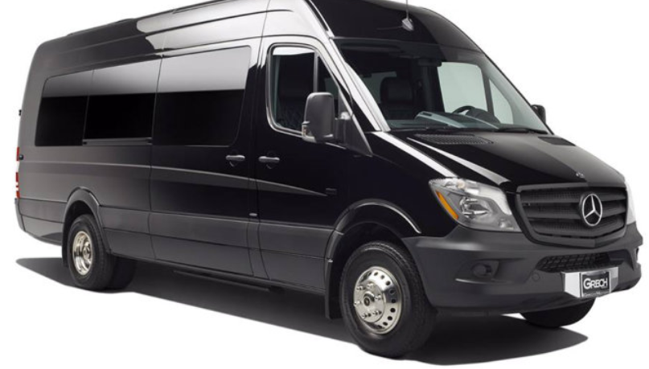
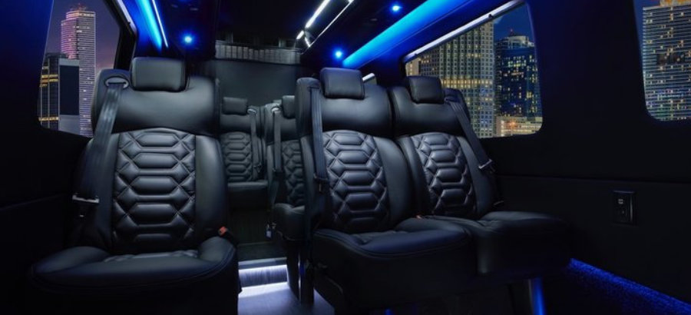
Ford Transit Vans & Mercedes Benz Sprinters
11-14 Passengers
Black Leather Interior
TV & DVD
WI-FI
110V/USB Every Row

Slide 4
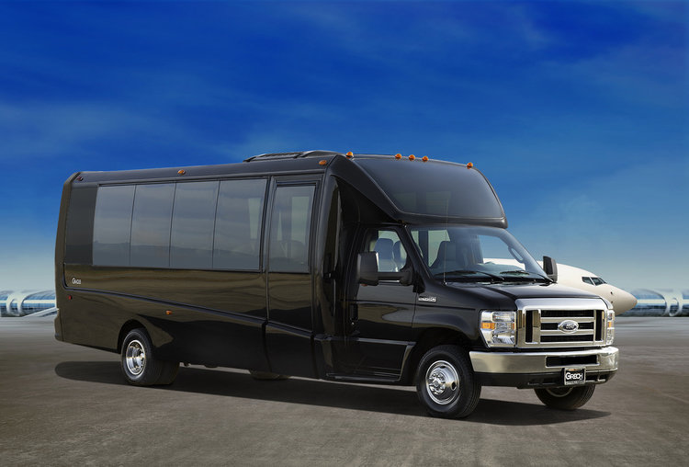
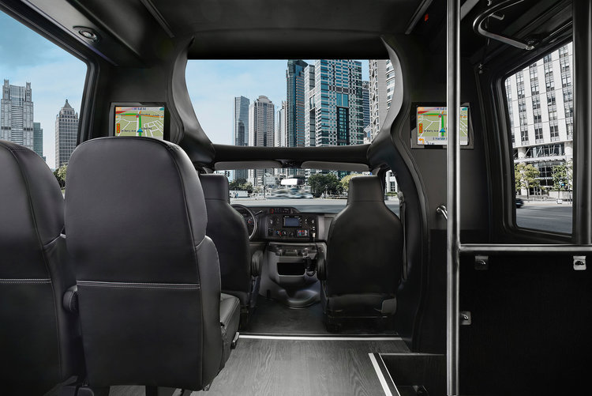
Grech Mini Bus
23-24 Passengers
Black Leather Interior
Panoramic Front Viewing Window
DVD Player
WI-FI
LED Interior and Exterior Lighting

Slide 5
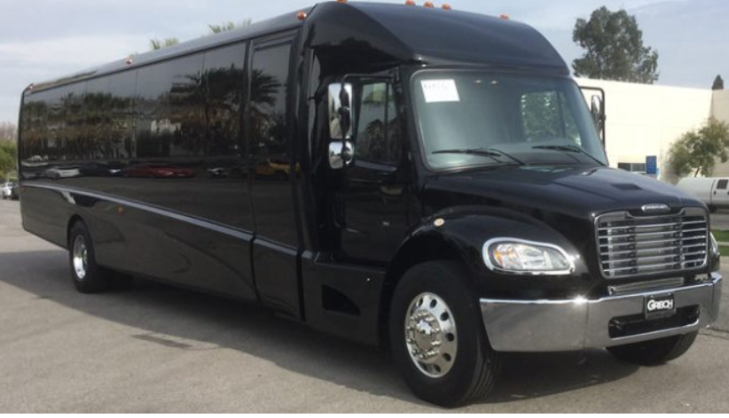
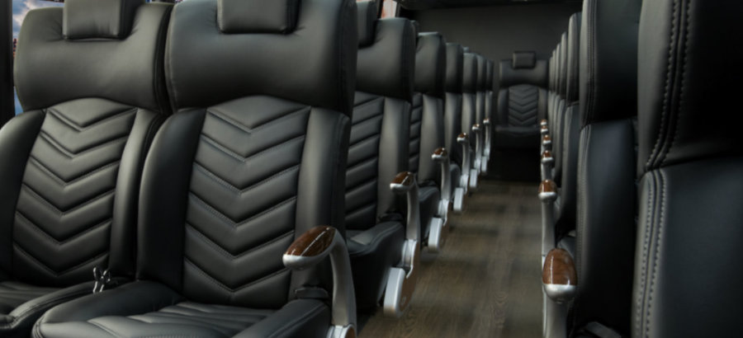
Grech Mini Coaches
38/40/41 Passengers
Black Leather Interior
Panoramic Front Viewing Window
DVD Player
WI-FI
LED Interior and Exterior Lighting

Slide 6
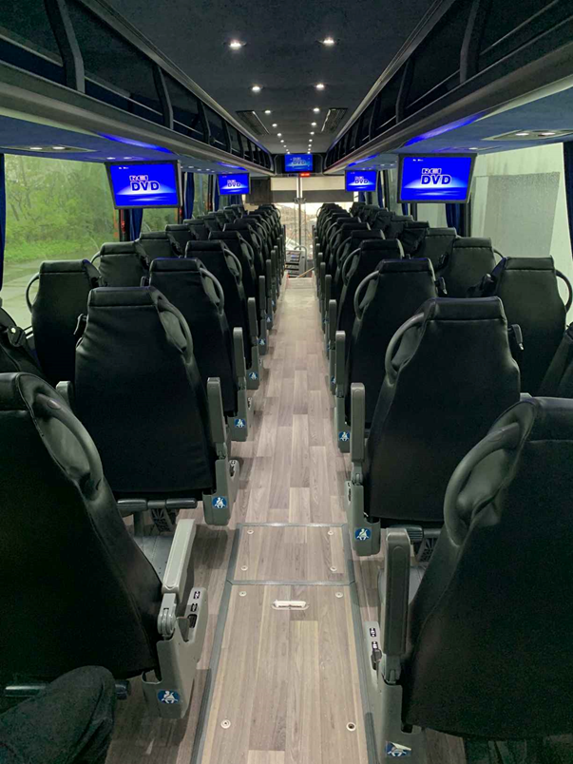
Vahool & Setra Coaches w/ Lavatory
56-57 Passengers
Black Leather Interior
DVD Player
WI-FI
USB Outlets

