Slide 1
LITTLE LEAGUE SOFTBALL®

Slide 2
Presentation Highlights
Basics of the Program
Chartering Options and Development Strategies
You Draft It

Slide 3
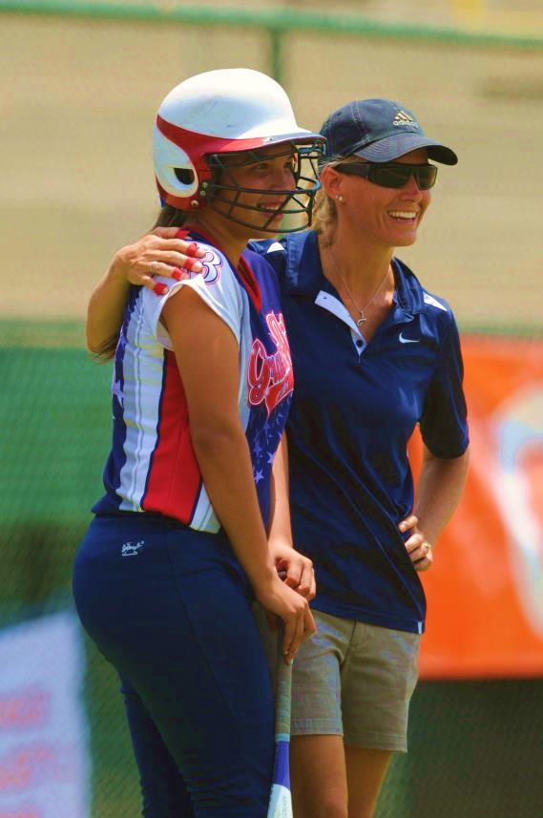
Education & Training
Coaches Clinics with Callista Balko, USA Elite and Mark Cooke
Softball Excellence
Softball Factory Player Camps and recruiting information
Free Instructional Content
Little League University
Tee Ball Program

Slide 4
Coaches Resource Center
Free to all Chartered Leagues
Updated regularly
Features both video and text based articles as well as the latest Little League news
Content specific for softball, describing skills, helpful drills and suggestions on how to structure practice
Tee Ball & Coach Pitch Program
LittleLeagueCoach.org

Slide 5
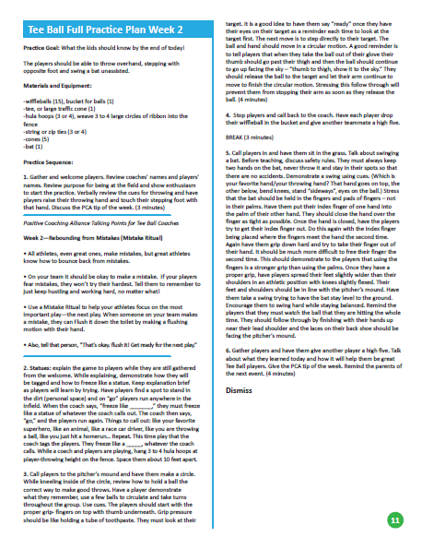
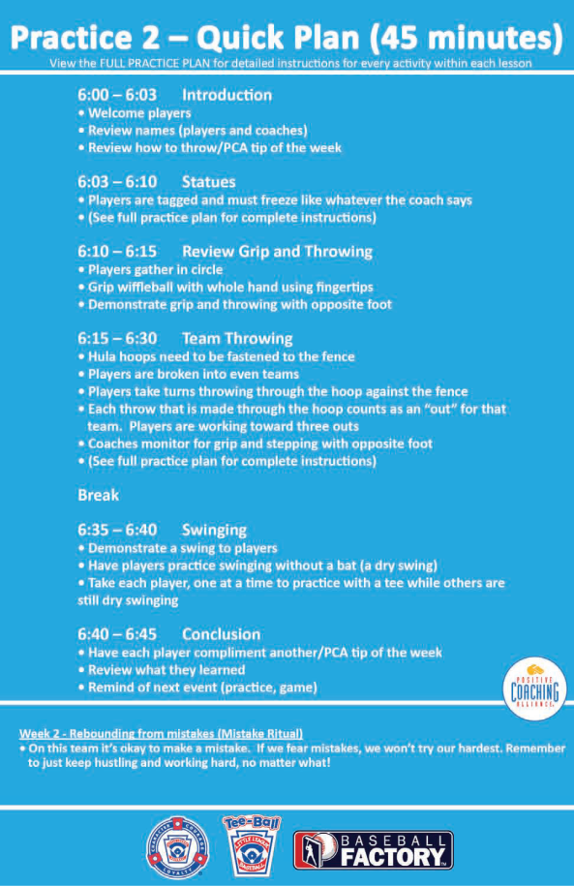
10-Week Tee Ball Program LittleLeague.org/TeeBall

Slide 6
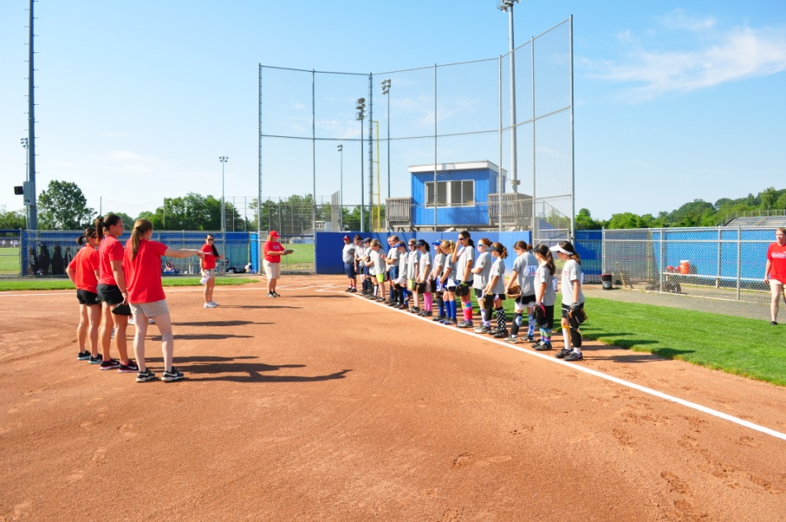
Softball Factory Partnership
Little League’s Preferred Softball Player Development Partner and College Recruiting Service offers instructional services, access to hundreds of US colleges and universities, and direction concerning the recruiting process.
National Player Evaluation and Training Tour
2016 Site:
Indianapolis, IN
Bellevue, WA
Bristol, VA
Pearland, TX
Players will received instruction and an evaluation with areas of improvement with video skills and drills.

Slide 7
Partnership with Softball Excellence
www.LittleLeague.org/SE
Partnership provides Little League® approved content to coaches and parents for a discount
Seven online seminars covering 11 game aspects
Coaching Courses for all levels
Online Instructional photo and video tutorial with downloadable notes

Slide 8
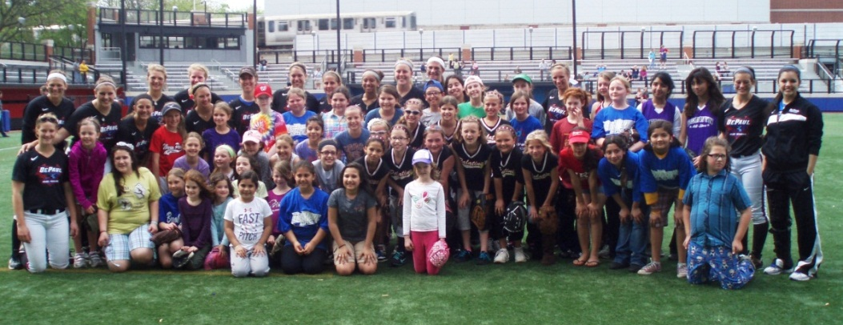
Initiatives

Slide 9
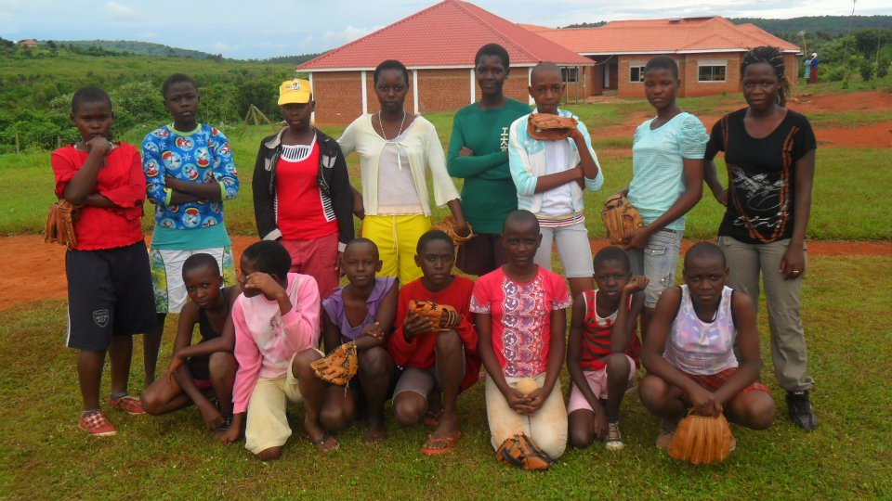
Grow the Game Grant Program
Little League Softball Grants available
Up to $20,000
Who can apply?
In good standing with Little League, Region and District
Any league chartered with the program or planning to charter the program
Non-profit status
What can they be used for?
Camps/clinics
Special Game Tournaments
Capital Budget Improvement
Marketing (TV, Radio, Fliers, etc.)
How?
Submit Completed Form, Written Proposal and Project Estimate
3 Letters of Recommendation
Financial Statement
League Point Person must be willing to follow-up with individual overseeing those grant funds

Slide 10
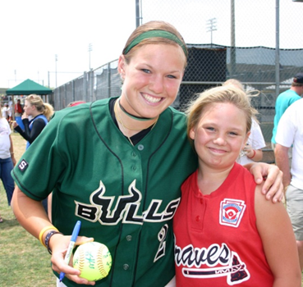
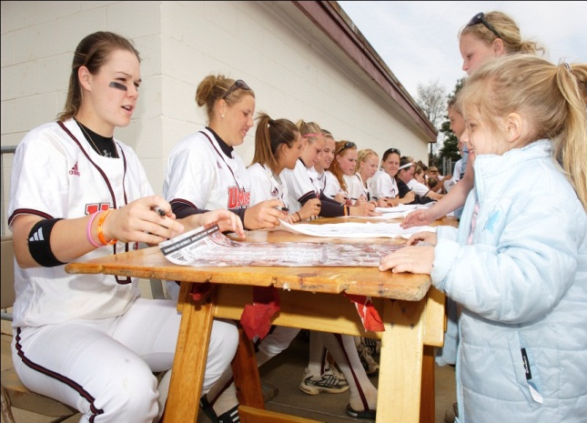
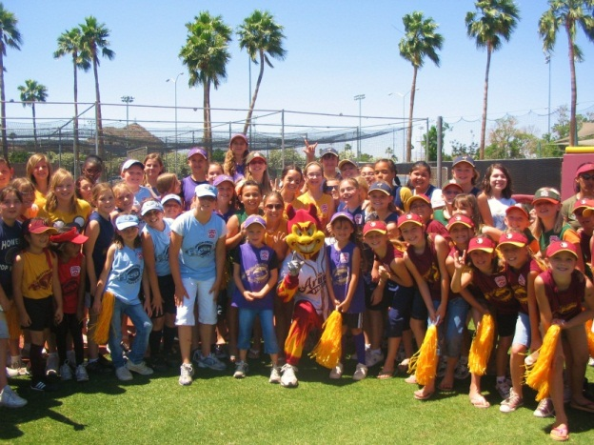
Little League Softball Days
Over 35 colleges and universities across the country hosted Little League Softball Days
Partnered with Oregon State, Arizona State, UCLA, UMASS, Boston College, Hofstra, South Florida, Tennessee, DePaul, Michigan,
Baylor and many more.

Slide 11
Little League Softball Special Games
Allows Little League programs to organize weekend tournaments easier during the Regular Season, Second Season and Fall Ball.
Additional flexibility in rules for participation, pitching, games in a day and team composition to increase the attractiveness and competitive level.
Games played count towards tournament eligibility for Junior and Senior League.
Complete details of special games options are available online at LittleLeague.org/Assets/forms_pubs/Special GamesGuidelines_Softball.pdf

Slide 12
Recent Softball Changes
The following changes were recently revised in the past few years:
Regulation IV – allow 12-year-olds to participate in Majors and Juniors;
Pitching Distance change from 40’ to 43’ for Junior and Senior League Softball (aligns with NCAA and ISF);
Bat BPF to 1.20;
Metal cleats option for upper divisions;
Definition of a bunt (aligns with NCAA);
Allowing a runner to steal at the release of the pitch in the Major Division;
Allowing the batter to run on a dropped 3rd strike at the Major Division;
Allowing tournament teams to participate in special games after tournament teams are announced;
Penalty for use of an illegal bat

Slide 13
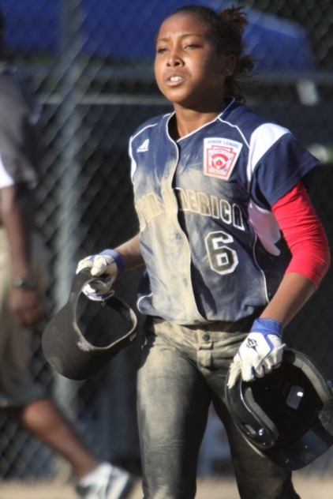
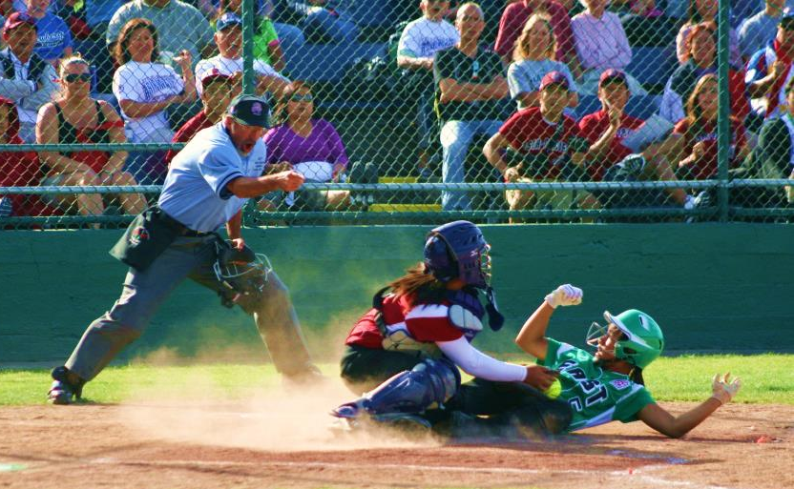
Softball Changes cont.
Relaxed pitching regulations –
Minor/Majors: 12 innings in a day; 6 innings or less, no rest required.
Junior/Senior League: No restrictions
Relaxed games in a day:
Minor/Majors: Two doubleheaders in a
7-day period
Junior/Senior League: Up to 3 games in a day.

Slide 17
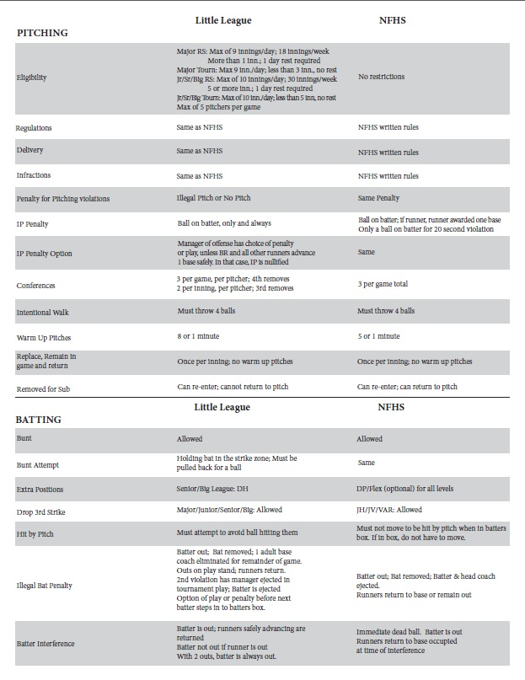
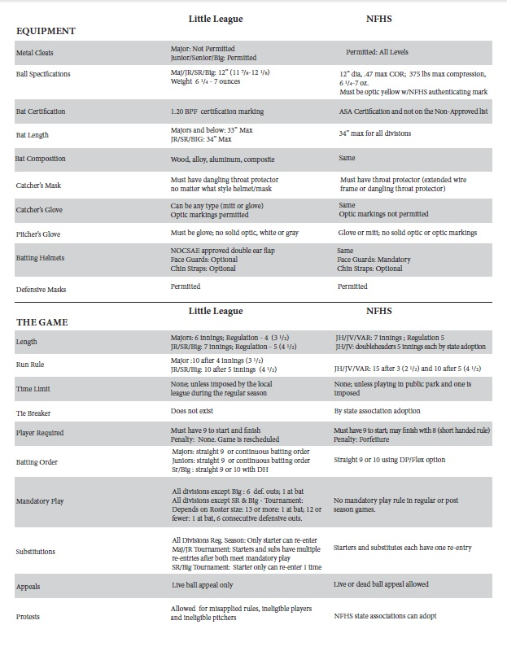
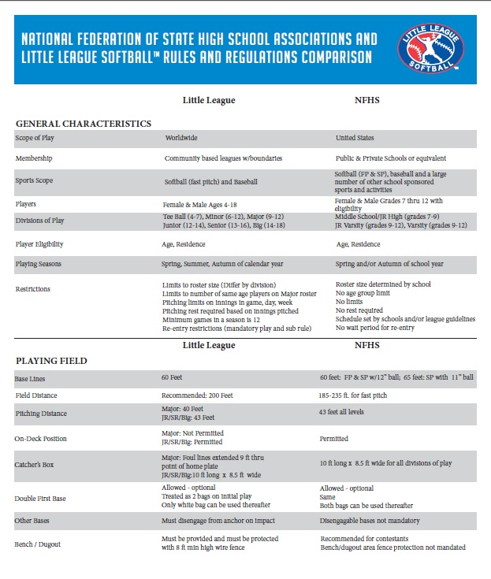
Little League vs. NFHS Rules & Regulations

Slide 18
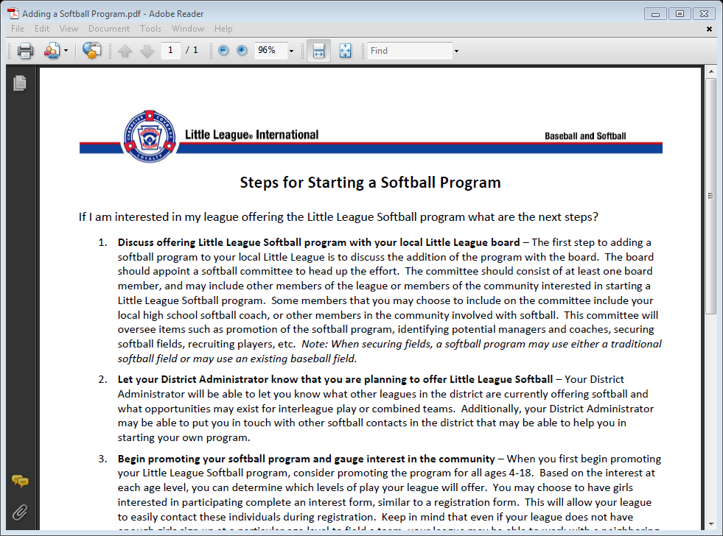
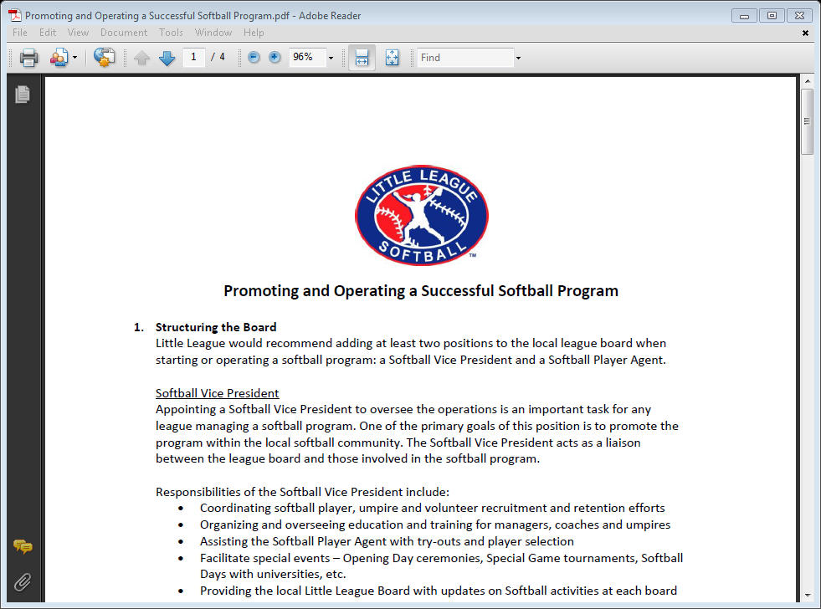

Slide 19
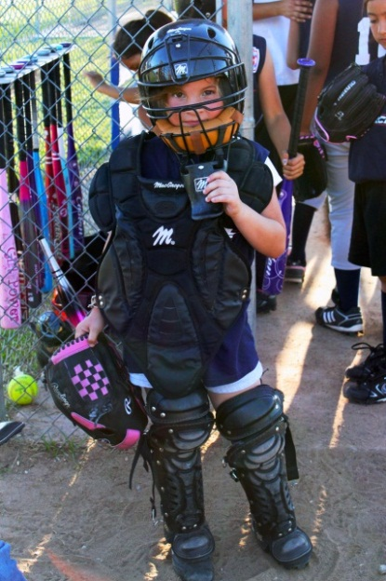
Starting Softball at the District Level
Tee Ball or District-wide programs
Work Together and Communicate
Softball ADAs or Committees
Education and Training Opportunities
Schedules
Junior and Senior League
Tournament
Divisions being entered
Combine Teams
Interleague
Special Games

Slide 20
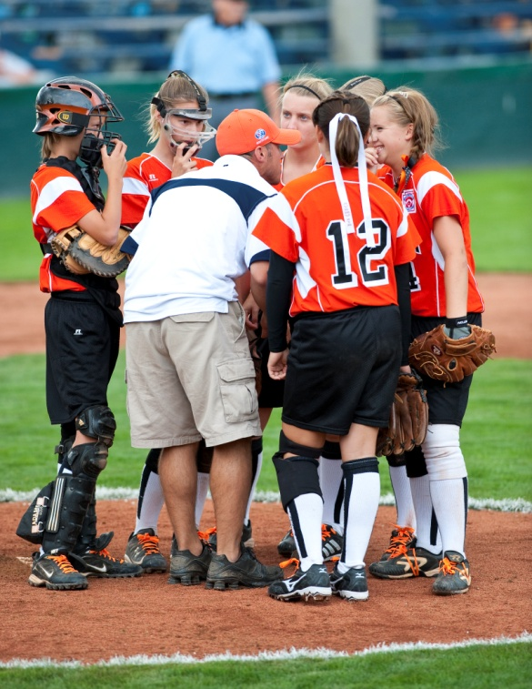
Starting Softball Local League Suggestions
Board Structure – League should add at least two positions to their Boards to help oversee the softball program
Softball Vice President
Softball Player Agent
Marketing Position
Fall Ball/Second Season
Tee Ball Softball
Age Structure for Softball
Regulation IV and Player Pools
Find Facilities
Promote the Program
Training and Education
Work with DAs to coordinate Regular Season schedule

Slide 21
Chartering Little League Softball
Methods of Chartering
Addition to an existing charter
Addition to an existing charter with modified boundaries
Softball Only Charter

Slide 22
Addition to an Existing Charter
Softball can be chartered by simply listing softball teams on your league’s charter application
Charter fees and insurance rates are the same as those for baseball
Most appropriate when the same board is running both baseball and softball programs in a community

Slide 23
Addition to an Existing Charter with Modified Boundaries (cont’d)
Chartered by listing softball teams on the league’s charter application
Charter fees and insurance rates are the same as those for baseball
The league may request to operate with expanded boundaries for the softball program only to draw more girls to the program

Slide 24
Addition to an Existing Charter with Modified Boundaries (cont’d)
Modified boundaries may include unchartered areas or areas chartered by another league not offering softball
If an area in a modified boundary is chartered by another league, that league must give up rights to operate softball in that area
All modified softball boundaries must be submitted as a waiver request and approved by the Charter Committee

Slide 25
Softball Only Charter
A softball league can be chartered as a separate entity from a baseball league in a community
This option is best when the softball program is operated by a separate board or when there is a group of individuals who would like to focus only on softball operations

Slide 26
Softball Only Charter (cont’d)
To charter a softball only league:
Complete and submit a charter application
Complete and submit a Little League constitution
Complete and submit a boundary map signed by the District Administrator, the League President, and the League Presidents of any baseball leagues whose boundaries the softball only league encompasses

Slide 27
Softball Only Charter (cont’d)
All baseball leagues whose boundaries the softball only league overlaps must submit a letter giving up their rights to charter softball
All softball only charters must be approved by the Charter Committee

Slide 28
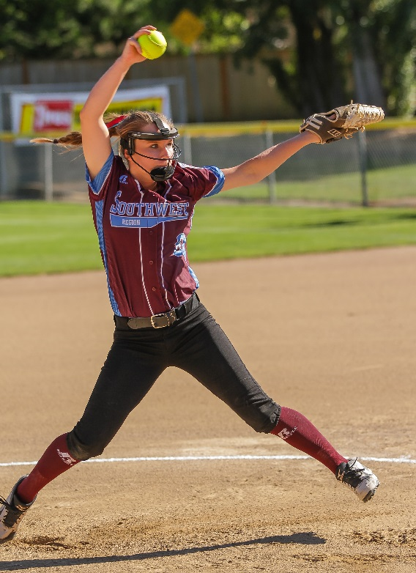
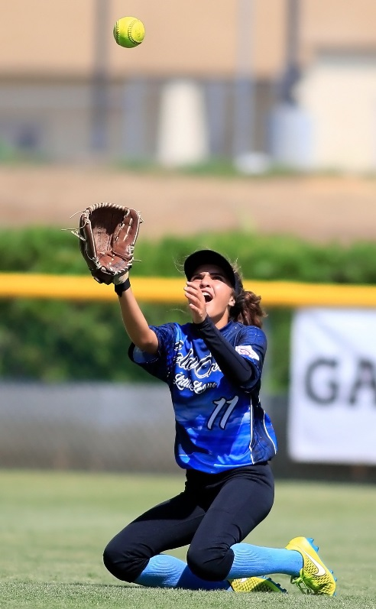
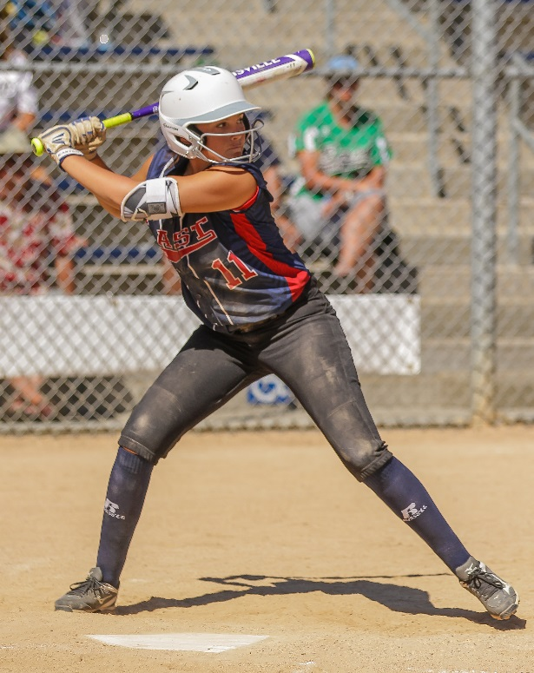
You Draft It

Slide 29
District/League Issues
My district/leagues don’t offer softball, what can I do?
A County/Park & Rec. won’t let my league add softball or they’ll let in a competing baseball program.
My softball leagues/parents are constantly complaining they are underserved in comparison to baseball. What can I/they do?

Slide 30
Recommendations/Feedback
What other benefits do we need to be attractive?
If you have competing softball, what have you “heard” is the reason they play/charter with another organization?
Rule changes?
Best way to educate coaches, managers, parents?

Slide 31
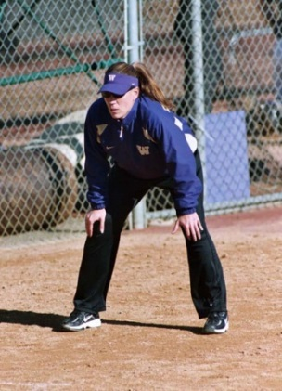
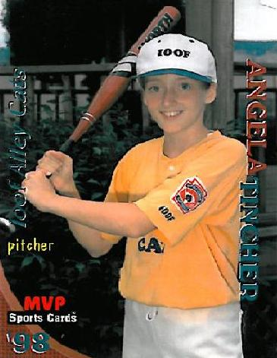
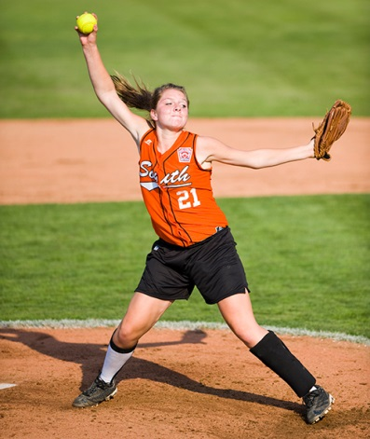
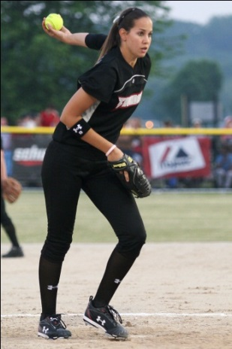
Little League® Graduates
A few Little League Softball graduates through the
years:
Crystal Bustos: USA Softball Team (Canyon Country LL)
Sue Enquist: Former Head Coach at UCLA
Cat Osterman: USA Olympian (Bear Creek LL)
Heather Tarr: Head Coach at the University of Washington
Angela Tincher: VA Tech; No hitter against US Team (Clifton Forge LL)
Jackie Traina – University of Alabama and 2012 WCWS Champions (Naples LL)
Gatorade National Players of the Years
Carly Hoover (SC), Alexis Bower (PA), Pauline Tufi (AK) Sarah Ing (Washington DC), Carolyn Szymanski (DE)

Slide 32
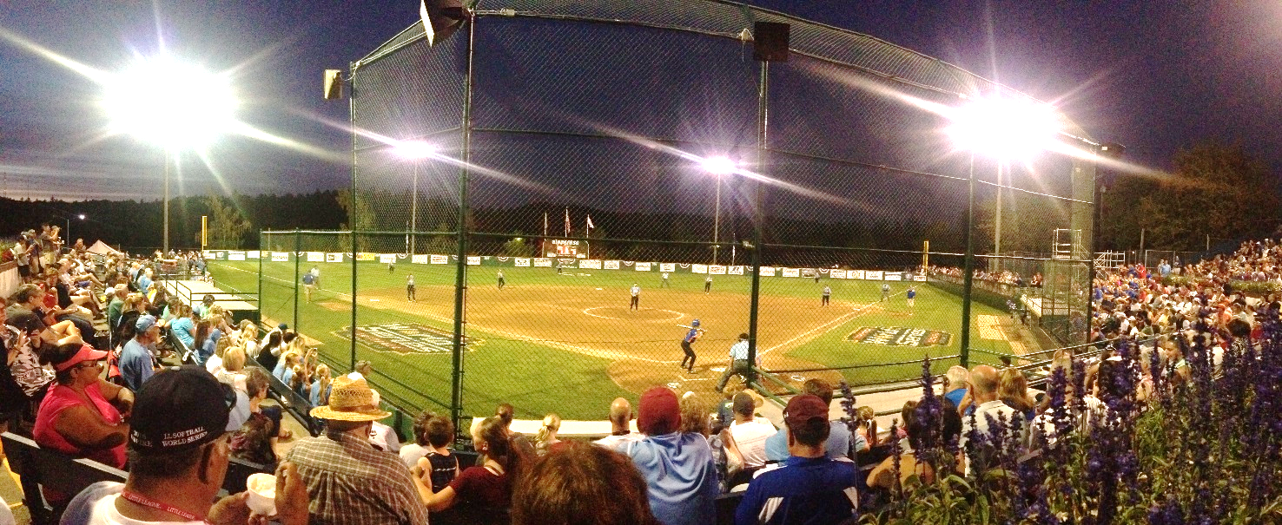
For more information, visit www.LittleLeagueSoftball.org or www.Facebook.com/LittleLeagueSoftball
Sara Thompson
Director of Softball Development
Sthompson@LittleLeague.org

