Slide 1
Progress Check-In #1
July 15th, 2021
4:30 PM ET
Sharing Strategies, Successes and Secrets
D2D and AMDA Team

Slide 2
D2D Mission
A 25% reduction of scheduled medications in long stay patients
Provide PA-LTC providers the necessary tools, support and the community to implement deprescribing into clinical practice

Slide 3
D2D Check in
Data dash board
Strategies Successes & Secrets “All teach, All Learn”
Brief Skill Presentation “Deprescribing Communication Techniques”

Slide 4
Participation encouraged! Please use the chat function during the formal presentation
This session is being recorded and slides will be available soon

Slide 5
Current Data Dashboard
Asks for: #total number of scheduled medications and prevalence of certain medication classes
https://paltc.org/d2d-submit-report

Slide 6
Strategies, Successes and Secrets All teach All Learn

Slide 7
Poll Question
Who is part of your deprescribing team?
Prescribers: Doctors, Advanced Practice Providers, Pharmacists
Bedside Nursing Representation
Pharmacists
Administration: Chief Medical/Nursing Officer
Social Work
Therapists
Other

Slide 8
Chat Question
What recent successes have you encountered within your initiative?
What barriers are you struggling with within your initiative?

Slide 9
Brief Skill Presentation

Slide 10
Deprescribing Communication Techniques Jennifer Pruskowski, PharmD, MS, BCPS, BCGP D2D Implementation Lead Associate Director for Education and Evaluation, Pittsburgh Veterans Affairs GRECC Assistant Professor and Director of Geriatric Pharmacy Research and Education University of Pittsburgh School of Medicine, Division of Geriatric Medicine

Slide 11
FRAME Communication Map
Form or Fortify Relationship
Recognize Willingness to Deprescribe
Align Recommendations to Goals
Manage Cognitive Dissonance
Empower to Continue Deprescribing
J Palliat Med. 2019 Mar;22(3):335-336.

Slide 12
Form or Fortify Relationship
Call interaction a “medication check-up”
Goal is to learn patient’s, family’s/caregiver’s, or other prescriber’s medication related goals of care
For patients and family/caregivers: consider reviewing common symptoms (e.g. pain, dyspnea, fatigue, nausea, constipation, dizziness)
For other prescribers: consider asking about previous goals of care conversations

Slide 13
POP QUIZ
What percentage of patients are willing to deprescribe at least 1 medication if their doctors says it is possible?:
A. 12%
B. 52%
C. 82%
D. 92%
JAMA Intern Med. 2018 Dec 1;178(12):1673-1680.

Slide 14
Recognize Willingness…
“Do you feel like you are on too many medications, too few medications, or just the right amount?”
Evidence suggests patients are very willing to deprescribe:
One Australian study of older adults found 98% (95% CI 84.4-93.6) of participants reported that they would be willing to stop one or more of their medications¹
One study of those with serious illness found fewer than 5% of participants expressed concern that statin deprescribing indicated physician abandonment²
1. Int J Clin Pharm. 2015 Oct;37(5):949-57. 2. Palliat Med. 2017 Oct;20(10):1098-1103.

Slide 15
Align Recommendations…
“Thank you for telling me you want more energy to play bingo. I want to discontinue your metoprolol as this medication can often cause fatigue and your heart rate has been low lately.”
Aligning recommendations reduces stigma and improves relationships
Motivational interviewing can help clinicians better understand a patient’s intrinsic willingness or associated barriers of making a change¹

Slide 16
Manage Cognitive Dissonance
Are you still a poor sleeper?
Cognitive dissonance occurs when a person experiences mental discomfort or stress from two or more simultaneous contradictory beliefs, ideas or values
Oh yes, just terrible! I need my pills
Really? How many times do you wake up each night?
At least 3 or 4 times!
Oh my! I guess the pills are not really working then…
Huh!?

Slide 17
Manage Cognitive Dissonance
Direct: “You are taking a lot of medications. I want to reduce this high number.”
Indirect: “You told me your sleep hasn’t improved on [medication]; it must not be working.”
Emotional: “I am worried about your falls…some of your medication may be clouding your mind and affecting your concentration and balance.”
Reading for Next Time: “Here is some information regarding [medication]. Please read this prior to our next visit and we will discuss.”

Slide 18
Empower to Continue…
“I’m so glad you don’t feel worse since discontinuing the metoprolol. Maybe some of these medications have done their job and now we can come off of them safely.”
Deprescribing is a process; usually can’t do everything at first visit
Never want to make more than 3 medication changes at a time

Slide 19
Skill Pearls
1. Consider the FRAME acronym when communicating deprescribing recommendations
2. Most important to first recognize willingness to deprescribe

Slide 20
Pearls and Next Steps

Slide 21
Next D2D Webinar & Progress Check-In
August 19th (4:30-5:15 PM EST) D2D Webinar
September 18th (4:30-5:15 PM EST) D2D Check-In

Slide 22
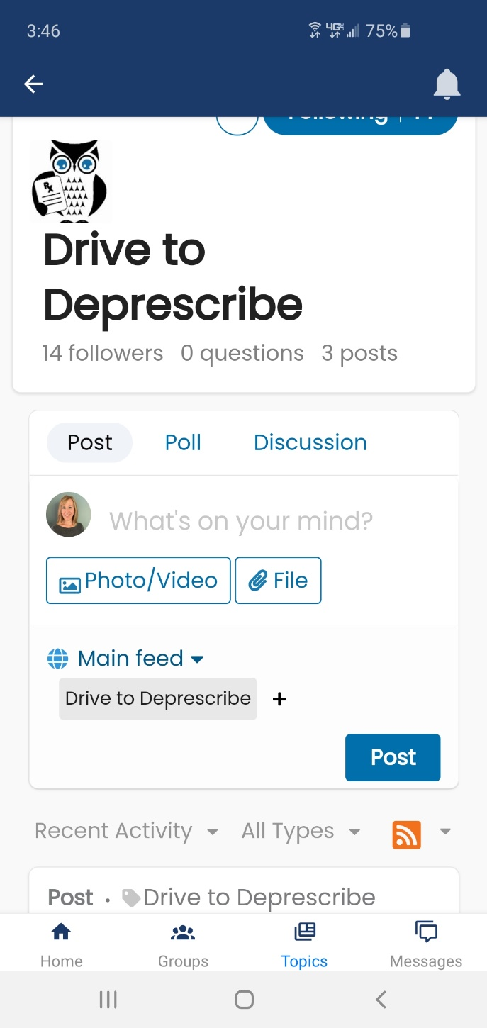
In the meantime…
Download the AMDA app, log on to AMDA Social, and click on the topic “Drive to Deprescribe” to participate in ongoing discussions with peers
Access call recordings, slides and other resources at: https://paltc.org/drive2deprescribe

Slide 23
Thank you and the AMDA staff!

