Slide 1
Webinar #3
October 21, 2021
4:30 PM ET
Optimizing Use of Anticholinergics

Slide 2
Background
D2D Mission: A 25% reduction of scheduled medications in long stay patients
Provide PALTC providers the necessary tools, support and the community to implement deprescribing into clinical practice

Slide 3
Manju T Beier, Pharm D., BCGP, FASCP Chair of ASCP Deprescribing Task Force Senior Partner, Geriatric Consultant Resources LLC Adjunct Associate Professor of Pharmacy The University of Michigan
ASCP Adds Voice to Choosing Wisely Initiative
Focus on Anticholinergic Burden

Slide 4
Five Choosing Wisely Statements Published May 2021 on ABIM Site
Statements reviewed by ABIM (physician and pharmacist reviewer comments)
https://www.choosingwisely.org/societies/american-society-of-consultant-pharmacists/
Discussion Focus today:
Share medication management review statements briefly
Optimizing use of anticholinergics

Slide 5
General MRR Statements Prescribing Cascade
Don’t initiate medications to treat new and emerging symptoms without first ascertaining that the new symptom is not an adverse drug event of an already prescribed medication.
JAMA Intern Med 2019;179(7):863-864
BMJ 2020 Feb 19;368:m261.
MRR: Medication Regimen Review

Slide 6
Why Focus on Prescribing Cascade? Benefit for patient and care team
First be familiar with common side-effects of medications
Then, consider if it’s a side-effect of an existing medication or a new medical condition?
Important distinction to avoid prescribing cascade
Consider, if decreasing the dose helps?
Consider substituting with a different medication
Adding a medication is easier than deprescribing, so awareness is key!!

Slide 7
General MRR Statements Medication History
Don’t continue medications at transitions of care without a pharmacist or other qualified health care professional performing a comprehensive medication review to verify accurate and complete medication information in concert with current medical problems.
J Am Coll Clin Pharm 2020;3(2):532-545.
Ann Intern Med 2013;158:397-403.
MRR: Medication Regimen Review

Slide 8
CNS Statements: Anticholinergic Burden
Don’t recommend highly anticholinergic medications in older adults without first considering safer alternatives or non-drug measures.
JAMA Intern Med 2015;175:401-407
J Am Geriatr Soc 2015;63(12):e8-e18.

Slide 9
Possible Adverse Effects of Anticholinergics
confusion
dry mouth
blurry vision
constipation
urinary retention
decreased perspiration
excess sedation
increased dementia risk??
delirium
falls

Slide 10
Medications with Strong Anticholinergic Activity
first generation antihistamines diphenydramine, doxylamine, cyproheptadine
tricyclic antidepressants amitriptyline, nortriptyline
antispasmodics dicyclomine, glycopyrrolate
muscle relaxants carisoprodol
OAB medications oxybutynin, trospium
medications to treat Parkinson’s disease benztropine, trihexyphenidyl
Table 7 AGS Beers Criteria 2019 https://agsjournals.onlinelibrary.wiley.com/doi/10.1111/jgs.15767

Slide 11
Optimizing Use Anticholinergics
Avoid
Avoid first-generation antihistamines for allergy or sleep use
Use
Use nasal steroids for allergies instead (Flonase, etc.)
Select
Select meds with low or no anticholinergic activity from the therapeutic class
Use second generation antihistamines when needed:
Zyrtec
Claritin
Allegra

Slide 12
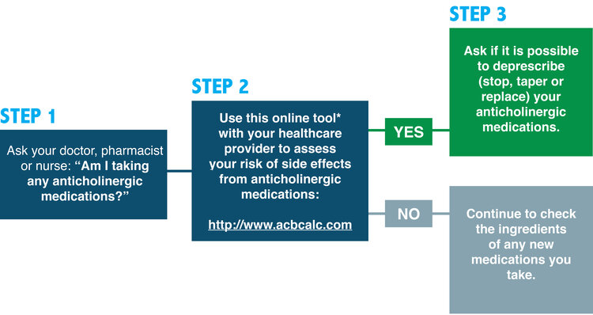
How do I lower my risk of side effects from anticholinergic medications?
https://www.deprescribingnetwork.ca/blog/anticholinergic-medications

Slide 13
Example of a Prescribing Cascade Leading to Anticholinergic Medication Use
Amlodipine for treatment of hypertension
Use of furosemide for peripheral edema
Use of tolterodine for OAB symptoms from furosemide!

Slide 14
Mrs. Smith
Mrs. Smith is an 88 years old former schoolteacher. She was widowed 5 years ago after 60 years of marriage. Prior to coming to your SNF 8 weeks ago after a hip fracture, she lived in her own house, but needed a lot of support from her two very involved daughters and part time caregivers.
Mrs. Smith carries the diagnosis of dementia, HTN, HLD, Diabetes Mellitus Type 2, obesity, CKD, Afib , diastolic CHF, CAD, OA, osteoporosis, incontinence. She also suffers from depression and anxiety.

Slide 15
Current prescriptions
Apixaban 5 mg po BID
FeSO4 325mg BID
Ibuprofen 200mg q 6 h prn
Tylenol 1000 mg q 6 h prn
Tramadol 50mg po q8 h
Lasix 60mg po BID
Carvedilol 6.25mg BID
Ondansetron 4mg q8h prn
MVI once daily
Omeprazole 20mg daily
Vit D 2000 units daily
Ca gluconate BID
Insulin Sliding Scale
Metformin 500mg BID
Glyburide 2.5mg po BID
Losartan 25mg daily
Amlodipine 5mg daily
Prozac 20mg daily
Seroquel 25mg qhs
Buspar 15mg TID
Melatonin 6mg at hs
Atorvastatin 20mg daily
Oxybutynin 5mg q 8 h
ASA 81 mg daily
Miralax daily
Colace 100mg BID
Bowel protocol prn
Donepezil 10 mg daily
Mg 400mg po BID

Slide 16
Estimating Anticholinergic Burden
Estimate anticholinergic burden using calculator:
http://www.acbcalc.com
A score of 3+ is associated with an increased cognitive impairment and mortality
Anticholinergic Burden tables were created in 2008
quantify the effects of these medications
http://www.acbcalc.com/pages/reducing
https://www.uptodate.com/contents/image?imageKey=PC%2F100289&topicKey=PC%2F3013

Slide 17
Audience Poll (enter in chat)
Which medications contribute to our patient’s anticholinergic burden?

Slide 18
Current prescriptions
Apixaban 5 mg po BID
FeSO4 325mg BID
Ibuprofen 200mg q 6 h prn
Tylenol 1000 mg q 6 h prn
Tramadol 50mg po q8 h
Lasix 60mg po BID
Carvedilol 6.25mg BID
Ondansetron 4mg q8h prn
MVI once daily
Omeprazole 20mg daily
Vit D 2000 units daily
Ca gluconate BID
Insulin Sliding Scale
Metformin 500mg BID
Glyburide 2.5mg po BID
Losartan 25mg daily
Amlodipine 5mg daily
Prozac 20mg daily
Seroquel 25mg qhs
Buspar 15mg TID
Melatonin 6mg at hs
Atorvastatin 20mg daily
Oxybutynin 5mg q 8 h
ASA 81 mg daily
Miralax daily
Colace 100mg BID
Bowel protocol prn
Donepezil 10 mg daily
Mg 400mg po BID

Slide 19
Questions and Discussion
Please use the chat box or raise your hand

Slide 20
Summary
ASCP has contributed important Choosing Wisely statements – Discuss with your consulting pharmacist!
https://www.choosingwisely.org/societies/american-society-of-consultant-pharmacists/
Anticholinergic burden contributes to poor outcomes
D2D Tool: Anticholinergic Calculator http://www.acbcalc.com

Slide 21
Continue the Conversation on AMDA’s Mobile App!
Once you’ve downloaded the app and logged in using your AMDA member login, click on “AMDA Social” and find the topic, “Drive to Deprescribe” to continue the conversation!
https://paltc.org/amda-app

Slide 22
Next D2D Webinar and Progress Updates
November 18th (4:30-5:15 PM EST) D2D Check-In
December 16th (4:30-5:15 PM EST) D2D Webinar

Slide 23
D2D Resources
D2D Landing Page
paltc.org/drive2deprescribe
Archived Tools and Resources
paltc.org/d2d-meeting-archives
ASCP’s Choosing Wisely Statements
choosingwisely.org/societies/american-society-of-consultant-pharmacists/
AMDA’s Choosing Wisely Statements
paltc.org/choosing-wisely

