Slide 1


Slide 2



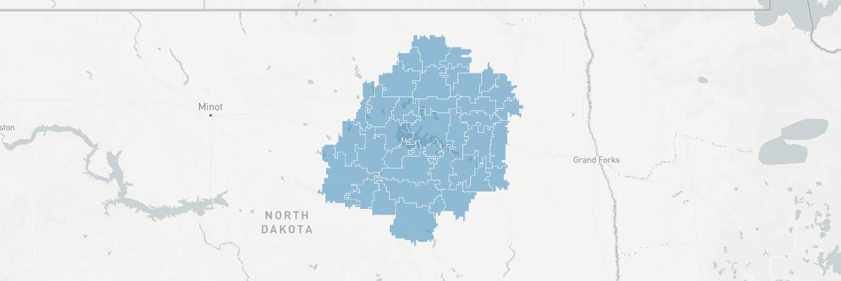
Overview
PRODUCTS
$ YouTube
$ OTT
$ TV/Sports Advertising
58301 - 36 MILE RADIUS
Population: 32,339
Median Age: 47
Average Home Value: $104,549
Average Income: $76,891
People/Household: 104,549
# of Businesses: 1,069

Slide 3
Audience Targeting
Where do my customers live online?
Finding your audience and where they spend most of their time is key to capturing their attention. We use several data sources to gauge things like interests, demographics, extra resources and time spent online. The results give us a clear map of where to place your ad.
Target Interests
Food & Drink
Hotels & Accommod…
Outdoors
Tourist Destinations
Travel
AUDIENCE TARGETING APPLIES TO:
Travel Agencies & S…
YouTube
OTT
TV/Sports Advertising
TARGET DEMOGRAPHICS
Gender All
Age 25-64
Income 50k+
Family All
Education All
Travel Guides & Trav…

Slide 4
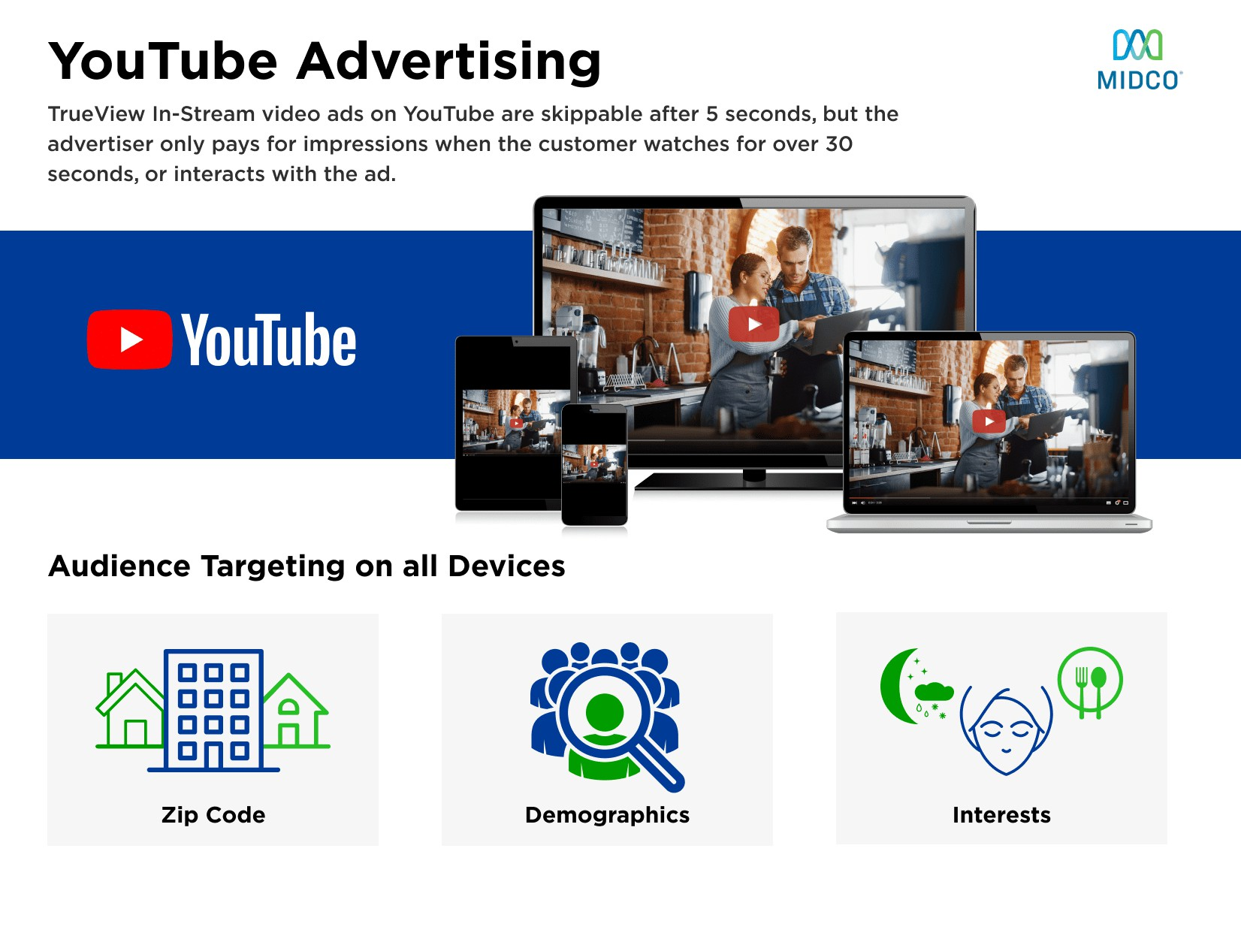


Slide 5
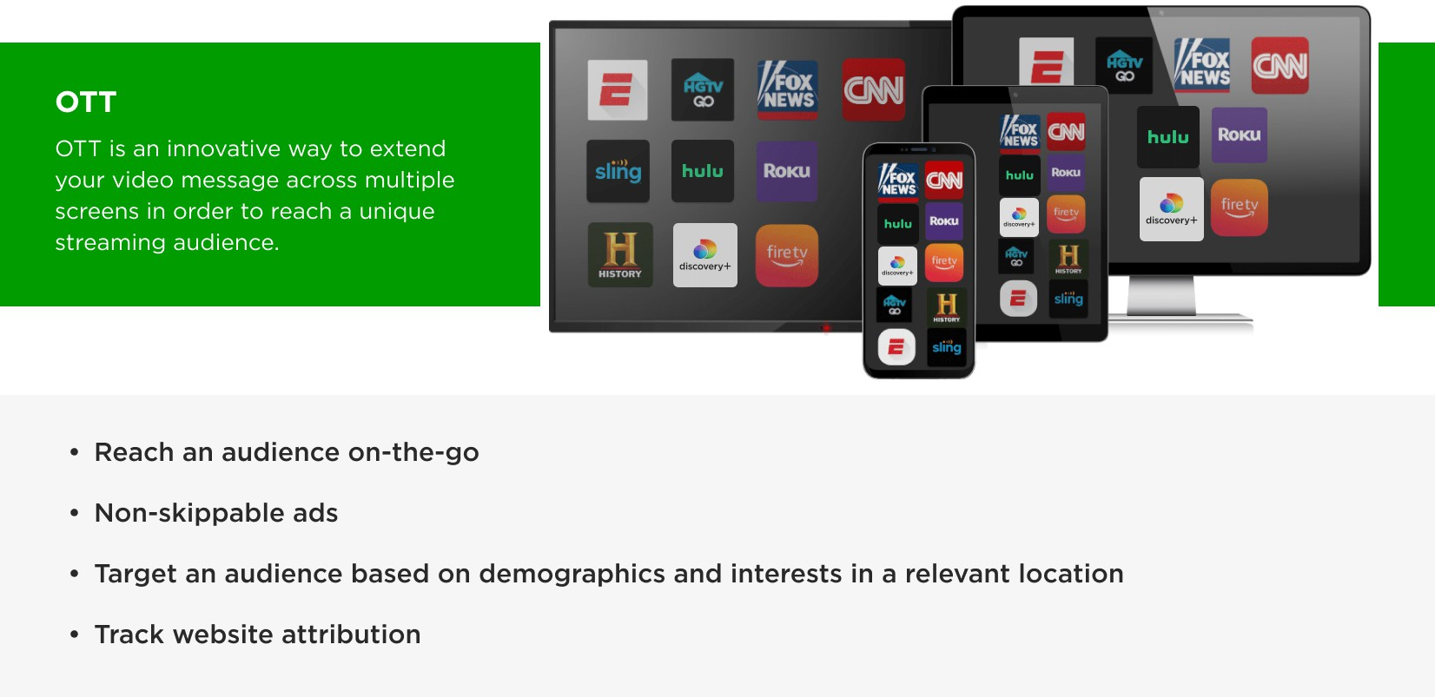
Over-the-Top
Targeted video advertising across ANY internet connected TV or mobile device within premium, short- and long-form content.

Slide 6























Networks
This is a list of networks where your ad may appear by relation to Contextual, Demographic, and Industry data.
Audience Interests
Demographic
Industry
Demographics and Psychographics supported by Winter 2022 MRI-Simmons USA.
Retrieved from Simmons Insights Database
Travel Channel
Sportsman Channel
TLC
CNBC
Disney
NFL App
Fox Sports
TNT
Nickelodeon
Cartoon Network
Outdoor Channel
ESPN
History
Destination America
HGTV
Bravo
Oxygen
E!
Lifetime Movies
Cooking Channel

Slide 7
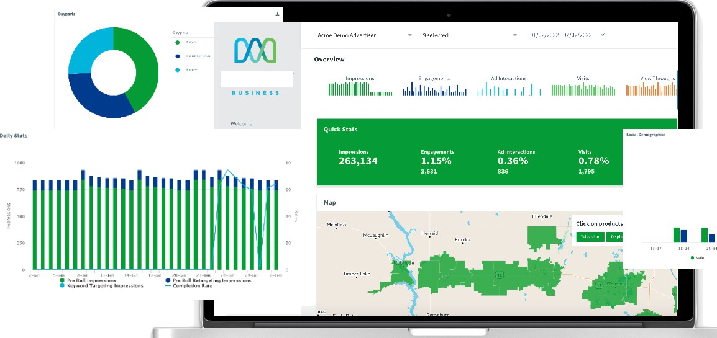
Analytics
MIDCO
With Midco, you always know exactly what was delivered for your advertising dollar.
24/7 access to an industry leading dashboard with unprecedented transparency.
Campaign impressions and engagement data by website.
Ad saturation by geography with impressions heat map.
Lift measurement available after 3 months to show the true impact of the digital program.*
* Lift measurement is only available with a 3-month campaig n and SOK impressions/month leveraging platform creative and Dixel placement on the site.
MIDCO”
1. II

Slide 8
Budget 1
BUDGET 1
4-MONTH TERM
PRODUCTS | DETAILS | BUDGETS
OTT | 6,250 Impressions/Mo | $250/Month
Monthly Total |  | $250
Grand Total |  | $1,000
CLIENT AGREEMENT
4 MONTHS START DATE: END DATE:

Slide 9
Budget 2
BUDGET 2
4-MONTH TERM
PRODUCTS | DETAILS | BUDGETS
YouTube | 1,563 YouTube Views/Mo | $250/Month
Monthly Total |  | $250
Grand Total |  | $1,000
CLIENT AGREEMENT
4 MONTHS START DATE: END DATE:

Slide 10
Budget 3
BUDGET 3
4-MONTH TERM
PRODUCTS | DETAILS | BUDGETS
TV/Sports Advertising |  | $250
Monthly Total |  | $250
Grand Total |  | $1,000
CLIENT AGREEMENT
4 MONTHS START DATE: END DATE:

