Slide 1
11 | 10 | 9 | 8 | 7 | 6 | 5 | 4 | 3 | 2 | 1
1700 Narrow Backset Mortise Lock
REDEFINING OPTIONS FOR ULTRA NARROW STILE DOORS
11 | 10 | 9 | 8 | 7 | 6 | 5 | 4 | 3 | 2 | 1

Slide 2
11 | 10 | 9 | 8 | 7 | 6 | 5 | 4 | 3 | 2 | 1
STILE INNOVATION
1700 SERIES
Accurate’s lock innovation makes its debut to allow more flexibility for ultra narrow stile aluminum doors. Pair with a variety of decorative or commercial trim options to do more with less. Available in a range of finishes and functions, the 1700 Series opens the door to endless possibilities.
1756 FUNCTION SHOWN WITH 17L LEVERS AND 2R ROSE
11 | 10 | 9 | 8 | 7 | 6 | 5 | 4 | 3 | 2 | 1

Slide 3
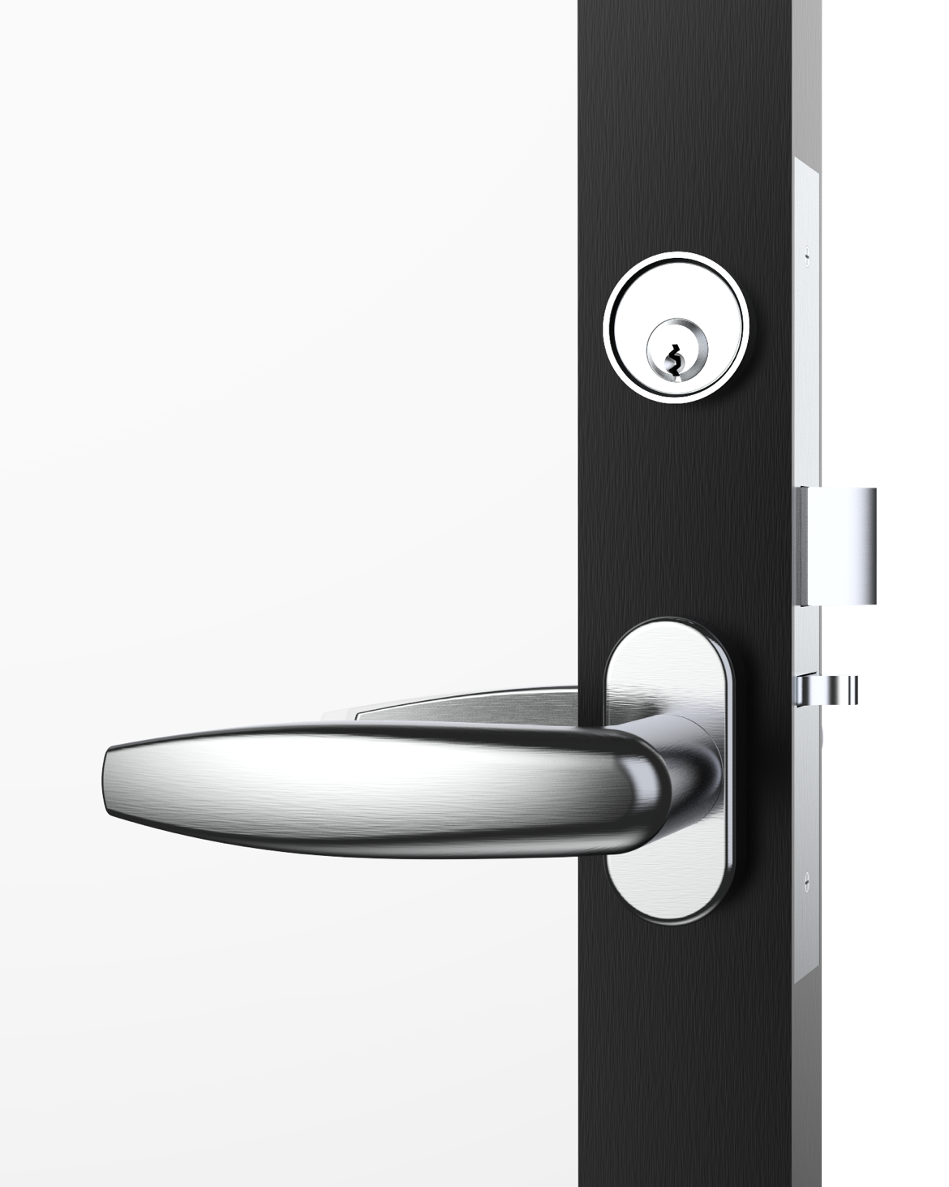
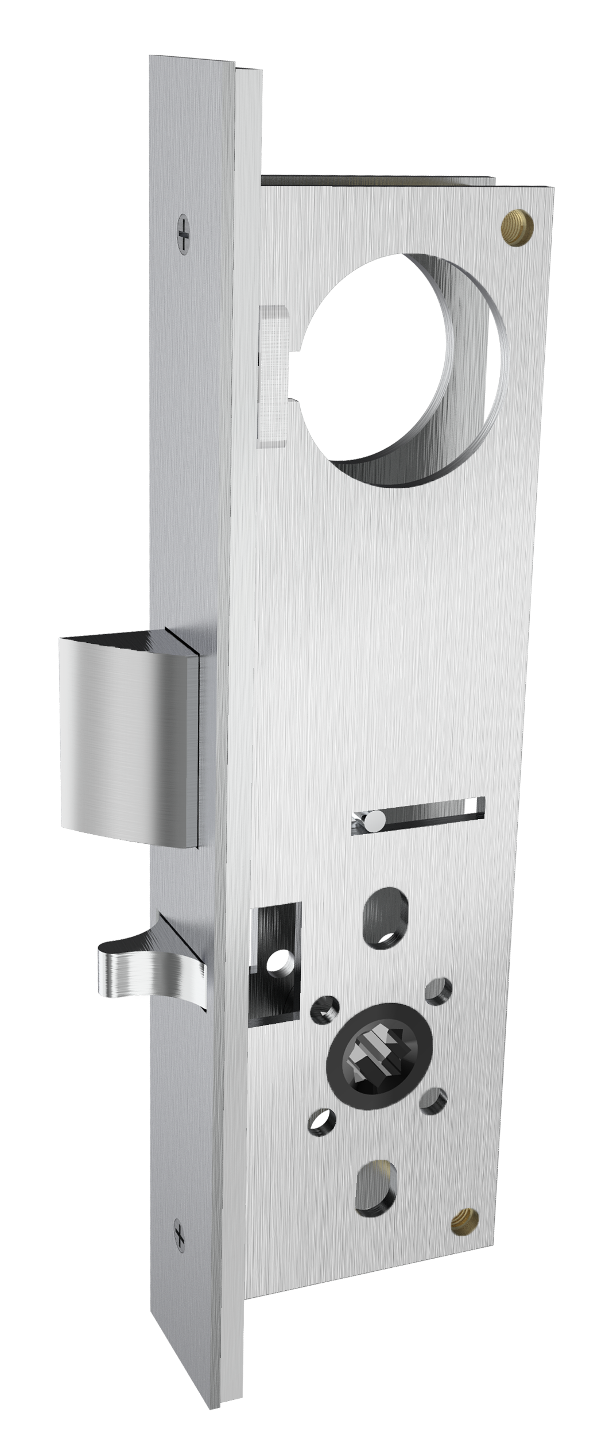
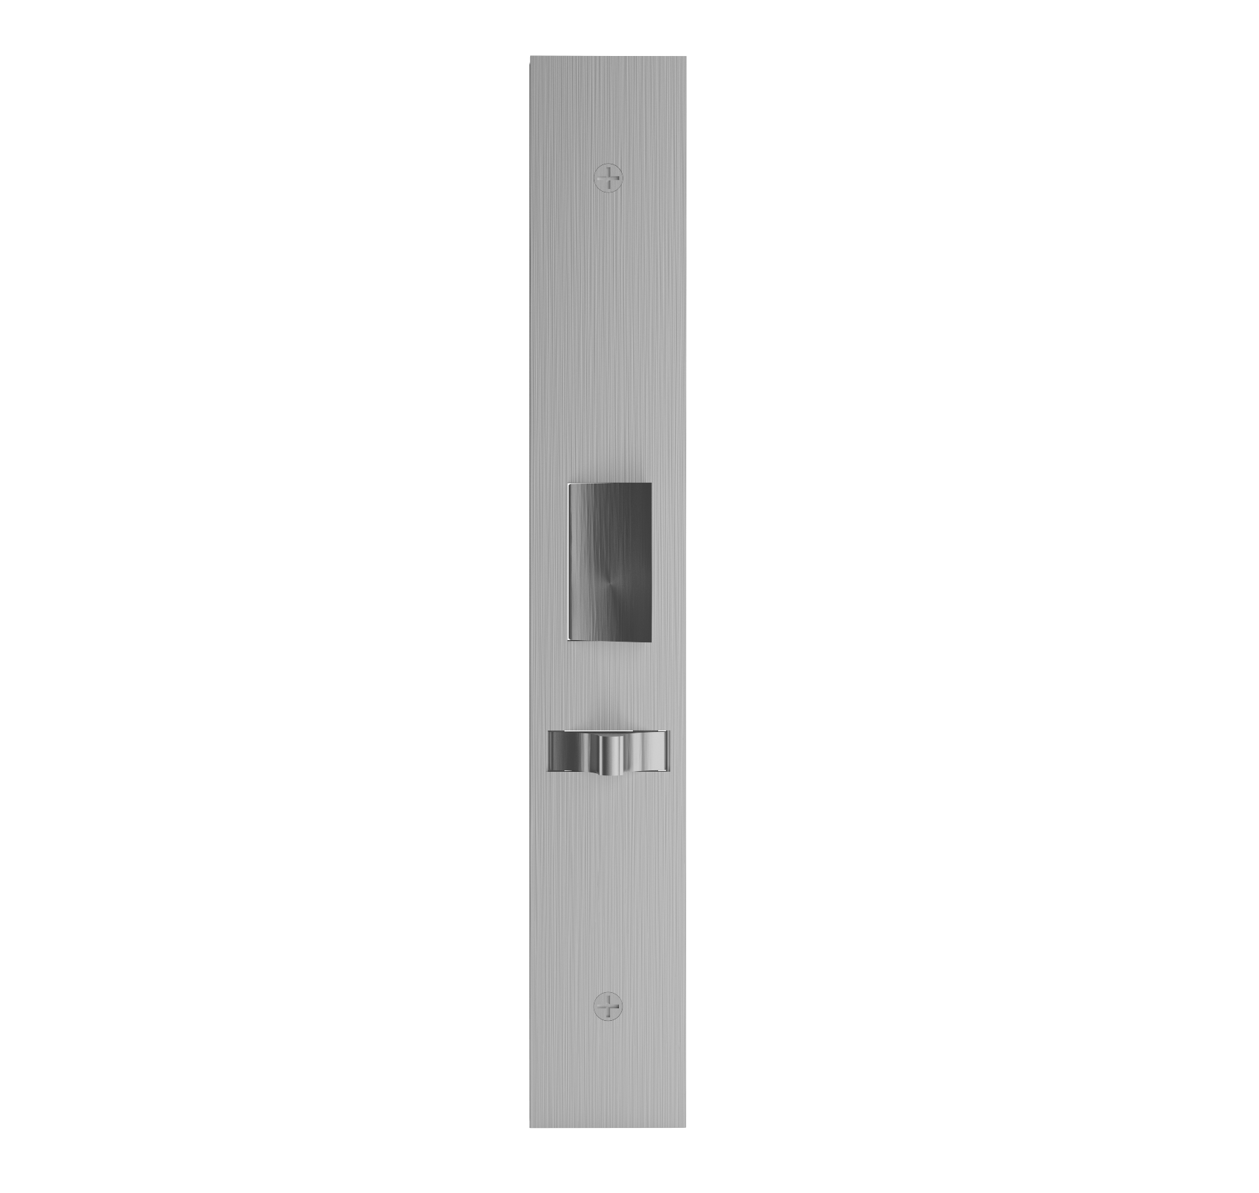
11 | 10 | 9 | 8 | 7 | 6 | 5 | 4 | 3 | 2 | 1
STILE INNOVATION
1700 SERIES NARROW BACKSET LOCK
SLEEK AESTHETICS
Maintain sleek lines where narrow stile doors are prominent
Narrow backsets (1$1/8”)$ are ideal for aluminum storefront and glass wall partition systems with narrow stile framing (minimum 1 $7/8$” stile recommended)
DESIGN VERSATILITY
Compatible with Accurate Lever Trim or custom fitted for most manufacturers’ sectional lever trim (narrow roses/escutcheon)
FUNCTIONALITY
Can be used with standard mortise cylinders
Features latch holdback by cylinder option
STANDARD
29L LEVER/2R ROSE SET
1757 ENTRANCE OR OFFICE FUNCTION
11 | 10 | 9 | 8 | 7 | 6 | 5 | 4 | 3 | 2 | 1

Slide 4
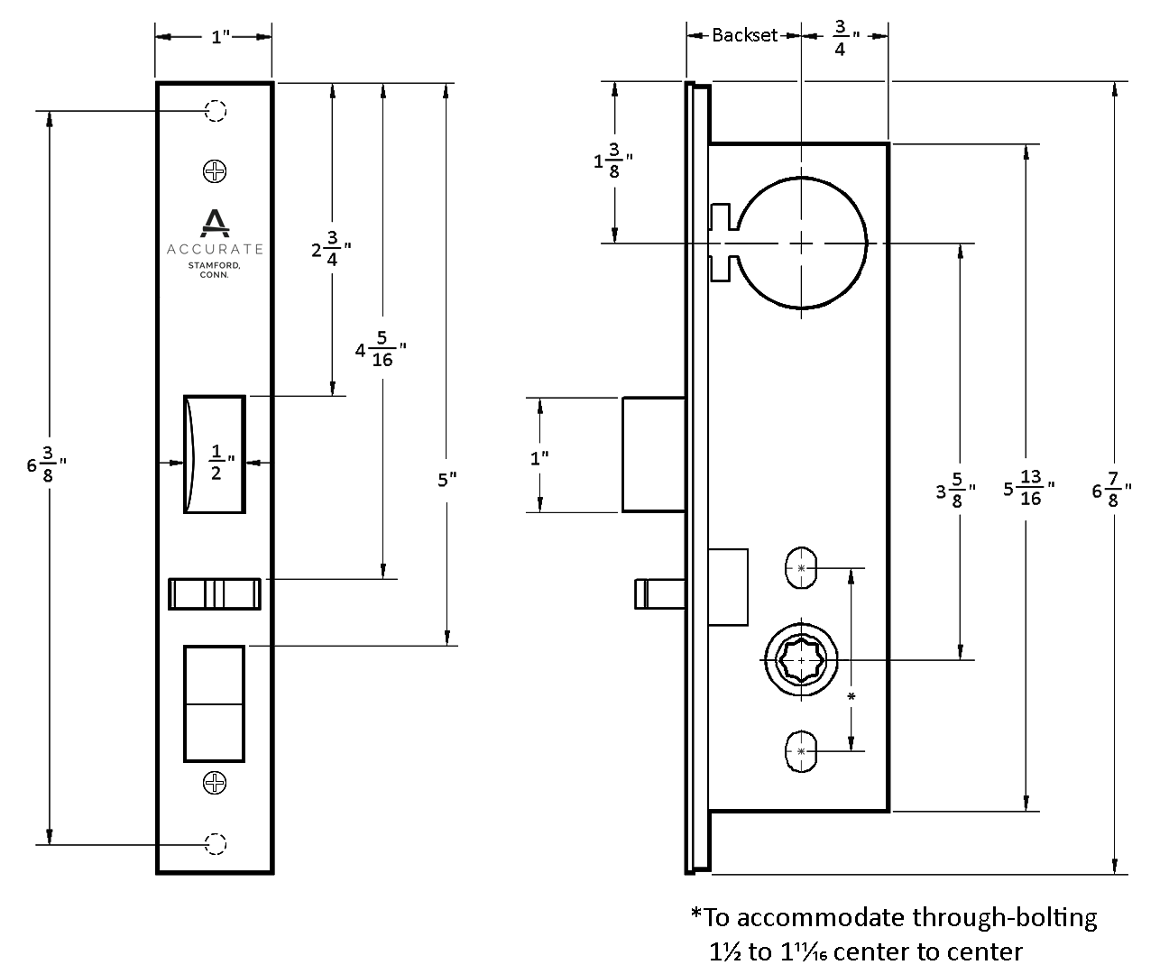
11 | 10 | 9 | 8 | 7 | 6 | 5 | 4 | 3 | 2 | 1
1700 Series: Technical Details
BACKSET: 1$1/8$” (Special order 1” backset available, please contact us for assistance).
CASE: Heavy gauge, stainless steel
ARMOR FRONT: Brass, bronze, aluminum or stainless steel, finished as required. Faceplate options: flat (default), radius or beveled (see How to Specify pgs. 10-11)
LATCH BOLT: Brass or stainless steel, solid type $1/2$” throw
STRIKE: 4$7/8$” ASA
HUBS: Set up to accept 8mm spindles. Other sizes can be accommodated.
DUST BOX: Brass, stainless steel or oil rubbed bronze
11 | 10 | 9 | 8 | 7 | 6 | 5 | 4 | 3 | 2 | 1

Slide 5
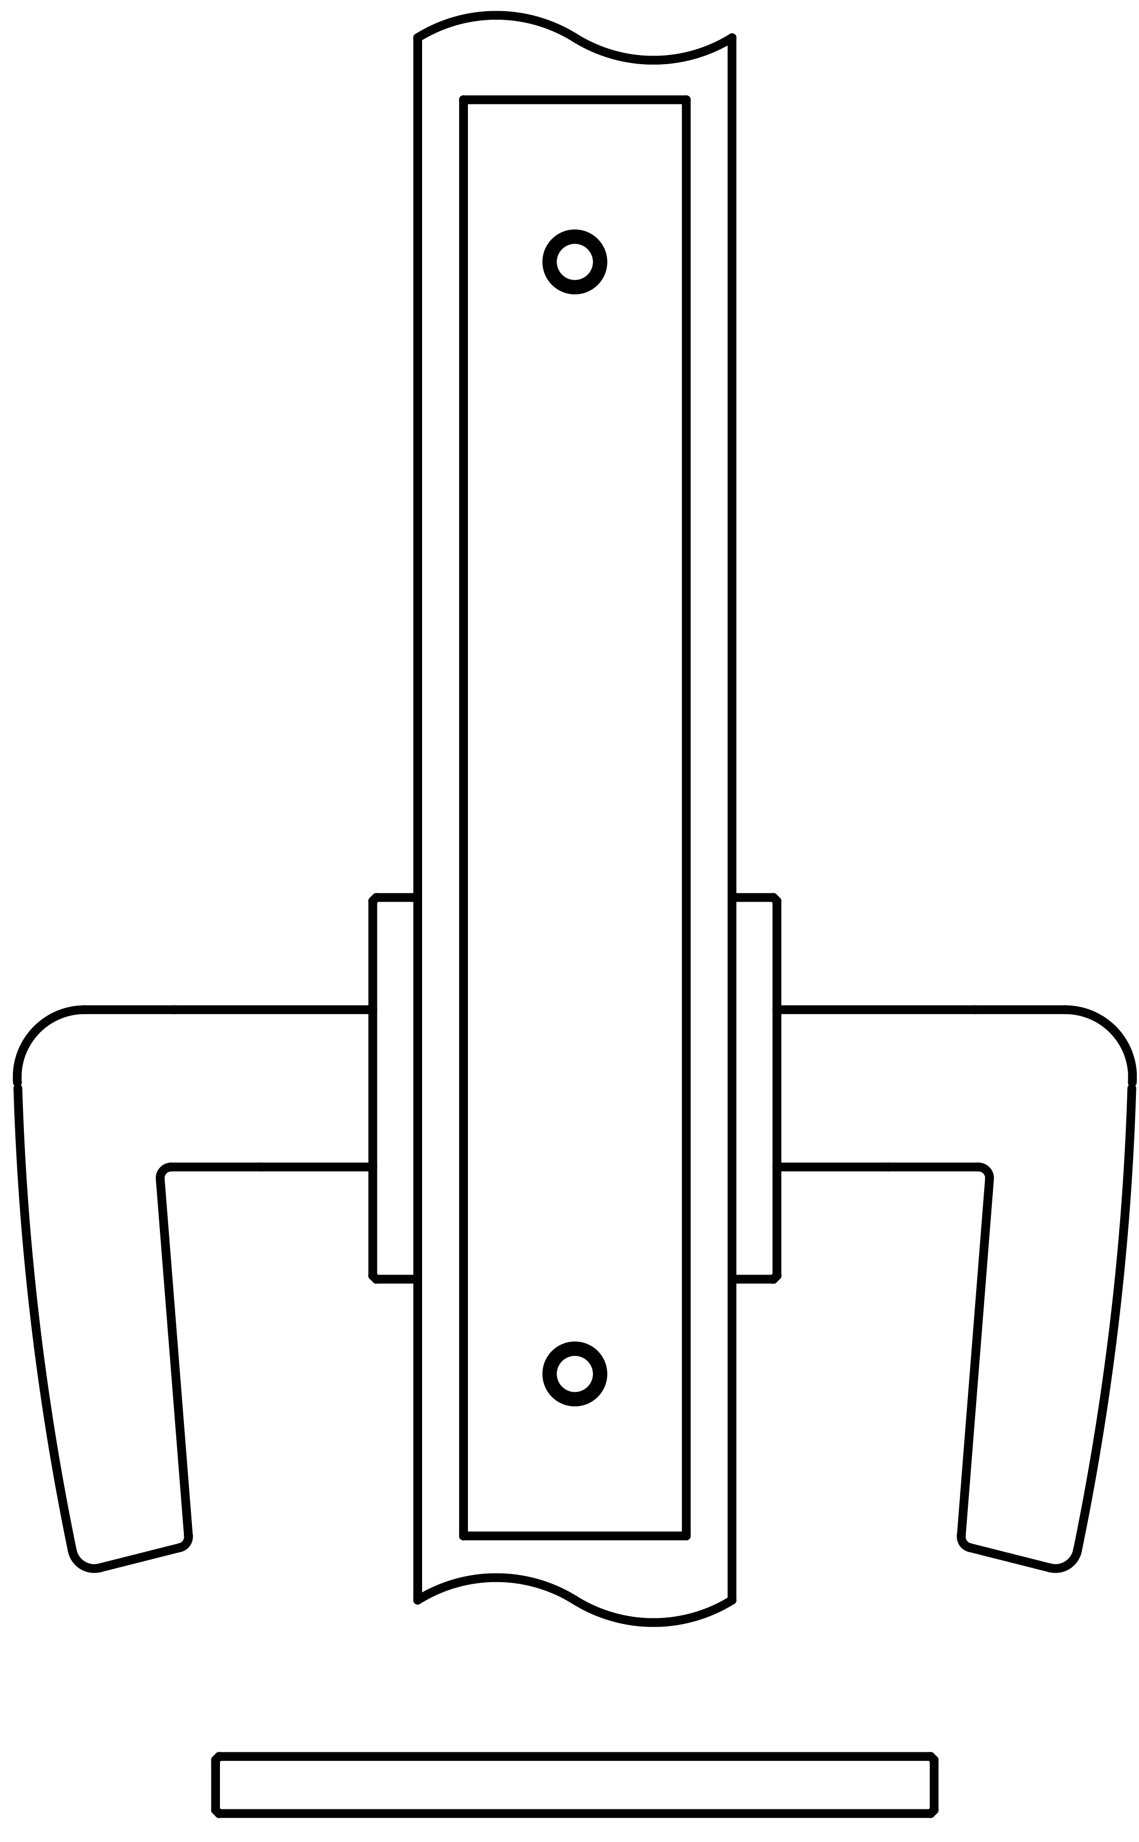
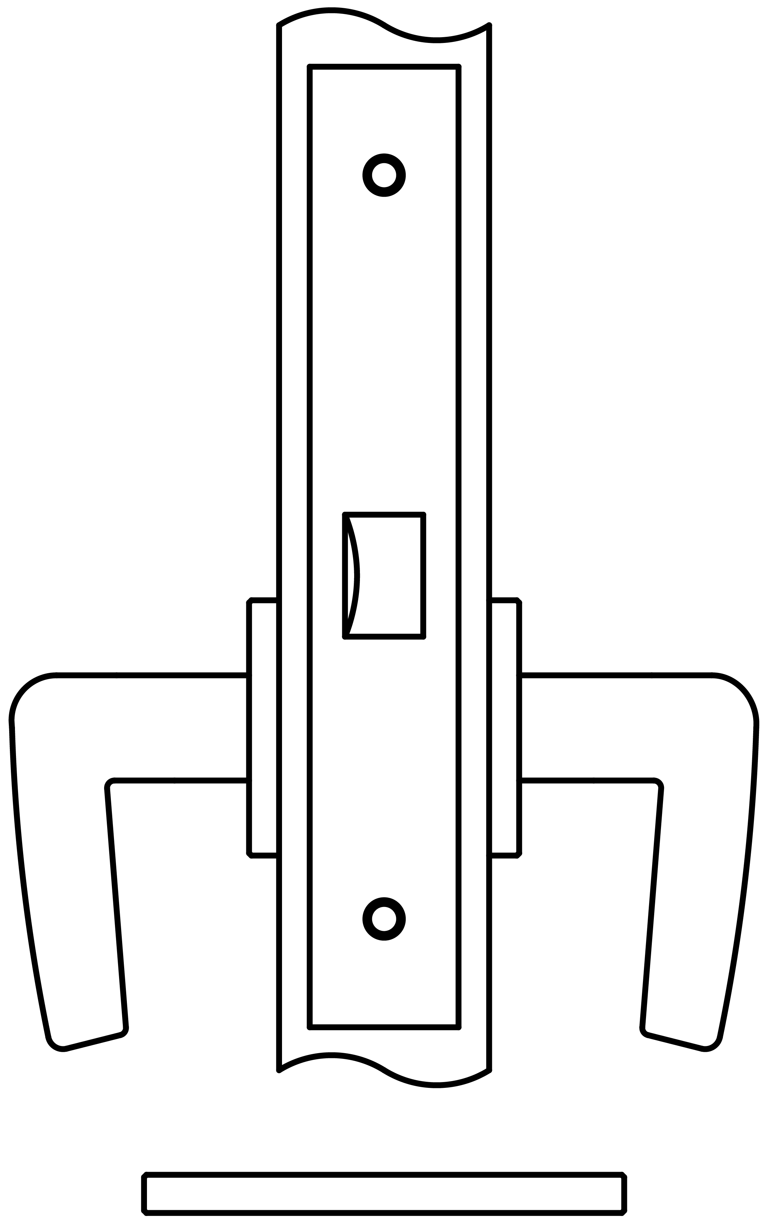
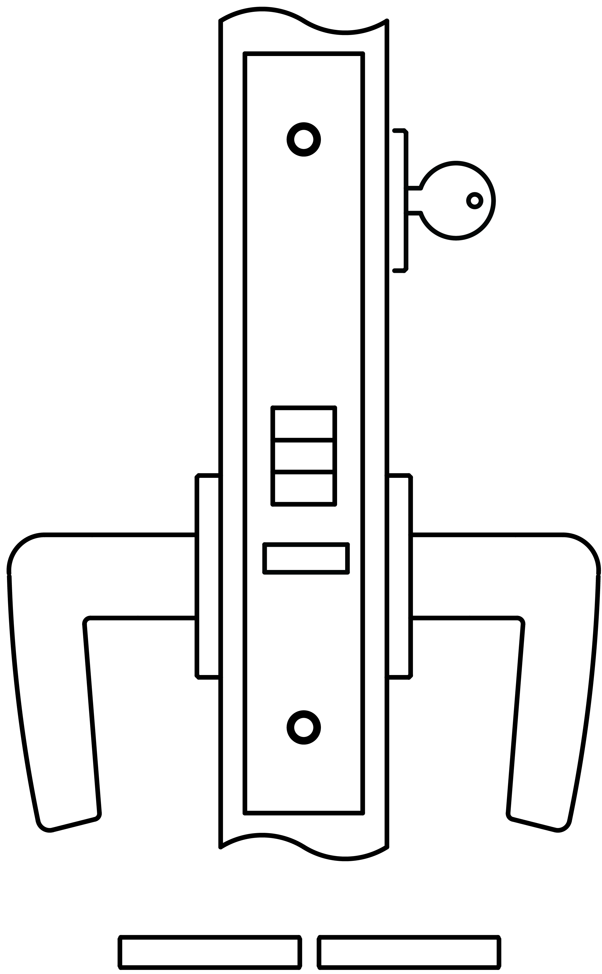
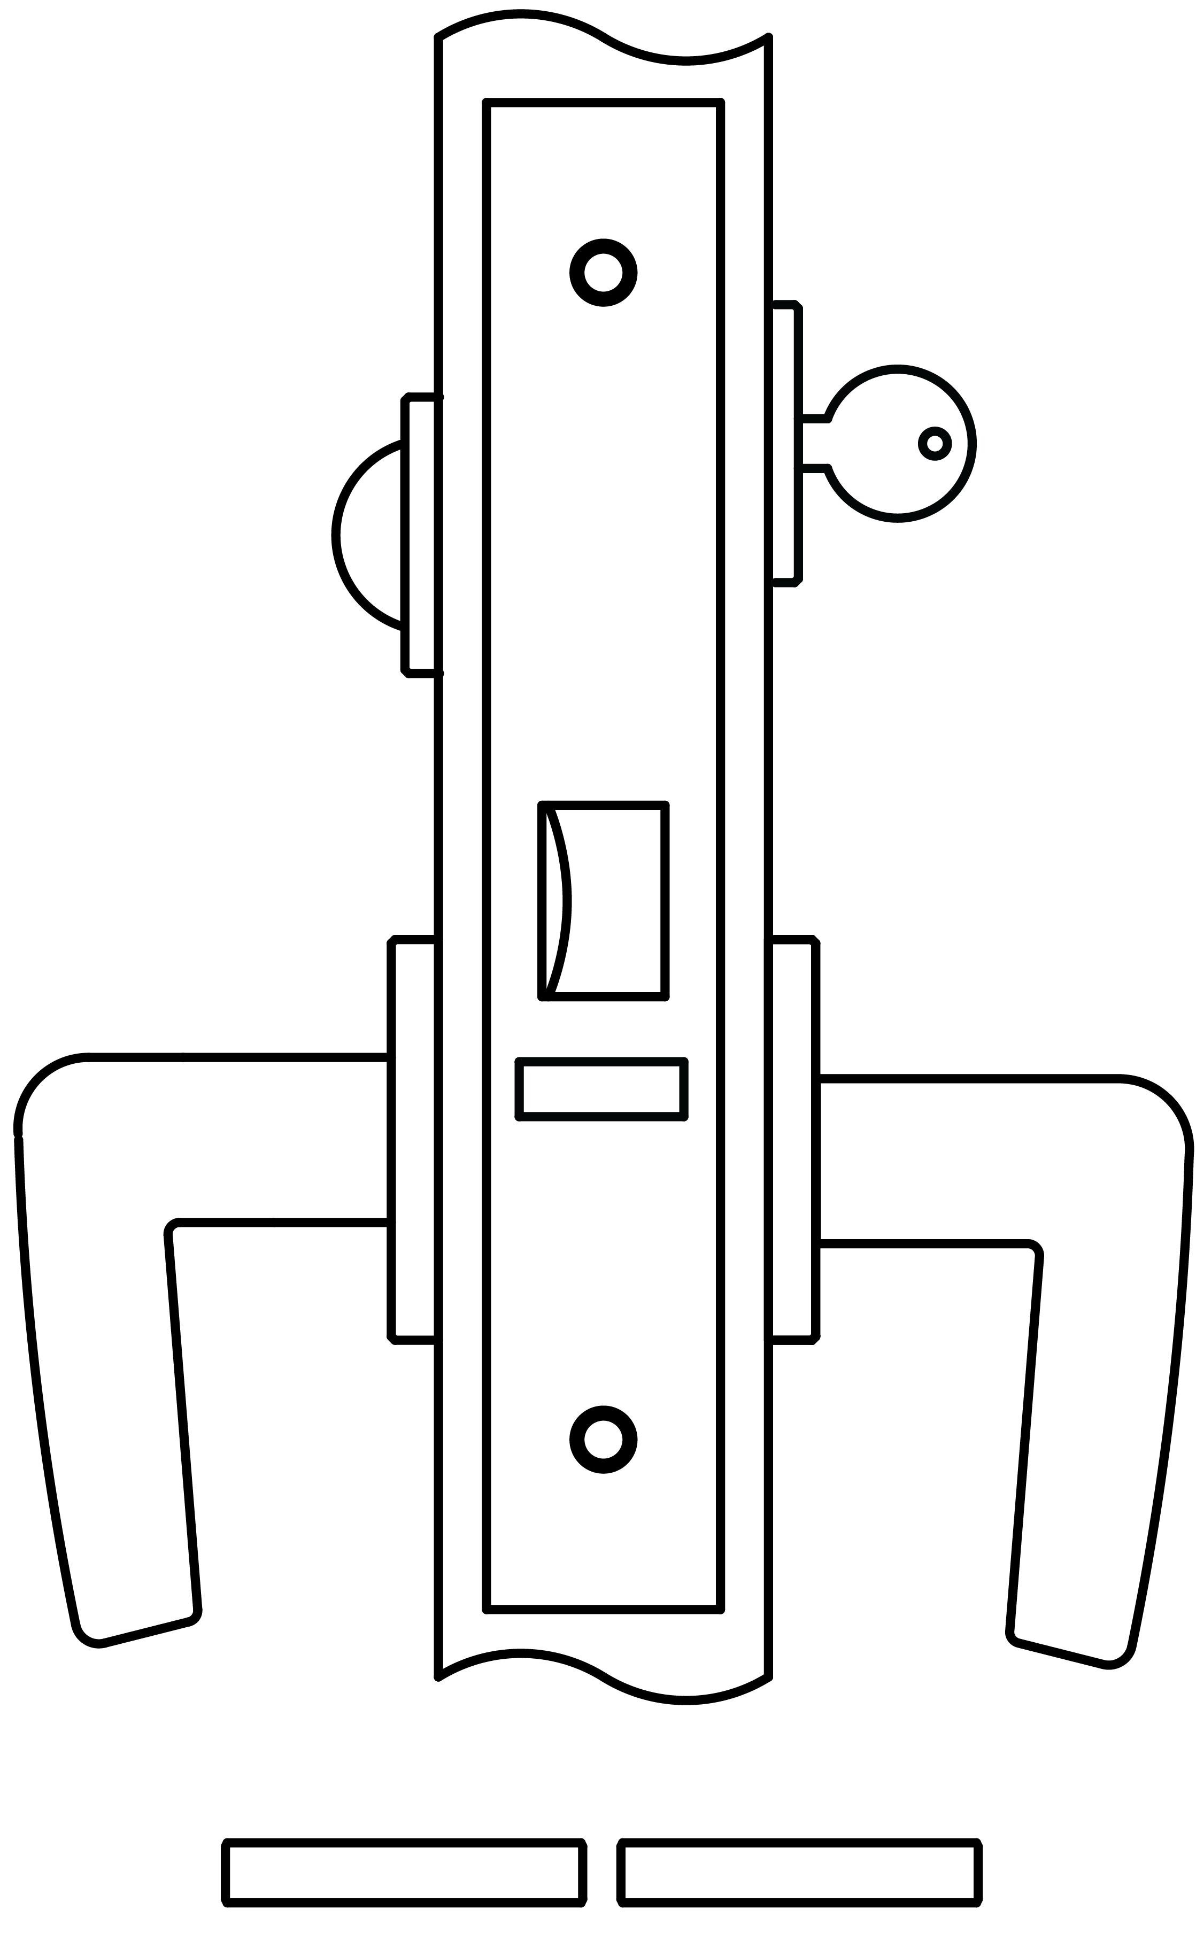
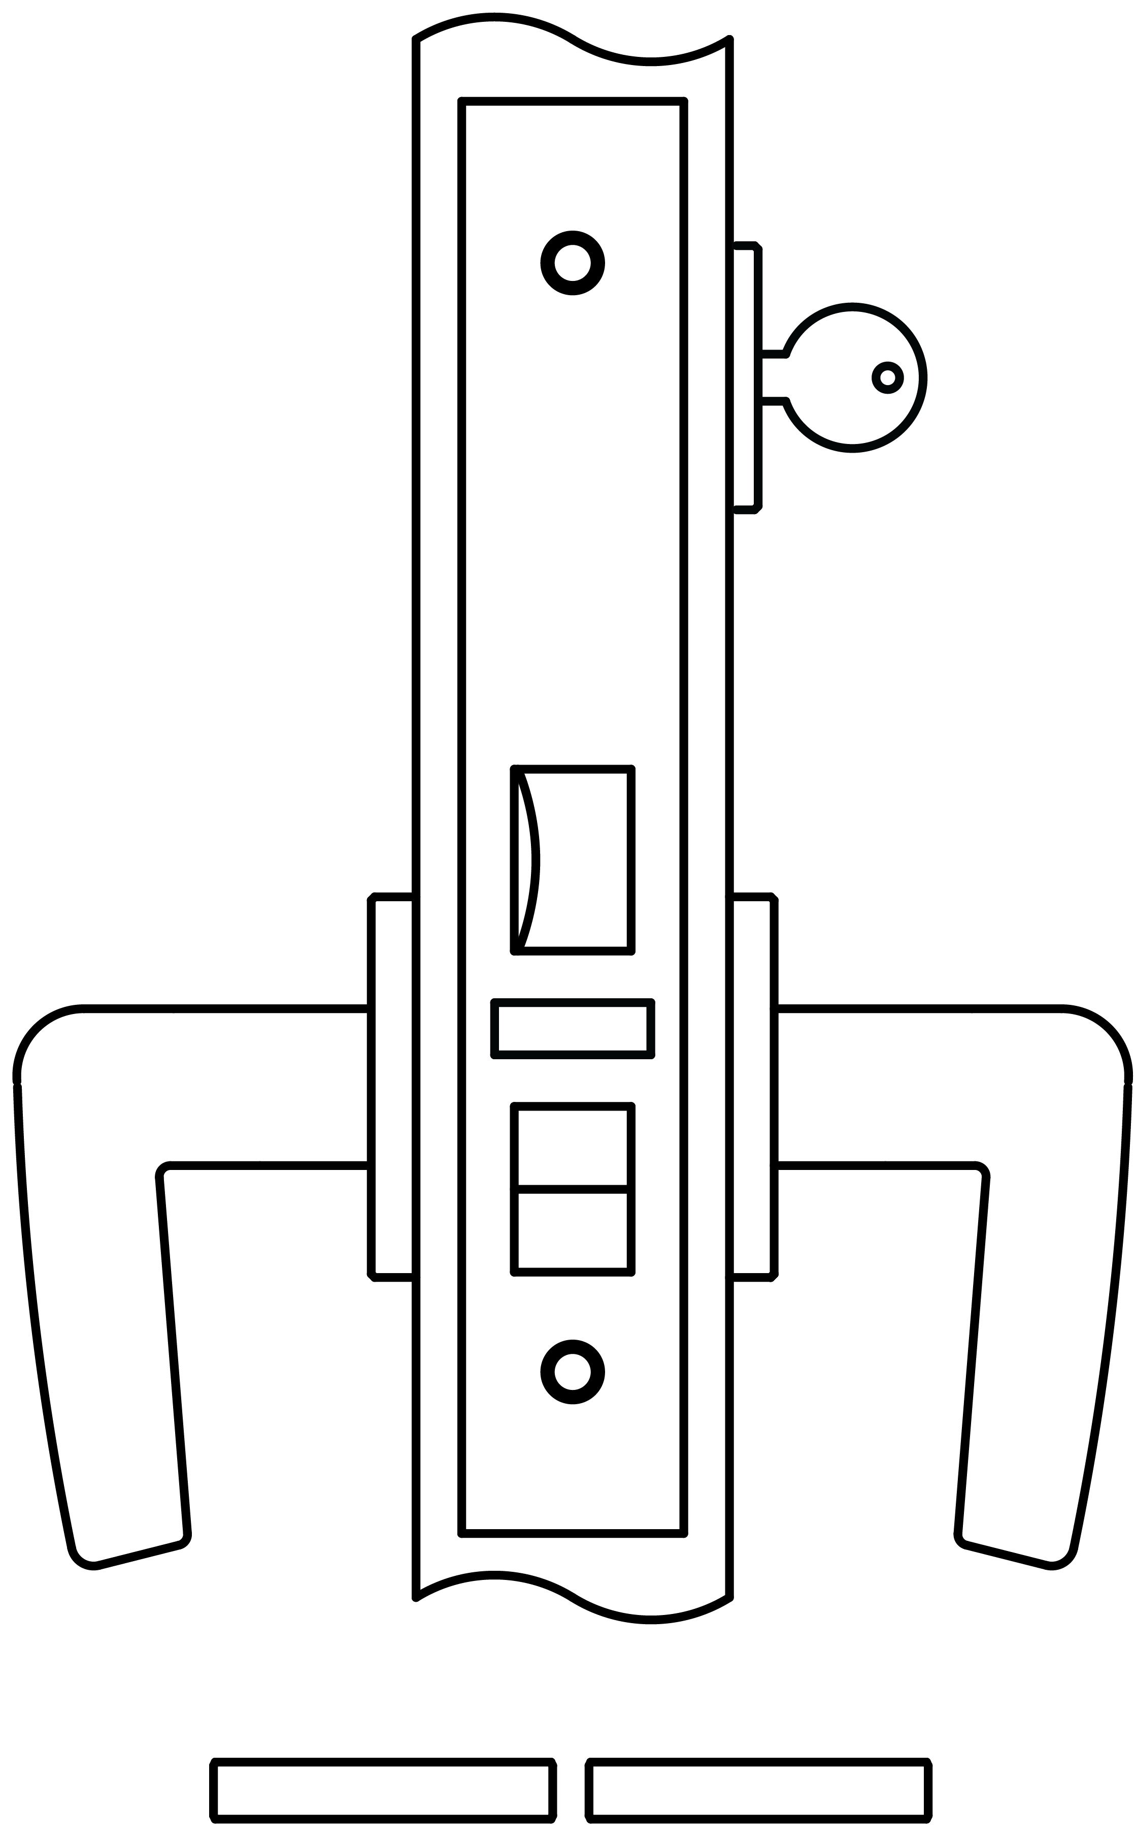
11 | 10 | 9 | 8 | 7 | 6 | 5 | 4 | 3 | 2 | 1
1700 Series: Functions
1700ADL
ACTIVE DUMMY LOCK
1725
PASSAGE
1745
CLASSROOM
Active handles inside and outside.
Latch bolt by lever either side.
Latch bolt can be held retracted by depressing, then turning key.*
*Optional, please specify 1725H
Latch bolt by lever either side unless outside lever is locked by key.
Auxiliary latch deadlocks latch bolt.
Inside lever always free egress.
1750
ENTRANCE
1753
ENTRANCE
1756
ENTRANCE OR OFFICE
Latch bolt by key outside.
Latch bolt by lever either side unless outside lever locked by thumb turn inside.
When outside lever is locked, operating the inside lever will NOT unlock outside lever.
Auxiliary latch deadlocks latch bolt. Inside lever always free egress.
Latch bolt by key outside.
Latch bolt by lever either side unless locked by thumb turn inside (both levers become rigid).
Auxiliary latch deadlocks latch bolt.
No emergency egress.
Latch bolt by key outside and lever either side unless outside lever is locked by toggle-action stop.
Auxiliary latch deadlocks latch bolt.
Latch bolt can be held retracted by depressing, then turning key.*
*Optional, please specify 1756H
11 | 10 | 9 | 8 | 7 | 6 | 5 | 4 | 3 | 2 | 1

Slide 6
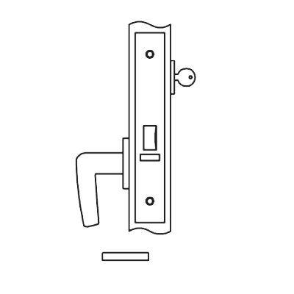
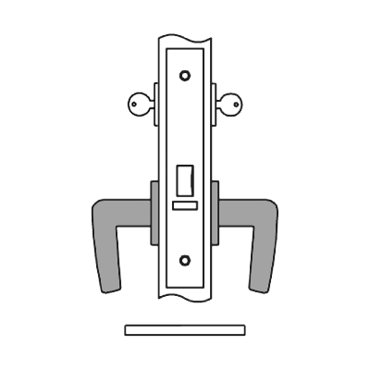
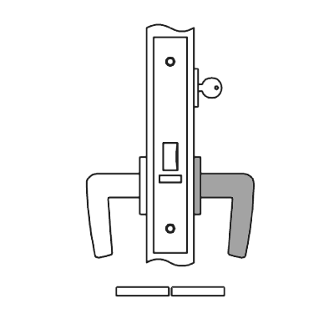
11 | 10 | 9 | 8 | 7 | 6 | 5 | 4 | 3 | 2 | 1
1700 Series: Functions
1757
ENTRANCE OR OFFICE
Latch by lever inside and key outside.
No outside lever.
Auxiliary latch deadlocks latch bolt.
Latch bolt can be held retracted by depressing, then turning key.*
*Optional, please specify 1757H
1758
INSTITUTION OR ASYLUM
Latch by key either side.
Inside and outside levers always rigid.*
Auxiliary latch deadlocks latch bolt.
Latch bolt can be held retracted by depressing, then turning key.**
*Verify code compliance before using this function
**Optional, please specify 1758H
1759
STOREROOM OR CLOSET
Latch by lever inside and key outside.
Outside lever always rigid.
Auxiliary latch deadlocks latch bolt.
*Optional, please specify 1759H
11 | 10 | 9 | 8 | 7 | 6 | 5 | 4 | 3 | 2 | 1

Slide 7
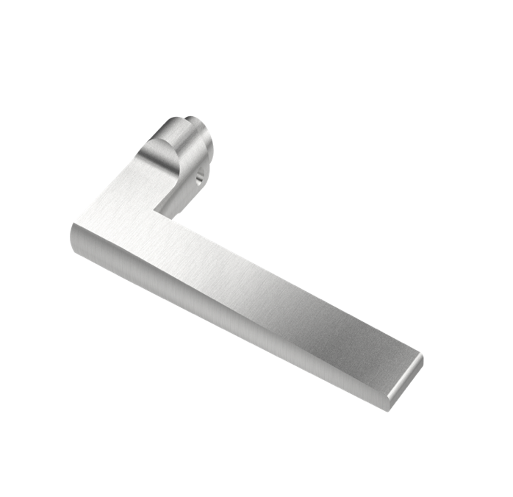
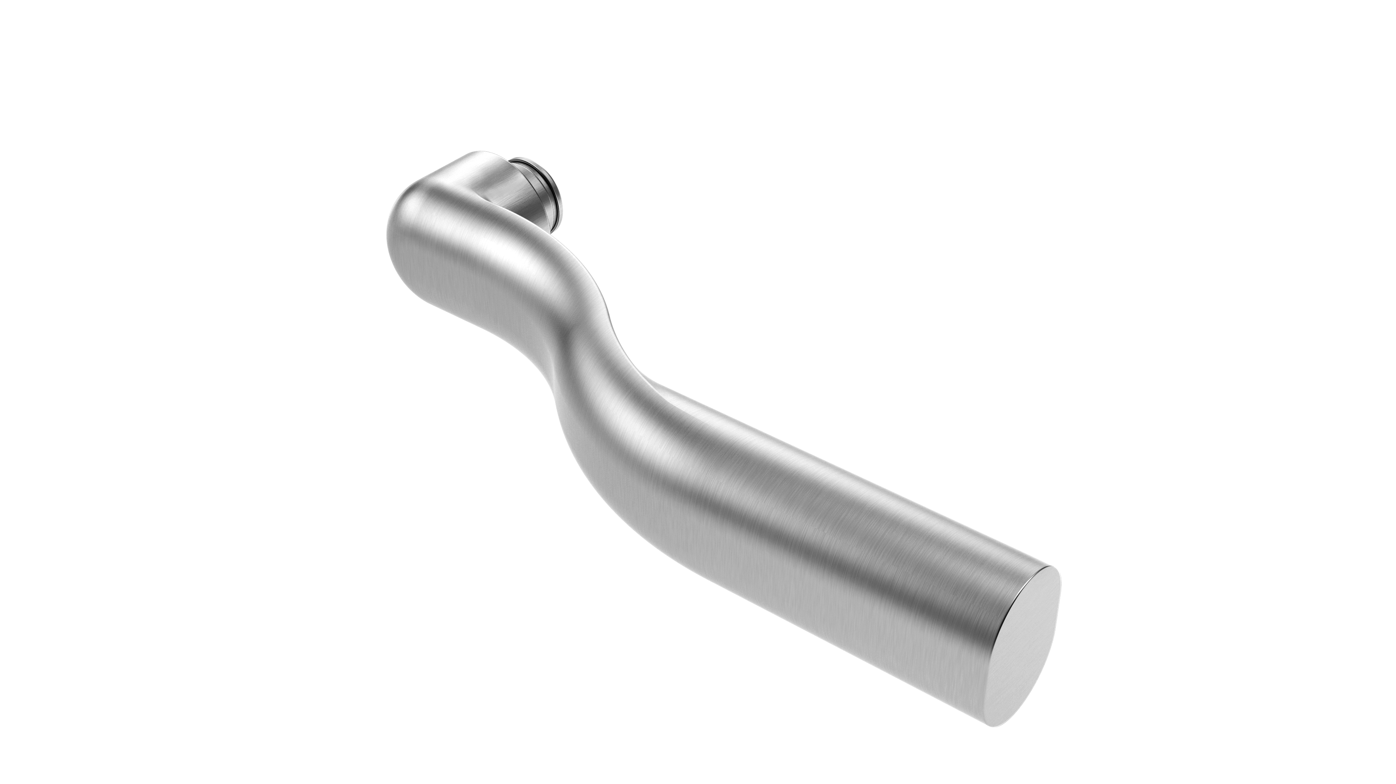
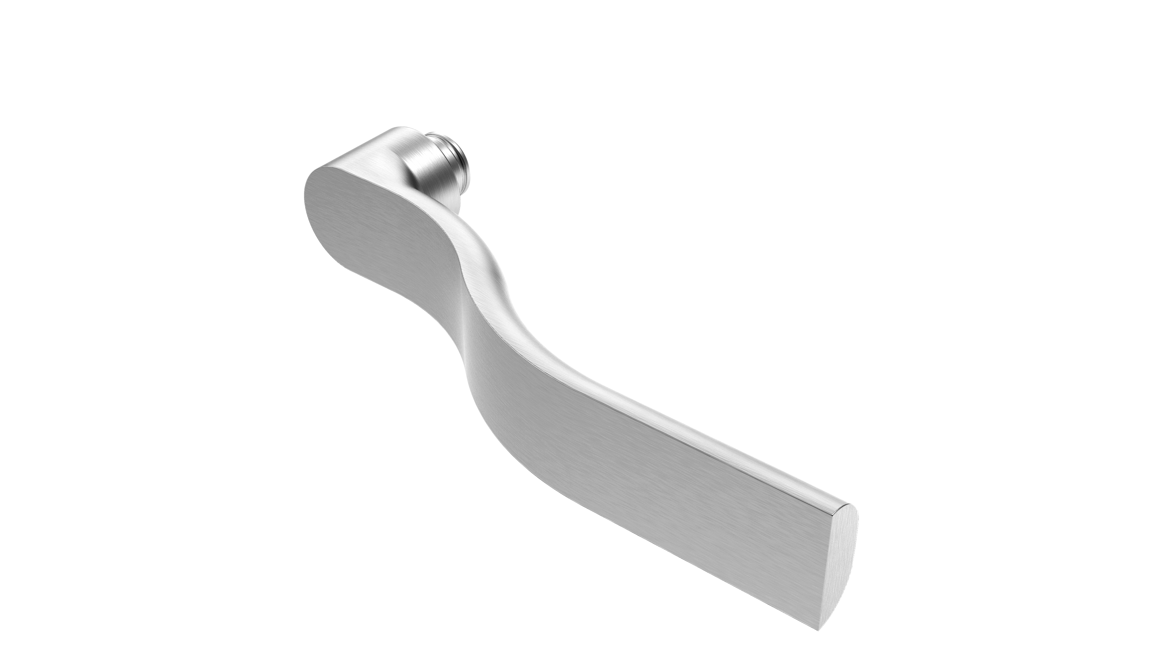
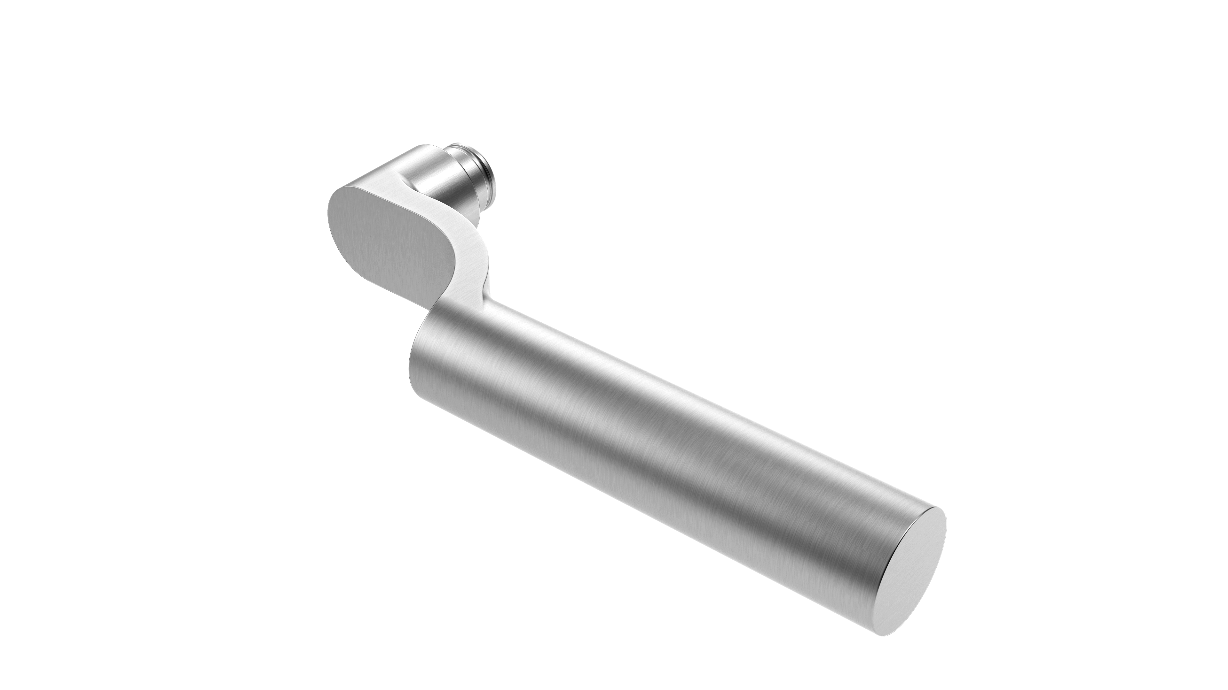
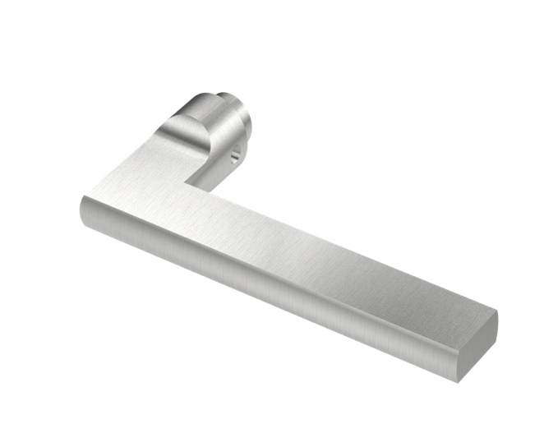
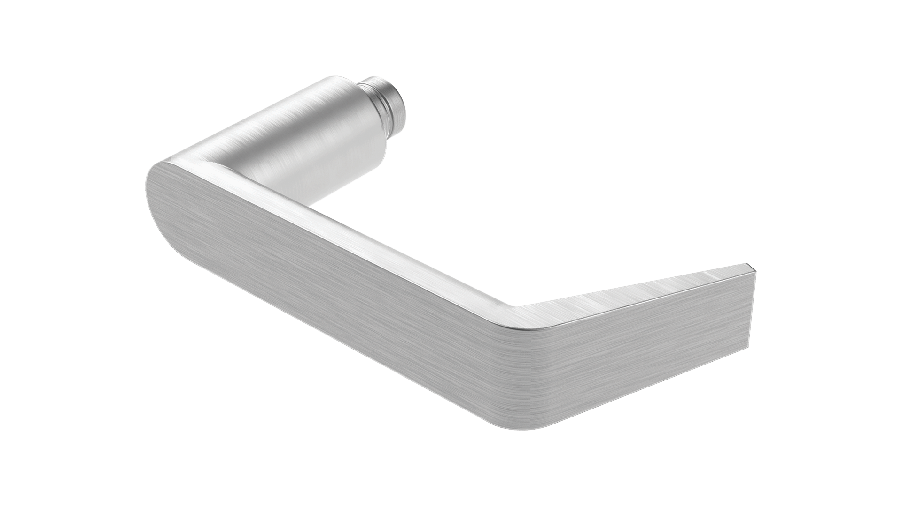
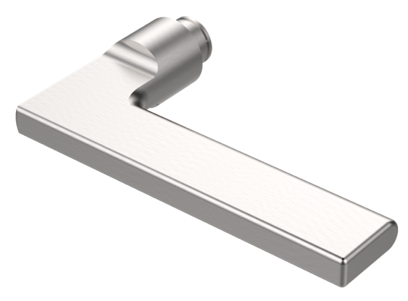
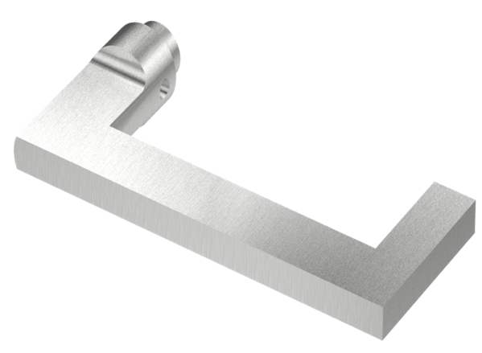
11 | 10 | 9 | 8 | 7 | 6 | 5 | 4 | 3 | 2 | 1
Accurate Lever Trim
15L LEVER
16L LEVER
17L LEVER
18L LEVER
19L LEVER
20L LEVER
21L LEVER
24L LEVER
CLICK TO SEE MORE INFO ON TRIM OPTIONS
11 | 10 | 9 | 8 | 7 | 6 | 5 | 4 | 3 | 2 | 1

Slide 8
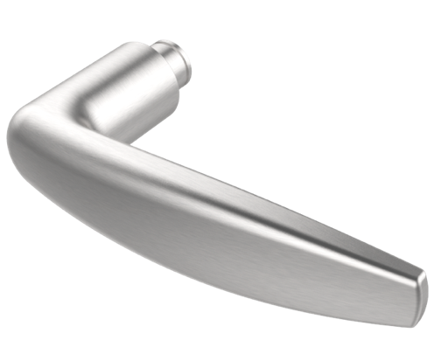
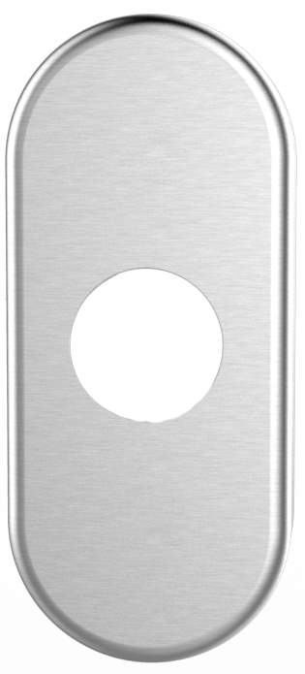
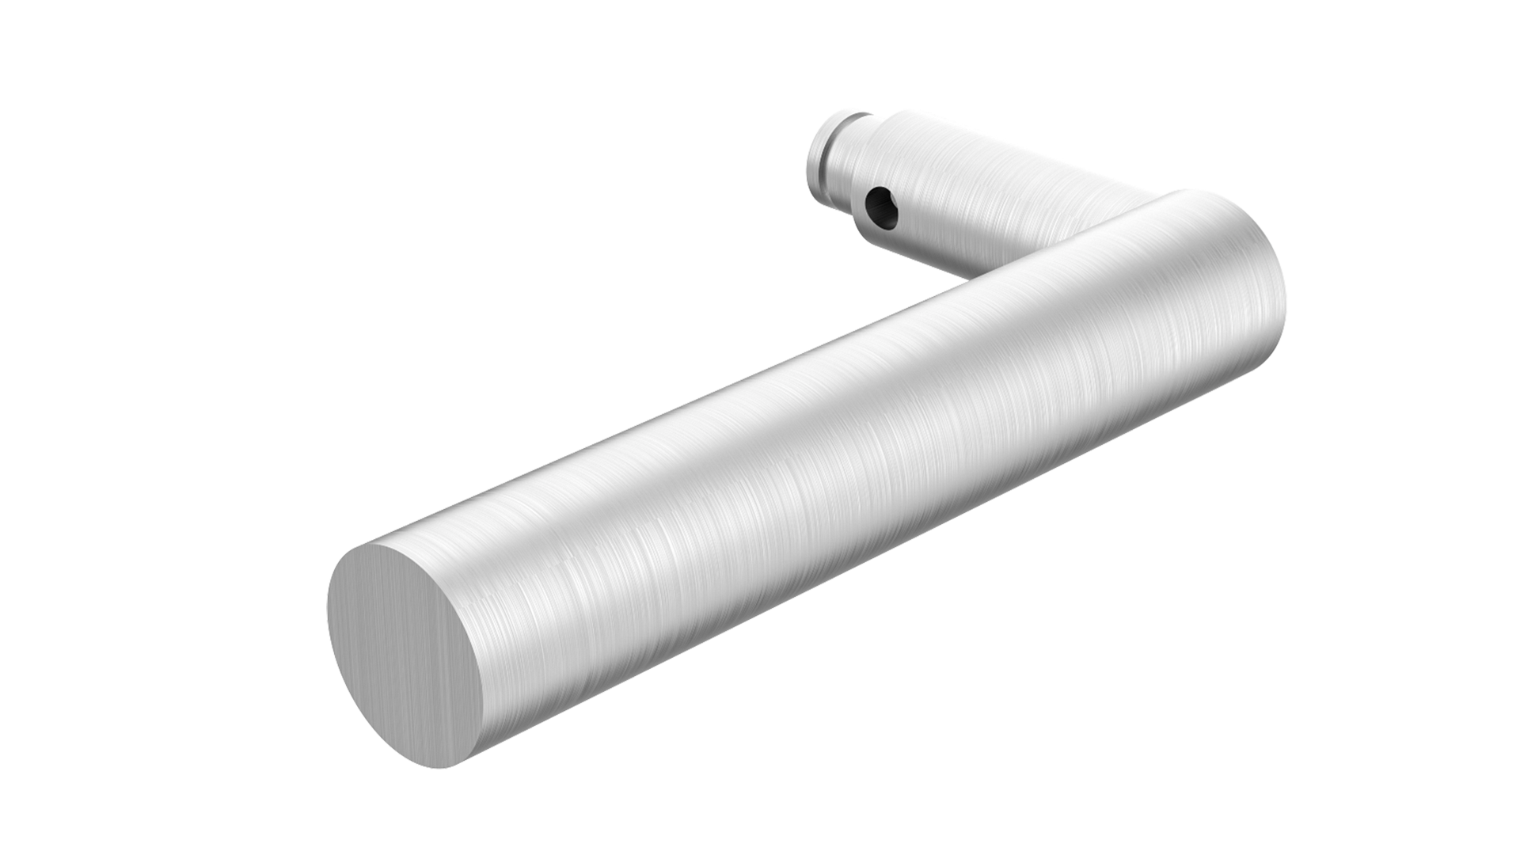
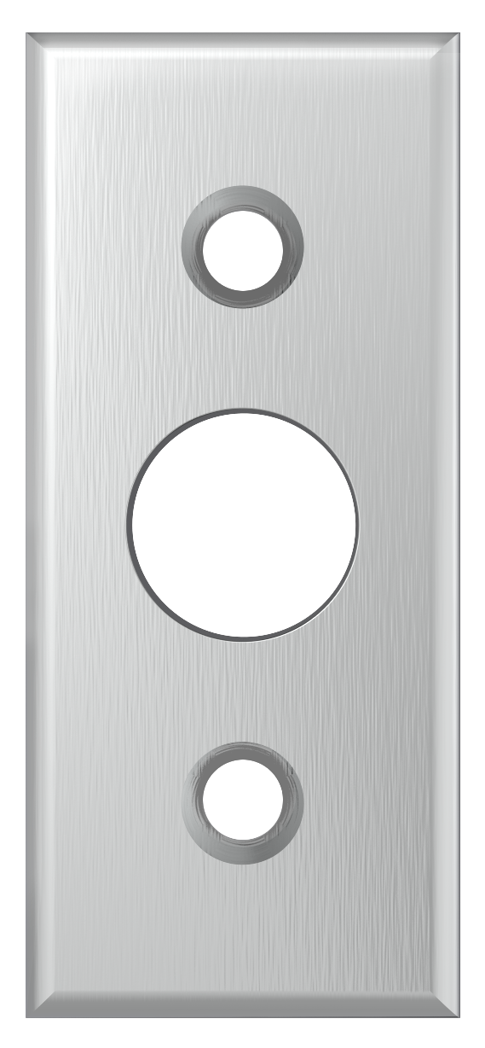
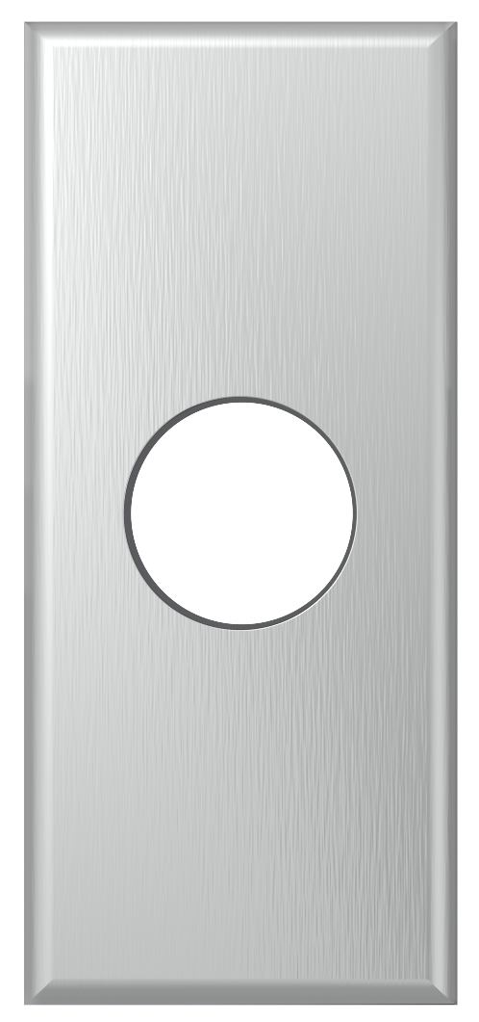
11 | 10 | 9 | 8 | 7 | 6 | 5 | 4 | 3 | 2 | 1
Accurate Trim
29L LEVER
1E-175
NARROW ESCUTCHEON
2R ROSE
Side
Inside
Outside
74L LEVER
4R ROSE
Side
Outside
11 | 10 | 9 | 8 | 7 | 6 | 5 | 4 | 3 | 2 | 1

Slide 9
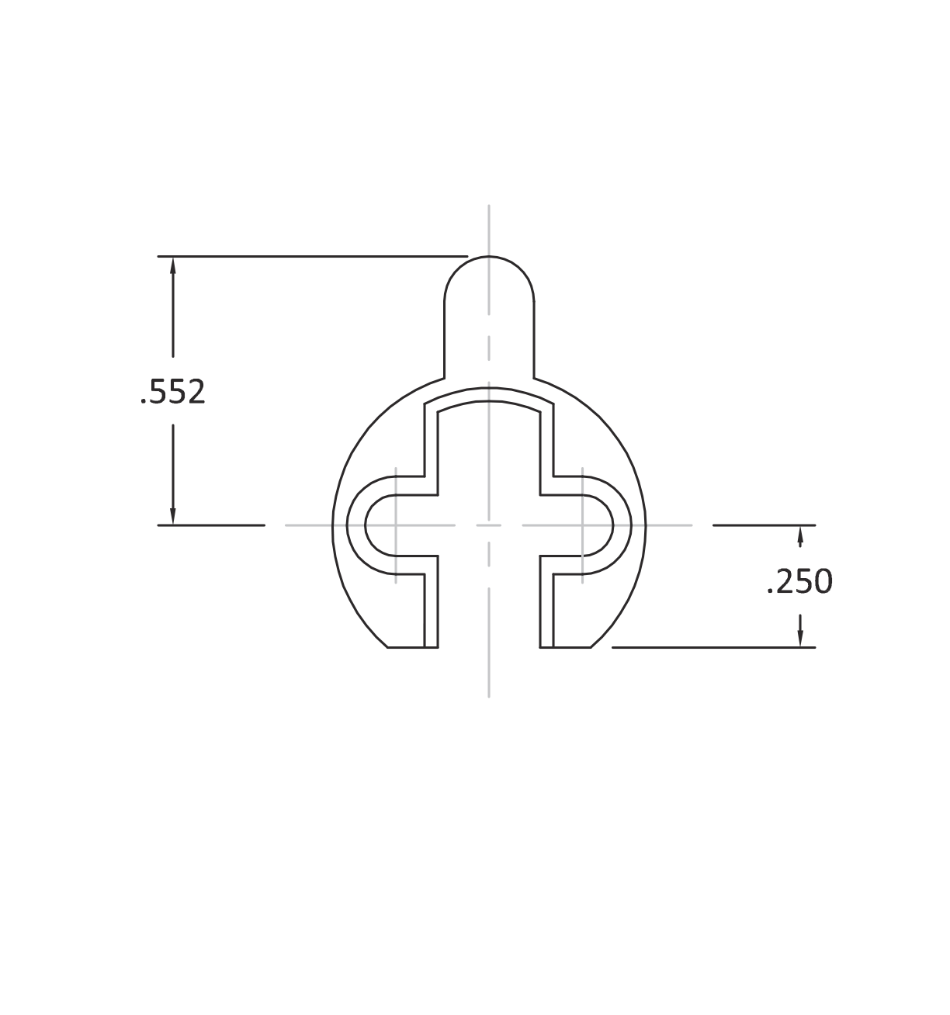
11 | 10 | 9 | 8 | 7 | 6 | 5 | 4 | 3 | 2 | 1
HOW TO SPECIFY
HANDING
FINISHES
CYLINDERS & KEYING
FACEPLATE
GROUP 1: US4, US4NL, US32D*, US26D
GROUP 2: US3, US3NL, US26, US32*, US9*, US10*, US10B, US14, US15, US19
GROUP 3: BN, BB, TN, TB, DURO, ESN, US15A, US5
* Trim options (including Accurate Levers) may not be available in US32D, US32, US9, or US10 finish. Please call for assistance.
To view example of finishes visit: Accurate Finishes.
FACEPLATE EDGE
FACEPLATE CORNERS
1700 Series locks accept any standard American mortise cylinder. For details on required cams and compatibility with other manufacturers’ cylinders, please visit: Accurate Support.
Flat Faceplate Edge furnished unless otherwise specified.
Bevel Faceplate determined by handing.
Square Faceplate Corners furnished unless otherwise specified.
11 | 10 | 9 | 8 | 7 | 6 | 5 | 4 | 3 | 2 | 1

Slide 10
11 | 10 | 9 | 8 | 7 | 6 | 5 | 4 | 3 | 2 | 1
HOW TO SPECIFY
FUNCTION.FACEPLATE.BACKSET.TRIM.FINISH.HAND.DOORTHICKNESS
FUNCTIONS
See available functions (pg. 5)
FINISHES
See available finishes (pg. 10)
FACEPLATE
For Faceplate Edge:
Specify: RF for Radius Edge, BF for Beveled Edge (determined by handing), otherwise Flat Faceplate Edge will be supplied.
For Faceplate Corners:
Specify RC for Round Corners, otherwise Square Corners will be supplied.
TRIM
Accurate trim (see pg. 7-8)
Other manufacturers’ sectional rose trim, please call for assistance.
BACKSET
1$1/8$” (Special order 1” backset available, please contact us for assistance).
EXAMPLES
CUSTOM OPTIONS AVAILABLE
Office Lock| Radius Faceplate Round Corners | Accurate Trim
E.g.: 1756.RFRC.1.29L/1E-175.US26D.RH.134
Storeroom Lock| Flat Faceplate Round Corners | Accurate Trim
E.g.: 1759.RC.1.15L/2R.US26D.RH.134
Entry Lock | Beveled Faceplate Square Corners| Other Manufacturers’ Trim*
E.g.: 1757.BF.1125.8mm.US26D.RH.138
Passage Lock with Hold Back | Flat Faceplate Round Corners | Other Manufacturers’ Trim*
E.g.: 1725H.RC.1125.7mm.US3NL.RH.138
Set up for levers by other manufacturers
Sliding door functionality
Glass Patch Narrow Backset Locks (G17)
Cylinders are not included. Please specify separately.
*Note: For compatibility with other manufacturers’ trim please call for assistance.
11 | 10 | 9 | 8 | 7 | 6 | 5 | 4 | 3 | 2 | 1

Slide 11
11 | 10 | 9 | 8 | 7 | 6 | 5 | 4 | 3 | 2 | 1
ACCURATE LOCK & HARDWARE MANUFACTURERS OF LOCKS AND
CUSTOM ARCHITECTURAL HARDWARE
1 Annie Place | Stamford, CT 06902
P: 203.348.8865
F: 203.348.5234
E: sales@accuratelockandhardware.com
www.accuratelockandhardware.com
11 | 10 | 9 | 8 | 7 | 6 | 5 | 4 | 3 | 2 | 1

