Slide 1

The Blessed Trinity –
The Real Truth

Slide 2

Is there any Biblical support for the Blessed Trinity or Holy Trinity Doctrine.
In this study we hope to separate the facts from fiction.
Before we dive into GOD’S word lets look at some articles about the issue.

Slide 3
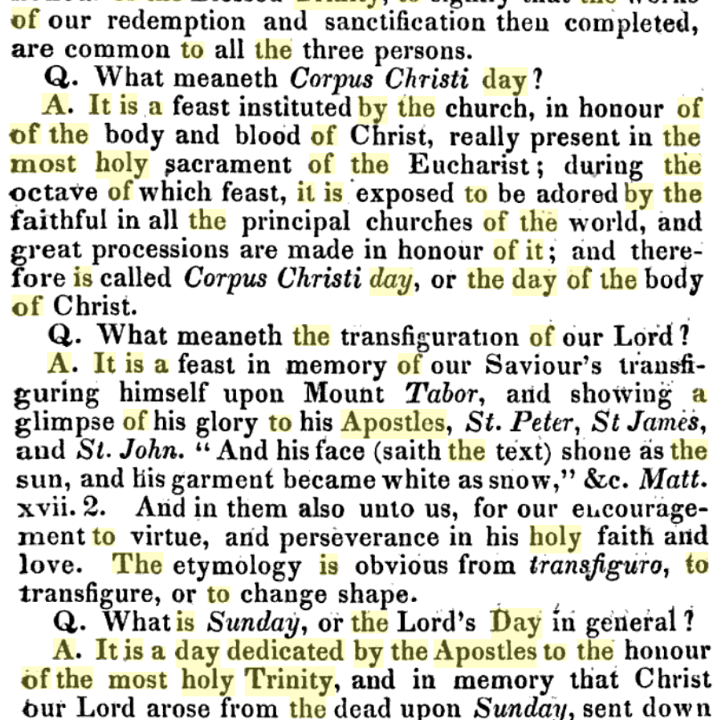
https://books.google.tt/books?id=2SkPAAAAIAAJ&pg=PA143&lpg=PA143&dq=because+it+is+a+day+dedicated+by+the+apostles+to+the+honor+of+the+most+holy+trinity&source=bl&ots=Lx6yf9jiAY&sig=ACfU3U0AXhM2iHhqqGzKAz3l4ugx-qWhdw&hl=en&sa=X&ved=2ahUKEwjZpL_ElMnpAhXCct8
An Abridgement of the Christian Doctrine

Slide 4
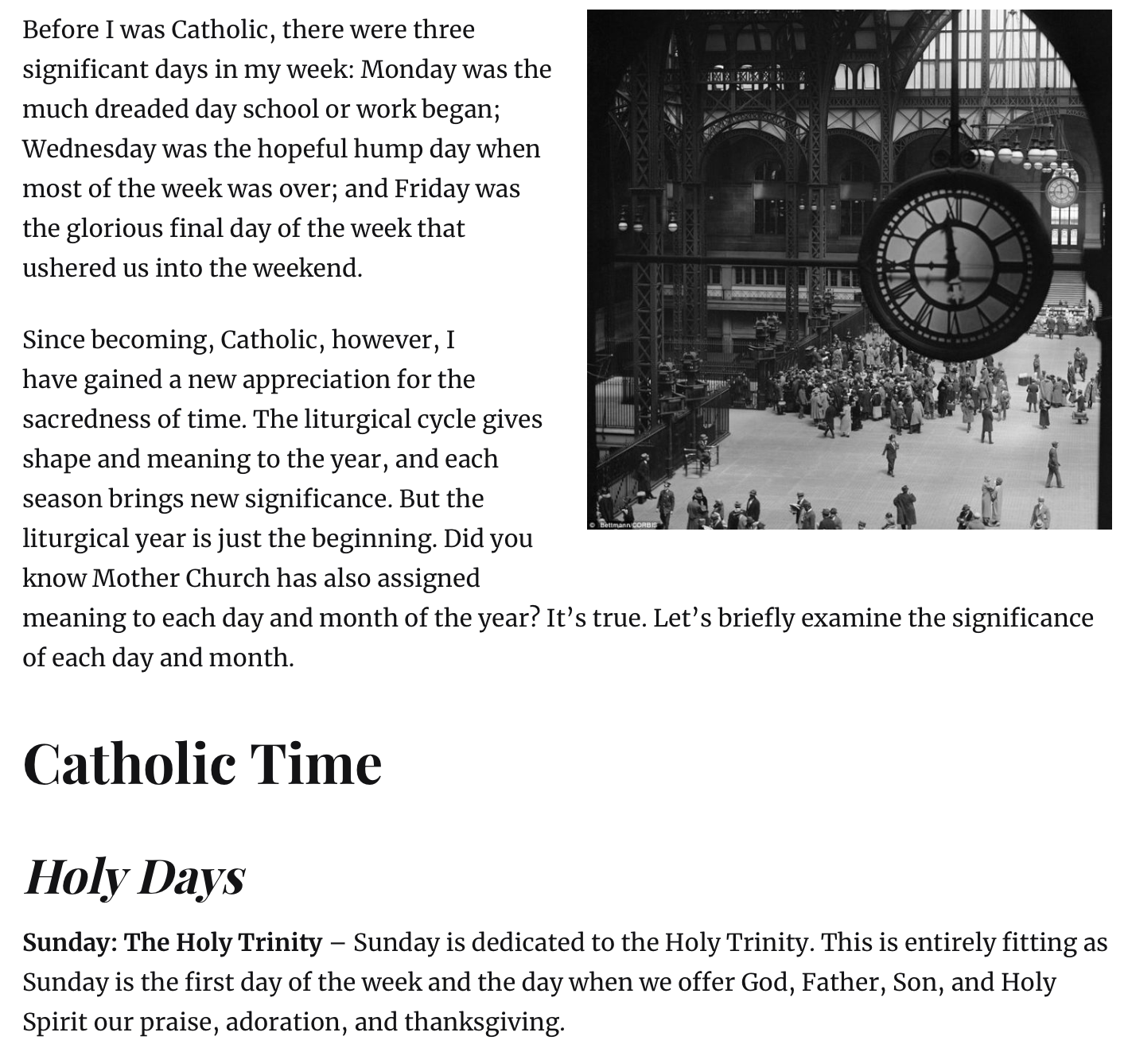
The Catholic Gentleman.
https://www.catholicgentleman.net/2015/02/sanctifying-time-the-catholic-meaning-of-days-and-months/

Slide 5
I. "IN THE NAME OF THE FATHER AND OF THE SON AND OF THE HOLY SPIRIT"
232 Christians are baptized "in the name of the Father and of the Son and of the Holy Spirit"⁵³ Before receiving the sacrament, they respond to a three-part question when asked to confess the Father, the Son and the Spirit: "I do." "The faith of all Christians rests on the Trinity."⁵⁴
233 Christians are baptized in the name of the Father and of the Son and of the Holy Spirit: not in their names,⁵⁵ for there is only one God, the almighty Father, his only Son and the Holy Spirit: the Most Holy Trinity.

Slide 6
234 The mystery of the Most Holy Trinity is the central mystery of Christian faith and life. It is the mystery of God in himself. It is therefore the source of all the other mysteries of faith, the light that enlightens them. It is the most fundamental and essential teaching in the "hierarchy of the truths of faith".⁵⁶ The whole history of salvation is identical with the history of the way and the means by which the one true God, Father, Son and Holy Spirit, reveals himself to men "and reconciles and unites with himself those who turn away from sin".⁵⁷
III. THE HOLY TRINITY IN THE TEACHING OF THE FAITH
The formation of the Trinitarian dogma

Slide 7
249 From the beginning, the revealed truth of the Holy Trinity has been at the very root of the Church's living faith, principally by means of Baptism. It finds its expression in the rule of baptismal faith, formulated in the preaching, catechesis and prayer of the Church. Such formulations are already found in the apostolic writings, such as this salutation taken up in the Eucharistic liturgy: "The grace of the Lord Jesus Christ and the love of God and the fellowship of the Holy Spirit be with you all."⁸¹
250 During the first centuries the Church sought to clarify her Trinitarian faith, both to deepen her own understanding of the faith and to defend it against the errors that were deforming it. This clarification was the work of the early councils, aided by the theological work of the Church Fathers and sustained by the Christian people's sense of the faith.

Slide 8
251 In order to articulate the dogma of the Trinity, the Church had to develop her own terminology with the help of certain notions of philosophical origin: "substance", "person" or "hypostasis", "relation" and so on. In doing this, she did not submit the faith to human wisdom, but gave a new and unprecedented meaning to these terms, which from then on would be used to signify an ineffable mystery, "infinitely beyond all that we can humanly understand".⁸²
252 The Church uses (I) the term "substance" (rendered also at times by "essence" or "nature") to designate the divine being in its unity, (II) the term "person" or "hypostasis" to designate the Father, Son and Holy Spirit in the real distinction among them, and (III) the term "relation" to designate the fact that their distinction lies in the relationship of each to the others.
https://www.vatican.va/archive/ccc_css/archive/catechism/p1s2c1p2.htm

Slide 9
Arguments on the Breckinridge Sunday Bill
Trivia Fact
Did you know that when J.O.Corliss along with A.T.Jones and others debated the Sunday bill, that as law it applied a fine to anyone found working on a Sunday, but there was also a second law in its shadow.
This law made it illegal to deny the trinity… Yes folks it was illegal to deny the trinity. In the shadow of the Sunday law was the trinity. And at that time Seventh-Day Adventists would have been guilty of these two laws.
Well all the articles before confirms that the trinity is tied to Sunday !
Read the Arguments here….
https://m.egwwritings.org/en/book/966.18#18

Slide 10
Please observe the following article with the title “The Assumption of Mary”, on the next slide written by Catholic convert and prolific author Graham Green. The link to the article if you wish to read it online is here ( Life Magazine pg51)…. https://books.google.tt/books?id=AkwEAAAAMBAJ&printsec=frontcover&source=gbs_ge_summary_r&cad=0#v=onepage&q&f=false
N.B.
Please read the boxed in sections on the next slide

Slide 11
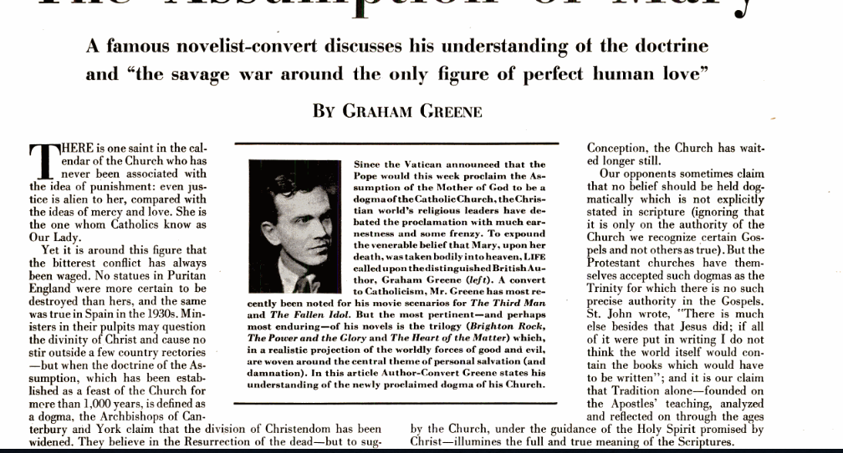

Slide 12
Now according to Graham Green a Catholic, he is stating that there is no Biblical support for the trinity doctrine.
It’s an interesting view coming as we say, ‘from the horse’s mouth’. We will investigate it for ourselves, but first let's get a brief definition for this Trinity Doctrine.

Slide 13
Belief in a God of three persons is one of the most demanding biblical teachings. Christianity is the only world religion that makes this claim. The doctrine of the Trinity is truly distinctive of the Christian faith, crucial because it deals with who God is, what He is like, and how He works. Christians believe the doctrine is necessary to do justice to the testimony of Scripture, the primary source of our knowledge of God. We must speak concerning God in the terms He uses. Biblical evidence has three facets: (a) there is one God; (b) three-in-oneness; and (c) three persons who are God.

Slide 14
This definition seems to be a world view of the Trinity doctrine. It sites that, “Christianity is the only world religion that makes this claim”. It also states that, “the doctrine of the Trinity is truly distinctive of the Christian faith”. This definition is the World Christian view, can we then consider it an ecumenical document.
For definitions on ecumenism check the links below:
https://www.britannica.com/topic/ecumenism
https://www.bbc.co.uk/bitesize/guides/zdcbcj6/revision/11
Why not visit the link below to see the full article… You may be shocked…
Find the article here

Slide 15
Three things jump out at me from this article.
The Author’s name is missing.
The definition claims that, “we must speak concerning God in the terms he uses”. This could not be further from the truth.
In the absence of the author, two names are given. Thomas Oden and J.I.Packer. Who are these men? Let’s find out.

Slide 16
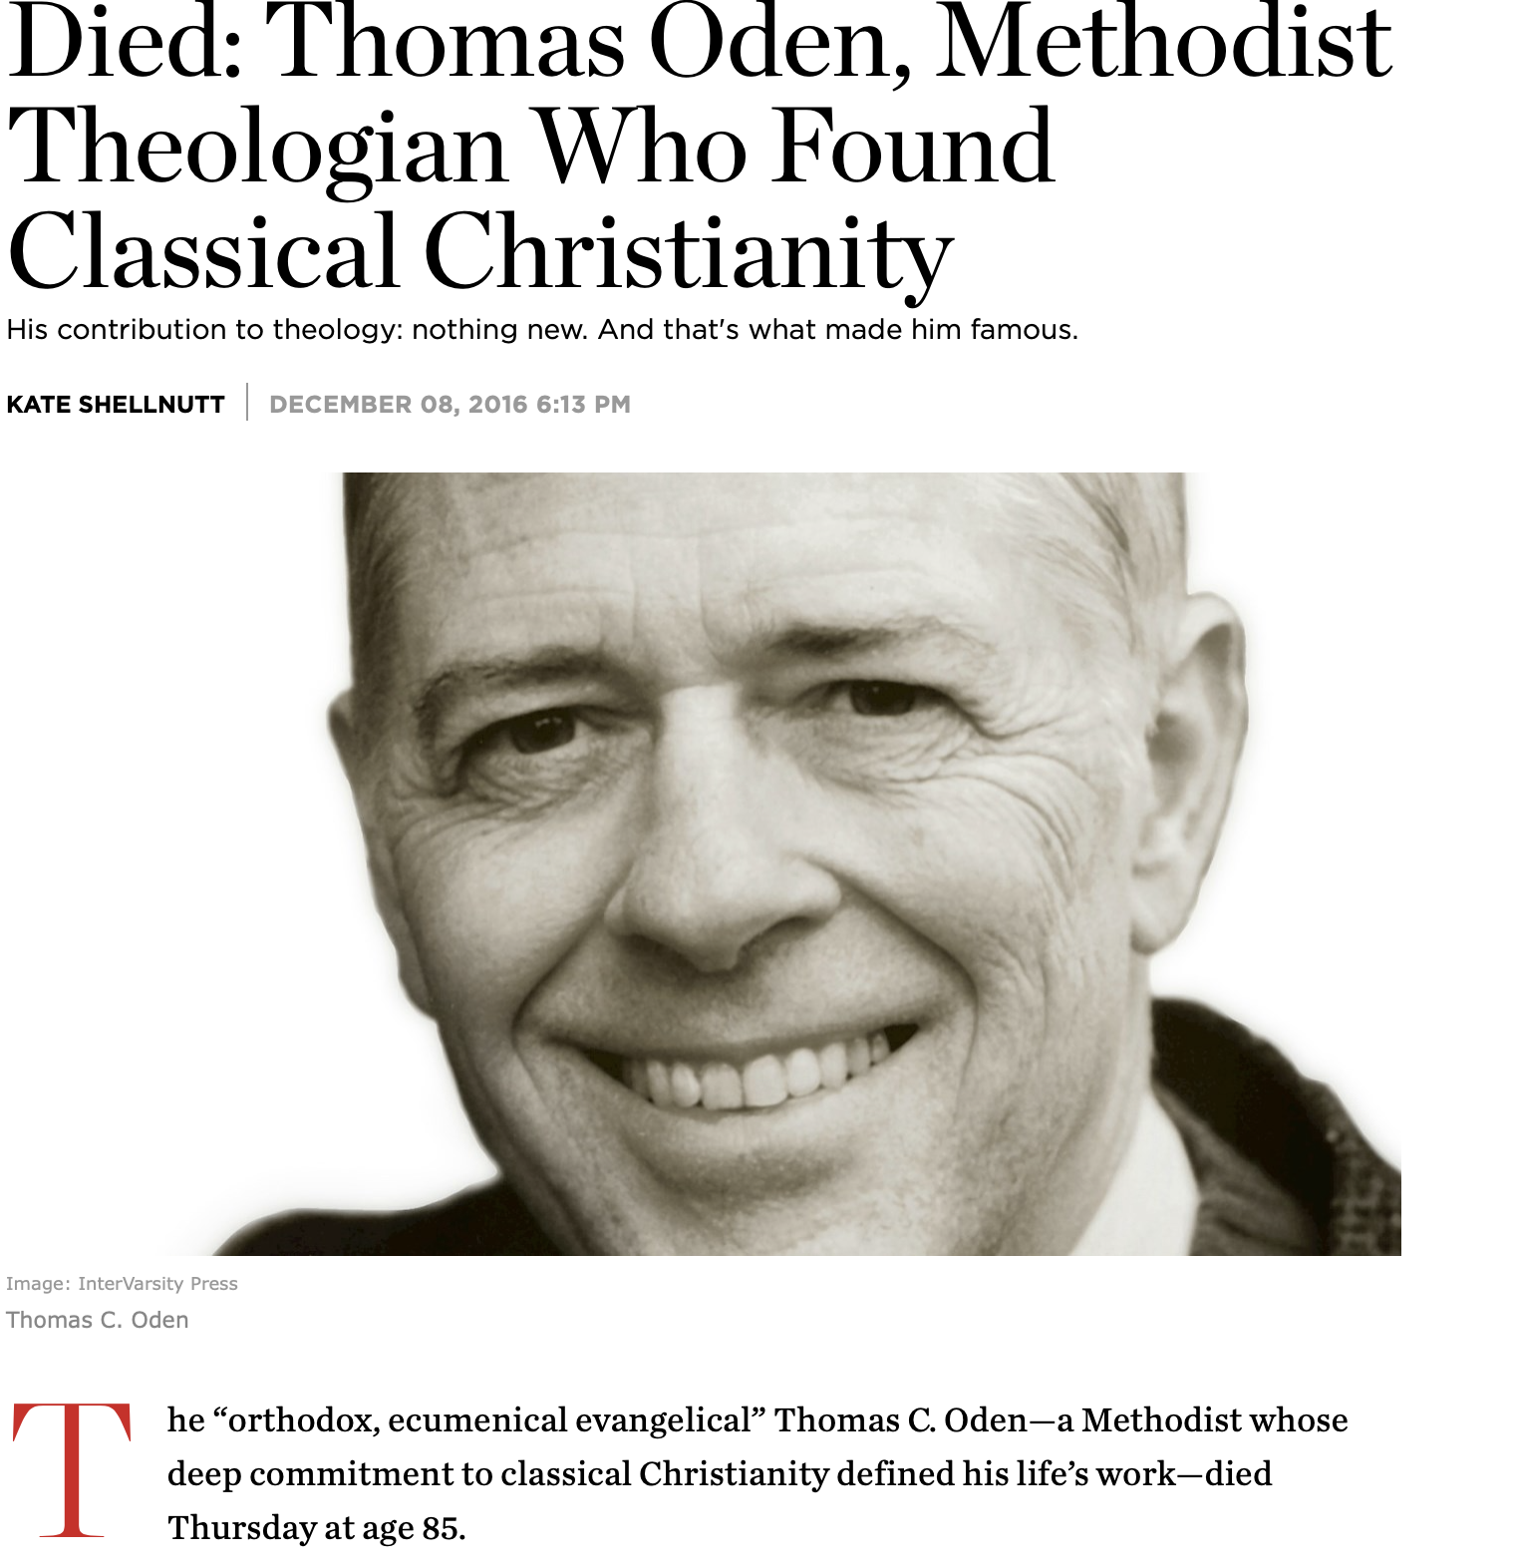
“The heart of my story is that the first part of 40 years of my life, I was way, way out there on a path that I had to go on in order to come back like the prodigal son to the father,” Oden told Al Mohler, president of Southern Baptist Theological Seminary, in a 2015 interview. “But eventually I did and by my 40th year, I became deeply invested in listening carefully to the classical Christian consensus … of the ancient Christian writers and their interpretation of Scripture.”
https://www.christianitytoday.com/news/2016/december/died-thomas-oden-methodist-theologian-who-found-classical.html

Slide 17
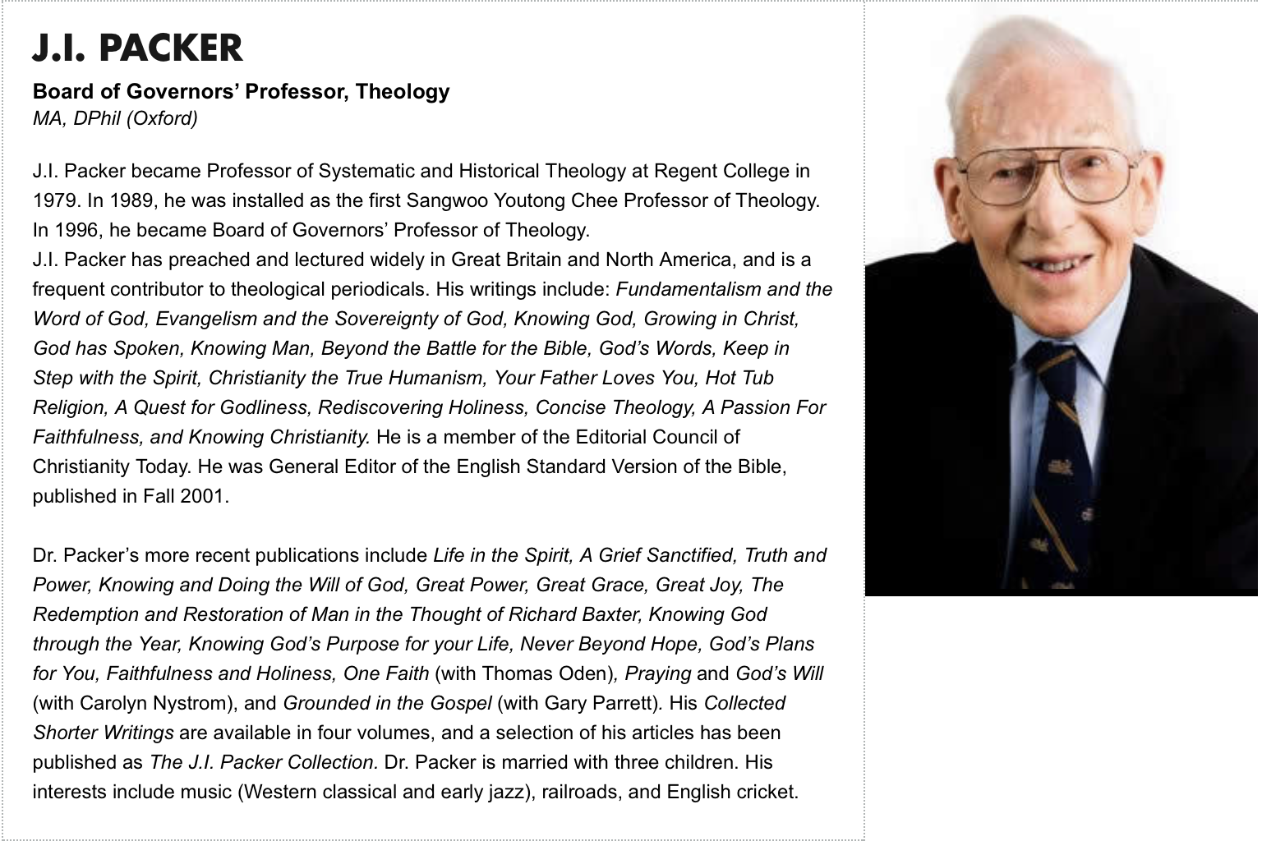
https://www.regent-college.edu/faculty/retired/ji-packer
https://www.theopedia.com/j-i-packer
https://www.monergism.com/thethreshold/articles/bio/jipacker.html

Slide 18
It is very interesting that in the absence of the author’s name we have two leading evangelical minds on an S.D.A website as reference for a doctrine which is part of our fundamental beliefs. Interesting.
Both support ecumenism, so again we are not surprised at the tone of the document.
They also promote and teach “Systematic Theology”.

Slide 19
What is Systematic Theology
“Systematic theology makes use of biblical theology and often builds on its results. At some points, especially where great detail and care is needed in the development of a doctrine, systematic theology will even use the same methods as biblical theology, analyzing the development of each doctrine through the historical development of Scripture. But the focus of systematic theology remains different: it focuses on the collection and summary of all biblical passages on a subject and attempts to summarize the teachings of Scripture in brief, understandable, and carefully formulated statements.”
https://zondervanacademic.com/blog/systematic-theology

Slide 20
What is Systematic Theology
“Picture it this way: You have a bunch of buckets. They are labeled things like the end times, holy spirit, and Jesus Christ. (Which, these have their own special names in theology: eschatology, pneumatology, and Christology, respectively).
Then, you cut out big portions of Scripture that talk about these topics in context. You put the passages in their respective buckets. Lastly, you go bucket-by-bucket, researching those passages. You write a few short, concise paragraphs describing your findings.
How does this process help us build on our knowledge of God in a consistent and coherent way?
The Bible cannot contradict itself—it is inerrant. So, we can confidently take all these different passages and use them to show us the big picture.
Setting the bucket illustration aside, another way to imagine systematic theology is that it is a 15,000ft view of the Bible. Imagine you are on top of a mountain, and below you is scripture laid out from beginning to end. You can make a lot of connections this way!”
https://www.olivetree.com/blog/biblical-vs-systematic-theology/
https://www.youtube.com/watch?time_continue=70&v=himv8PLyZ8o&feature=emb_title

Slide 21
What is Systematic Theology
“Systematic theology is a discipline of Christian theology that formulates an orderly, rational, and coherent account of the doctrines of the Christian faith. It addresses issues such as what the Bible teaches about certain topics or what is true about God and his universe.^{[1]} It also builds on biblical disciplines, church history, as well as biblical and historical theology.^{[2]} Systematic theology shares its systematic tasks with other disciplines such as constructive theology, dogmatics, ethics, apologetics, and philosophy of religion.^{[3]}”
https://en.wikipedia.org/wiki/Systematic_theology

Slide 22
What is Systematic Theology
“...systematic theology leads to worldview formation as we seek to set the biblical-theological framework of Scripture over against all other worldviews and learn “to think God’s thoughts after him,” even in areas that the Bible does not directly address. In this important way, systematic theology presents a well-thought-out worldview, over against all of its competitors, as it seeks to apply biblical truth to every domain of life.
"As a discipline it is also critical in seeking to evaluate ideas within and outside the church. Outside the church, systematic theology takes on an apologetic function as it first sets forth the faith to be believed and defended, and then critiques and evaluates views that reject the truth of God’s Word. In this way, apologetics is properly a subset of systematic theology. Within the church, theology is critical by analyzing theological proposals first in terms of their fit with Scripture and secondly in terms of their implications for other doctrines. In all these ways, systematic theology is the discipline which attempts “to bring our entire thought captive to Christ” (see 2 Cor. 10:1–5), for our good as the church and ultimately for God’s glory.” ”
https://www.thebrooksideinstitute.net/blog/the-importance-of-systematic-theology

Slide 23
What is Systematic Theology
Here are a couple links to more resources on systematic theology
https://www.crossway.org/articles/10-things-you-should-know-about-systematic-theology/
https://www.gotquestions.org/systematic-theology.html
https://www.merriam-webster.com/dictionary/systematic%20theology
https://www.monergism.com/thethreshold/articles/onsite/qna/systemimport.html
http://www.teachingtheword.org/apps/articles/?columnid=5772&articleid=59193

Slide 24
Systematic Theology
In my humble opinion there are many variations to what systematic theology is, in which all can be correct.
What is concerning to me is that while it does attempt to look at all the verses in the Bible on a topic, it is the summarization that is troubling to me, it is possible to loose the importance or weight of each text in the summarization process.
Don’t take my word for it consider the results of systematic theology, consider the doctrines that have arisen from such a method and see for yourself.
What is interesting is that it promotes a world view of theology as far as I can tell or maybe I’m wrong, you be the judge.

Slide 25
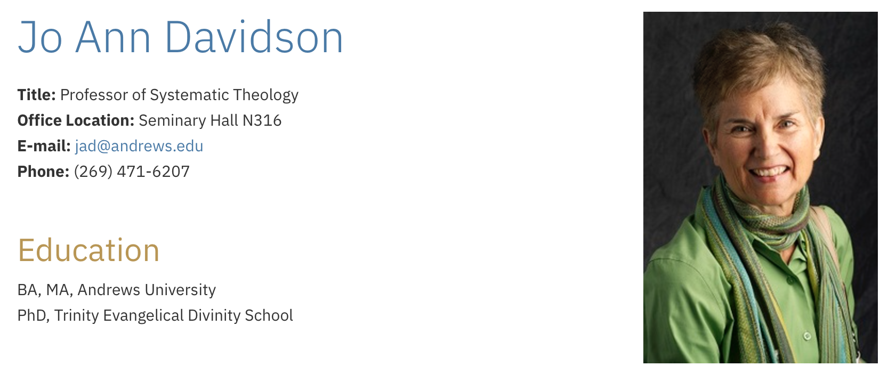
Well we caught up with the author…. https://www.andrews.edu/sem/contact/faculty/jo-ann-davidson.html

Slide 26
Hmmmm…
So on our church website is a World Christian view of the trinity doctrine, which describes the nature of GOD.
So my question is as Seventh-Day Adventists what do we believe.
(Aside from the ecumenical document.)

Slide 27

Study to shew thyself approved unto God, a workman that needeth not to be ashamed, rightly dividing the word of truth.
2 Timothy 2:15

Slide 28

Hear the word of the Lord, ye children of Israel: for the Lord hath a controversy with the inhabitants of the land, because there is no truth, nor mercy, nor knowledge of God in the land. Hosea 4:1
Does God want us to know Him ?

Slide 29

Let us hear the conclusion of the whole matter: Fear God, and keep his command-ments: for this is the whole duty of man.
Eccl. 12:13

Slide 30
Do we Fear God ?
Proverbs 1:7
The fear of the Lord is the beginning of knowledge: but fools despise wisdom and instruction
Proverbs 9:10
The fear of the Lord is the beginning of wisdom: and the knowledge of the holy is understanding.

Slide 31
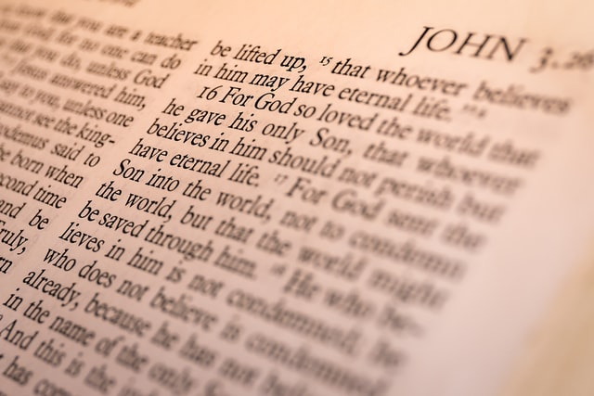
Then shalt thou understand the fear of the Lord, and find the knowledge of God. Prov.2:35
The Fear of God must be accompanied by a know-ledge of GOD

Slide 32
Saying with a loud voice, Fear God, and give glory to him; for the hour of his judgment is come: and worship him that made heaven, and earth, and the sea, and the fountains of waters.
Revelation 14:7

Slide 33
The First Angel’s Message calls us back to a knowledge of God.

Slide 34
Should we make every effort to Know GOD?
Hosea 4:6
My people are destroyed for lack of knowledge: because thou hast rejected knowledge, I will also reject thee, that thou shalt be no priest to me: seeing thou hast forgotten the law of thy God, I will also forget thy children

Slide 35
Should we make every effort to Know GOD?
Hosea 6:6
For I desired mercy, and not sacrifice; and the knowledge of God more than burnt offerings.

Slide 36
John 17:3
And this is life eternal, that they might know thee the only true God, and Jesus Christ, whom thou hast sent.
2 Peter 2:1
Grace and peace be multiplied unto you through the knowledge of God, and of Jesus our Lord,

Slide 37
What must we do in order to get a knowledge of our God?
Proverbs 2:3-5
Yea, if thou criest after knowledge, and liftest up thy voice for understanding;
If thou seekest her as silver, and searchest for her as for hid treasures;
Then shalt thou understand the fear of the Lord, and find the knowledge of God.

Slide 38
Can we really know who GOD is ?
Romans 1:20
For the invisible things of him from the creation of the world are clearly seen, being understood by the things that are made, even his eternal power and Godhead; so that they are without excuse:

Slide 39
Can we really know who GOD is ?
1 John 5:20
And we know that the Son of God is come, and hath given us an understanding, that we may know him that is true, and we are in him that is true, even in his Son Jesus Christ. This is the true God, and eternal life.

Slide 40
What can We glory in ?
Jeremiah 9:23,24
Thus saith the Lord, Let not the wise man glory in his wisdom, neither let the mighty man glory in his might, let not the rich man glory in his riches:
But let him that glorieth glory in this, that he understandeth and knoweth me, that I am the Lord which exercise lovingkindness, judgment, and righteousness, in the earth: for in these things I delight, saith the Lord.

Slide 41

Next Study we will look at God the Father…

