Slide 1

Who is GOD our Father ?

Slide 2

Genesis 1:1
In the beginning God created the heaven and the earth.
God is introduced to us in the first verse of the Bible

Slide 3

The word translated into ’GOD’ in this verse is ‘Elohim’.
This word does present some difficulty in our understanding of GOD and a closer look at it should reveal its true meaning.
This word is in a plural form, and as such it has been used to suggest that ‘The GOD’ mentioned here is more than one.

Slide 4
https://jewsforjudaism.org/knowledge/articles/oneness-of-god-the-meaning-of-elohim
ONENESS OF GOD - The Meaning of 'Elohim
“ The Jewish Scriptures teach us that ’Elohim is an honorific title, which expresses the plural of majesty. The underlying reason for the grammatically plural form ’Elohim is to indicate the all-inclusiveness of God’s authority as possessing every conceivable attribute of power ”.

Slide 5
https://www.jewishvirtuallibrary.org/the-name-of-god
Jewish Concepts: The Name of God
“ The first Name used for God in scripture is Elohim. In form, the word is a masculine plural of a word that looks feminine in the singular (Eloha). The same word (or, according to Maimonides, a homonym of it) is used to refer to princes, judges, other gods, and other powerful beings. This Name is used in scripture when emphasizing God's might, His creative power, and his attributes of justice and rulership. Variations on this name include El, Eloha, Elohai (my God) and Elohaynu (our God). ”.

Slide 6
https://www.britannica.com/topic/Elohim
ELOHIM
“ Though Elohim is plural in form, it is understood in the singular sense. Thus, in Genesis the words, “In the beginning God (Elohim) created the heavens and the earth,” Elohim is monotheistic in connotation, though its grammatical structure seems polytheistic ”.

Slide 7

Deuteronomy 6:4
Hear, O Israel: The LORD our God is one LORD:

Slide 8
Deuteronomy 4:35
Unto thee it was shewed, that thou mightest know that the Lord he is God; there is none else beside him.

Slide 9
Jeremiah 10:10
But the LORD is the true God, he is the living God, and an everlasting king: at his wrath the earth shall tremble, and the nations shall not be able to abide his indignation.

Slide 10
John 17:3
And this is life eternal, that they might know thee the only true God, and Jesus Christ, whom thou hast sent.

Slide 11

GOD the Father = One LORD
GOD the Father = True GOD
GOD the Father = Living GOD

Slide 12

The Father - Source of all things and the living God

Slide 13

Revelation 7: 2,3
And I saw another angel ascending from the east, having the seal of the living God: and he cried with a loud voice to the four angels, to whom it was given to hurt the earth and the sea,
Saying, Hurt not the earth, neither the sea, nor the trees, till we have sealed the servants of our God in their foreheads.

Slide 14
Matthew 16:16
And Simon Peter answered and said, Thou art the Christ, the Son of the living God.

Slide 15
So we know from the conversation between Simon Peter and Jesus Christ that When the Bible speaks about the living GOD it is speaking about GOD the Father.
We know also that the seal of the living God in Revelation 7:2,3 is the seal of God the Father. Knowing who the living GOD is, is essential since it his name that will be written in the foreheads of his saints.
(Revelation 14: 1)

Slide 16
1 Corinthians 8:6
But to us there is but one God, the Father, of whom are all things, and we in him; and one Lord Jesus Christ, by whom are all things, and we by him.

Slide 17
2 Corinthians 5:17-21
Therefore if any man be in Christ, he is a new creature: old things are passed away; behold, all things are become new.
¹⁸ And all things are of God, who hath reconciled us to himself by Jesus Christ, and hath given to us the ministry of reconciliation;
¹⁹ To wit, that God was in Christ, reconciling the world unto himself, not imputing their trespasses unto them; and hath committed unto us the word of reconciliation.

Slide 18
2 Corinthians 5:17-21
²⁰ Now then we are ambassadors for Christ, as though God did beseech you by us: we pray you in Christ's stead, be ye reconciled to God.
²¹ For he hath made him to be sin for us, who knew no sin; that we might be made the righteousness of God in him.

Slide 19
1 Thessalonians 1:9,10
For they themselves shew of us what manner of entering in we had unto you, and how ye turned to God from idols to serve the living and true God;
And to wait for his Son from heaven, whom he raised from the dead, even Jesus, which delivered us from the wrath to come.

Slide 20
Romans 11:36
For of him, and through him, and to him, are all things: to whom be glory for ever. Amen.
Ref – 1 Chronicles 29:10,11...Psalm 33:6

Slide 21
Ephesians 3:14,15
For this cause I bow my knees unto the Father of our Lord Jesus Christ,
Of whom the whole family in heaven and earth is named,
Ref – Ephesians 1:15-23

Slide 22
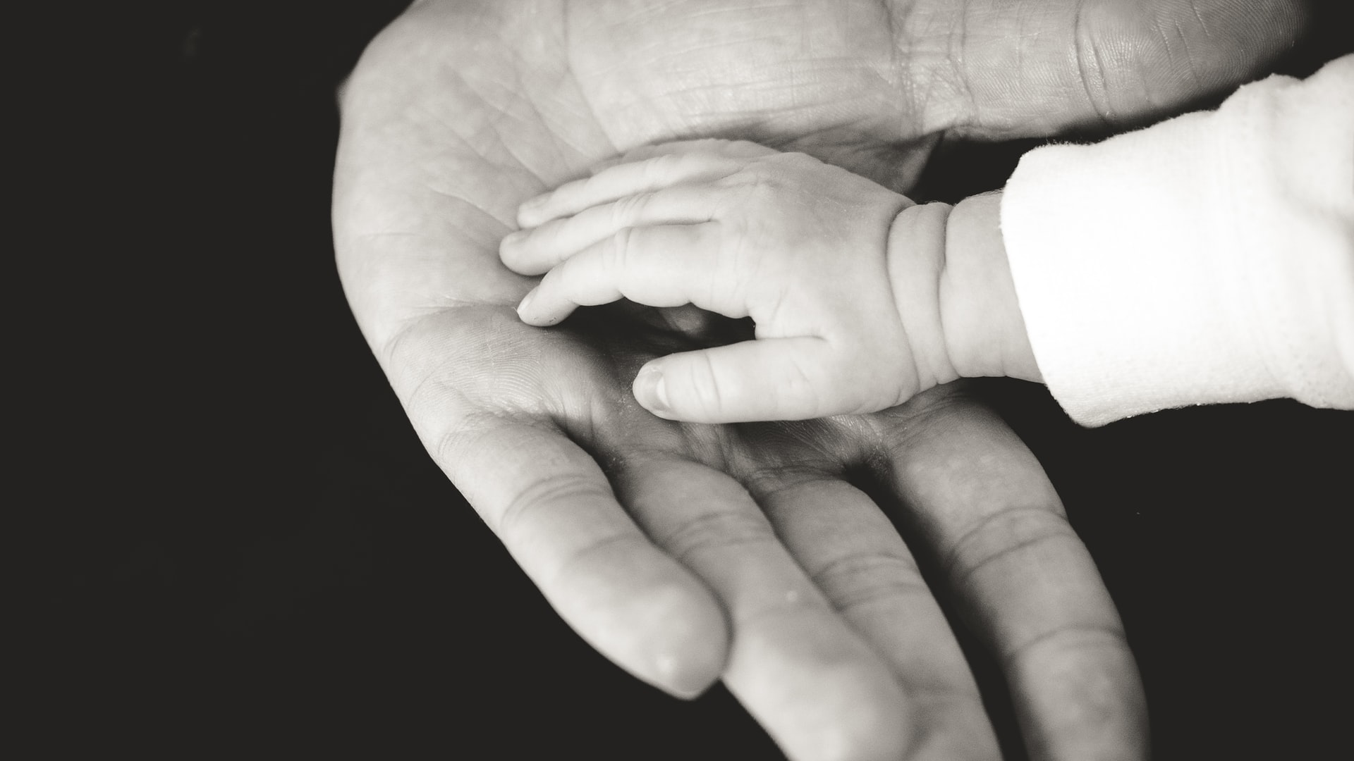
Jesus refers to his Father as his GOD

Slide 23
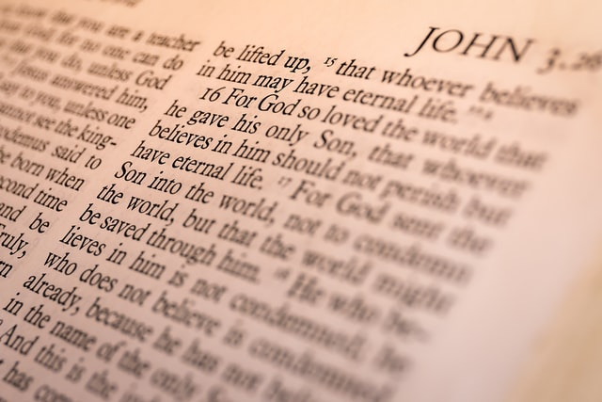
Matthew 27:46
And about the ninth hour Jesus cried with a loud voice, saying, Eli, Eli, lama sabachthani? that is to say, My God, my God, why hast thou forsaken me?

Slide 24
John 20:17
Jesus saith unto her, Touch me not; for I am not yet ascended to my Father: but go to my brethren, and say unto them, I ascend unto my Father, and your Father; and to my God, and your God.

Slide 25
EPHESIANS 1:3
Blessed be the God and Father of our Lord Jesus Christ, who hath blessed us with all spiritual blessings in heavenly places in Christ:
Ref – 1 Peter 1:3

Slide 26

So we see that Jesus referred to his Father as his GOD, but that was when he was on earth, what about when he is in heaven, will anything change. Let’s find out…

Slide 27
Revelation 3:12
Him that overcometh will I make a pillar in the temple of my God, and he shall go no more out: and I will write upon him the name of my God, and the name of the city of my God, which is new Jerusalem, which cometh down out of heaven from my God: and I will write upon him my new name.
Ref – 1 Peter 1:3…Hebrews 1:9

Slide 28

Who is referred to as the Most high ?

Slide 29
Psalm 78:17
And they sinned yet more against him by provoking the Most High in the wilderness.

Slide 30
Isaiah 63: 8-10
For he said, Surely they are my people, children that will not lie: so he was their Saviour.
In all their affliction he was afflicted, and the angel of his presence saved them: in his love and in his pity he redeemed them; and he bare them, and carried them all the days of old.
But they rebelled, and vexed his holy Spirit: therefore he was turned to be their enemy, and he fought against them.

Slide 31
We see that the one who Israel rebelled against was the Most High, Psalm78:17 tells us this.
The one referred to as Saviour who Israel rebelled against in Isaiah 63:8-10 must be the same person.
We know it is not in reference to Jesus because Jesus in this verse is called the Angel of his Presence. This is not the only reference to Jesus in this manner.

Slide 32
Exodus 14:19,24
And the angel of God, which went before the camp of Israel, removed and went behind them; and the pillar of the cloud went from before their face, and stood behind them:
And it came to pass, that in the morning watch the Lord looked unto the host of the Egyptians through the pillar of fire and of the cloud, and troubled the host of the Egyptians,

Slide 33
Exodus 23: 20-23
Behold, I send an Angel before thee, to keep thee in the way, and to bring thee into the place which I have prepared.
²¹ Beware of him, and obey his voice, provoke him not; for he will not pardon your transgressions: for my name is in him.

Slide 34
Exodus 23: 20-23
²² But if thou shalt indeed obey his voice, and do all that I speak; then I will be an enemy unto thine enemies, and an adversary unto thine adversaries.
²³ For mine Angel shall go before thee, and bring thee in unto the Amorites, and the Hittites, and the Perizzites, and the Canaanites, the Hivites, and the Jebusites: and I will cut them off.

Slide 35
Exodus 32: 34
Therefore now go, lead the people unto the place of which I have spoken unto thee: behold, mine Angel shall go before thee: nevertheless in the day when I visit I will visit their sin upon them.

Slide 36
Exodus 33: 14,15
And he said, My presence shall go with thee, and I will give thee rest.
¹⁵ And he said unto him, If thy presence go not with me, carry us not up hence.

Slide 37
In Exodus 33: 14,15 the word Angel is not used along with presence; however it is understood.
The word used for presence is, “Paniym”, which can be understood as presence/person. It can also be used to mean face.
Because it is used in this instance as presence/person, My person or My presence would have the same effect.

Slide 38
In all these revelations of the divine presence the glory of God was manifested through Christ. Not alone at the Saviour's advent, but through all the ages after the Fall and the promise of redemption, “God was in Christ, reconciling the world unto Himself.” 2 Corinthians 5:19. Christ was the foundation and center of the sacrificial system in both the patriarchal and the Jewish age. Since the sin of our first parents there has been no direct communication between God and man.

Slide 39
The Father has given the world into the hands of Christ, that through His mediatorial work He may redeem man and vindicate the authority and holiness of the law of God. All the communion between heaven and the fallen race has been through Christ. It was the Son of God that gave to our first parents the promise of redemption.

Slide 40
It was He who revealed Himself to the patriarchs. Adam, Noah, Abraham, Isaac, Jacob, and Moses understood the gospel. They looked for salvation through man's Substitute and Surety. These holy men of old held communion with the Saviour who was to come to our world in human flesh; and some of them talked with Christ and heavenly angels face to face.

Slide 41
Christ was not only the leader of the Hebrews in the wilderness—the Angel in whom was the name of Jehovah, and who, veiled in the cloudy pillar, went before the host—but it was He who gave the law to Israel. [See Appendix, note 7.] Amid the awful glory of Sinai, Christ declared in the hearing of all the people the ten precepts of His Father's law. It was He who gave to Moses the law engraved upon the tables of stone.
Patriarch's and Prophets Ch. 32 pg. 366

Slide 42
Note 7. Page 366. That the One who spoke the law, who called Moses into the mount and talked with him, was our Lord Jesus Christ, is evident from the following considerations: PP 761.3
Christ is the One through whom God has at all times revealed Himself to man. “But to us there is but one God, the Father, of whom are all things, and we in Him; and one Lord Jesus Christ, by whom are all things, and we by Him.” 1 Corinthians 8:6. “This is he [Moses], that was in the church in the wilderness with the Angel which spake to him in the Mount Sinai, and with our fathers: who received the lively oracles to give unto us.” Acts 7:38. This Angel was the Angel of God's presence (Isaiah 63:9), the Angel in whom was the name of the great Jehovah (Exodus 23:20-23). The expression can refer to no other than the Son of God. PP 761.4
Again: Christ is called the Word of God. John 1:1-3. He is so called because God gave His revelations to man in all ages through Christ. It was His Spirit that inspired the prophets. 1 Peter 1:10, 11. He was revealed to them as the Angel of Jehovah, the Captain of the Lord's host, Michael the Archangel.

Slide 43
Jesus - son of the Most High
Mark 5:7
And cried with a loud voice, and said, What have I to do with thee, Jesus, thou Son of the most high God? I adjure thee by God, that thou torment me not.
Ref – Luke 8:28 & 4:34…Mark 1:24…

Slide 44
The Father is greater than Jesus
John 14:28
Ye have heard how I said unto you, I go away, and come again unto you. If ye loved me, ye would rejoice, because I said, I go unto the Father: for my Father is greater than I.

Slide 45
The Father is greater than all
John 10:29
My Father, which gave them me, is greater than all; and no man is able to pluck them out of my Father's hand.

Slide 46
The Father is the head of Christ
1 Corinthians 11:3
But I would have you know, that the head of every man is Christ; and the head of the woman is the man; and the head of Christ is God.

Slide 47
The Father is above all
Ephesians 4:4-6
There is one body, and one Spirit, even as ye are called in one hope of your calling;
One Lord, one faith, one baptism,
One God and Father of all, who is above all, and through all, and in you all.

Slide 48
Who is Lord of Heaven and Earth
Matthew 11:25
At that time Jesus answered and said, I thank thee, O Father, Lord of heaven and earth, because thou hast hid these things from the wise and prudent, and hast revealed them unto babes.

Slide 49

What did Jesus Receive From his Father ?

Slide 50
His Life
John 5: 26
For as the Father hath life in himself; so hath he given to the Son to have life in himself;
The word used for life here is, “ZOE”. This is the life that God Possesses.
This “ZOE”, life is the source of all life. In the Bible when eternal life is mentioned it is the “ZOE”, life that it refers to.
Ref – John 17: 1-3

Slide 51
His Power and Authority
Matthew 28:18
And Jesus came and spake unto them, saying, All power is given unto me in heaven and in earth.
His Right to receive worship
John 5:22
For the Father judgeth no man, but hath committed all judgment unto the Son: That all men should honour the Son, even as they honour the Father. He that honoureth not the Son honoureth not the Father which hath sent him.

Slide 52
His Kingdom
Daniel 7:14
And there was given him dominion, and glory, and a kingdom, that all people, nations, and languages, should serve him: his dominion is an everlasting dominion, which shall not pass away, and his kingdom that which shall not be destroyed.
Luke 1:32
He shall be great, and shall be called the Son of the Highest: and the Lord God shall give unto him the throne of his father David:

Slide 53
His Name
Philippians 2:9,10
Wherefore God also hath highly exalted him, and given him a name which is above every name:
That at the name of Jesus every knee should bow, of things in heaven, and things in earth, and things under the earth;
Hebrews 1:4
Being made so much better than the angels, as he hath by inheritance obtained a more excellent name than they.

Slide 54
All Things
John 3:34-36
For he whom God hath sent speaketh the words of God: for God giveth not the Spirit by measure unto him.
The Father loveth the Son, and hath given all things into his hand.
He that believeth on the Son hath everlasting life: and he that believeth not the Son shall not see life; but the wrath of God abideth on him.

Slide 55

We see according to scripture that GOD the Father is Supreme, he is Sovereign, he is GOD of all.
Does this in any way remove or diminish Jesus’ value, position and divinity, of course not, on the contrary.
In our next study we will look at “Who is Jesus Christ”.

