Slide 1
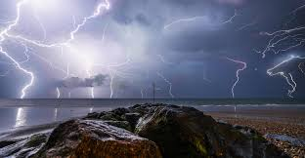
THE 7 THUNDERS PT 4.1
They that follow the lamb
THE 144000

Slide 2
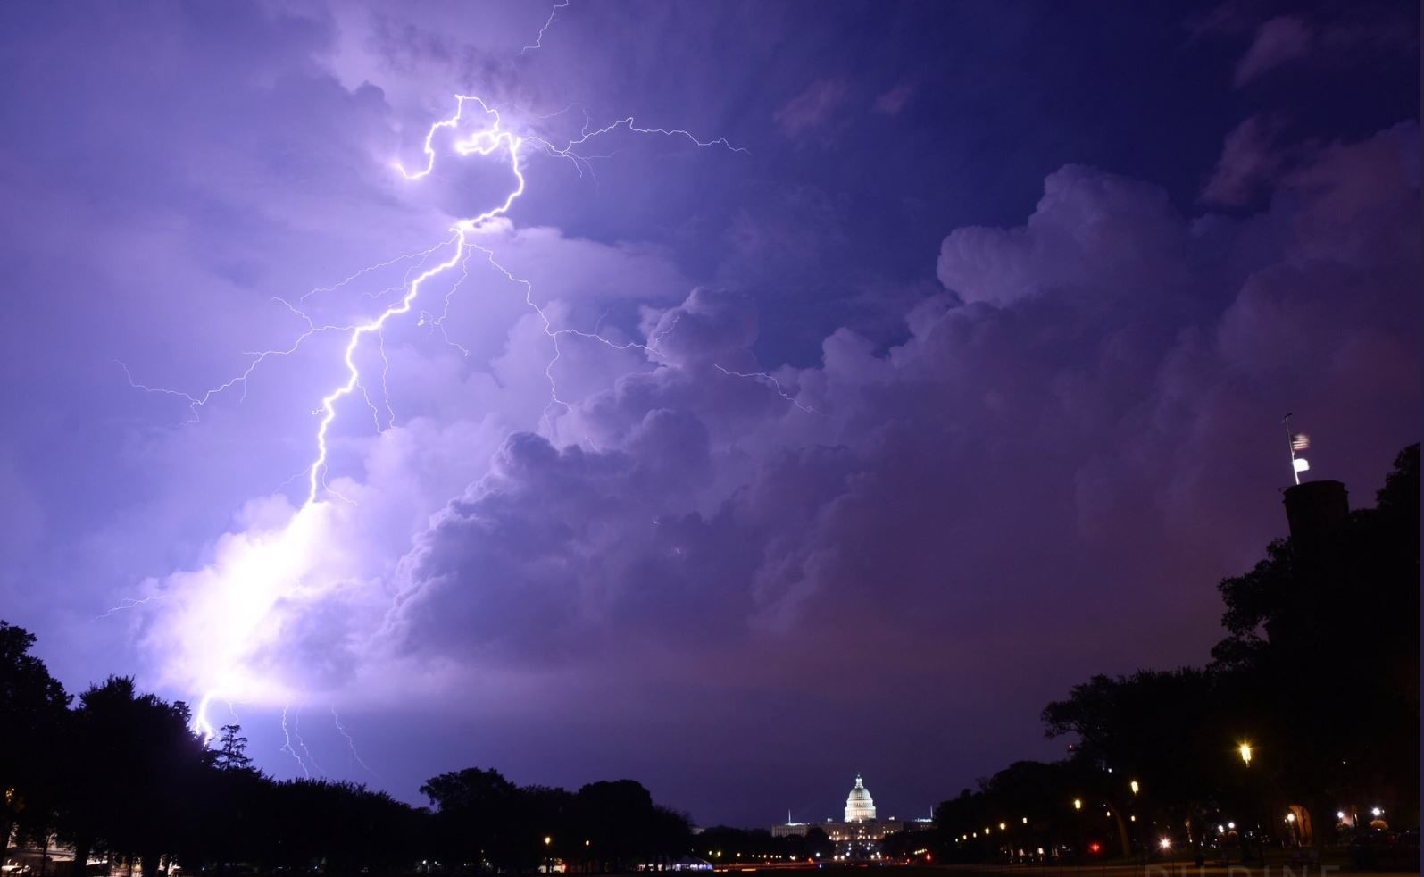
The 7 Thunders - Reflections
PT 1 – Ignorance IS NOT Bliss
PT 2 – The Final Repeat
PT 3 – 5G? The Last Generation – The Rain The Fig Tree The Locust

Slide 3
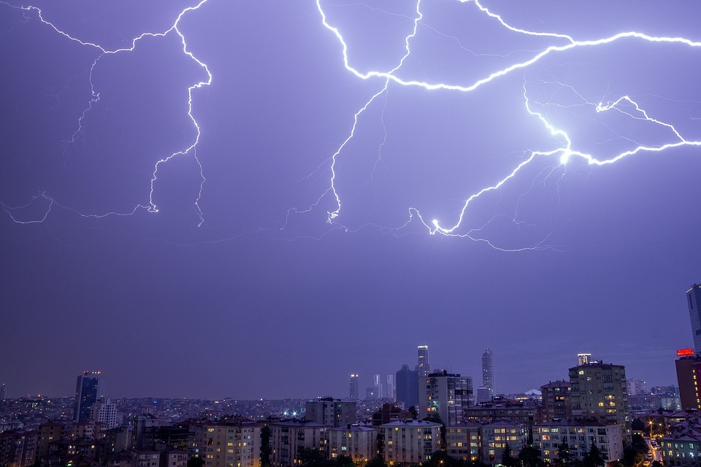
Ignorance IS NOT Bliss ---- WHY?
QUOTE
It is necessary that our unity today be of a character that will bear the test of trial. . . . We have many lessons to learn, and many, many to unlearn. God and Heaven alone are infallible. Those who think that they will never have to give up a cherished view, never have occasion to change an opinion, will be disappointed. As long as we hold to our own ideas and opinions with determined persistency, we cannot have the unity for which Christ prayed. {CET 203.2}
When a brother receives new light upon the Scriptures, he should frankly explain his position, and
every minister should search the Scriptures with the spirit of candor to see if the points presented can be substantiated by the inspired word. "The servant of the Lord must not strive; but be gentle unto all men, apt to teach, patient, in meekness instructing those that oppose themselves; if God peradventure will give them repentance to the acknowledging of the truth." 2 Timothy 2:24, 25. {CET 203.3}

Slide 4
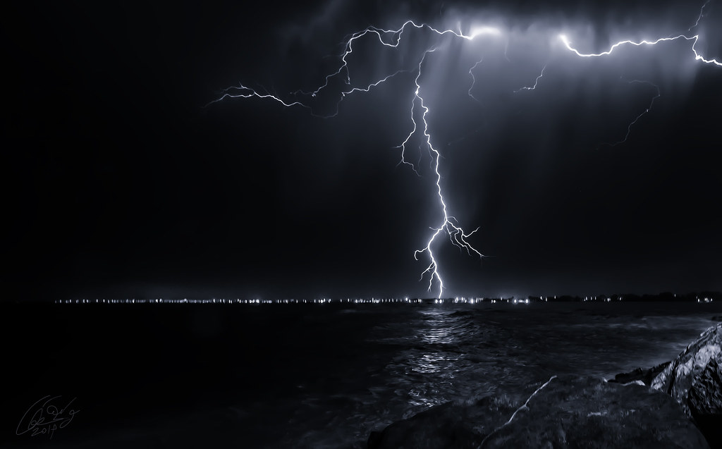
The Final Repeat---- WHEN?
QUOTE
Science and history cannot of themselves make men wise unto salvation; but through the aid of the Holy Spirit, which, in answer to prayer, will be given to guide into all truth, science and history may be made use of as a clear, definite light, blending with that of the written, inspired word. There are lessons to be learned from the history of the past; and attention is called to these, that all may understand that God works on the same lines now that He ever has done. His hand is seen in His work and among the nations now, just the same as it has been ever since the gospel was first proclaimed to Adam in Eden. {BEcho, August 26, 1895 par. 10}
There are periods which are turning points in the history of nations and of the church. In the providence of God, when these different crises arrive, the light for that time is given. If it is received, there is spiritual progress; if it is rejected, spiritual declension and shipwreck follow. The Lord in His word has opened up the aggressive work of the gospel as it has been carried on in the past, and will be in the future, even to the closing conflict, when Satanic agencies will make their last wonderful movement. From that word we understand that the forces are now at work that will usher in the last great conflict between good and evil--between Satan, the prince of darkness, and Christ, the Prince of life. But the coming triumph for the men who love and fear God is as sure as that His throne is established in the heavens. {BEcho, August 26, 1895 par. 11}

Slide 5
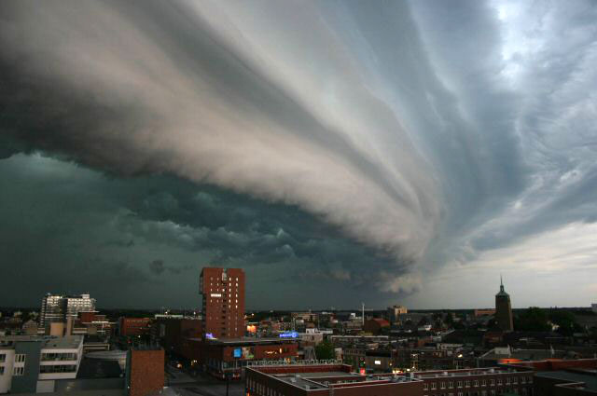
5G? The Last Generation
QUOTE
God expects the youth to think soberly and intelligently of how those of past generations toiled and sacrificed to leave to future generations a heritage of light. The patriarchs and prophets and the disciples of Christ received impressions from the Great Teacher, and this light and knowledge they bequeathed to those who live in this age. The youth now have the privilege of improving all the treasures that have been acquired by past generations. The Lord expects these hereditary trusts to be gathered up as golden treasures, and imparted to others. {YI, June 29, 1899 par. 2}

Slide 6

They that follow the lamb
THE 144000
Gods Last Day SRP’s
(Special Remnant Peculiars)

Slide 7
EPH 6:12 For we wrestle not against flesh and blood, but against principalities, against powers, against the rulers of the darkness of this world, against spiritual wickedness in high [places].

Slide 8

The WAR
It is a battle for our minds
It is a battle for our devotion
It is a battle for our loyalty
It is a battle for who we worship

Slide 9
We will begin to look at the infamous tabooed subject of the 144000 of Revelation.
We will study this topic by answering these questions-
Who are the 144000?
What do they represent?
When do they arrive?
Where do they come from?
Why should we strive to be among them?

Slide 10
Note:
Primary and Secondary Interpretation
Numbers in the bible are literal…(Primary)
Seven Trumpets – 7 (Rev. 8:6)
Three Angels – 3 (Rev 14:6-12)
Ten Virgins – 10 (Matt 25:1-12)
Six day creation week -6 (Gen 1,2)
…However the meaning of the numbers can be symbolic as well (Secondary)

Slide 11
Some Problems with the 144000
The number presents a hopeless case for some – how can I make it?
The tribes of Israel do not exists today
That cannot be all the people alive when Jesus comes
Fallouts, fights and arguments because we understand it differently…. So leave the topic alone please (Taboo)
The subject is not salvivic – some say

Slide 12
Some hints in the bible about the 144000
Matthew 7
13 Enter ye in at the strait gate: for wide [is] the gate, and broad [is] the way, that leadeth to destruction, and many there be which go in there at: 14 Because strait [is] the gate, and narrow [is] the way, which leadeth unto life, and few there be that find it.

Slide 13
Some hints in the bible about the 144000
Ezekiel 9
4 And the LORD said unto him, Go through the midst of the city, through the midst of Jerusalem, and set a mark upon the foreheads of the men that sigh and that cry for all the abominations that be done in the midst thereof.
5 And to the others he said in mine hearing, Go ye after him through the city, and smite: let not your eye spare, neither have ye pity:
6 Slay utterly old [and] young, both maids, and little children, and women: but come not near any man upon whom [is] the mark; and begin at my sanctuary. Then they began at the ancient men which [were] before the house.

Slide 14
Some hints in the bible about the 144000
Revelation 12
17 And the dragon was wroth with the woman, and went to make war with the remnant of her seed, which keep the commandments of God, and have the testimony of Jesus Christ.

Slide 15
Some hints in the bible about the 144000
Revelation 14
12 Here is the patience of the saints: here [are] they that keep the commandments of God, and the faith of Jesus.

Slide 16
Some hints in the bible about the 144000
Genesis 7
1 And the LORD said unto Noah, Come thou and all thy house into the ark; for thee have I seen righteous before me in this generation.

Slide 17
Some hints in the bible about the 144000
2 Kings 2
11 And it came to pass, as they still went on, and talked, that, behold, [there appeared] a chariot of fire, and horses of fire, and parted them both asunder; and Elijah went up by a whirlwind into heaven.

Slide 18
Some hints in the bible about the 144000
Genesis 5
22 And Enoch walked with God: and he [was] not; for God took him.

Slide 19
Hints reveal the following>
They follow the straight and narrow path to Life - Unpopular
They cry out against abominations in the church
They keep the Commandments of God - Obedient
They not only have faith in Jesus, but the faith OF Jesus
They live in the time of the proclamation of the 3rd Angels Message – Established in the Present Truth (2 Pet 1:12)
They are alive and of the remaining righteous (overcomers) from the last generation
They are of Israel (Gods People) and are translated without tasting death

Slide 20
Who are the 144000 and what do they represent?
Revelation
14:4 These are they which were not defiled with women; for they are virgins. These are they which follow the Lamb whithersoever he goeth. These were redeemed from among men, [being] the firstfruits unto God and to the Lamb.
14:5 And in their mouth was found no guile: for they are without fault before the throne of God.
12:11 And they overcame him by the blood of the Lamb, and by the word of their testimony; and they loved not their lives unto the death.

Slide 21
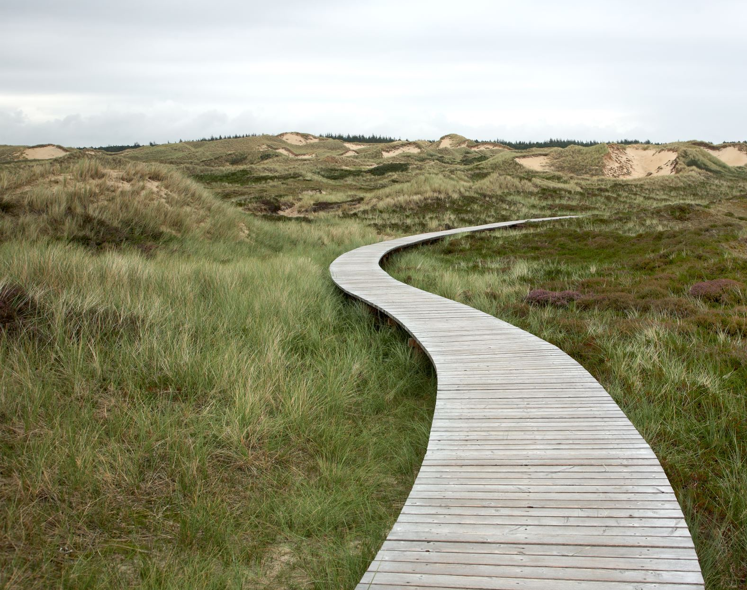
QUOTE{Mar 287.4}
The living saints, 144,000 in number, knew and understood the voice, while the wicked thought it was thunder and an earthquake. {Mar 287.4}
QUOTE {14MR 93.1}
One of the marked features in the representation of the 144,000 is that in their mouth was found no guile. The Lord has said, "Blessed is the man . . . in whose spirit there is no guile" [Psalms 32:2]. They profess to be children of God, and are represented following the Lamb whithersoever He goeth. They are prefigured before us as standing on Mount Zion, girt for holy service, clothed in white linen, which is the righteousness of the saints. But all who follow the Lamb in heaven will first have followed Him on earth, in trustful, loving, willing obedience; followed Him not fretfully and capriciously, but confidently, truthfully, as the flock follows the shepherd. {14MR 93.1}

Slide 22
QUOTE {LS 66.1}
Then Jesus' silver trumpet sounded, as He descended on the cloud, wrapped in flames of fire. He gazed on the graves of the sleeping saints, then raised His eyes and hands to heaven, and cried, "Awake! awake! awake! ye that sleep in the dust, and arise." Then there was a mighty earthquake. The graves opened, and the dead came up clothed with immortality. The 144,000 shouted "Alleluia!" as they recognized their friends who had been torn from them by death, and in the same moment we were changed and caught up together with them to meet the Lord in the air. {LS 66.1}

Slide 23
The 144000 are the saints that are sealed alive just before the second coming of Christ

Slide 24
When do they arrive?
Revelation 7:3,4
Saying, Hurt not the earth, neither the sea, nor the trees, till we have sealed the servants of our God in their foreheads. And I heard the number of them which were sealed: and there were sealed an hundred and forty and four thousand of all the tribes of the children of Israel.

Slide 25
QUOTE {7BC 978.4,7}
Christ says that there will be those in the church who will present fables and suppositions, when God has given grand, elevating, ennobling truths, which should ever be kept in the treasure house of the mind. When men pick up this theory and that theory, when they are curious to know something it is not necessary for them to know, God is not leading them. It is not His plan that His people shall present something which they have to suppose, which is not taught in the Word. It is not His will that they shall get into controversy over questions which will not help them spiritually, such as, Who is to compose the hundred and forty-four thousand. This those who are the elect of God will in a short time know without question. {7BC 978.4}

Slide 26
QUOTE {7BC 978.4,7}
….. We need not wait till we are translated to follow Christ. God's people may do this here below. We shall follow the Lamb of God in the courts above only if we follow Him here. Following Him in heaven depends on our keeping His commandments now. We are not to follow Christ fitfully or capriciously, only when it is for our advantage. {7BC 978.7}
We must choose to follow Him. In daily life we must follow His example, as a flock trustfully follows its shepherd. We are to follow Him by suffering for His sake, saying, at every step, "Though he slay me, yet will I trust in him."

Slide 27
The 144,000 arrive at the completion of the sealing – Gods appointed time

Slide 28
Where do they come from?
Revelation 14:4,12
These are they which were not defiled with women; for they are virgins. These are they which follow the Lamb whithersoever he goeth. These were redeemed from among men, [being] the firstfruits unto God and to the Lamb…..Here is the patience of the saints: here [are] they that keep the commandments of God, and the faith of Jesus.

Slide 29
QUOTE {PK 715.1}
No longer have the hosts of evil power to keep the church captive; for "Babylon is fallen, is fallen, that great city," which hath "made all nations drink of the wine of the wrath of her fornication;" and to spiritual Israel is given the message, "Come out of her, My people, that ye be not partakers of her sins, and that ye receive not of her plagues.{PK 715.1}

Slide 30
QUOTE {Mar 287.4,5}
The living saints, 144,000 in number, knew and understood the voice, while the wicked thought it was thunder and an earthquake. The Israel of God stand listening, with their eyes fixed upward. Their countenances are lighted up with His glory, and shine as did the face of Moses when he came down from Sinai. The wicked cannot look upon them. And when the blessing is pronounced on those who have honored God by keeping His Sabbath holy, there is a mighty shout of victory.

Slide 31
The 144,000 come from the group that is known as Spiritual Israel. Those that are faithful and true to the Law of God.

Slide 32
Why should we strive to be among them?
Revelation 4:5
And in their mouth was found no guile: for they are without fault before the throne of God.

Slide 33
QUOTE{Mar 368.7}
…I begged of my attending angel to let me remain in that place. I could not bear the thought of coming back to this dark world again. Then the angel said, "You must go back, and if you are faithful, you, with the 144,000, shall have the privilege of visiting all the worlds and viewing the handiwork of God." {Mar 368.7}

Slide 34
QUOTE
Let us strive with all the power that God has given us to be among the hundred and forty-four thousand. And let us do all that we can to help others to gain heaven.”—The Review and Herald, March 9, 1905

Slide 35
Point…
We should strive to be among the 144000 because there purpose is to call others out of darkness (Babylon) into the saving Light (Truth) of Jesus. These individuals would have been living the overcomers’ life.
John saw the 144000 and the great multitude two separate groups which receive the same reward of eternal life.

Slide 36
Just as in the days of Noah, there will be 2 classes of people in 4 categories on the earth after the close of human probation at the second coming of Jesus

Slide 37

Consider the following:
CAT 1 - (Type A) The Living Saints from Spiritual Israel – awaiting translation – 144000 Gods Special reserve (Type B) The Living called out of the world under the proclamation of the 3AM – awaiting translation – Great Multitude
CAT 2 - The Sleeping Saints awaiting resurrection – Great Multitude
CAT 3 - The Living Wicked – awaiting judgment
CAT 4 – The Dead Wicked – awaiting judgment

Slide 38
The Sleeping Soldiers / Multitude
Hebrews 11:39,40
And these all, having obtained a good report through faith, received not the promise: God having provided some better thing for us, that they without us should not be made perfect.

Slide 39
God has made provision for my salvation,
I must choose to accept

Slide 40
They That Follow The Lamb
Revelation 22:19-21
And if any man shall take away from the words of the book of this prophecy, God shall take away his part out of the book of life, and out of the holy city, and [from] the things which are written in this book.
He which testifieth these things saith, Surely I come quickly. Amen. Even so, come, Lord Jesus.
The grace of our Lord Jesus Christ [be] with you all. Amen

Slide 41
AMEN!

Slide 42
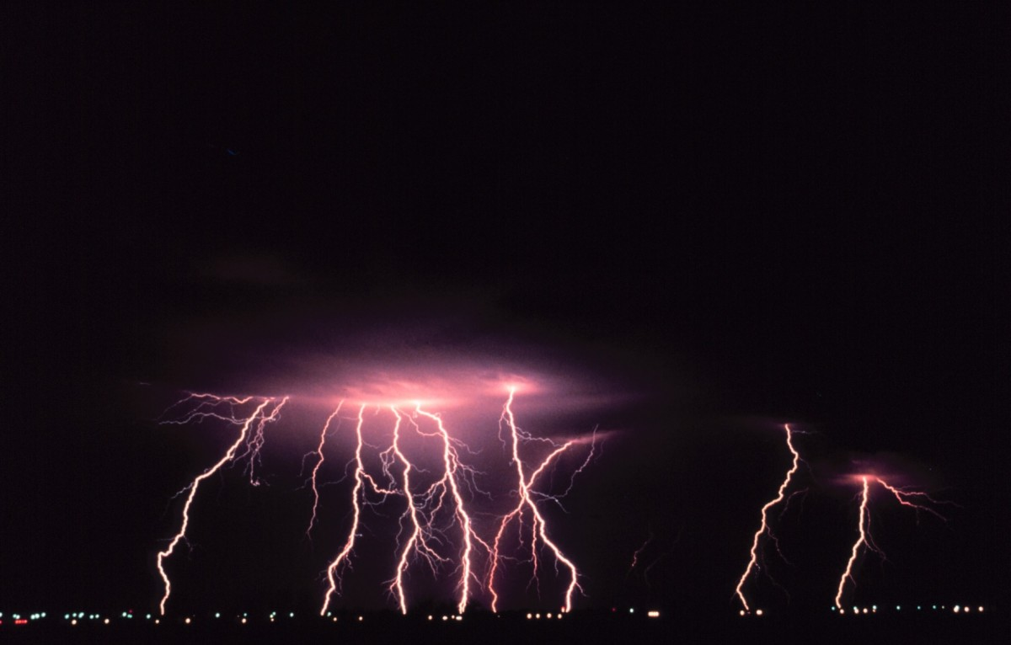
Next on The 7 Thunders
PT 4.2
WHEN COMES THE RAIN

