Slide 1
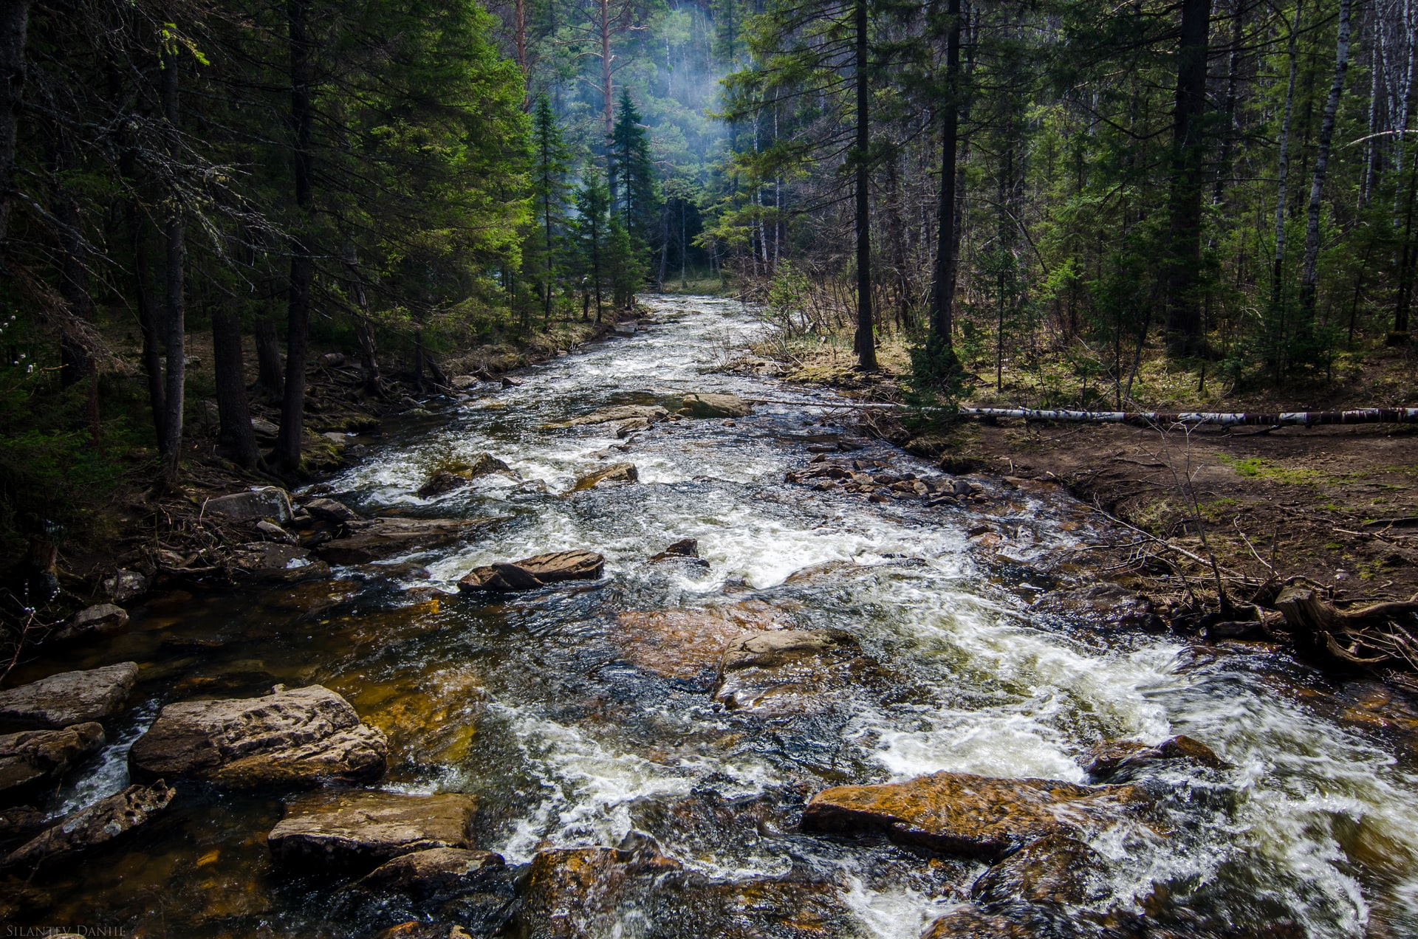
Who is Jesus ?
A journey through our Bible

Slide 2

In Matthew 3: 13-17 Jesus is introduced at the beginning of his ministry.
In verse 17 is a startling revelation where the Father tells the world who Jesus is..
“This is My Beloved Son, in whom
I am well pleased”.

Slide 3
This is an anointing; GOD has now poured out his Spirit in full measure upon Christ to start his work for the redemption of men. Jesus is referred to in scripture as the Lord’s anointed.

Slide 4
Isaiah 61:1
The Spirit of the Lord God is upon me; because the Lord hath anointed me to preach good tidings unto the meek; he hath sent me to bind up the brokenhearted, to proclaim liberty to the captives, and the opening of the prison to them that are bound;

Slide 5
Luke 4: 1
And Jesus being full of the Holy Ghost returned from Jordan, and was led by the Spirit into the wilderness,

Slide 6

Luke 4: 17-21
And there was delivered unto him the book of the prophet Esaias. And when he had opened the book, he found the place where it was written,
¹⁸ The Spirit of the Lord is upon me, because he hath anointed me to preach the gospel to the poor; he hath sent me to heal the brokenhearted, to preach deliverance to the captives, and recovering of sight to the blind, to set at liberty them that are bruised,
¹⁹ To preach the acceptable year of the Lord.
²⁰ And he closed the book, and he gave it again to the minister, and sat down. And the eyes of all them that were in the synagogue were fastened on him.
²¹ And he began to say unto them, This day is this scripture fulfilled in your ears.

Slide 7
John 3: 31-33
He that cometh from above is above all: he that is of the earth is earthly, and speaketh of the earth: he that cometh from heaven is above all.
³² And what he hath seen and heard, that he testifieth; and no man receiveth his testimony.
³³ He that hath received his testimony hath set to his seal that God is true.

Slide 8
John 3: 34-36
³⁴ For he whom God hath sent speaketh the words of God: for God giveth not the Spirit by measure unto him.
³⁵ The Father loveth the Son, and hath given all things into his hand.
³⁶ He that believeth on the Son hath everlasting life: and he that believeth not the Son shall not see life; but the wrath of God abideth on him.

Slide 9
Acts 10: 38
How God anointed Jesus of Nazareth with the Holy Ghost and with power: who went about doing good, and healing all that were oppressed of the devil; for God was with him.

Slide 10
At his anointing Jesus’ identity was given so that many would know. So that they could testify of what they had seen and heard.

Slide 11

ST Aug 4, 1887 - Christ's Triumph in Our Behalf
When Christ presented himself to John for baptism, Satan was among the witnesses of that event. He saw the lightnings flash from the cloudless heavens. He heard the majestic voice of Jehovah that resounded through Heaven, and echoed through the earth like peals of thunder, announcing, “This is my beloved Son, in whom I am well pleased.” He saw the brightness of the Father's glory overshadowing the form of Jesus, thus pointing out with unmistakable assurance the One in that crowd whom he acknowledged as his Son. The circum-stances connected with this baptismal scene were of the greatest interest to Satan. He knew then for a certainty that unless he could overcome Christ, from thenceforth there would be a limit to his power.

Slide 12
ST Aug 4, 1887 - Christ's Triumph in Our Behalf
He understood that this communication from the throne of God signified that Heaven was now more directly accessible to man than it had been, and the most intense hatred was aroused in his breast.
ST Aug 4, 1887. par.6
When Satan led man to sin, he hoped that God's abhorrence of sin would forever separate him from man, and break the connecting link between Heaven and earth. When from the opening heavens he heard the voice of God addressing his Son, it was to him as the sound of a death-knell. It told him that now God was about to unite man more closely to himself,

Slide 13
ST Aug 4, 1887 - Christ's Triumph in Our Behalf
and give moral power to overcome temptation, and to escape from the entanglements of Satanic devices. Satan well knew the position which Christ had held in Heaven as the Son of God, the Beloved of the Father; and that Christ should leave the joy and honor of Heaven, and come to this world as a man, filled him with apprehension. He knew that this condescension on the part of the Son of God boded no good to him. ST Aug 1887. par.7
Satan could not comprehend the mystery of this great sacrifice for the benefit of fallen man. His selfish soul could not understand how there could exist benevolence and love for the deceived race,

Slide 14
ST Aug 4, 1887 - Christ's Triumph in Our Behalf
so great as to induce the Prince of Heaven to leave his home, and come to a world marred with sin and with the traces of the curse. Satan knew that the value of Heaven far exceeded man's anticipation and appreciation, and that the most costly treasures of the world would not compare with it in worth. He had a knowledge of the inestimable value of eternal riches that man did not possess. He had experienced the pure contentment, the peace, the exalted happiness and unalloyed joys, of the heavenly abode. He had realized, before his rebellion, the satisfaction of the full approval of God. He had had a full appreciation of the glory that enshrouded the Father, and knew that there was no limit to his power. ST Aug 4 1887. par.8

Slide 15

This announcement was not made once but twice.
In Matthew 17: 5 Jesus is transfigured, and a bright cloud over -shadows him and his three disciples. And a voice announces,
“This is My Beloved Son, in whom
I am well pleased ; hear ye him.”

Slide 16
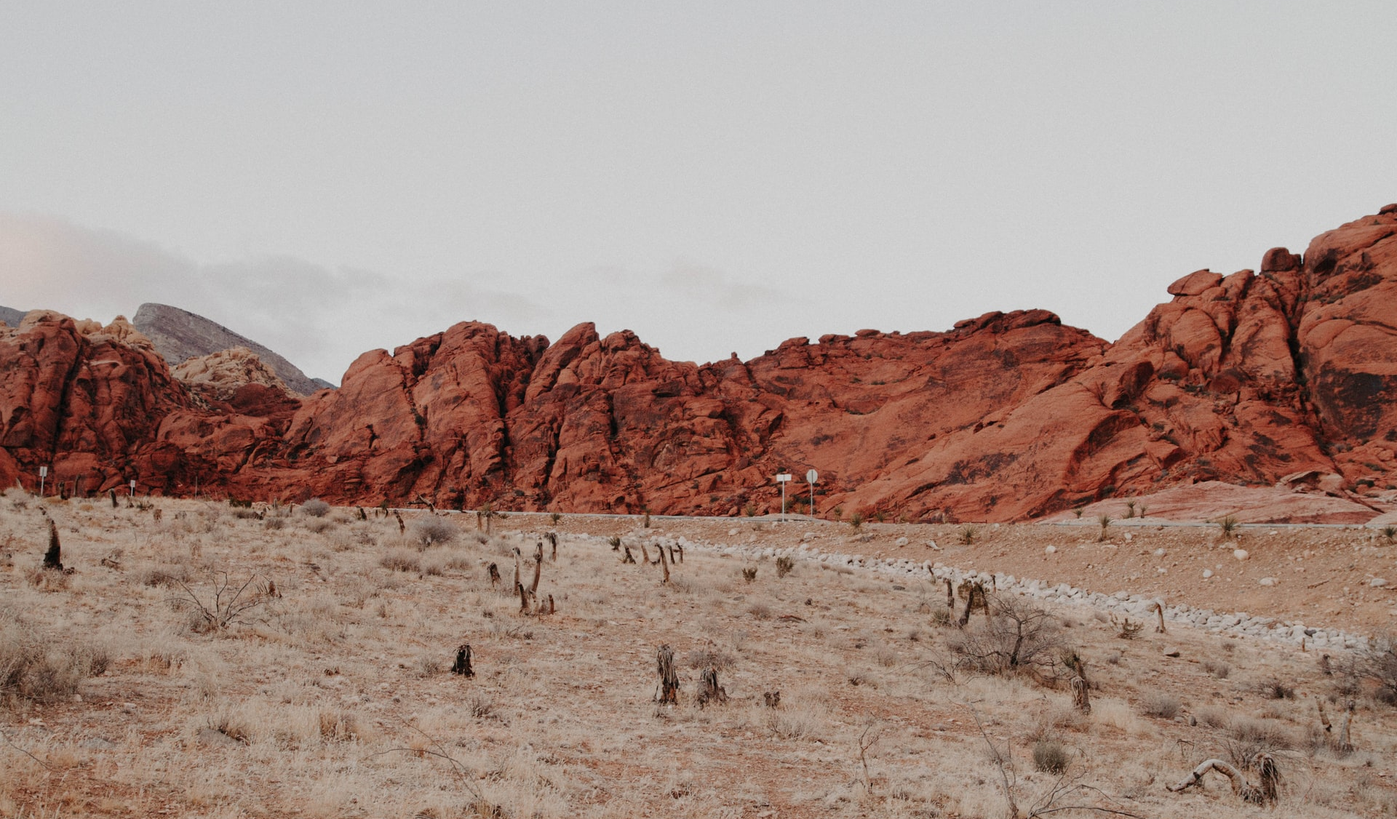
In the wilderness Satan tries to plant seeds of doubt in the mind of Christ.
Matthew 4: 3
“If thou be the Son of God”…
Did Jesus doubt his Sonship ?

Slide 17
In the wilderness Satan tries to plant seeds of doubt in the mind of Christ.
1SM 275.1
Christ could have worked a miracle on His own account; but this would not have been in accordance with the plan of salvation. The many miracles in the life of Christ show His power to work miracles for the benefit of suffering humanity. By a miracle of mercy He fed five thousand at once with five loaves and two small fishes. Therefore He had power to work a miracle, and satisfy His own hunger. Satan flattered himself that he could lead Christ to doubt the words spoken from heaven at His baptism. And if he could tempt Him to question His sonship, and doubt the truth of the word spoken by His Father, he would gain a great victory.

Slide 18
This is what Jesus confessed about himself.
John 5: 17,18
But Jesus answered them, My Father worketh hitherto, and I work.
¹⁸ Therefore the Jews sought the more to kill him, because he not only had broken the sabbath, but said also that God was his Father, making himself equal with God.

Slide 19
This is what Jesus confessed about himself.
John 10: 31-36
Then the Jews took up stones again to stone him.
³² Jesus answered them, Many good works have I shewed you from my Father; for which of those works do ye stone me?
³³ The Jews answered him, saying, For a good work we stone thee not; but for blasphemy; and because that thou, being a man, makest thyself God.

Slide 20
This is what Jesus confessed about himself.
³⁴ Jesus answered them, Is it not written in your law, I said, Ye are gods?
³⁵ If he called them gods, unto whom the word of God came, and the scripture cannot be broken;
³⁶ Say ye of him, whom the Father hath sanctified, and sent into the world, Thou blasphemest; because I said, I am the Son of God ?
See Psalm 82:1-8 in reference to verse 34

Slide 21
How did the Jews know about the Son of GOD?
The Jews wanted to stone him for blasphemy, but Jesus never claimed to be GOD the Father, he claimed to be the Son of GOD and yet they claimed he made himself GOD. Where did they get this concept of GOD from. They did not have the New Testament Scriptures, unless this concept is clear in the Old Testament that GOD had a Son. We only look at Jesus as the Son of GOD after his incarnation, however, could he have been a Son before his incarnation.
Time to dive into the Old Testament…

Slide 22

Proverbs 30: 1-3
The words of Agur the son of Jakeh, even the prophecy: the man spake unto Ithiel, even unto Ithiel and Ucal,
² Surely I am more brutish than any man, and have not the understanding of a man.
³ I neither learned wisdom, nor have the knowledge of the holy.

Slide 23
Proverbs 30:4
⁴ Who hath ascended up into heaven, or descended? who hath gathered the wind in his fists? who hath bound the waters in a garment? who hath established all the ends of the earth? what is his name, and what is his son's name, if thou canst tell?

Slide 24
John 3: 13
And no man hath ascended up to heaven, but he that came down from heaven, even the Son of man which is in heaven.

Slide 25
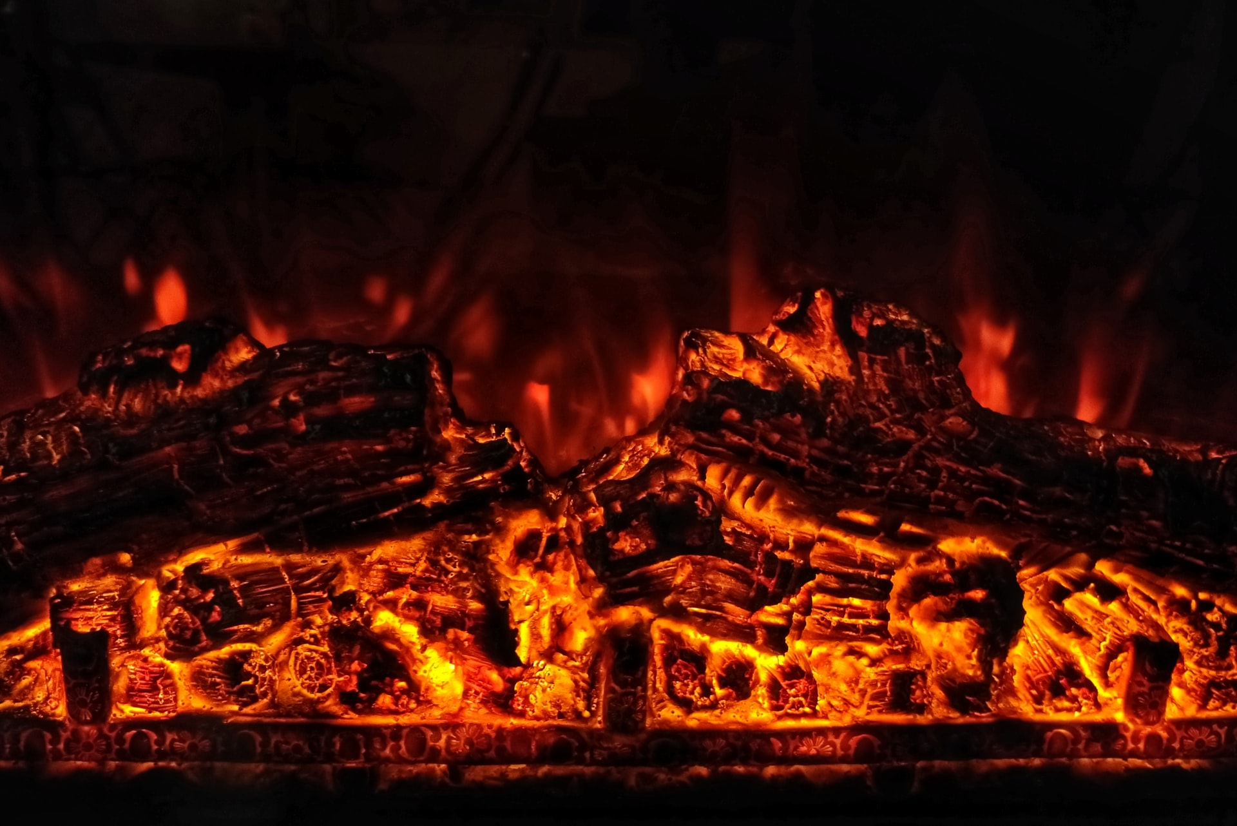
Daniel 3: 25
He answered and said, Lo, I see four men loose, walking in the midst of the fire, and they have no hurt; and the form of the fourth is like the Son of God.

Slide 26
Christ's Instruction to His Followers
RH May 03, 1892, par. 9
“Whosoever therefore shall confess me before men, him will I confess also before my Father which is in heaven.” We have a different confession to make from that which we have made; and we shall have to make it under different circumstances. The three Hebrews were called upon to confess Christ in the face of the burning fiery furnace. They had been commanded by the king to fall down and worship the golden image which he had set up, and threatened that if they would not, they should be cast alive into the fiery furnace, but they answered, “We are not careful to answer thee in this matter. If it be so, our God whom we serve is able to deliver us from the burning fiery furnace, and he will deliver us out of

Slide 27
Christ's Instruction to His Followers
RH May 03, 1892, par. 9
thine hand, O king. But if not, be it known unto thee, O king, that we will not serve thy gods, nor worship the golden image which thou hast set up.” It cost them something to confess Christ, for their lives were at stake. Then the king commanded that the furnace be heated seven times hotter than it is was wont to be heated, and the faithful children of God were cast into the furnace. “Then Nebuchadnezzar the king was astonished, and rose up in haste, and spake, and said unto his counselors, Did not we cast three men bound into the midst of the fire? They answered and said unto the king, True, O king. He answered and said, Lo, I see four men loose, walking in the midst of the fire, and they have no hurt; and the form of the fourth is like the Son of God.”

Slide 28
Christ's Instruction to His Followers
RH May 03, 1892, par. 10
How did Nebuchadnezzar know that the form of the fourth was like the Son of God? He had heard of the Son of God from the Hebrew captives that were in his kingdom. They had brought the knowledge of the living God who ruleth all things. Then Nebuchadnezzar called forth the servants of God, and they had not so much as the smell of fire upon them. If you are called to go through the fiery furnace for Christ's sake, Jesus will be at your side. “When thou passest through the waters, I will be with thee; and through the rivers, they shall not overflow thee: when thou walketh through the fire, thou shalt not be burned; neither shall the flame kindle upon thee.”

Slide 29
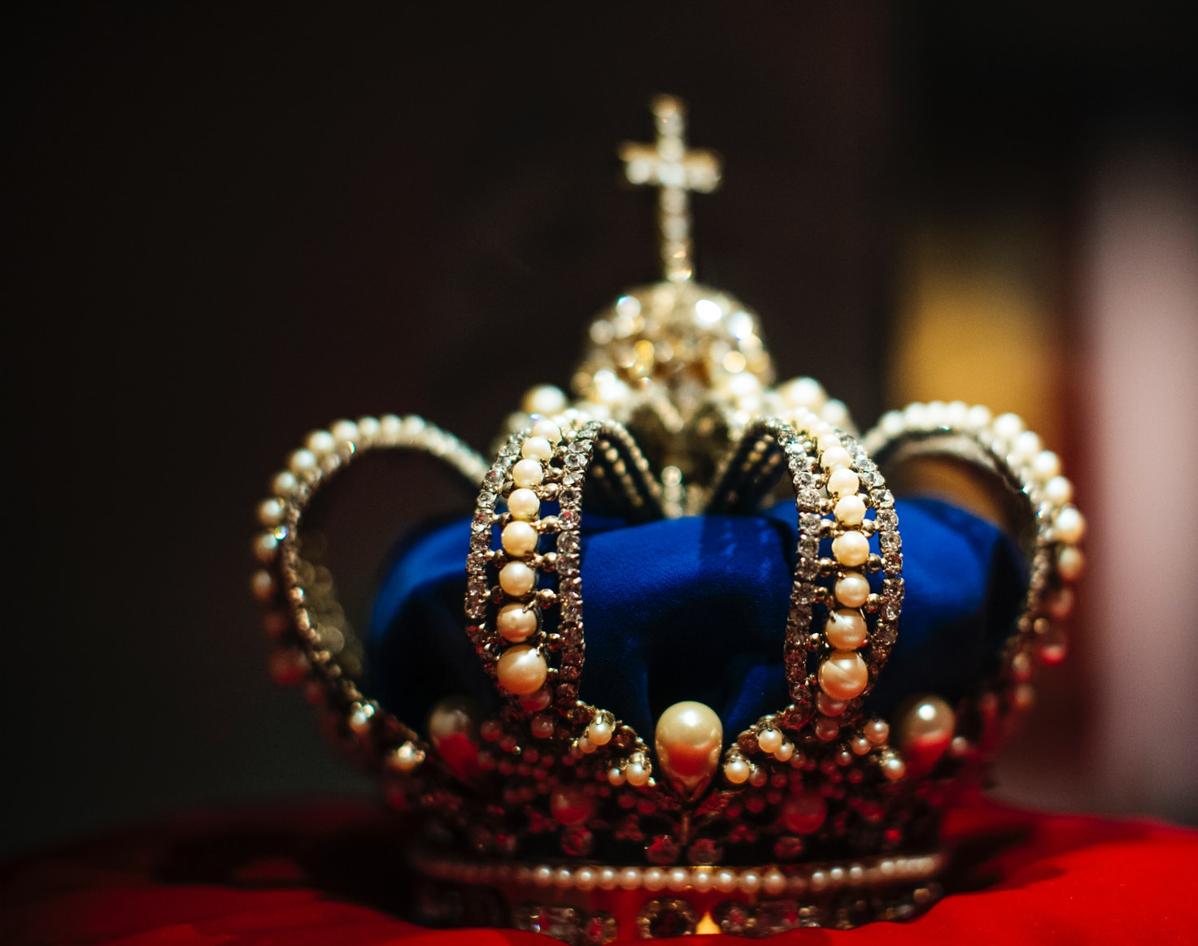
How did that heathen king know what the Son of God was like? The Hebrew captives filling positions of trust in Babylon had in life and character represented before him the truth.

Slide 30
When asked for a reason of their faith, they had given it without hesitation. Plainly and simply they had presented the principles of righteousness

Slide 31
thus teaching those around them of the God whom they worshiped. They had told of Christ, the Redeemer to come;

Slide 32
and in the form of the fourth in the midst of the fire the king recognized the Son of God.
Prophet and Kings Ch.41

Slide 33
RH Feb.1, 1881
When the Son of God manifests himself to men, an unseen power speaks to the soul that this is God. And before his majesty, kings and nobles tremble, and acknowledge the superiority of the living God over every earthly power.
par.18

Slide 34
RH Feb.1, 1881
These faithful Hebrews possessed great natural ability and intellectual culture, and they occupied a high position of honor; but all these advantages did not lead them to forget God. All their powers were yielded to the sanctifying influence of divine grace. By their godly example, their steadfast integrity, they showed forth the praises of Him who had called them out of darkness into his marvelous light. In their wonderful deliverance was displayed, before that vast assembly, the power and majesty of God. par.21

Slide 35
RH Feb.1, 1881
Jesus placed himself by their side in the fiery furnace, and by the glory of his presence convinced the proud king of Babylon that it could be no other than the Son of God. The light of Heaven had been shining forth from Daniel and his companions, until all their associates understood the faith which ennobled their lives and beautified their characters. By the deliverance of his faithful servants, the Lord declares that he will take his stand with the oppressed, and overthrow, all earthly powers that would exalt their own glory and trample under foot the God of Heaven. par.21

Slide 36
Psalm 2: 1-6
Why do the heathen rage, and the people imagine a vain thing?
² The kings of the earth set themselves, and the rulers take counsel together, against the Lord, and against his anointed, saying,
³ Let us break their bands asunder, and cast away their cords from us.
⁴ He that sitteth in the heavens shall laugh: the Lord shall have them in derision.
⁵ Then shall he speak unto them in his wrath, and vex them in his sore displeasure.
⁶ Yet have I set my king upon my holy hill of Zion.

Slide 37
Psalm 2: 7-9
⁷ I will declare the decree: the Lord hath said unto me, Thou art my Son; this day have I begotten thee.
⁸ Ask of me, and I shall give thee the heathen for thine inheritance, and the uttermost parts of the earth for thy possession.
⁹ Thou shalt break them with a rod of iron; thou shalt dash them in pieces like a potter's vessel.

Slide 38
Psalm 2: 10-12
¹⁰ Be wise now therefore, O ye kings: be instructed, ye judges of the earth.
¹¹ Serve the Lord with fear, and rejoice with trembling.
¹² Kiss the Son, lest he be angry, and ye perish from the way, when his wrath is kindled but a little. Blessed are all they that put their trust in him.

Slide 39
Psalm 2: 7
⁷ I will declare the decree: the Lord hath said unto me, Thou art my Son; this day have I begotten thee.
Acts 13: 33
God hath fulfilled the same unto us their children, in that he hath raised up Jesus again; as it is also written in the second psalm, Thou art my Son, this day have I begotten thee.

Slide 40
According to Acts 13:33, Jesus was raised
up again. Now this is very interesting it gives us a glimpse at what begotten could possibly mean but we will explore this in greater detail later.

Slide 41
Micah 5: 2
But thou, Bethlehem Ephratah, though thou be little among the thousands of Judah, yet out of thee shall he come forth unto me that is to be ruler in Israel; whose goings forth have been from of old, from everlasting.

Slide 42
Mowtsa’ah
(goings forth)
Only other use in the Bible is found in 2 Kings 10:27
“And they brake down the image of Baal, and brake down the house of Baal, and made it a draught house unto this day.”
Strong's ref. # - H4163

Slide 43
Mowtsa’ah
(goings forth)
(privy)
Going forth speaks to origin – Place of going out from.
Privy speaks to places of going out to or from.

Slide 44
Mowtsa’ah primitive root is
Yatsa’
Yatsa’ is the primitive root for Mowtsa’ah. Look up the reference number below and confirm its usage.
Strong’s ref.# - H3318

Slide 45
Mowtsa’ah primitive root is
Yatsa’
Yatsa’ is used extensively throughout the Old Testament Scriptures. It is used as brought forth, to come out of and many other similar applications. In 2 Samuel 7:12 Yatsa’ is used with another word, Me’ah.

Slide 46
Mowtsa’ah primitive root is
Yatsa’
Combined they form the phrase, “which shall proceed (Yatsa’)”, “out of thy bowels(Me’ah)”.
Could it be coincidental that
Mowtsa’ah combines these
two ideas into one. It is more specific than Yatsa’ and only used twice in the Bible.

Slide 47
Mowtsa’ah primitive root is
Yatsa’
How can one word mean origin and privy(toilet). Does the phrase, to proceed out of(origin) the bowels(privy), provide a suitable answer to our dilemma. I believe it
does.

Slide 48
Mowtsa’ah primitive root is
Yatsa’
מוֹצָאָה Mowtsa’ah
יָצָא Yatsa’
מֵעֶה Me’ah
N.B.
For your research and consideration

Slide 49
Micah 5:2 says that, “whose goings forth have been from of old, from everlasting.”
If we add our latest findings the text is now understood as, “who proceeds from the bowels have been from of old, from everlasting.”
Is there any other evidence to support this in the Bible.

Slide 50
Proverbs 8: 22-30
The Lord possessed me in the beginning of his way, before his works of old.
²³ I was set up from everlasting, from the beginning, or ever the earth was.
²⁴ When there were no depths, I was brought forth; when there were no fountains abounding with water.
²⁵ Before the mountains were settled, before the hills was I brought forth:
²⁶ While as yet he had not made the earth, nor the fields, nor the highest part of the dust of the world.
²⁷ When he prepared the heavens, I was there: when he set a compass upon the face of the depth:
²⁸ When he established the clouds above: when he strengthened the fountains of the deep:
²⁹ When he gave to the sea his decree, that the waters should not pass his commandment: when he appointed the foundations of the earth:
³⁰ Then I was by him, as one brought up with him: and I was daily his delight, rejoicing always before him;

Slide 51
I have been told growing up that these verses are the personification of wisdom. However my research has uncovered something interesting.
1 Corinthians 1: 22-25
²² For the Jews require a sign, and the Greeks seek after wisdom:
²³ But we preach Christ crucified, unto the Jews a stumblingblock, and unto the Greeks foolishness;
²⁴ But unto them which are called, both Jews and Greeks, Christ the power of God, and the wisdom of God.
²⁵ Because the foolishness of God is wiser than men; and the weakness of God is stronger than men.

Slide 52
1 Corinthians 1: 26-30
²⁶ For ye see your calling, brethren, how that not many wise men after the flesh, not many mighty, not many noble, are called:
²⁷ But God hath chosen the foolish things of the world to confound the wise; and God hath chosen the weak things of the world to confound the things which are mighty;
²⁸ And base things of the world, and things which are despised, hath God chosen, yea, and things which are not, to bring to nought things that are:
²⁹ That no flesh should glory in his presence.
³⁰ But of him are ye in Christ Jesus, who of God is made unto us wisdom, and righteousness, and sanctification, and redemption:

Slide 53
Colossians 2: 2,3
That their hearts might be comforted, being knit together in love, and unto all riches of the full assurance of understanding, to the acknowledgement of the mystery of God, and of the Father, and of Christ;
³ In whom are hid all the treasures of wisdom and knowledge.

Slide 54

Selected Messages Chapter 34 – The Word Made Flesh
Christ's Pre-existence
But while God's Word speaks of the humanity of Christ when upon this earth, it also speaks decidedly regarding His pre-existence. The Word existed as a divine being, even as the eternal Son of God, in union and oneness with His Father. From everlasting He was the Mediator of the covenant, the one in whom all nations of the earth, both Jews and Gentiles, if they accepted Him, were to be blessed. “The Word was with God, and the Word was God” (John 1:1). Before men or angels were created, the Word was with God, and was God. 1SM 247.2

Slide 55
Selected Messages Chapter 34 – The Word Made Flesh
Christ's Pre-existence
The world was made by Him, “and without him was not any thing made that was made” (John 1:3). If Christ made all things, He existed before all things. The words spoken in regard to this are so decisive that no one need be left in doubt. Christ was God essentially, and in the highest sense. He was with God from all eternity, God over all, blessed forevermore. 1SM 247.3

Slide 56
Selected Messages Chapter 34 – The Word Made Flesh
Christ's Pre-existence
The Lord Jesus Christ, the divine Son of God, existed from eternity, a distinct person, yet one with the Father. He was the surpassing glory of heaven. He was the commander of the heavenly intelligences, and the adoring homage of the angels was received by Him as His right. This was no robbery of God. “The Lord possessed me in the beginning of his way,” He declares, “before his works of old. I was set up from everlasting, from the beginning, or ever the earth was.

Slide 57
Christ's Pre-existence
The words possessed, eternity, everlasting, may seem to produce a challenge, but there is none really. The word possessed here means to “acquire” and “everlasting or eternity” is understood to mean anytime before the earth was created. You can do your own research and check it out. We can also render, “in the beginning of his way”, as “in the beginning of his journey”, and what way or journey is that ? His journey in his works of old, all his creations of old. Before anything was created the divine SON of GOD was brought forth.

Slide 58
Selected Messages Chapter 34 – The Word Made Flesh
Christ's Pre-existence
When there were no depths, I was brought forth; when there were no fountains abounding with water. Before the mountains were settled, before the hills was I brought forth: while as yet he had not made the earth, nor the fields, nor the highest part of the dust of the world. When he prepared the heavens, I was there: when he set a compass upon the face of the depth” (Proverbs 8:22-27). 1SM 247.4

Slide 59
ST August 29, 1900
Christ's Pre-existence
Through Solomon Christ declared: “The Lord possessed Me in the beginning of His way, before His works of old. I was set up from everlasting, from the beginning, or ever the earth was. When there were no depths, I was brought forth; when there were no fountains abounding with water. Before the mountains were settled, before the hills was I brought forth.... When He gave to the sea His decree, that the waters should not pass His commandment; when He appointed the foundations of the earth; then I was by Him, as one brought up with Him; and I was daily His delight, rejoicing always before Him.” par.15

Slide 60
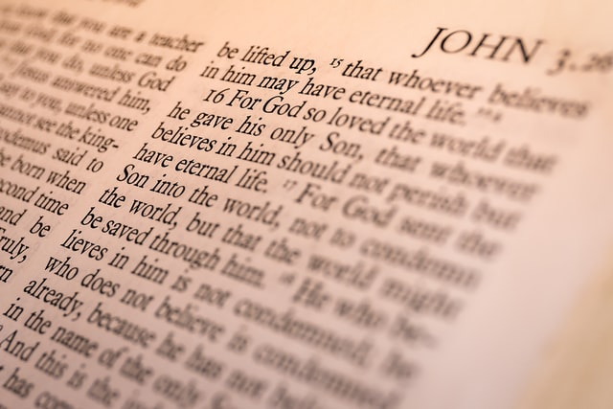
John 1:18
No man hath seen God at any time, the only begotten Son, which is in the bosom of the Father, he hath declared him.

Slide 61
Is this concept or idea in the Bible.
Daniel 2: 34,35
³⁴ Thou sawest till that a stone was cut out without hands, which smote the image upon his feet that were of iron and clay, and brake them to pieces.
³⁵ Then was the iron, the clay, the brass, the silver, and the gold, broken to pieces together, and became like the chaff of the summer threshingfloors; and the wind carried them away, that no place was found for them: and the stone that smote the image became a great mountain, and filled the whole earth.

Slide 62
Can we identify this stone?
Psalm 118: 22
The stone which the builders refused is become the head stone of the corner.

Slide 63
Can we identify this stone?
Isaiah 28: 16
¹⁶ Therefore thus saith the Lord God, Behold, I lay in Zion for a foundation a stone, a tried stone, a precious corner stone, a sure foundation: he that believeth shall not make haste.

Slide 64
Can we identify this stone?
Matthew 16: 16-18
¹⁶ And Simon Peter answered and said, Thou art the Christ, the Son of the living God.
¹⁷ And Jesus answered and said unto him, Blessed art thou, Simon Barjona: for flesh and blood hath not revealed it unto thee, but my Father which is in heaven.
¹⁸ And I say also unto thee, That thou art Peter, and upon this rock I will build my church; and the gates of hell shall not prevail against it.

Slide 65
Can we identify this stone?
1Peter 2: 7,8
Unto you therefore which believe he is precious: but unto them which be disobedient, the stone which the builders disallowed, the same is made the head of the corner,
⁸ And a stone of stumbling, and a rock of offence, even to them which stumble at the word, being disobedient: whereunto also they were appointed.

Slide 66
How does Christ get his Kingdom?
Daniel 7: 13,14
¹³ I saw in the night visions, and, behold, one like the Son of man came with the clouds of heaven, and came to the Ancient of days, and they brought him near before him.
¹⁴ And there was given him dominion, and glory, and a kingdom, that all people, nations, and languages, should serve him: his dominion is an everlasting dominion, which shall not pass away, and his kingdom that which shall not be destroyed.

Slide 67
Daniel 2: 45
⁴⁵ Forasmuch as thou sawest that the stone was cut out of the mountain without hands, and that it brake in pieces the iron, the brass, the clay, the silver, and the gold; the great God hath made known to the king what shall come to pass hereafter: and the dream is certain, and the interpretation thereof sure.
Can we identify the mountain ?

Slide 68
Ezekiel 28: 12-16
Son of man, take up a lamentation upon the king of Tyrus, and say unto him, Thus saith the Lord God; Thou sealest up the sum, full of wisdom, and perfect in beauty.
¹³ Thou hast been in Eden the garden of God; every precious stone was thy covering, the sardius, topaz, and the diamond, the beryl, the onyx, and the jasper, the sapphire, the emerald, and the carbuncle, and gold: the workmanship of thy tabrets and of thy pipes was prepared in thee in the day that thou wast created.
¹⁴ Thou art the anointed cherub that covereth; and I have set thee so: thou wast upon the holy mountain of God; thou hast walked up and down in the midst of the stones of fire.
¹⁵ Thou wast perfect in thy ways from the day that thou wast created, till iniquity was found in thee.
¹⁶ By the multitude of thy merchandise they have filled the midst of thee with violence, and thou hast sinned: therefore I will cast thee as profane out of the mountain of God: and I will destroy thee, O covering cherub, from the midst of the stones of fire.

Slide 69
Daniel 2: 45
⁴⁵ Forasmuch as thou sawest that the stone was cut out of the mountain without hands, and that it brake in pieces the iron, the brass, the clay, the silver, and the gold; the great God hath made known to the king what shall come to pass hereafter: and the dream is certain, and the interpretation thereof sure.
What is interesting is the imagery used, the Kingdom of Christ given to him by his Father (Dan.7:13,14), is cut out from his Father’s kingdom, without hands. One coming forth from the other.

Slide 70
Lt 36a, 1890 par.11
Who can anticipate the gifts of infinite Love. “God so loved the world, that he gave his only begotten Son, that whosoever believeth on him should not perish, but have everlasting life.” [John 3:16.] God’s love for the world was not manifest because He sent His Son, but because He loved the world He sent His Son into the world that divinity clothed with humanity might touch humanity, while divinity lay hold of infinity. Though sin had produced a gulf between man and his God, divine benevolence provided a plan to bridge that gulf.

Slide 71
Lt 36a, 1890 par.11
And what material did He use? A part of Himself. The brightness of the Father’s glory came to a world all seared and marred with the curse, and in His own divine character, in His own divine body, bridged the gulf and opened a channel of communication between God and man. The windows of heaven were opened, and the showers of heavenly grace in healing streams came to our benighted world. O what love, what matchless, inexpressible love!

Slide 72
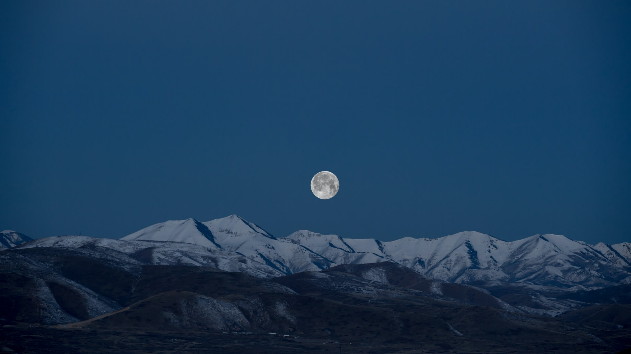
RH July 9, 1895 par.13
The Eternal Father, the unchangeable one, gave his only begotten Son, tore from his bosom Him who was made in the express image of his person, and sent him down to earth to reveal how greatly he loved mankind. He is willing to do more, “more than we can ask or think.” An inspired writer asks a question which should sink deep into every heart: “He that spared not his own Son, but delivered him up for us all,

Slide 73
RH July 9, 1895 par.13
how shall he not with him also freely give us all things?” Shall not every believer in the Lord Jesus Christ say, “Since God has done so much for us, how shall we not, for Christ's sake, show our love to him by obedience to his commandments, by being doers of his word, by unreservedly consecrating ourselves to his service?”

Slide 74
1 John 4: 9
In this was manifested the love of God toward us, because that God sent his only begotten Son into the world, that we might live through him.

Slide 75
Is there a second witness to these facts.
Genesis 1: 26
And God said, Let us make man in our image, after our likeness: and let them have dominion over the fish of the sea, and over the fowl of the air, and over the cattle, and over all the earth, and over every creeping thing that creepeth upon the earth.
²⁷ So God created man in his own image, in the image of God created he him; male and female created he them.

Slide 76
The phrase “after our likeness” used in Genesis 1: 26 is translated from the Hebrew word, “demuwth”.
resemblance; concretely, model, shape; adverbially, like:—fashion, like (-ness, as), manner, similitude.
Strong’s H1823

Slide 77
The word “image” used in Genesis 1: 26,27 is translated from the Hebrew word, “tselem”.
It is from an unused root meaning to shade; a phantom, i.e. (figuratively) illusion, resemblance; hence, a representative figure, especially an idol:—image, vain shew.
Strong’s H6754

Slide 78
Genesis 5: 3
Tselem (H6754)
And Adam lived an hundred and thirty years, and begat a son in his own likeness, and after his image(tselem); and called his name Seth:

Slide 79
PP. Ch.6 p80.1
Tselem (H6754)
To Adam was given another son, to be the inheritor of the divine promise, the heir of the spiritual birthright. The name Seth, given to this son, signified “appointed,” or “compensation;” “for,” said the mother, “God hath appointed me another seed instead of Abel, whom Cain slew.” Seth was of more noble stature than Cain or Abel, and resembled Adam more closely than did his other sons.

Slide 80
PP. Ch.2 p45.2
“after our likeness”
Demuwth
(H1823)
“Image”
Tselem (H6754)
Man was to bear God's image, both in outward resemblance and in character. Christ alone is “the express image” (Hebrews 1:3) of the Father; but man was formed in the likeness of God. His nature was in harmony with the will of God. His mind was capable of comprehending divine things. His affections were pure; his appetites and passions were under the control of reason. He was holy and happy in bearing the image of God and in perfect obedience to His will.

Slide 81
Let us look at the model, representative figure, resemblance, likeness, concretely.
Genesis 2: 7
And the Lord God formed man of the dust of the ground, and breathed into his nostrils the breath of life; and man became a living soul.

Slide 82
Let us look at the model, representative figure, resemblance, likeness, concretely.
Genesis 2: 21,22
And the Lord God caused a deep sleep to fall upon Adam, and he slept: and he took one of his ribs, and closed up the flesh instead thereof;
²² And the rib, which the Lord God had taken from man, made he a woman, and brought her unto the man.

Slide 83
Let us look at the model, representative figure, resemblance, likeness, concretely.
Genesis 2: 23,24
And Adam said, This is now bone of my bones, and flesh of my flesh: she shall be called Woman, because she was taken out of Man.
²⁴ Therefore shall a man leave his father and his mother, and shall cleave unto his wife: and they shall be one flesh.

Slide 84
PP. Ch.2 p46.1,2
God Himself gave Adam a companion. He provided “an help meet for him”—a helper corresponding to him—one who was fitted to be his companion, and who could be one with him in love and sympathy. Eve was created from a rib taken from the side of Adam, signifying that she was not to control him as the head, nor to be trampled under his feet as an inferior, but to stand by his side as an equal, to be loved and protected by him. A part of man, bone of his bone, and flesh of his flesh, she was his second self, showing the close union and the affectionate attachment that should exist in this relation. “For no man ever yet hated his own flesh; but nourisheth and cherisheth it.” Ephesians 5:29. “Therefore shall a man leave his father and his mother, and shall cleave unto his wife; and they shall be one.” PP 46.2

Slide 85
The creation of man gives a model, a photograph of our creator. It gave to those looking on a glimpse of the GOD of the universe and his SON.
Could it be coincidence ?
Jesus is the only begotten SON of GOD, brought forth from the Father in eternity past. When did it happen, we don’t know, how exactly GOD did it, we don’t know but by faith we accept that it happened.
Adam and eve did not possess every attribute of GOD, but do they have to, to be a model?

Slide 86
Many make the claim that if Jesus was begotten, he was created. They make the claim that if we assume that begotten was him coming forth as a birth, then he is created and that it is just a play on words, and thus if we accept this position, then Jesus cannot be God for he was created. They propose that there is no difference between creation and begotten if we accept it to mean a birth.

Slide 87
There is but one way of escape for the sinner. There is but one agency whereby he may be cleansed from sin. He must accept the propitiation that has been made by the Lamb of God, who taketh away the sins of the world. The shed blood of Christ cleanseth us from all sin. “For he hath made him to be sin for us, who knew no sin; that we might be made the righteousness of God in him.”
ST May 30, 1895, par.3

Slide 88
“Him hath God exalted with his right hand to be a Prince and a Saviour, for to give repentance to Israel, and forgiveness of sins.” A complete offering has been made; for “God so loved the world, that he gave his only-begotten Son,”—not a son by creation, as were the angels, nor a son by adoption, as is the forgiven sinner, but a Son begotten in the express image of the Father's person,
ST May 30, 1895, par.3

Slide 89
and in all the brightness of his majesty and glory, one equal with God in authority, dignity, and divine perfection. In him dwelt all the fullness of the Godhead bodily.
ST May 30, 1895, par.3

Slide 90
Did men of earth confess this truth ?

Slide 91
He saith unto them, But whom say ye that I am?
¹⁶ And Simon Peter answered and said, Thou art the Christ, the Son of the living God.
Matthew 16: 15, 16

Slide 92
Then they that were in the ship came and worshipped him, saying, Of a truth thou art the Son of God.
Matthew 14: 33

Slide 93
And as they went on their way, they came unto a certain water: and the eunuch said, See, here is water; what doth hinder me to be baptized?
³⁷ And Philip said, If thou believest with all thine heart, thou mayest. And he answered and said, I believe that Jesus Christ is the Son of God.
Acts 8: 36,37

Slide 94
And immediately there fell from his eyes as it had been scales: and he received sight forthwith, and arose, and was baptized.
¹⁹ And when he had received meat, he was strengthened. Then was Saul certain days with the disciples which were at Damascus.
²⁰ And straightway he preached Christ in the synagogues, that he is the Son of God.
Acts 9: 18-20

Slide 95
Since Jesus is the only begotten-SON of GOD, how is there so much controversy concerning this. Where did this obscurity originate?

Slide 96

MS 86 – August 21, 1910 par. 28
We want your faith to grasp the living promise. We want your faith to walk out so that it will be demonstrated to believers and unbelievers that your life is hid with Christ in God. Shall it be so? Will you grieve the Saviour that left the royal courts? What did He do it for? Well, Lucifer, he was striving; he had glory in the heavenly courts, but he was striving for Christ’s place next to God. Next he wanted to be God, but he could not obtain that.

Slide 97
MS 86 – August 21, 1910 par. 29
Christ was the only begotten Son of God, and Lucifer, that glorious angel, got up a warfare over the matter, until he had to be thrust down to the earth. He knows what I am saying today. He knows whenever there is a company assembled together as you are here. He knows when we are making efforts in every way possible to reach out to win the minds of the people. He has his agencies appointed so that after this meeting will be over, circumstances will arise and the enemy will try to gain the victory.

Slide 98
Lt42 – 1910 par. 3
Angels were expelled from heaven because they would not work in harmony with God. They fell from their high estate because they wanted to be exalted. They had come to exalt themselves, and they forgot that their beauty of person and of character came from the Lord Jesus.

Slide 99
Lt42 – 1910 par. 3
This fact the angels would obscure, that Christ was the only begotten Son of God, and they came to consider that they were not to consult Christ. One angel began the controversy and carried it on until there was rebellion in the heavenly courts among the angels. They were lifted up because of their beauty.

Slide 100
Satan is the one that obscured the sonship of GOD in heaven and he is doing the same on earth today. Do the evil angels have any doubt in their minds as to Christ’s being the SON of GOD.

Slide 101
Luke 8:28
When he saw Jesus, he cried out, and fell down before him, and with a loud voice said, What have I to do with thee, Jesus, thou Son of God most high? I beseech thee, torment me not.

Slide 102
Mark 5: 7
And cried with a loud voice, and said, What have I to do with thee, Jesus, thou Son of the most high God? I adjure thee by God, that thou torment me not.

Slide 103
Did GOD the Father seek to shine a light on the obscurity of his SON.

Slide 104
Patriarchs and Prophets Ch.1 pg. 36.2
The King of the universe summoned the heavenly hosts before Him, that in their presence He might set forth the true position of His Son and show the relation He sustained to all created beings. The Son of God shared the Father's throne, and the glory of the eternal, self-existent One encircled both.

Slide 105
Patriarchs and Prophets Ch.1 pg. 36.2
About the throne gathered the holy angels, a vast, unnumbered throng—“ten thousand times ten thousand, and thousands of thousands” (Revelation 5:11.), the most exalted angels, as ministers and subjects, rejoicing in the light that fell upon them from the presence of the Deity. Before the assembled inhabitants of heaven the King declared that none but Christ, the Only Begotten of God

Slide 106
Patriarchs and Prophets Ch.1 pg. 36.2
could fully enter into His purposes, and to Him it was committed to execute the mighty counsels of His will. The Son of God had wrought the Father's will in the creation of all the hosts of heaven; and to Him, as well as to God, their homage and allegiance were due. Christ was still to exercise divine power, in the creation of the earth and its inhabitants.

Slide 107
Patriarchs and Prophets Ch.1 pg. 36.2
But in all this He would not seek power or exaltation for Himself contrary to God's plan, but would exalt the Father's glory and execute His purposes of beneficence and love.

Slide 108
John 8: 38
I speak that which I have seen with my Father: and ye do that which ye have seen with your father.

Slide 109
John 8: 39
They answered and said unto him, Abraham is our father. Jesus saith unto them, If ye were Abraham's children, ye would do the works of Abraham.

Slide 110
John 8: 40
But now ye seek to kill me, a man that hath told you the truth, which I have heard of God: this did not Abraham.

Slide 111
John 8: 41
Ye do the deeds of your father. Then said they to him, We be not born of fornication; we have one Father, even God.

Slide 112
John 8: 42
Jesus said unto them, If God were your Father, ye would love me: for I proceeded forth and came from God; neither came I of myself, but he sent me

Slide 113
John 8: 43
Why do ye not understand my speech? even because ye cannot hear my word.

Slide 114
Another claim is that if Jesus is the begotten of GOD, and this is understood to mean that at some point in eternity he came out of GOD, he therefore cannot be divine as a literal SON of GOD.

Slide 115

John 11: 25-27
Jesus said unto her, I am the resurrection, and the life: he that believeth in me, though he were dead, yet shall he live:
²⁶ And whosoever liveth and believeth in me shall never die. Believest thou this?
²⁷ She saith unto him, Yea, Lord: I believe that thou art the Christ, the Son of God, which should come into the world.

Slide 116
From Heaven with Love pg. 355.1
To the Saviour's words, “Believest thou?” Martha responded, “Yea, Lord: I believe that Thou art the Christ, the Son of God, which should come into the world.” She confessed her faith in His divinity, and her confidence that He was able to perform whatever it pleased Him to do.

Slide 117
Desire of Ages Ch. 58 pg. 535.5
Calmly Christ stands before the tomb. A sacred solemnity rests upon all present. Christ steps closer to the sepulcher. Lifting His eyes to heaven, He says, “Father, I thank Thee that Thou hast heard Me.” Not long before this, Christ's enemies had accused Him of blasphemy, and had taken up stones to cast at Him because He claimed to be the Son of God. They accused Him of performing miracles by the power of Satan. But here Christ claims God as His Father, and with perfect confidence declares that He is the Son of God.

Slide 118
Desire of Ages Ch. 58 pg. 536.1
In all that He did, Christ was co-operating with His Father. Ever He had been careful to make it evident that He did not work independently; it was by faith and prayer that He wrought His miracles. Christ desired all to know His relationship with His Father. “Father,” He said, “I thank Thee that Thou hast heard Me. And I knew that Thou hearest Me always: but because of the people which stand by I said it, that they may believe that Thou hast sent Me.” Here the disciples and the people were to be given the most convincing evidence in regard to the relationship existing between Christ and God. They were to be shown that Christ's claim was not a deception.

Slide 119
Desire of Ages Ch. 58 pg. 536.2
“And when He thus had spoken, He cried with a loud voice, Lazarus, come forth.” His voice, clear and penetrating, pierces the ear of the dead. As He speaks, divinity flashes through humanity. In His face, which is lighted up by the glory of God, the people see the assurance of His power. Every eye is fastened on the entrance to the cave. Every ear is bent to catch the slightest sound. With intense and painful interest all wait for the test of Christ's divinity, the evidence that is to substantiate His claim to be the Son of God, or to extinguish the hope forever.

Slide 120
RH December 5, 1893 par. 5
For instance, an effort was made to obtain the use of the hall at a village four miles from Hastings, where some of our workers proposed to present the gospel to the people; but they did not succeed in obtaining the hall, because a school-teacher there opposed the truth, and declared to the people that Seventh-day Adventists did not believe in the divinity of Christ.

Slide 121
RH December 5, 1893 par. 5
This man may not have known what our faith is on this point, but he was not left in ignorance. He was informed that there is not a people on earth who hold more firmly to the truth of Christ's pre-existence than do Seventh-day Adventists. But the answer was given that they did not want that the doctrines of Seventh-day Adventists should be promulgated in that community. So the door was closed.

Slide 122
Matthew 27: 54
Now when the centurion, and they that were with him, watching Jesus, saw the earthquake, and those things that were done, they feared greatly, saying, Truly this was the Son of God.

Slide 123
From Heaven with Love 512. 4, 5
In the closing events of the crucifixion day, new witness was borne to Christ's divinity. When the Saviour's dying cry had been uttered, another voice was heard, saying, “Truly this was the Son of God.”
These words were said in no whispered tones. Who had spoken? It was the centurion, the Roman soldier. The divine patience of the Saviour, His sudden death, the cry of victory on His lips, had impressed this heathen. In the broken body hanging on the cross, the centurion recognized the Son of God. On the very day of the Redeemer's death, three men had declared their faith—he who commanded the Roman guard, he who bore His cross, and he who died at His side.

Slide 124
Colossians 1 : 19
For it pleased the Father that in him should all fulness dwell;
Colossians 2 : 9
For in him dwelleth all the fulness of the Godhead bodily.
N.B.
The word Godhead is found three times in the bible and it means divinity or divine nature not three or a group of persons.

Slide 125
John 1: 1-3 made simple
There is a lot of controversy over this passage which is used to prove that Jesus is co-eternal with the Father, but when this declaration is properly examined it shows that John isn’t referring at all to Christ eternal existence but that in the beginning of all created things Christ was there with his Father. He is simply stating that Christ is the beginning of all things. Before anything was created Christ was there with his Father.

Slide 126
John 1: 1-6
In the beginning was the Word, and the Word was with God, and the Word was God.
² The same was in the beginning with God.
³ All things were made by him; and without him was not any thing made that was made.
⁴ In him was life; and the life was the light of men.
⁵ And the light shineth in darkness; and the darkness comprehended it not.
⁶ There was a man sent from God, whose name was John.

Slide 127
John 1: 7-12
⁷ The same came for a witness, to bear witness of the Light, that all men through him might believe.
⁸ He was not that Light, but was sent to bear witness of that Light.
⁹ That was the true Light, which lighteth every man that cometh into the world.
¹⁰ He was in the world, and the world was made by him, and the world knew him not.
¹¹ He came unto his own, and his own received him not.
¹² But as many as received him, to them gave he power to become the sons of God, even to them that believe on his name:

Slide 128
Let us identify the Word and the God that was with the Word.

Slide 129
1 John 1: 1-4
That which was from the beginning, which we have heard, which we have seen with our eyes, which we have looked upon, and our hands have handled, of the Word of life;
² (For the life was manifested, and we have seen it, and bear witness, and shew unto you that eternal life, which was with the Father, and was manifested unto us;)
³ That which we have seen and heard declare we unto you, that ye also may have fellowship with us: and truly our fellowship is with the Father, and with his Son Jesus Christ.
⁴ And these things write we unto you, that your joy may be full.

Slide 130
Now that we have identified the two personalities in John 1, we can get a full understanding of the declaration that John was giving.
The same declaration made in John was also made in Colossians. You will be amazed at how identical they are, and one expands the other.

Slide 131
Colossians 1: 12-15
Giving thanks unto the Father, which hath made us meet to be partakers of the inheritance of the saints in light:
¹³ Who hath delivered us from the power of darkness, and hath translated us into the kingdom of his dear Son:
¹⁴ In whom we have redemption through his blood, even the forgiveness of sins:
¹⁵ Who is the image of the invisible God, the firstborn of every creature:

Slide 132
Colossians 1: 16-19
¹⁶ For by him were all things created, that are in heaven, and that are in earth, visible and invisible, whether they be thrones, or dominions, or principalities, or powers: all things were created by him, and for him:
¹⁷ And he is before all things, and by him all things consist.
¹⁸ And he is the head of the body, the church: who is the beginning, the firstborn from the dead; that in all things he might have the preeminence.
¹⁹ For it pleased the Father that in him should all fulness dwell;

Slide 133
Let's compare
John 1:1,2
In the beginning was the Word, and the Word was with God, and the Word was God.
² The same was in the beginning with God.
Colossians 1: 15,17,19
¹⁵ Who is the image of the invisible God, the firstborn of every creature: (this whole phrase can replace the word beginning)
¹⁷ And he is before all things, and by him all things consist. (explains when this beginning points to)
¹⁹ For it pleased the Father that in him should all fulness dwell;
(explains how the word is GOD) (Col.2:9)

Slide 134
Let's compare
John 1:3
³ All things were made by him; and without him was not any thing made that was made.
Colossians 1: 16
¹⁶ For by him were all things created, that are in heaven, and that are in earth, visible and invisible, whether they be thrones, or dominions, or principalities, or powers: all things were created by him, and for him:

Slide 135
Let's compare
John 1:4,5,12
⁴ In him was life; and the life was the light of men.
⁵ And the light shineth in darkness; and the darkness comprehended it not.
¹² But as many as received him, to them gave he power to become the sons of God, even to them that believe on his name:
Colossians 1: 12-14
¹² Giving thanks unto the Father, which hath made us meet to be partakers of the inheritance of the saints in light:
¹³ Who hath delivered us from the power of darkness, and hath translated us into the kingdom of his dear Son:
¹⁴ In whom we have redemption through his blood, even the forgiveness of sins:

Slide 136
For the word beginning in John 1:1
Archē – Strong's #G746
beginning, origin
the person or thing that commences, the first person or thing in a series, the leader
that by which anything begins to be, the origin, the active cause
the extremity of a thing
  of the corners of a sail
the first place, principality, rule, magistracy
  of angels and demons

Slide 137
Simply put Jesus was with his Father at the beginning of all creation and in him the fullness of divinity dwells so that makes him God.

Slide 138
Begotten just as simple to understand.
Acts 13:33
God hath fulfilled the same unto us their children, in that he hath raised up Jesus again; as it is also written in the second psalm, Thou art my Son, this day have I begotten thee.

Slide 139
Begotten just as simple to understand.
This verse compares Jesus coming forth from the tomb as being begotten. We know that Jesus was the only begotten SON of GOD before he came to earth, so that is not being debated here. What we are observing is that the act of coming forth from the tomb is called being begotten. It sheds some light on the word itself. Jesus came forth from the tomb by the will of the Father. In a similar way in eternity past he was brought forth by the will of the Father. When and how did the Father do it, we don’t know but we accept it by faith.

Slide 140
Begotten just as simple to understand.
Acts 13:33
Begotten – gennaō Strong’s #G1085
of men who fathered children
  to be born
  to be begotten
    of women giving birth to children
metaph.
  to engender, cause to arise, excite
  in a Jewish sense, of one who brings others over to his way of life, to convert someone
  of God making Christ his son
  of God making men his sons through faith in Christ's work

Slide 141
Begotten just as simple to understand.
Acts 13:33
Begotten – gennaō Strong’s #G1085
But this word is a variation of another word
genos – Strong’s #G1096
kindred
  offspring
  family
  stock, tribe, nation
    i.e. nationality or descent from a particular people
  the aggregate of many individuals of the same nature, kind, sort

Slide 142
Begotten just as simple to understand.
Acts 13:33
But this word, genos is a from another word, ginomai
to become, i.e. to come into existence, begin to be, receive being
to become, i.e. to come to pass, happen
  of events
to arise, appear in history, come upon the stage
  of men appearing in public
to be made, finished
  of miracles, to be performed, wrought
to become, be made

Slide 143
Monogenēs- Strong’s G3439
This word is is translated, “only begotten” from John 3:16. And it means:
single of its kind, only
  used of only sons or daughters (viewed in relation to their parents)
  used of Christ, denotes the only begotten son of God
Monogenēs comes from 2 words:
The first Monos – Strong’s #G3441
alone (without a companion), forsaken, destitute of help, alone, only, merely

Slide 144
Monogenēs- Strong’s G3439
Monogenēs comes from 2 words:
The second Ginomai – Strong’s #G1096 which we have met already.
Monogenēs is from monos-ginomai – only begotten or only born.
Simple….
Acts 13:33 give us the clue…

Slide 145
The great men of earth will then understand that they have surrendered mind and heart to ensnaring philosophy which pleased the carnal heart. Hope and grace and every inducement had been held out by One who loved them, and gave His life for them, that whosoever believeth in Him should not perish, but have everlasting life; but they refused the love of God. Their lofty opinions, their human reasonings, were extolled; they declared themselves sufficient in themselves to understand divine mysteries, and they thought their own powers of discrimination were strong enough to discern truth for themselves.
ST August 30, 1910, par.3

Slide 146
They fell an easy prey to Satan's subtlety, for he presented before them specious errors in human philosophy, which has an infatuation for human minds. They turned from the Source of all wisdom, and worshipped intellect. The message and the messengers of God were criticized and discarded as beneath their human, lofty ideas. The invitations of mercy were made a jest, and they denied the divinity of Jesus Christ, and derided the idea of His preexistence before He assumed human nature. But the tattered shreds of human reasoning will be found to be only as ropes of sand in the great day of God.
ST August 30, 1910, par.3

Slide 147
The truths most plainly revealed in the Bible have been involved in doubt and darkness by learned men, who, with a pretense of great wisdom, teach that the Scriptures have a mystical, a secret, spiritual meaning not apparent in the language employed. These men are false teachers. It was to such a class that Jesus declared: “Ye know not the Scriptures, neither the power of God.” Mark 12:24. The language of the Bible should be explained according to its
Great Controversy Ch. 37 Pg. 598.3

Slide 148
obvious meaning, unless a symbol or figure is employed. Christ has given the promise: “If any man will do His will, he shall know of the doctrine.” John 7:17. If men would but take the Bible as it reads, if there were no false teachers to mislead and confuse their minds, a work would be accomplished that would make angels glad and that would bring into the fold of Christ thousands upon thousands who are now wandering in error.
Great Controversy Ch. 37 Pg. 598.3

Slide 149
We have looked at Jesus as the literal Only Begotten Son of God.
His Sonship is before his incarnation.
Being a Son does not mean he is not divine, because of his Sonship he is divine.
Being a Son means that he is GOD, Why? The fullness of the Godhead (divinity, divine nature) dwells in him.

