Slide 1
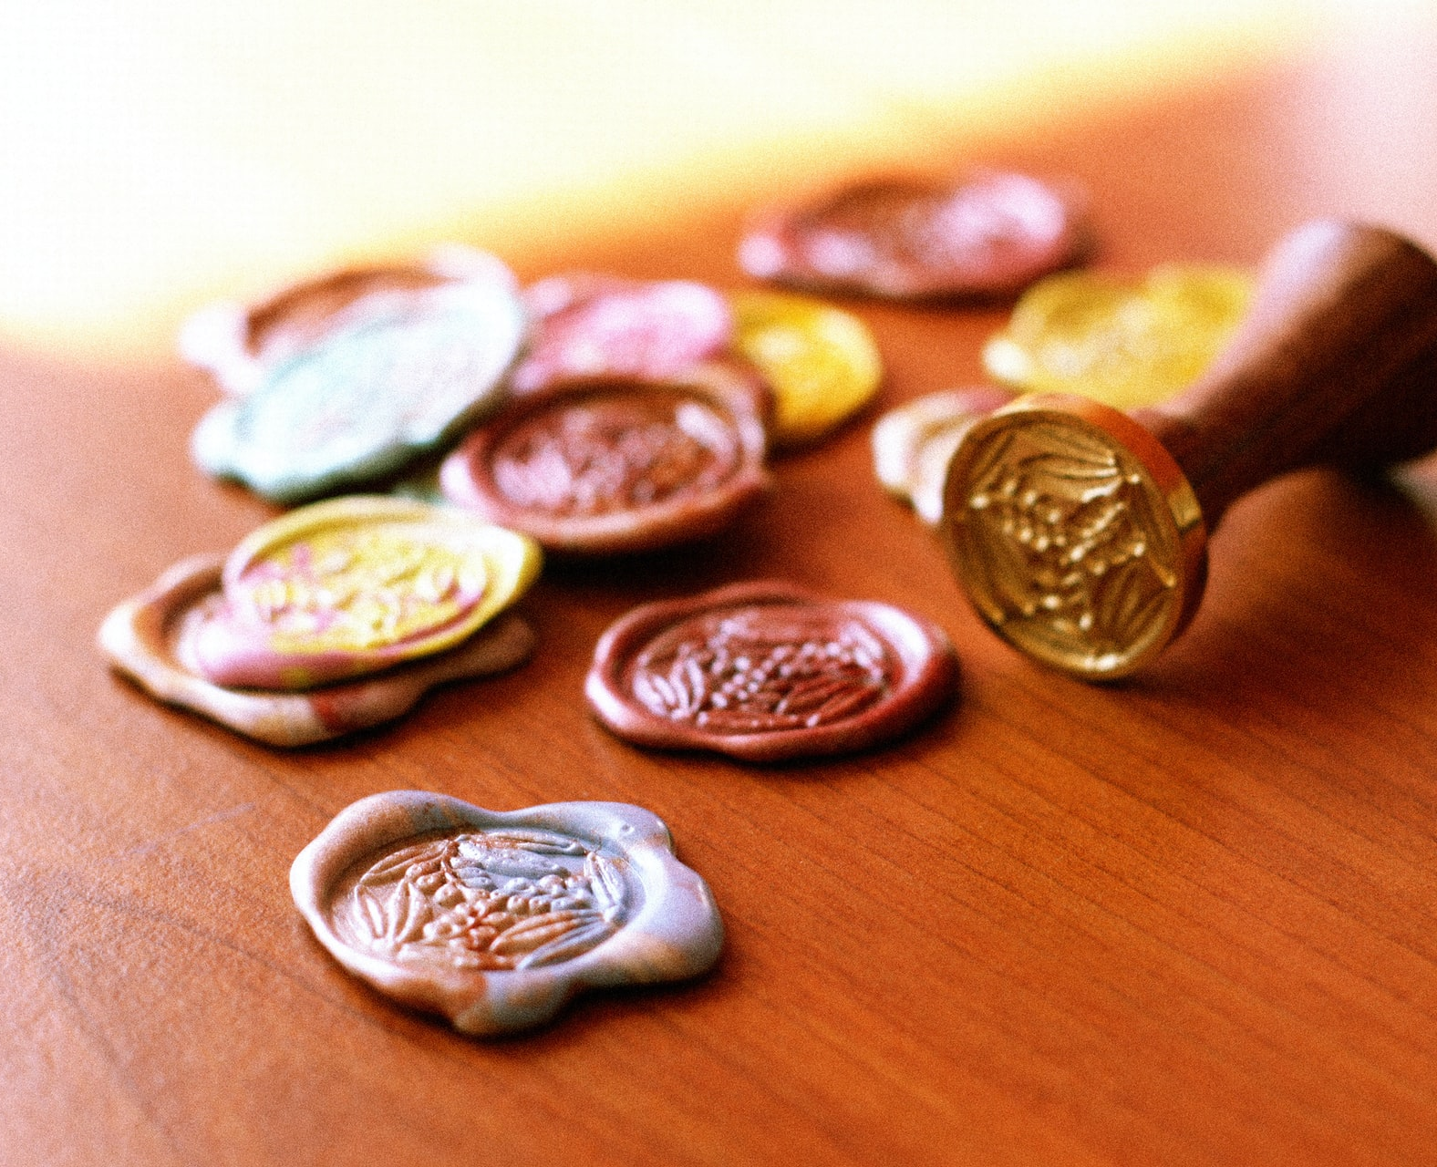
The Sign and The Seal

Slide 2
The Sign
Exodus 31: 12-18
12 And the Lord spake unto Moses, saying,
13 Speak thou also unto the children of Israel, saying, Verily my sabbaths ye shall keep: for it is a sign between me and you throughout your generations; that ye may know that I am the Lord that doth sanctify you.
14 Ye shall keep the sabbath therefore; for it is holy unto you: every one that defileth it shall surely be put to death: for whosoever doeth any work therein, that soul shall be cut off from among his people.

Slide 3
The Sign
15 Six days may work be done; but in the seventh is the sabbath of rest, holy to the Lord: whosoever doeth any work in the sabbath day, he shall surely be put to death.
16 Wherefore the children of Israel shall keep the sabbath, to observe the sabbath throughout their generations, for a perpetual covenant.
17 It is a sign between me and the children of Israel for ever: for in six days the Lord made heaven and earth, and on the seventh day he rested, and was refreshed.
18 And he gave unto Moses, when he had made an end of communing with him upon mount Sinai, two tables of testimony, tables of stone, written with the finger of God.

Slide 4
The Sign
Ezekiel 20: 1-22
And it came to pass in the seventh year, in the fifth month, the tenth day of the month, that certain of the elders of Israel came to enquire of the Lord, and sat before me.
2 Then came the word of the Lord unto me, saying,
3 Son of man, speak unto the elders of Israel, and say unto them, Thus saith the Lord God; Are ye come to enquire of me? As I live, saith the Lord God, I will not be enquired of by you.
4 Wilt thou judge them, son of man, wilt thou judge them? cause them to know the abominations of their fathers:

Slide 5
The Sign
Ezekiel 20: 1-22
5 And say unto them, Thus saith the Lord God; In the day when I chose Israel, and lifted up mine hand unto the seed of the house of Jacob, and made myself known unto them in the land of Egypt, when I lifted up mine hand unto them, saying, I am the Lord your God;
6 In the day that I lifted up mine hand unto them, to bring them forth of the land of Egypt into a land that I had espied for them, flowing with milk and honey, which is the glory of all lands:
7 Then said I unto them, Cast ye away every man the abominations of his eyes, and defile not yourselves with the idols of Egypt: I am the Lord your God.

Slide 6
The Sign
Ezekiel 20: 1-22
8 But they rebelled against me, and would not hearken unto me: they did not every man cast away the abominations of their eyes, neither did they forsake the idols of Egypt: then I said, I will pour out my fury upon them, to accomplish my anger against them in the midst of the land of Egypt.
9 But I wrought for my name's sake, that it should not be polluted before the heathen, among whom they were, in whose sight I made myself known unto them, in bringing them forth out of the land of Egypt.
10 Wherefore I caused them to go forth out of the land of Egypt, and brought them into the wilderness.

Slide 7
The Sign
Ezekiel 20: 1-22
11 And I gave them my statutes, and shewed them my judgments, which if a man do, he shall even live in them.
12 Moreover also I gave them my sabbaths, to be a sign between me and them, that they might know that I am the Lord that sanctify them.
13 But the house of Israel rebelled against me in the wilderness: they walked not in my statutes, and they despised my judgments, which if a man do, he shall even live in them; and my sabbaths they greatly polluted: then I said, I would pour out my fury upon them in the wilderness, to consume them.

Slide 8
The Sign
Ezekiel 20: 1-22
14 But I wrought for my name's sake, that it should not be polluted before the heathen, in whose sight I brought them out.
15 Yet also I lifted up my hand unto them in the wilderness, that I would not bring them into the land which I had given them, flowing with milk and honey, which is the glory of all lands;
16 Because they despised my judgments, and walked not in my statutes, but polluted my sabbaths: for their heart went after their idols.

Slide 9
The Sign
Ezekiel 20: 1-22
17 Nevertheless mine eye spared them from destroying them, neither did I make an end of them in the wilderness.
18 But I said unto their children in the wilderness, Walk ye not in the statutes of your fathers, neither observe their judgments, nor defile yourselves with their idols:
19 I am the Lord your God; walk in my statutes, and keep my judgments, and do them;

Slide 10
The Sign
Ezekiel 20: 1-22
20 And hallow my sabbaths; and they shall be a sign between me and you, that ye may know that I am the Lord your God.
21 Notwithstanding the children rebelled against me: they walked not in my statutes, neither kept my judgments to do them, which if a man do, he shall even live in them; they polluted my sabbaths: then I said, I would pour out my fury upon them, to accomplish my anger against them in the wilderness.
22 Nevertheless I withdrew mine hand, and wrought for my name's sake, that it should not be polluted in the sight of the heathen, in whose sight I brought them forth.

Slide 11
The Seal
Revelation 7: 1-4
And after these things I saw four angels standing on the four corners of the earth, holding the four winds of the earth, that the wind should not blow on the earth, nor on the sea, nor on any tree.
2 And I saw another angel ascending from the east, having the seal of the living God: and he cried with a loud voice to the four angels, to whom it was given to hurt the earth and the sea,
3 Saying, Hurt not the earth, neither the sea, nor the trees, till we have sealed the servants of our God in their foreheads.
4 And I heard the number of them which were sealed: and there were sealed an hundred and forty and four thousand of all the tribes of the children of Israel.

Slide 12
The Seal
Revelation 14: 1
And I looked, and, lo, a Lamb stood on the mount Sion, and with him an hundred forty and four thousand, having his Father's name written in their foreheads.

Slide 13
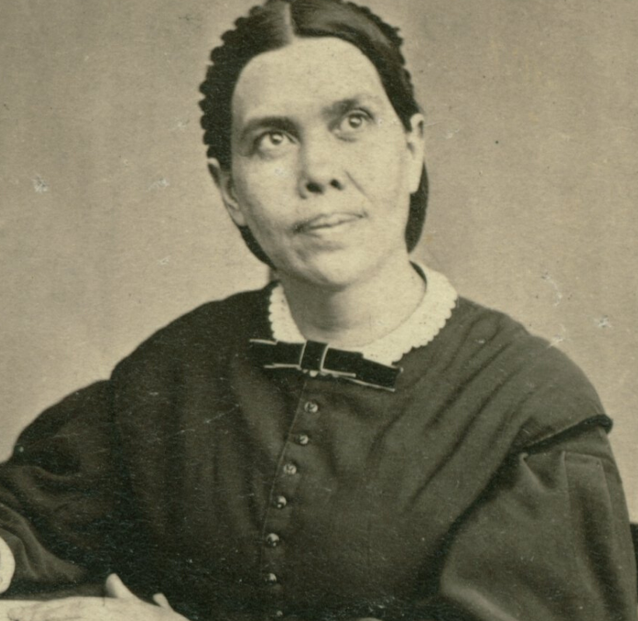
What does the Prophet say on this?

Slide 14
The Sign
Quote - Counsels for the Church Ch. 47 - The Observance of God’s Holy Sabbath pg.261.2
When the Lord delivered His people Israel from Egypt and committed to them His law, He taught them that by the observance of the Sabbath they were to be distinguished from idolaters. It was this that made the distinction between those who acknowledge the sovereignty of God and those who refuse to accept Him as their Creator and King. “It is a sign between Me and the children of Israel forever,” the Lord said. “Wherefore the children of Israel shall keep the Sabbath, to observe the Sabbath throughout their generations, for a perpetual covenant.” Exodus 31:17, 16.

Slide 15
The Sign
Quote - Counsels for the Church Ch. 47 - The Observance of God’s Holy Sabbath pg.261.3
As the Sabbath was the sign that distinguished Israel when they came out of Egypt to enter the earthly Canaan, so it is the sign that now distinguishes God's people as they come out from the world to enter the heavenly rest. The Sabbath is a sign of the relationship existing between God and His people, a sign that they honor His law. It distinguishes between His loyal subjects and transgressors.

Slide 16
The Sign
Quote - Counsels for the Church Ch. 47 - The Observance of God’s Holy Sabbath pg.261.3
From the pillar of cloud Christ declared concerning the Sabbath: “Verily My Sabbaths ye shall keep: for it is a sign between Me and you throughout your generations; that ye may know that I am the Lord that doth sanctify you.” Exodus 31:13. The Sabbath given to the world as the sign of God as the Creator is also the sign of Him as the Sanctifier. The power that created all things is the power that re-creates the soul in His own likeness.

Slide 17
The Sign
Quote - Counsels for the Church Ch. 47 - The Observance of God’s Holy Sabbath pg.261.3
To those who keep holy the Sabbath day it is the sign of sanctification. True sanctification is harmony with God, oneness with Him in character. It is received through obedience to those principles that are the transcript of His character. And the Sabbath is the sign of obedience. He who from the heart obeys the fourth commandment will obey the whole law. He is sanctified through obedience.

Slide 18
The Seal
Quote - Letter 45, 1900
Seventh-day Sabbath to Be Emphasized.—There are many places where the means should have been appropriated to make aggressive warfare in cities and towns in connection with tent efforts, and raise up churches which should be as memorials of truth and righteousness. Every stroke should tell for God and His holy Sabbath. That is to stand out in all our work distinctly and pronounced, to be a witness that the seventh day is the sign, the seal of God.

Slide 19
The Seal
Quote - Great Controversy Ch. 40 - God’s People Delivered pg.640.1
The enemies of God's law, from the ministers down to the least among them, have a new conception of truth and duty. Too late they see that the Sabbath of the fourth commandment is the seal of the living God. Too late they see the true nature of their spurious sabbath and the sandy foundation upon which they have been building.

Slide 20
The Seal
Quote - Great Controversy Ch. 40 - God’s People Delivered pg.640.1
They find that they have been fighting against God. Religious teachers have led souls to perdition while professing to guide them to the gates of Paradise. Not until the day of final accounts will it be known how great is the responsibility of men in holy office and how terrible are the results of their unfaithfulness. Only in eternity can we rightly estimate the loss of a single soul. Fearful will be the doom of him to whom God shall say: Depart, thou wicked servant.

Slide 21
The Seal
So we see that from the Spirit of prophecy the Sabbath is viewed both as a Sign and as a Seal. So what are we to make of this. How do we get a better understanding of this. Well the Spirit of Prophecy does not stop there, much more has been said.

Slide 22

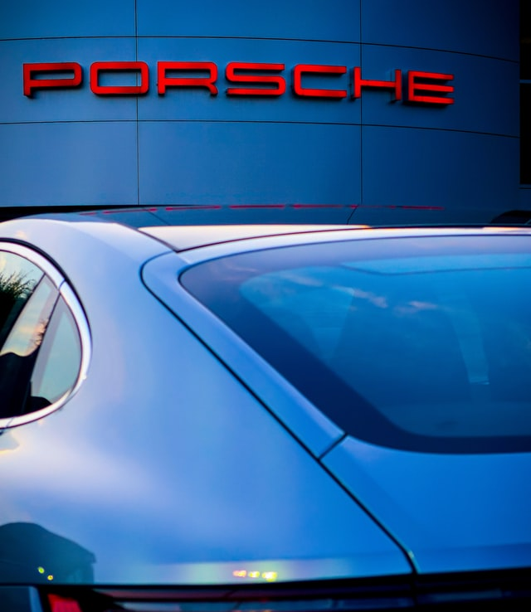
Sign or Mark

Slide 23
The Sign or Mark
Quote - Counsels on Health - Closing on the Sabbath pg.489.1
The question has been asked, “Should our restaurants be opened on the Sabbath?” My answer is, No, no! The observance of the Sabbath is our witness to God—the mark, or sign, between Him and us that we are His people. Never is this mark to be obliterated.

Slide 24
The Sign or Mark
Quote - Great Controversy 1888 - pg.691.1
In Ezekiel 9:4 the word used in the original is translated mark Gesenius says, “a mark, sign.” The Septuagint gives the same word in this text that is given in the Greek of Romans 4:11, rendered “sign.” Thus the words sign, mark, and seal are applied to the same things, or used as of like signification, in the scriptures.

Slide 25
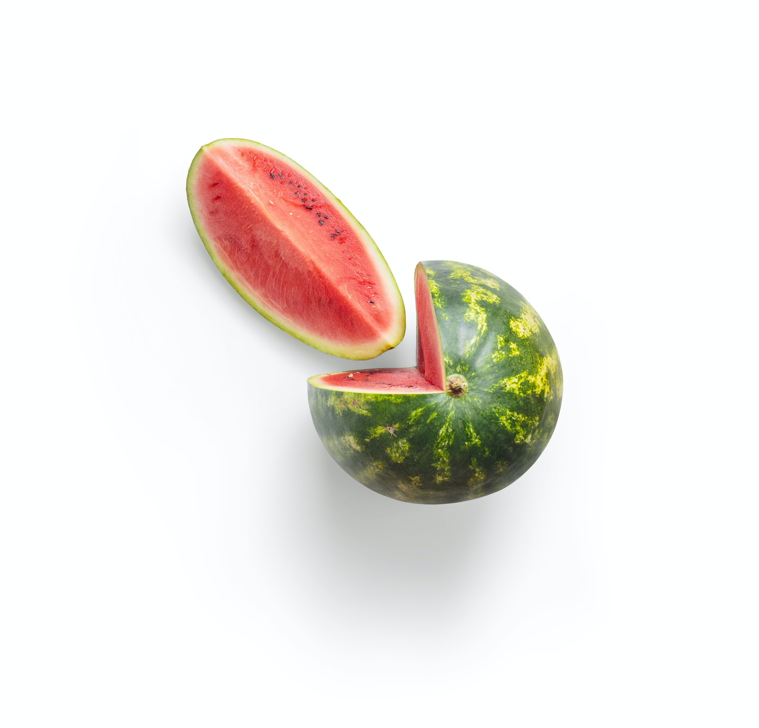
The _____ contains the ____ of God..

Slide 26
Contains the Seal of God
Quote - Eternity Past pg.212.4
The Sabbath is not introduced as a new institution but as having been founded at creation. Pointing to God as the Maker of the heavens and the earth, it distinguishes the true God from false gods. Thus the Sabbath is the sign of man's allegiance to God. The fourth commandment is the only one of the ten in which are found both the name and the title of the Lawgiver, the only one that shows by whose authority the law is given. Thus it contains the seal of God.

Slide 27
Contains the Seal of God
Quote – Last Day Events pg.220.4
The fourth commandment alone of all the ten contains the seal of the great Lawgiver, the Creator of the heavens and the earth.

Slide 28
Contains the Seal of God
Quote - Great Controversy Ch.26 A work of reform pg.452.1
The Lord commands by the same prophet: “Bind up the testimony, seal the law among My disciples.” Isaiah 8:16. The seal of God's law is found in the fourth commandment. This only, of all the ten, brings to view both the name and the title of the Lawgiver. It declares Him to be the Creator of the heavens and the earth, and thus shows His claim to reverence and worship above all others.

Slide 29
Contains the Seal of God
Quote - Great Controversy Ch.26 A work of reform pg.452.1
Aside from this precept, there is nothing in the Decalogue to show by whose authority the law is given. When the Sabbath was changed by the papal power, the seal was taken from the law. The disciples of Jesus are called upon to restore it by exalting the Sabbath of the fourth commandment to its rightful position as the Creator's memorial and the sign of His authority.

Slide 30
Professed Sabbath Keeping
Quote - Christian Experience and Training Ch.32 Preparing for the Judgement pg.189.1
Not all who profess to keep the Sabbath will be sealed. There are many even among those who teach the truth to others who will not receive the seal of God in their foreheads. They had the light of truth, they knew their Master's will, they understood every point of our faith, but they had not corresponding works.

Slide 31
Professed Sabbath Keeping
Quote - Christian Experience and Training Ch.32 Preparing for the Judgement pg.189.1
These who were so familiar with prophecy and the treasures of divine wisdom, should have acted their faith. They should have commanded their households after them, that by a well-ordered family they might present to the world the influence of the truth upon the human heart.

Slide 32
Professed Sabbath Keeping
Quote - Counsels for the Church - Attending School on Sabbath pg.269.1
If parents allow their children to receive an education with the world, and make the Sabbath a common day, then the seal of God cannot be placed upon them. They will be destroyed with the world; and will not their blood rest upon the parents?

Slide 33
Professed Sabbath Keeping
Quote - Counsels for the Church - Attending School on Sabbath pg.269.1
But if we faithfully teach our children God's commandments, bring them into subjection to parental authority, and then by faith and prayer commit them to God, he will work with our efforts; for he has promised it. And when the overflowing scourge shall pass through the land, they with us may be hidden in the secret of the Lord's pavilion.

Slide 34
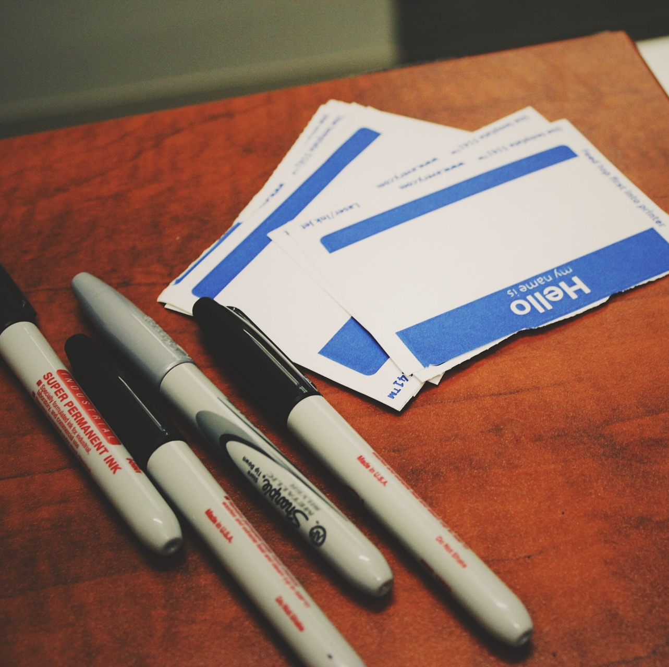
The Name of God

Slide 35
The Name of God
Exodus 6:3
And I appeared unto Abraham, unto Isaac, and unto Jacob, by the name of God Almighty, but by my name Jehovah was I not known to them.
Exodus 20:7
Thou shalt not take the name of the Lord thy God in vain; for the Lord will not hold him guiltless that taketh his name in vain.
Exodus 23:13
And in all things that I have said unto you be circumspect: and make no mention of the name of other gods, neither let it be heard out of thy mouth.

Slide 36
The Name of God
Exodus 23: 20-22
Behold, I send an Angel before thee, to keep thee in the way, and to bring thee into the place which I have prepared.
21 Beware of him, and obey his voice, provoke him not; for he will not pardon your transgressions: for my name is in him.
22 But if thou shalt indeed obey his voice, and do all that I speak; then I will be an enemy unto thine enemies, and an adversary unto thine adversaries.

Slide 37
The Name of God
Deuteronomy 12:3-5
3 And ye shall overthrow their altars, and break their pillars, and burn their groves with fire; and ye shall hew down the graven images of their gods, and destroy the names of them out of that place.
4 Ye shall not do so unto the Lord your God.
5 But unto the place which the Lord your God shall choose out of all your tribes to put his name there, even unto his habitation shall ye seek, and thither thou shalt come:

Slide 38
The Name of God
Deuteronomy 18:20
But the prophet, which shall presume to speak a word in my name, which I have not commanded him to speak, or that shall speak in the name of other gods, even that prophet shall die.

Slide 39
Jeremiah 28:10-17
Then Hananiah the prophet took the yoke from off the prophet Jeremiah's neck, and brake it.
¹¹ And Hananiah spake in the presence of all the people, saying, Thus saith the Lord; Even so will I break the yoke of Nebuchadnezzar king of Babylon from the neck of all nations within the space of two full years. And the prophet Jeremiah went his way.
¹² Then the word of the Lord came unto Jeremiah the prophet, after that Hananiah the prophet had broken the yoke from off the neck of the prophet Jeremiah, saying,

Slide 40
Jeremiah 28:10-17
¹³ Go and tell Hananiah, saying, Thus saith the Lord; Thou hast broken the yokes of wood; but thou shalt make for them yokes of iron.
¹⁴ For thus saith the Lord of hosts, the God of Israel; I have put a yoke of iron upon the neck of all these nations, that they may serve Nebuchadnezzar king of Babylon; and they shall serve him: and I have given him the beasts of the field also.
¹⁵ Then said the prophet Jeremiah unto Hananiah the prophet, Hear now, Hananiah; The Lord hath not sent thee; but thou makest this people to trust in a lie.

Slide 41
Jeremiah 28:10-17
¹⁶ Therefore thus saith the Lord; Behold, I will cast thee from off the face of the earth: this year thou shalt die, because thou hast taught rebellion against the Lord.
¹⁷ So Hananiah the prophet died the same year in the seventh month.

Slide 42
The Name of God
1 Kings 18:24
And call ye on the name of your gods, and I will call on the name of the Lord: and the God that answereth by fire, let him be God. And all the people answered and said, It is well spoken.
Psalm 20:7
Some trust in chariots, and some in horses: but we will remember the name of the Lord our God.
Ezekiel 20: 1-22

Slide 43
The Name of God
Ezekiel 39:7
So will I make my holy name known in the midst of my people Israel; and I will not let them pollute my holy name any more: and the heathen shall know that I am the Lord, the Holy One in Israel.

Slide 44
The Name of God
Isaiah 12:6
Cry out and shout, thou inhabitant of Zion: for great is the Holy One of Israel in the midst of thee.
Revelation 16:9
And men were scorched with great heat, and blasphemed the name of God, which hath power over these plagues: and they repented not to give him glory.

Slide 45

Who do we belong to..

Slide 46
Who are we?
1 Corinthians 6:19
What? know ye not that your body is the temple of the Holy Ghost which is in you, which ye have of God, and ye are not your own?

Slide 47
Who are we?
The Name of God is significant. Where God’s Name dwells, he defends. Where God’s Name is his law will be established, that is why the Sabbath is the Seal of the law. Where God Name dwells his character will be seen. Where God Name dwells, His presence will be seen.

Slide 48
What will we do Now?
Revelation 14:6,7
And I saw another angel fly in the midst of heaven, having the everlasting gospel to preach unto them that dwell on the earth, and to every nation, and kindred, and tongue, and people,
⁷ Saying with a loud voice, Fear God, and give glory to him; for the hour of his judgment is come: and worship him that made heaven, and earth, and the sea, and the fountains of waters.

Slide 49
What will we do Now?
Living to receive the seal of God is our Priority..

Slide 50
What will we do Now?
The time for God’s people is now…

Slide 51
The Sign and The Seal

