Slide 1
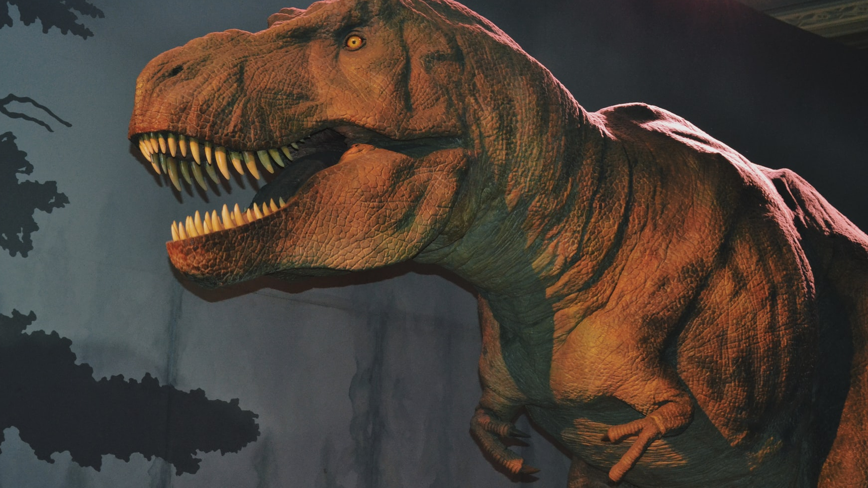
The Mark of The Beast
Revelation 13:17

Slide 2

Revelation 13:17
And that no man might buy or sell, save he that had the mark, or the name of the beast, or the number of his name.

Slide 3
To know what the mark of the beast is, we must first identify who or what is the beast, is it a literal beast or is it symbolic.
I want to start our study from Revelation 12.

Slide 4
Revelation 12: 1
And there appeared a great wonder in heaven; a woman clothed with the sun, and the moon under her feet, and upon her head a crown of twelve stars:

Slide 5
We have a couple of symbols in this first verse so in order to understand what is happening we must first interpret the symbols.
A woman in Bible Prophecy represents people or Church. A pure woman a pure people or Church, a corrupt woman a corrupt people or false Church.

Slide 6

Pure Woman

Slide 7
Pure Woman
Jeremiah 6:2
I have likened the daughter of Zion to a comely and delicate woman.
2 Corinthians 11:2
For I am jealous over you with godly jealousy: for I have espoused you to one husband, that I may present you as a chaste virgin to Christ.
Ephesian 5:23-27
For the husband is the head of the wife, even as Christ is the head of the church: and he is the saviour of the body.

Slide 8
Pure Woman
24 Therefore as the church is subject unto Christ, so let the wives be to their own husbands in everything.
25 Husbands, love your wives, even as Christ also loved the church, and gave himself for it;
26 That he might sanctify and cleanse it with the washing of water by the word,
27 That he might present it to himself a glorious church, not having spot, or wrinkle, or any such thing; but that it should be holy and without blemish.

Slide 9
Pure Woman
Revelation 19:7,8
Let us be glad and rejoice, and give honour to him: for the marriage of the Lamb is come, and his wife hath made herself ready.
8 And to her was granted that she should be arrayed in fine linen, clean and white: for the fine linen is the righteousness of saints.

Slide 10
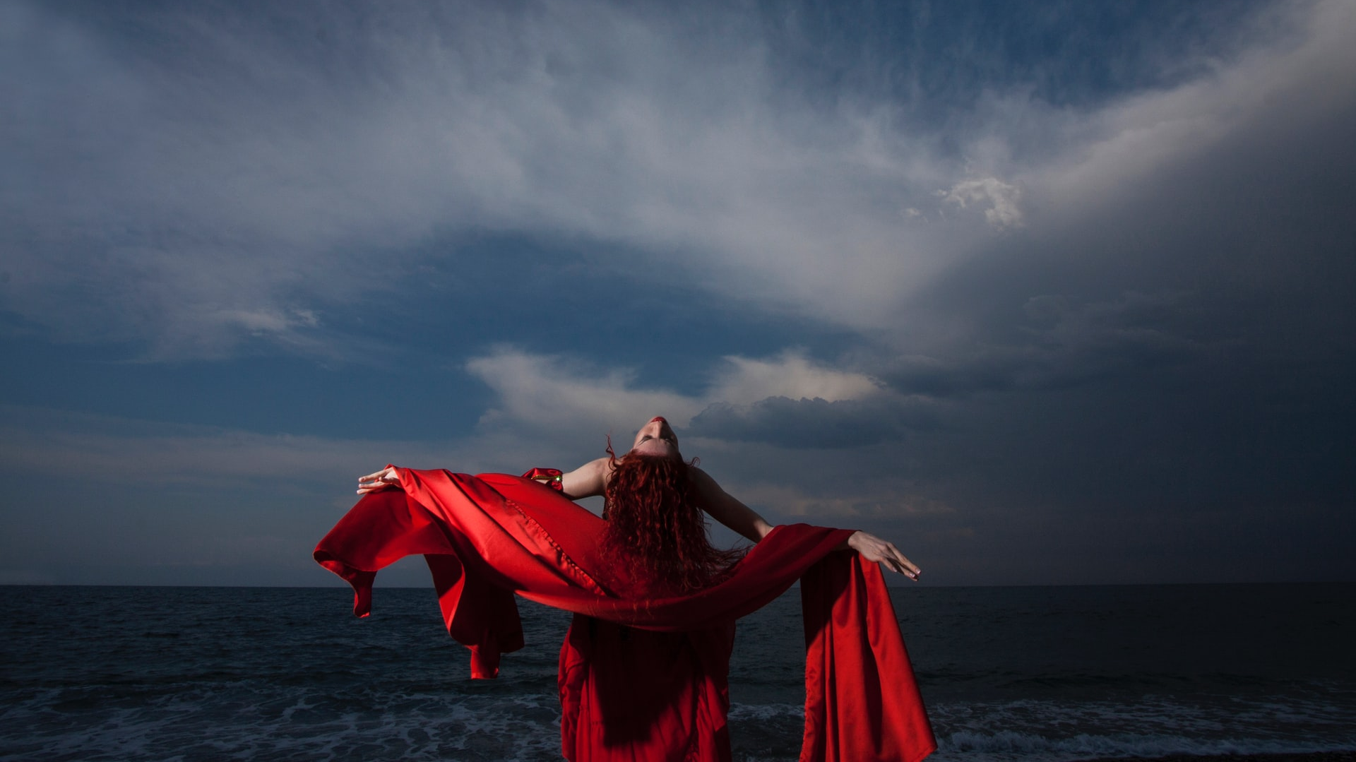
Corrupt Woman

Slide 11
Corrupt Woman
Ezekiel 16:15-58
But thou didst trust in thine own beauty, and playedst the harlot because of thy renown, and pouredst out thy fornications on every one that passed by; his it was.
16 And of thy garments thou didst take, and deckedst thy high places with divers colours, and playedst the harlot thereupon: the like things shall not come, neither shall it be so.
17 Thou hast also taken thy fair jewels of my gold and of my silver, which I had given thee, and madest to thyself images of men, and didst commit whoredom with them,

Slide 12
Corrupt Woman
Ezekiel 16:15-58
18 And tookest thy broidered garments, and coveredst them: and thou hast set mine oil and mine incense before them.
19 My meat also which I gave thee, fine flour, and oil, and honey, wherewith I fed thee, thou hast even set it before them for a sweet savour: and thus it was, saith the Lord God.

Slide 13
Corrupt Woman
Hosea 2:5, 3:1
5 For their mother hath played the harlot: she that conceived them hath done shamefully: for she said, I will go after my lovers, that give me my bread and my water, my wool and my flax, mine oil and my drink.
Then said the Lord unto me, Go yet, love a woman beloved of her friend, yet an adulteress, according to the love of the Lord toward the children of Israel, who look to other gods, and love flagons of wine.

Slide 14


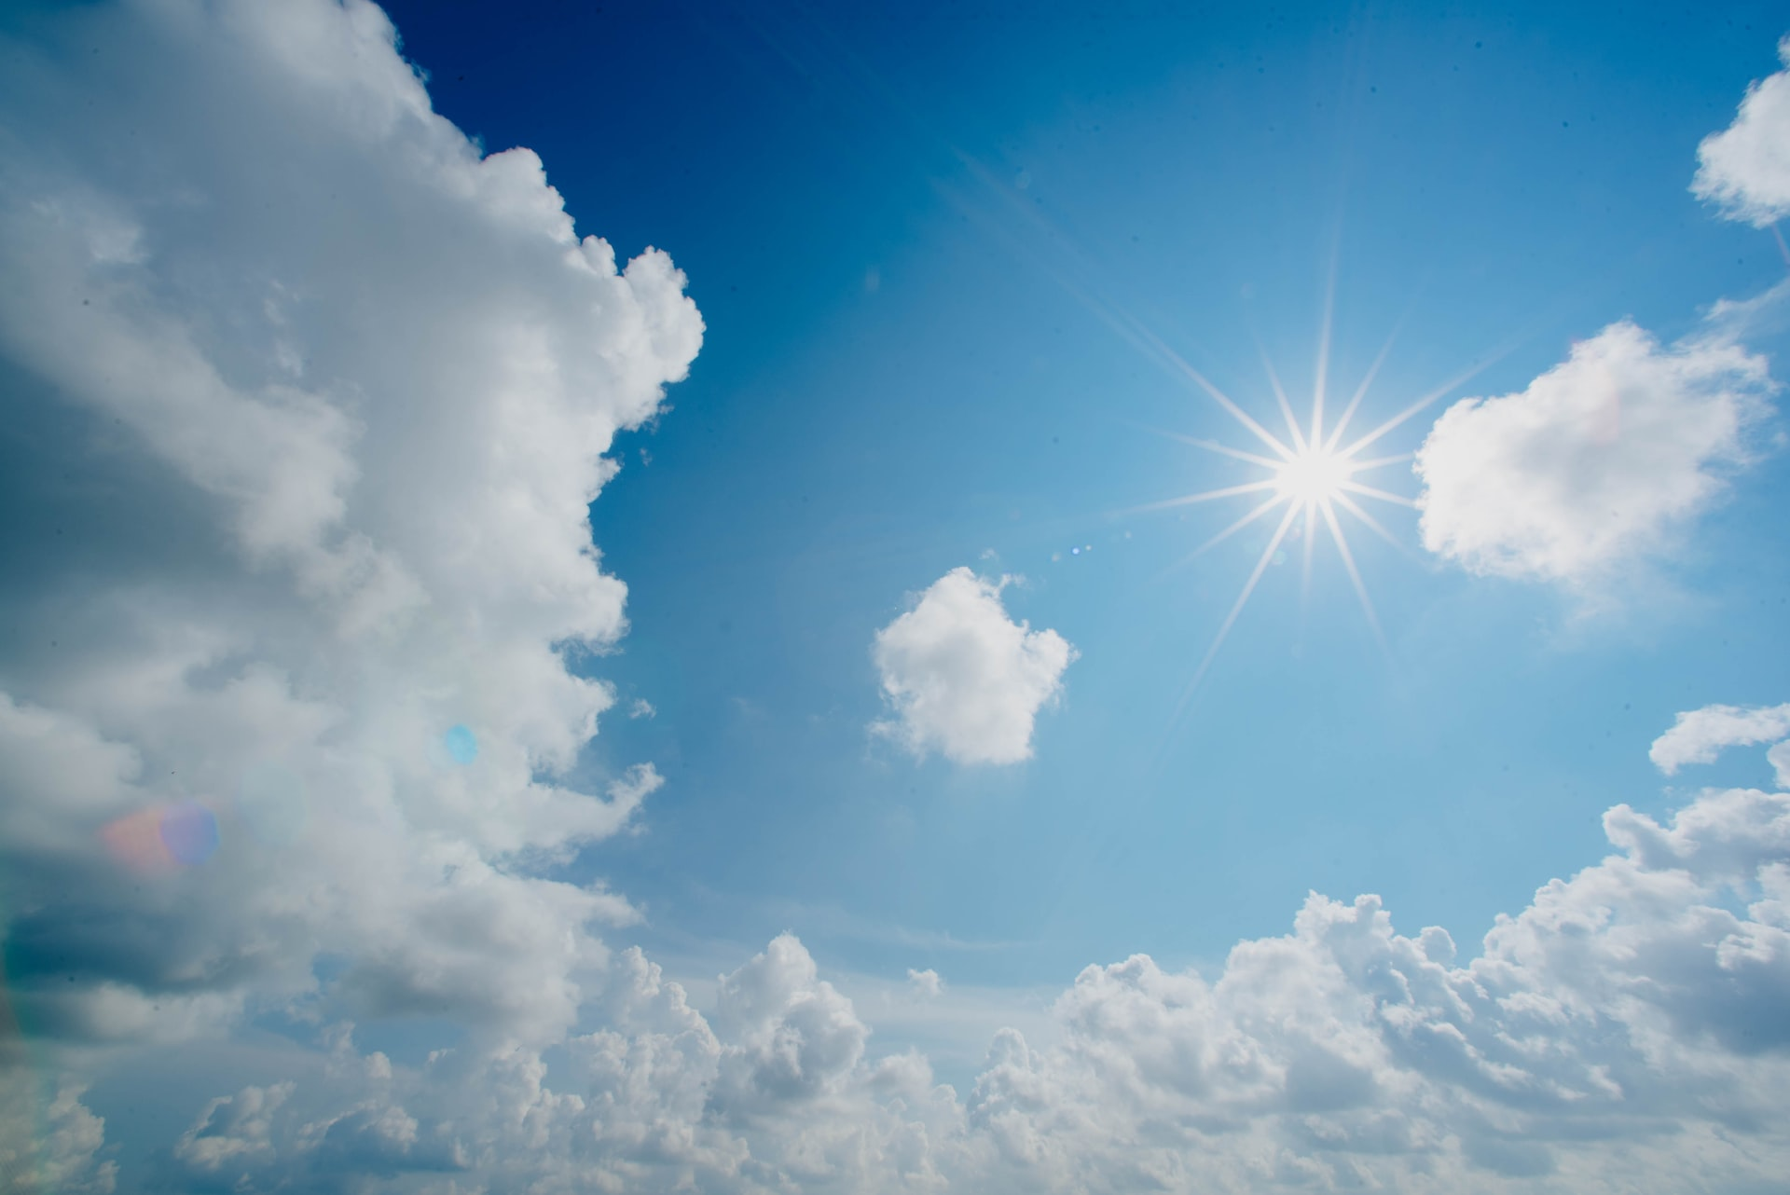
Sun and Moon

Slide 15
Sun and Moon
The Sun in Bible Prophecy represents the glory of God or Christ or the Gospel of Christ.
Psalm 84:11
For the Lord God is a sun and shield: the Lord will give grace and glory: no good thing will he withhold from them that walk uprightly.
Psalm 27:1
The Lord is my light and my salvation; whom shall I fear? the Lord is the strength of my life; of whom shall I be afraid?
Malachi 4:2
2 But unto you that fear my name shall the Sun of righteousness arise with healing in his wings; and ye shall go forth, and grow up as calves of the stall.

Slide 16
Sun and Moon
John 8:12
12 Then spake Jesus again unto them, saying, I am the light of the world: he that followeth me shall not walk in darkness, but shall have the light of life.
2 Corinthians 4:6
6 For God, who commanded the light to shine out of darkness, hath shined in our hearts, to give the light of the knowledge of the glory of God in the face of Jesus Christ.
2 Peter 1:19
19 We have also a more sure word of prophecy; whereunto ye do well that ye take heed, as unto a light that shineth in a dark place, until the day dawn, and the day star arise in your hearts:

Slide 17
Sun and Moon
Revelation 22:16
16 I Jesus have sent mine angel to testify unto you these things in the churches. I am the root and the offspring of David, and the bright and morning star.
This is what we call a prolepsis. John is presenting the future as if it is already happened. Christ is not born as yet but the Church is seen clothed in his glory, the light of the gospel, the glory of the Word. If the Sun represents Christ, the Word or the Gospel of Christ, then the moon will represent the Prophets of old.

Slide 18
Sun and Moon
Hebrew 1:1-3
God, who at sundry times and in divers manners spake in time past unto the fathers by the prophets,
2 Hath in these last days spoken unto us by his Son, whom he hath appointed heir of all things, by whom also he made the worlds;
3 Who being the brightness of his glory, and the express image of his person, and upholding all things by the word of his power, when he had by himself purged our sins, sat down on the right hand of the Majesty on high:

Slide 19
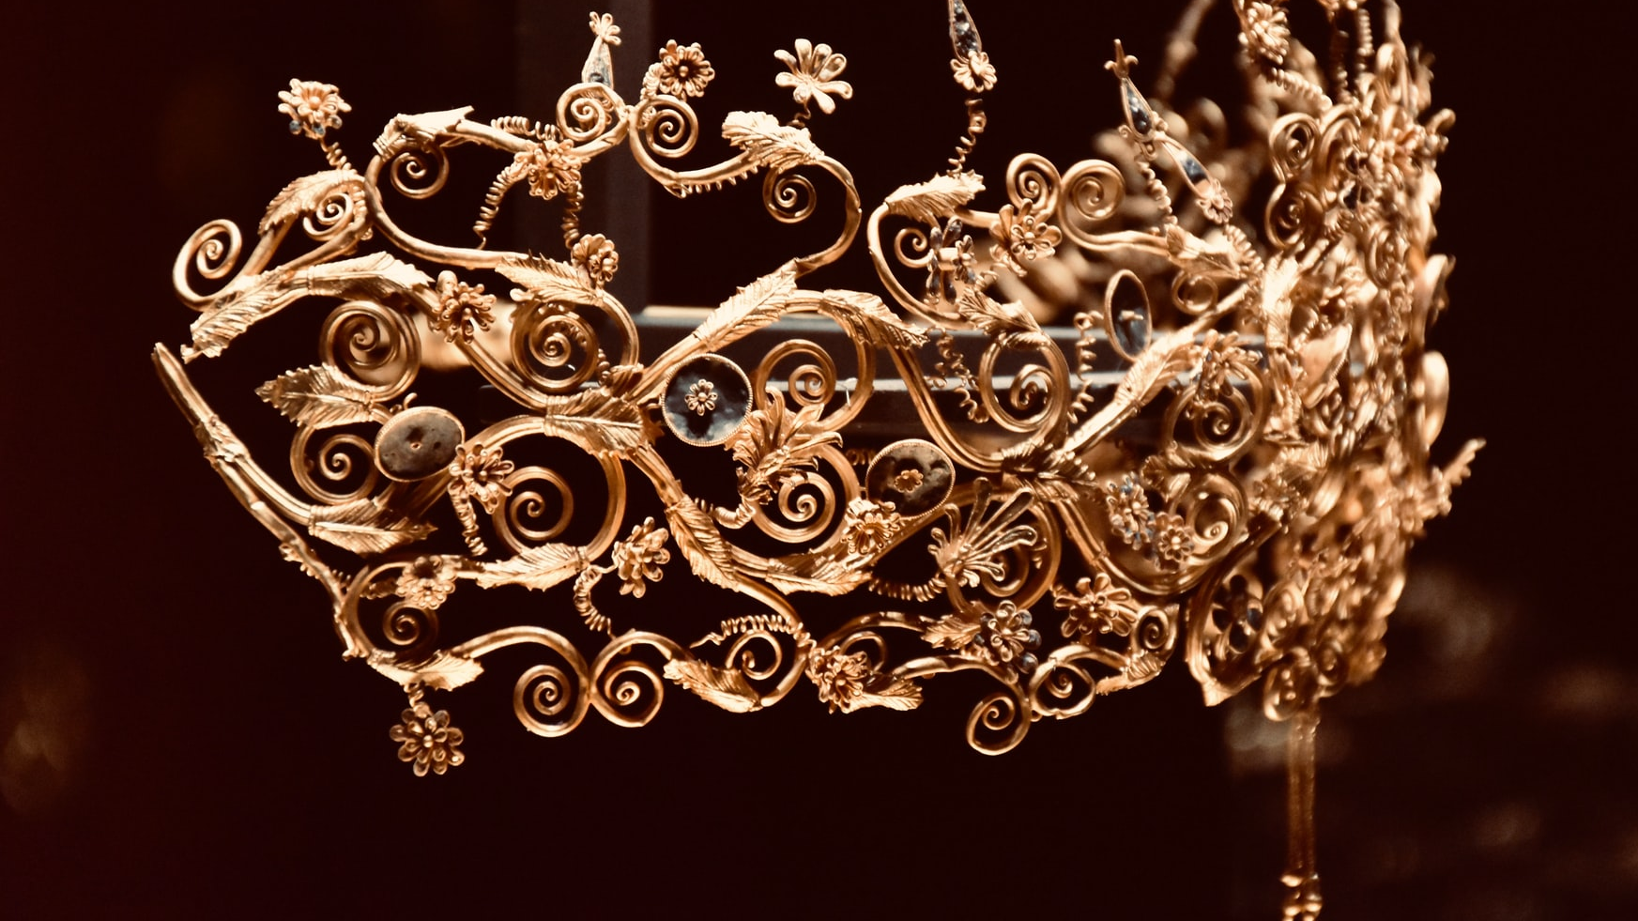
Crown
Royalty

Slide 20
Crown
Crown in Bible Prophecy represents royalty, righteousness, anointed, chosen, reward, grace
Leviticus 21:12
12 Neither shall he go out of the sanctuary, nor profane the sanctuary of his God; for the crown of the anointing oil of his God is upon him: I am the Lord.
Psalm 89:39
39 Thou hast made void the covenant of thy servant: thou hast profaned his crown by casting it to the ground.

Slide 21
Crown
Proverb 4:9
9 She shall give to thine head an ornament of grace: a crown of glory shall she deliver to thee.
2 Timothy 4:8
Henceforth there is laid up for me a crown of righteousness, which the Lord, the righteous judge, shall give me at that day: and not to me only, but unto all them also that love his appearing.

Slide 22
Crown
Revelation 3:11
11 Behold, I come quickly: hold that fast which thou hast, that no man take thy crown.

Slide 23
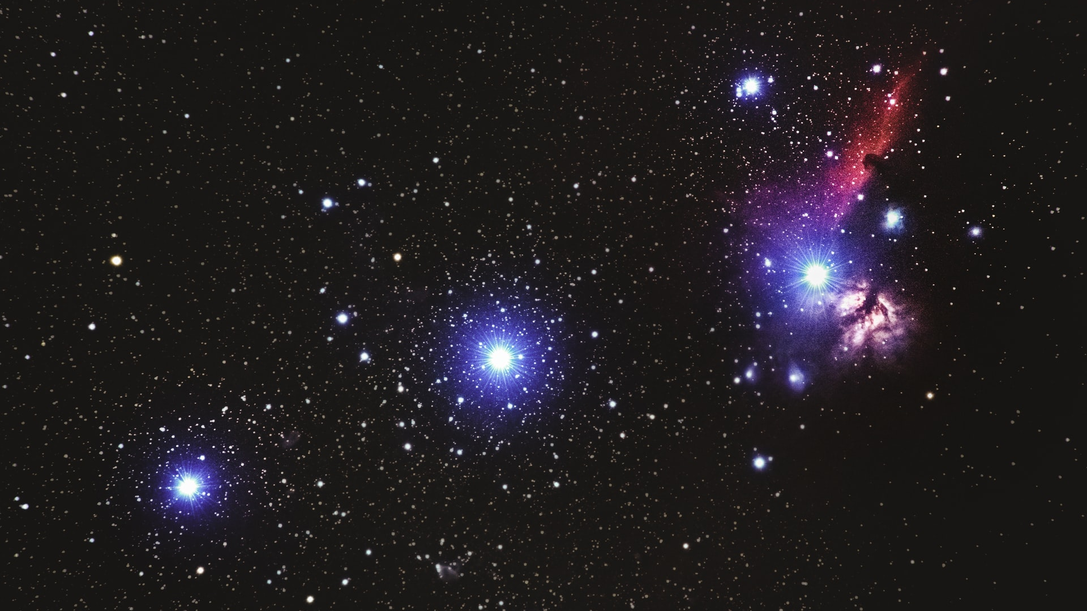
Stars
Stars represents Angels, messengers or prophets of God.

Slide 24
Stars
Job 38:7
7 When the morning stars sang together, and all the sons of God shouted for joy?
Daniel 12:3
3 And they that be wise shall shine as the brightness of the firmament; and they that turn many to righteousness as the stars for ever and ever.

Slide 25
Stars
Jude 1:13
11 Woe unto them! for they have gone in the way of Cain, and ran greedily after the error of Balaam for reward, and perished in the gainsaying of Core.
12 These are spots in your feasts of charity, when they feast with you, feeding themselves without fear: clouds they are without water, carried about of winds; trees whose fruit withereth, without fruit, twice dead, plucked up by the roots;
13 Raging waves of the sea, foaming out their own shame; wandering stars, to whom is reserved the blackness of darkness for ever.

Slide 26
Stars
Revelation 1:20
The mystery of the seven stars which thou sawest in my right hand, and the seven golden candlesticks. The seven stars are the angels of the seven churches: and the seven candlesticks which thou sawest are the seven churches.

Slide 27
Stars
There are 12 Stars. These twelve stars cannot refer to Israel as at this time the ten tribes are no more. The only group of twelve that we know about that are messengers (and not angels) would be the disciples. Yet again we have another prolepsis where Christ has not yet started his ministry but his disciples are featured here.

Slide 28
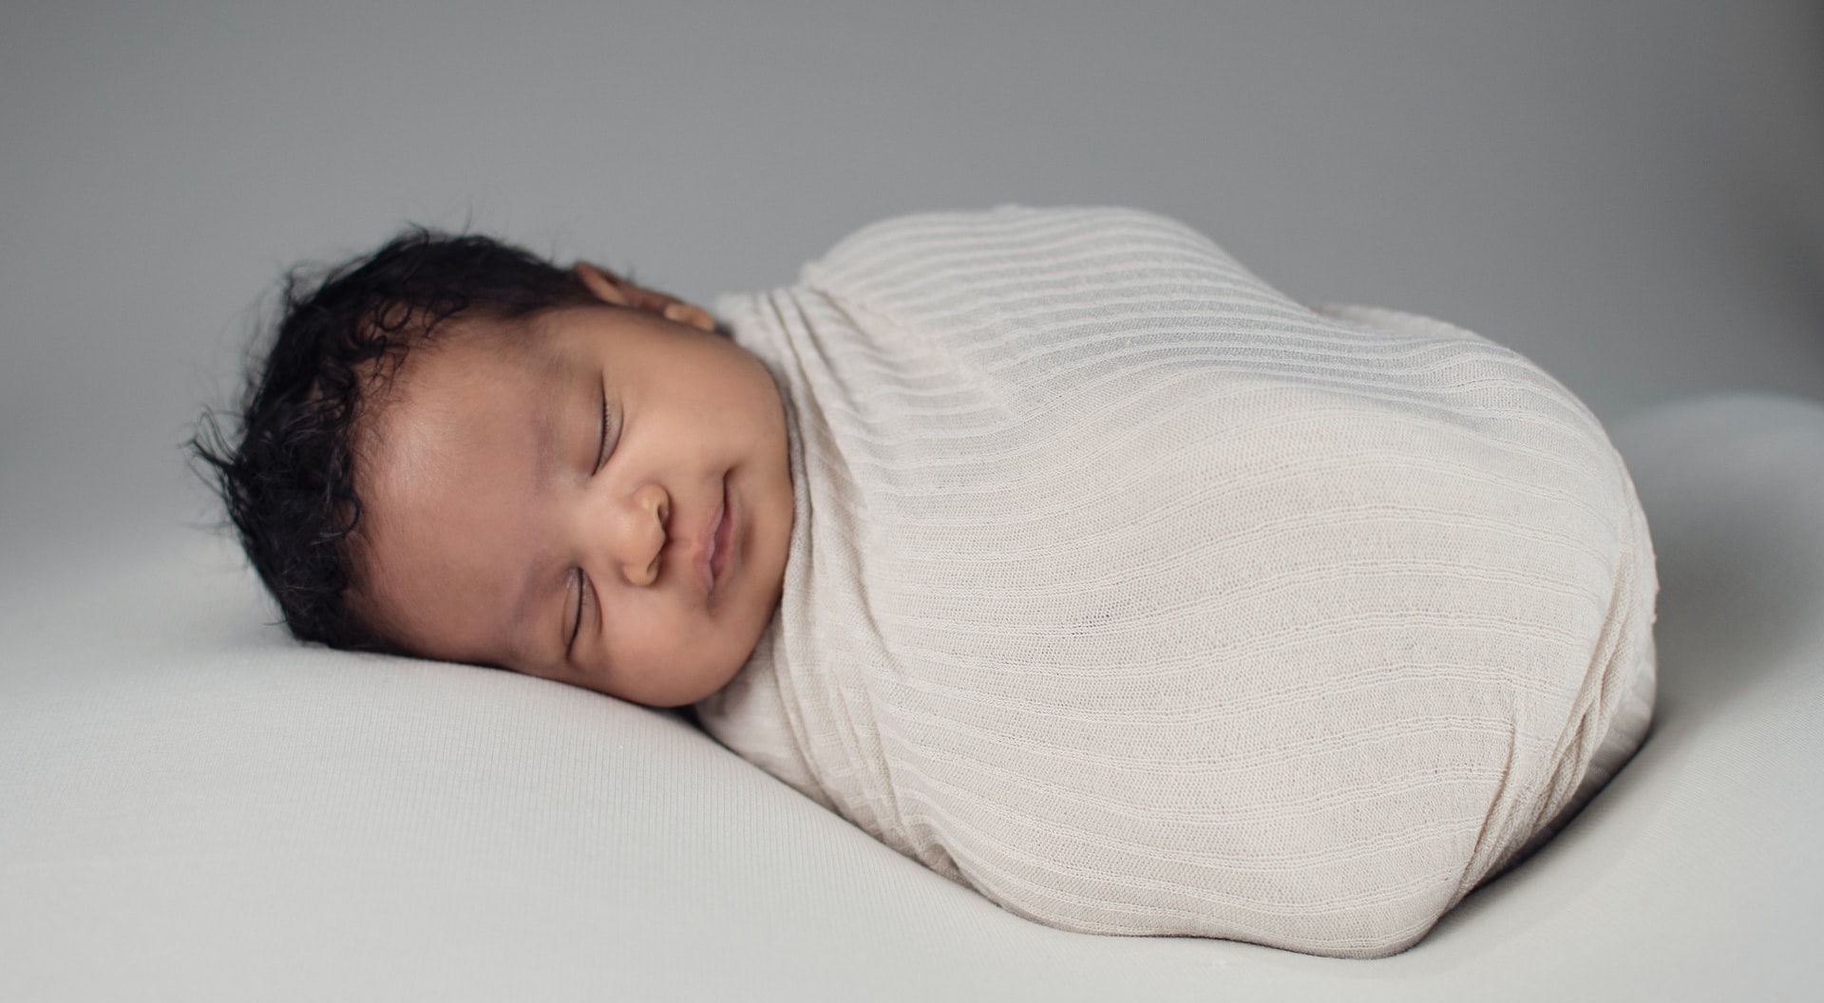
The Child

Slide 29
The Child
Revelation 12:5
5 And she brought forth a man child, who was to rule all nations with a rod of iron: and her child was caught up unto God, and to his throne.
John 3:13
13 And no man hath ascended up to heaven, but he that came down from heaven, even the Son of man which is in heaven.
Daniel 7:13,14
13 I saw in the night visions, and, behold, one like the Son of man came with the clouds of heaven, and came to the Ancient of days, and they brought him near before him.

Slide 30
The Child
14 And there was given him dominion, and glory, and a kingdom, that all people, nations, and languages, should serve him: his dominion is an everlasting dominion, which shall not pass away, and his kingdom that which shall not be destroyed.
We have the Child ruling with a rod of Iron. A rod in the Bible was often made of wood and used as a tool to guide or separate or correct, a symbol of strength or a weapon to defend the weak.
Exodus 4:2
2 And the Lord said unto him, What is that in thine hand? And he said, A rod.
20 And Moses took his wife and his sons, and set them upon an ass, and he returned to the land of Egypt: and Moses took the rod of God in his hand.

Slide 31
The Child
Numbers 17:3,8,10
3 And thou shalt write Aaron's name upon the rod of Levi: for one rod shall be for the head of the house of their fathers.
8 And it came to pass, that on the morrow Moses went into the tabernacle of witness; and, behold, the rod of Aaron for the house of Levi was budded, and brought forth buds, and bloomed blossoms, and yielded almonds.
10 And the Lord said unto Moses, Bring Aaron's rod again before the testimony, to be kept for a token against the rebels; and thou shalt quite take away their murmurings from me, that they die not.

Slide 32
The Child
Psalm 2:9-12
9 Thou shalt break them with a rod of iron; thou shalt dash them in pieces like a potter's vessel.
10 Be wise now therefore, O ye kings: be instructed, ye judges of the earth.
11 Serve the Lord with fear, and rejoice with trembling.
12 Kiss the Son, lest he be angry, and ye perish from the way, when his wrath is kindled but a little. Blessed are all they that put their trust in him.

Slide 33
The Child
Proverbs 26:3
3 A whip for the horse, a bridle for the ass, and a rod for the fool's back.
Psalm 23:4, Psalm 110:2

Slide 34

Rod

Slide 35
Rod
Rod no longer wood but of iron shows the surety and perpetual nature of Christ’s rulership or sovereignty. Many items have been referred to as being made of iron to show its permanence.
Jeremiah 28:10-14
10 Then Hananiah the prophet took the yoke from off the prophet Jeremiah's neck, and brake it.

Slide 36
Rod
11 And Hananiah spake in the presence of all the people, saying, Thus saith the Lord;
Even so will I break the yoke of Nebuchadnezzar king of Babylon from the neck of all nations within the space of two full years. And the prophet Jeremiah went his way.
12 Then the word of the Lord came unto Jeremiah the prophet, after that Hananiah the prophet had broken the yoke from off the neck of the prophet Jeremiah, saying,
13 Go and tell Hananiah, saying, Thus saith the Lord; Thou hast broken the yokes of wood; but thou shalt make for them yokes of iron.

Slide 37
Rod
14 For thus saith the Lord of hosts, the God of Israel; I have put a yoke of iron upon the neck of all these nations, that they may serve Nebuchadnezzar king of Babylon; and they shall serve him: and I have given him the beasts of the field also.
Jeremiah 17:1
The sin of Judah is written with a pen of iron, and with the point of a diamond: it is graven upon the table of their heart, and upon the horns of your altars;

Slide 38
Travailing in Birth
The Birth of Christ was accompanied by much wailing and mourning as prophesied by Jeremiah.
Jeremiah 31: 15
15 Thus saith the Lord; A voice was heard in Ramah, lamentation, and bitter weeping; Rahel weeping for her children refused to be comforted for her children, because they were not.

Slide 39
Travailing in Birth
Matthew 2:16-18
16 Then Herod, when he saw that he was mocked of the wise men, was exceeding wroth, and sent forth, and slew all the children that were in Bethlehem, and in all the coasts thereof, from two years old and under, according to the time which he had diligently inquired of the wise men.
17 Then was fulfilled that which was spoken by Jeremiah the prophet, saying,
18 In Rama was there a voice heard, lamentation, and weeping, and great mourning, Rachel weeping for her children, and would not be comforted, because they are not.

Slide 40
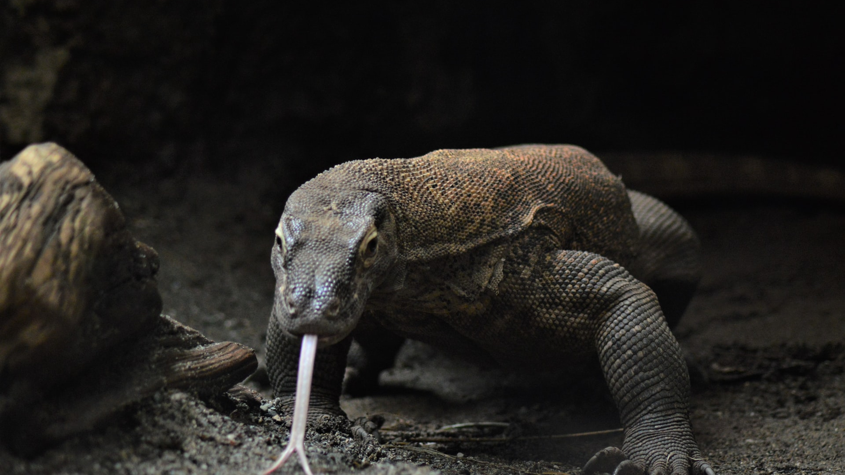
Dragon

Slide 41
Dragon
Revelation 12:9
9 And the great dragon was cast out, that old serpent, called the Devil, and Satan, which deceiveth the whole world: he was cast out into the earth, and his angels were cast out with him.

Slide 42
Dragon
The Bible Identifies the Dragon as satan however, this beast has heads, horns and crowns which imply that it also represents an earthly kingdom. We need to identify who was the earthly kingdom that tried to destroy the Child as he was born.

Slide 43
Dragon
Now horns in Bible Prophecy represent kings, kingdoms, power.
Deuteronomy 33:17
17 His glory is like the firstling of his bullock, and his horns are like the horns of unicorns: with them he shall push the people together to the ends of the earth: and they are the ten thousands of Ephraim, and they are the thousands of Manasseh.
Psalm 75:10
10 All the horns of the wicked also will I cut off; but the horns of the righteous shall be exalted.
Daniel 8:20
20 The ram which thou sawest having two horns are the kings of Media and Persia.

Slide 44
Dragon
4 That in the day that I shall visit the transgressions of Israel upon him I will also visit the altars of Bethel: and the horns of the altar shall be cut off, and fall to the ground.
Habakkuk 3:4
4 And his brightness was as the light; he had horns coming out of his hand: and there was the hiding of his power.

Slide 45
Dragon
We have seven heads with crowns, crowns signify a monarchy. We now must turn to history. History tells us that Pagan Rome was the Kingdom that ruled at the birth of Christ, could this seven head dragon be Pagan Rome? Lets look at the details.

Slide 46
Dragon
Early Pagan Rome was ruled by Kings. Can you guess how many Kings Pagan Rome had?
Seven

Slide 47

Kings of Rome
1.Romulus
2. Numa Pompilius
3. Tullus Hostilius
4. Ancus Marcus
5. Lucius Tarquinius Priscus
6. Servius Tullius
7. Lucius Tarquinius Superbus

Slide 48
Three Horns without a crown
The Consuls – Two Generals that had command of the two arms of Pagan Rome’s Military
The Dictator Julius Caesar who brought an end to the consuls and began to rule.
Octavian who’s name was changed to Augustus became the first Emperor of the new Roman Empire

Slide 49
Luke 2:1-6
And it came to pass in those days, that there went out a decree from Caesar Augustus that all the world should be taxed.
2 (And this taxing was first made when Cyrenius was governor of Syria.)
3 And all went to be taxed, every one into his own city.

Slide 50
Luke 2:1-6
4 And Joseph also went up from Galilee, out of the city of Nazareth, into Judaea, unto the city of David, which is called Bethlehem; (because he was of the house and lineage of David:)
5 To be taxed with Mary his espoused wife, being great with child.
6 And so it was, that, while they were there, the days were accomplished that she should be delivered.

Slide 51
Emperor Octavian changed his name to Caesar Augustus. The First Emperor of the Roman Empire and the tenth horn without a crown.
After his death in 14 A.D. he was succeeded by Tiberius Julius Caesar Augustus. The ten horns does not mean Pagan Rome had only ten rulers but the ten horns mark the birth of Christ.
Thus we can rightly Identify this red dragon as Pagan Rome.

Slide 52
The Tail of the Dragon
In Bible Prophecy a tail represents a false prophet
Isaiah 9:15
15 The ancient and honourable, he is the head; and the prophet that teacheth lies, he is the tail.
Revelation 9:19
19 For their power is in their mouth, and in their tails: for their tails were like unto serpents, and had heads, and with them they do hurt.

Slide 53
Pontifex Maximus – “greater Priest”
The Emperor of Rome carried the title of Pontifex Maximus, which means the greatest priest. Obviously not a true priest but a false priest as he led pagan worship. So this false priest cast down a third of the stars of heaven to the ground.
Since stars we have seen so far represent the people of God or his messengers, who did this false priest cast down to the ground.

Slide 54
Pontifex Maximus – “greater Priest”
The Jews had three levels of leadership, the King, the priest and the Sanhedrin.
So a third part of the rulership was removed. The King.

Slide 55
This dragon sought to devour the Child.
Matthew 2:13-15
13 And when they were departed, behold, the angel of the Lord appeareth to Joseph in a dream, saying, Arise, and take the young child and his mother, and flee into Egypt, and be thou there until I bring thee word: for Herod will seek the young child to destroy him.
14 When he arose, he took the young child and his mother by night, and departed into Egypt:
15 And was there until the death of Herod: that it might be fulfilled which was spoken of the Lord by the prophet, saying, Out of Egypt have I called my son.
Hosea - 11:1 - The prophecy spoken of in Matthew 2:15

