Slide 1
New products
Summer – Fall 2017

Slide 2
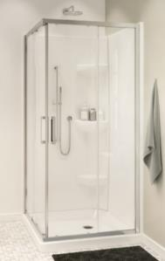
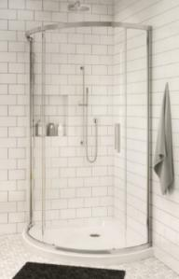
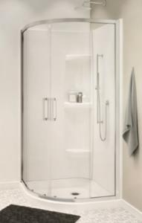
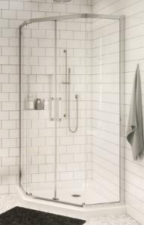
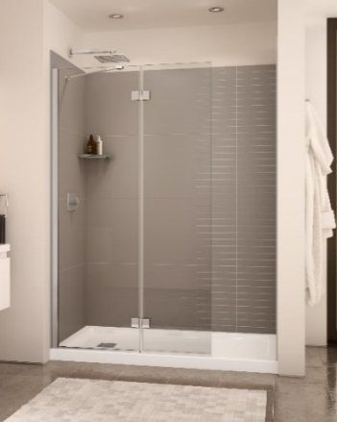
New products
Radia
Neo-Angle Round
Neo-Round Square
Edge
Tub shield
Shower shield
Duel
Brushed Nickel
Dark Bronze
Return panel 32, 36
Link Curve
Chrome
Brushed Nickel
Dark Bronze

Slide 3
Radia Corner Doors

Slide 4
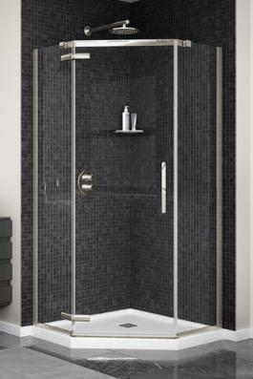
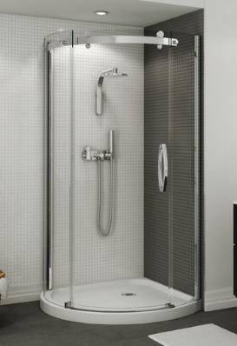
Corner doors: A complete offering
Silhouette
Silhouette Plus
Radia
Neo-Angle
Neo-Round
Round
Square
Link Curve
Neo-Angle
Halo
Round
$
$$$
New Construction
Renovation

Slide 5
Why a Radia?
Opportunity: Showroom
Fits on Freestyle and wall and base program
Opening price point in corner doors
Easy to install, make the renovation cost less
Easy to clean solution:
Lotus glass protection
Clip and Push to easily clean the bottom track
One display can sell 34 skus
Opportunity: New Construction
Affordable frameless doors for corner showers and bases
Simplified offer to choose from
Fits with Freestyle, Corner shower bases and walls and Aker’s SH-NA*
Hardware is pre-installed cutting the installation time and the complexity .

Slide 6
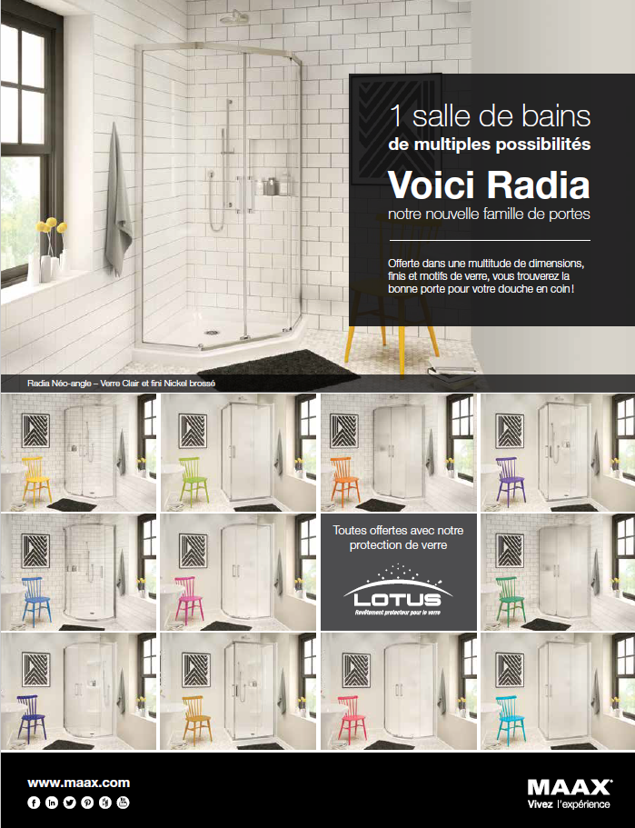
RADIA Corner doors - Improved
4 products = 1 family, all sliders
Updated look, minimalist header and bottom track
6mm glass with Lotus glass protection
Nice big handle and standard features across the family
Height = 71.5 maximum for our showers
2 aluminum finishes: Chrome + Brushed Nickel
2 glass finishes: Clear + Mistelite*
1 bathroom
Multiple possibilities
This is Radia
our new Corner Dorr Family
All offered with
* Round in clear glass only

Slide 7
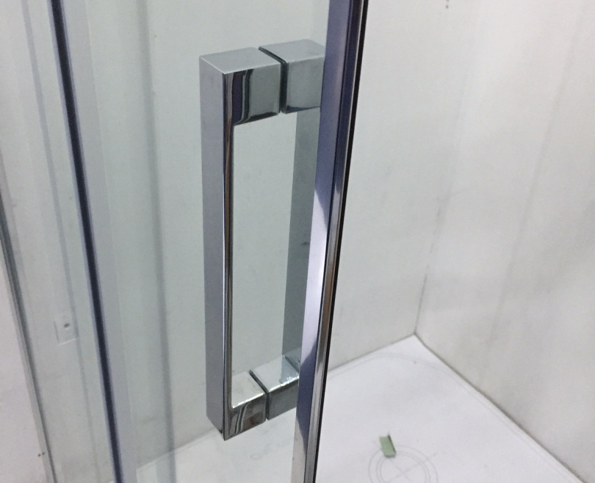
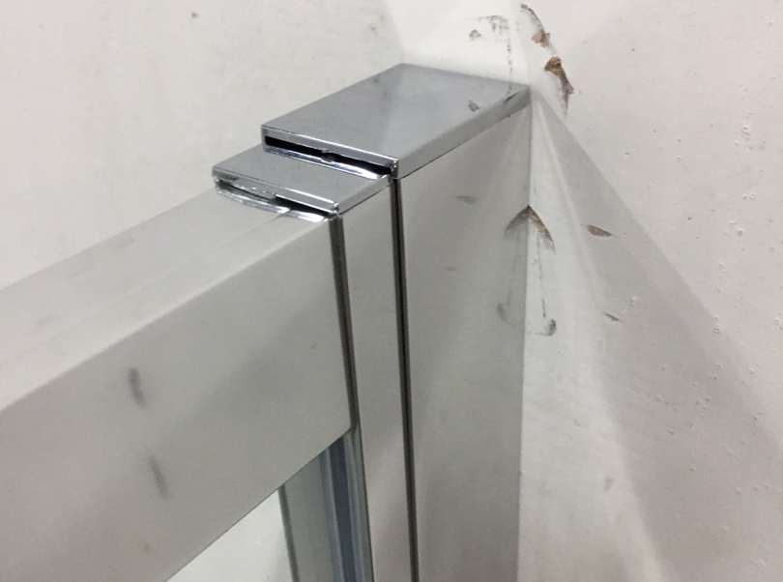
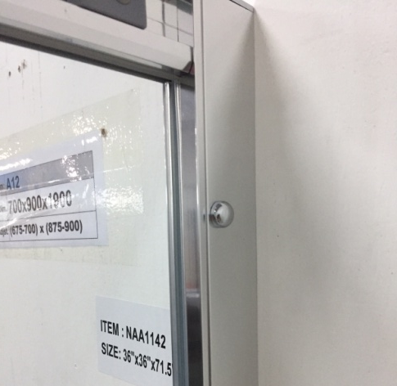
RADIA Features on corner doors
Modern « C » handle
Clip and Push
Adjustments
Hardware pre-installed
Chrome cap inside
Caps for top extrusion
Caps for screws

Slide 8
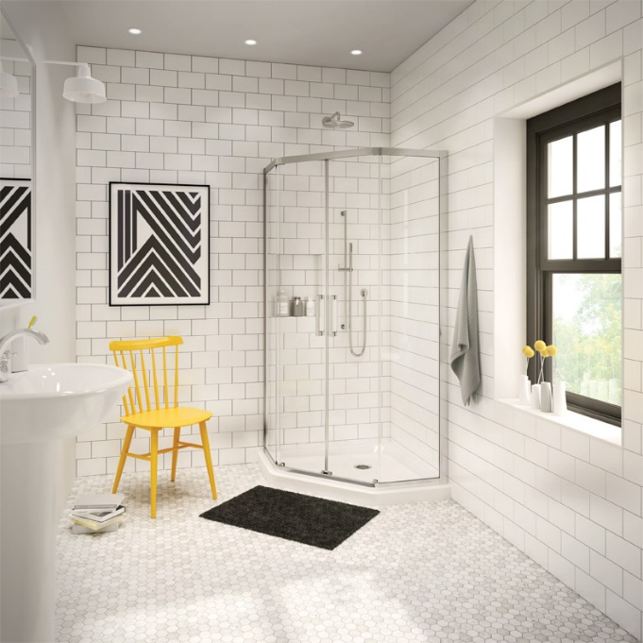
RADIA – Neo-Angle
Chrome - Clear
Chrome - Mistelite
Dimensions available
36 – 36 x 71.5
38 – 38 x 71.5
40 – 40 x 71.5
Fits on:
Brushed Nickel - Clear
Brushed Nickel - Mistelite
Marketing Price list ENGLISH | Sales code | Product dimension (in) | base fit |  | shower fit
RADIA Neo-Angle 36 | 137440 | 36 x 36 x 71.5 | 105042 | W&B NA 36x36 | 102994 | FREESTYLE NA 37''
RADIA Neo-Angle 38 | 137441 | 38 x 38 x 71.5 | 105043 | W&B NA 38x38 | 141038 | SH-NA
RADIA Neo-Angle 40 | 137442 | 40 x 40 x 71.5 | 105044 | W&B NA 40 | 102997 | FREESTYLE NA 40''

Slide 9
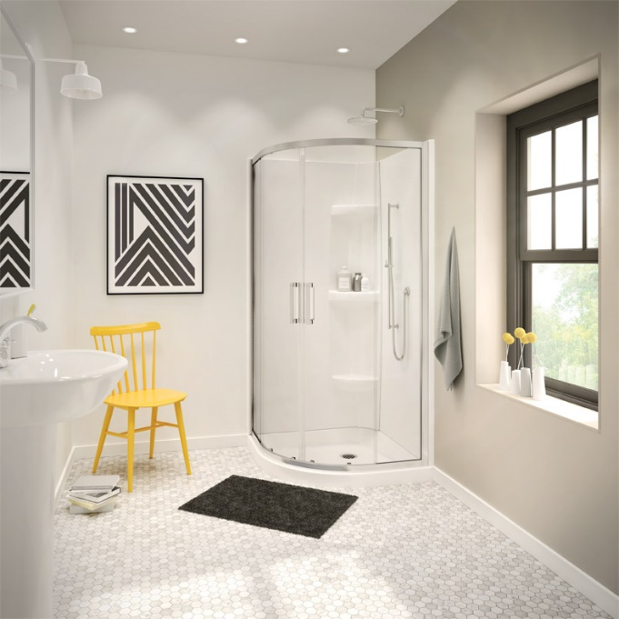
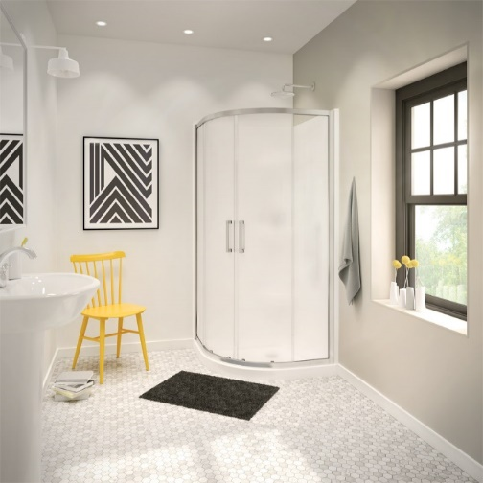
RADIA – Neo-Round
Chrome - Clear
Chrome - Mistelite
Dimensions available
32 – 32 x 71.5
36 – 36 x 71.5
40 – 40 x 71.5
Fits on:
Brushed Nickel - Clear
Brushed Nickel - Mistelite
Marketing Price list ENGLISH | Sales code | Product dimension (in) | base fit |  | shower fit
RADIA Neo-Round 32 | 137443 | 32 x 32 x 71.5 | 102798 | W&B NR 32
RADIA Neo-Round 36 | 137444 | 36 x 36 x 71.5 | 102799 | W&B NR 36'' | 102995 | FREESTYLE NR 37''
RADIA Neo-Round 40 | 137445 | 40 x 40 x 71.5 | 102800 | W&B NR 40 | 102998 | FREESTYLE NR 40''

Slide 10
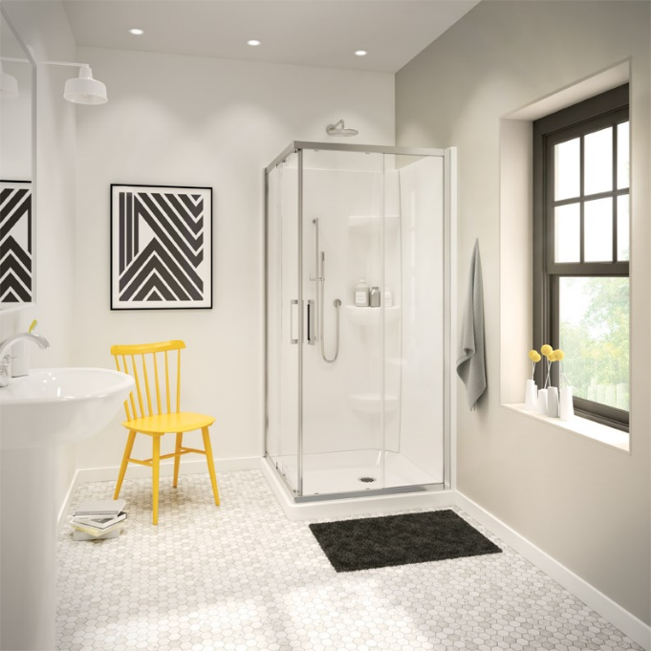
RADIA – Square
Chrome - Clear
Chrome - Mistelite
Dimensions available
32 – 32 x 71.5
36 – 36 x 71.5
Fits on:
Brushed Nickel - Clear
Brushed Nickel - Mistelite
Marketing Price list ENGLISH | Sales code | Product dimension (in) | base fit
RADIA Square 32 | 137447 | 32 x 32 x 71.5 | 105053 | W&B S 32
RADIA Square 36 | 137448 | 36 x 36 x 71.5 | 105054 | W&B S 36

Slide 11
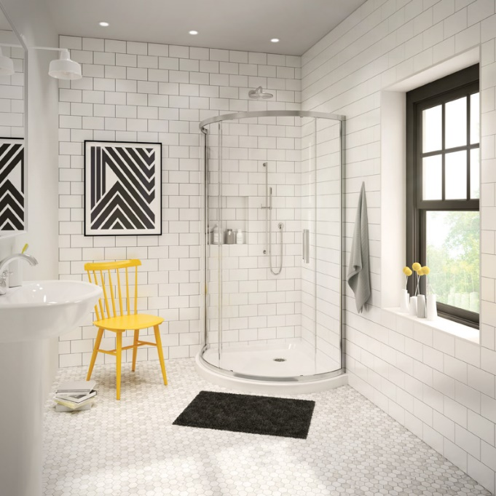
RADIA – Round
Chrome - Clear
Dimensions available
36 – 36 x 71.5
Fits on:
Brushed Nickel - Clear
Marketing Price list ENGLISH | Sales code | Product dimension (in) | Base and shower fit
RADIA Round 36 | 137446 | 36 x 36 x 71.5 | 102801 | W&B Round 36
 |  |  | 102996 | Freestyle round 37

Slide 12
Edge Shield Doors

Slide 13
Why a Edge shield?
Opportunity: Showroom
Customers that don’t want a shower curtain are looking for a solution that makes the bathroom look bigger and brighter.
Upscale look with 8mm glass, but less expensive than a complete shower door.
Easy access to help bathe kids or increase access to the bath.
Absolutely easy to clean solution:
Lotus glass protection
Nothing on the tub, no hard to clean corner or track
DIY – shields are super easy to install
Ideal for slanted ceilings
Opportunity: New construction
Increase perceived value and finishing touches by adding a tub shield instead of leaving it blank for a curtain or a home center door installed by home owner
Can be installed by anyone
Price point progression from very aggressive to value added
Shower shields are highly requested by builders to please younger buyers.
Category | Panel | Chrome | Brushed Nickel
Tub | 1-panel 30in x 55.5in | 1 | -
 | 1-panel 34in x 58in | 1 | 1
 | 2-panels 42in x 58in | 1 | 1
Shower | 2-panels 42in x 75in | 1 | 1
Total |  | 7

Slide 14
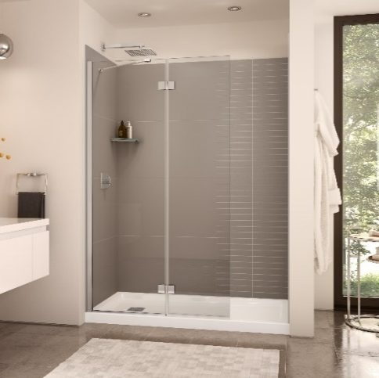
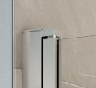
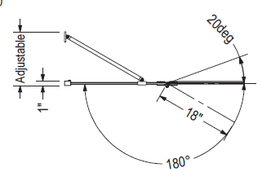
Edge: Features on Wholesale shields
Single panel 180deg of rotation
New shower and tub shields offer various configurations to answer many construction and renovation requirements
6mm and 8mm glass with Lotus glass protection
Single panel and double panels
2 aluminum finishes: Chrome + Brushed Nickel*

Slide 15
Edge – tub shield
 | Edge tub shield 6
New Build | vvv Low price - Easy to install - Upgrade from curtain rod - Condo/Second bath
Showroom | vvv Low price

Slide 16
Edge – tub shield
 | Edge Square tub shield 8
New Build | vv Upgrade from 6mm
Showroom | vvv Mid price - Basic tub shield with a Square design element

Slide 17
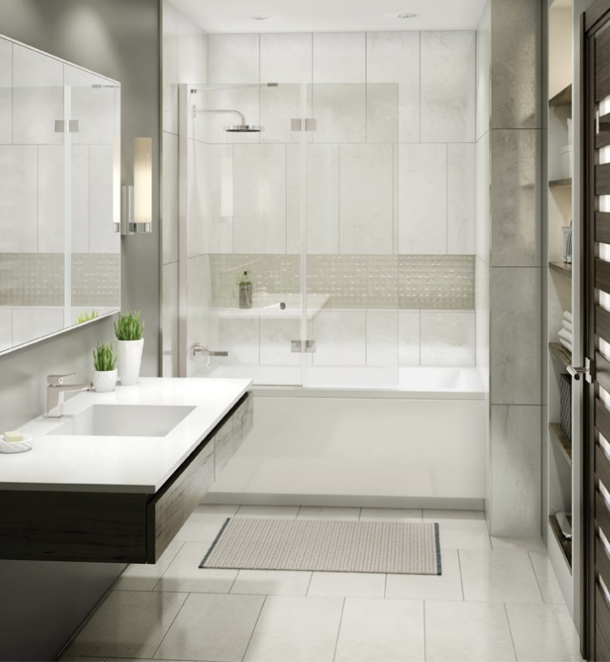
Edge – tub shield
 | Edge Duo tub shield 8
New Build | vvv Mid price point - Easy to install - Upgrade from single shield - More water protection - Condo/Second bath
Showroom | vvv Perfect for showroom, lifting hinges add value - Improve water protection - Lotus, looks modern on Rubix and Exhibit

Slide 18
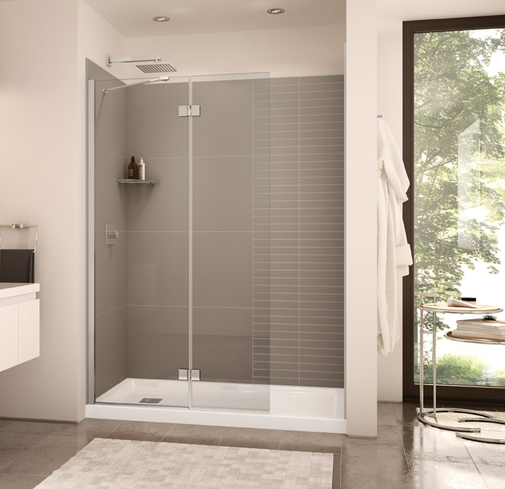
Edge – tub shield
 | Edge duo shower shield 8
New Build | vv Better water protection than a single fixed panel
Showroom | vvv Tub to shower replacement, Downtown minimalistic shower, Hospitality,

Slide 19
Duel Doors + RP

Slide 20
Why a Duel?
Opportunity: Showroom
High end bypass door, allows access from left and right
Wall jambs keep the water inside and allow for adjustment for out of plumb walls
Adjustable header by 1/4in to make sure the doors close perfectly with the wall jamb
Return panel available, allowing for a corner installation
All 3 finishes available
Included Lotus glass protection for a faster day to day cleaning
Opportunity: New Construction
Solid construction with 3 adjustments
Header leveling
Wall jamb
Wheel adjustment
8mm (5/16in) is close to custom but the price is much more affordable

Slide 21
Opportunity & How we win?
2 return panel sizes: 32 and 36 in 3 finishes
2 new finishes Brushed nickel and dark bronze

Slide 22
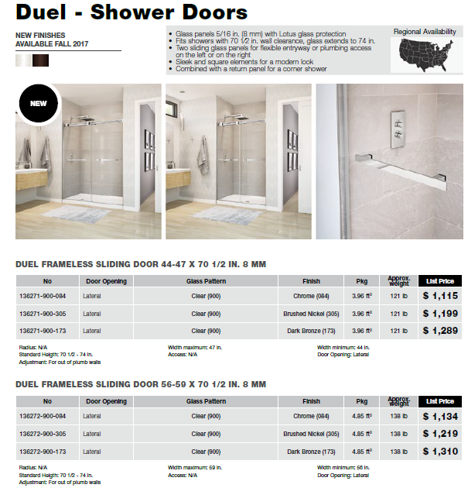
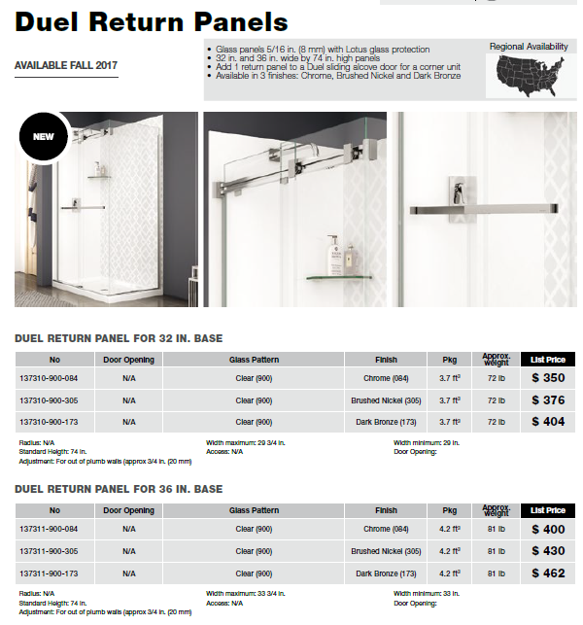
Duel extension

Slide 23
Why Link?
Opportunity: Showroom
High end Neo-angle door, a classic shape still used today in many renovations
Great to combine with a tile wall since the door is higher than other neo-angle doors
Heavy glass with Lotus and generous hardware design makes this a higher end product
Solid and comfortable handle
Easy to clean with the flush mount hinges, just a quick squeegee will clean.
Opportunity: New Construction
Classic construction in high end build

Slide 24
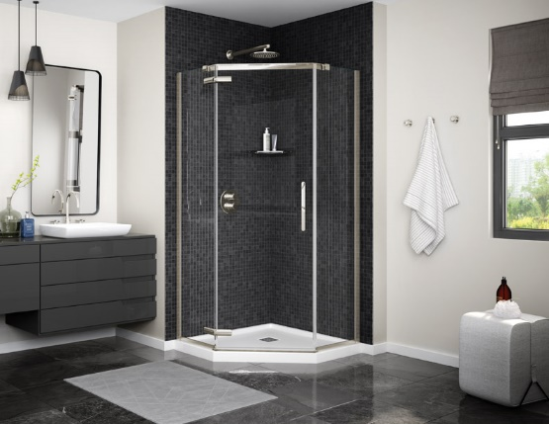
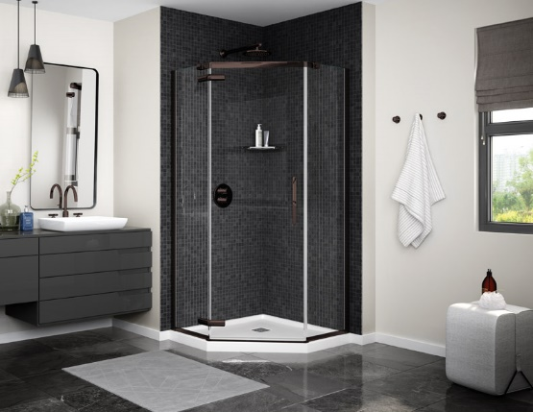
Link Curve – Neo-Angle
Brushed Nickel
Dark Bronze
LINK CURVE NEO-ANGLE |  |  | 38 | 40
MODEL | BASE | DRAIN DIMENSIONS | 137280 | 137281
101423 | NEO-ANGLE 38 (3 in.) | 38 X 38 | •
105043 | NEO-ANGLE 38 (5 in.) | 38 X 38 | •
101424 | NEO-ANGLE 40 (3 in.) | 40 X 40 |  | •
105044 | NEO-ANGLE 40 (5 in.) | 40 X 40 |  | •
Chrome
HPP Neo-Angle doors, all pivot
Updated look, minimalist header and bottom track
Flush mount Hinges
Height = 75’’
3 aluminum finishes: Chrome + Brushed Nickel + Dark Bronze
8mm glass
Lotus glass protection
¾ in of WJ adjustment

Slide 25
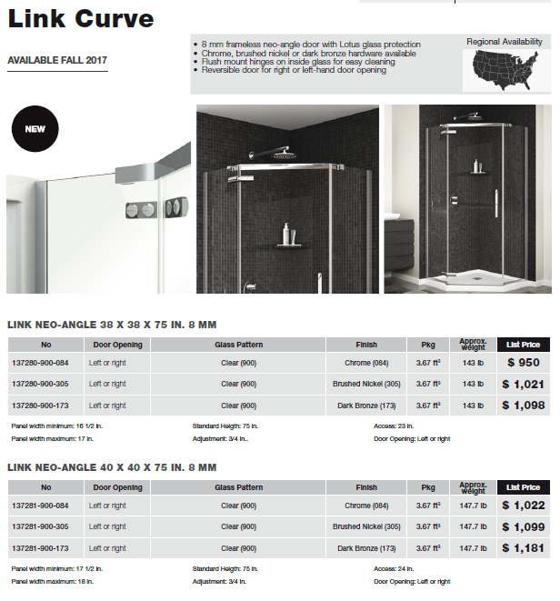
Link Curve
Perfect for Showroom

