Slide 1
Invisible Adversaries: How Radiation Shapes the Reliability of Integrated Circuits
Stephen Buchner
Consultant

Slide 2
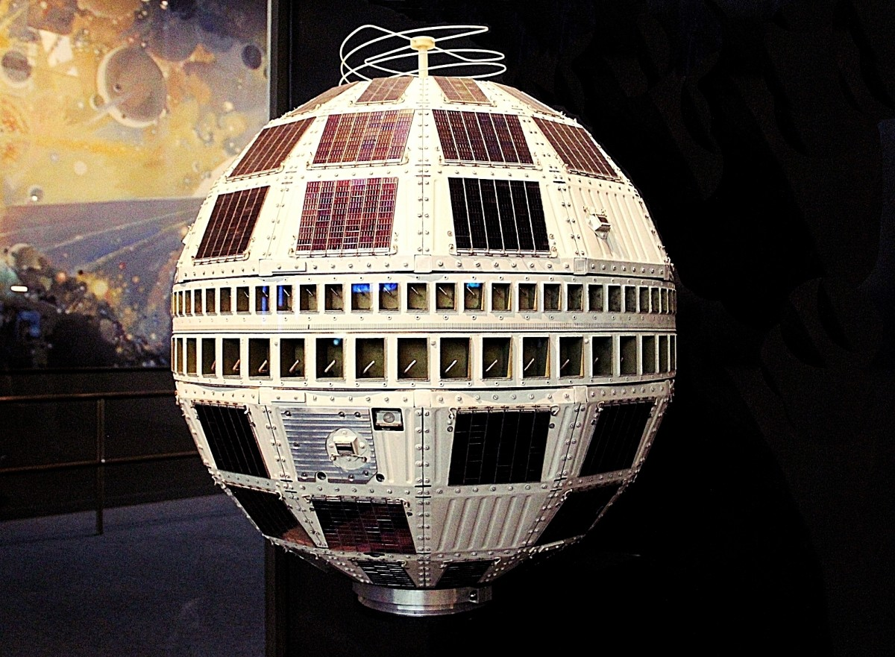
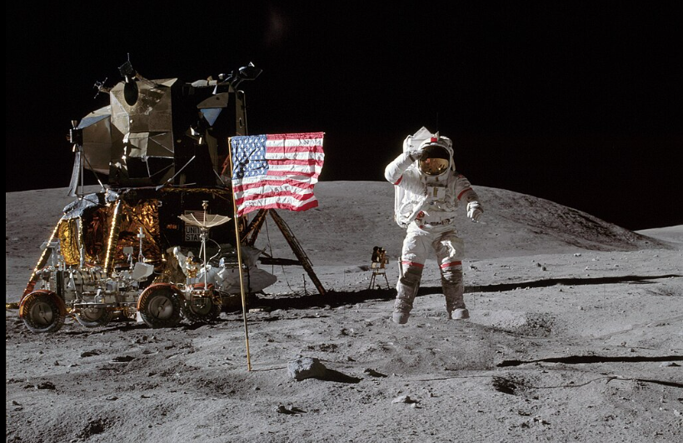
Evidence of Radiation Effects on Systems
TELSTAR
First telecommunications satellite launched July10 1962
Operated successfully until February 1963, when it suffered radiation damage due to exo-atmospheric nuclear weapons test STARFISH.
https://upload.wikimedia.org/wikipedia/commons/4/4c/Telstar_satellite%2C_Smithsonian_National_Air_and_Space_Museum%2C_April_2019.jpg
ASTRONAUTS ON THE MOON
The Apollo 17 astronauts would have absorbed radiation doses on the Moon ~150x that on Earth, which would have been lethal if mission occurred in August 1972 when a large solar event occurred instead of Dec. 1972.
Wikipedia Apollo 16

Slide 3
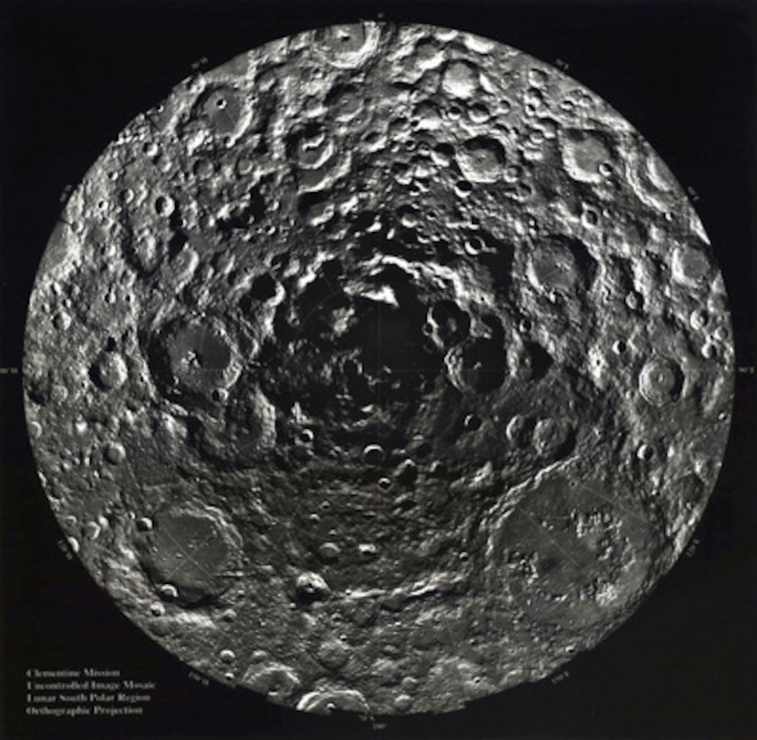
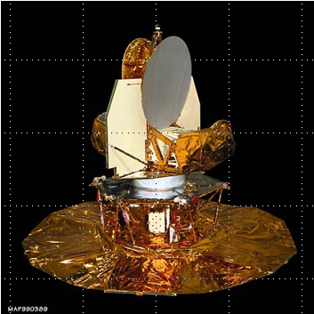
Examples of Radiation Effects on Systems
CLEMENTINE
Launched Jan 25th, 1994, and mapped entire surface of the Moon.
Extended mission to visit asteroid Geographos. Failed due to uncontrolled firing of rockets that used up all the fuel, causing the satellite to spin rapidly – Attributed to bitflip in electronics.
South Pole
Defense.gov
MICROWAVE ANISOTROPY PROBE (MAP)
In 2001, a voltage glitch in a comparator monitoring the spacecraft’s processor supply voltage caused the spacecraft to go into “safehold”. Lost one week of data.
MAP Satellite

Slide 4

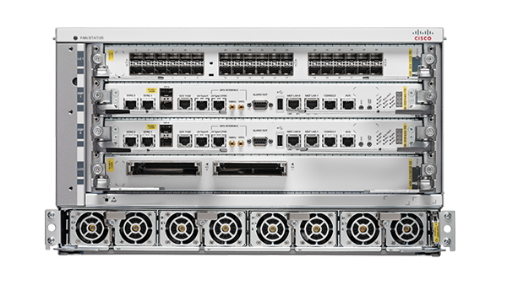
Evidence of Radiation Effects on Systems
AIRCRAFT MALFUNCTION
In 2008, a Quantus Airbus A330 aircraft suddenly pitched down twice, injuring passengers.
Cause traced to a bitflip in the air data inertial reference unit (ADIRU).
CISCO ROUTERS
In 2016, Cisco suffered a partial data traffic loss on the company’s ASR 9000 Series routers. Attributed to “cosmic radiation causing SEU soft errors.”
ASR900 Router

Slide 5
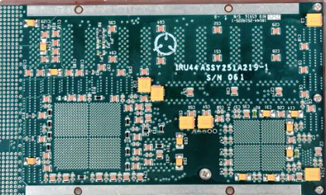
RAD750 Radiation Hard Computer by BAE Systems
The RAD750 radiation-hardened computer has been widely used in NASA missions since the early 2000s.
Solar Dynamics Observatory (SDO),
Mars Reconnaissance Orbiter (MRO),
Juno Curiosity
Perseverance rovers
For SDO in 2006:
Non-radiation-hardened version ~ $500
Radiation-hardened version ~ $450,000
  Small market and few manufacturers
Clock speed: 110–200 MHz
Performance: 200–400 MIPS

Slide 6
Radiation is One of Many Reliability Issues for ICs
Thermal – extremes of temperature
Electrical – voltage glitches
Mechanical – stress and strain on the device
Aging or wear-out – e.g. electromigration
Manufacturing defects – faulty designs or fabrication
Radiation – particles and photons

Slide 7
ENVIRONMENT

Slide 8
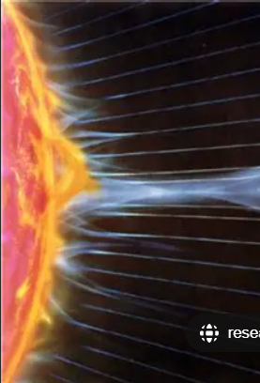
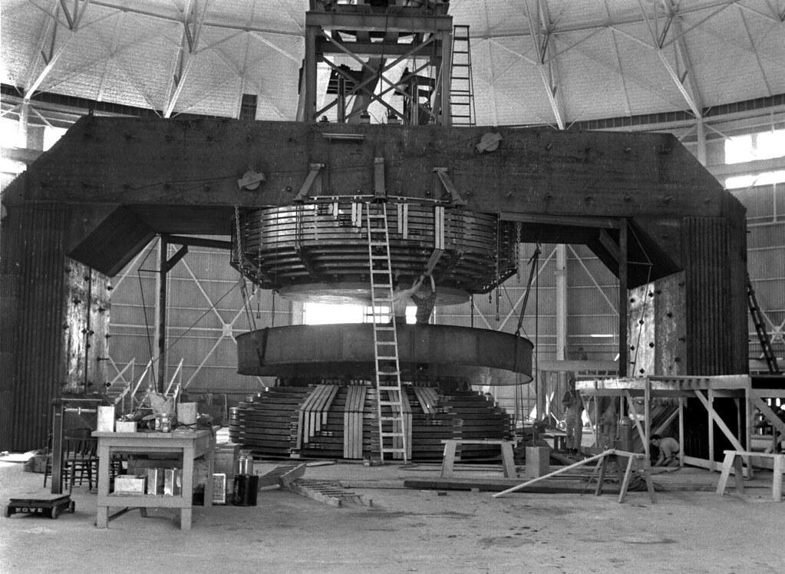
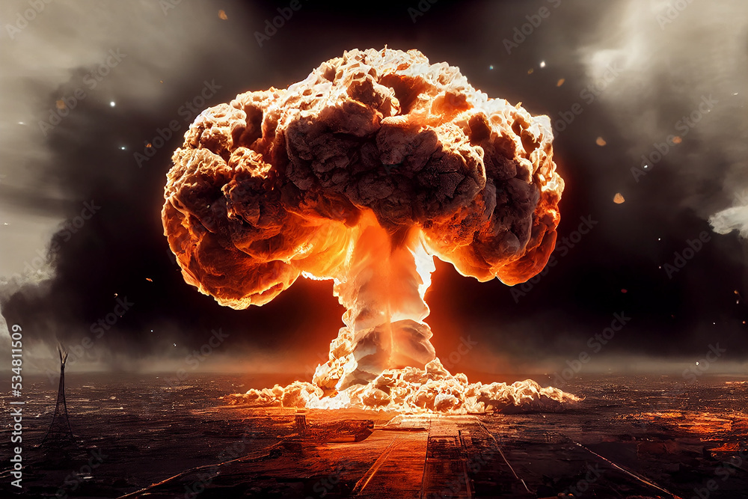
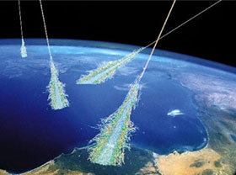
Sources of Radiation
Sun – Solar wind, CMEs, SPEs
Man-made Machines – accelerators, X-ray.
Radioactive Elements – e.g. Ra, Pu, U emit primarily α particles and γ-rays
Galactic Cosmic Rays
Nuclear Explosions
n and γ-rays (prompt)
x-rays and p (delayed)

Slide 9
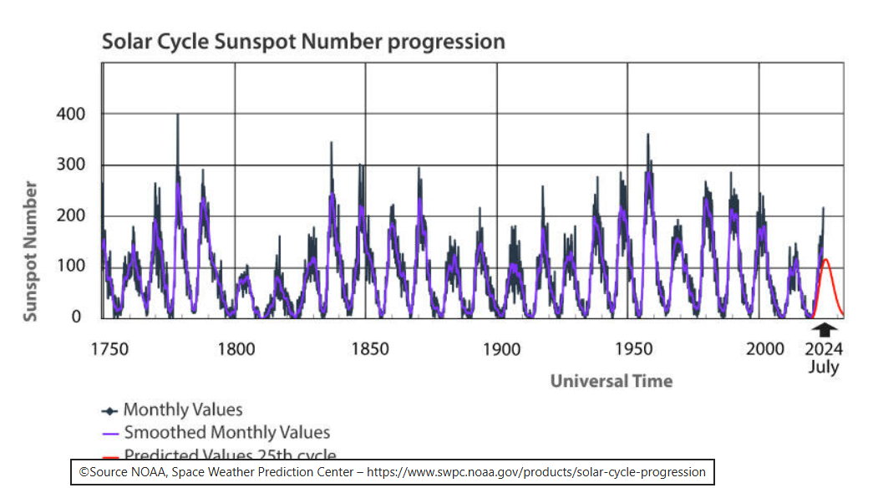
Space Missions Affected by Solar Cycle
The Sun’s magnetic field switches direction every 11 years.
Solar activity (# of sunspots) varies with the switching magnetic field.
Maxima in CMEs and SPEs occur when the Sun’s magnetic field is a minimum, i.e., north and south poles of the Sun cross over at the equator.
During a solar storm, the solar wind can increase by 5 orders of magnitude – more energetic particles.
Last maximum was in October 2024.

Slide 10
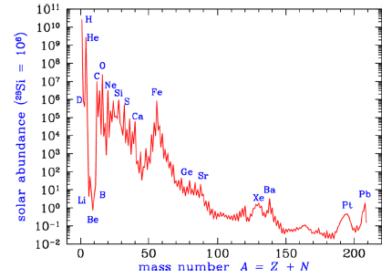
Solar Wind
The heaviest elements synthesized by the Sun are C, O, and N.
Heavier elements (up to Fe) emitted by the Sun in the solar wind were synthesized by larger stars.
The larger stars emitted the heavy ions that were subsequently captured by our Sun.
Anders et al, Geochimica et Cosmochimica Acta, Jan. 1989

Slide 11
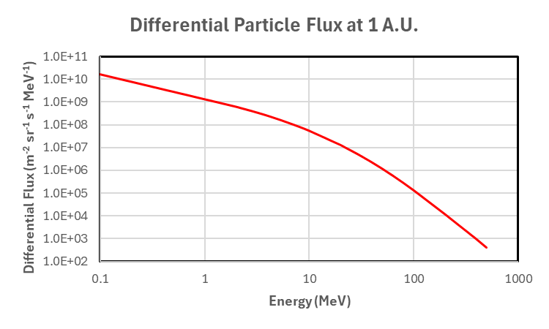
Solar Wind
The figure shows differential flux for all elements from H to O emitted by the sun as a function of energy during a flare.
Particle energies:
  Solar wind: ~1 keV/n.
  Solar flare: 10 keV/n to several GeV/n.
Particles with higher energies are more able to penetrate a spacecraft’s superstructure to reach sensitive electronics.

Slide 12
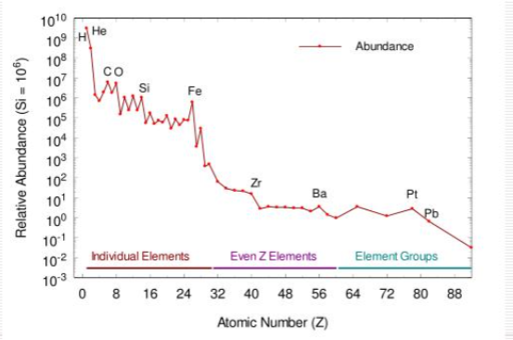
Galactic Cosmic Rays
Originate outside the solar system.
Have higher energies than solar particles making them more penetrating.
GCR flux is much lower than flux of particles in solar wind.
Composition is:
  90% protons
  9% helium
  1% heavier ions.
N. Yasuda “Space Radiation Dosimetry and the Fluorescent Nuclear Track Detector,” PPT - Space radiation dosimetry and the fluorescent nuclear track detector PowerPoint Presentation - ID:334182

Slide 13
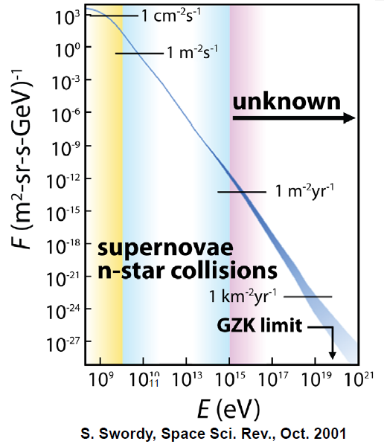
GCR Energy Spectra
Energy Spectra of GCRs:
Origins are supernova and neutron star collision.
Origins of very high-energy particles are unknown.
Flux depends on solar cycle. During solar max, the GCR flux is a minimum.
GZK limit is 5x10¹⁹ eV

Slide 14
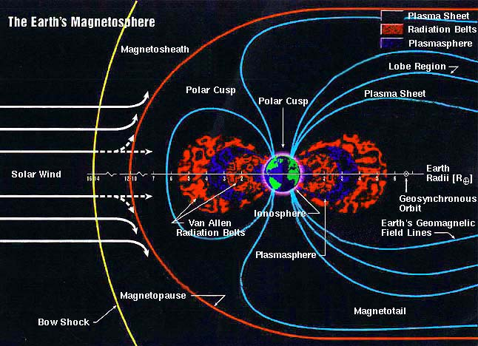
Radiation Environment Surrounding the Earth
Earth has a magnetic field affecting the radiation environment.
Solar wind deflected by the Earth’s magnetic field.
Some solar wind particles are captured by Earth’s magnetic field forming Van Allen belts consisting of:
      Inner proton belt from 600 km to 6,000 km
      Outer electron belt from 13,000 km to 40,000 km.
Radiation flux higher at north and south poles than near the equator.
GEO

Slide 15
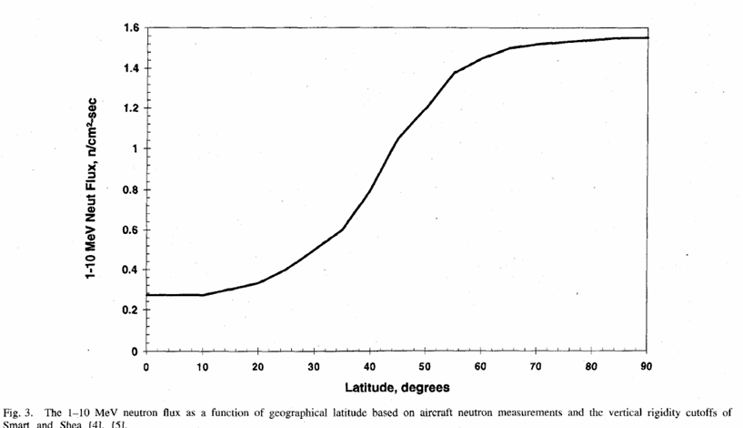
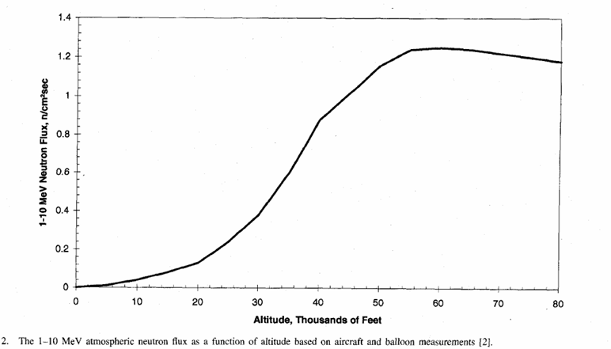
Radiation in the Earth’s Atmosphere (Neutrons)
Latitude
Large flux of neutrons from GCR interactions with N₂ and O₂ in the atmosphere.
Neutrons are thermalized following multiple collisions so that the maximum is around 25 meV.
Neutrons pose a single-event threat to highly scaled electronics on Earth.
Several systems have experienced failures due to GCR neutrons (destructive failure of high-power FETs on Siemens trains).
Altitude

Slide 16
TYPES OF RADIATION EFFECTS

Slide 17
Types of Radiation Effects
Total Ionizing Dose (TID) caused by solar wind and van Allen Belts.
Displacement Damage Dose (DDD) caused by solar wind and van Allen Belts.
Single-Event Effect (SEE) caused by solar wind, radiation belts, GCRs and terrestrial sources.

Slide 18

Total Ionizing Dose (TID)
Incident ion liberates electrons and holes in insulator.
V_{dd}(V=+5V)
V_{dd}(V=+5V)
Cathode
SiO₂
+-+-+-+-+-+-+-+-+-+-
n⁺-Si
Diode
+-+-+-+-+-+-+-+-+-+-
p-Si
Anode
GND

Slide 19
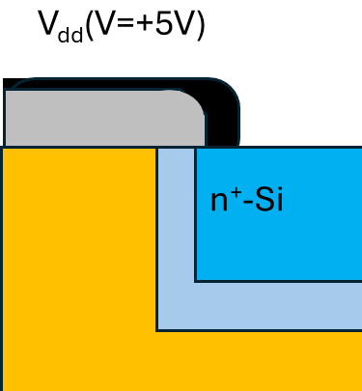


Total Ionizing Dose (TID)
With V_{dd} positive, holes move to interface and electrons move to V_{dd} contact and exit insulator.
E

Slide 20
Total Ionizing Dose (TID)
Trapped charge at interface in diodes leads to:
  Reduction in operating frequency
  Leakage currents.
Cumulative buildup of charge causes the device to operate outside specifications and eventually to fail.
E
+ + + + + + + + +

Slide 21
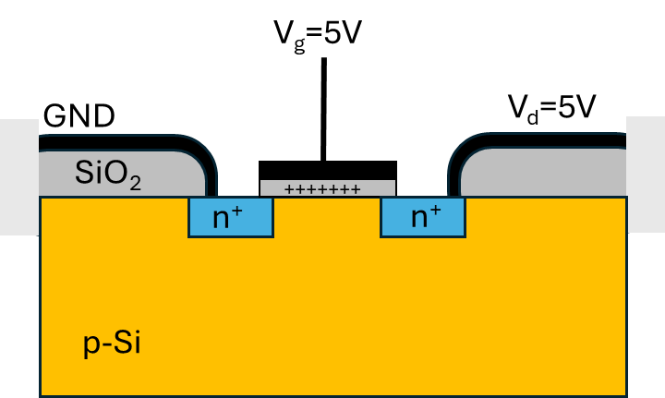
Total Ionizing Dose (TID)
Trapped charge at interface affects devices in several ways:
  Leakage currents.
  Reduction in frequency.
  Failure to switch - cannot turn off
Cumulative buildup of charge causes the device to operate outside specifications and eventually to fail.
N-channel MOSFET

Slide 22
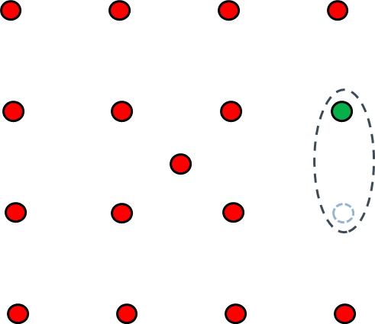
Displacement Damage Dose
Lattice Defect Formation by Incident Particle
Nuclear collisions between incident ion and target material produce lattice damage that disrupts the crystal lattice.
Most of the initial vacancy/interstitial pairs recombine and little permanent damage.
Vacancies can move relatively easily through the lattice and form multiple different kinds of complexes such as a complex with an impurity (dopant) atom.
Vacancy/dopant complexes are electrically active and can affect performance.
Vacancy
Si nucleus
Phosphorus = N-type Dopant

Slide 23
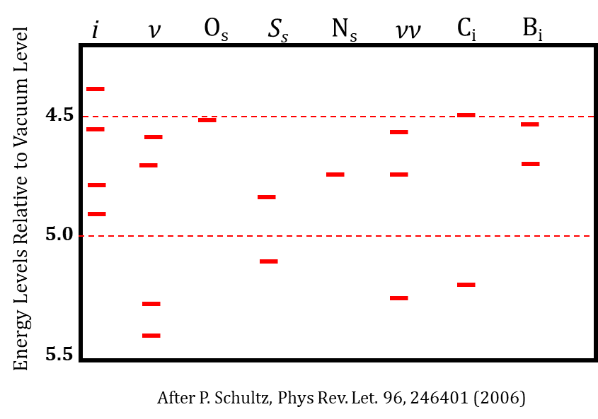
Displacement Damage Dose
Defects are formed including interstitials, substitutional, and compounds – affect minority carrier lifetimes.
i: Interstitial Si
v: Vacancy – a missing silicon atom
Os: Substitutional Oxygen (replaces Si atom).
Ss: Substitutional Sulfur. (replaces Si atom).
Ns: Substitutional Nitrogen (replaces Si atom).
vv: Divacancy – two adjacent silicon vacancies.
Ci: Interstitial Carbon.
Bi: Interstitial Boron
Eight Common Different Defect Levels in Si
Different defect structures have different energy levels within the semiconductor energy bandgap. Some defects have multiple energy levels.
Defects degrade performance.

Slide 24
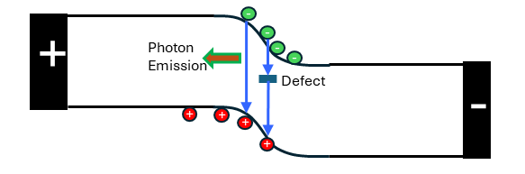
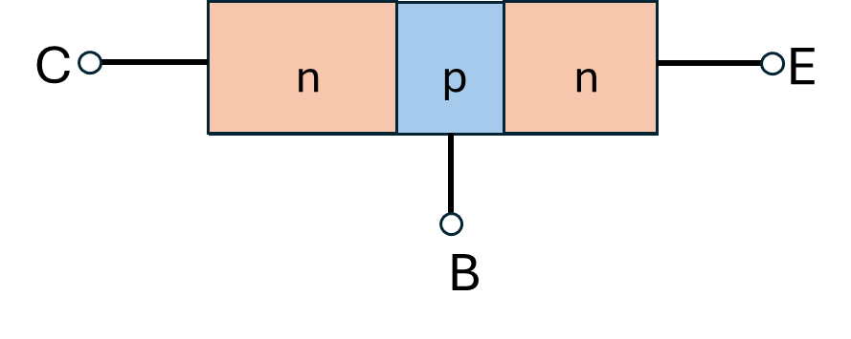
Displacement Damage Dose (DDD)
Occurs primarily in bipolar transistors and optoelectronic devices (LED)s where minority carrier lifetimes are crucial to performance.
DDD causes a reduction in gain of a bipolar transistor and a reduction in optical emission of LED.
Light Emitting Diode
Bipolar Transistor

Slide 25
Single-Event Effects (SEEs)
5
  A single ion passing through the device liberates charge in the semiconductor causing a momentary voltage glitch.
  Depending on device type and ion strike location, the SEE can be either destructive or non-destructive.
  With +5V on the n-contact, the device is reverse bias and most sensitive to SETs because of:
    Wide depletion layer
    High electric fields.
4
Amplitude (V)
3
2
1
0
0
1
2
3
4
5
Time (μs)
V_{dd}=+5V
SiO₂
n⁺-Si
+-+-+-+-+-+-+-+-+-+-
+-+-+-+-+-+-+-+-+-+-
p-Si
GND

Slide 26
Energetic Particle Interactions with Matter

Slide 27
Passage of Ion Through Silicon Lattice
Silicon Lattice
Valence
Electrons
Atomic
Nucleus
Volume of Si unit cell:
1.6x10⁻²² cm³
Volume of Si nucleus:
2x10⁻⁴¹ cm³

Slide 28
Direct Ionization
Silicon Lattice
e-h
e-h
e-h
e-h

Slide 29
Elastic Scattering off Nucleus
Silicon Lattice
e-h
e-h
Incident and recoil particles can both produce e-h pairs.
Cross-section much smaller than for direct ionization.
Recoil
e-h
e-h
e-h
Incident Ion

Slide 30
Inelastic Nuclear Scattering
Silicon Lattice
e-h
e-h
Threshold energy in Si is 10 MeV for protons.
Protons usually produce SEUs by nuclear interactions.
e-h
e-h

Slide 31
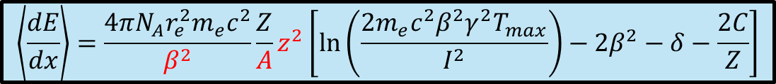
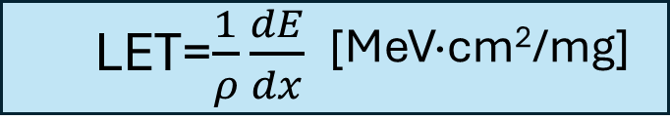
Energy Loss via Ionization – Bethe Bloch Equation
Where:
<dE/dx> is the average energy loss per unit path length
N_{A} is Avagadro’s number
r_{e} is the classical electron radius
m_{e} is the electron mass
c is the speed of light
z is the charge number of the incident particle
Z is the atomic number of the target material
A is the atomic mass of the target material
β=v/c is the particle speed relative to light
γ=1/√(1-v²/c²)
T_{max} is the maximum kinetic energy transferable toa free electron in a single collision
I is the mean excitation potential of the medium
δ is the density effect correction at high energies
C/Z is the shell correction at low energies
Linear Energy Transfer (LET)

Slide 32
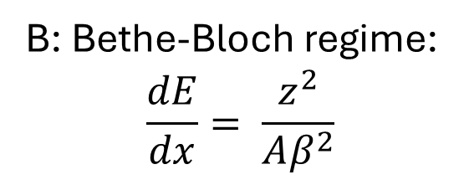
Energy Loss of Ions in Matter
A: Electron capture by incident ions.
A
B: Bethe-Bloch regime:
$$\frac{dE}{dx}= \frac{z^{2}}{Aβ^{2}}$$
B
Stopping Power
C: Radiative Losses (γ rays) – relativistic effects. Few particles in nature with those energies.
C
Energy per Nucleon

Slide 33
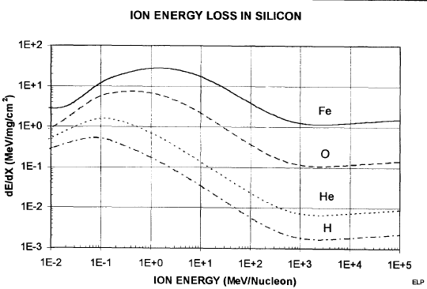
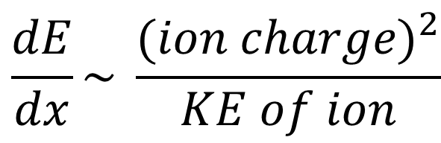
Energy Loss via Ionization – Bethe Bloch Regime
$$\frac{dE}{dx}\sim \frac{{(ion charge)}^{2}}{KE of ion}$$

Slide 34
Bragg Peak
silicon
Oxygen fully ionized
Energy = 1E3 MeV/n
Range
Bragg Peak

Slide 35
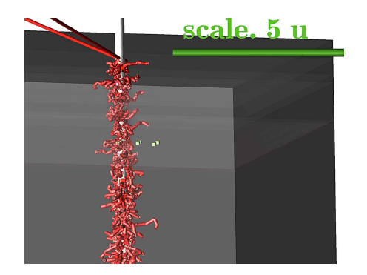
Track Structure
High-energy track - 28 GeV Iron
Low-energy track - 280 MeV Iron
M. King et al. IEEE TNS vol. 57, no. 6, pp. 3169-3175, Dec. 2010
Energy Loss is stochastic (random collisions), i.e., not continuous

Slide 36
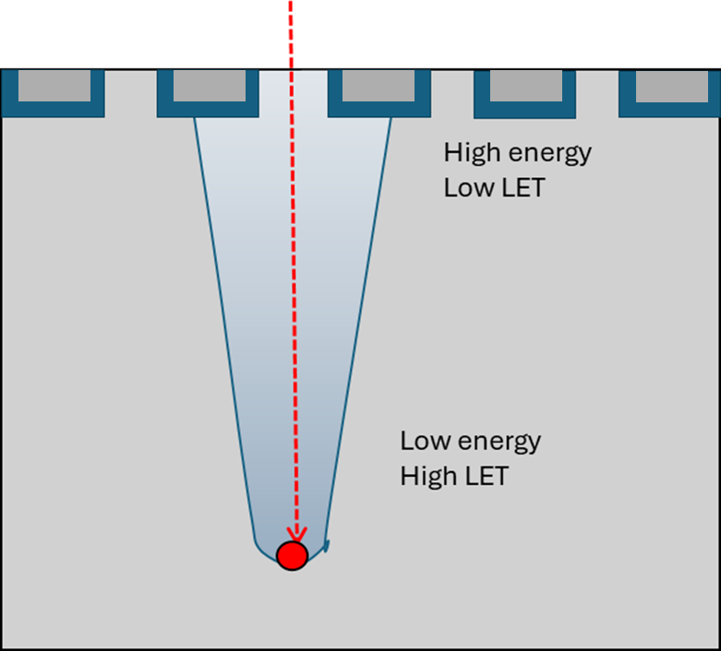
Ionization Track
  Charge track diameter depends on ion energy through energy lost to delta rays (electrons).
  High-energy ions generate energetic delta rays that move further from track center, producing a track with a larger diameter.
  As the ion slows down, the delta rays have lower energy and electrons and holes are generated closer together.
  Implications for multiple-bit upsets.

Slide 37
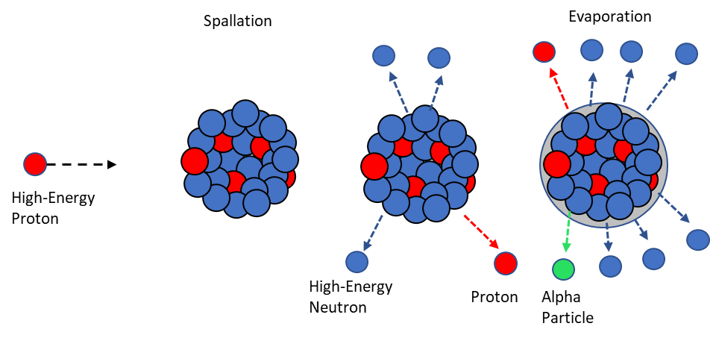
Single-Event Effects via Indirect Ionization
All particles can undergo nuclear elastic or in-elastic scattering with Si.
But ionization dominates, i.e., nuclear collisions are rare (down by 10⁴) so ignore.
In older circuits, protons do not liberate sufficient charge via direct ionization to cause SEEs. However, they can contribute to the SEE rate via indirect ionization.
Emitted particles have larger mass than proton, so can liberate more charge in Si.
Fission produces heavy particles
37

Slide 38
Single-Event Effects via Indirect Ionization
Neutrons are uncharged – no SEEs via direct ionization.
Produce SEEs via elastic or inelastic nuclear interactions. Similar to SEEs produced by protons.
The secondary particles have LETs up to ~ 15 MeV.cm²/mg which can cause SEEs.
Protons and neutrons interact with heavy metals, like Au and Ti, used in modern ICs. Secondary particles have masses (nuclear charge) greater than silicon and therefore greater energy loss.
n
¹⁴Si
+
+
¹²Ne
+
+
+
+
+
+
+
+
+
+
+
+
n
+
+
+
n
+
+
+
+
+
+
+
+
⁴Be
+
+
No Ionization
+
n
Ionization
38

Slide 39
Single Event Effects

Slide 40
Types of Single-Event Effects
Destructive SEEs
Non-Destructive SEEs
Single-Event Transient
Single-Event Upset
Single-Event Functional Interrupt
Single-Event Burnout
Single-Event Gate Rupture
Single-Event Latchup

Slide 41
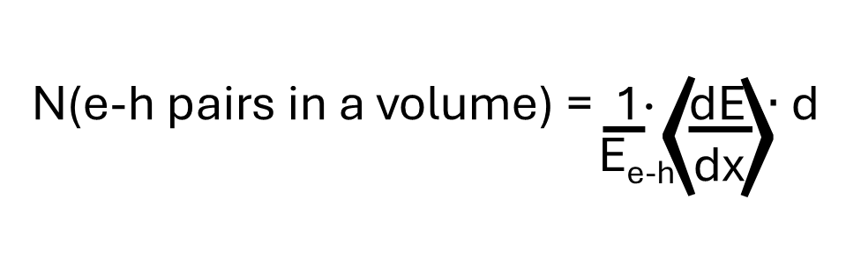
Single Event Transient in a Diode
SEE ~ amount of charge deposited in depletion layer
V_{dd}
V_{dd}
SiO₂
E_{e-h} = Energy to create an e-h pair in the material (3.6 eV in Si and 17 eV in SiO₂).
dE/dx = energy loss to ionization per unit distance.
d = distance the particle travels through a chosen volume.
When diode reverse-biased, d is large and the diode is more sensitive to SETs.
n⁺-Si
+-+-+-+-+-+-+-+-+-+-
+-+-+-+-+-+-+-+-+-+-
d
p-Si
GND
n⁺-p Diode

Slide 42
Single Event Transient in a Diode
Depletion
Layer
V_{dd}
V_{dd}
SiO₂
n⁺-Si
p-Si
V_{dd}
n⁺-Si
E_{c}
+-+-+-+-+-+-+-+-+-+-
R
+-+-+-+-+-+-+-+-+-+-
E_{F}
d
E
E_{V}
V_{out}
p-Si
GND
Transient size depends on:
Amount of charge deposited by ion
Width of depletion layer (d)
Applied bias
Capacitance
V_{out}
Time

Slide 43
Single Event Transient in a Diode
Depletion
Layer
V_{dd}
V_{dd}
SiO₂
V_{dd}
n⁺-Si
p-Si
n⁺-Si
E_{c}
R
+-+-+-+-+-+-+-+-+-+-
+-+-+-+-+-+-+-+-+-+-
d
E_{F}
E_{V}
V_{out}
E
p-Si
GND
Size depends on:
Amount of charge deposited by ion
Width of depletion layer (d)
Applied bias
Capacitance
V_{out}
Time

Slide 44
Single Event Transient in a Diode
Depletion
Layer
V_{dd}
V_{dd}
SiO₂
V_{dd}
n⁺-Si
p-Si
n⁺-Si
E_{c}
R
+-+-+-+-+-+-+-+-+-+-
+-+-+-+-+-+-+-+-+-+-
d
E_{F}
E_{V}
V_{out}
p-Si
GND
Recovery depends on:
Resistance value (R)
Recombination rate
Diffusion current
V_{out}
Time

Slide 45

Recombination
Band-to-Band
Shockley-Read-Hall
Auger
Geminate Recombination
Occurs immediately after ionization.
Dominates when charge pairs are close together and there’s low charge density.
Depends on local electric field, temperature, and initial separation of the pair.
E_{c}
Photon
Phonon
Columnar Recombination
E_{v}
Occurs when ionization density is high, such as in a dense ion track.
Occurs between neighboring carriers from different e-h pairs.
Depends on track geometry, spatial distribution, and external electric field strength that tries to separate the charges.
Because of recombination
Q_{dep} > Q_{col}

Slide 46
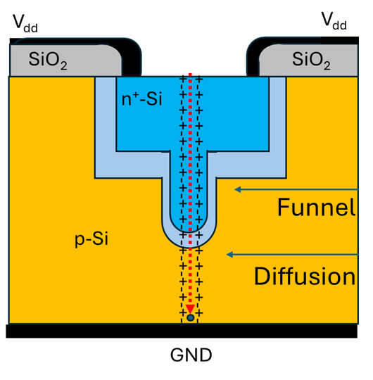
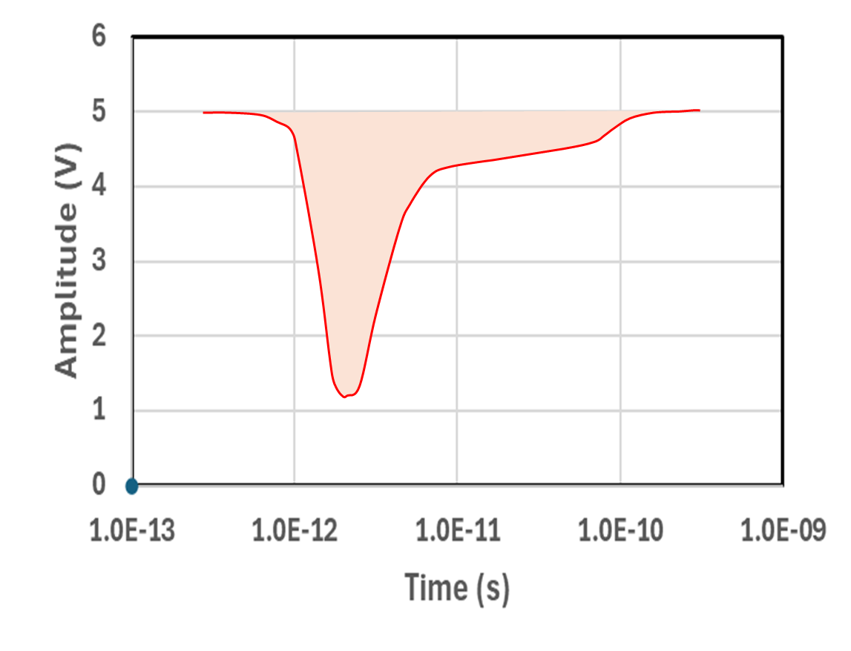
Total Collected Charge at Anode
Amplitude and shape of the voltage transient depend on:
Total collected charge.
Time over which charge is collected.
Q_{tot} = Q_{drift}+ Q_{diffusion} - Q_{recomb}
Q_{drift} = Q_{depletion} + Q_{funnel}
Drift
Diffusion
Recombination
Charge collection via drift is fast.
Charge collection vis diffusion is slow.

Slide 47
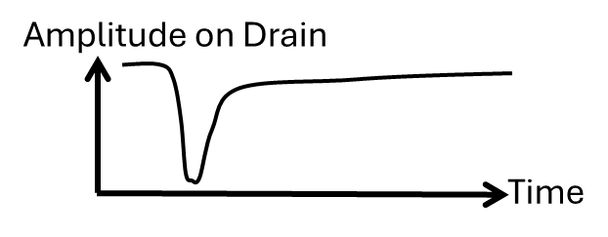
SETs in N-Channel MOS Transistor biased OFF
GATE
D = 5V
SOURCE
DRAIN
BODY
Reverse-biased
n-p Junction
N+
N+
P+
V
P
G = 0V
B = 0V
Depletion Layer
Funnel
Diffusion
S

Slide 48
Transient in CMOS Inverter
5V
5V
ON
OFF
V_{in} = 0V
V_{in} = 5V
V_{out} = 5V
V_{out} = 0V
OFF
ON
V_{out}
V_{out}
t
t
Transistor Restoring Drive Determines Duration –
The larger the restoring drive the shorter the SET

Slide 49
Upset in CMOS SRAM
Competition between upset (I_{seu}) and restoring (I_{r}) currents
If charge deposition time and collection time are less than the response time of the circuit and Q_{col} exceeds Q_{crit} an SEU will occur
There are two sensitive nodes for an SRAM cell – OFF n-channel and OFF p-channel transistors.
5V
I_{r}
0V
5V
0V
5V
I_{seu}
1
DATA =
0

Slide 50
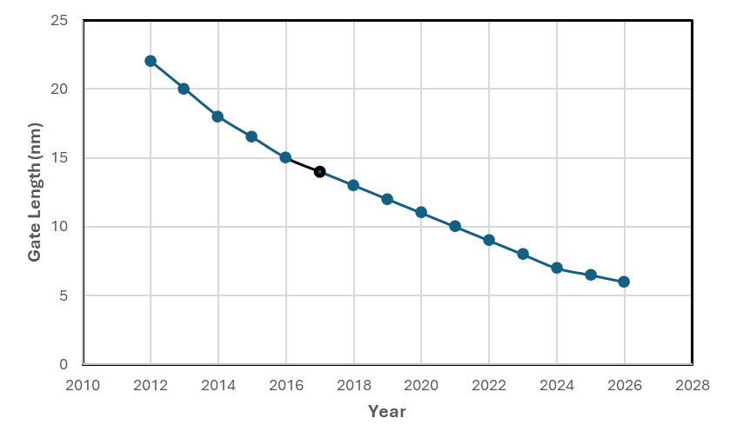
Prediction of Single Event Upsets
Gate Length vs Time
(Research Transistors)
In 1962, transistor minimum sizes were 25 μm.
Wallmark and Marcus¹ predicted cosmic rays would cause bit flips in memories that would limit non-redundant miniaturization of the circuits. Predicted a minimum size of 10 μm³ for a non-redundant circuit.
First SEUs observed in space 1975 by Binder and Smith² and on Earth in 1978 by May and Woods³
Currently, commercial transistors have minimum gate lengths of about 10 nm (0.01 μm) and operate using a variety of mitigation schemes.
22
18
15
13
11
9
7
6
Requirement for SEE
Q_{coll} > Q_{crit}
J.T. Wallmark, et al, Proc. of the IRE, vol. 50, no. 3, pp. 286-298, March 1962
D. Binder, E.C. Smith, A.B. Holman, IEEE Trans. on Nucl. Sci., vol. 22, no. 6, pp. 2675-2680, Dec. 1975
T. C. May and M. H. Woods, Proc. 16 Int'l Rel. Phys. Symp., p. 33, April, 1978

Slide 51
Mitigation

Slide 52
SEE Mitigation Approaches
Add Shielding
  Effective for TID but less effective for SEE by GCRs
Reduce Charge Generation
  Change to wide bandgap material, e.g. GaAs instead of Si
Reduce Charge Collection
  Silicon-on-insulator
  Highly doped substrate
Slow Circuit Response
  Add elements to slow circuit response
Add Redundancy with Majority Voting
  Store information on multiple nodes spatially separated
Logical Mitigation
  Error-detection-and-correction

Slide 53
Slow Down the Response
Prevent an SEU in a CMOS SRAM by adding:
  resistors,
  capacitors,
  transistors
Slows down the response to charge deposition and allows the restoring current to overcome the disturbing current.
Problem is temperature dependence of resistors.
5V
1
Off
On
4
5
2
3
On
Off

Slide 54
Mitigation Failure in Memory
Pulsed Laser Used to Identify Mitigation Failure:
93L422 Bit Map
93L422 1K (256x4) Bipolar SRAM: Despite being protected with EDAC, it still exhibited SEUs while operating in space – NASA’s Tracking and Data Relay Satellite (TDRS).
Hamming Code: Can detect two but correct only one error in a word.
Bit Map: Manufacturer would not provide it.
Pulsed Laser: NRL asked us to use our pulsed laser to generate bit map, which helped identify the cause.
16 Mbit DRAM: Took several days to determine bit map (7 years later).
Vital for data analysis when part flown on a satellite containing a test-bed (MPRB).

Slide 55
Mitigation – Penalties
All Mitigation Approaches have penalties in the form of:
  Increased Area
  Reduced Speed
  Increased Power
  Expensive Process Modifications
  Immature Technology, lagging by at least 2 generations
Notes:
The penalties are:
Area because one has to use more real estate to add filters or to do TMR
Reduced speed because of filters, temporal redundancy, and resistors in the SRAM
Increased power because there are more transistors
The process modifications can be costly and the resulting technology must be proven as it is relatively immature.

Slide 56
Testing

Slide 57
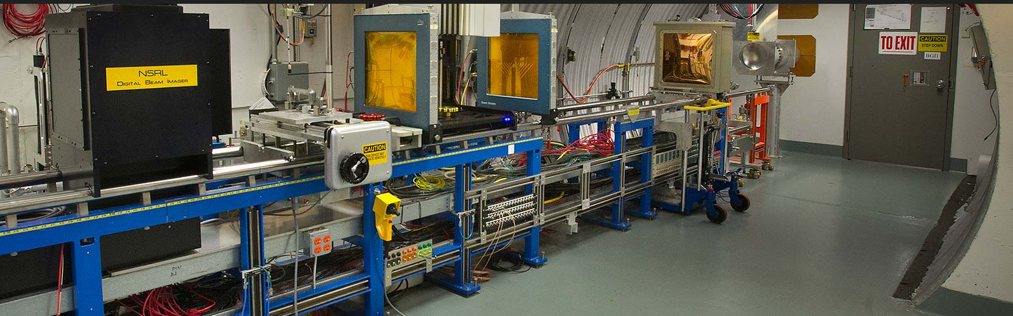
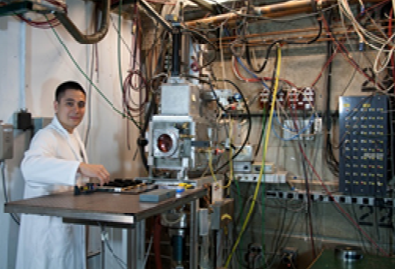
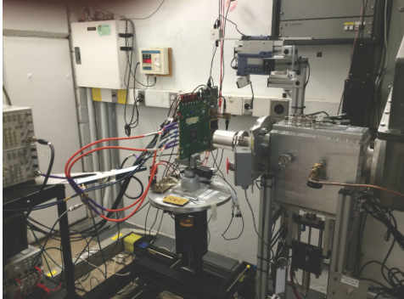
Accelerator Facilities for Heavy Ion and Proton Testing
NSRL Brookhaven (heavy ions)
Crocker Nuclear Laboratory (protons)
Texas A&M Cyclotron Facility (heavy ions)

Slide 58
Issues
Few facilities
Over-subscribed – long wait times
Limited Beam Time when assigned
Involves Travel to Remote Facility
Limited Number of Ions and Energies
Test part and not system.
No Spatial or Temporal Information

Slide 59
Why Test
Determine SEE rates during a mission.
Are the SEEs destructive or non-destructive?
What are their LET thresholds?
Validate TCAD models.
Confirm design of mitigation schemes.

Slide 60

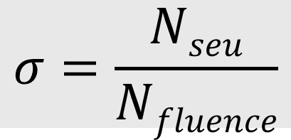
Determine Cross-Section of SEE Sensitive Areas
Accelerator Port
Diode Array
Select ion beams with different atomic numbers and energies to mimic environment
$$σ=\frac{Nseu}{Nfluence}$$

Slide 61
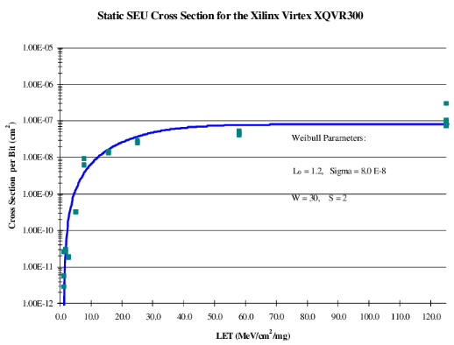
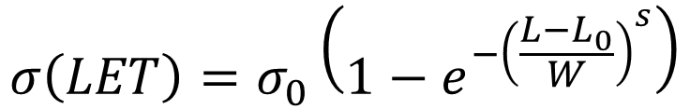
Cross-Section vs LET (Normalized Energy Loss)
Integral Weibull Function
$$σ\left(LET\right)=σ_{0}\left(1−e^{−{\left(\frac{L−L_{0}}{W}\right)}^{s}}\right)$$
σ₀ = Saturated Cross Section
S = Shape parameter
W = Width Parameter
L₀ = Onset LET

Slide 62
Single-Event Rate for a Mission
Need to know:
  Cross section S(L,φ,cos(θ)) – Test data
  Fluence f(L,φ,cos(θ)) - Environment
  Sensitive Volume Dimensions – Device structure
Particle Fluence
Cross-Section
To harden device to SEEs:
Move cross-section to right and down
Move environment to left – not easy
Linear Energy Transfer

Slide 63
Conclusion
Radiation is everywhere and its effects on electronics and optoelectronics is of great concern.
Radiation effects are divided into three categories:
  Total ionizing dose - insulators
  Displacement damage dose - semiconductor
  Single-event effects – semiconductor.
TID and DDD are cumulative effects that cause a gradual decrease in the functioning of a device, whereas SEEs can occur at any time.
Need to understand the operation to evaluate a device’s response to radiation.
Mitigation can be effective but has penalties.
The goal of testing is to determine a rate during the mission, but it faces significant challenges.

