Slide 1
Lesson 15
Meet Jesus
Volume 2
Ten Bible-based English lessons
High Beginner
Notes:
(Lesson 15 title page)

Slide 2
Lesson 15
PART 1
A common meal in Australia
Notes:
(Part 1 title page)

Slide 3
Ingredients
Notes:
Activate knowledge
Face-to-face lesson:
Display the ingredients for spaghetti bolognaise on a table.
Ask ‘Where’s the spaghetti?’
Invite a volunteer to find the item.
Invite a volunteer to write spaghetti on the board.
Repeat for the remaining ingredients: beef mince, garlic, onion, olive oil, dried oregano, fresh parsley, tomato paste, red wine, beef stock cubes, tinned tomatoes, salt, pepper, parmesan cheese. (You may also want to include items you would use to cook with – e.g. large saucepan, wooden spoon, chopping board, etc. If you do this, write a second heading on the board: Equipment.)
Practise and repeat correct pronunciation with students as you complete this activity.
Online lesson:
Display each of the ingredients by holding it in front of your camera.
Invite volunteers to tell you the name of each item or type it into the chat function.
Practise and repeat correct pronunciation of each item.

Slide 4
Spaghetti bolognaise
These ingredients make spaghetti bolognaise.
It’s a common meal in Australia
Notes:
Focus on language
Activity 1: Common meals
Say ‘spaghetti bolognaise’.
Click to reveal sentences and say ‘These ingredients make spaghetti bolognaise. It’s a common meal in Australia.’
Invite students to repeat after you, focusing on pronunciation as you do this.

Slide 5
Student A: What’s a common meal in your home country?
Student B: A common meal in __________ is __________.
The main ingredients are __________.
Notes:
Focus on language (continued)
Activity 1: Common meals (continued)
Divide students into pairs. (If possible, place students from different cultural backgrounds together.)
Nominate Student A and Student B in each pair.
Invite students to practise the dialogue on the slide with their partners.
Swap student roles and repeat.
Write a list of common meals from students’ home countries on the board.

Slide 6
Heat the olive oil in a large saucepan over medium heat. Add the onion and garlic and cook, stirring, for 2–3 minutes until the onion softens. Add the beef mince and cook, stirring, for 3–4 minutes until browned all over. Add the dried oregano and tomato paste and cook for a further 1 minute, then add the red wine and bring to the boil. Add the beef stock cube and chopped tomatoes then season to taste with salt and freshly ground pepper. Reduce the heat to low and simmer for 30 minutes until the bolognaise thickens.
Notes:
Focus on language (continued)
Activity 2: Identifying ingredients
Distribute one copy of RESOURCE 15.1 – Recipe to each student.
Invite students to work together to complete the activity.
Check answers together by clicking to reveal underlined ingredients (continues on next slide).

Slide 7
Meanwhile, cook spaghetti in a saucepan of boiling salted water according to the packet instructions, then drain and set aside.
Add drained spaghetti and chopped parsley to the sauce and toss well to combine.
Divide spaghetti among bowls then serve topped with parmesan cheese.
Notes:
Focus on language (continued)
Activity 2: Identifying ingredients (continued)
Click to continue revealing the underlined ingredients.

Slide 8
[ORANGE] Heat the olive oil in a large saucepan over medium heat.
[LIGHT BLUE] Meanwhile, cook spaghetti in a saucepan of boiling salted water according to the packet instructions, then drain and set aside.
[DARK BLUE] Add the beef stock cube and chopped tomatoes then season to taste with salt and freshly
ground pepper.
[LIGHT GREEN] Add the beef mince and cook, stirring, for 3–4 minutes until browned all over.
[DARK GREEN] Divide spaghetti among bowls then serve topped with parmesan cheese.
[ORANGE] Heat the olive oil in a large saucepan over medium heat.
[RED] Add drained spaghetti and chopped parsley to the sauce and toss well to combine.
[PURPLE] Reduce the heat to low and simmer for 30 minutes until the bolognaise thickens.
[PINK] Add the onion and garlic and cook, stirring, for 2–3 minutes until the onion softens.
[BROWN] Add the dried oregano and tomato paste and cook for a further 1 minute, then add the red wine and bring to the boil.
[PINK] Add the onion and garlic and cook, stirring, for 2–3 minutes until the onion softens.
[LIGHT GREEN] Add the beef mince and cook, stirring, for 3–4 minutes until browned all over.
[BROWN] Add the dried oregano and tomato paste and cook for a further 1 minute, then add the red wine and bring to the boil.
[DARK BLUE] Add the beef stock cube and chopped tomatoes then season to taste with salt and freshly ground pepper.
[PURPLE] Reduce the heat to low and simmer for 30 minutes until the bolognaise thickens.
[LIGHT BLUE] Meanwhile, cook spaghetti in a saucepan of boiling salted water according to the packet instructions, then drain and set aside.
[RED] Add drained spaghetti and chopped parsley to the sauce and toss well to combine.
[DARK GREEN] Divide spaghetti among bowls then serve topped with parmesan cheese.
Notes:
Focus on language (continued)
Activity 3: Recipe steps
Divide students into 9 pairs or groups if your class is large enough (if not, the activity can be completed by individuals or a mix of individuals and pairs).
Distribute one sentence from RESOURCE 15.2 – Recipe sentences to each student, pair or group (if using). [Alternatively, if online, complete the activity together using the PowerPoint slide according to the steps below.]
Face-to-face lesson:
Invite students to stand in a line so that the recipe steps are in the correct order.
Click to reveal the steps in the correct order.
Online lesson:
Invite students to list the steps in the correct order on a piece of paper using the colours on the slide.
Say ‘For example, the first step is “Heat the oil in a large saucepan over medium heat”. That step is in orange on the slide. So you need to write the word “orange” first on your piece of paper. Then you write down the colour of the next step, and so on.’
Click to reveal the steps in the correct order.
Extension activity: Cooking and/or eating together
Prepare a meal of spaghetti bolognaise and eat it together. If this isn’t possible, you could bring a pre-prepared batch of bolognaise from home to share.

Slide 9
Lesson 15
PART 2
Jesus’ last meal
Matthew 26:20–28
Notes:
(Part 2 title page)

Slide 10

Notes:
Read for gist
Say ‘In the Bible story, Jesus eats a meal with his friends.’
Distribute copies of Matthew 26:20–28 in your students’ heart languages (if in the classroom). [Alternatively, if online, invite students to refer to the heart language texts they have been sent in advance.]
Give students a few minutes to read the text silently for context, then ask them to put it away for the rest of the lesson.

Slide 11
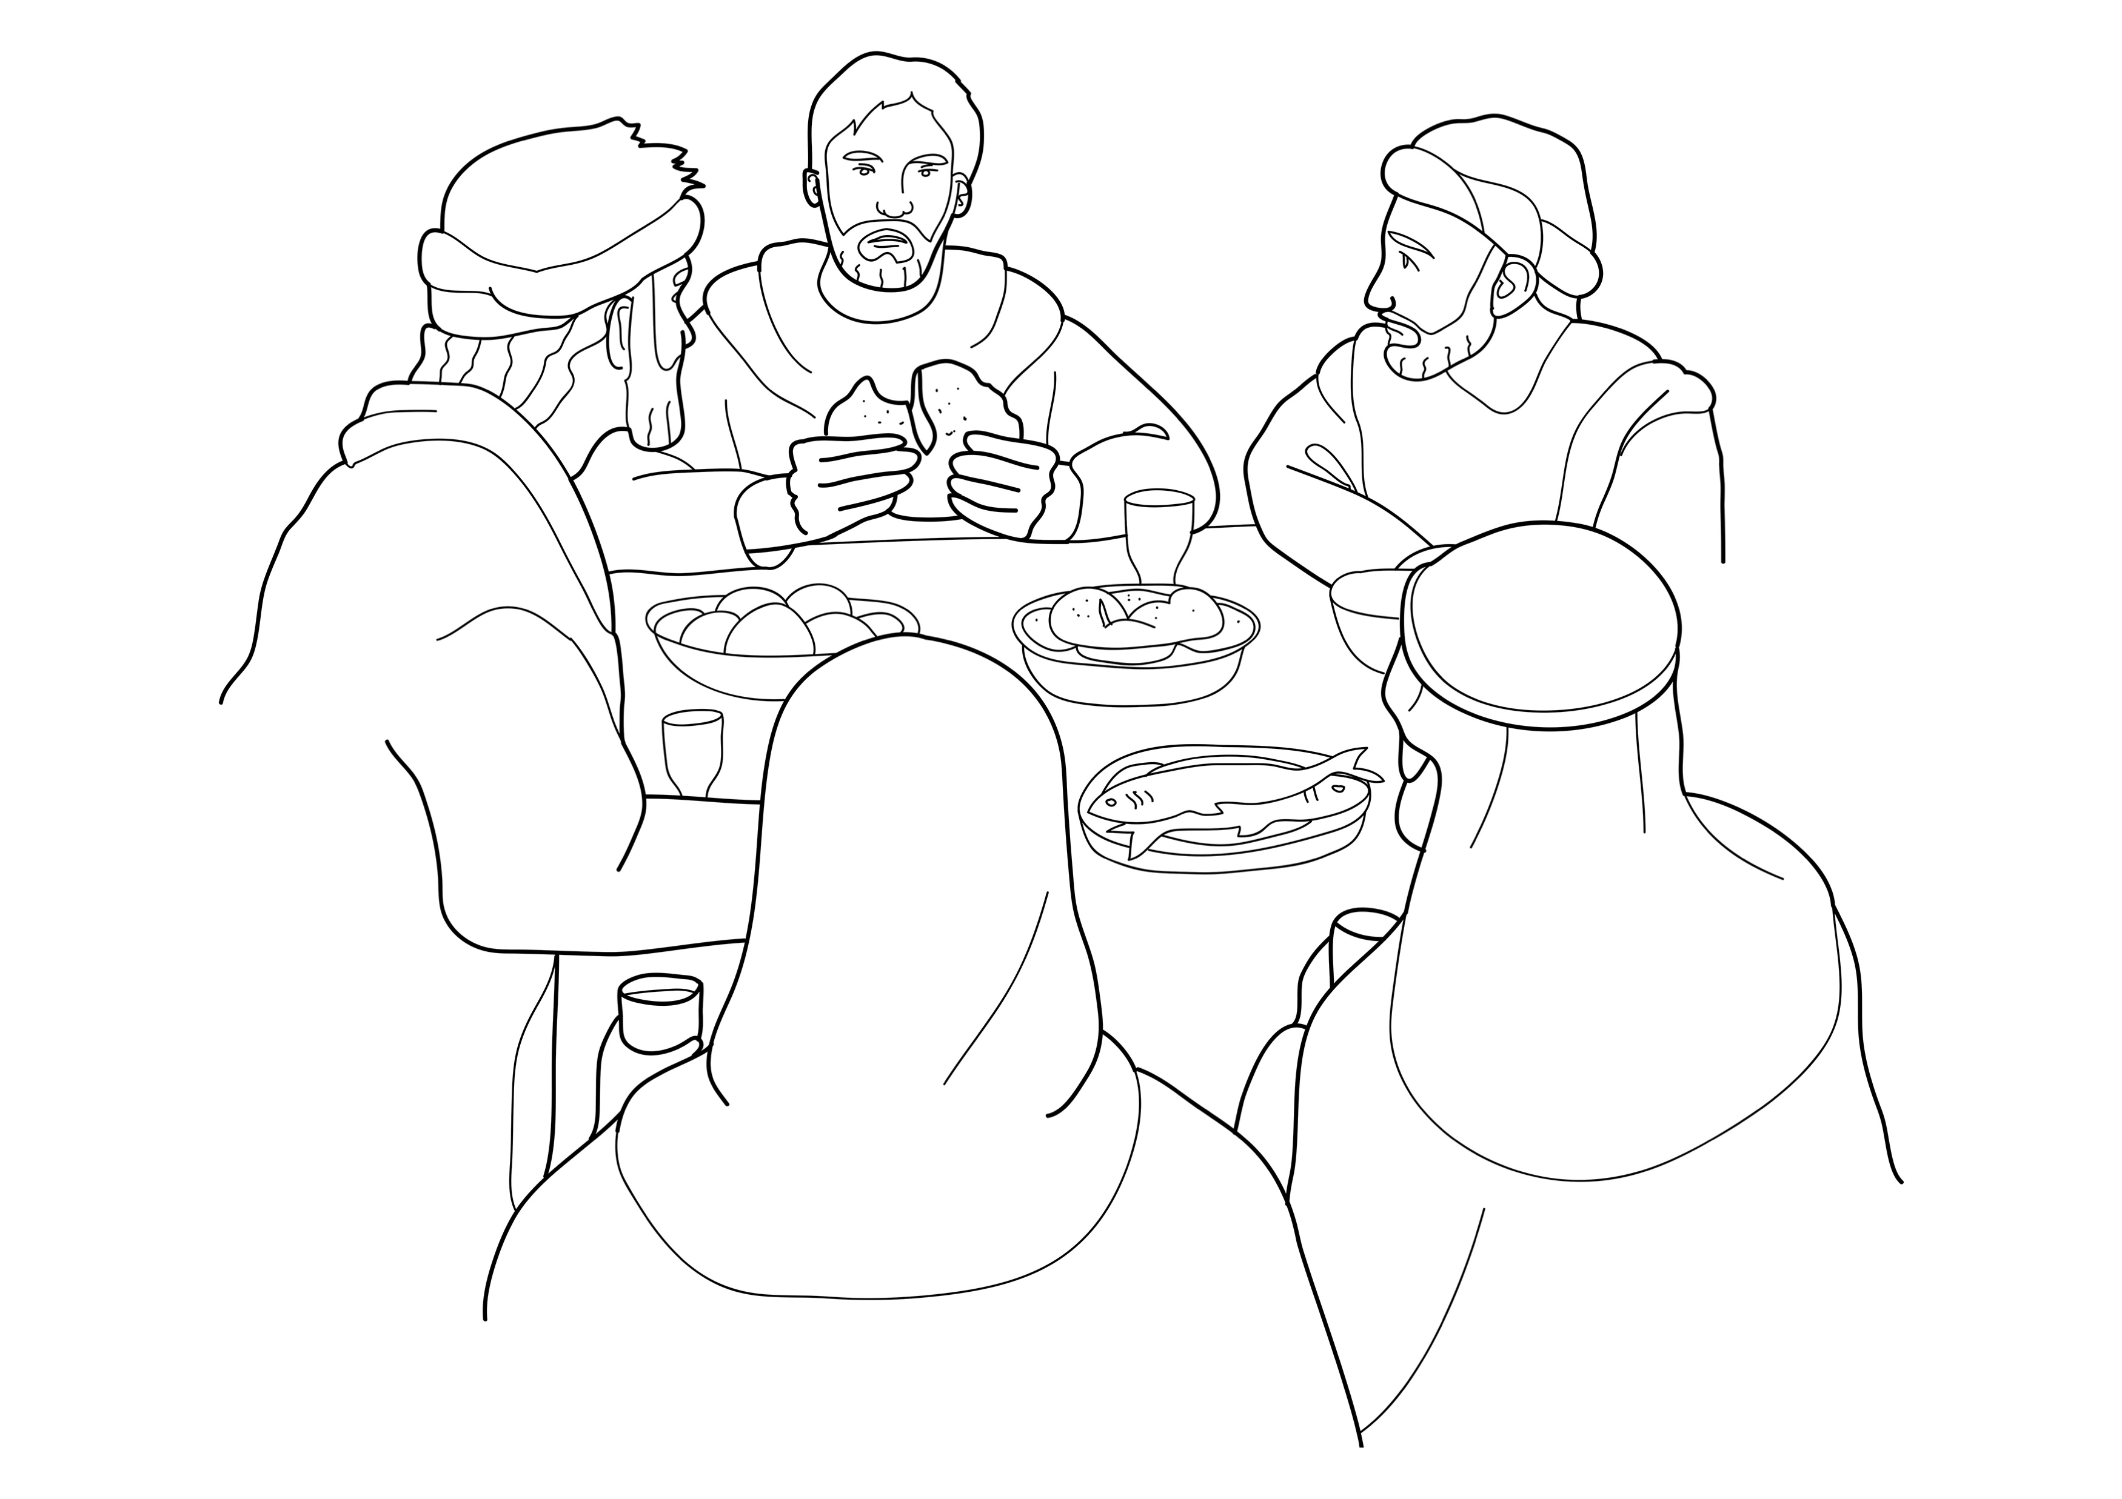
Jesus ate with his friends.
Notes:
Read for detail
[This slide and the 6 slides that follow contain RESOURCE 15.3 – Large sketches and RESOURCE 15.4 – Large sentences.]
Read the sentence on the slide aloud slowly.
Invite students to repeat the sentence after you.
Repeat several times to reinforce correct pronunciation.
Click through the presentation to display the remaining 6 sketches and sentences.

Slide 12
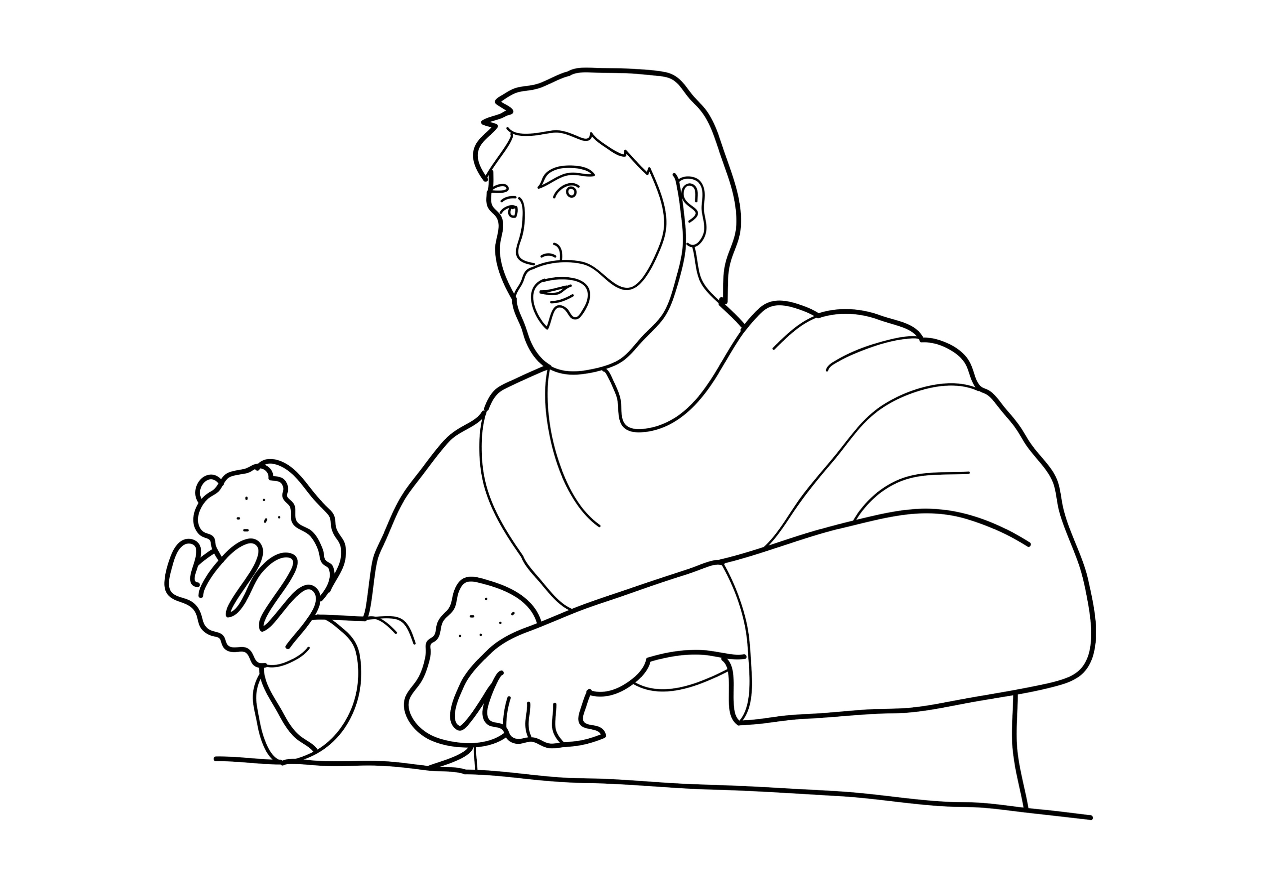
Jesus took bread and broke it.
Notes:
Read for detail (continued)
Read the sentence aloud slowly.
Invite students to repeat the sentence after you.
Repeat several times to reinforce correct pronunciation.

Slide 13
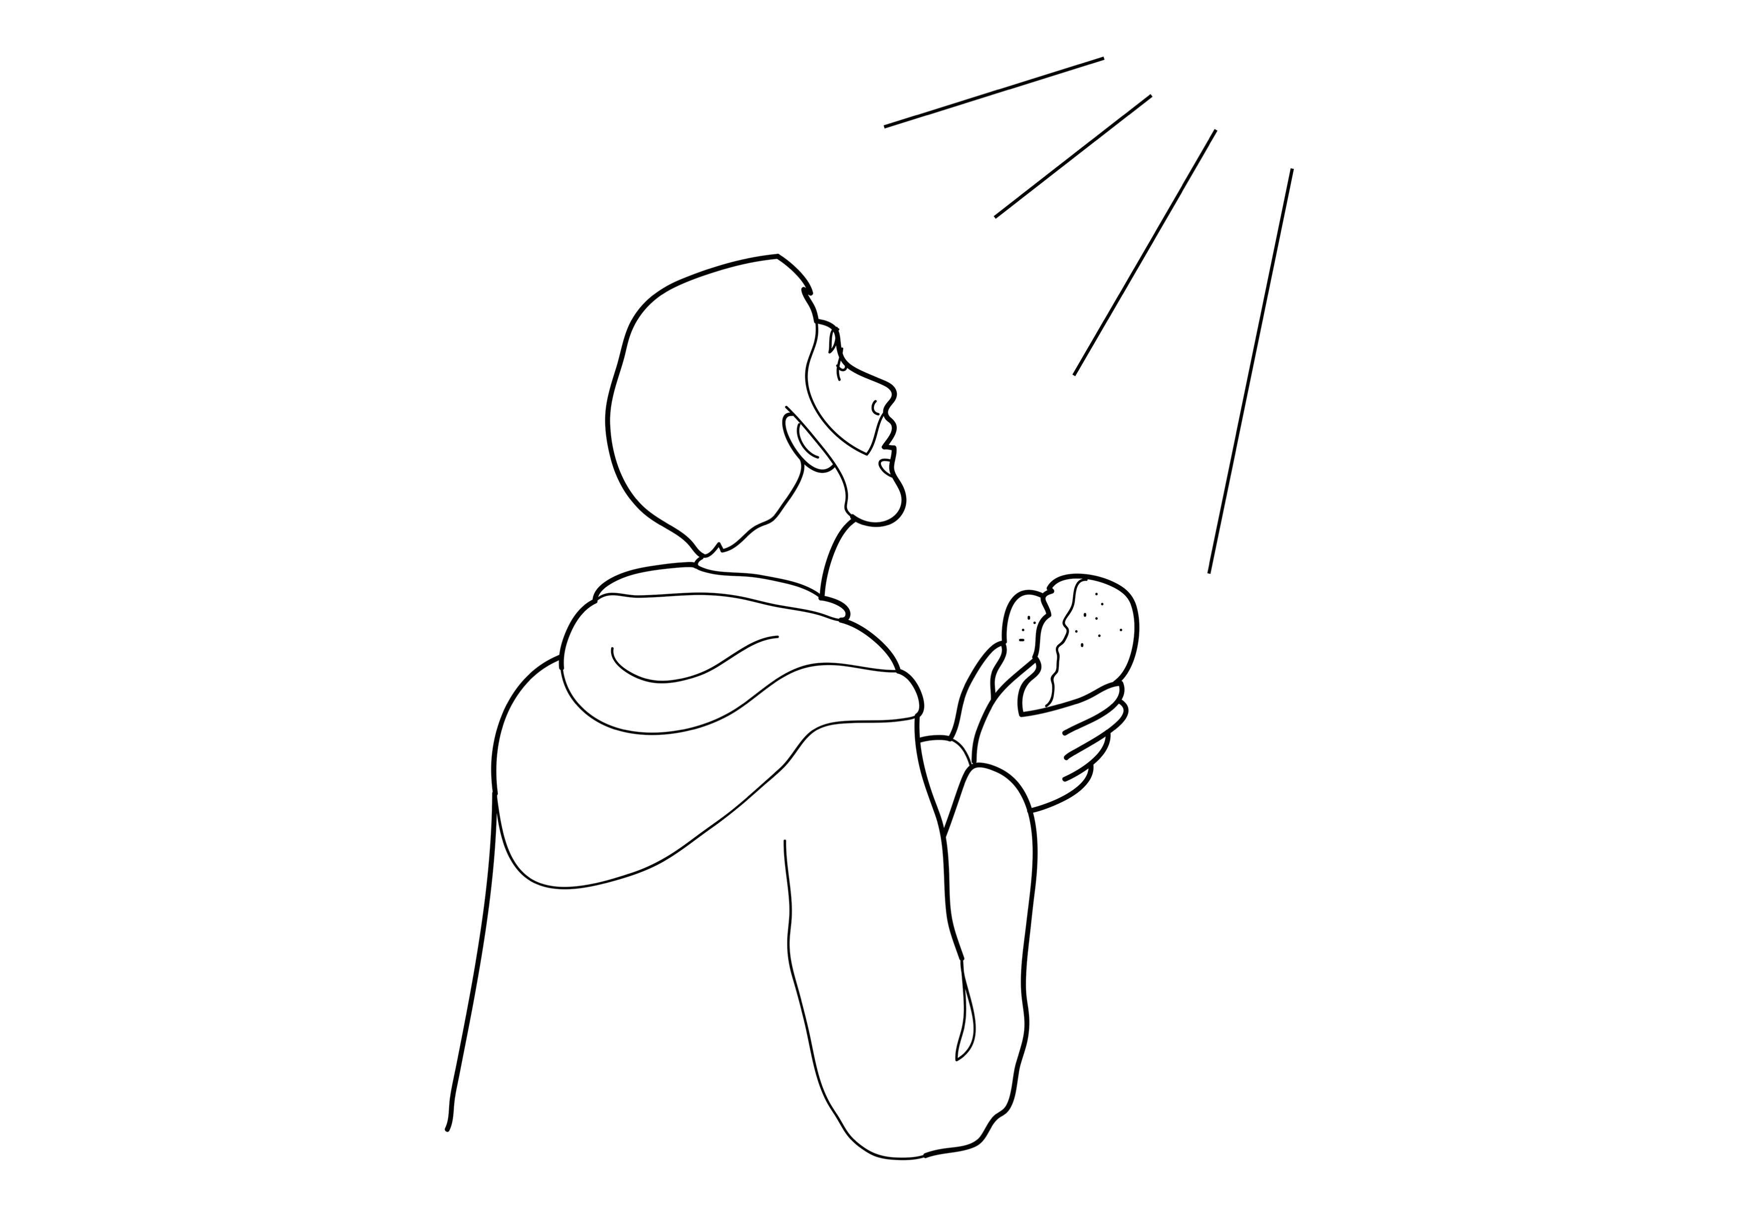
Jesus thanked God for the bread.
Notes:
Read for detail (continued)
Read the sentence aloud slowly.
Invite students to repeat the sentence after you.
Repeat several times to reinforce correct pronunciation.

Slide 14
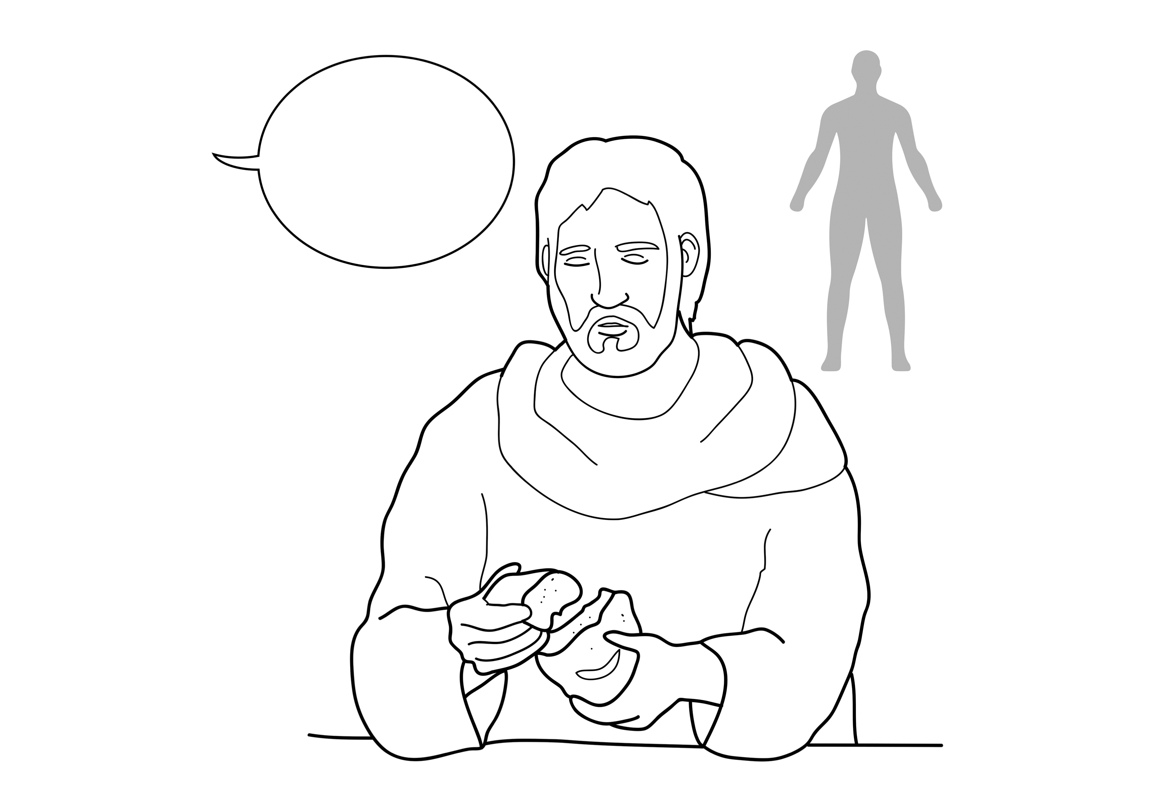
He said, ‘This is my body for you.’
Notes:
Read for detail (continued)
Read the sentence aloud slowly.
Invite students to repeat the sentence after you.
Repeat several times to reinforce correct pronunciation.

Slide 15
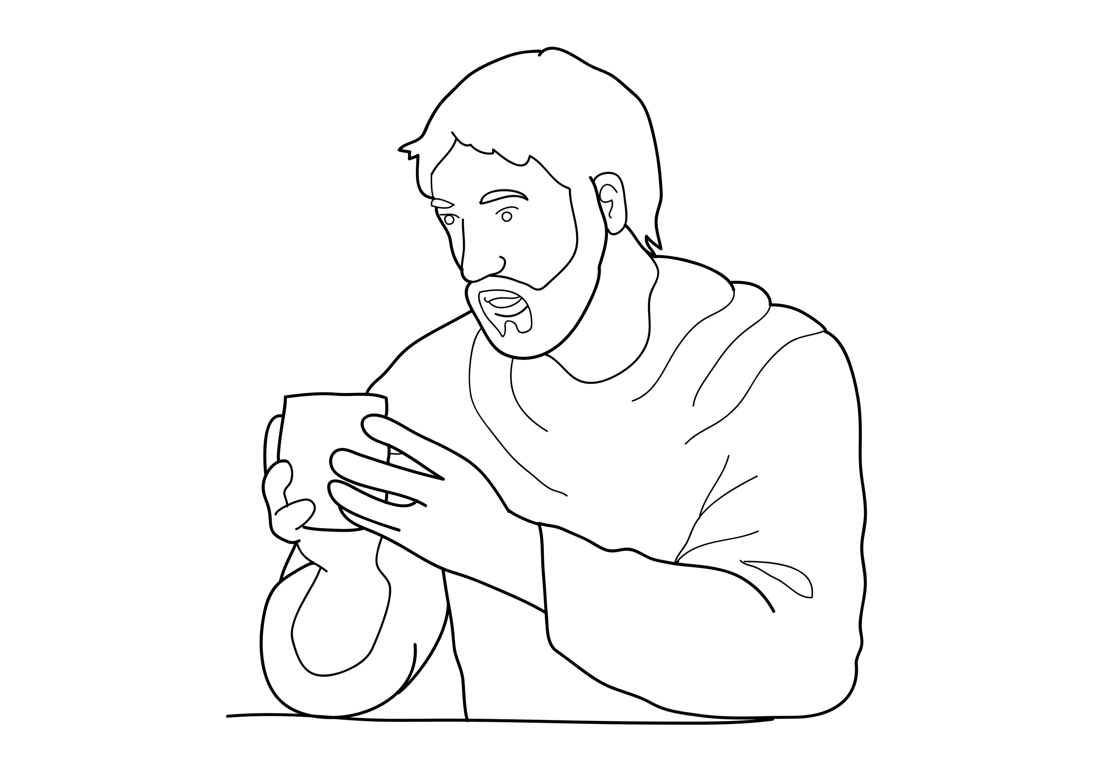
Jesus took a cup of wine.
Notes:
Read for detail (continued)
Read the sentence aloud slowly.
Invite students to repeat the sentence after you.
Repeat several times to reinforce correct pronunciation.

Slide 16
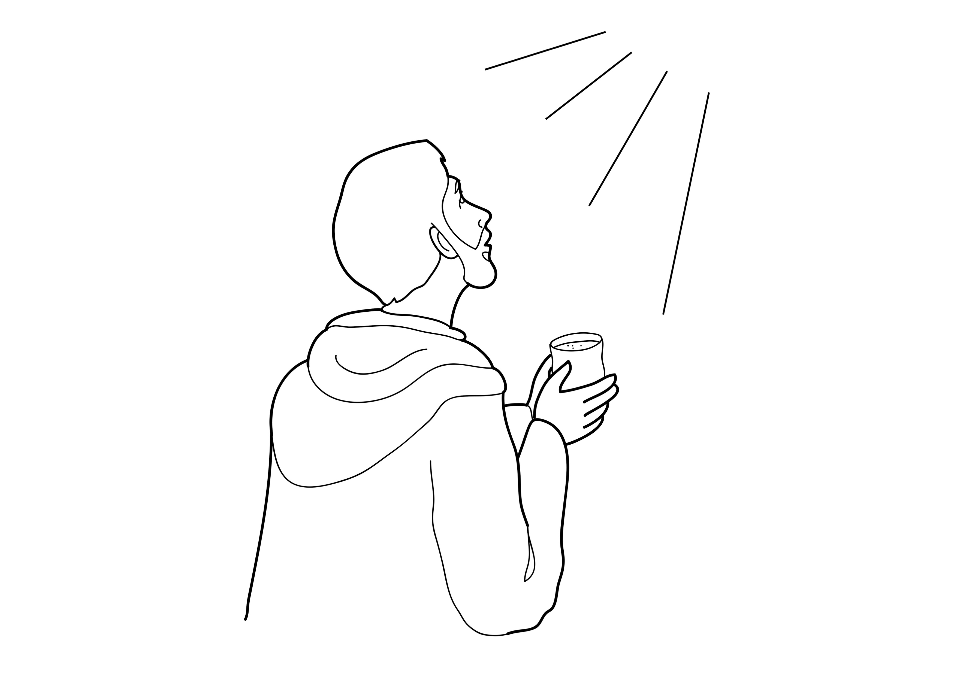
Jesus thanked God for the wine.
Notes:
Read for detail (continued)
Read the sentence aloud slowly.
Invite students to repeat the sentence after you.
Repeat several times to reinforce correct pronunciation.

Slide 17
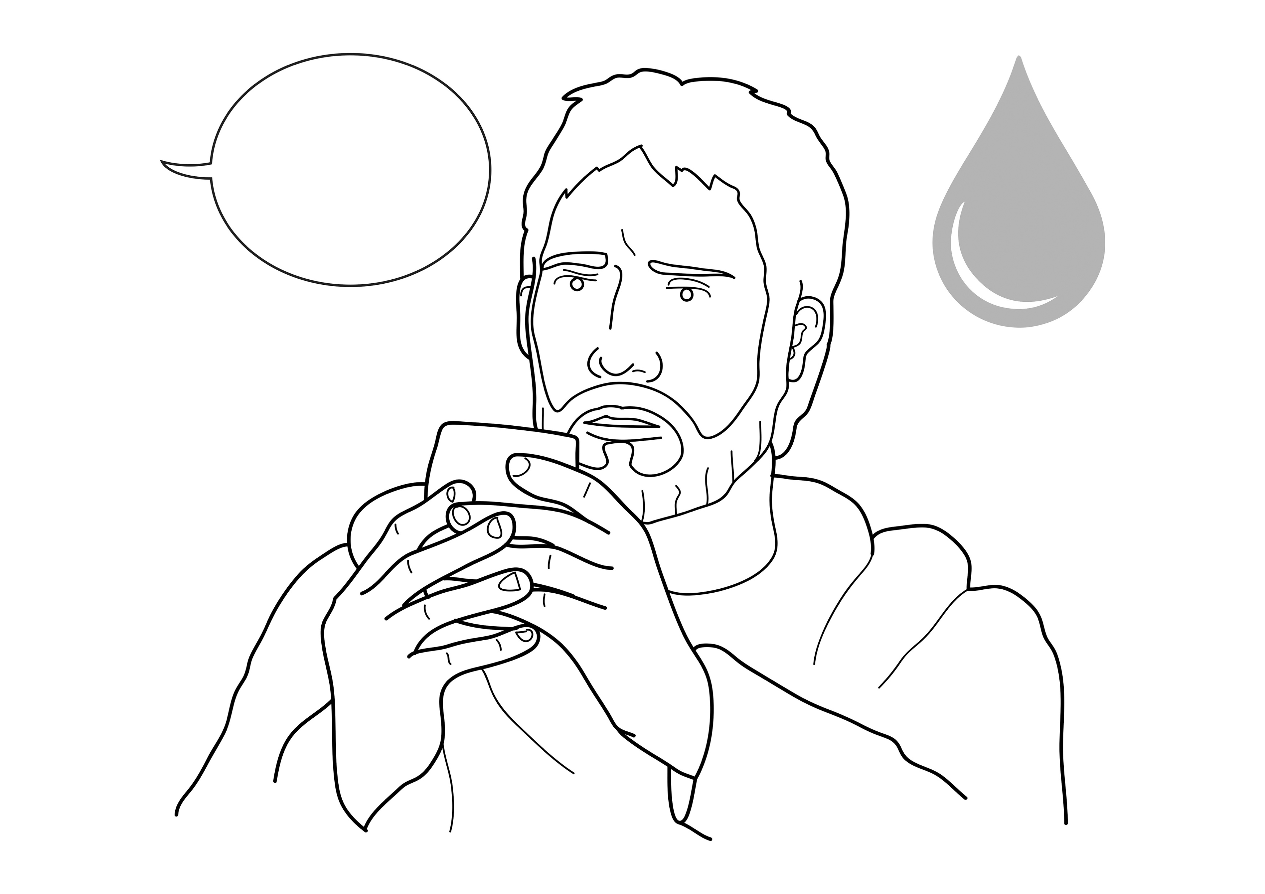
He said, ‘This is my blood for you.’
Notes:
Read for detail (continued)
Read the sentence aloud slowly.
Invite students to repeat the sentence after you.
Repeat several times to reinforce correct pronunciation.

Slide 18
Notes:
Reinforce the language
[The activity on this slide and the 6 slides that follow replaces the activity in the lesson book in which students point to corresponding sketches.]
Invite students to say any words that they remember about this sketch.
Accept responses.

Slide 19
Notes:
Reinforce the language (continued)
Invite students to say any words that they remember about this sketch.
Accept responses.

Slide 20
Notes:
Reinforce the language (continued)
Invite students to say any words that they remember about this sketch.
Accept responses.

Slide 21
Notes:
Reinforce the language (continued)
Invite students to say any words that they remember about this sketch.
Accept responses.

Slide 22
Notes:
Reinforce the language (continued)
Invite students to say any words that they remember about this sketch.
Accept responses.

Slide 23
Notes:
Reinforce the language (continued)
Invite students to say any words that they remember about this sketch.
Accept responses.

Slide 24
Notes:
Reinforce the language (continued)
Invite students to say any words that they remember about this sketch.
Accept responses.

Slide 25
Notes:
Reinforce the language (continued)
NB This slide will at first appear blank in Slide Show mode.
Distribute RESOURCE 15.5 – Small sketches (if using) to pairs/groups. [Alternatively, complete this activity together verbally using the PowerPoint slides.]
Invite pairs/groups to sequence or try to remember the sketches in the correct order.
Click your mouse to display the sketches one at a time in the correct order.

Slide 26
Jesus ate with his friends.
Notes:
Reinforce the language (continued)
Distribute RESOURCE 15.6 – Small sentence strips (if using) to pairs/groups.
Invite pairs/groups to match the sentence strips to the corresponding sketches (if using). More advanced students can sequence the sentence strips without looking at the sketches.
[Alternatively, complete this activity together verbally using the PowerPoint slides.]
Invite students to identify the sketch on the slide that corresponds to the sentence.
Click to display the arrow and confirm the correct response.

Slide 27
Jesus took bread and broke it.
Notes:
Reinforce the language (continued)
Invite students to point to the sketch on the slide that corresponds to the sentence.
Click to display the arrow and confirm the correct response.

Slide 28
Jesus thanked God for the bread.
Notes:
Reinforce the language (continued)
Invite students to point to the sketch on the slide that corresponds to the sentence.
Click to display the arrow and confirm the correct response.

Slide 29
He said, ‘This is my body for you.’
Notes:
Reinforce the language (continued)
Invite students to point to the sketch on the slide that corresponds to the sentence.
Click to display the arrow and confirm the correct response.

Slide 30
Jesus took a cup of wine.
Notes:
Reinforce the language (continued)
Invite students to point to the sketch on the slide that corresponds to the sentence.
Click to display the arrow and confirm the correct response.

Slide 31
Jesus thanked God for the wine.
Notes:
Reinforce the language (continued)
Invite students to point to the sketch on the slide that corresponds to the sentence.
Click to display the arrow and confirm the correct response.

Slide 32
He said, ‘This is my blood for you.’
Notes:
Reinforce the language (continued)
Invite students to point to the sketch on the slide that corresponds to the sentence.
Click to display the arrow and confirm the correct response.

Slide 33
1. Jesus _______ with his friends.
ate
Notes:
Reinforce the language (continued)
Distribute RESOURCE 15.7 – Gap-fill worksheet (if using) to each student. [Alternatively, complete this activity together verbally using the PowerPoint slides.]
Encourage students to work together to complete the worksheet.
Click to reveal the missing word and check the answer together.

Slide 34
2. Jesus took _______ and broke it.
bread
Notes:
Reinforce the language (continued)
Click to reveal the missing word and check the answer together.

Slide 35
thanked
3. Jesus _________ God for the bread.
Notes:
Reinforce the language (continued)
Click to reveal the missing word and check the answer together.

Slide 36
4. He said,
‘This is my _______ for you.’
body
Notes:
Reinforce the language (continued)
Click to reveal the missing word and check the answer together.

Slide 37
5. Jesus took a _______ of wine.
cup
Notes:
Reinforce the language (continued)
Click to reveal the missing word and check the answer together.

Slide 38
6. Jesus thanked _______ for the wine.
God
Notes:
Reinforce the language (continued)
Click to reveal the missing word and check the answer together.

Slide 39
7. He said,
‘This is my ________ for you.’
blood
Notes:
Reinforce the language (continued)
Click to reveal the missing word and check the answer together.

