Slide 1
Lesson 20
Meet Jesus
Volume 2
Ten Bible-based English lessons
High Beginner
Notes:
(Lesson 20 title page)

Slide 2
Lesson 20
PART 1
Talking about the future
Notes:
(Part 1 title page)

Slide 3
The sun ___________ set (go down) tonight.
The sun __________ rise (come up) tomorrow.
Next birthday, I ___________ be [insert age] years old.
Notes:
Activate knowledge
Say ‘Today we are talking about the future.’
Invite a volunteer to tell you the missing word from the line on the screen.
Click to reveal the next sentence.
Invite another volunteer to tell you the missing word from the line on the screen.
Click to reveal the final sentence.
Invite a third volunteer to tell you the missing word from the line on the screen.
Divide students into pairs.
Invite students to share the sentence about their next birthday with their partners.

Slide 4
Tonight I will …
Next week I will ...
Next year I will …
Notes:
Focus on language
Activity 1: Brainstorming plans
Divide students into small groups of 3–4. [Alternatively, if online, complete the activity together verbally using the PowerPoint slide. Use the chat function (if available) to record student responses.]
Invite a volunteer to complete the sentence on the slide.
Give each group a piece of A4 paper with Tonight I will … written at the top.
Invite groups to discuss their plans for the evening – e.g. ‘cook dinner’, ‘brush my teeth’, ‘read a book’.
Invite students to complete the sentence with as many ideas as possible and write them on their piece of paper.
Write responses on the board, correcting errors as you go. (Note: If you have enough helpers, error correction can be done in small groups.)
Click to display the next sentence prompt.
Give each group a piece of A4 paper with Next week I will … written at the top.
Repeat the activity using this sentence prompt (e.g. ‘go to the dentist’, ‘have a haircut’).
Click to display the next sentence prompt.
Give each group a piece of A4 paper with Next year I will … written at the top.
Repeat the activity using this sentence prompt (e.g. ‘visit Malaysia’, ‘be a grandmother’).

Slide 5
Weekend activities
Notes:
Focus on language (continued)
Activity 2: Matching activity
Distribute one copy of RESOURCE 20.1 – Weekend activities to each group.
Invite students to name each of the activities.
Distribute RESOURCE 20.2 – Weekend words (if using) to each group. (Note: this step may only be necessary if students are not able to name all of the activities in RESOURCE 20.1 – Weekend activities. Assess whether your class needs to do this part of the activity.)
Invite students to match the words to the activities.
Check answers and practise pronunciation together by clicking through following slides and reading the answers aloud.

Slide 6
Cook
Walk the dog
Talk to friends
Watch TV
Play tennis
Go to the beach
Sleep
Go for a bike ride
Read a book
Spend time with family
Notes:
Focus on language (continued)
Activity 2: Matching activity (continued)
Click to reveal the answer and practise saying it together, focusing on pronunciation.

Slide 7
Cook
Walk the dog
Talk to friends
Watch TV
Play tennis
Go to the beach
Sleep
Go for a bike ride
Read a book
Spend time with family
Notes:
Focus on language (continued)
Activity 2: Matching activity (continued)
Click to reveal the answer and practise saying it together, focusing on pronunciation.

Slide 8
Cook
Walk the dog
Talk to friends
Watch TV
Play tennis
Go to the beach
Sleep
Go for a bike ride
Read a book
Spend time with family
Notes:
Focus on language (continued)
Activity 2: Matching activity (continued)
Click to reveal the answer and practise saying it together, focusing on pronunciation.

Slide 9
Cook
Walk the dog
Talk to friends
Watch TV
Play tennis
Go to the beach
Sleep
Go for a bike ride
Read a book
Spend time with family
Notes:
Focus on language (continued)
Activity 2: Matching activity (continued)
Click to reveal the answer and practise saying it together, focusing on pronunciation.

Slide 10
Cook
Walk the dog
Talk to friends
Watch TV
Play tennis
Go to the beach
Sleep
Go for a bike ride
Read a book
Spend time with family
Notes:
Focus on language (continued)
Activity 2: Matching activity (continued)
Click to reveal the answer and practise saying it together, focusing on pronunciation.

Slide 11
Cook
Walk the dog
Talk to friends
Watch TV
Play tennis
Go to the beach
Sleep
Go for a bike ride
Read a book
Spend time with family
Notes:
Focus on language (continued)
Activity 2: Matching activity (continued)
Click to reveal the answer and practise saying it together, focusing on pronunciation.

Slide 12
Cook
Walk the dog
Talk to friends
Watch TV
Play tennis
Go to the beach
Sleep
Go for a bike ride
Read a book
Spend time with family
Notes:
Focus on language (continued)
Activity 2: Matching activity (continued)
Click to reveal the answer and practise saying it together, focusing on pronunciation.

Slide 13
Cook
Walk the dog
Talk to friends
Watch TV
Play tennis
Go to the beach
Sleep
Go for a bike ride
Read a book
Spend time with family
Notes:
Focus on language (continued)
Activity 2: Matching activity (continued)
Click to reveal the answer and practise saying it together, focusing on pronunciation.

Slide 14
Cook
Walk the dog
Talk to friends
Watch TV
Play tennis
Go to the beach
Sleep
Go for a bike ride
Read a book
Spend time with family
Notes:
Focus on language (continued)
Activity 2: Matching activity (continued)
Click to reveal the answer and practise saying it together, focusing on pronunciation.

Slide 15
Cook
Walk the dog
Talk to friends
Watch TV
Play tennis
Go to the beach
Sleep
Go for a bike ride
Read a book
Spend time with family
Notes:
Focus on language (continued)
Activity 2: Matching activity (continued)
Click to reveal the answer and practise saying it together, focusing on pronunciation.

Slide 16
On a perfect weekend, I will ___________, ___________ and ___________.
Notes:
Focus on language (continued)
Activity 3: Speaking practice
Invite a volunteer to choose three preferred activities from RESOURCE 20.1 – Weekend activities and complete the sentence above.
Reallocate student groups. [If online, complete together as a whole group.]
Invite students to share the sentence with their group members. (Invite students to include activities not listed in RESOURCE 20.1 – Weekend activities if they wish.)
Invite volunteers to share their perfect weekend with the whole class.
Write sentences on the board, correcting errors as you go.

Slide 17
Lesson 20
PART 2
Jesus is taken to heaven
Acts 1:6–11
Notes:
(Part 2 title page)

Slide 18

Notes:
Read for gist
Say ‘In the Bible story, Jesus talks about the future.’
Distribute copies of Acts 1:6–11 in your students’ heart languages (if in the classroom). [Alternatively, if online, invite students to refer to the heart language texts they have been sent in advance.]
Give students a few minutes to read the text silently for context, then ask them to put it away for the rest of the lesson.

Slide 19
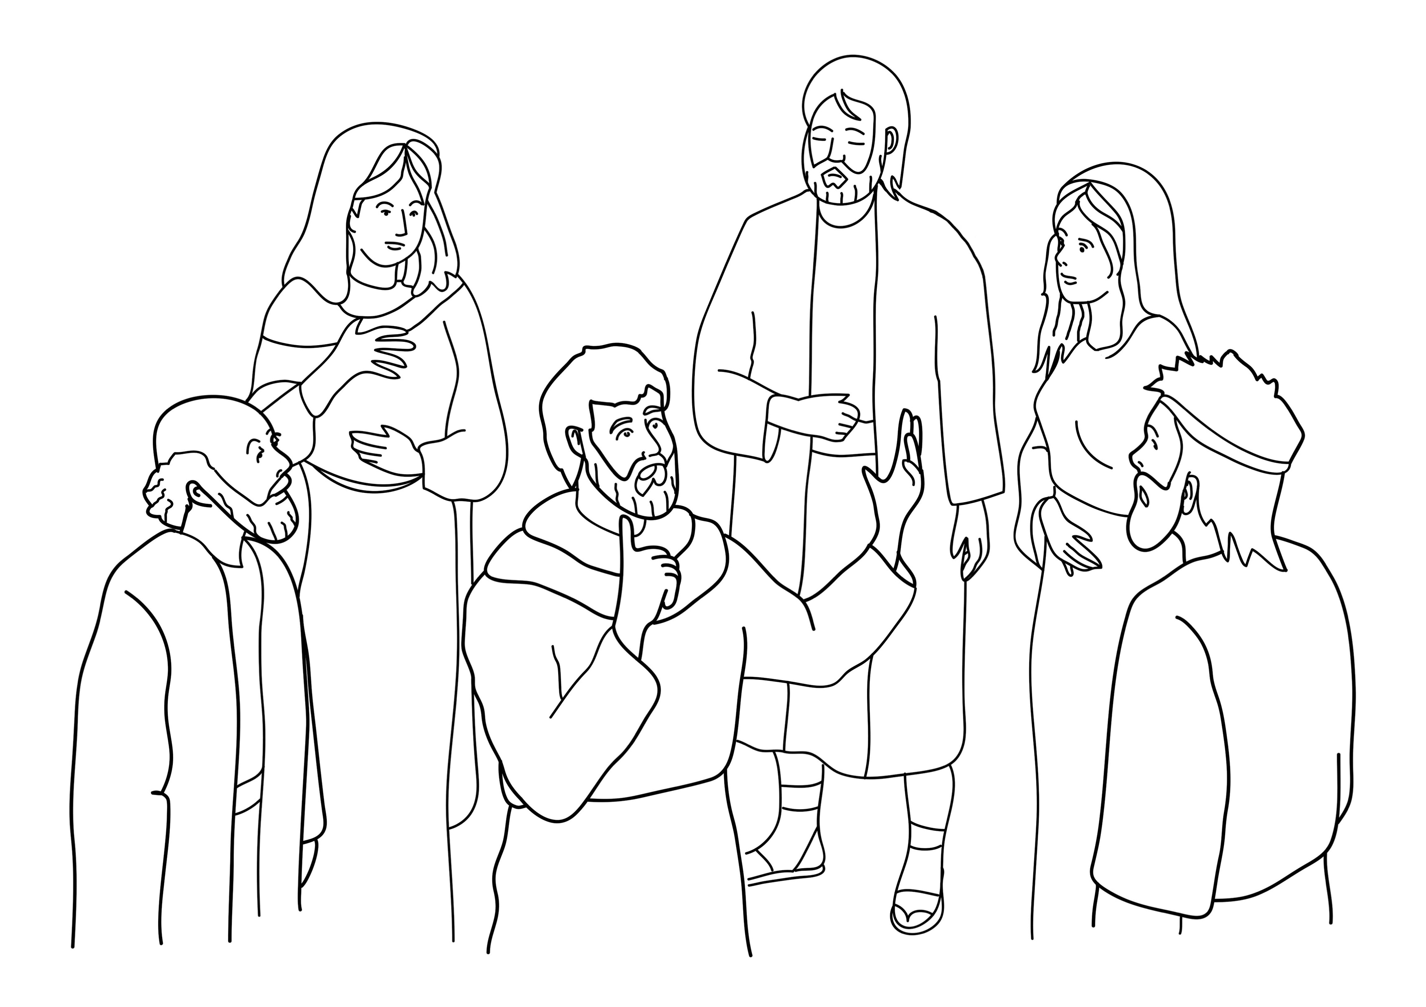
Jesus talked to his friends.
Notes:
Read for detail
[This slide and the 6 slides that follow contain RESOURCE 20.3 – Large sketches and RESOURCE 20.4 – Large sentences.]
Read the sentence on the slide aloud slowly.
Invite students to repeat the sentence after you.
Repeat several times to reinforce correct pronunciation.
Click through the presentation to display the remaining 6 sketches and sentences.

Slide 20
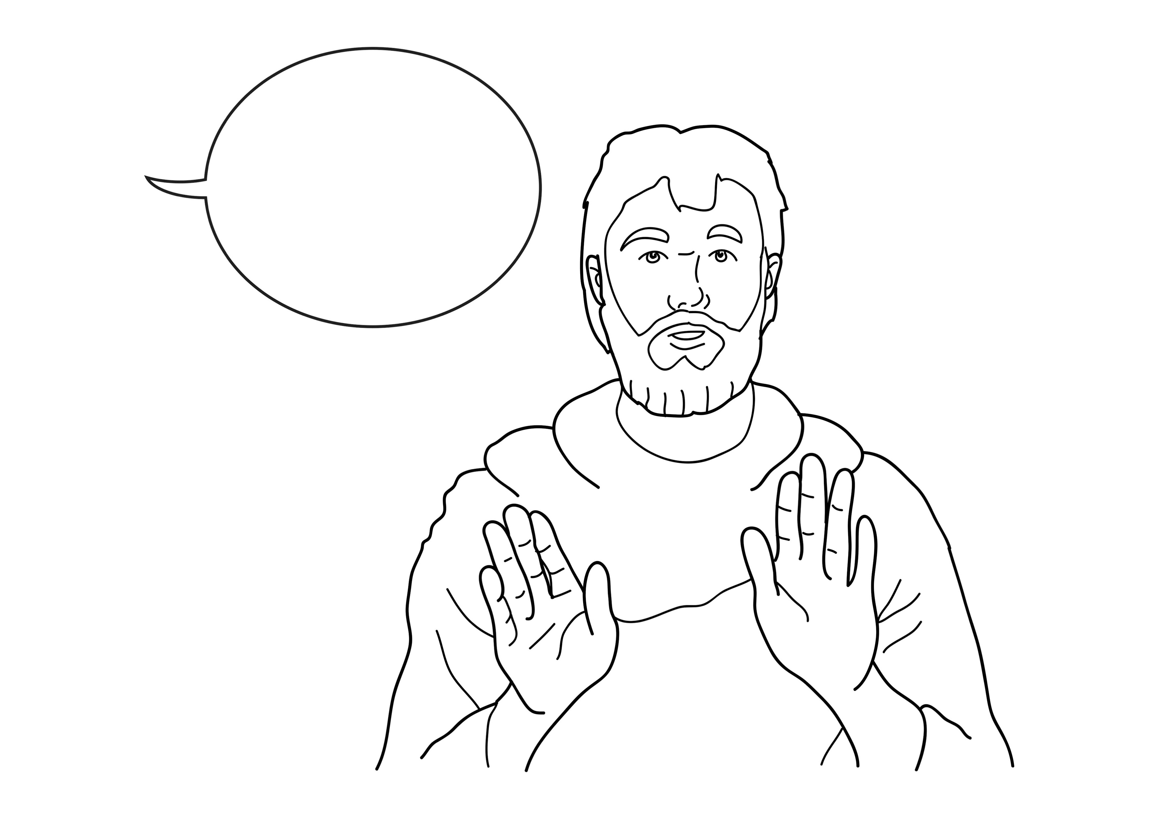
He said, ‘Don’t worry about the future.’
Notes:
Read for detail (continued)
Read the sentence aloud slowly.
Invite students to repeat the sentence after you.
Repeat several times to reinforce correct pronunciation.

Slide 21
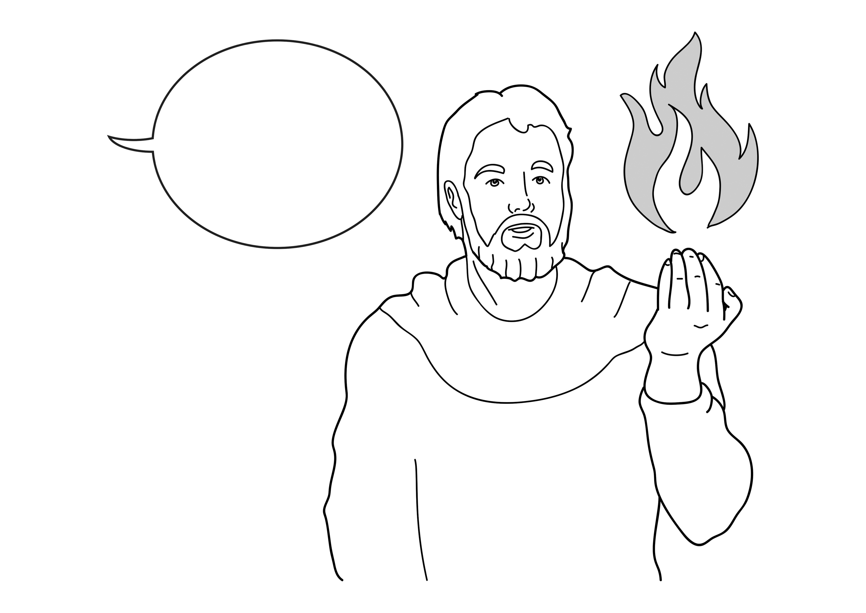
He said, ‘God’s Spirit will come.’
Notes:
Read for detail (continued)
Read the sentence aloud slowly.
Invite students to repeat the sentence after you.
Repeat several times to reinforce correct pronunciation.

Slide 22
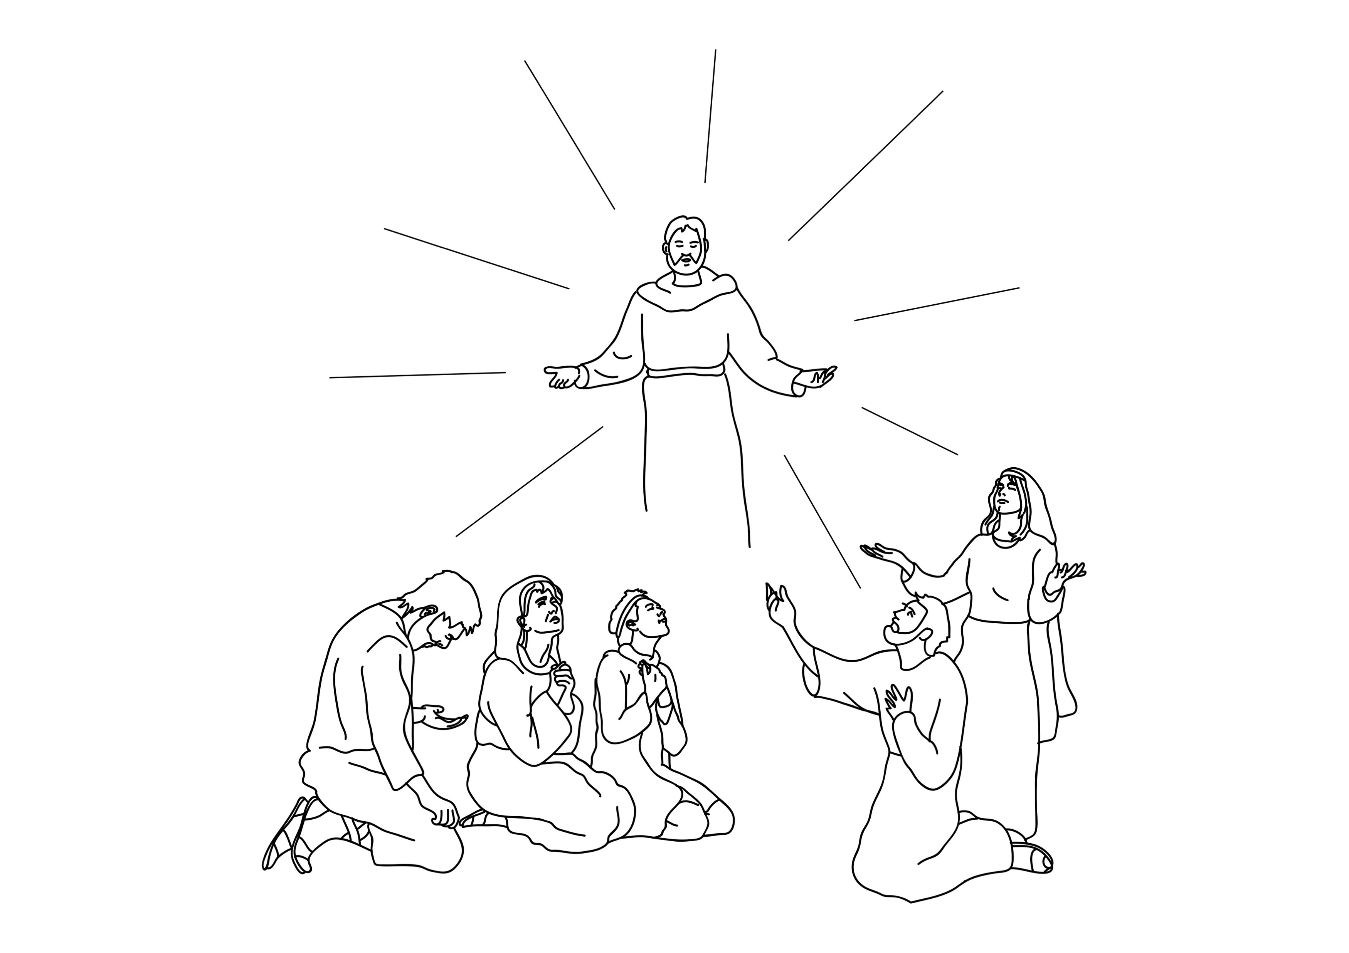
Jesus was taken to heaven.
Notes:
Read for detail (continued)
Read the sentence aloud slowly.
Invite students to repeat the sentence after you.
Repeat several times to reinforce correct pronunciation.

Slide 23
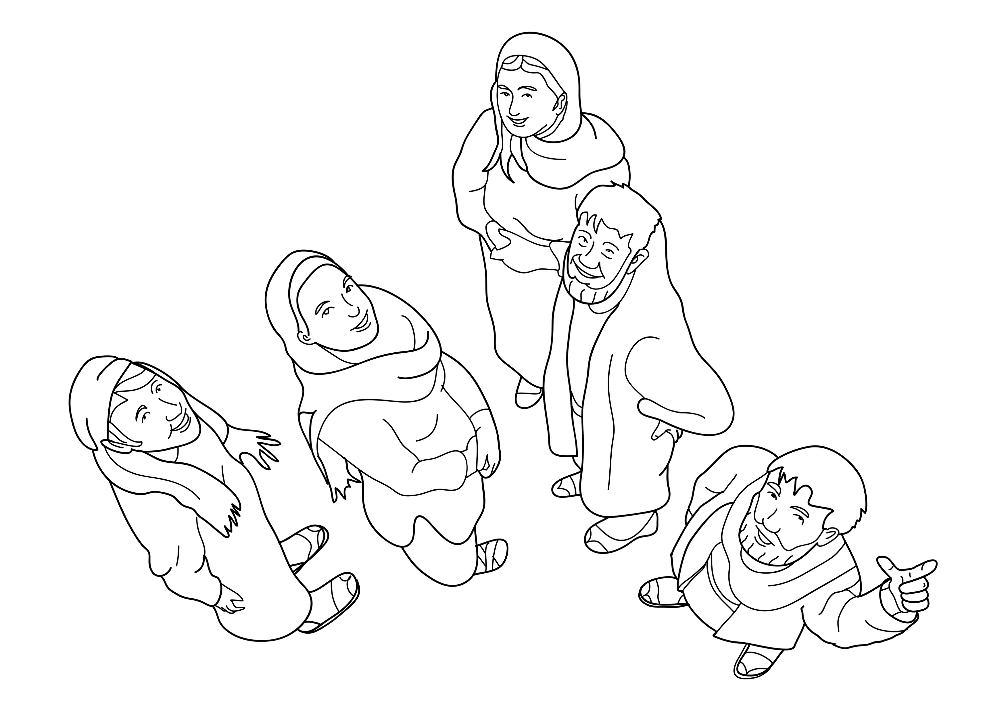
Jesus’ friends looked up.
Notes:
Read for detail (continued)
Read the sentence aloud slowly.
Invite students to repeat the sentence after you.
Repeat several times to reinforce correct pronunciation.

Slide 24
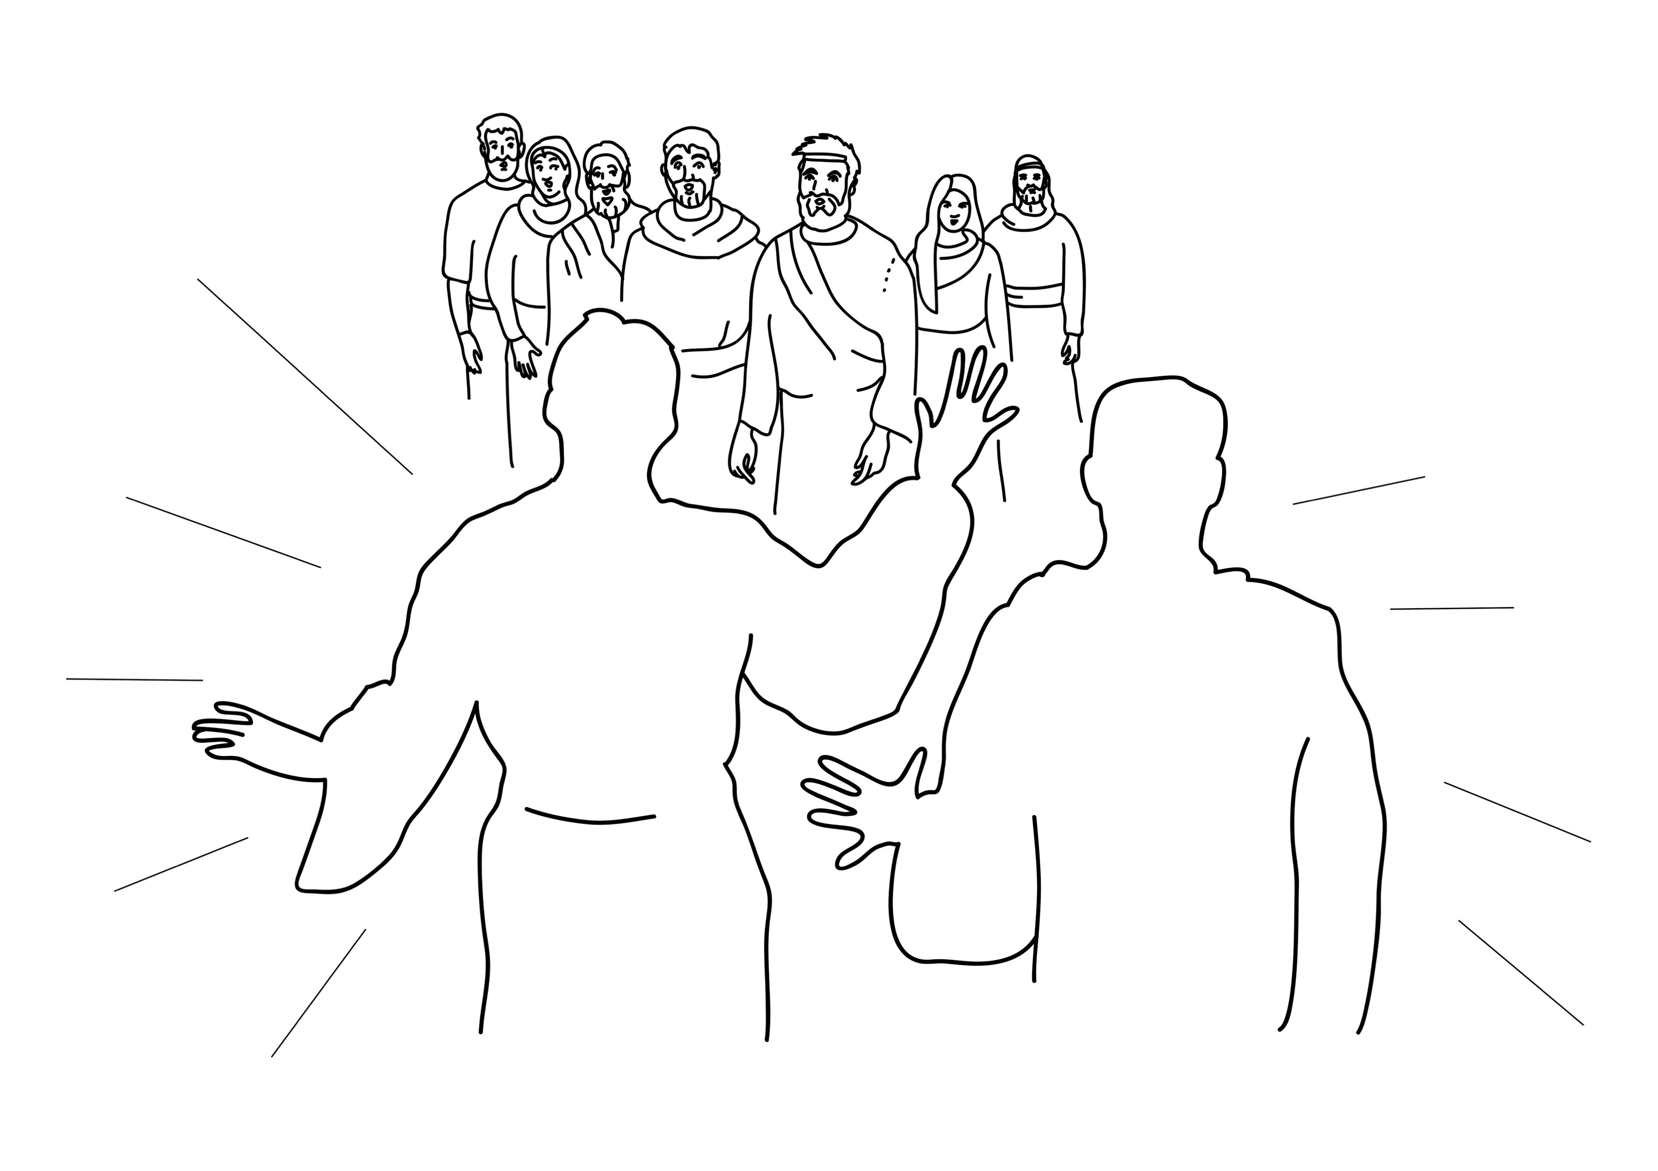
Two men appeared.
Notes:
Read for detail (continued)
Read the sentence aloud slowly.
Invite students to repeat the sentence after you.
Repeat several times to reinforce correct pronunciation.

Slide 25
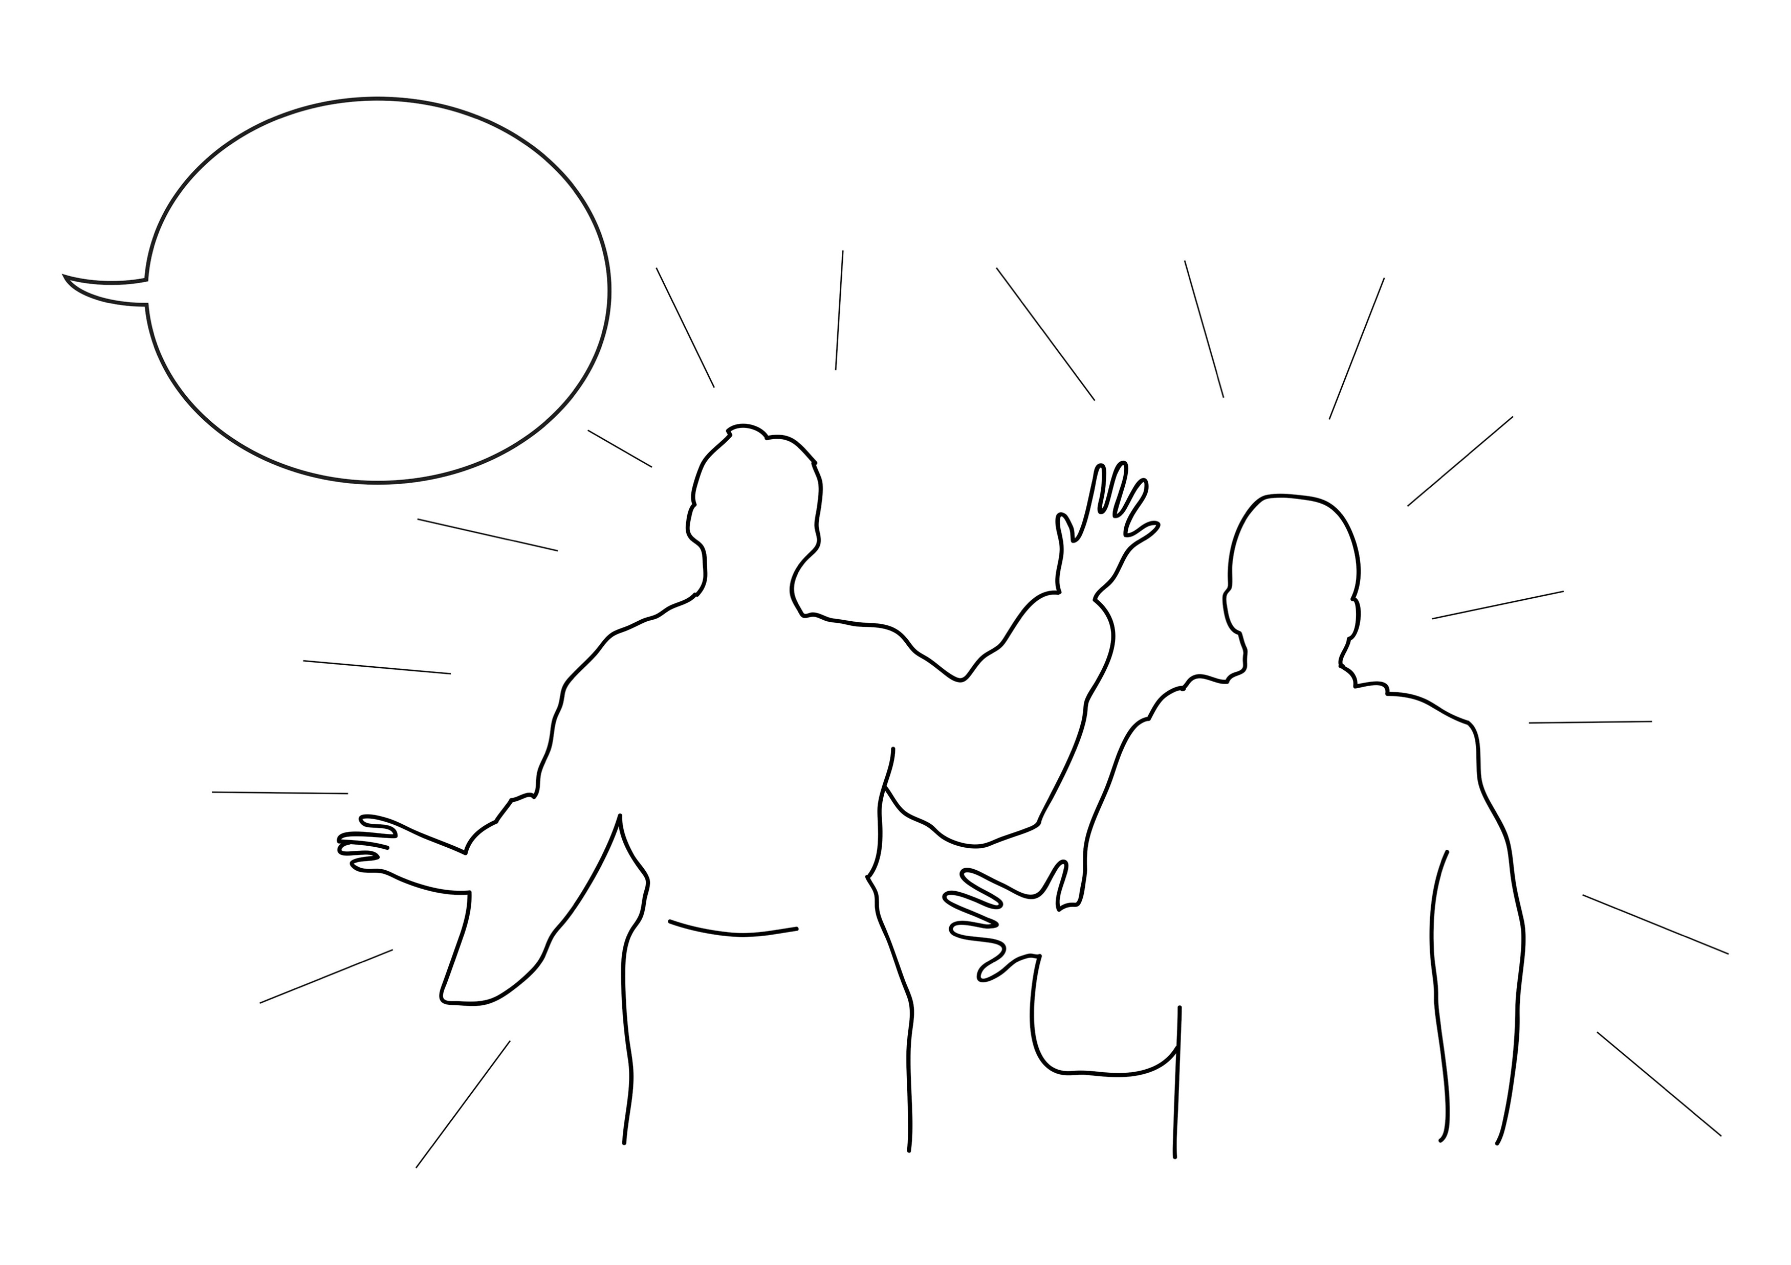
They said, ‘Jesus will return.’
Notes:
Read for detail (continued)
Read the sentence aloud slowly.
Invite students to repeat the sentence after you.
Repeat several times to reinforce correct pronunciation.

Slide 26
Notes:
Reinforce the language
[The activity on this slide and the 6 slides that follow replaces the activity in the lesson book in which students point to corresponding sketches.]
Invite students to say any words that they remember about this sketch.
Accept responses.

Slide 27
Notes:
Reinforce the language (continued)
Invite students to say any words that they remember about this sketch.
Accept responses.

Slide 28
Notes:
Reinforce the language (continued)
Invite students to say any words that they remember about this sketch.
Accept responses.

Slide 29
Notes:
Reinforce the language (continued)
Invite students to say any words that they remember about this sketch.
Accept responses.

Slide 30
Notes:
Reinforce the language (continued)
Invite students to say any words that they remember about this sketch.
Accept responses.

Slide 31
Notes:
Reinforce the language (continued)
Invite students to say any words that they remember about this sketch.
Accept responses.

Slide 32
Notes:
Reinforce the language (continued)
Invite students to say any words that they remember about this sketch.
Accept responses.

Slide 33
Notes:
Reinforce the language (continued)
NB This slide will at first appear blank in Slide Show mode.
Distribute RESOURCE 20.5 – Small sketches (if using) to pairs/groups. [Alternatively, complete this activity together verbally using the PowerPoint slides.]
Invite pairs/groups to sequence or try to remember the sketches in the correct order.
Click your mouse to display the sketches one at a time in the correct order.

Slide 34
Jesus talked to his friends.
Notes:
Reinforce the language (continued)
Distribute RESOURCE 20.6 – Small sentence strips (if using) to pairs/groups.
Invite pairs/groups to match the sentence strips to the corresponding sketches (if using). More advanced students can sequence the sentence strips without looking at the sketches.
[Alternatively, complete this activity together verbally using the PowerPoint slides.]
Invite students to identify the sketch on the slide that corresponds to the sentence.
Click to display the arrow and confirm the correct response.

Slide 35
He said, ‘Don’t worry about the future.’
Notes:
Reinforce the language (continued)
Invite students to point to the sketch on the slide that corresponds to the sentence.
Click to display the arrow and confirm the correct response.

Slide 36
He said, ‘God’ Spirit will come.’
Notes:
Reinforce the language (continued)
Invite students to point to the sketch on the slide that corresponds to the sentence.
Click to display the arrow and confirm the correct response.

Slide 37
Jesus was taken to heaven.
Notes:
Reinforce the language (continued)
Invite students to point to the sketch on the slide that corresponds to the sentence.
Click to display the arrow and confirm the correct response.

Slide 38
Jesus’ friends looked up.
Notes:
Reinforce the language (continued)
Invite students to point to the sketch on the slide that corresponds to the sentence.
Click to display the arrow and confirm the correct response.

Slide 39
Two men appeared.
Notes:
Reinforce the language (continued)
Invite students to point to the sketch on the slide that corresponds to the sentence.
Click to display the arrow and confirm the correct response.

Slide 40
They said, ‘Jesus will return.’
Notes:
Reinforce the language (continued)
Invite students to point to the sketch on the slide that corresponds to the sentence.
Click to display the arrow and confirm the correct response.

Slide 41
1. Jesus _________ to his friends.
talked
Notes:
Reinforce the language (continued)
Distribute RESOURCE 20.7 – Gap-fill worksheet (if using) to each student. [Alternatively, complete this activity together verbally using the PowerPoint slides.]
Encourage students to work together to complete the worksheet.
Click to reveal the missing word and check the answer together.

Slide 42
2. He said,
‘Don’t worry about the _________.’
future
Notes:
Reinforce the language (continued)
Click to reveal the missing word and check the answer together.

Slide 43
3. He said,
‘God’s Spirit ________ come.’
will
Notes:
Reinforce the language (continued)
Click to reveal the missing word and check the answer together.

Slide 44
4. ________ was taken to heaven.
Jesus
Notes:
Reinforce the language (continued)
Click to reveal the missing word and check the answer together.

Slide 45
5. Jesus’ _________ looked up.
friends
Notes:
Reinforce the language (continued)
Click to reveal the missing word and check the answer together.

Slide 46
appeared
6. Two men ___________.
Notes:
Reinforce the language (continued)
Click to reveal the missing word and check the answer together.

Slide 47
7. They said,
‘Jesus ________ return.’
will
Notes:
Reinforce the language (continued)
Click to reveal the missing word and check the answer together.

