Slide 1
Lesson 10
Meet Jesus
Volume 1
Ten Bible-based English lessons
High Beginner
Notes:
(Lesson 1 title page)

Slide 2
Lesson 10
PART 1
Using our voices
Notes:
(Part 1 title page)

Slide 3
t a l k
_ _ _ _
talked
Notes:
Activate knowledge
Play a game of hangman.
Invite students to suggest letters to complete the word on the slide (talk).
Click to display the word talk when students have guessed the word.
Ask ‘What is the past tense of talk?’
Invite responses.
Click to display the word talked.

Slide 4
o b e y
_ _ _ _
obeyed
Notes:
Activate knowledge (continued)
Invite students to suggest letters to complete the word on the slide (obey).
Click to display the word obey when students have guessed the word.
Ask ‘What is the past tense of obey?’
Invite responses.
Click to display the word obeyed.

Slide 5
t e a c h
_ _ _ _ _
taught
Notes:
Activate knowledge (continued)
Invite students to suggest letters to complete the word on the slide (teach).
Click to display the word teach when students have guessed the word.
Ask ‘What is the past tense of teach?’
Invite responses.
Click to display the word taught.

Slide 6
s a y
_ _ _
said
Notes:
Activate knowledge (continued)
Invite students to suggest letters to complete the word on the slide (say).
Click to display the word say when students have guessed the word.
Ask ‘What is the past tense of say?’
Invite responses.
Click to display the word said.

Slide 7
l e a v e
_ _ _ _ _
left
Notes:
Activate knowledge (continued)
Invite students to suggest letters to complete the word on the slide (leave).
Click to display the word leave when students have guessed the word.
Ask ‘What is the past tense of leave?’
Invite responses.
Click to display the word left.

Slide 8
h a v e
_ _ _ _
had
Notes:
Activate knowledge (continued)
Invite students to suggest letters to complete the word on the slide (have).
Click to display the word have when students have guessed the word.
Ask ‘What is the past tense of have?’
Invite responses.
Click to display the word had.

Slide 9
s h o u t
_ _ _ _ _
shouted
Notes:
Activate knowledge (continued)
Invite students to suggest letters to complete the word on the slide (shout).
Click to display the word shout when students have guessed the word.
Ask ‘What is the past tense of shout?’
Invite responses.
Click to display the word shouted.

Slide 10
Present tense and past tense
Notes:
Focus on language
Activity 1: Past tense words
Distribute RESOURCE 10.1.1 – Tenses worksheet to each student.
Encourage students to work together to complete the worksheet.
Check answers together.
Write the list of extra verbs that the students have compiled on the board (if using).

Slide 11
Student A asks: What’s the past tense of ______?
Student B answers:
      The past tense of ______ is ______.
Student B asks: What’s the present tense of ______?
Student A answers:
      The present tense of ______ is ______.
Notes:
Focus on language (continued)
Activity 2: Speaking activity
[NB This activity has been adapted for PowerPoint and does not require the distribution of RESOURCE 10.1.2 – Questions and answers worksheet. However, students will still need to refer to their RESOURCE 10.1.1 – Tenses worksheets from the previous activity.]
Ask ‘What’s the past tense of talk?’
Invite responses.
Say ‘The past tense of talk is talked’, focusing on pronunciation as you do this.
Divide students into pairs.
Nominate Student A and Student B in each pair.
Invite Student A to use a present tense verb from RESOURCE 10.1.1 – Tenses worksheet to ask Student B the first question on the slide. (Ensure that Student B does not look at RESOURCE 10.1.1 – Tenses worksheet during the activity.)
Invite Student B to use a past tense verb from RESOURCE 10.1.1 – Tenses worksheet to ask Student A the second question on the slide. (Ensure that Student A does not look at RESOURCE 10.1.1 – Tenses worksheet during the activity.)
Encourage students to respond with complete sentences, focusing on correct pronunciation.
Ensure that both students in each pair have an opportunity to ask and respond.
Swap student roles and repeat using different verbs.

Slide 12
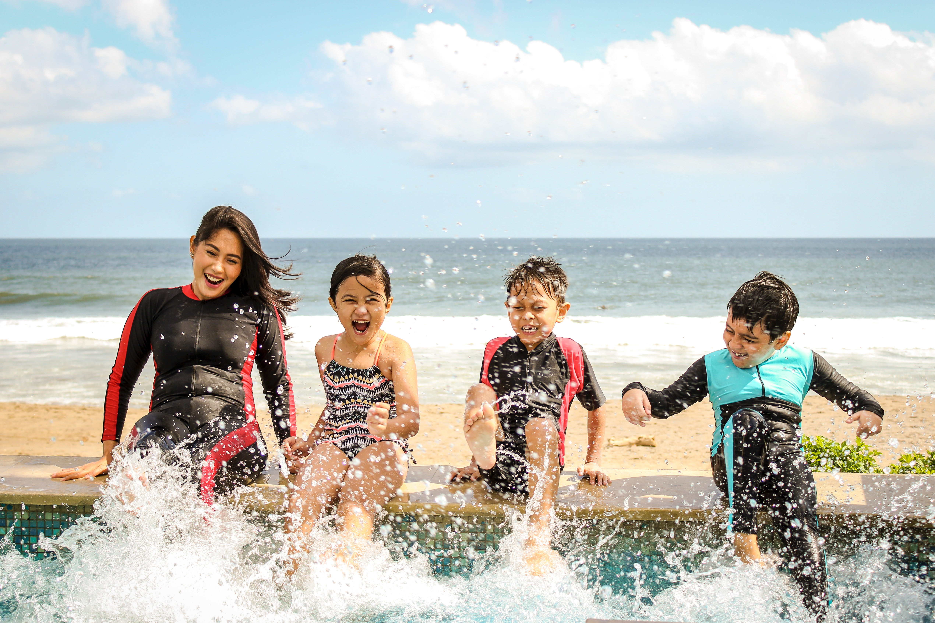
Is it okay to shout in/at a beach?
Yes, it’s okay to shout at a beach.
Notes:
Focus on language (continued)
Activity 3: Is shouting okay?
[Slides 12–20 contain RESOURCE 10.2 – Nine photos.]
Ask ‘Is it okay to shout at a beach?’
Say ‘Yes. It’s okay to shout at a beach.’
Click to display the answer.

Slide 13

Is it okay to shout in/at a church?
No, I should be quiet in a church.
Notes:
Focus on language (continued)
Activity 3: Is shouting okay? (continued)
Ask ‘Is it okay to shout in a church?’
Say ‘No, I should be quiet in a church.’
Click to display the answer.

Slide 14
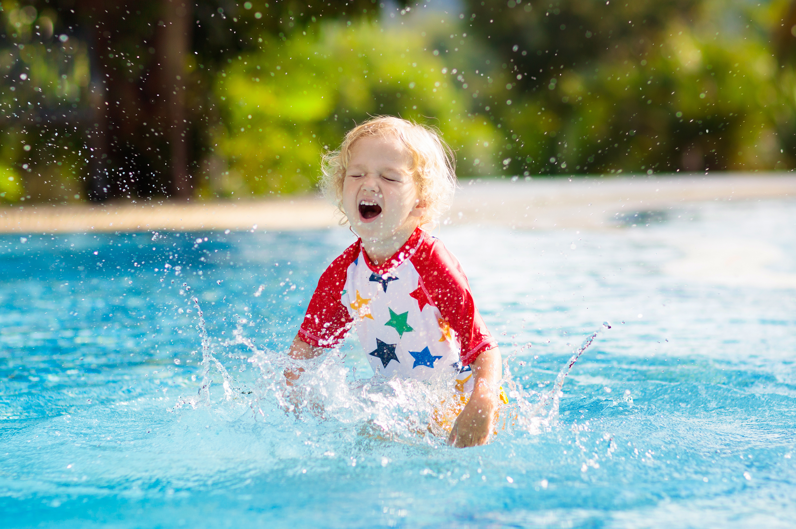
Is it okay to shout in/at a swimming pool?
Yes, it’s okay to shout at a swimming pool.
Notes:
Focus on language (continued)
Activity 3: Is shouting okay? (continued)
Ask ‘Is it okay to shout at a swimming pool?’
Invite students to respond using complete sentences, focusing on correct pronunciation.
Say ‘Yes. It’s okay to shout at a swimming pool.’
Click to display the answer.

Slide 15

Is it okay to shout in/at a gallery?
No, I should be quiet in a gallery.
Notes:
Focus on language (continued)
Activity 3: Is shouting okay? (continued)
Ask ‘Is it okay to shout in a gallery?’
Invite students to respond using complete sentences, focusing on correct pronunciation.
Say ‘No, I should be quiet in a gallery.’
Click to display the answer.

Slide 16

Is it okay to shout in/at a library?
No, I should be quiet in a library.
Notes:
Focus on language (continued)
Activity 3: Is shouting okay? (continued)
Ask ‘Is it okay to shout in a library?’
Invite students to respond using complete sentences, focusing on correct pronunciation.
Say ‘No, I should be quiet in a library.’
Click to display the answer.

Slide 17
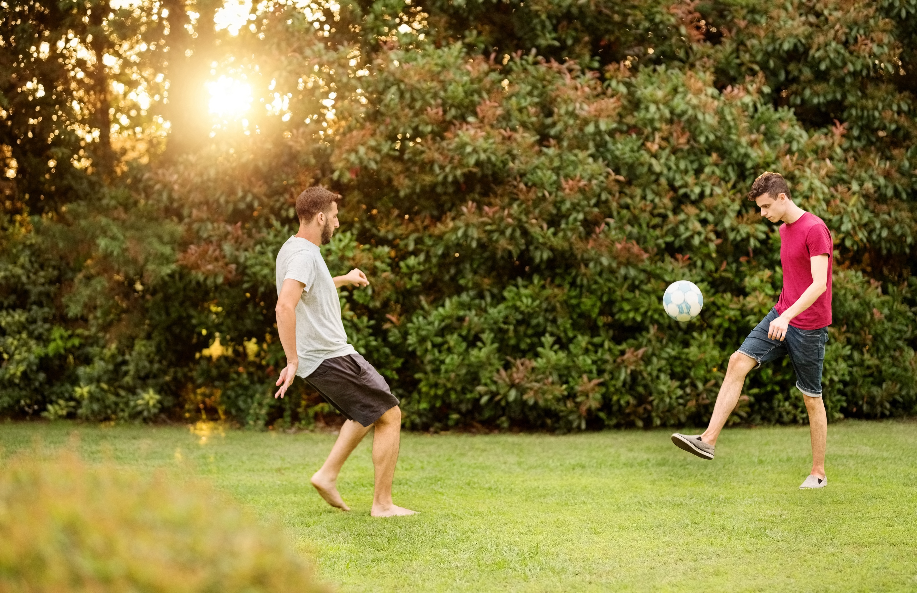
Is it okay to shout in/at a park?
Yes, it’s okay to shout at a park.
Notes:
Focus on language (continued)
Activity 3: Is shouting okay? (continued)
Ask ‘Is it okay to shout at a park?’
Invite students to respond using complete sentences, focusing on correct pronunciation.
Say ‘Yes. It’s okay to shout at a park.’
Click to display the answer.

Slide 18
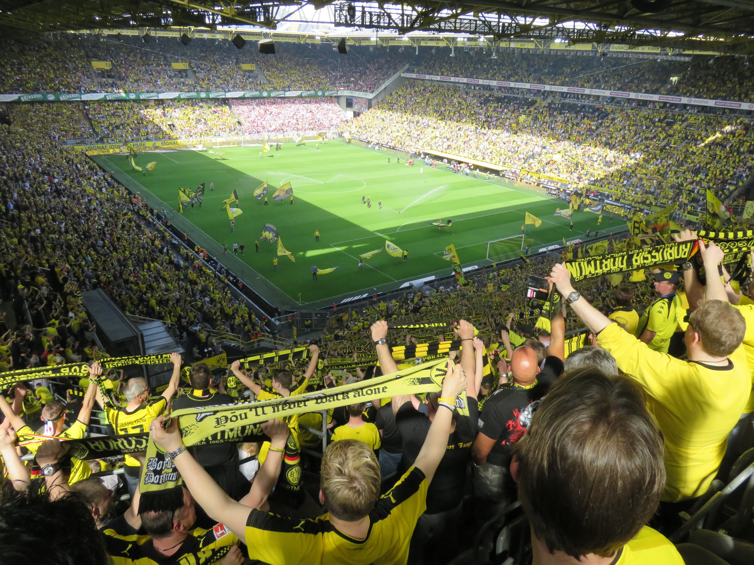
Is it okay to shout in/at a sports stadium?
Yes, it’s okay to shout at a sports stadium.
Notes:
Focus on language (continued)
Activity 3: Is shouting okay? (continued)
Ask ‘Is it okay to shout at a sports stadium?’
Invite students to respond using complete sentences, focusing on correct pronunciation.
Say ‘Yes. It’s okay to shout at a sports stadium.’
Click to display the answer.

Slide 19
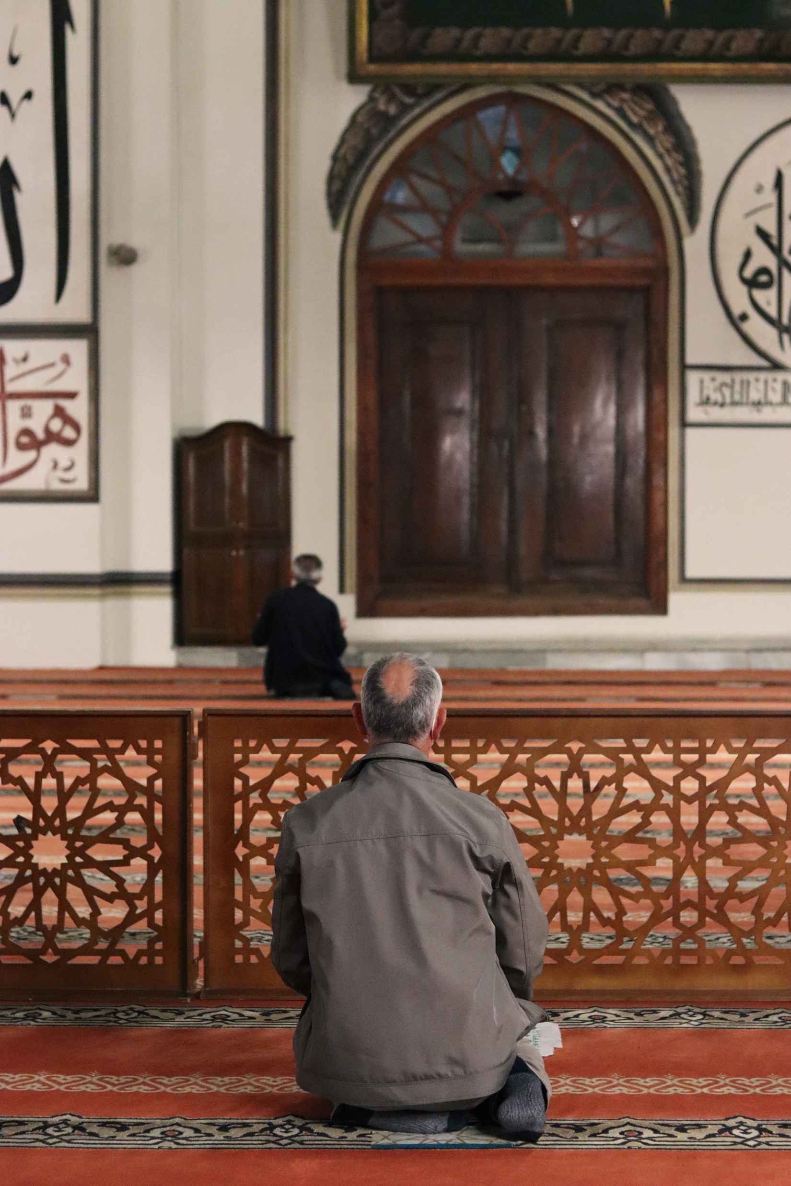
Is it okay to shout in/at a mosque?
No, I should be quiet in a mosque.
Notes:
Focus on language (continued)
Activity 3: Is shouting okay? (continued)
Ask ‘Is it okay to shout in a mosque?’
Invite students to respond using complete sentences, focusing on correct pronunciation.
Say ‘No, I should be quiet in a mosque.’
Click to display the answer.

Slide 20
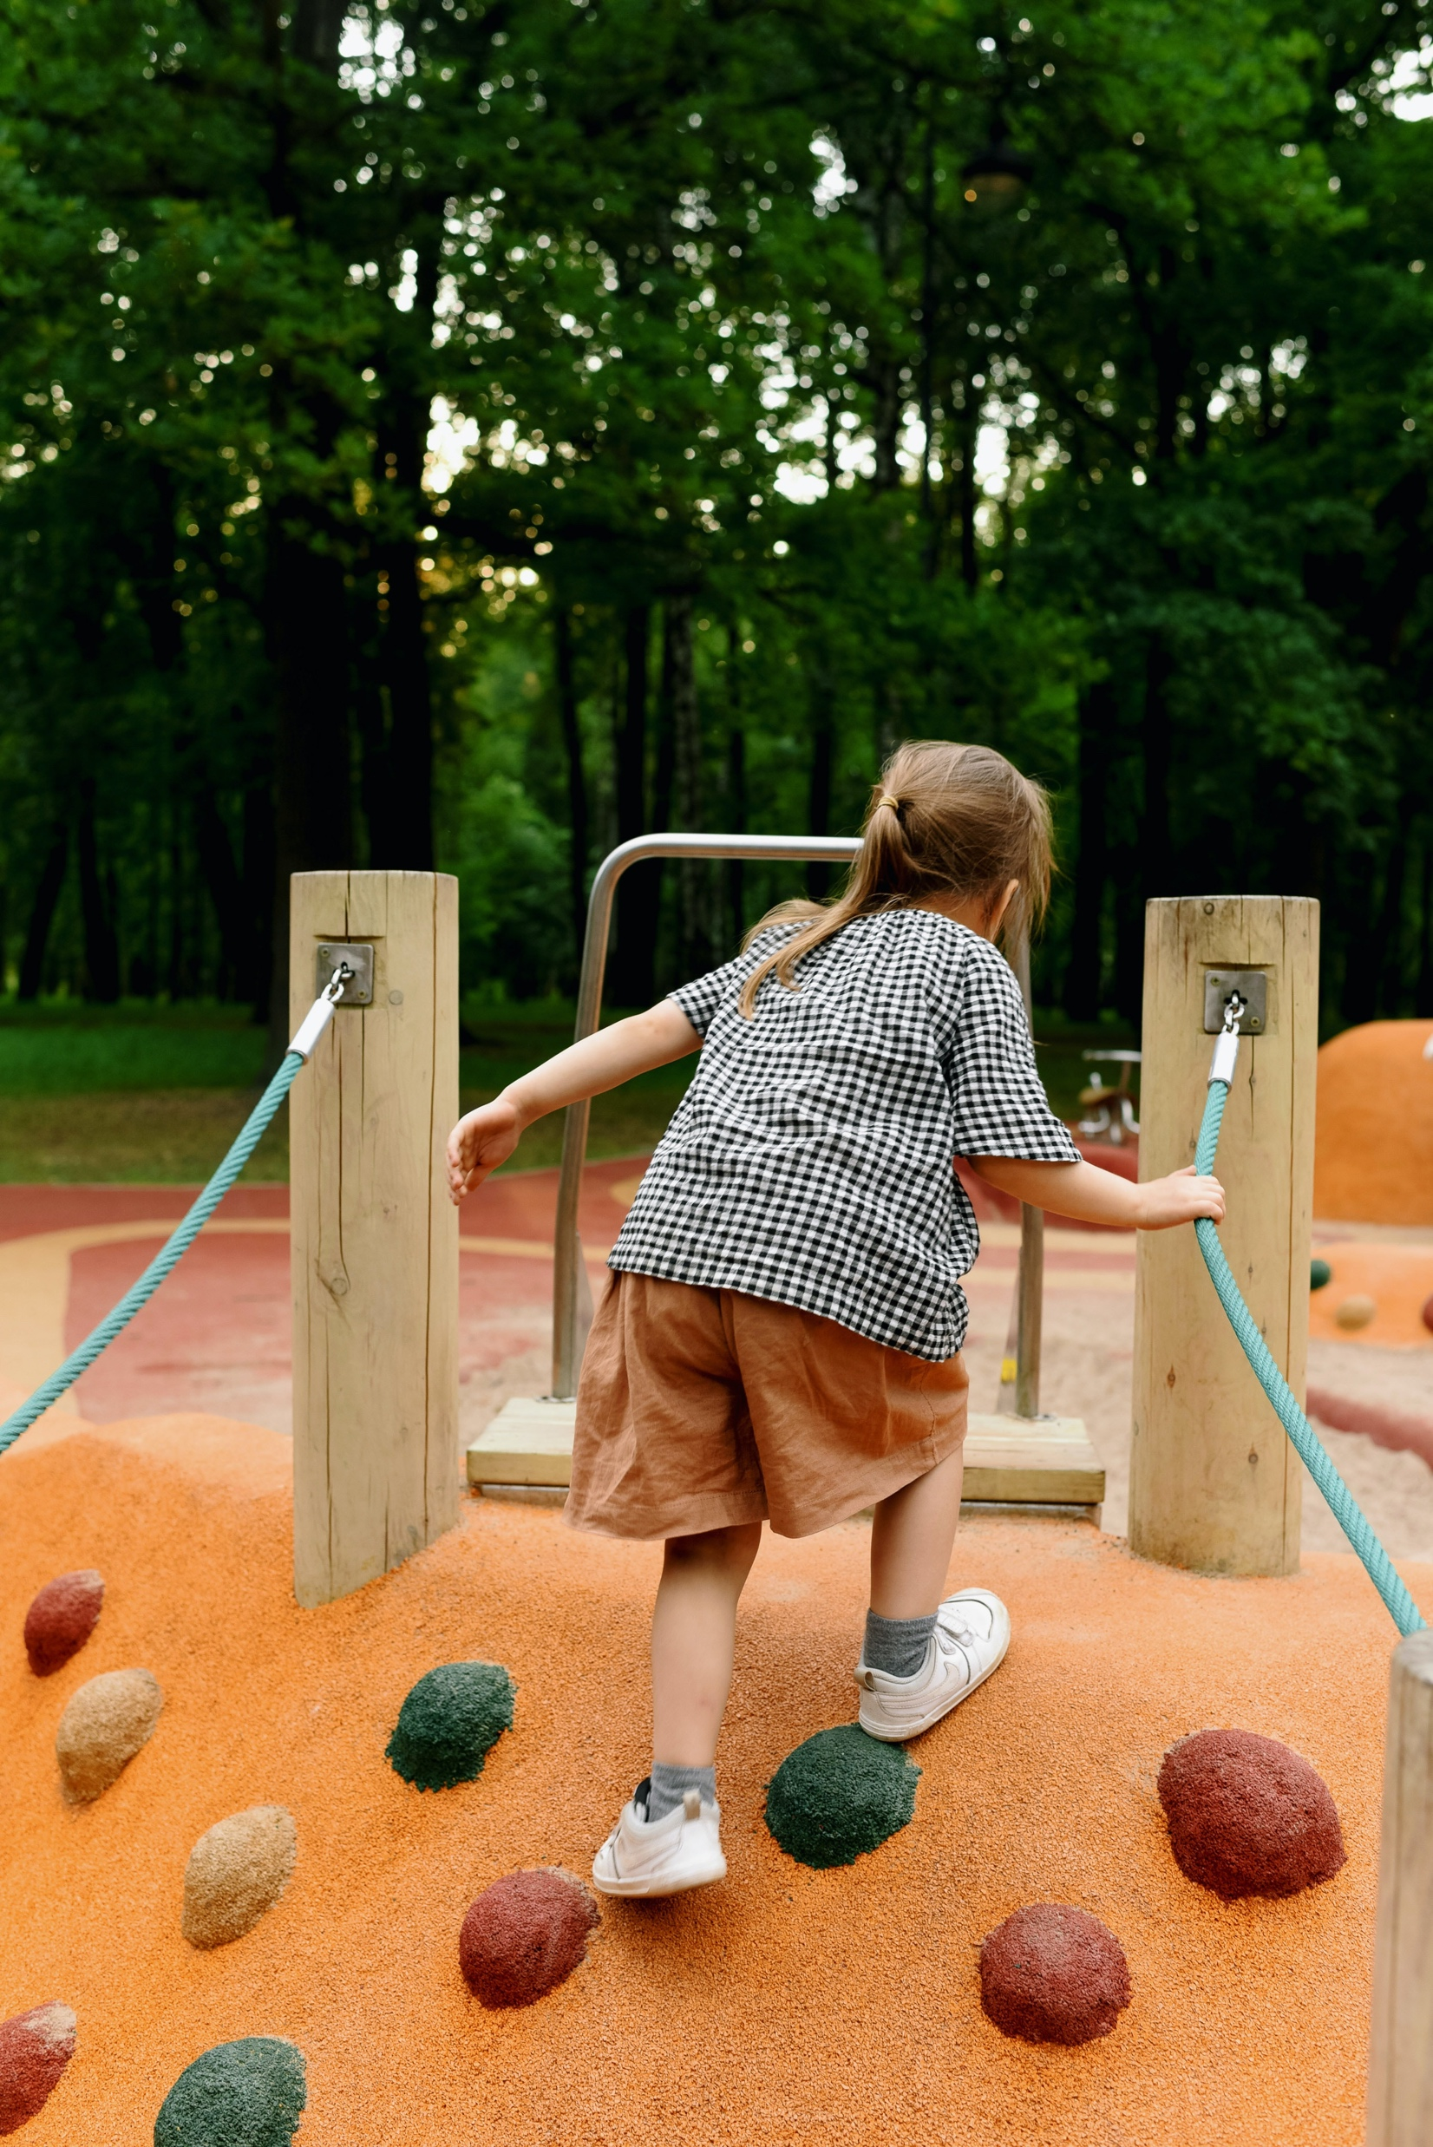
Is it okay to shout in/at a playground?
Yes, it’s okay to shout at a playground.
Notes:
Focus on language (continued)
Activity 3: Is shouting okay? (continued)
Ask ‘Is it okay to shout at a playground?’
Invite students to respond using complete sentences, focusing on correct pronunciation.
Say ‘Yes. It’s okay to shout at a playground.’
Click to display the answer.

Slide 21
sports stadium church gallery
library beach mosque
park playground swimming pool
It’s okay to shout at a _____________________.
sports stadium
It’s okay to shout at a _____________________.
beach
It’s okay to shout at a _____________________.
park
It’s okay to shout at a _____________________.
playground
It’s okay to shout at a _____________________.
swimming pool
Notes:
Focus on language (continued)
Activity 3: Is shouting okay? (continued)
Distribute RESOURCE 10.3 – Shout or be quiet worksheet (if using). [Alternatively, complete this activity together verbally using the PowerPoint slides.]
Invite students to work together to complete the worksheet.
Click to check answers together.

Slide 22
sports stadium church gallery
library beach mosque
park playground swimming pool
I should be quiet in a _____________________.
church
I should be quiet in a _____________________.
gallery
I should be quiet in a _____________________.
library
I should be quiet in a _____________________.
mosque
Notes:
Focus on language (continued)
Activity 3: Is shouting okay? (continued)
Click to check answers together.

Slide 23
Student A: Is it okay to shout in/at ____________________________?
Student B: Yes, it’s okay to shout at a ____________________________.
  OR
Student B: No, I should be quiet in a ____________________________.
Notes:
Focus on language (continued)
Activity 4: Speaking activity
Divide students into pairs.
Nominate Student A and Student B in each pair.
Encourage students to speak with each other about the photos using the prompts on the slide.
Ensure that both students in each pair practise asking and responding.
Swap student roles and repeat.

Slide 24
Lesson 10
PART 2
Jesus tells a bad spirit to leave a man
Mark 1:21–28
Notes:
(Part 2 title page)

Slide 25

Notes:
Read for gist
Say ‘In the Bible story, an evil spirit shouts at Jesus.’
Distribute copies of Mark 1:21–28 in your students’ heart languages (if in the classroom). [Alternatively, if online, invite students to refer to the heart language texts they have been sent in advance.]
Give students a few minutes to read the text silently for context, then ask them to put it away for the rest of the lesson.

Slide 26
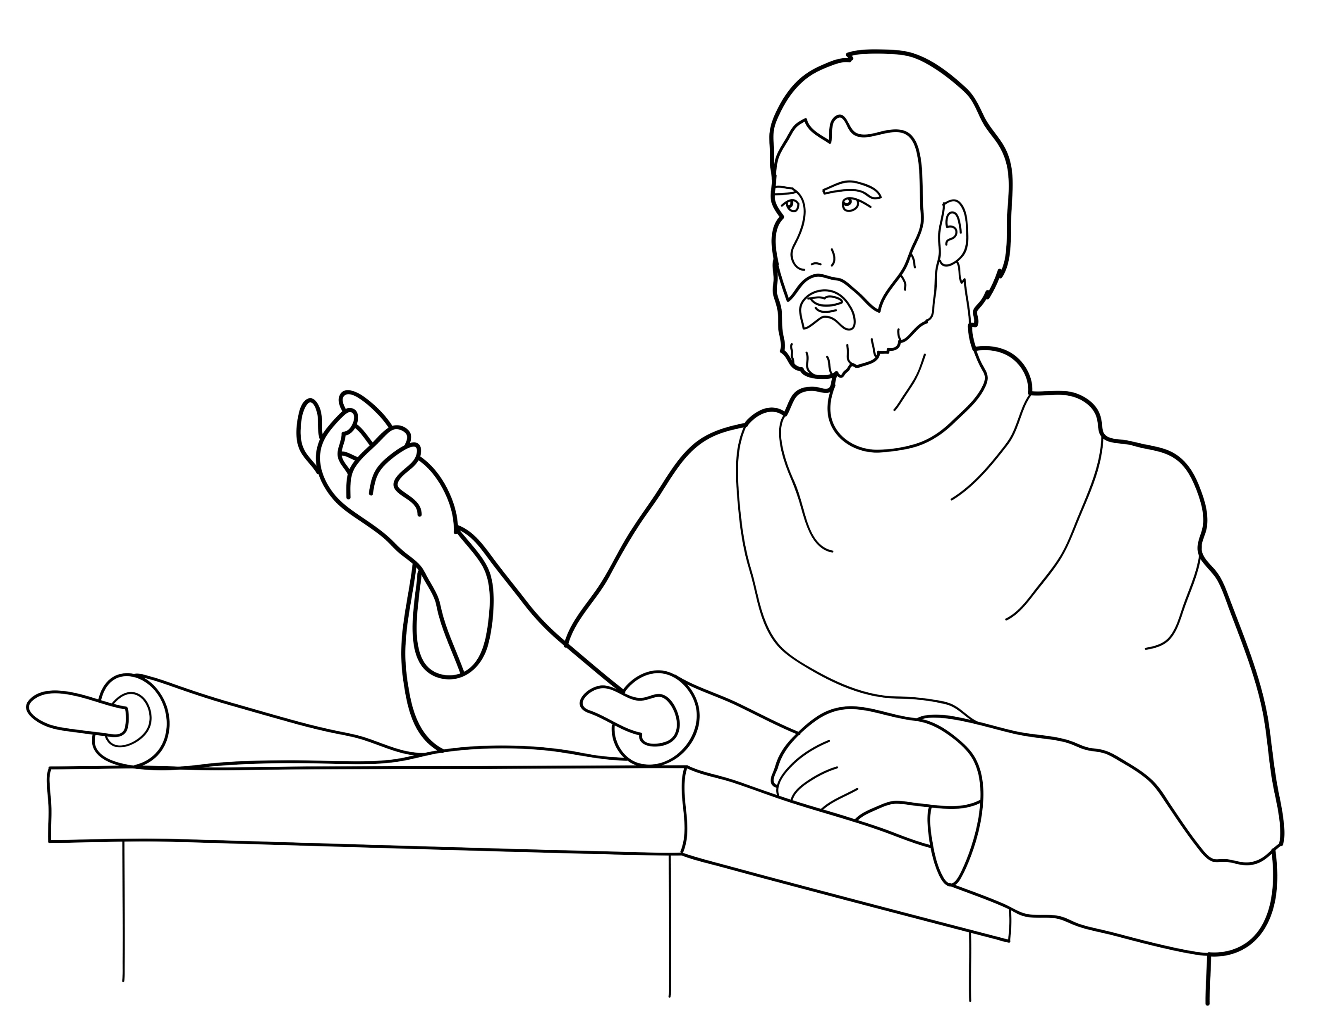
Jesus taught people in the synagogue.
Notes:
Read for detail
[This slide and the 6 slides that follow contain RESOURCE 10.4 – Large sketches and RESOURCE 10.5 – Large sentences.]
Read the sentence on the slide aloud slowly.
Invite students to repeat the sentence after you.
Repeat several times to reinforce correct pronunciation.
Click through the presentation to display the remaining 6 sketches and sentences.

Slide 27
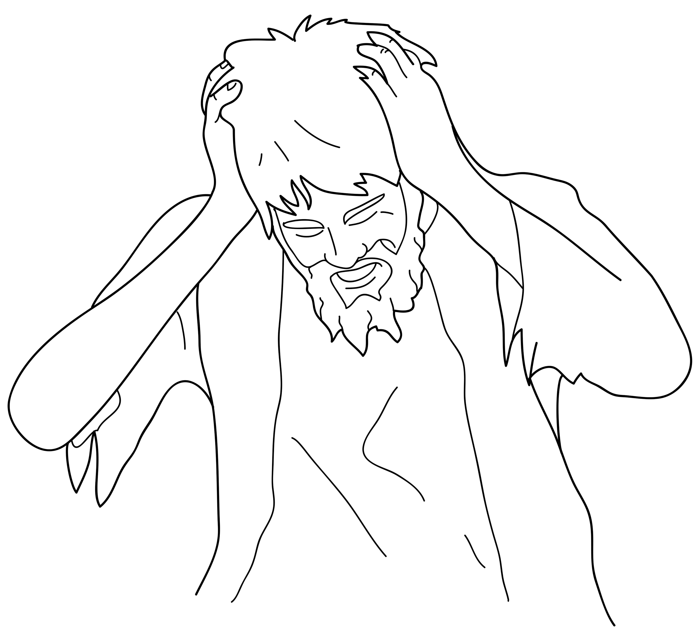
A man had an evil spirit.
Notes:
Read for detail (continued)
Read the sentence aloud slowly.
Invite students to repeat the sentence after you.
Repeat several times to reinforce correct pronunciation.

Slide 28
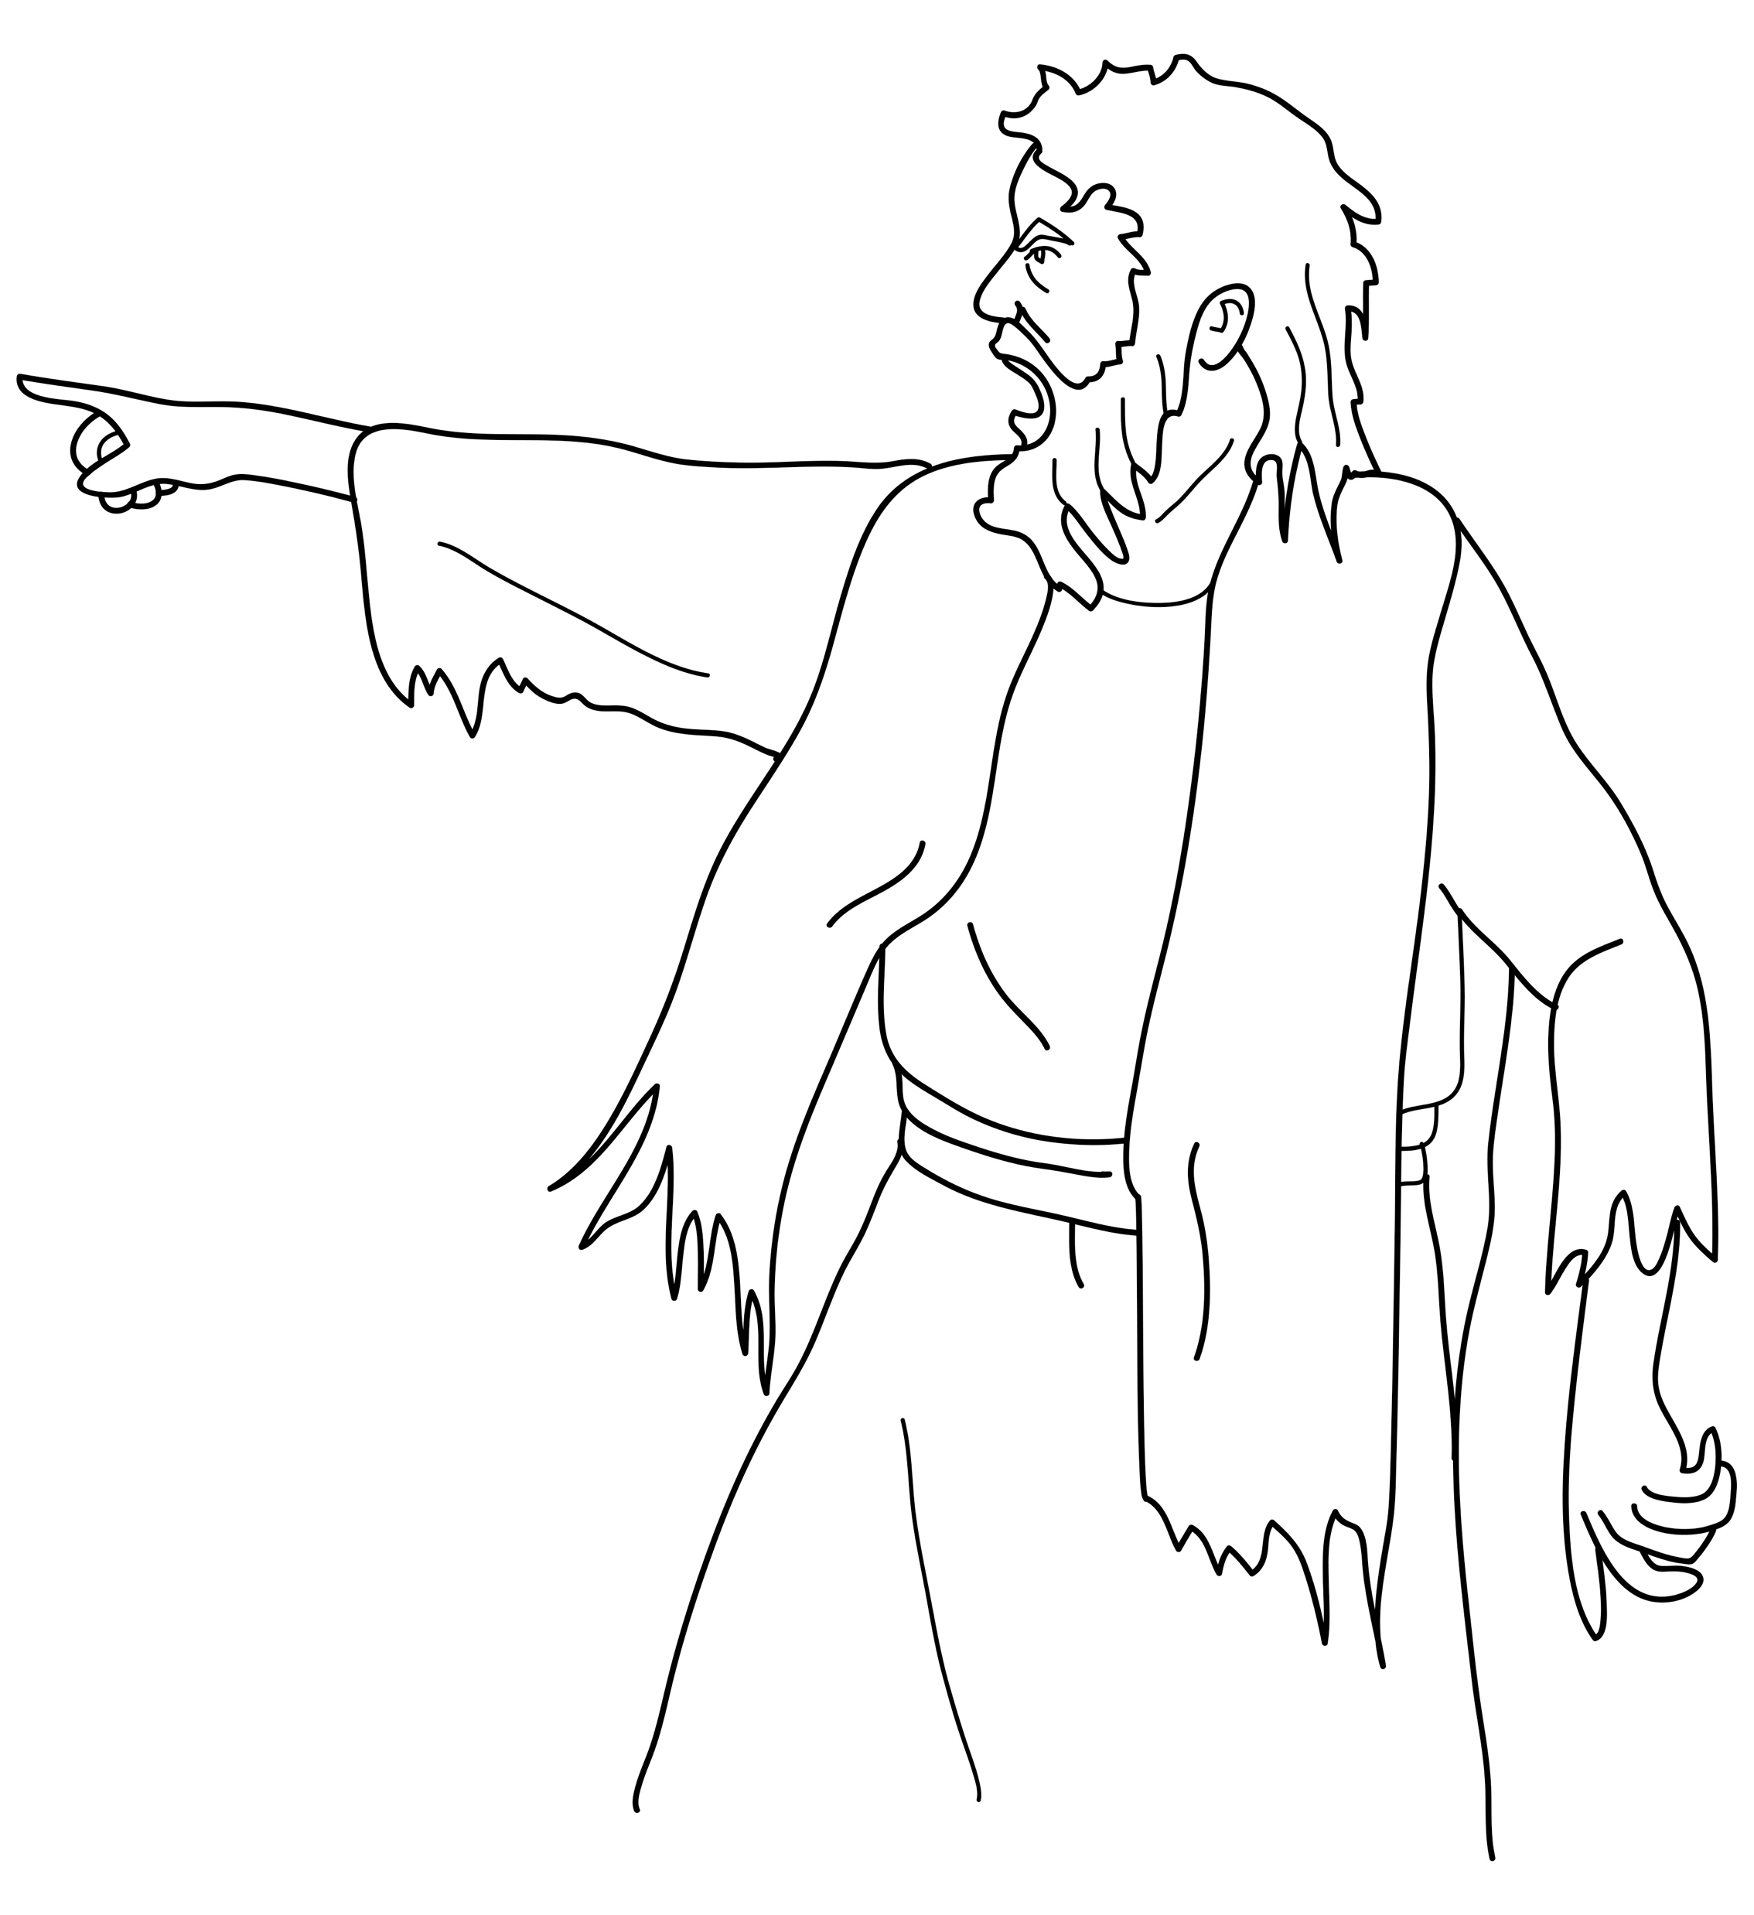
The spirit shouted at Jesus.
Notes:
Read for detail (continued)
Read the sentence aloud slowly.
Invite students to repeat the sentence after you.
Repeat several times to reinforce correct pronunciation.

Slide 29
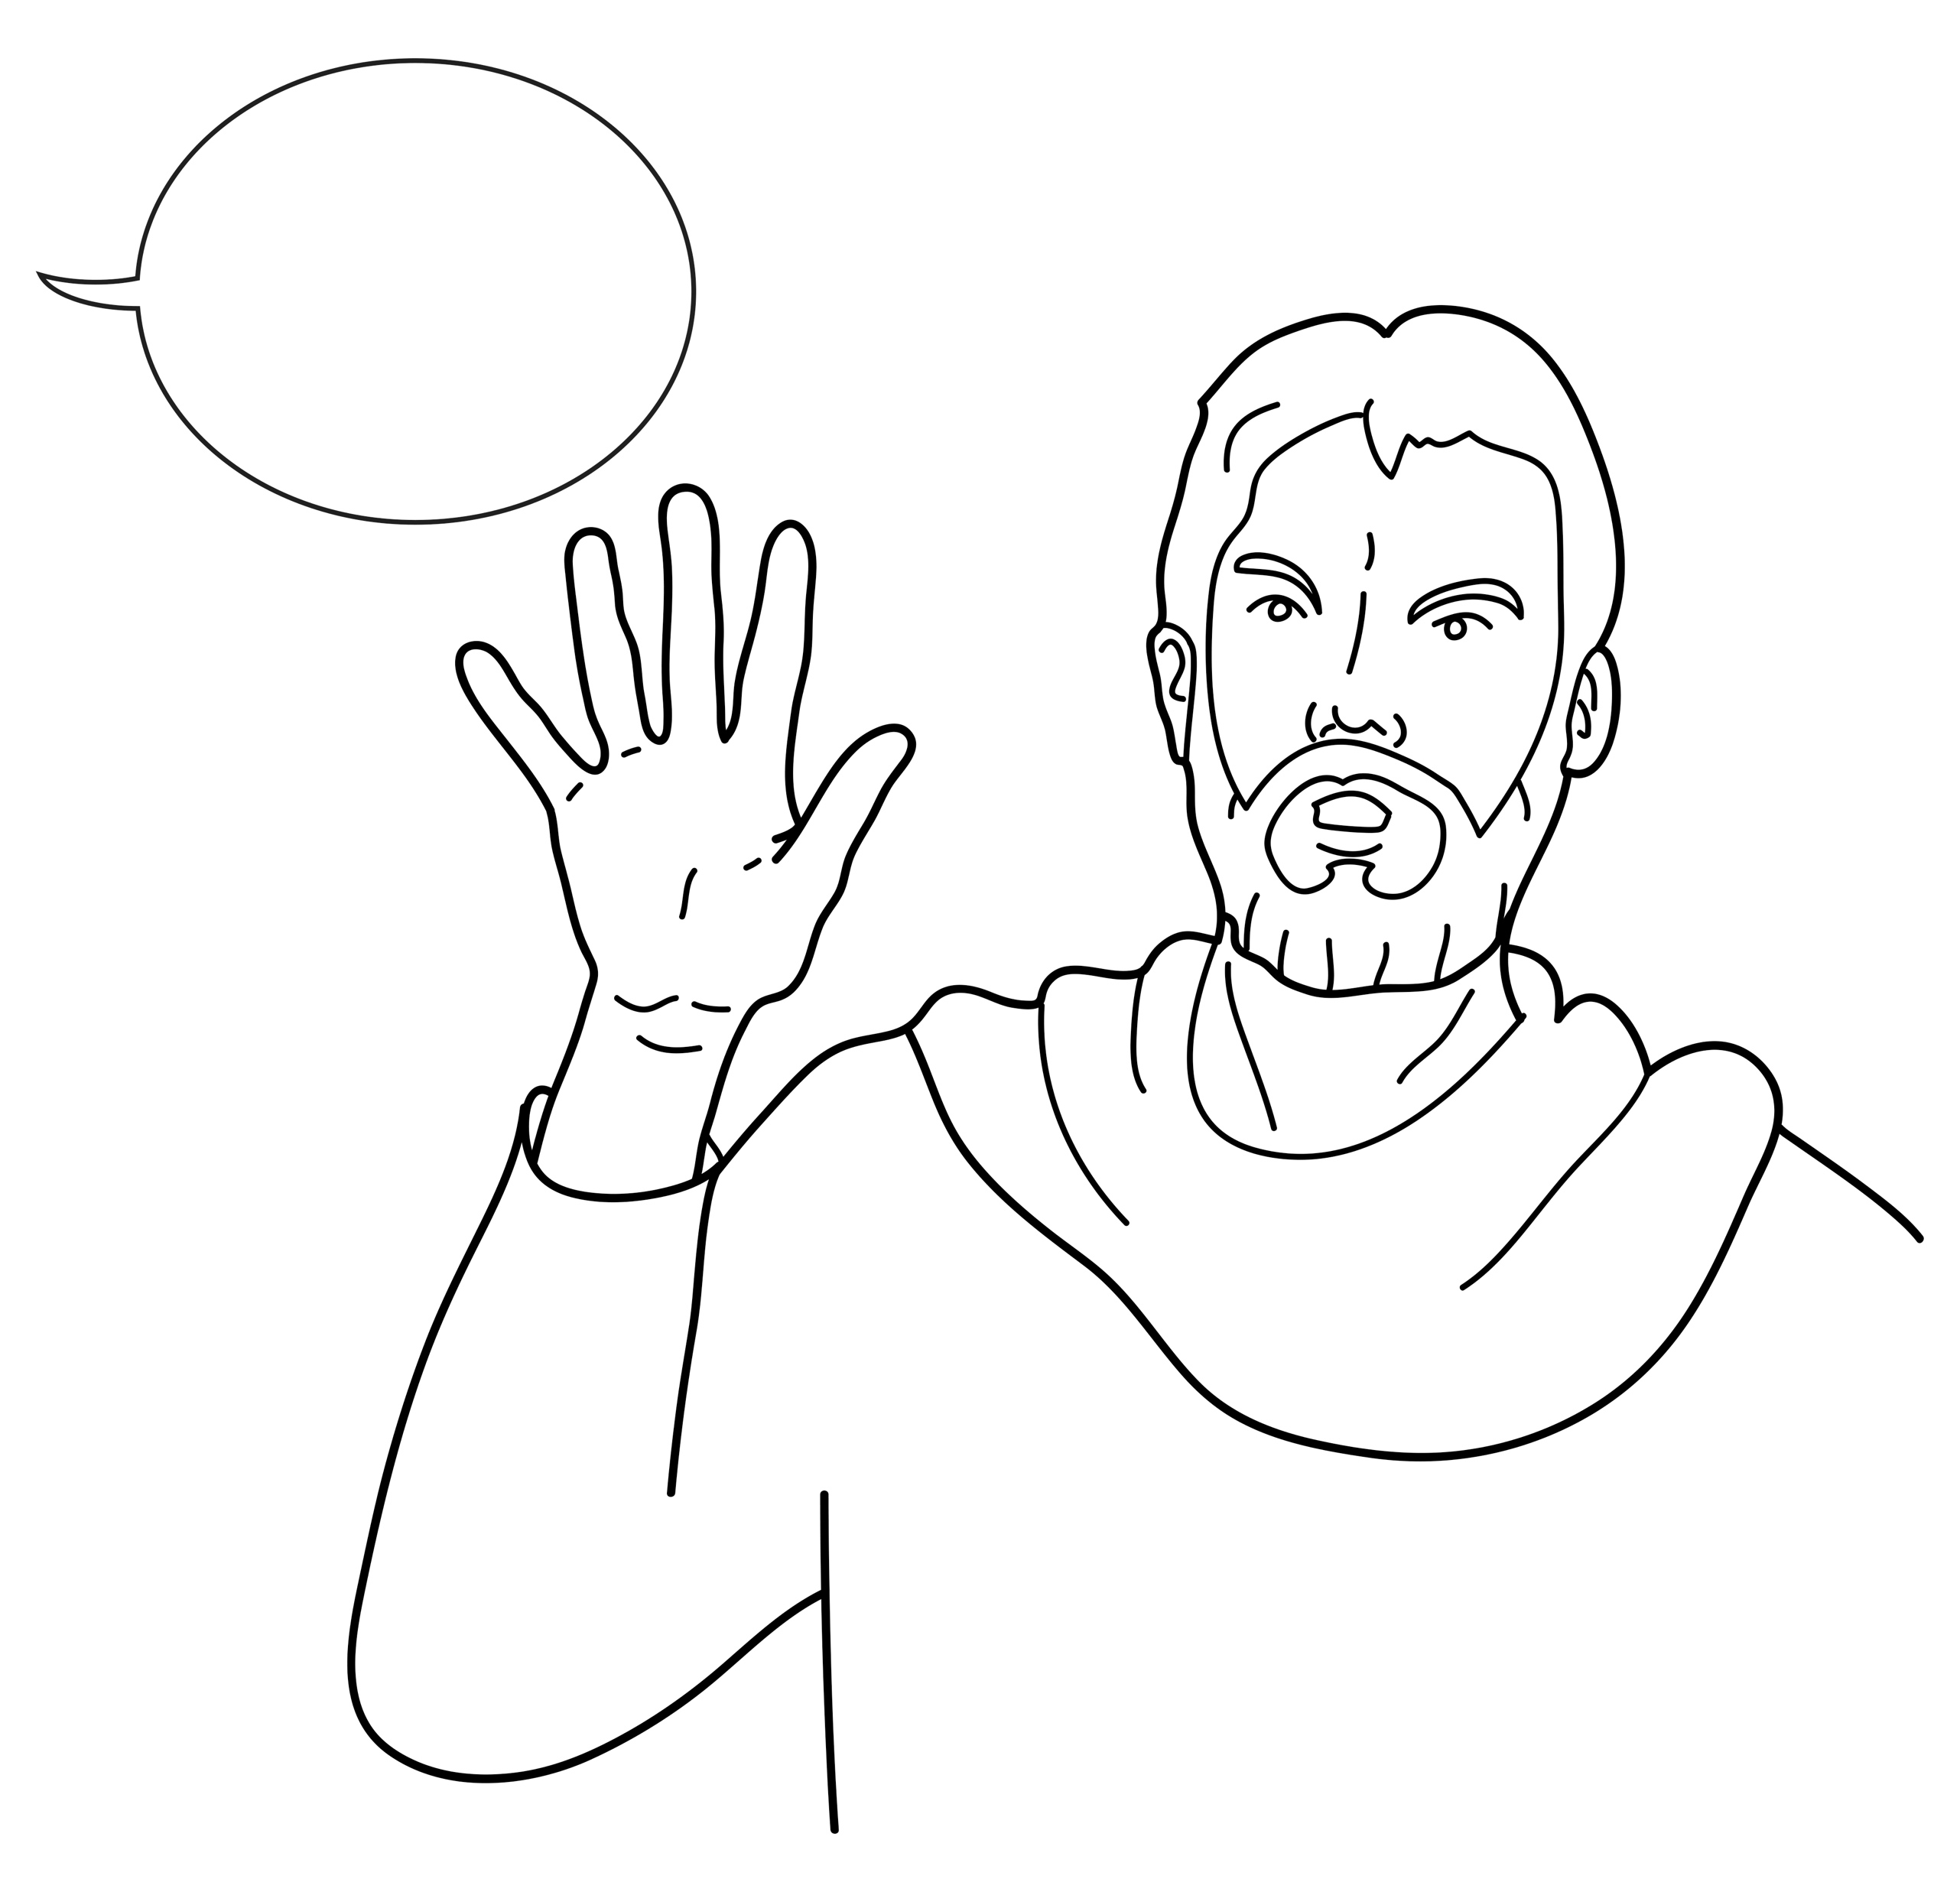
Jesus said, ‘Be quiet and come out!’
Notes:
Read for detail (continued)
Read the sentence aloud slowly.
Invite students to repeat the sentence after you.
Repeat several times to reinforce correct pronunciation.

Slide 30
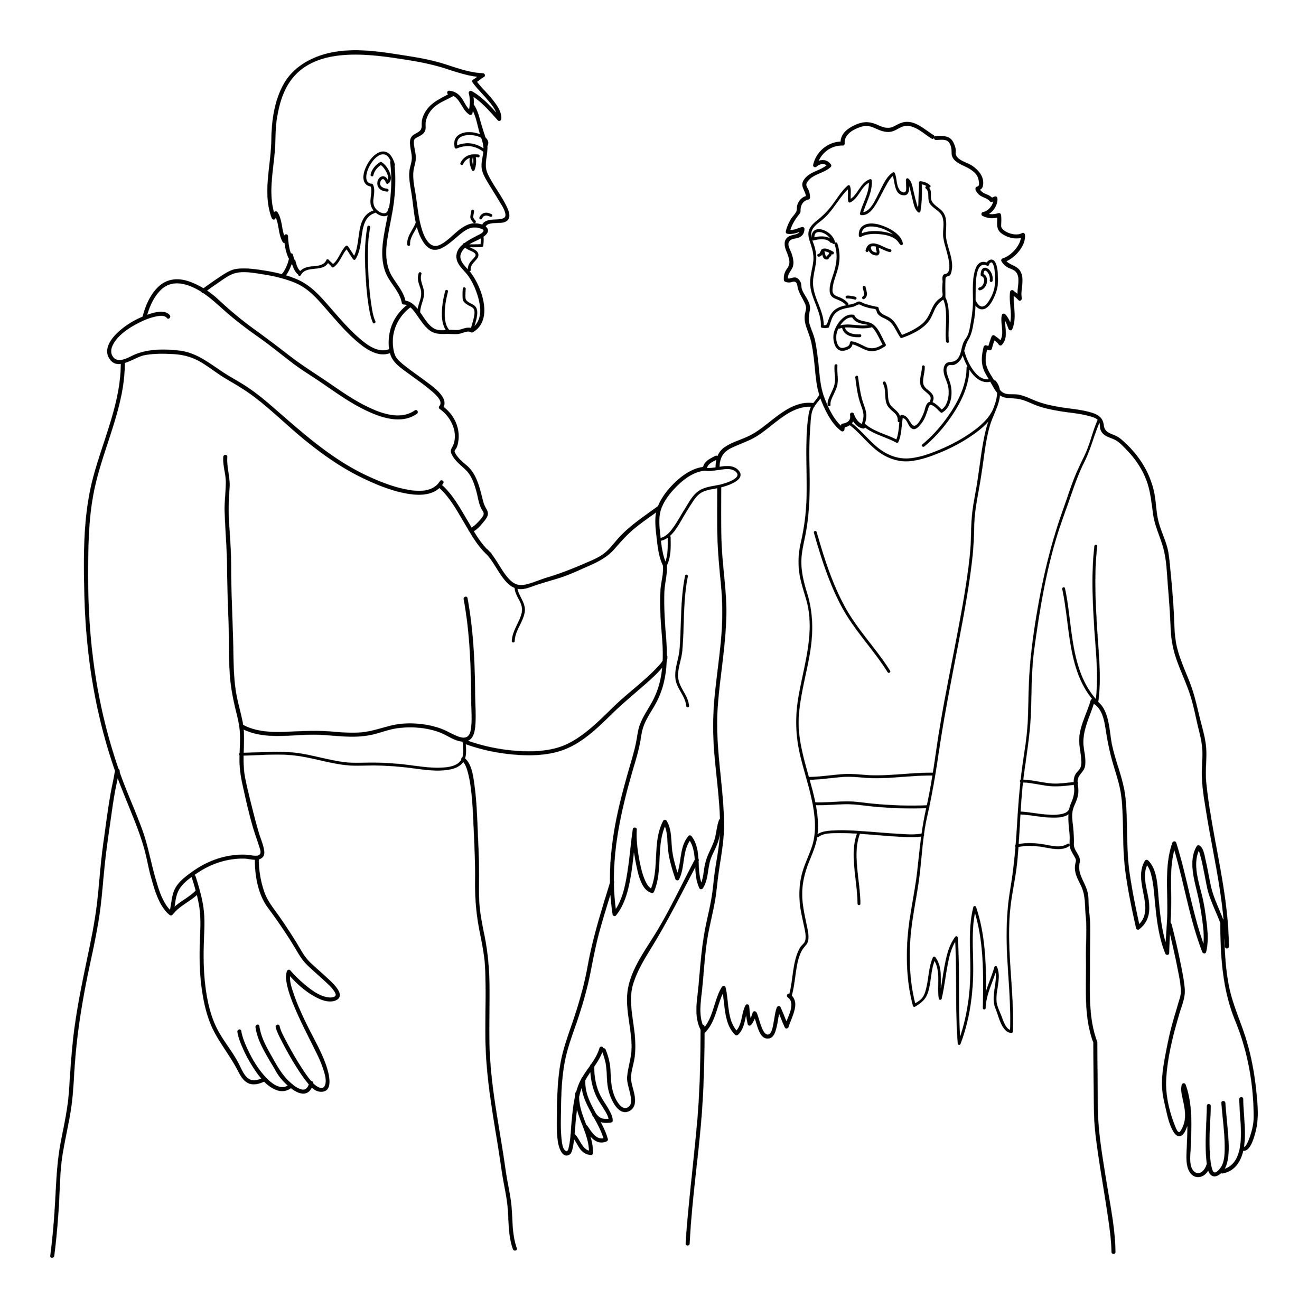
The spirit obeyed Jesus and left the man.
Notes:
Read for detail (continued)
Read the sentence aloud slowly.
Invite students to repeat the sentence after you.
Repeat several times to reinforce correct pronunciation.

Slide 31
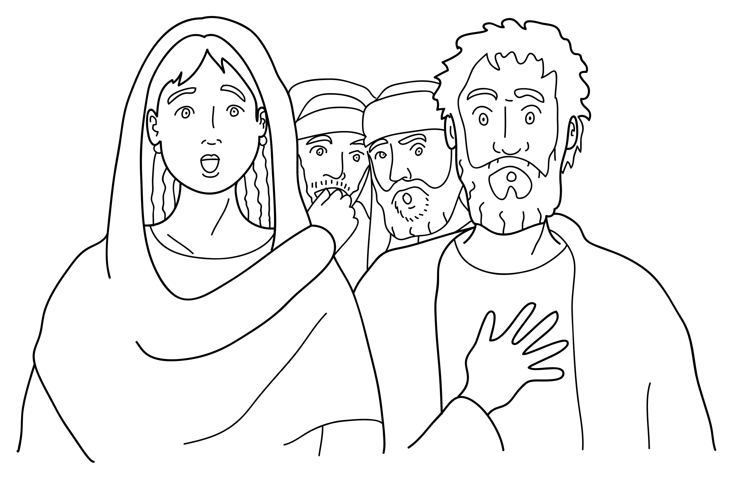
The people were amazed.
Notes:
Read for detail (continued)
Read the sentence aloud slowly.
Invite students to repeat the sentence after you.
Repeat several times to reinforce correct pronunciation.

Slide 32
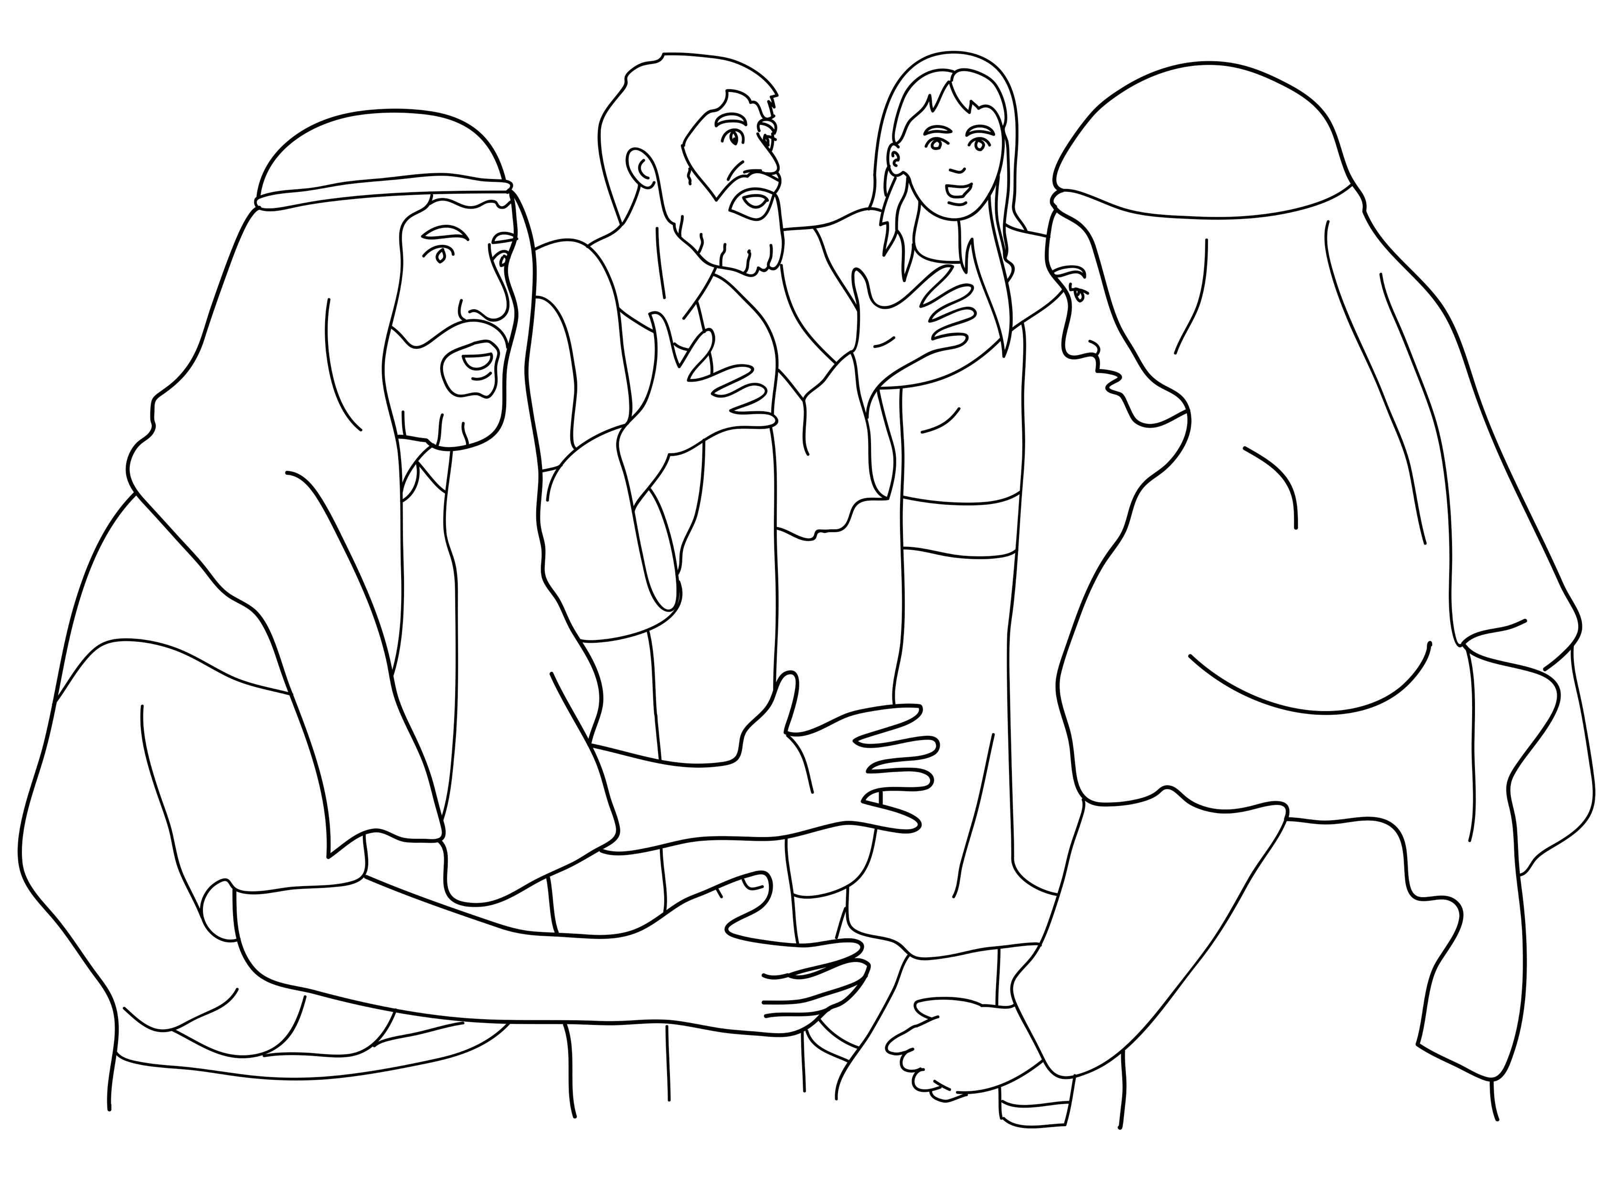
Many people talked about Jesus.
Notes:
Read for detail (continued)
Read the sentence aloud slowly.
Invite students to repeat the sentence after you.
Repeat several times to reinforce correct pronunciation.

Slide 33
Notes:
Reinforce the language
[The activity on this slide and the 6 slides that follow replaces the activity in the lesson book in which students point to corresponding sketches.]
Invite students to say any words that they remember about this sketch.
Accept responses.

Slide 34
Notes:
Reinforce the language (continued)
Invite students to say any words that they remember about this sketch.
Accept responses.

Slide 35
Notes:
Reinforce the language (continued)
Invite students to say any words that they remember about this sketch.
Accept responses.

Slide 36
Notes:
Reinforce the language (continued)
Invite students to say any words that they remember about this sketch.
Accept responses.

Slide 37
Notes:
Reinforce the language (continued)
Invite students to say any words that they remember about this sketch.
Accept responses.

Slide 38
Notes:
Reinforce the language (continued)
Invite students to say any words that they remember about this sketch.
Accept responses.

Slide 39
Notes:
Reinforce the language (continued)
Invite students to say any words that they remember about this sketch.
Accept responses.

Slide 40
Notes:
Reinforce the language (continued)
NB This slide will at first appear blank in Slide Show mode.
Distribute RESOURCE 10.6 – Small sketches (if using) to pairs/groups. [Alternatively, complete this activity together verbally using the PowerPoint slides.]
Invite pairs/groups to sequence or try to remember the sketches in the correct order.
Click your mouse to display the sketches one at a time in the correct order.

Slide 41
Jesus taught people in the synagogue.
Notes:
Reinforce the language (continued)
Distribute RESOURCE 10.7 – Small sentence strips (if using) to pairs/groups.
Invite pairs/groups to match the sentence strips to the corresponding sketches (if using). More advanced students can sequence the sentence strips without looking at the sketches.
[Alternatively, complete this activity together verbally using the PowerPoint slides.]
Invite students to identify the sketch on the slide that corresponds to the sentence.
Click to display the arrow and confirm the correct response.

Slide 42
A man had an evil spirit.
Notes:
Reinforce the language (continued)
Invite students to point to the sketch on the slide that corresponds to the sentence.
Click to display the arrow and confirm the correct response.

Slide 43
The spirit shouted at Jesus.
Notes:
Reinforce the language (continued)
Invite students to point to the sketch on the slide that corresponds to the sentence.
Click to display the arrow and confirm the correct response.

Slide 44
Jesus said, ‘Be quiet and come out!’
Notes:
Reinforce the language (continued)
Invite students to point to the sketch on the slide that corresponds to the sentence.
Click to display the arrow and confirm the correct response.

Slide 45
The spirit obeyed Jesus and left the man.
Notes:
Reinforce the language (continued)
Invite students to point to the sketch on the slide that corresponds to the sentence.
Click to display the arrow and confirm the correct response.

Slide 46
The people were amazed.
Notes:
Reinforce the language (continued)
Invite students to point to the sketch on the slide that corresponds to the sentence.
Click to display the arrow and confirm the correct response.

Slide 47
Many people talked about Jesus.
Notes:
Reinforce the language (continued)
Invite students to point to the sketch on the slide that corresponds to the sentence.
Click to display the arrow and confirm the correct response.

Slide 48
1. Jesus _________ people in
the synagogue.
taught
Notes:
Reinforce the language (continued)
Distribute RESOURCE 10.8 – Gap-fill worksheet (if using) to each student. [Alternatively, complete this activity together verbally using the PowerPoint slides.]
Encourage students to work together to complete the worksheet.
Click to reveal the missing word and check the answer together.

Slide 49
2. A man _________ an evil spirit.
had
Notes:
Reinforce the language (continued)
Click to reveal the missing word and check the answer together.

Slide 50
3. The spirit __________ at Jesus.
shouted
Notes:
Reinforce the language (continued)
Click to reveal the missing word and check the answer together.

Slide 51
4. Jesus said,
‘Be ________ and come out!’
quiet
Notes:
Reinforce the language (continued)
Click to reveal the missing word and check the answer together.

Slide 52
5. The spirit _________ Jesus
and left the man.
obeyed
Notes:
Reinforce the language (continued)
Click to reveal the missing word and check the answer together.

Slide 53
amazed
6. People were __________.
Notes:
Reinforce the language (continued)
Click to reveal the missing word and check the answer together.

Slide 54
7. Many people _________
about Jesus.
talked
Notes:
Reinforce the language (continued)
Click to reveal the missing word and check the answer together.

