Slide 1
Lesson 3
Meet Jesus
Volume 1
Ten Bible-based English lessons
High Beginner
Notes:
(Lesson 2 title page)

Slide 2
Lesson 3
PART 1
Washing
Notes:
(Part 1 title page)

Slide 3
Washing
Notes:
Activate knowledge
Display laundry powder/detergent brought from home.
Brainstorm words and simple sentences about the displayed item.
Write sentences on the board (if using), correcting errors as you go.
Repeat for remaining items (e.g. liquid soap, cake of soap, dishwashing detergent, sponge, bucket, cloth, rubber gloves, shampoo, paper towel/hand towel).

Slide 4
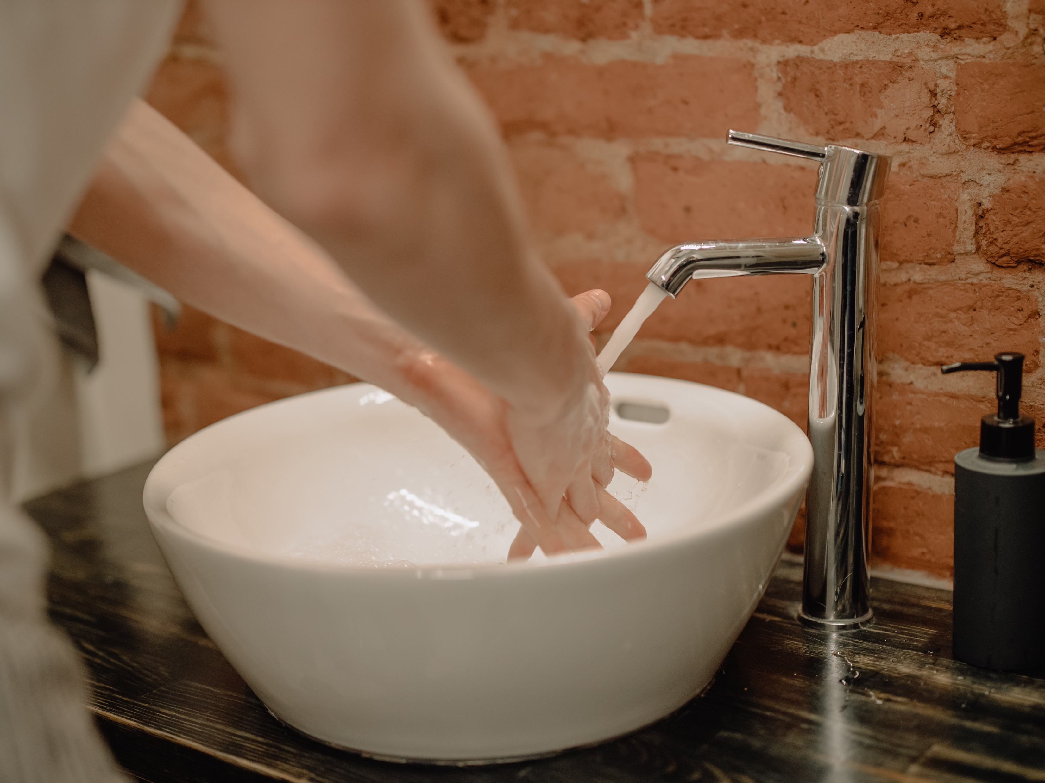
my hands
soap
I wash ___________ with __________.
Notes:
Focus on language
[Slides 4–9 contain RESOURCE 3.1 – Six photos.]
Activity 1: Washing
Ask ‘What do you wash your hands with?’
Click to reveal correct answers.
Invite students to respond with complete sentences focusing on correct pronunciation.

Slide 5
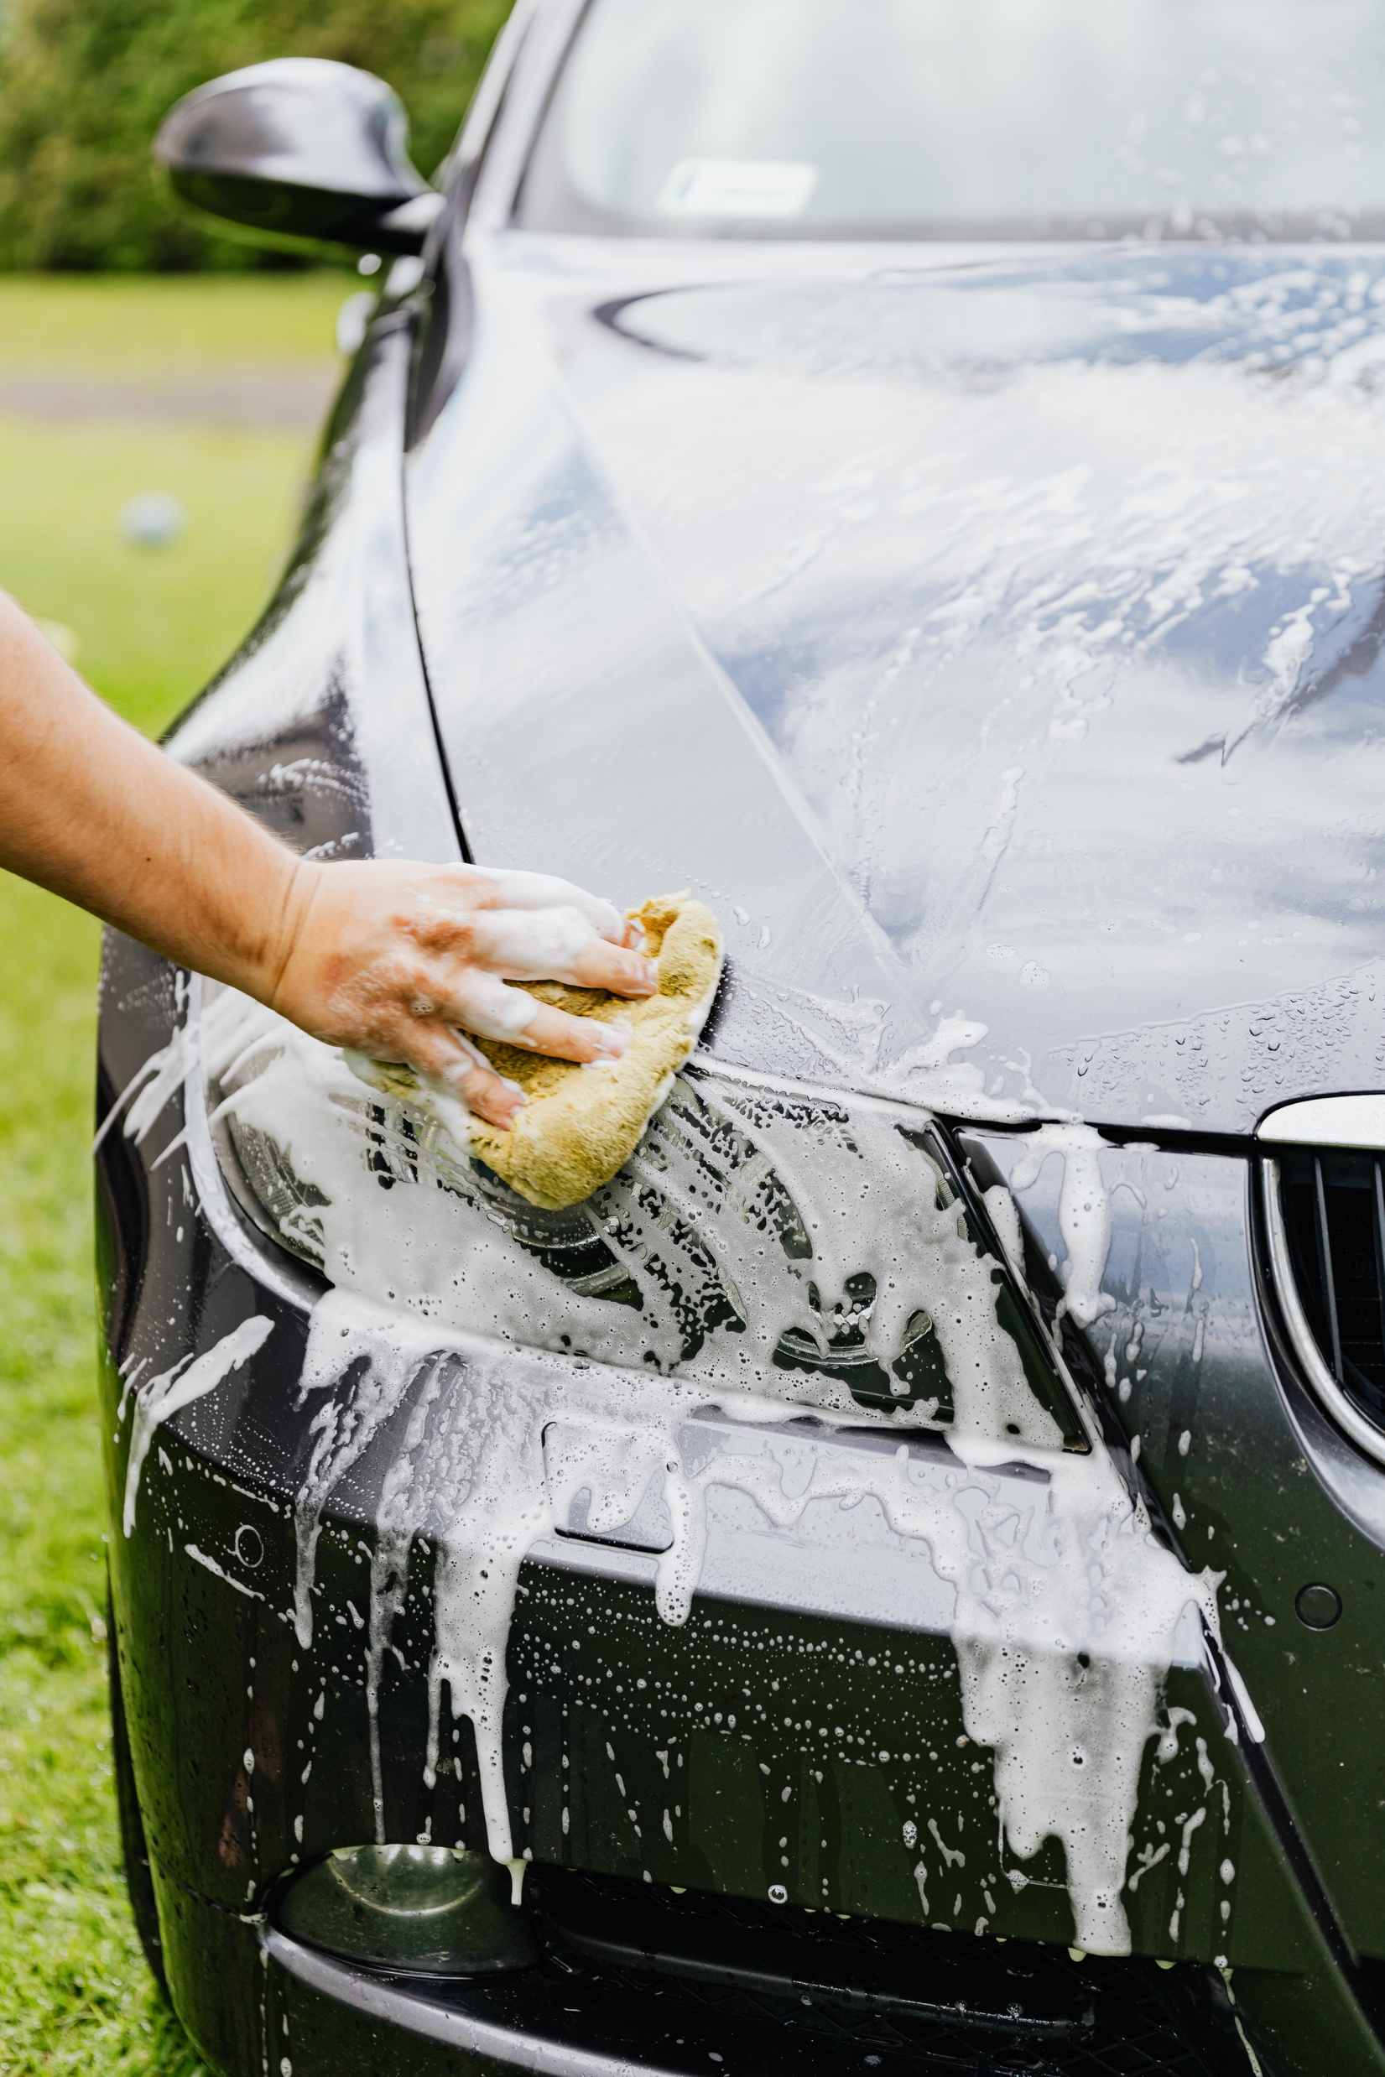
the car
a sponge
I wash _________ with __________.
Notes:
Focus on language (continued)
Activity 1: Washing (continued)
Ask ‘What do you wash the car with?’
Click to reveal correct answers.
Invite students to respond with complete sentences focusing on correct pronunciation.

Slide 6
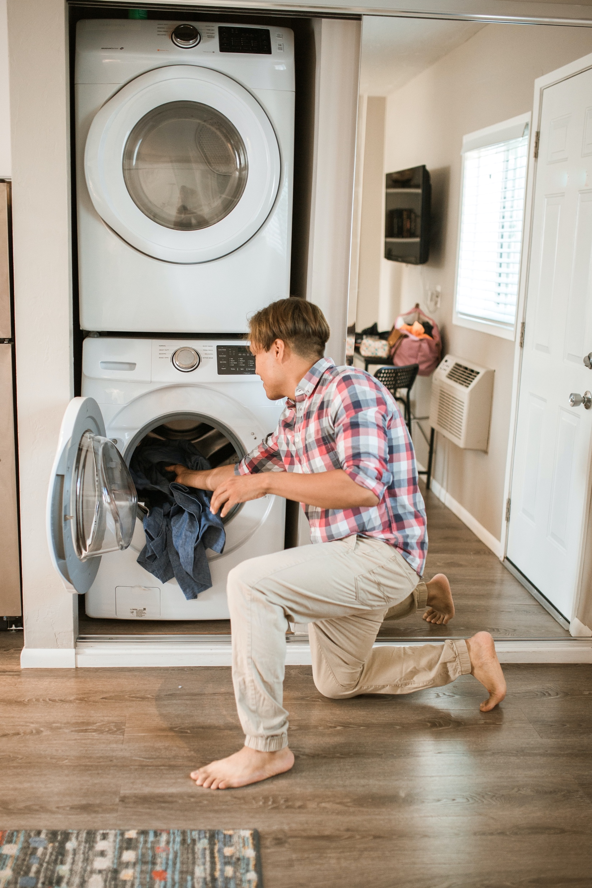
clothes
laundry powder/detergent
I wash _________ with ________________________.
Notes:
Focus on language (continued)
Activity 1: Washing (continued)
Ask ‘What do you wash clothes with?’
Click to reveal correct answers.
Invite students to respond with complete sentences focusing on correct pronunciation.

Slide 7
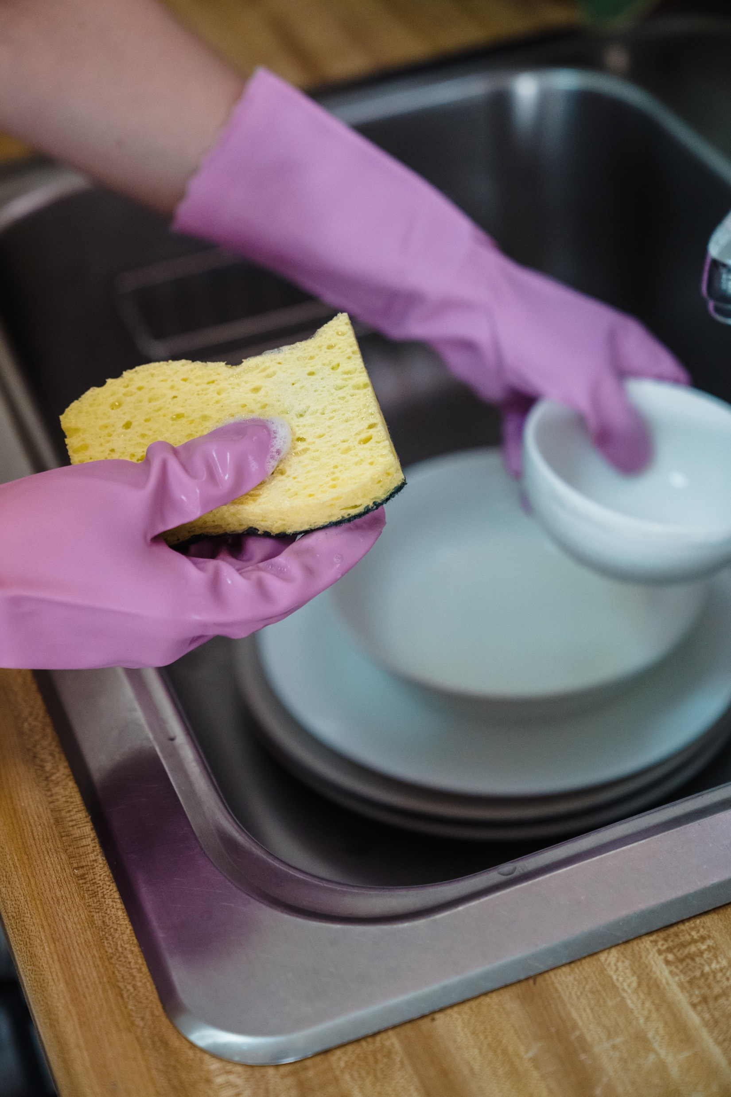
the dishes
dishwashing detergent
I wash ___________ with _____________________.
Notes:
Focus on language (continued)
Activity 1: Washing (continued)
Ask ‘What do you wash the dishes with?’
Click to reveal correct answers.
Invite students to respond with complete sentences focusing on correct pronunciation.

Slide 8
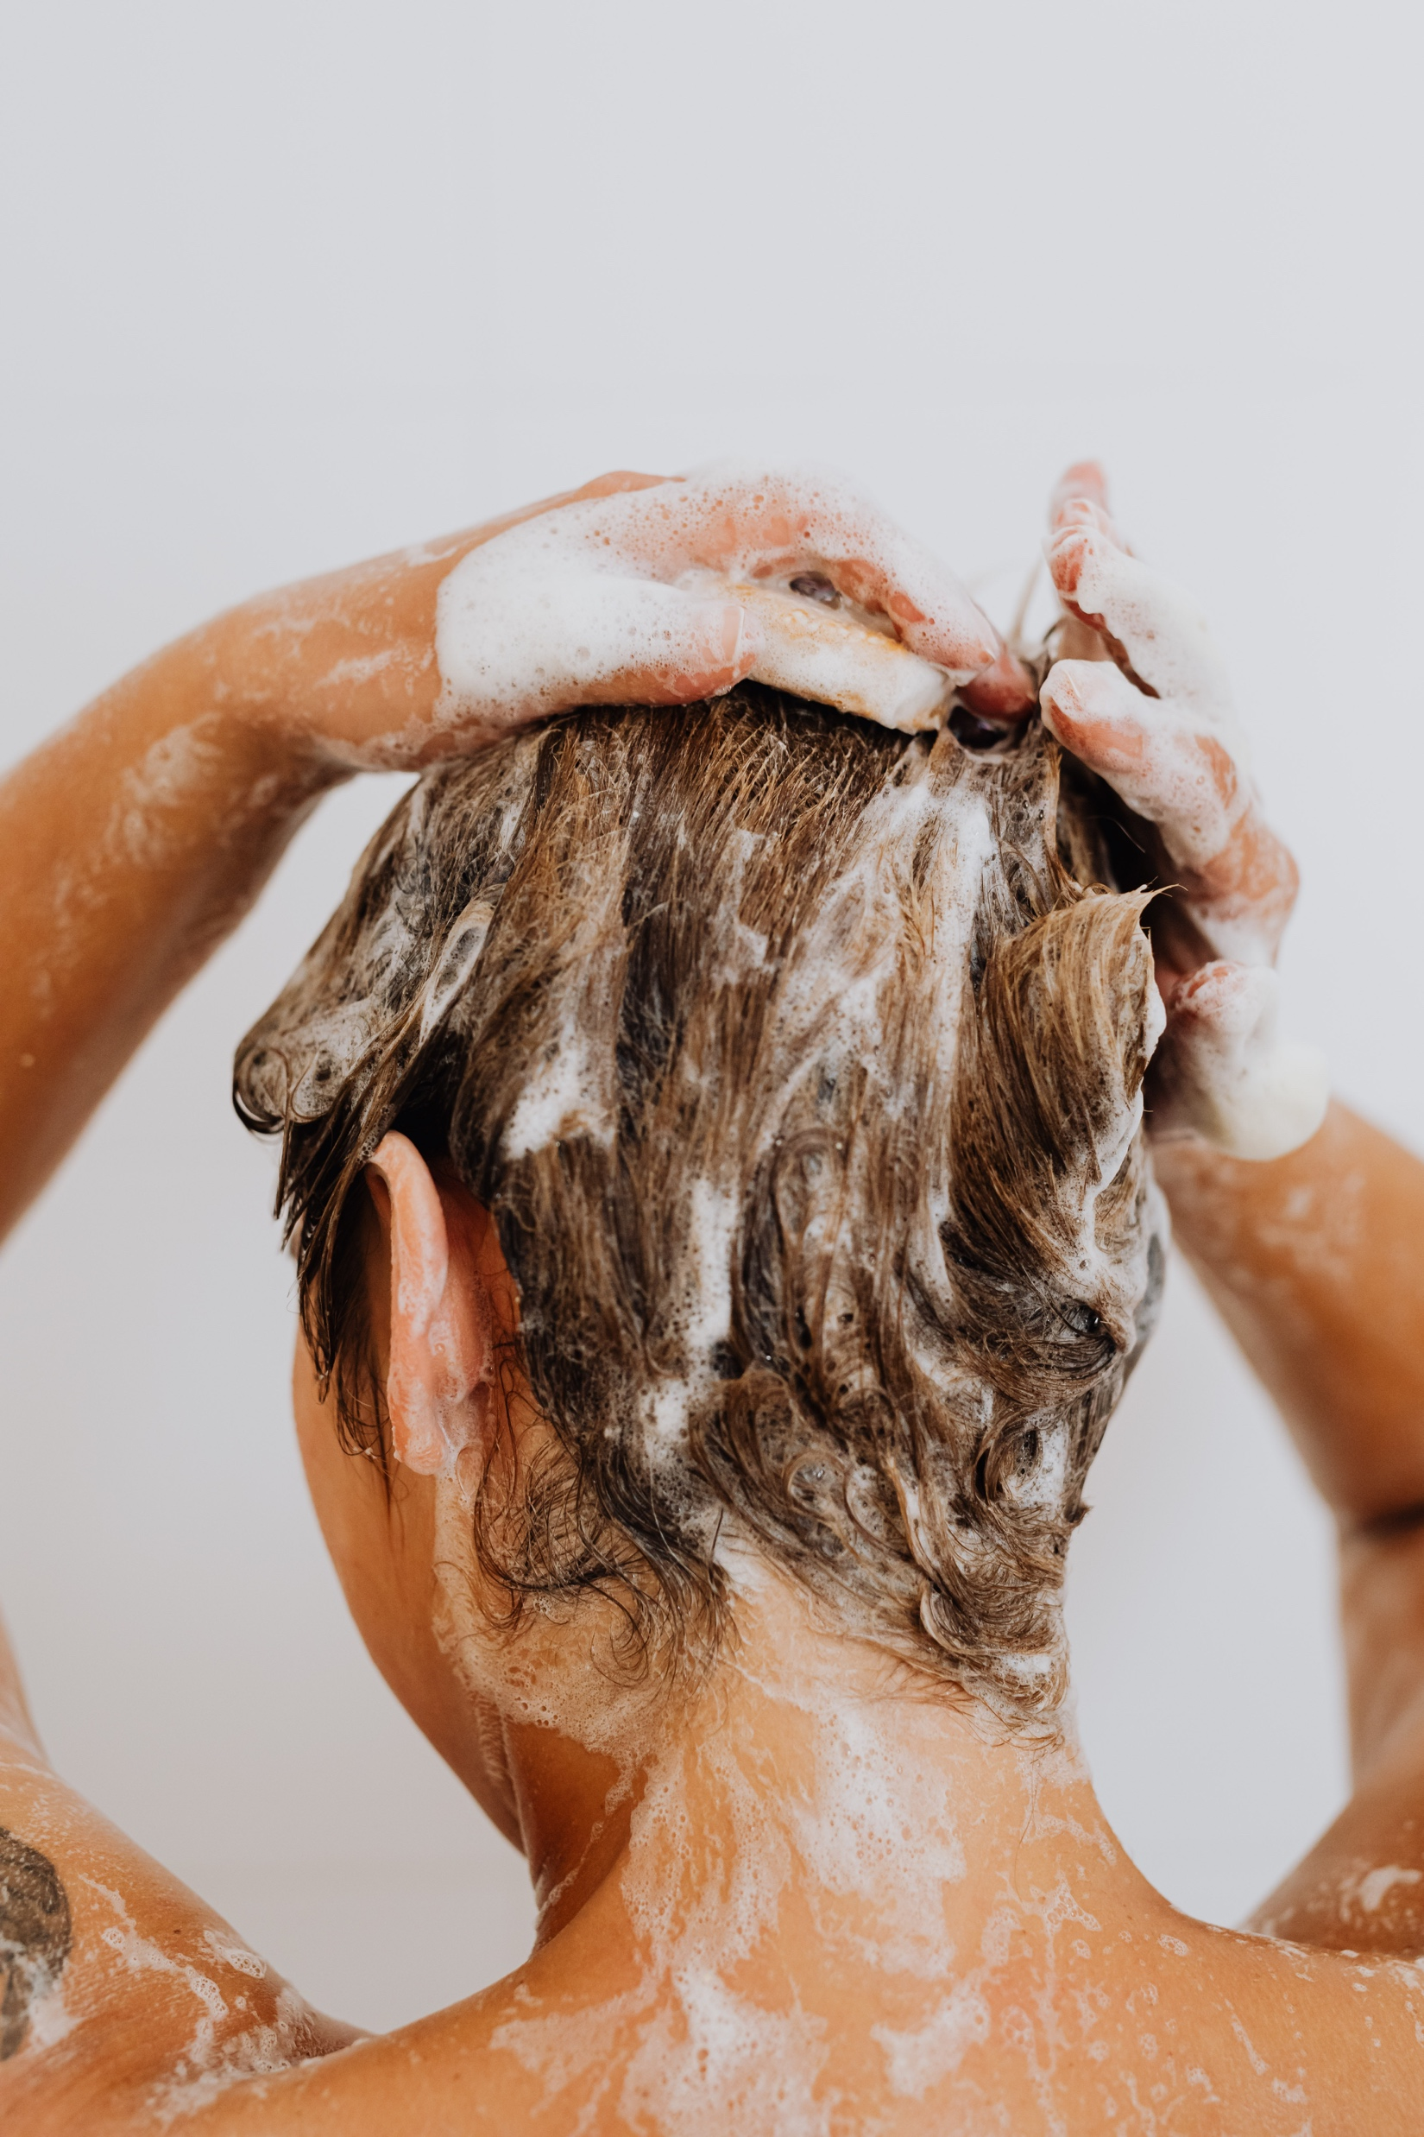
my hair
shampoo
I wash __________ with ____________.
Notes:
Focus on language (continued)
Activity 1: Washing (continued)
Ask ‘What do you wash your hair with?’
Click to reveal correct answers.
Invite students to respond with complete sentences focusing on correct pronunciation.

Slide 9
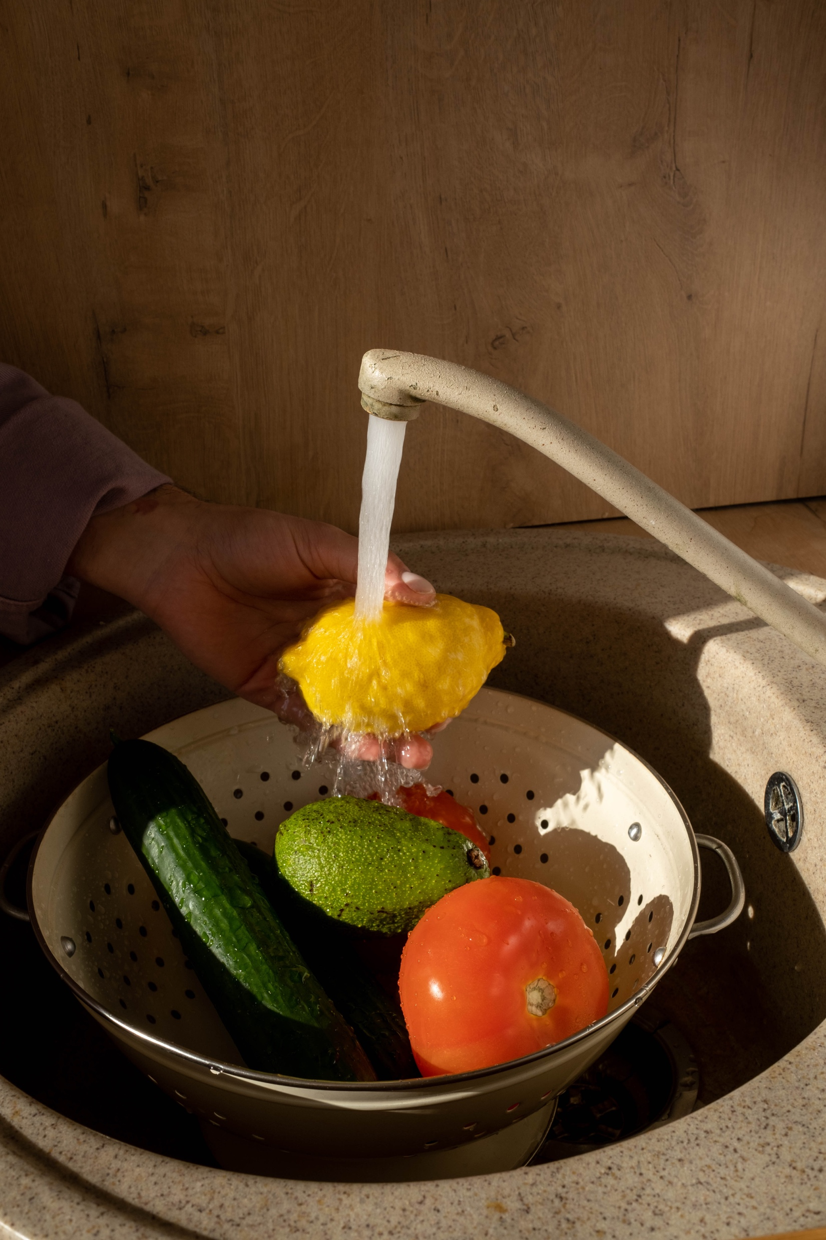
fruit
water
I wash _________ with __________.
Notes:
Focus on language (continued)
Activity 1: Washing (continued)
Ask ‘What do you wash fruit with?’
Click to reveal correct answers.
Invite students to respond with complete sentences focusing on correct pronunciation.

Slide 10
Washing worksheet
Notes:
Focus on language (continued)
Distribute RESOURCE 3.2 – Washing worksheet to each student.
Invite students to work together to complete the worksheet.
Check answers together.

Slide 11
What do you wash __________ with? (Student A)
I wash _________ with _________. (Student B)
Notes:
Focus on language
Activity 2: Speaking about washing
Divide students into pairs.
Nominate Student A and Student B in each pair.
Invite students to use the prompts and speak with each other about the photos on the slide.
Encourage students to use complete sentences focusing on correct pronunciation.
Ensure that both students in each pair have an opportunity to ask and respond.
Swap student roles and repeat.

Slide 12
Turn on the tap.
Wet your hands.
Use soap.
Lather and rub.
Rinse your hands.
Turn off the tap.
Dry your hands.
Notes:
Focus on language (continued)
Activity 3: Washing our hands
Invite a volunteer to demonstrate the following activity in a kitchen/bathroom.
Display the commands on the slide (from RESOURCE 3.3 – Washing our hands sentences) nearby, either on your laptop screen or on paper.
Say ‘Turn on the tap.’
Pause to allow time for the volunteer to demonstrate.
Invite a different volunteer to point to the corresponding command from RESOURCE 3.3 – Washing our hands sentences.
Repeat* for the remaining six commands:
‘Wet your hands.’
‘Use soap.’
‘Lather and rub.’
‘Rinse your hands.’
‘Turn off the tap.’
‘Dry your hands.’
* Depending on the level of your students, you may want to repeat this whole activity several times.

Slide 13

Rinse your hands.
Dry your hands.
Turn off the tap.
Use soap.
Lather and rub.
Wet your hands.
Turn on the tap.
Notes:
Focus on language (continued)
Activity 3: Washing our hands (continued)
NB This slide will at first appear blank in Slide Show mode.
Distribute RESOURCE 3.4 – Washing our hands matching worksheet (if using) to each student. [Alternatively, complete this activity together verbally using the PowerPoint slides.]
Invite students to work together to complete the worksheet.
Click to reveal the image and sentences, then click again to reveal the correct sentence and check the answer together.

Slide 14

Rinse your hands.
Dry your hands.
Turn off the tap.
Use soap.
Lather and rub.
Wet your hands.
Turn on the tap.
Notes:
Focus on language (continued)
Activity 3: Washing our hands (continued)
Click to check the answer together.

Slide 15

Rinse your hands.
Dry your hands.
Turn off the tap.
Use soap.
Lather and rub.
Wet your hands.
Turn on the tap.
Notes:
Focus on language (continued)
Activity 3: Washing our hands (continued)
Click to check the answer together.

Slide 16

Rinse your hands.
Dry your hands.
Turn off the tap.
Use soap.
Lather and rub.
Wet your hands.
Turn on the tap.
Notes:
Focus on language (continued)
Activity 3: Washing our hands (continued)
Click to check the answer together.

Slide 17
Rinse your hands.
Dry your hands.
Turn off the tap.
Use soap.
Lather and rub.
Wet your hands.
Turn on the tap.
Notes:
Focus on language (continued)
Activity 3: Washing our hands (continued)
Click to check the answer together.

Slide 18

Rinse your hands.
Dry your hands.
Turn off the tap.
Use soap.
Lather and rub.
Wet your hands.
Turn on the tap.
Notes:
Focus on language (continued)
Activity 3: Washing our hands (continued)
Click to check the answer together.

Slide 19

Rinse your hands.
Dry your hands.
Turn off the tap.
Use soap.
Lather and rub.
Wet your hands.
Turn on the tap.
Notes:
Focus on language (continued)
Activity 3: Washing our hands (continued)
Click to check the answer together.

Slide 20
Lesson 3
PART 2
The baptism of Jesus
Luke 3:16–22
Notes:
(Part 2 title page)

Slide 21

Notes:
Read for gist
Say ‘In the Bible story, people are washed.’
Distribute copies of Luke 3:16–22 in your students’ heart languages (if in the classroom). [Alternatively, if online, invite students to refer to the heart language texts they have been sent in advance.]
Give students a few minutes to read the text silently for context, then ask them to put it away for the rest of the lesson.

Slide 22
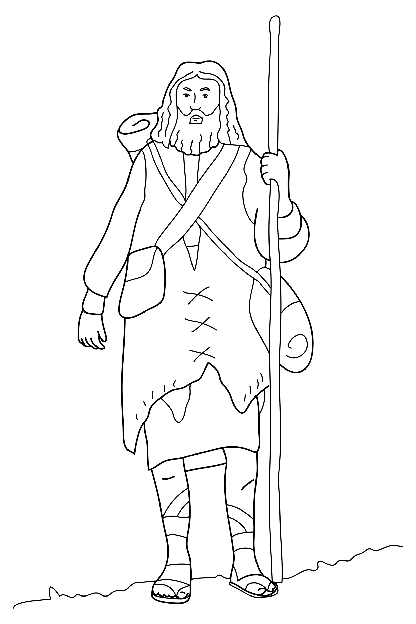
John was a prophet.
Notes:
Read for detail
[This slide and the 5 slides that follow contain RESOURCE 3.5 – Large sketches and RESOURCE 3.6 – Large sentences.]
Read the sentence on the slide aloud slowly.
Invite students to repeat the sentence after you.
Repeat several times to reinforce correct pronunciation.
Click through the presentation to display the remaining 5 sketches and sentences.

Slide 23
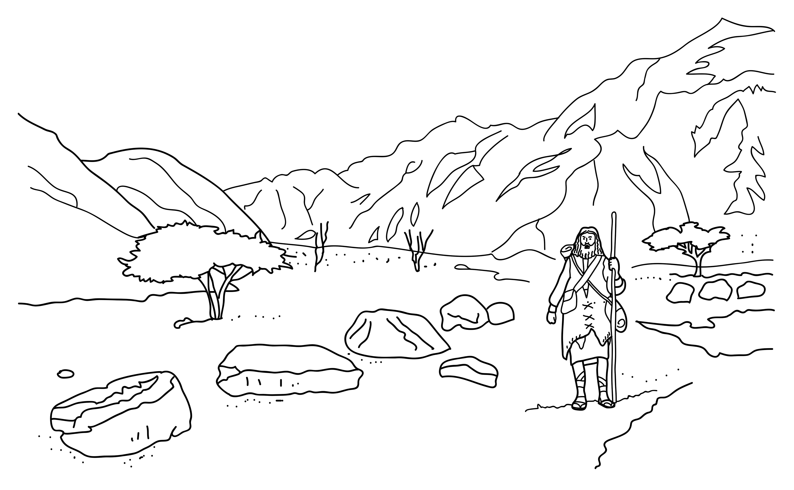
John lived in the desert.
Notes:
Read for detail (continued)
Read the sentence aloud slowly.
Invite students to repeat the sentence after you.
Repeat several times to reinforce correct pronunciation.

Slide 24
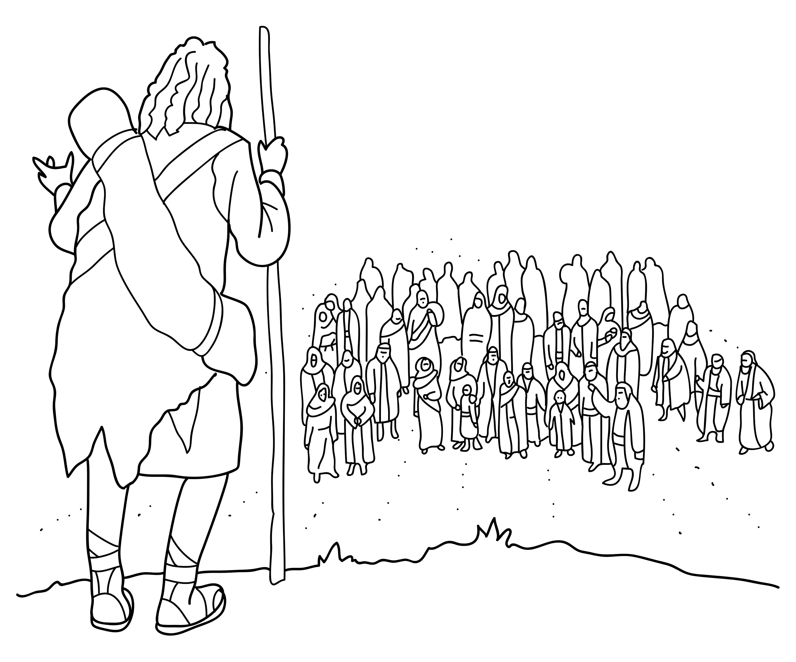
John told people about God.
Notes:
Read for detail (continued)
Read the sentence aloud slowly.
Invite students to repeat the sentence after you.
Repeat several times to reinforce correct pronunciation.

Slide 25
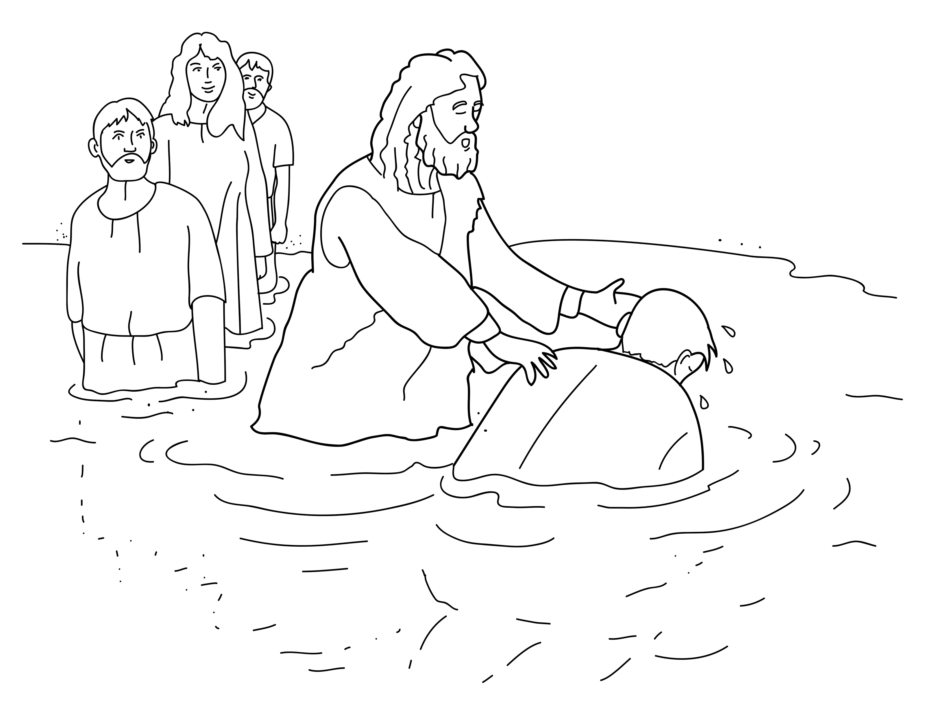
John washed people.
Notes:
Read for detail (continued)
Read the sentence aloud slowly.
Invite students to repeat the sentence after you.
Repeat several times to reinforce correct pronunciation.

Slide 26
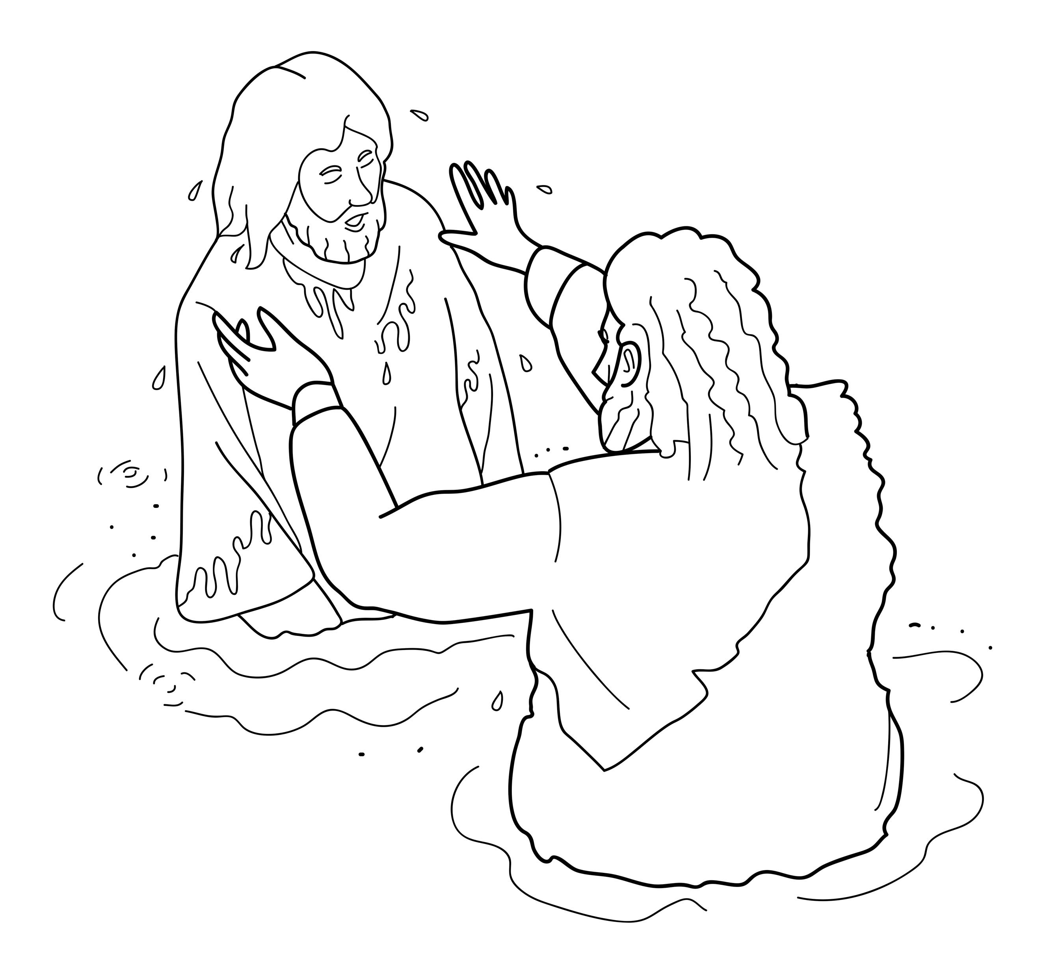
John washed Jesus.
Notes:
Read for detail (continued)
Read the sentence aloud slowly.
Invite students to repeat the sentence after you.
Repeat several times to reinforce correct pronunciation.

Slide 27
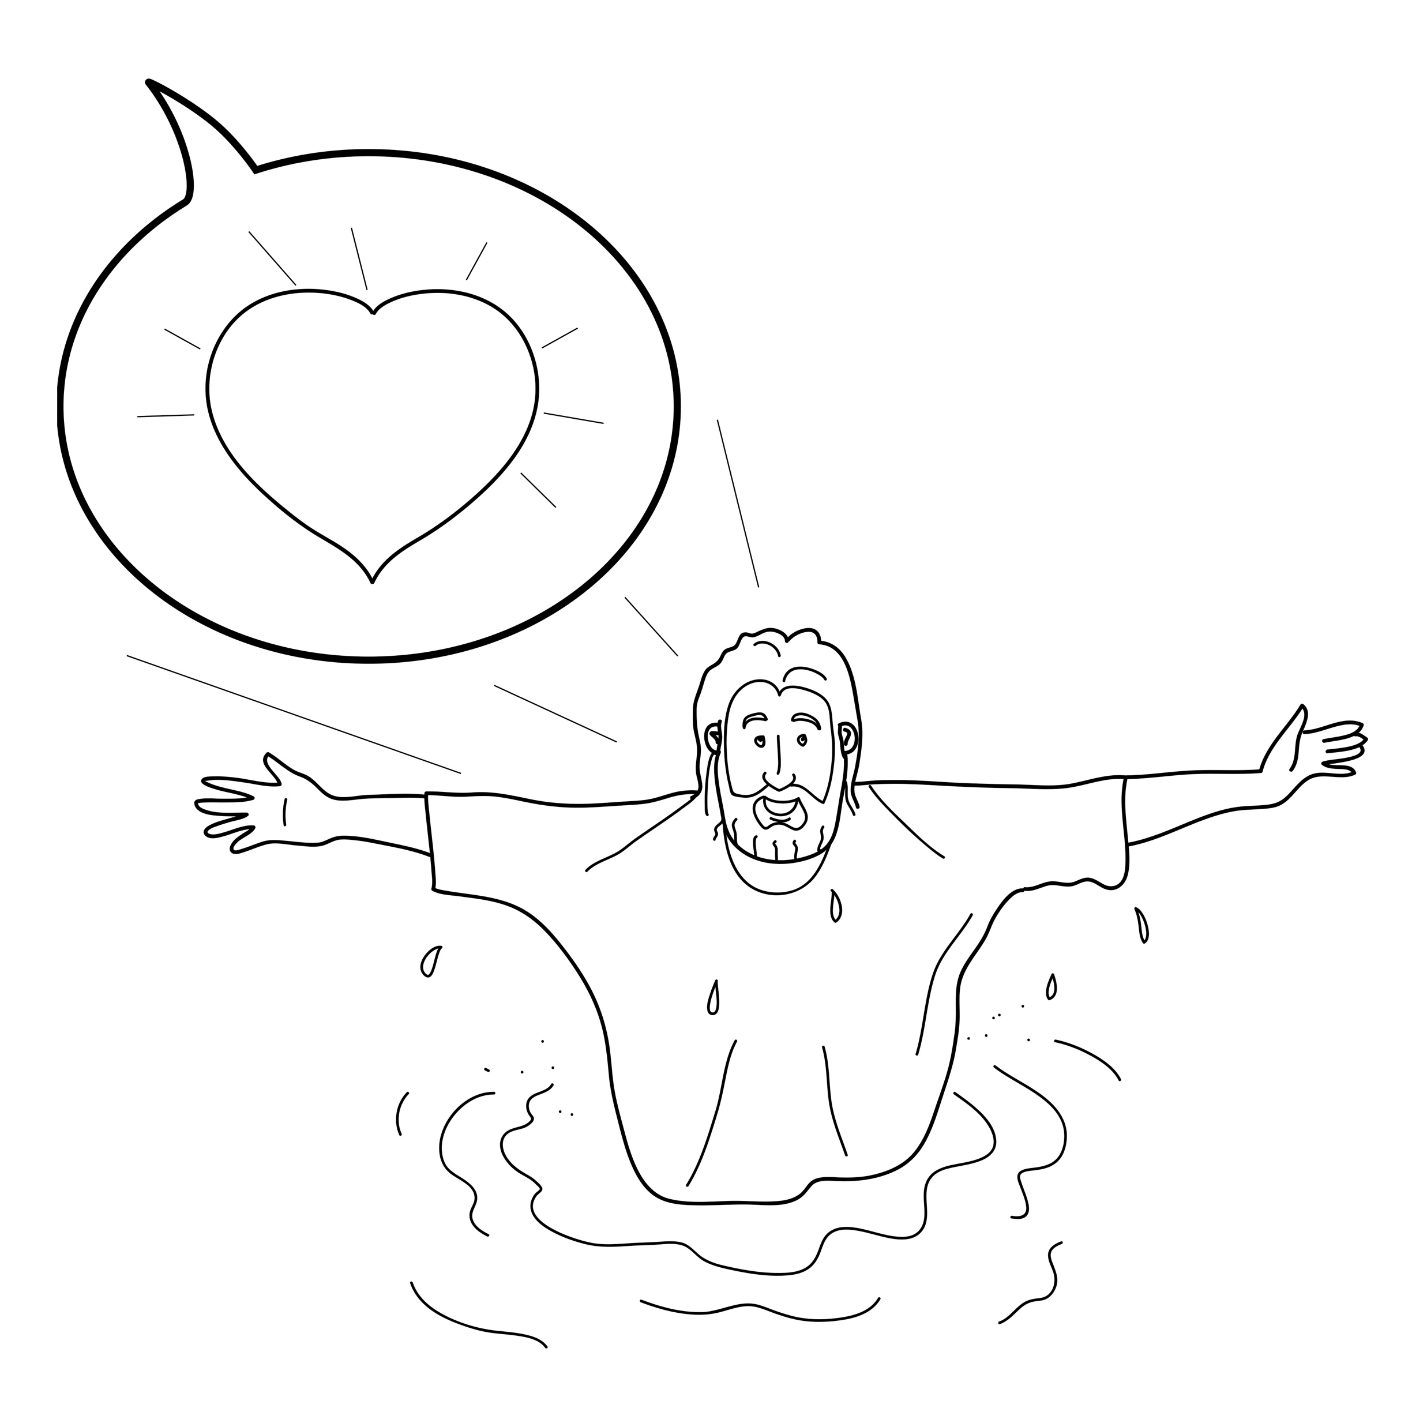
God said, ‘You are my Son. I love you.’
Notes:
Read for detail (continued)
Read the sentence aloud slowly.
Invite students to repeat the sentence after you.
Repeat several times to reinforce correct pronunciation.

Slide 28
Notes:
Reinforce the language
[The activity on this slide and the 5 slides that follow replaces the activity in the lesson book in which students point to corresponding sketches.]
Invite students to say any words that they remember about this sketch.
Accept responses.

Slide 29
Notes:
Reinforce the language (continued)
Invite students to say any words that they remember about this sketch.
Accept responses.

Slide 30
Notes:
Reinforce the language (continued)
Invite students to say any words that they remember about this sketch.
Accept responses.

Slide 31
Notes:
Reinforce the language (continued)
Invite students to say any words that they remember about this sketch.
Accept responses.

Slide 32
Notes:
Reinforce the language (continued)
Invite students to say any words that they remember about this sketch.
Accept responses.

Slide 33
Notes:
Reinforce the language (continued)
Invite students to say any words that they remember about this sketch.
Accept responses.

Slide 34

Notes:
Reinforce the language (continued)
NB This slide will at first appear blank in Slide Show mode.
Distribute RESOURCE 3.7 – Small sketches (if using) to pairs/groups. [Alternatively, complete this activity together verbally using the PowerPoint slides.]
Invite pairs/groups to sequence or try to remember the sketches in the correct order.
Click your mouse to display the sketches one at a time in the correct order.

Slide 35
John was a prophet.
Notes:
Reinforce the language (continued)
Distribute RESOURCE 3.8 – Small sentence strips (if using) to pairs/groups.
Invite pairs/groups to match the sentence strips to the corresponding sketches (if using). More advanced students can sequence the sentence strips without looking at the sketches.
[Alternatively, complete this activity together verbally using the PowerPoint slides.]
Invite students to identify the sketch on the slide that corresponds to the sentence.
Click to display the arrow and confirm the correct response.

Slide 36
John lived in the desert.
Notes:
Reinforce the language (continued)
Invite students to point to the sketch on the slide that corresponds to the sentence.
Click to display the arrow and confirm the correct response.

Slide 37
John told people about God.
Notes:
Reinforce the language (continued)
Invite students to point to the sketch on the slide that corresponds to the sentence.
Click to display the arrow and confirm the correct response.

Slide 38
John washed people.
Notes:
Reinforce the language (continued)
Invite students to point to the sketch on the slide that corresponds to the sentence.
Click to display the arrow and confirm the correct response.

Slide 39
John washed Jesus.
Notes:
Reinforce the language (continued)
Invite students to point to the sketch on the slide that corresponds to the sentence.
Click to display the arrow and confirm the correct response.

Slide 40
God said, ‘You are my Son. I love you.’
Notes:
Reinforce the language (continued)
Invite students to point to the sketch on the slide that corresponds to the sentence.
Click to display the arrow and confirm the correct response.

Slide 41
1. John was a _________.
prophet
Notes:
Reinforce the language (continued)
Distribute RESOURCE 3.9 – Gap-fill worksheet (if using) to each student. [Alternatively, complete this activity together verbally using the PowerPoint slides.]
Encourage students to work together to complete the worksheet.
Click to reveal the missing word and check the answer together.

Slide 42
2. John lived in the __________.
desert
Notes:
Reinforce the language (continued)
Click to reveal the missing word and check the answer together.

Slide 43
God
3. John told people about _________.
Notes:
Reinforce the language (continued)
Click to reveal the missing word and check the answer together.

Slide 44
4. John _________ people.
washed
Notes:
Reinforce the language (continued)
Click to reveal the missing word and check the answer together.

Slide 45
Jesus
5. John washed __________ .
Notes:
Reinforce the language (continued)
Click to reveal the missing word and check the answer together.

Slide 46
6. God said, ‘You are my son.
I ________ you.’
love
Notes:
Reinforce the language (continued)
Click to reveal the missing word and check the answer together.

