Slide 1
Lesson 4
Meet Jesus
Volume 1
Ten Bible-based English lessons
High Beginner
Notes:
(Lesson 2 title page)

Slide 2
Lesson 4
PART 1
Directions
Notes:
(Part 1 title page)

Slide 3

North
West
East
South
Notes:
Activate knowledge
Ask ‘Where is north?’
Click to display north near the corresponding arrow on the slide.
Repeat for east, south and west.

Slide 4
compass
Notes:
Activate knowledge (continued)
Ask ‘What is a compass?’
Invite responses.
Say ‘A compass gives direction.’
Invite students to open the compass app on their smartphones. (Students may need time to download an app; alternatively, they can look on with someone else.)
Ask ‘Where is north?’
Invite students to stand and turn to face towards the north.
Repeat for south, east and west.

Slide 5
Turn
Notes:
Focus on language
Activity 1: Turn
Invite all students to stand up.
Say ‘Turn to your right.’
Ensure that all students respond correctly before moving on to the next instruction.
Say ‘Turn to your right’ again (which should result in all students facing the back of the room).
Say ‘Turn to me’ (which should result in all students facing the front of the room).
Say ‘Turn to your left’, wait, then say ‘Turn to your left’ again (which should result in all students facing the back of the room).
Say ‘Turn to me’ (which should result in all students facing the front of the room).
Repeat until all students can follow instructions.

Slide 6
________ is near_______ .
Notes:
Focus on language (continued)
Activity 2: Near
Point to items/people in the room, inserting missing words on the lines on the screen as you go (e.g. The bathroom is near the cleaning cupboard; Ahmed is near Hassan).
Divide students into pairs.
Invite pairs to create sentences together using the prompt from the slide.

Slide 7
Notes:
Focus on language (continued)
Activity 3: Following directions
Say ‘Turn right.’
Click to display the blue arrow on the road as you say this.

Slide 8
Notes:
Focus on language (continued)
Activity 3: Following directions (continued)
Say ‘Turn left.’
Click to display the blue arrow on the road as you say this.

Slide 9
Turn left at the roundabout.
Start here
Start here
Notes:
Focus on language (continued)
Activity 4: Following more directions
Distribute RESOURCE 4.1 – Directions worksheet to each student.
Invite students to work together to complete the worksheet.
Click through slides 9–16 to check answers together.

Slide 10
Turn right at the roundabout.
Start here
Start here
Notes:
Focus on language (continued)
Activity 4: Following more directions (continued)
Click to reveal the correct answer.

Slide 11
Take the first turn on the left.
Start here
Notes:
Focus on language (continued)
Activity 4: Following more directions (continued)
Click to reveal the correct answer.

Slide 12
Take the second turn on the left.
Start here
Notes:
Focus on language (continued)
Activity 4: Following more directions (continued)
Click to reveal the correct answer.

Slide 13
Take the third turn on the left.
Start here
Notes:
Focus on language (continued)
Activity 4: Following more directions (continued)
Click to reveal the correct answer.

Slide 14
Take the first turn on the right.
Start here
Notes:
Focus on language (continued)
Activity 4: Following more directions (continued)
Click to reveal the correct answer.

Slide 15
Take the second turn on the right.
Start here
Notes:
Focus on language (continued)
Activity 4: Following more directions (continued)
Click to reveal the correct answer.

Slide 16
Take the third turn on the right.
Start here
Notes:
Focus on language (continued)
Activity 4: Following more directions (continued)
Click to reveal the correct answer.

Slide 17
Lesson 4
PART 2
Jesus begins his work
Matthew 4:12–17
Notes:
(Part 2 title page)

Slide 18

Notes:
Read for gist
Say ‘In the Bible story, Jesus gives directions to people.’
Distribute copies of Matthew 4:12–17 in your students’ heart languages (if in the classroom). [Alternatively, if online, invite students to refer to the heart language texts they have been sent in advance.]
Give students a few minutes to read the text silently for context, then ask them to put it away for the rest of the lesson.

Slide 19
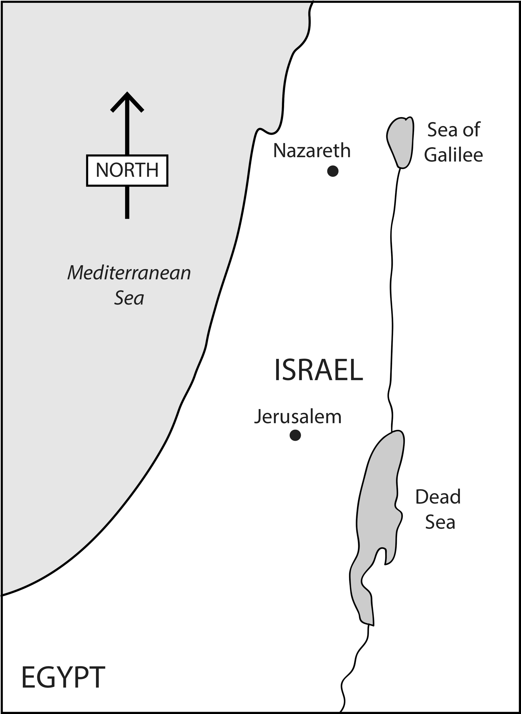
Jesus went to north Israel.
Notes:
Read for detail
[This slide and the 4 slides that follow contain RESOURCE 4.2 – Large sketches and RESOURCE 4.3 – Large sentences.]
Read the sentence on the slide aloud slowly.
Invite students to repeat the sentence after you.
Repeat several times to reinforce correct pronunciation.
Click through the presentation to display the remaining 4 sketches and sentences.

Slide 20
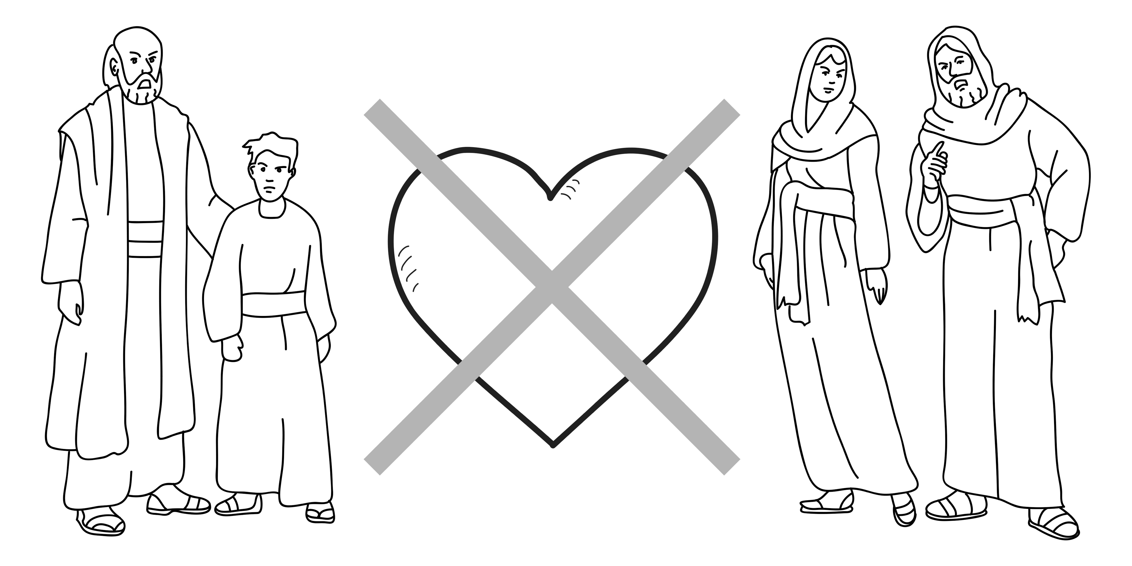
The people did not love God.
Notes:
Read for detail (continued)
Read the sentence aloud slowly.
Invite students to repeat the sentence after you.
Repeat several times to reinforce correct pronunciation.

Slide 21
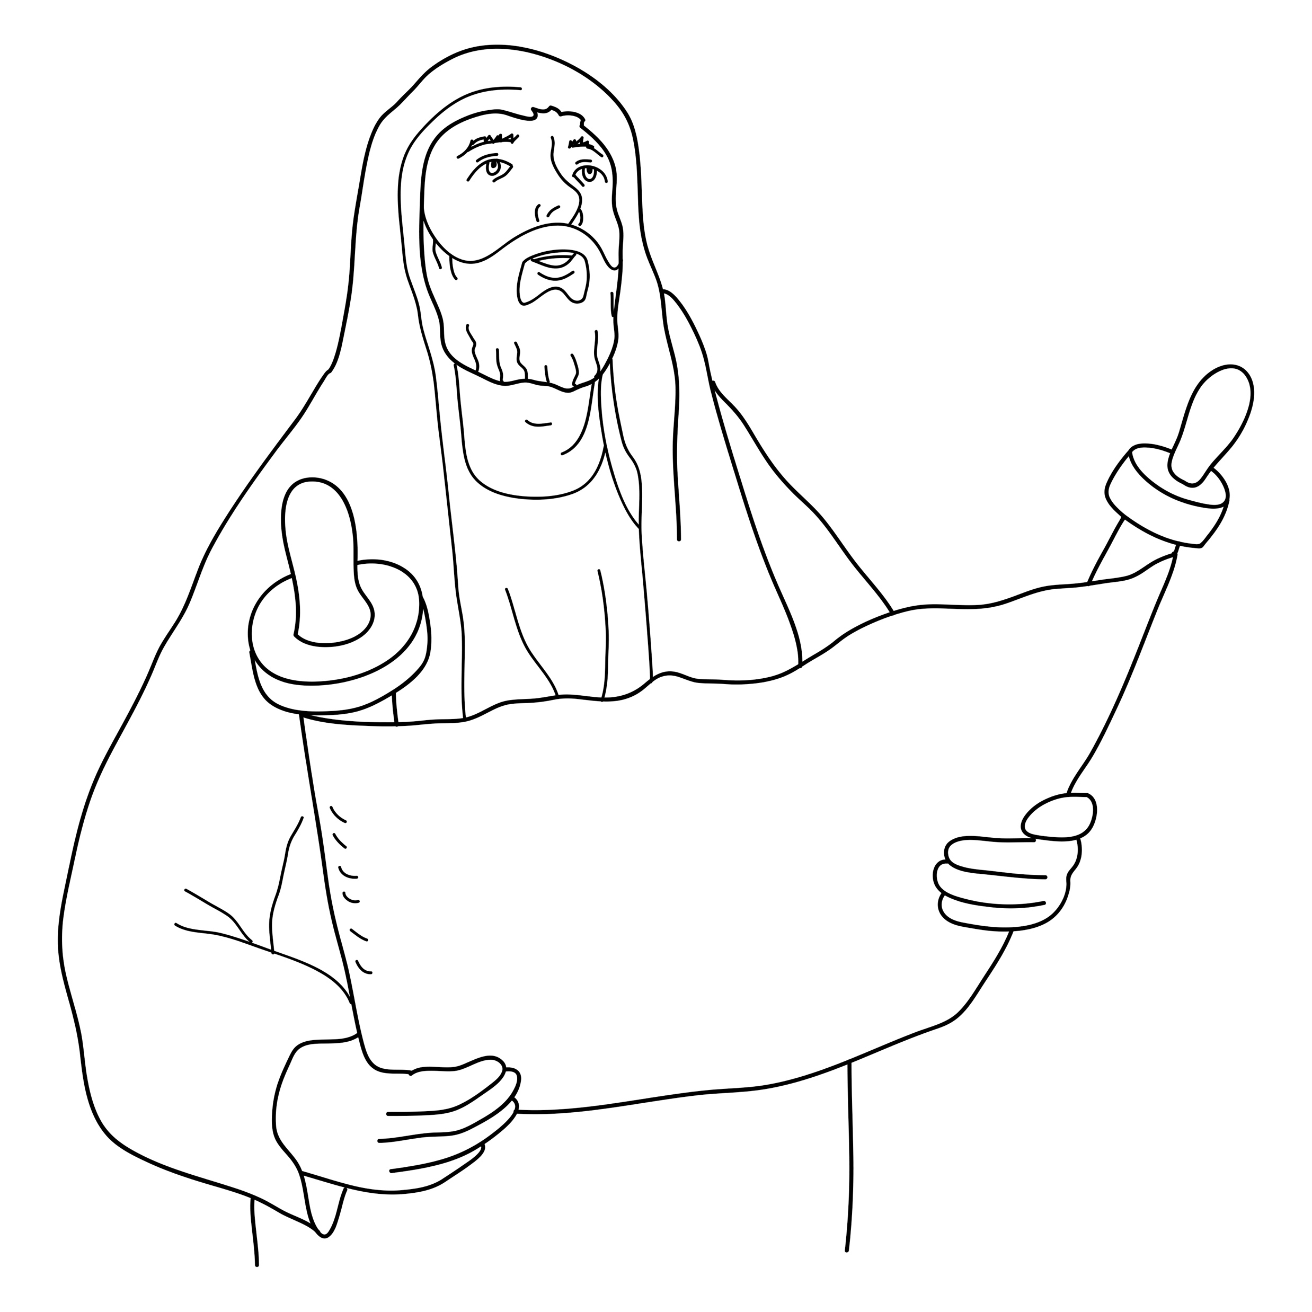
Jesus spoke God’s words.
Notes:
Read for detail (continued)
Read the sentence aloud slowly.
Invite students to repeat the sentence after you.
Repeat several times to reinforce correct pronunciation.

Slide 22

Jesus said, ‘Turn to me.’
Notes:
Read for detail (continued)
Read the sentence aloud slowly.
Invite students to repeat the sentence after you.
Repeat several times to reinforce correct pronunciation.

Slide 23

Jesus said, ‘My kingdom is near.’
Notes:
Read for detail (continued)
Read the sentence aloud slowly.
Invite students to repeat the sentence after you.
Repeat several times to reinforce correct pronunciation.

Slide 24
Notes:
Reinforce the language
[The activity on this slide and the 4 slides that follow replaces the activity in the lesson book in which students point to corresponding sketches.]
Invite students to say any words that they remember about this sketch.
Accept responses.

Slide 25
Notes:
Reinforce the language (continued)
Invite students to say any words that they remember about this sketch.
Accept responses.

Slide 26
Notes:
Reinforce the language (continued)
Invite students to say any words that they remember about this sketch.
Accept responses.

Slide 27
Notes:
Reinforce the language (continued)
Invite students to say any words that they remember about this sketch.
Accept responses.

Slide 28
Notes:
Reinforce the language (continued)
Invite students to say any words that they remember about this sketch.
Accept responses.

Slide 29
Notes:
Reinforce the language (continued)
NB This slide will at first appear blank in Slide Show mode.
Distribute RESOURCE 4.4 – Small sketches (if using) to pairs/groups. [Alternatively, complete this activity together verbally using the PowerPoint slides.]
Invite pairs/groups to sequence or try to remember the sketches in the correct order.
Click your mouse to display the sketches one at a time in the correct order.

Slide 30
Jesus went to north Israel.
Notes:
Reinforce the language (continued)
Distribute RESOURCE 4.5 – Small sentence strips (if using) to pairs/groups.
Invite pairs/groups to match the sentence strips to the corresponding sketches (if using). More advanced students can sequence the sentence strips without looking at the sketches.
[Alternatively, complete this activity together verbally using the PowerPoint slides.]
Invite students to identify the sketch on the slide that corresponds to the sentence.
Click to display the arrow and confirm the correct response.

Slide 31
The people did not love God.
Notes:
Reinforce the language (continued)
Invite students to point to the sketch on the slide that corresponds to the sentence.
Click to display the arrow and confirm the correct response.

Slide 32
Jesus spoke God’s words
Notes:
Reinforce the language (continued)
Invite students to point to the sketch on the slide that corresponds to the sentence.
Click to display the arrow and confirm the correct response.

Slide 33
Jesus said, ‘Turn to me.’
Notes:
Reinforce the language (continued)
Invite students to point to the sketch on the slide that corresponds to the sentence.
Click to display the arrow and confirm the correct response.

Slide 34
Jesus said, ‘My kingdom is near.’
Notes:
Reinforce the language (continued)
Invite students to point to the sketch on the slide that corresponds to the sentence.
Click to display the arrow and confirm the correct response.

Slide 35
1. Jesus went to _________ Israel.
north
Notes:
Reinforce the language (continued)
Distribute RESOURCE 4.6 – Gap-fill worksheet (if using) to each student. [Alternatively, complete this activity together verbally using the PowerPoint slides.]
Encourage students to work together to complete the worksheet.
Click to reveal the missing word and check the answer together.

Slide 36
2. The people did not love ________.
God
Notes:
Reinforce the language (continued)
Click to reveal the missing word and check the answer together.

Slide 37
spoke
3. Jesus _________ God’s words.
Notes:
Reinforce the language (continued)
Click to reveal the missing word and check the answer together.

Slide 38
4. Jesus said, ‘ _______ to me.’
Turn
Notes:
Reinforce the language (continued)
Click to reveal the missing word and check the answer together.

Slide 39
5. Jesus said,
‘My kingdom is _________ .’
near
Notes:
Reinforce the language (continued)
Click to reveal the missing word and check the answer together.

