Slide 1
Lesson 7
Meet Jesus
Volume 1
Ten Bible-based English lessons
High Beginner
Notes:
(Lesson 2 title page)

Slide 2
Lesson 7
PART 1
Forgiveness
Notes:
(Part 1 title page)

Slide 3

Notes:
Activate knowledge
[Slides 3–5 contain RESOURCE 7.1 – Two photos.]
Ask ‘What can you see?’
Write responses on the board (if using), correcting errors as you go.
Invite students to create simple sentences about the scene.

Slide 4
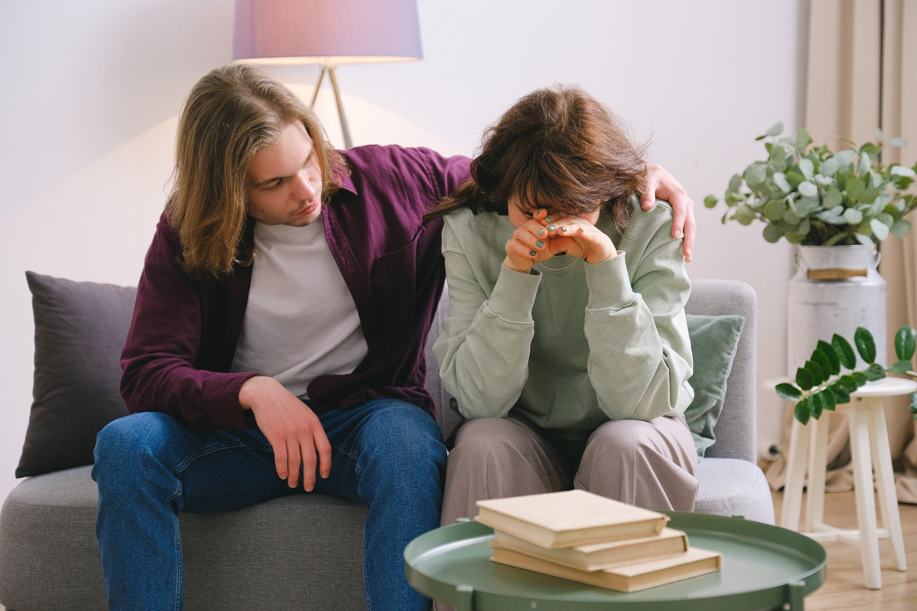
Notes:
Activate knowledge (continued)
Ask ‘What can you see?’
Write responses on the board (if using), correcting errors as you go.
Invite students to create simple sentences about the scene.

Slide 5
Notes:
Focus on language
Activity 1: Story of two women
Click to highlight the woman in the photo on the left (Photo 1 from RESOURCE 7.1 – Two photos).
Say the following:
‘There was a woman.’
‘She said hurtful things.’ (Gesture speaking.)
‘She hurt the man.’ (Place both hands on your heart.)
‘She didn’t say sorry.’ (Shake your head.)
Invite students to repeat the sentences after you.
Click to highlight the woman in the photo on the right (Photo 2 from RESOURCE 7.1 – Two photos).
Say the following:
‘There was another woman.’
‘She said hurtful things.’ (Gesture speaking.)
‘She hurt the man.’ (Place both hands on your heart.)
‘She said, “Please forgive me.”’ (Place your hands together to gesture pleading.)
‘The man forgave the woman.’ (Nod your head.)
Invite students to repeat the sentences after you.
Activity 2: Speaking activity
Divide students into pairs.
Invite students to retell one or both of these stories to their partners.

Slide 6
Please forgive me for ______________
= I’m sorry for ______________
getting angry
getting angry
Notes:
Focus on language (continued)
Activity 3: Miming and completing sentences
Mime being angry (e.g. slam the door, throw papers onto a table).
Invite students to guess your actions (getting angry).
Click to display getting angry on both of the blank lines on the screen.
Say ‘Please forgive me for getting angry. I’m sorry for getting angry.’
Invite students to repeat the phrases after you, focusing on correct pronunciation and expression.

Slide 7
Please forgive me for ______________
= I’m sorry for ______________
coughing
coughing
Notes:
Focus on language (continued)
Activity 3: Miming and completing sentences (continued)
Repeat the activity from the previous slide, this time using coughing instead of getting angry.

Slide 8
Please forgive me for ________________
= I’m sorry for ________________
crashing the car
crashing the car
Notes:
Focus on language (continued)
Activity 3: Miming and completing sentences (continued)
Show the ‘crashing the car’ strip from RESOURCE 7.2 – Miming to two volunteers/helpers without showing the other students.
Ensure that the volunteers don’t speak.
Invite the volunteers to mime driving and then having a car crash.
Invite students to guess what has been mimed.
Click to display crashing the car on both of the lines on the screen once the mime has been guessed correctly.
Say ‘Please forgive me for crashing the car. I’m sorry for crashing the car.’
Invite students to repeat the phrases after you, focusing on correct pronunciation and expression.

Slide 9
Please forgive me for _________________
= I’m sorry for _________________
spilling my drink
spilling my drink
Notes:
Focus on language (continued)
Activity 3: Miming and completing sentences (continued)
Repeat the activity from the previous slide using the ‘spilling my drink’ strip from RESOURCE 7.2 – Miming.

Slide 10
Please forgive me for ______________
= I’m sorry for ______________
not listening
not listening
Notes:
Focus on language (continued)
Activity 3: Miming and completing sentences (continued)
Repeat the activity using the ‘not listening’ strip from RESOURCE 7.2 – Miming.

Slide 11
Please forgive me for ______________
= I’m sorry for ______________
running late
running late
Notes:
Focus on language (continued)
Activity 3: Miming and completing sentences (continued)
Repeat the activity using the ‘running late’ strip from RESOURCE 7.2 – Miming.

Slide 12

Please forgive me for ____________
I’m sorry for _______________
spilling my drink
not listening
running late
getting angry
coughing
crashing the car
Notes:
Focus on language (continued)
Activity 4: Matching worksheet
Distribute RESOURCE 7.3 – Matching worksheet to each student.
Encourage students to work together to complete the worksheet.
Click through slides 12–17 to check answers together.

Slide 13

Please forgive me for ____________
I’m sorry for _______________
spilling my drink
not listening
running late
getting angry
coughing
crashing the car
Notes:
Focus on language (continued)
Activity 4: Matching worksheet (continued)
Click to check the answer together.

Slide 14
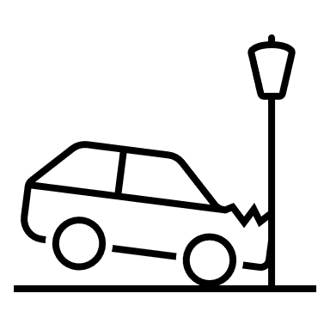
Please forgive me for ____________
I’m sorry for _______________
spilling my drink
not listening
running late
getting angry
coughing
crashing the car
Notes:
Focus on language (continued)
Activity 4: Matching worksheet (continued)
Click to check the answer together.

Slide 15

Please forgive me for ____________
I’m sorry for _______________
spilling my drink
not listening
running late
getting angry
coughing
crashing the car
Notes:
Focus on language (continued)
Activity 4: Matching worksheet (continued)
Click to check the answer together.

Slide 16

Please forgive me for ____________
I’m sorry for _______________
spilling my drink
not listening
running late
getting angry
coughing
crashing the car
Notes:
Focus on language (continued)
Activity 4: Matching worksheet (continued)
Click to check the answer together.

Slide 17

Please forgive me for ____________
I’m sorry for _______________
spilling my drink
not listening
running late
getting angry
coughing
crashing the car
Notes:
Focus on language (continued)
Activity 4: Matching worksheet (continued)
Click to check the answer together.

Slide 18
1 = easy
2 =
3 =
4 =
5 =
6 =
7 = difficult
coughing
crashing the car
Notes:
Focus on language (continued)
Extension activity: Easy or difficult?
Invite students to keep their RESOURCE 7.3 – Matching worksheet in front of them.
Ask ‘How easy is it to forgive someone for coughing?’
Invite responses.
Click to reveal coughing beside 1=easy on the slide.
Say ‘Write number 1 in the box next to coughing.’
Ask ‘How easy is it to forgive someone for crashing your car?’
Invite responses.
Click to reveal crashing the car beside 7=difficult on the slide.
Say ‘Write number 7 in the box next to the crashed car.’
Divide students into pairs.
Invite students to work together and allocate numbers from 1 to 7 to the remaining images on the worksheet according to how difficult they think each action is to forgive.
NB you may need to reassure students that there is no correct answer – this is just their opinion.

Slide 19
Lesson 7
PART 2
The Pharisee and the tax collector
Luke 18:9–14
Notes:
(Part 2 title page)

Slide 20
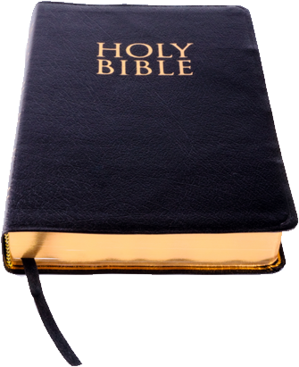
Notes:
Read for gist
Say ‘In the Bible story, God forgives a man.’
Distribute copies of Luke 15:11–24 in your students’ heart languages (if in the classroom). [Alternatively, if online, invite students to refer to the heart language texts they have been sent in advance.]
Give students a few minutes to read the text silently for context, then ask them to put it away for the rest of the lesson.

Slide 21
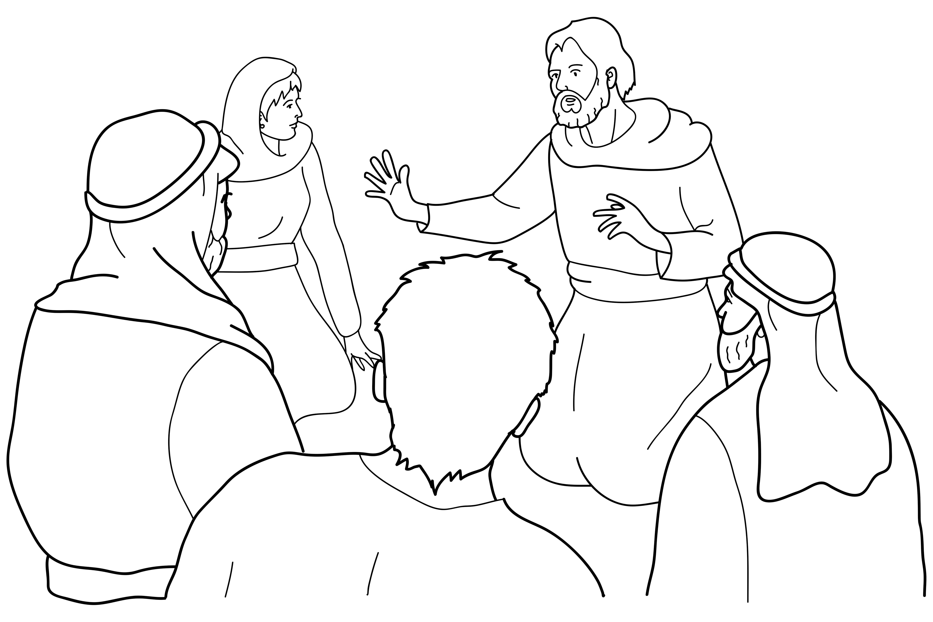
Jesus told this story:
Notes:
Read for detail
[This slide and the 7 slides that follow contain RESOURCE 7.4 – Large sketches and RESOURCE 7.5 – Large sentences.]
Read the sentence on the slide aloud slowly.
Invite students to repeat the sentence after you.
Repeat several times to reinforce correct pronunciation.
Click through the presentation to display the remaining 7 sketches and sentences.

Slide 22
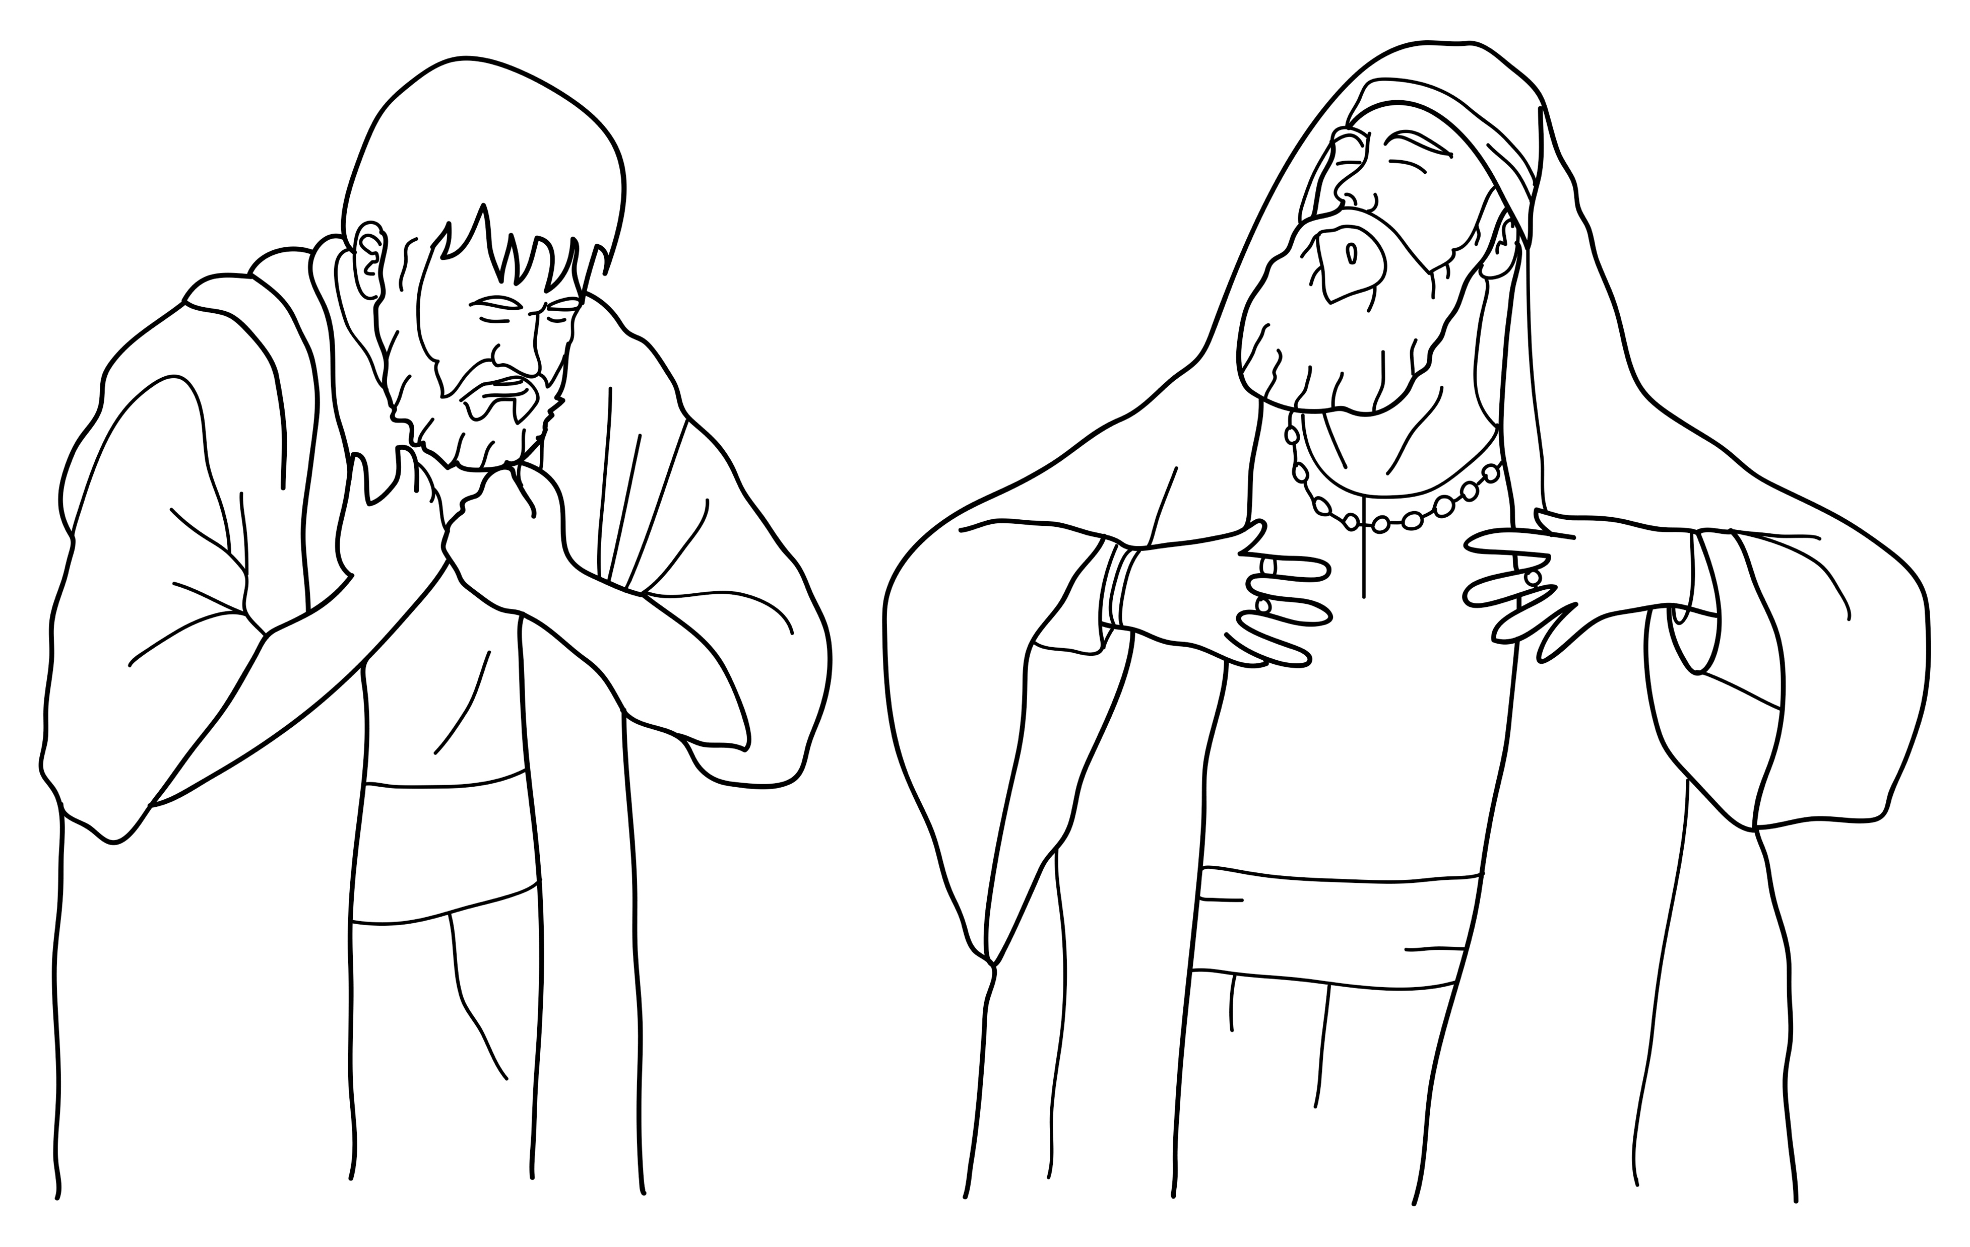
Two men prayed to God.
Notes:
Read for detail (continued)
Read the sentence aloud slowly.
Invite students to repeat the sentence after you.
Repeat several times to reinforce correct pronunciation.

Slide 23
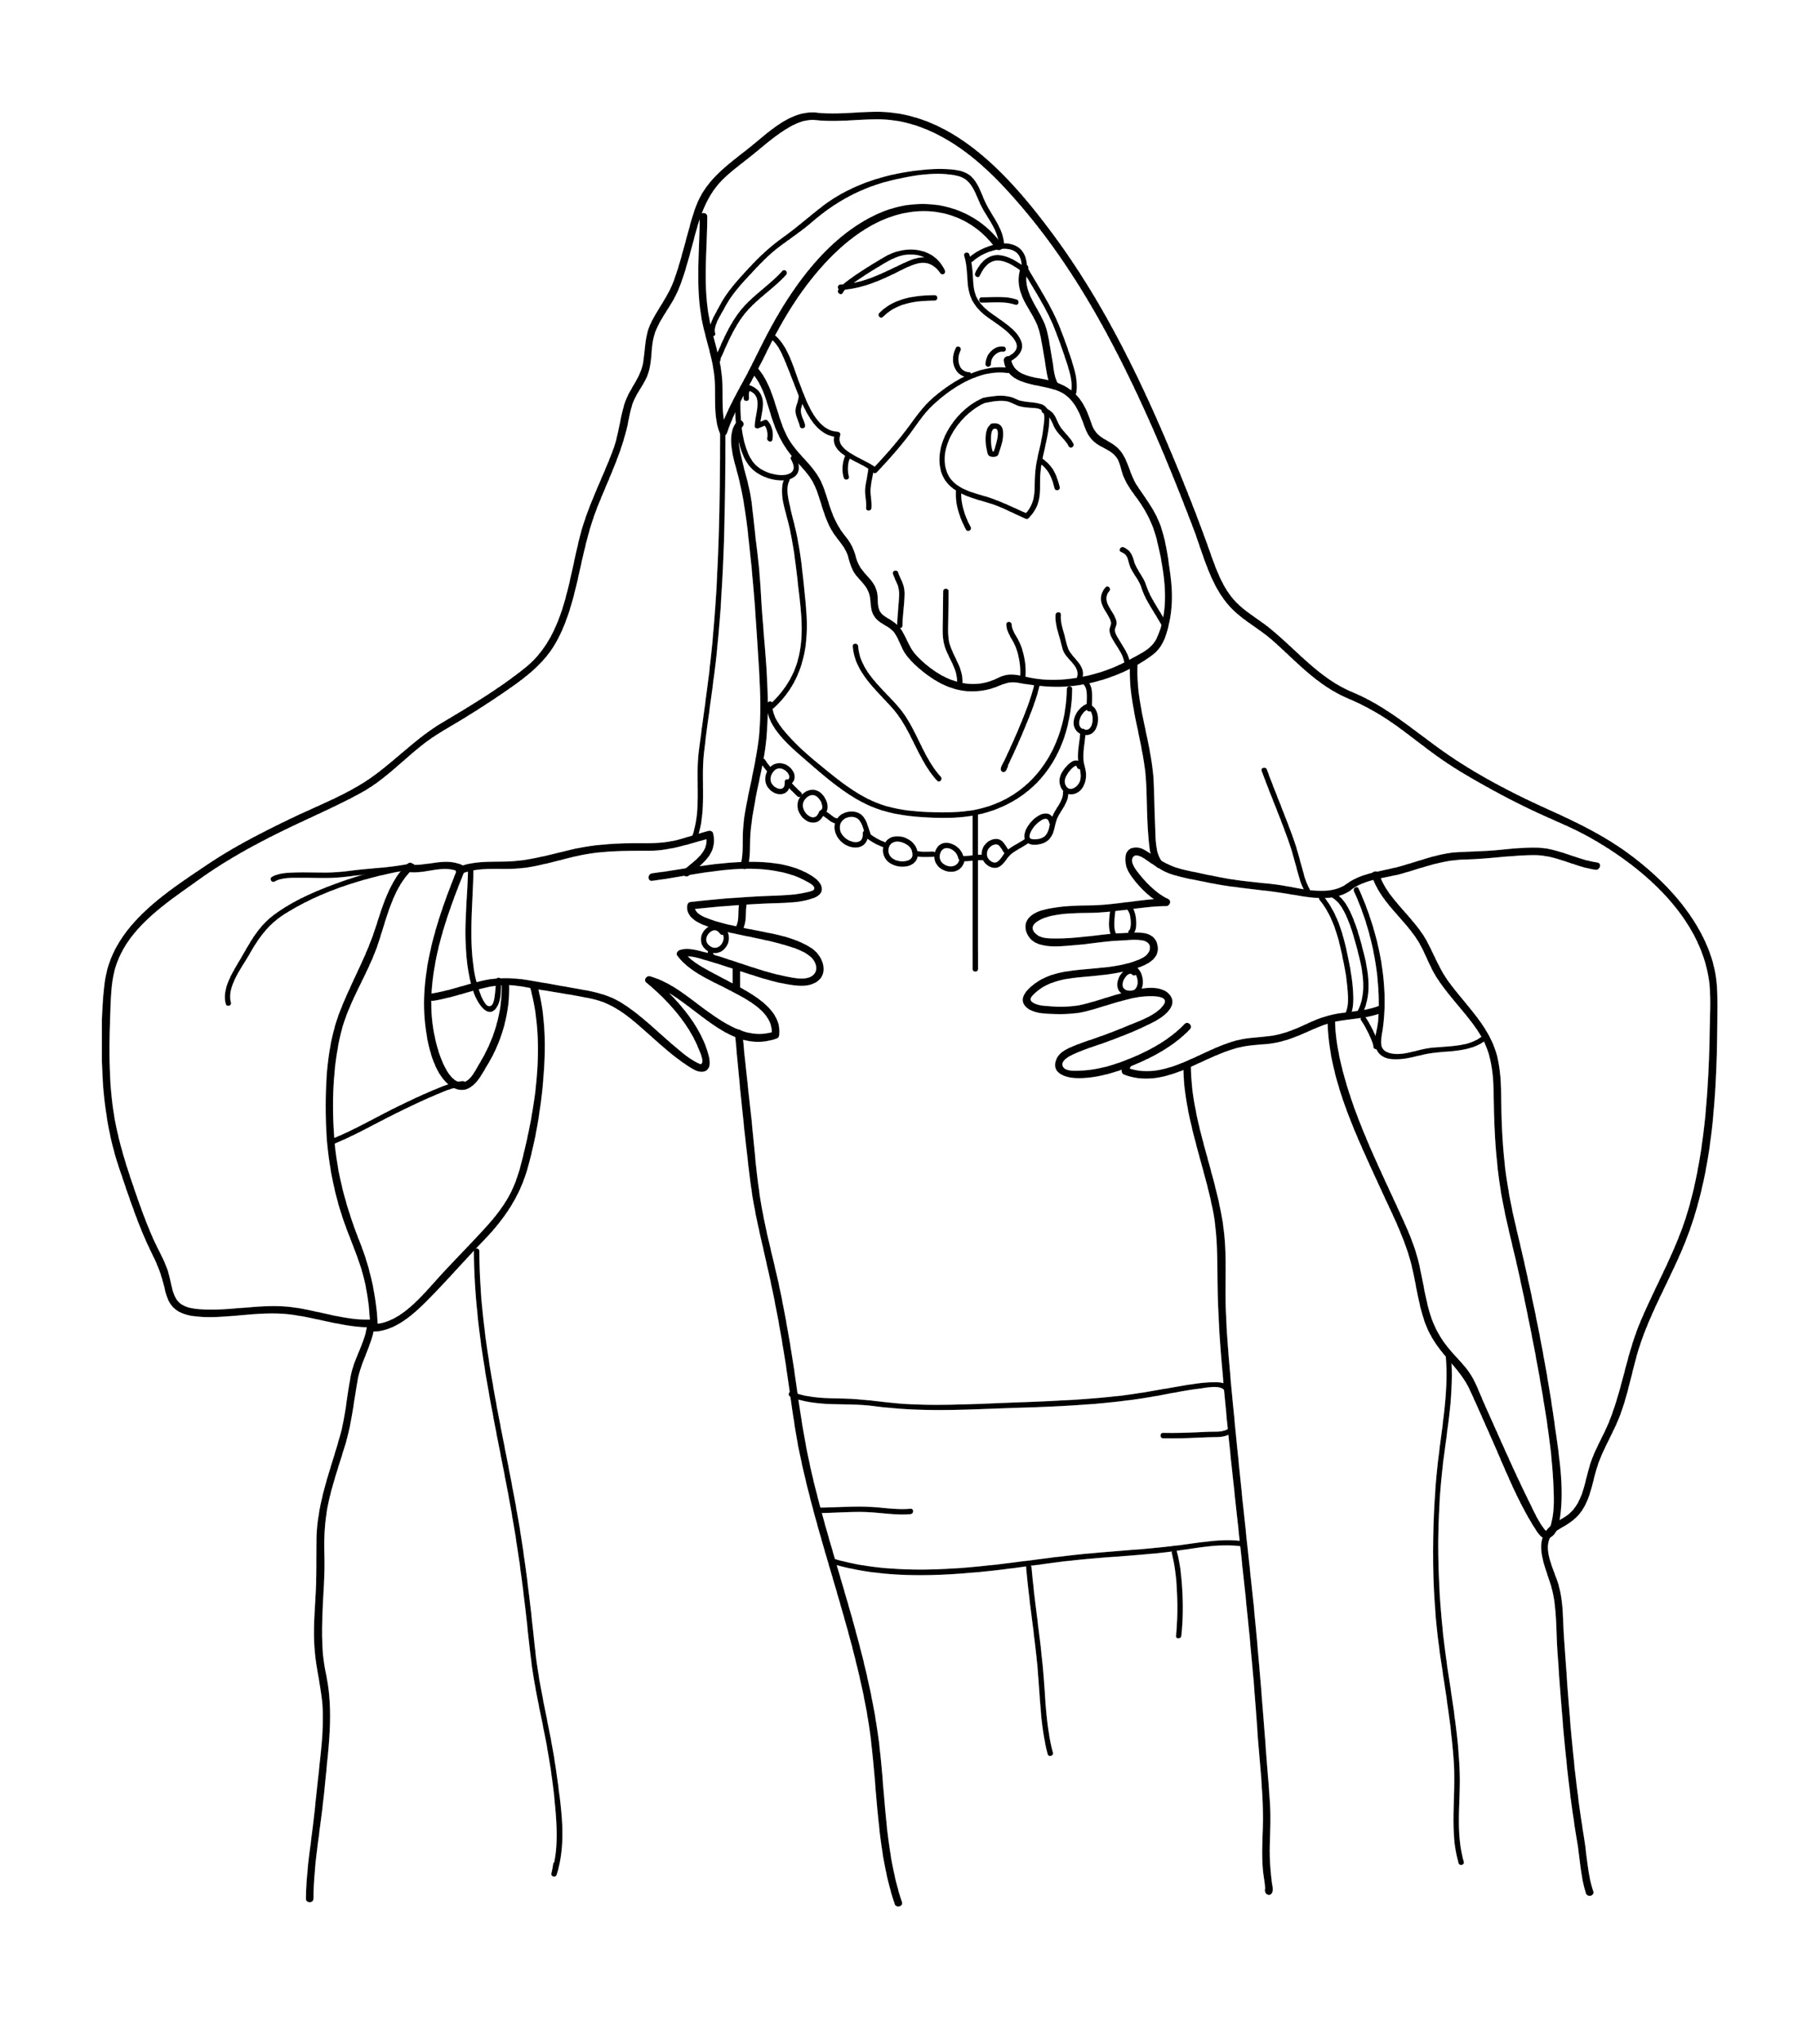
One man was a religious leader.
Notes:
Read for detail (continued)
Read the sentence aloud slowly.
Invite students to repeat the sentence after you.
Repeat several times to reinforce correct pronunciation.

Slide 24
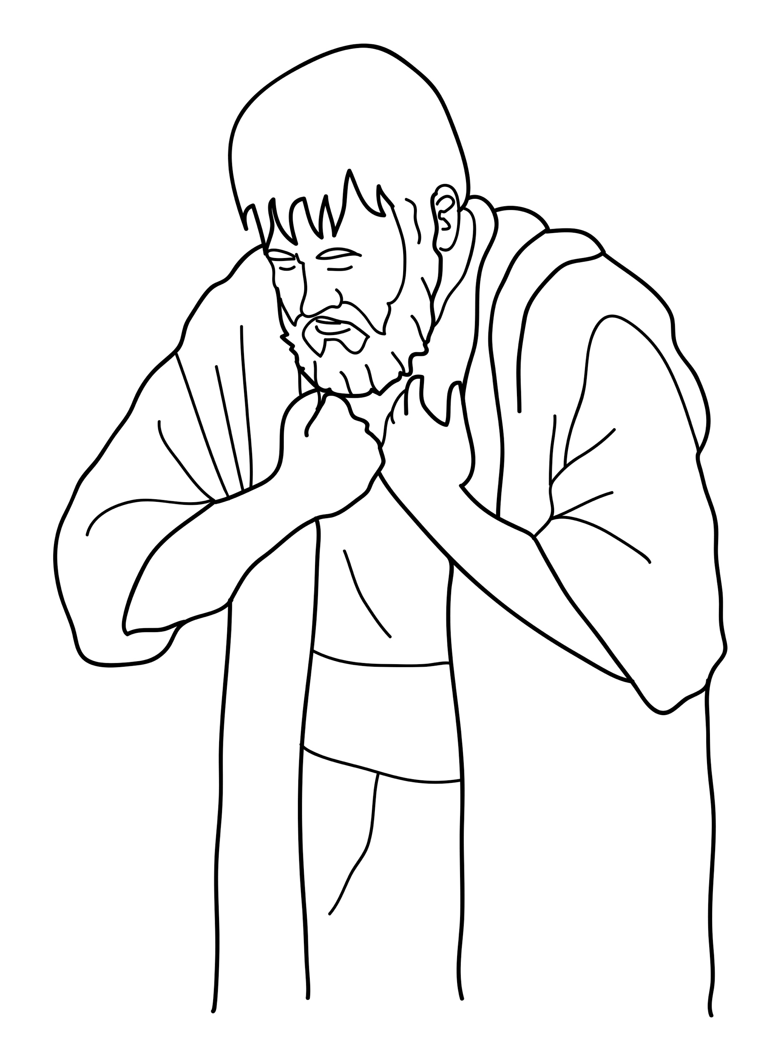
The other man was a tax collector.
Notes:
Read for detail (continued)
Read the sentence aloud slowly.
Invite students to repeat the sentence after you.
Repeat several times to reinforce correct pronunciation.

Slide 25
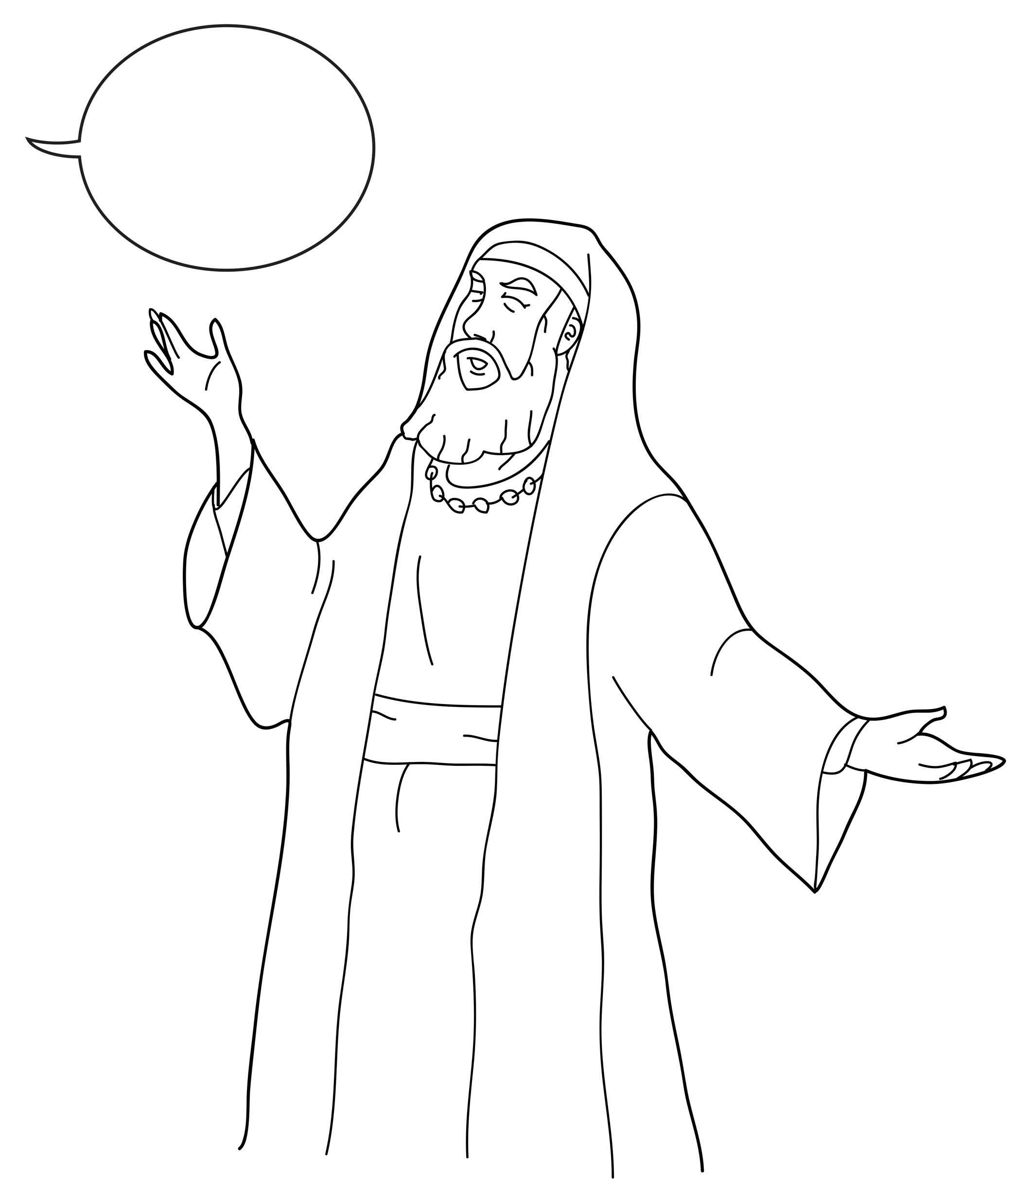
The religious leader prayed, ‘I’m a good man.’
Notes:
Read for detail (continued)
Read the sentence aloud slowly.
Invite students to repeat the sentence after you.
Repeat several times to reinforce correct pronunciation.

Slide 26
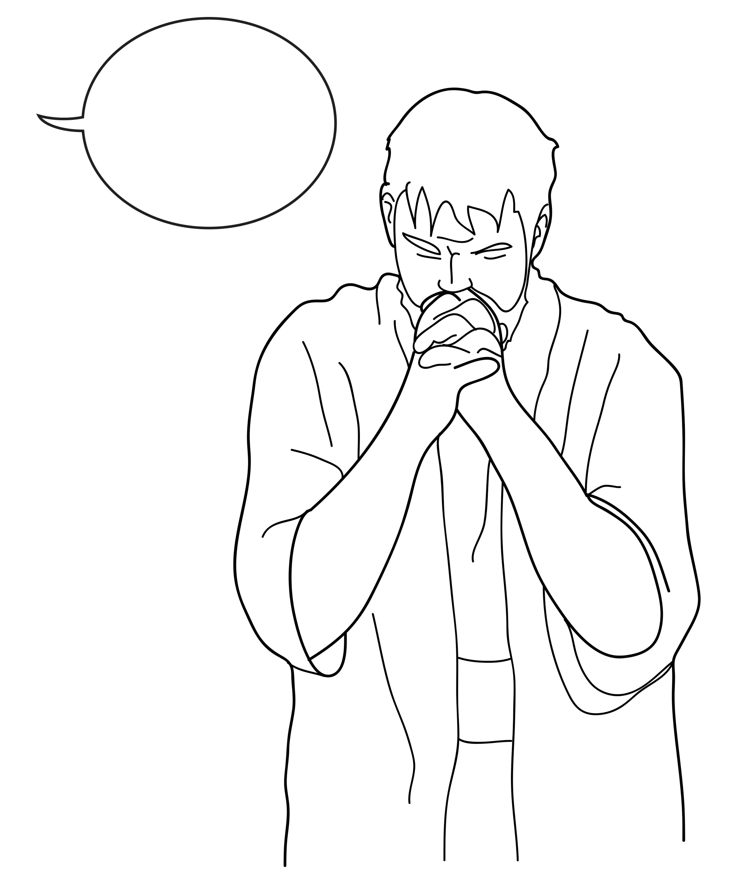
The tax collector prayed,
‘I’m a bad man. Please forgive me.’
Notes:
Read for detail (continued)
Read the sentence aloud slowly.
Invite students to repeat the sentence after you.
Repeat several times to reinforce correct pronunciation.

Slide 27
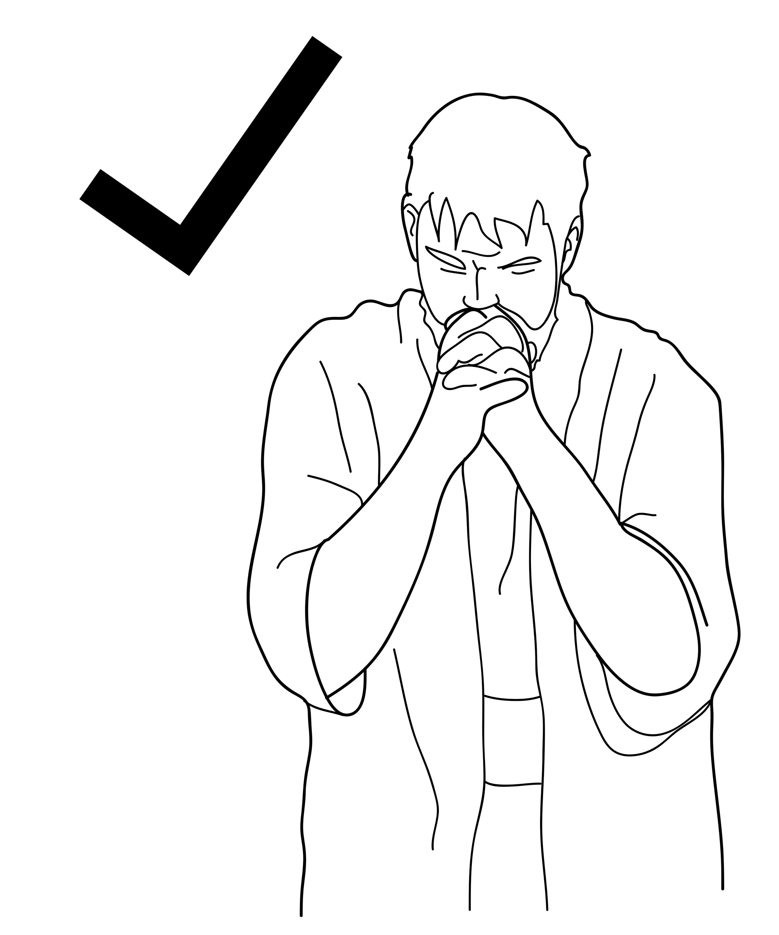
God forgave the tax collector.
Notes:
Read for detail (continued)
Read the sentence aloud slowly.
Invite students to repeat the sentence after you.
Repeat several times to reinforce correct pronunciation.

Slide 28
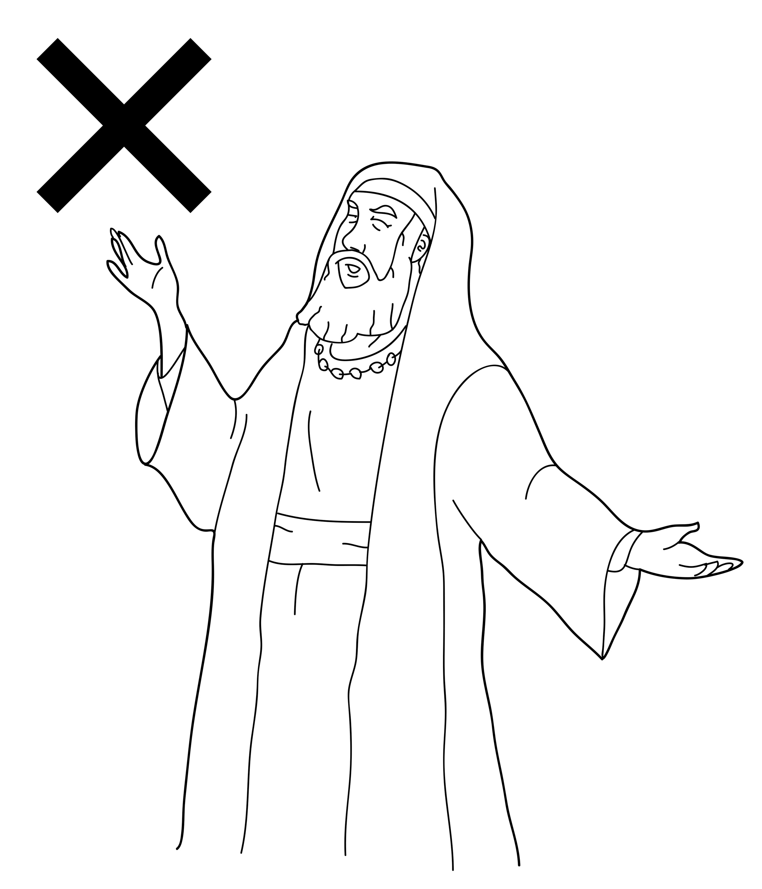
God did not forgive the religious leader.
Notes:
Read for detail (continued)
Read the sentence aloud slowly.
Invite students to repeat the sentence after you.
Repeat several times to reinforce correct pronunciation.

Slide 29
Notes:
Reinforce the language
[The activity on this slide and the 7 slides that follow replaces the activity in the lesson book in which students point to corresponding sketches.]
Invite students to say any words that they remember about this sketch.
Accept responses.

Slide 30
Notes:
Reinforce the language (continued)
Invite students to say any words that they remember about this sketch.
Accept responses.

Slide 31
Notes:
Reinforce the language (continued)
Invite students to say any words that they remember about this sketch.
Accept responses.

Slide 32
Notes:
Reinforce the language (continued)
Invite students to say any words that they remember about this sketch.
Accept responses.

Slide 33
Notes:
Reinforce the language (continued)
Invite students to say any words that they remember about this sketch.
Accept responses.

Slide 34
Notes:
Reinforce the language (continued)
Invite students to say any words that they remember about this sketch.
Accept responses.

Slide 35
Notes:
Reinforce the language (continued)
Invite students to say any words that they remember about this sketch.
Accept responses.

Slide 36
Notes:
Reinforce the language (continued)
Invite students to say any words that they remember about this sketch.
Accept responses.

Slide 37
Notes:
Reinforce the language (continued)
NB This slide will at first appear blank in Slide Show mode.
Distribute RESOURCE 7.6 – Small sketches (if using) to pairs/groups. [Alternatively, complete this activity together verbally using the PowerPoint slides.]
Invite pairs/groups to sequence or try to remember the sketches in the correct order.
Click your mouse to display the sketches one at a time in the correct order.

Slide 38
Jesus told this story:
Notes:
Reinforce the language (continued)
Distribute RESOURCE 7.7 – Small sentence strips (if using) to pairs/groups.
Invite pairs/groups to match the sentence strips to the corresponding sketches (if using). More advanced students can sequence the sentence strips without looking at the sketches.
[Alternatively, complete this activity together verbally using the PowerPoint slides.]
Invite students to identify the sketch on the slide that corresponds to the sentence.
Click to display the arrow and confirm the correct response.

Slide 39
Two men prayed to God.
Notes:
Reinforce the language (continued)
Invite students to point to the sketch on the slide that corresponds to the sentence.
Click to display the arrow and confirm the correct response.

Slide 40
One man was a religious leader.
Notes:
Reinforce the language (continued)
Invite students to point to the sketch on the slide that corresponds to the sentence.
Click to display the arrow and confirm the correct response.

Slide 41
The other man was a tax collector.
Notes:
Reinforce the language (continued)
Invite students to point to the sketch on the slide that corresponds to the sentence.
Click to display the arrow and confirm the correct response.

Slide 42
The religious leader prayed, ‘I’m a good man.’
Notes:
Reinforce the language (continued)
Invite students to point to the sketch on the slide that corresponds to the sentence.
Click to display the arrow and confirm the correct response.

Slide 43
The tax collector prayed,
‘I’m a bad man. Please forgive me.’
Notes:
Reinforce the language (continued)
Invite students to point to the sketch on the slide that corresponds to the sentence.
Click to display the arrow and confirm the correct response.

Slide 44
God forgave the tax collector.
Notes:
Reinforce the language (continued)
Invite students to point to the sketch on the slide that corresponds to the sentence.
Click to display the arrow and confirm the correct response.

Slide 45
God did not forgive the religious leader.
Notes:
Reinforce the language (continued)
Invite students to point to the sketch on the slide that corresponds to the sentence.
Click to display the arrow and confirm the correct response.

Slide 46
1. _________ told this story:
Jesus
Notes:
Reinforce the language (continued)
Distribute RESOURCE 7.8 – Gap-fill worksheet (if using) to each student. [Alternatively, complete this activity together verbally using the PowerPoint slides.]
Encourage students to work together to complete the worksheet.
Click to reveal the missing word and check the answer together.

Slide 47
2. Two ________ prayed to God.
men
Notes:
Reinforce the language (continued)
Click to reveal the missing word and check the answer together.

Slide 48
leader
3. One man was a religious _________.
Notes:
Reinforce the language (continued)
Click to reveal the missing word and check the answer together.

Slide 49
4. The other man was a tax _________.
collector
Notes:
Reinforce the language (continued)
Click to reveal the missing word and check the answer together.

Slide 50
5. The religious leader prayed,
‘I’m a _________ man.’
good
Notes:
Reinforce the language (continued)
Click to reveal the missing word and check the answer together.

Slide 51
6. The tax collector _________ ,
‘I’m a bad man. Please forgive me.’
prayed
Notes:
Reinforce the language (continued)
Click to reveal the missing word and check the answer together.

Slide 52
forgave
7. God _________ the tax collector.
Notes:
Reinforce the language (continued)
Click to reveal the missing word and check the answer together.

Slide 53
8. God did not forgive the
_________ leader.
religious
Notes:
Reinforce the language (continued)
Click to reveal the missing word and check the answer together.

