Slide 1
Lesson 8
Meet Jesus
Volume 1
Ten Bible-based English lessons
High Beginner
Notes:
(Lesson 2 title page)

Slide 2
Lesson 8
PART 1
Love and obey
Notes:
(Part 1 title page)

Slide 3
I love ___________.
Notes:
Activate knowledge
Say ‘I love [insert person’s name].’
Ask ‘Who do you love?’
Invite students to share with the class the name of one person they love.
Write responses on the board (if using), ensuring that each person has shared once.
Erase the names from the board.
Invite students to have a turn naming who each student loves (e.g. ‘Fatima loves [name], Lily loves [name], Poh loves [name],’ etc.).

Slide 4
I love Gareth. I wash his clothes.
I love my mum. I talk to her.
Notes:
Focus on language
Activity 1: What is love?
Say ‘I love Gareth. I wash his clothes. I love my mum. I talk to her.’
Ask ‘What is love?’
Brainstorm ideas about what love is. (Students may need prompting and support to create simple sentences – e.g. love is washing clothes; love is talking on the phone.)
Write responses on the board (if using), correcting errors as you go.

Slide 5

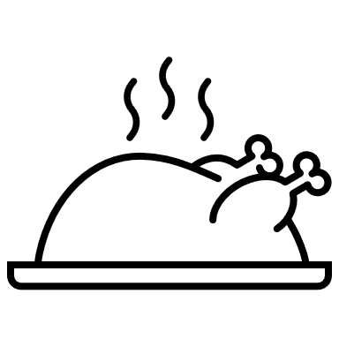
Cleaning
Cooking food
Giving flowers
Listening
Giving money
Praying
Talking on the phone
Washing clothes
Notes:
Focus on language (continued)
Activity 1: What is love? (continued)
Distribute RESOURCE 8.1 – What is love? worksheet (if using) to each student. [Alternatively, complete this activity together verbally using the PowerPoint slides.]
Encourage students to work together to complete the worksheet.
Check answers together by clicking through slides 5–12.

Slide 6


Cleaning
Cooking food
Giving flowers
Listening
Giving money
Praying
Talking on the phone
Washing clothes
Notes:
Focus on language (continued)
Activity 1: What is love? (continued)
Click to check the answer together.

Slide 7

Cleaning
Cooking food
Giving flowers
Listening
Giving money
Praying
Talking on the phone
Washing clothes
Notes:
Focus on language (continued)
Activity 1: What is love? (continued)
Click to check the answer together.

Slide 8


Cleaning
Cooking food
Giving flowers
Listening
Giving money
Praying
Talking on the phone
Washing clothes
Notes:
Focus on language (continued)
Activity 1: What is love? (continued)
Click to check the answer together.

Slide 9

Cleaning
Cooking food
Giving flowers
Listening
Giving money
Praying
Talking on the phone
Washing clothes
Notes:
Focus on language (continued)
Activity 1: What is love? (continued)
Click to check the answer together.

Slide 10

Cleaning
Cooking food
Giving flowers
Listening
Giving money
Praying
Talking on the phone
Washing clothes
Notes:
Focus on language (continued)
Activity 1: What is love? (continued)
Click to check the answer together.

Slide 11

Cleaning
Cooking food
Giving flowers
Listening
Giving money
Praying
Talking on the phone
Washing clothes
Notes:
Focus on language (continued)
Activity 1: What is love? (continued)
Click to check the answer together.

Slide 12

Cleaning
Cooking food
Giving flowers
Listening
Giving money
Praying
Talking on the phone
Washing clothes
Notes:
Focus on language (continued)
Activity 1: What is love? (continued)
Click to check the answer together.

Slide 13
o b e y
_ _ _ _
Notes:
Focus on language (continued)
Activity 2: What is obey?
Invite students to suggest letters until you complete the word o b e y.
Ask ‘What is obey?’
Brainstorm responses.

Slide 14
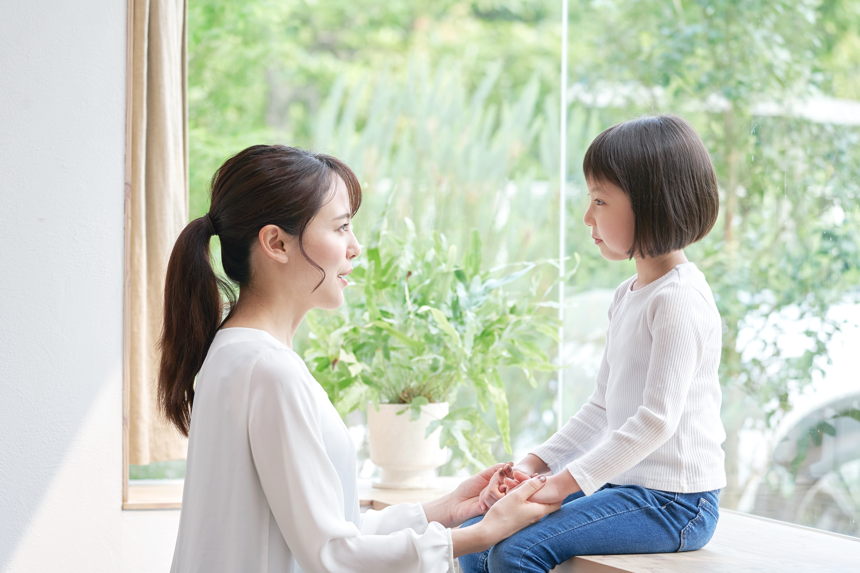
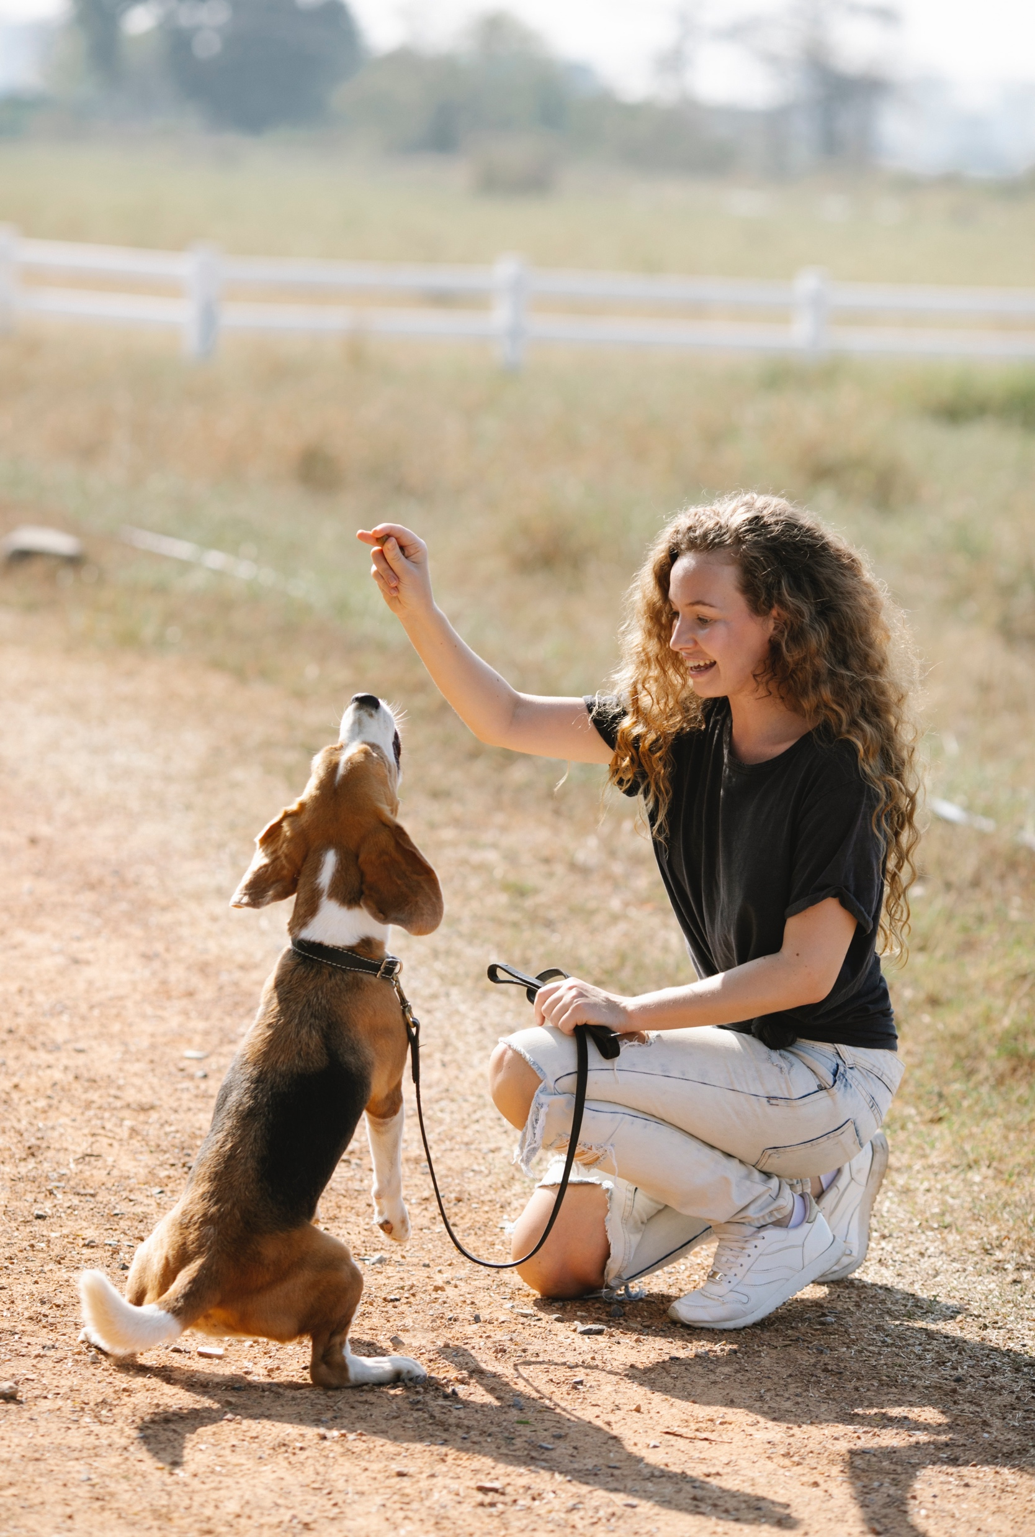
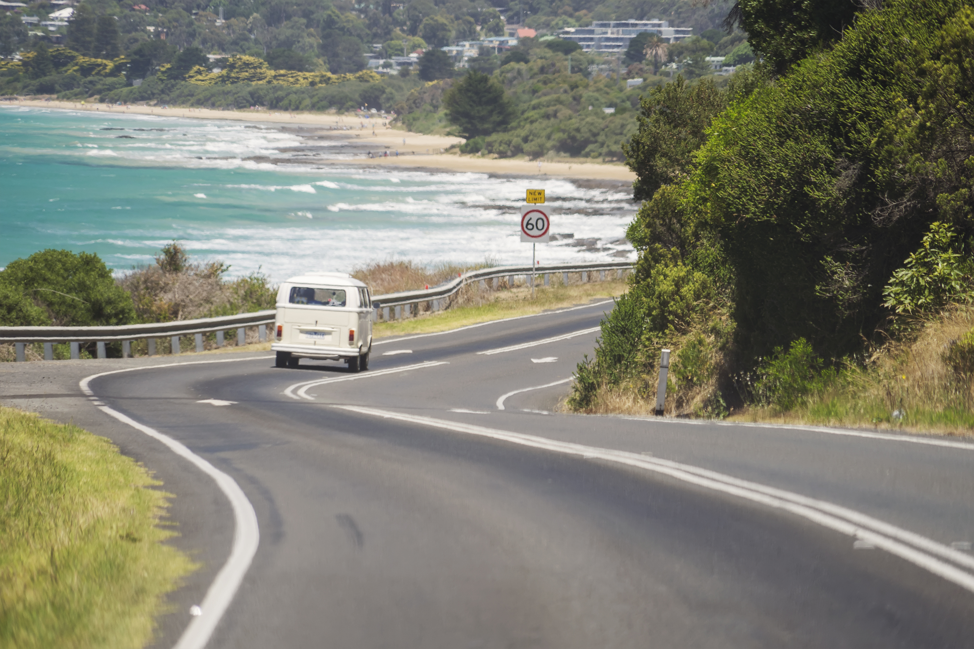
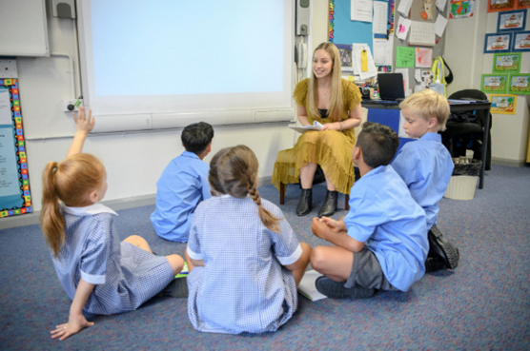
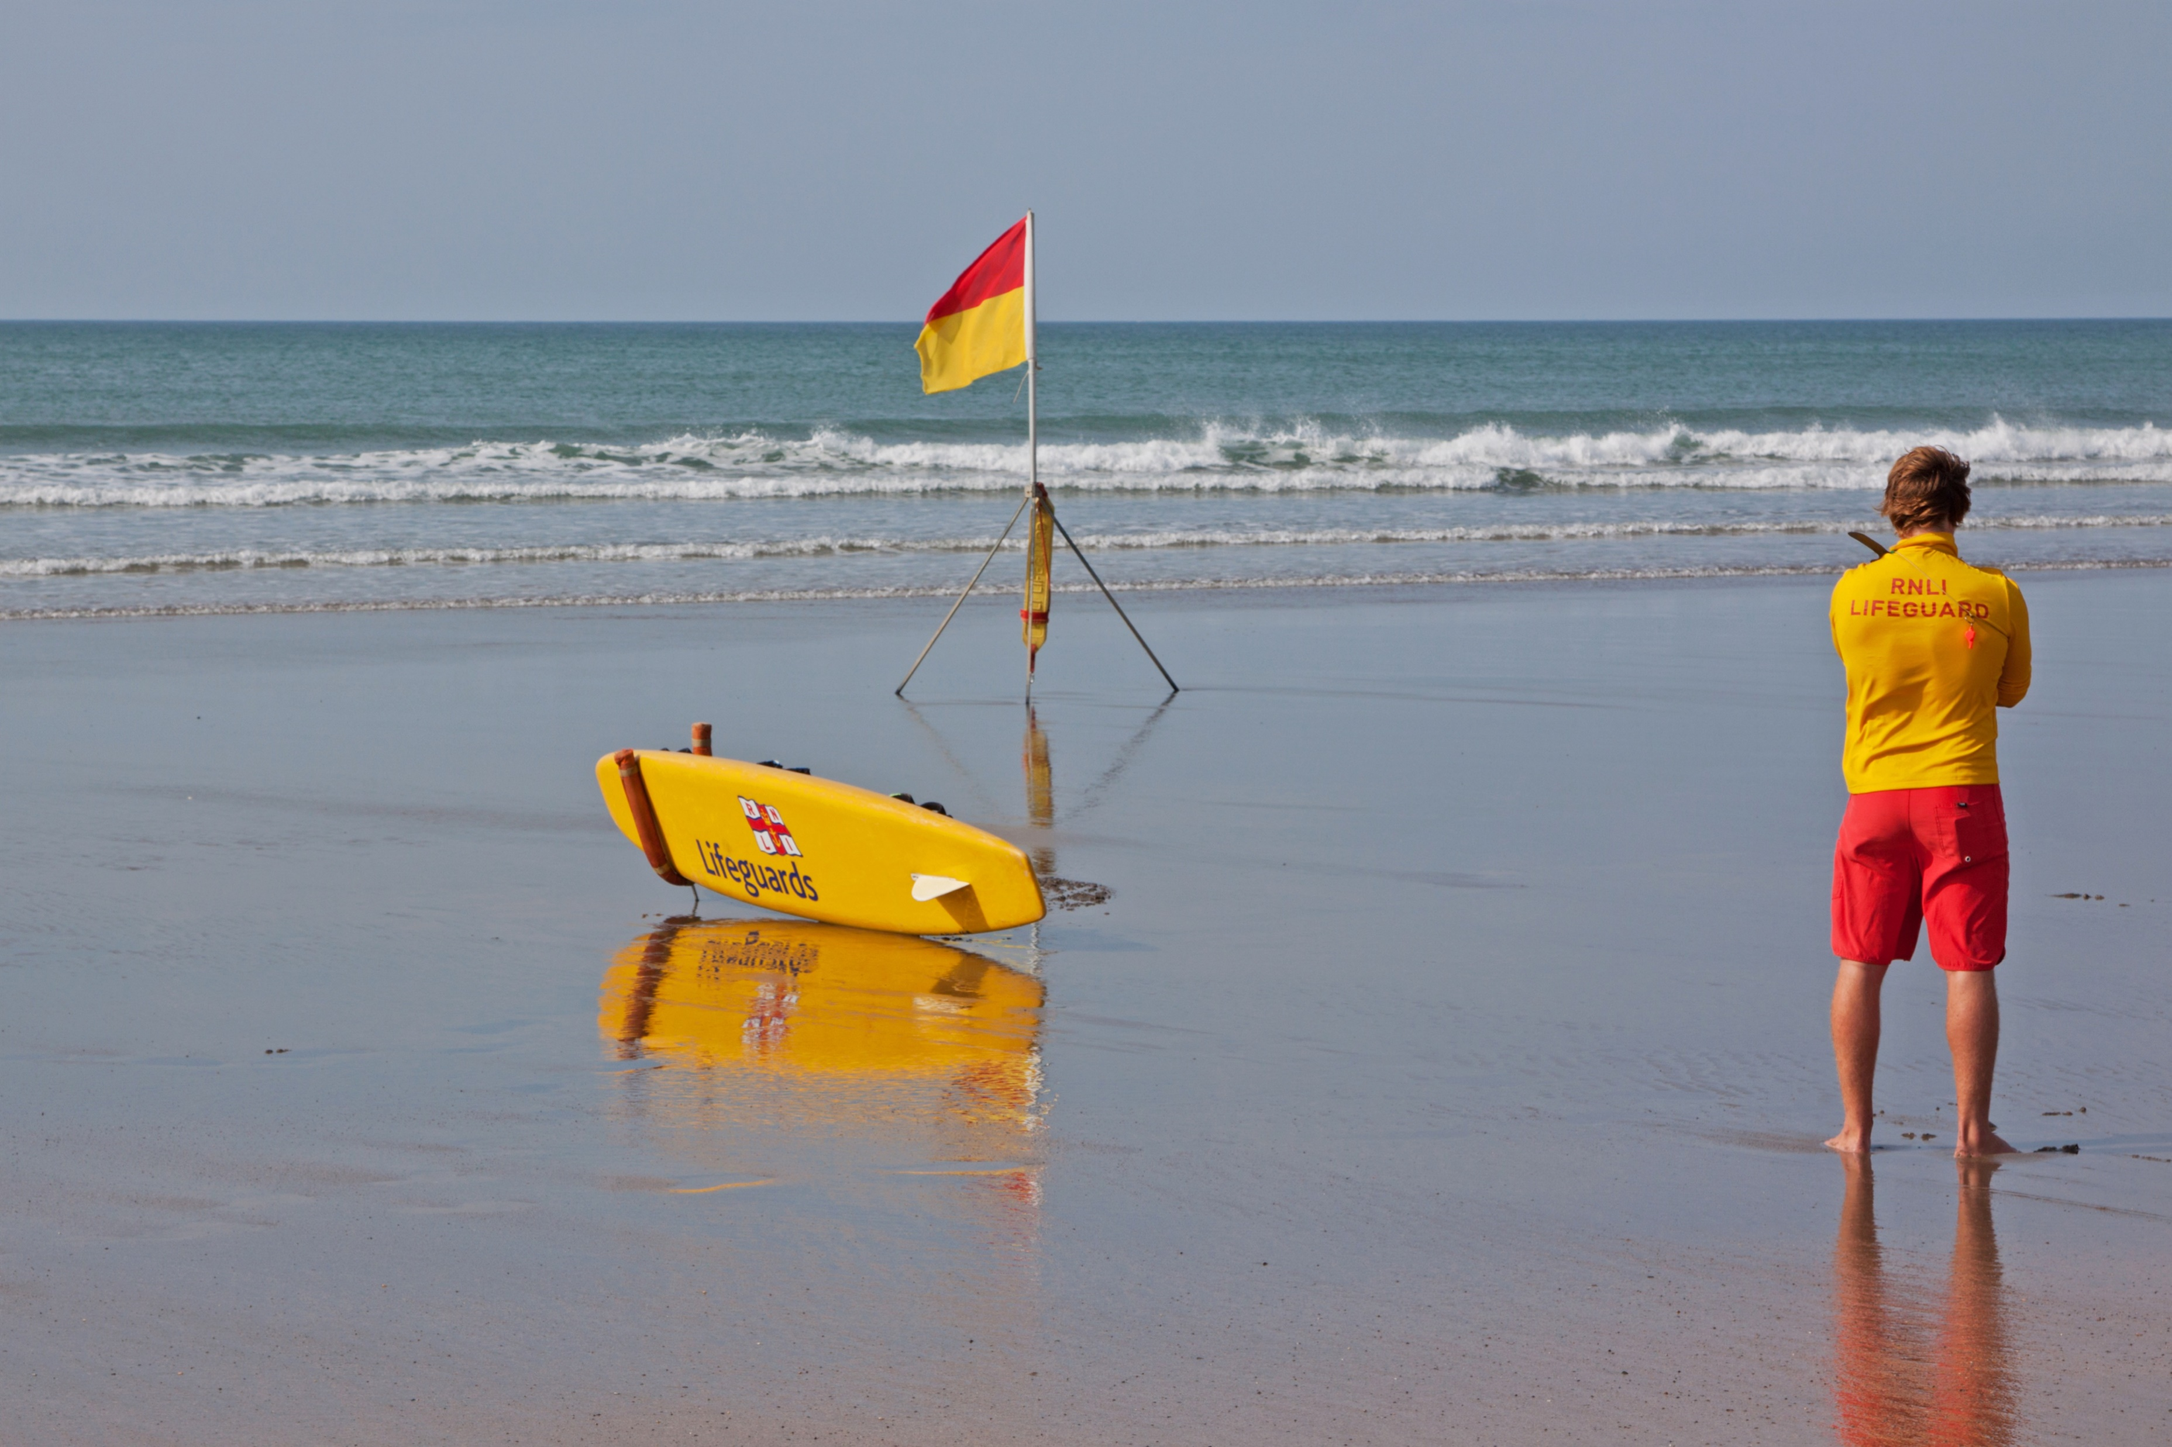
1
2
3
4
5
Drivers obey the law.
Notes:
Focus on language (continued)
Activity 2: What is obey? (continued)
[Slides 14–18 contain RESOURCE 8.2 – Obey photos. NB This activity has been adapted for PowerPoint and does not require the distribution of RESOURCE 8.3 – Obey sentences.]
Invite students to identify the picture on the slide that the sentence describes.
Click to check the answer together.

Slide 15
1
2
3
4
5
Students obey their teachers.
Notes:
Focus on language (continued)
Activity 2: What is obey? (continued)
Invite students to identify the picture on the slide that the sentence describes.
Click to check the answer together.

Slide 16
1
2
3
4
5
Children obey their parents.
Notes:
Focus on language (continued)
Activity 2: What is obey? (continued)
Invite students to identify the picture on the slide that the sentence describes.
Click to check the answer together.

Slide 17
1
2
3
4
5
Dogs obey their owners.
Notes:
Focus on language (continued)
Activity 2: What is obey? (continued)
Invite students to identify the picture on the slide that the sentence describes.
Click to check the answer together.

Slide 18
1
2
3
4
5
Swimmers obey the lifeguards.
Notes:
Focus on language (continued)
Activity 2: What is obey? (continued)
Invite students to identify the picture on the slide that the sentence describes.
Click to check the answer together.

Slide 19
their teachers their owners the law
their parents the lifeguards
1. Dogs obey ______________.
their owners
Notes:
Focus on language (continued)
Activity 2: What is obey? (continued)
Distribute RESOURCE 8.4 – Completing sentences worksheet (if using). [Alternatively, complete this activity together verbally using the PowerPoint slides.]
Invite students to work together to complete the worksheet.
Check answers together by clicking through slides 19–23.

Slide 20
their teachers their owners the law
their parents the lifeguards
2. Children obey ______________.
their parents
Notes:
Focus on language (continued)
Activity 2: What is obey? (continued)
Click to check the answer together.

Slide 21
their teachers their owners the law
their parents the lifeguards
3. Drivers obey ______________.
the law
Notes:
Focus on language (continued)
Activity 2: What is obey? (continued)
Click to check the answer together.

Slide 22
their teachers their owners the law
their parents the lifeguards
4. Swimmers obey ______________.
the lifeguards
Notes:
Focus on language (continued)
Activity 2: What is obey? (continued)
Click to check the answer together.

Slide 23
their teachers their owners the law
their parents the lifeguards
5. Students obey ______________.
their teachers
Notes:
Focus on language (continued)
Activity 2: What is obey? (continued)
Click to check the answer together.

Slide 24
Lesson 8
PART 2
The love command
Luke 18:9–14
Notes:
(Part 2 title page)

Slide 25

Notes:
Read for gist
Say ‘In the Bible story, we show love to God by obeying him.’
Distribute copies of John 15:9–14 in your students’ heart languages (if in the classroom). [Alternatively, if online, invite students to refer to the heart language texts they have been sent in advance.]
Give students a few minutes to read the text silently for context, then ask them to put it away for the rest of the lesson.

Slide 26
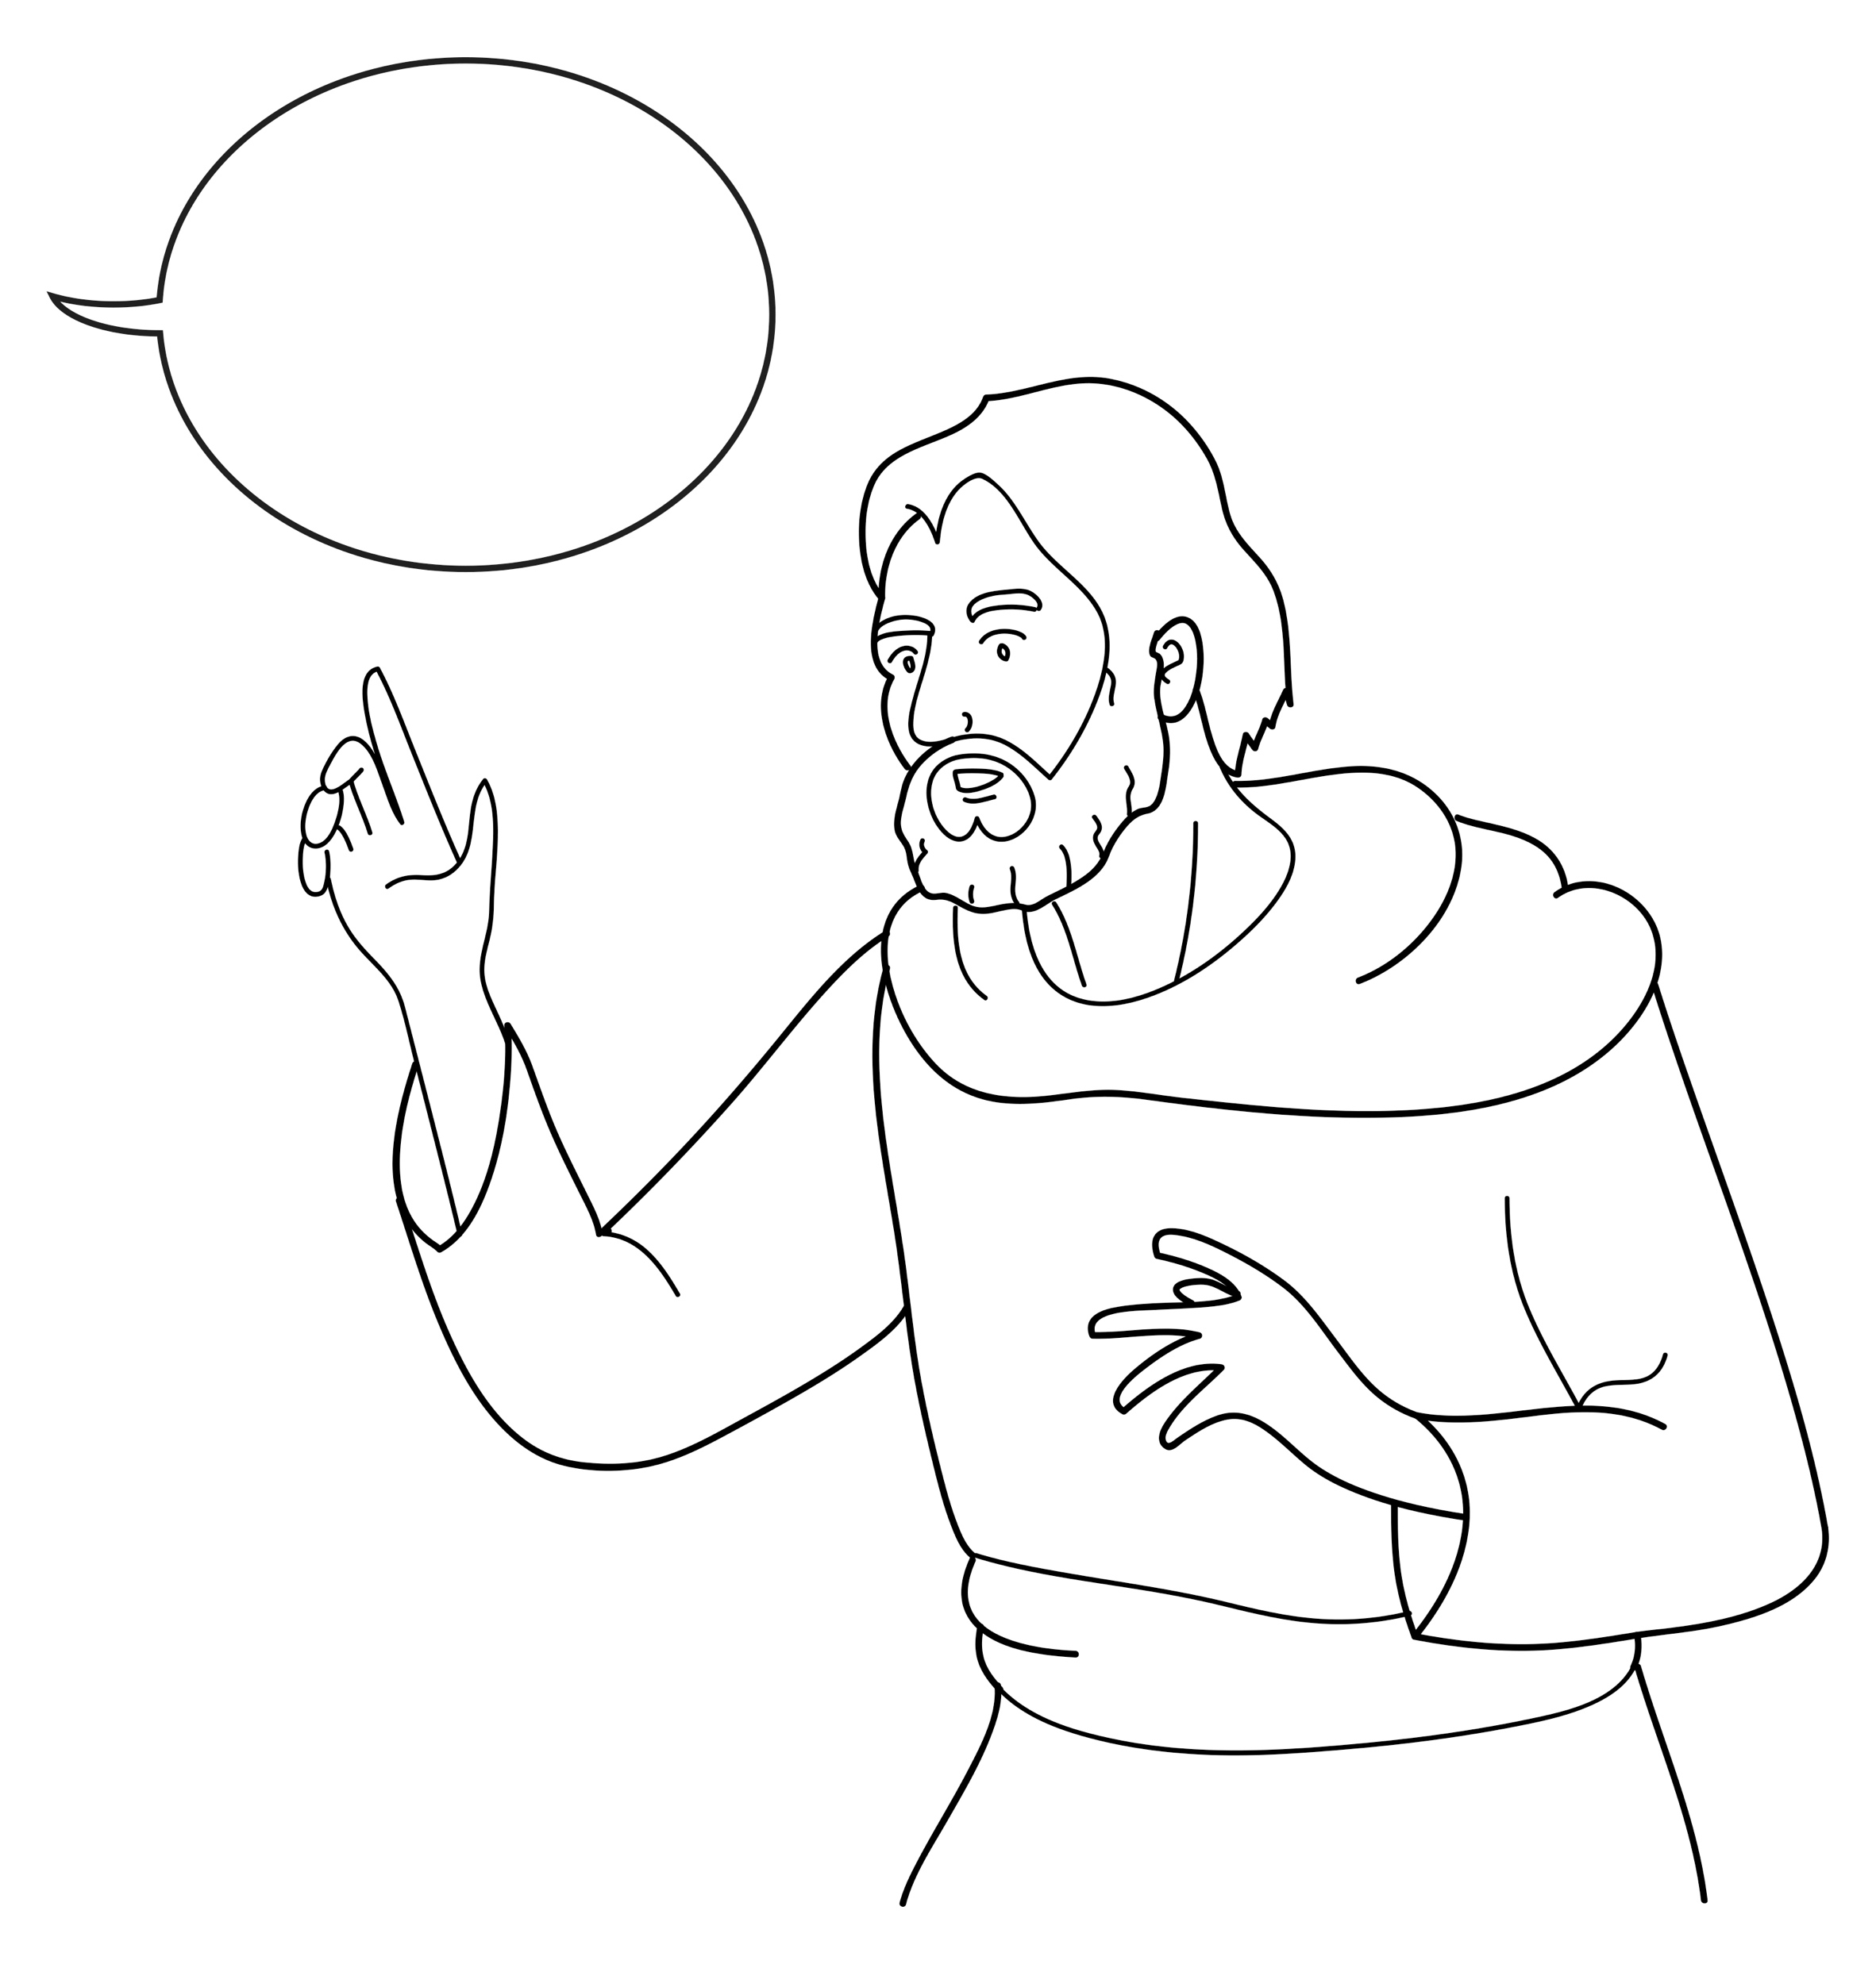
Jesus said:
Notes:
Read for detail
[This slide and the 6 slides that follow contain RESOURCE 8.5 – Large sketches and RESOURCE 8.6 – Large sentences.]
Read the sentence on the slide aloud slowly.
Invite students to repeat the sentence after you.
Repeat several times to reinforce correct pronunciation.
Click through the presentation to display the remaining 6 sketches and sentences.

Slide 27
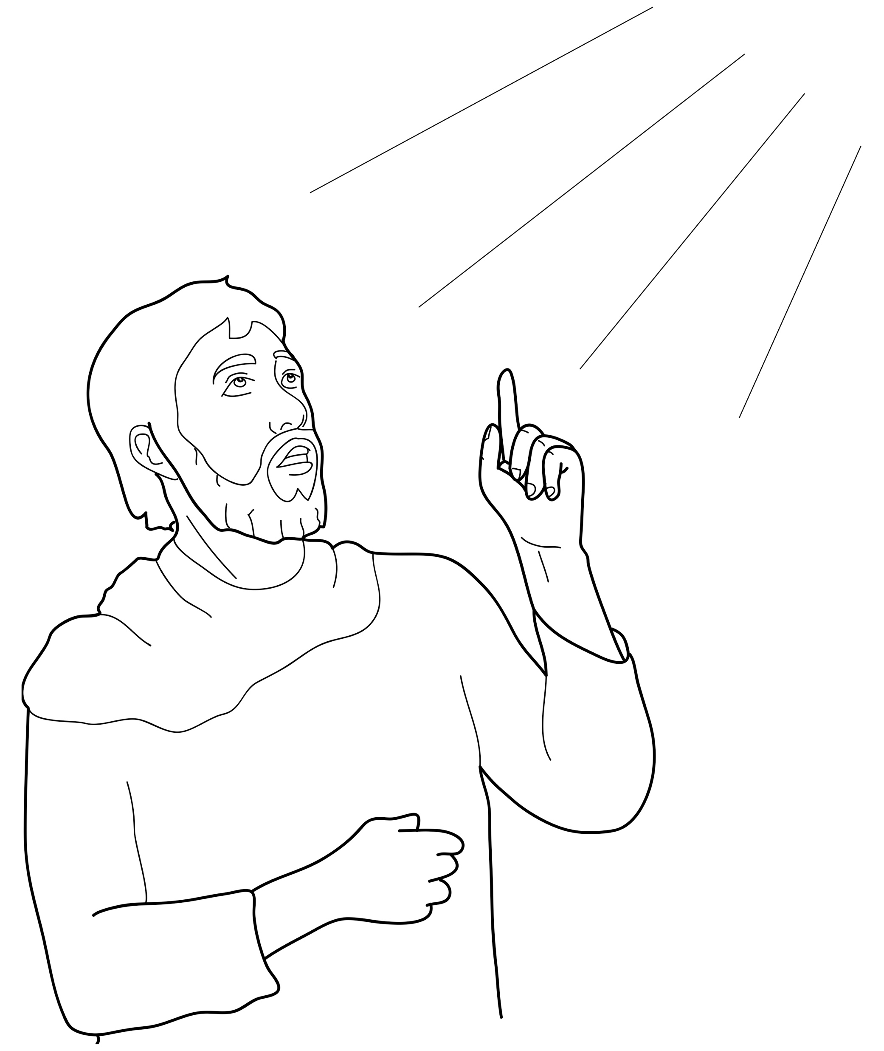
God is my father.
Notes:
Read for detail (continued)
Read the sentence aloud slowly.
Invite students to repeat the sentence after you.
Repeat several times to reinforce correct pronunciation.

Slide 28
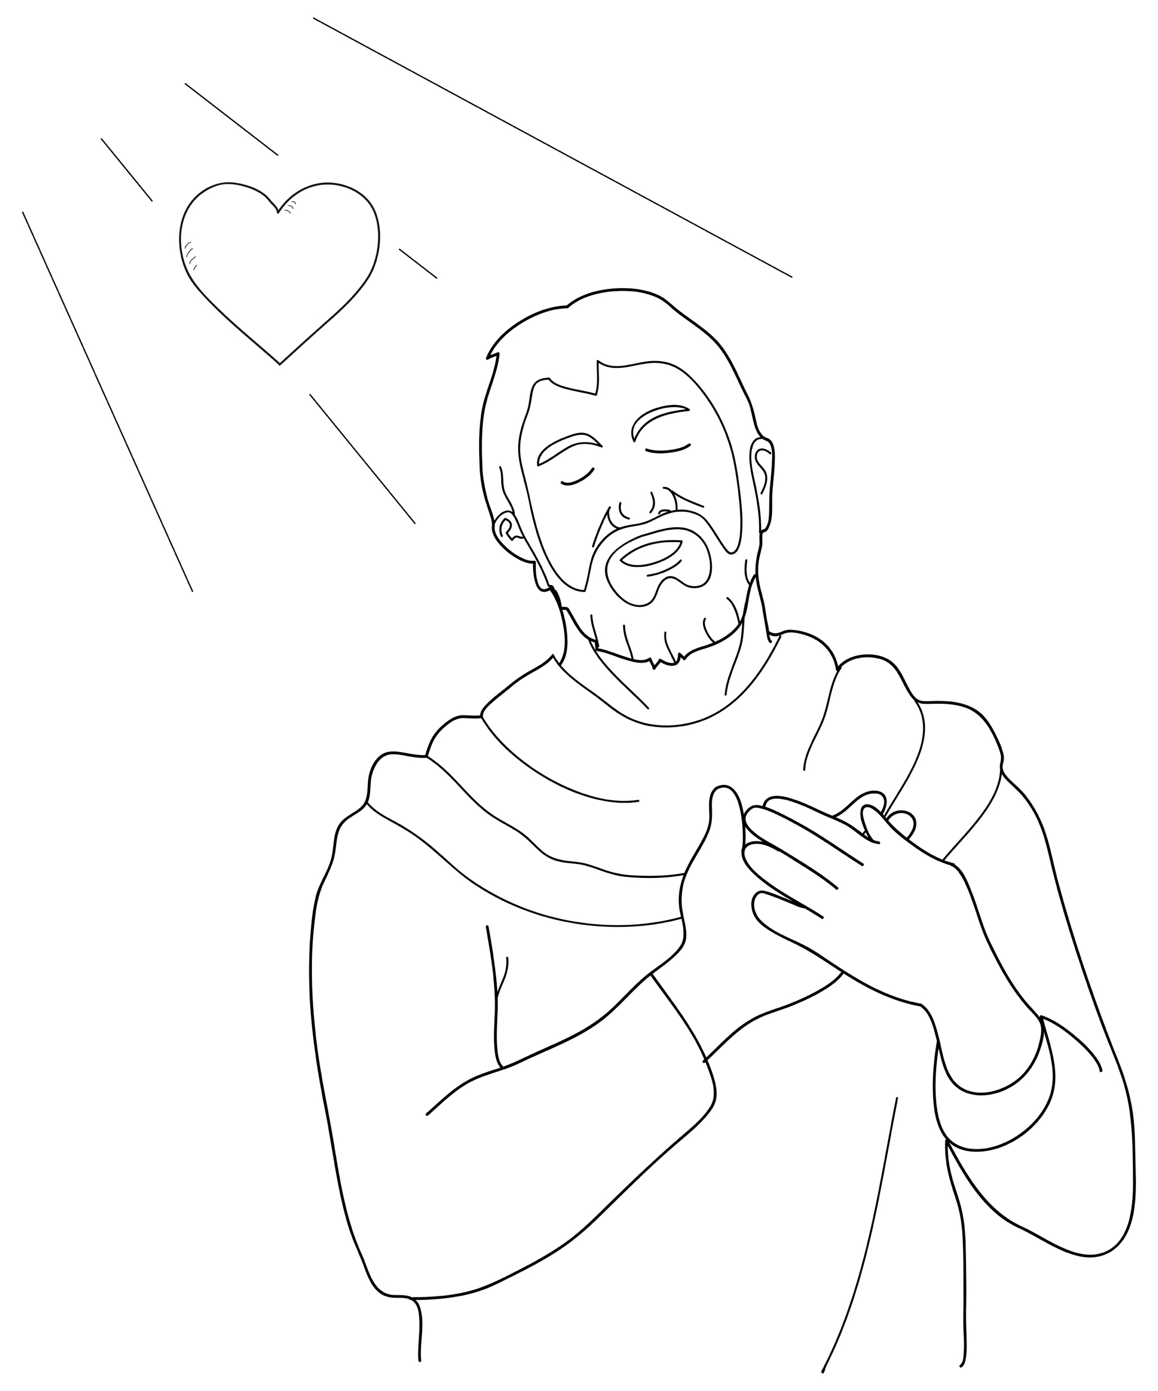
God loves me.
Notes:
Read for detail (continued)
Read the sentence aloud slowly.
Invite students to repeat the sentence after you.
Repeat several times to reinforce correct pronunciation.

Slide 29
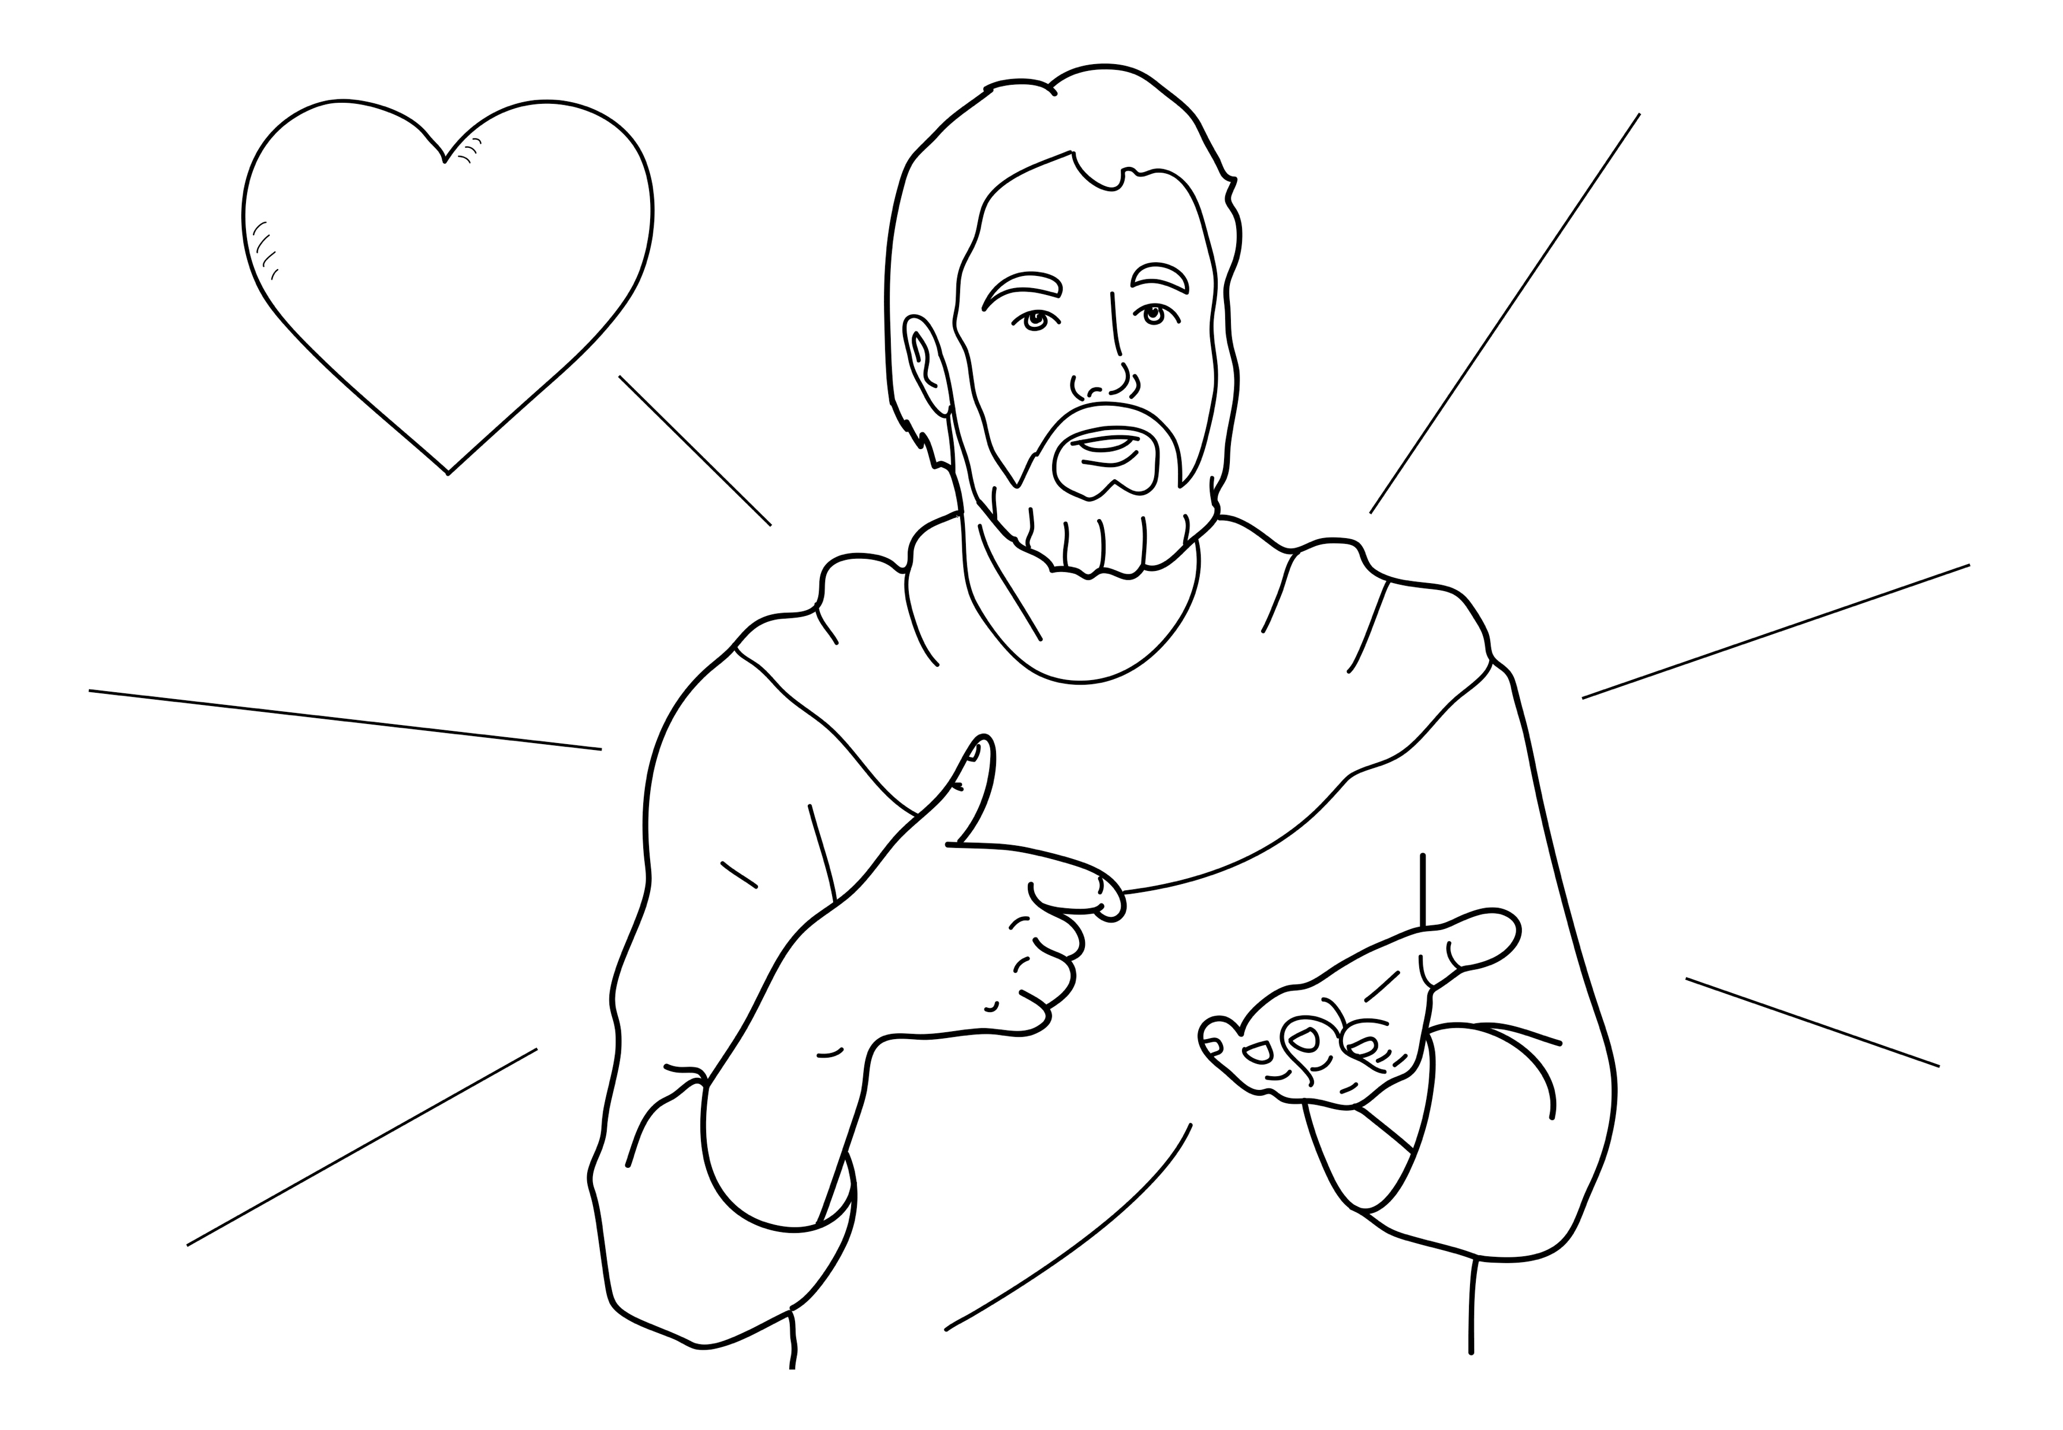
I love you.
Notes:
Read for detail (continued)
Read the sentence aloud slowly.
Invite students to repeat the sentence after you.
Repeat several times to reinforce correct pronunciation.

Slide 30
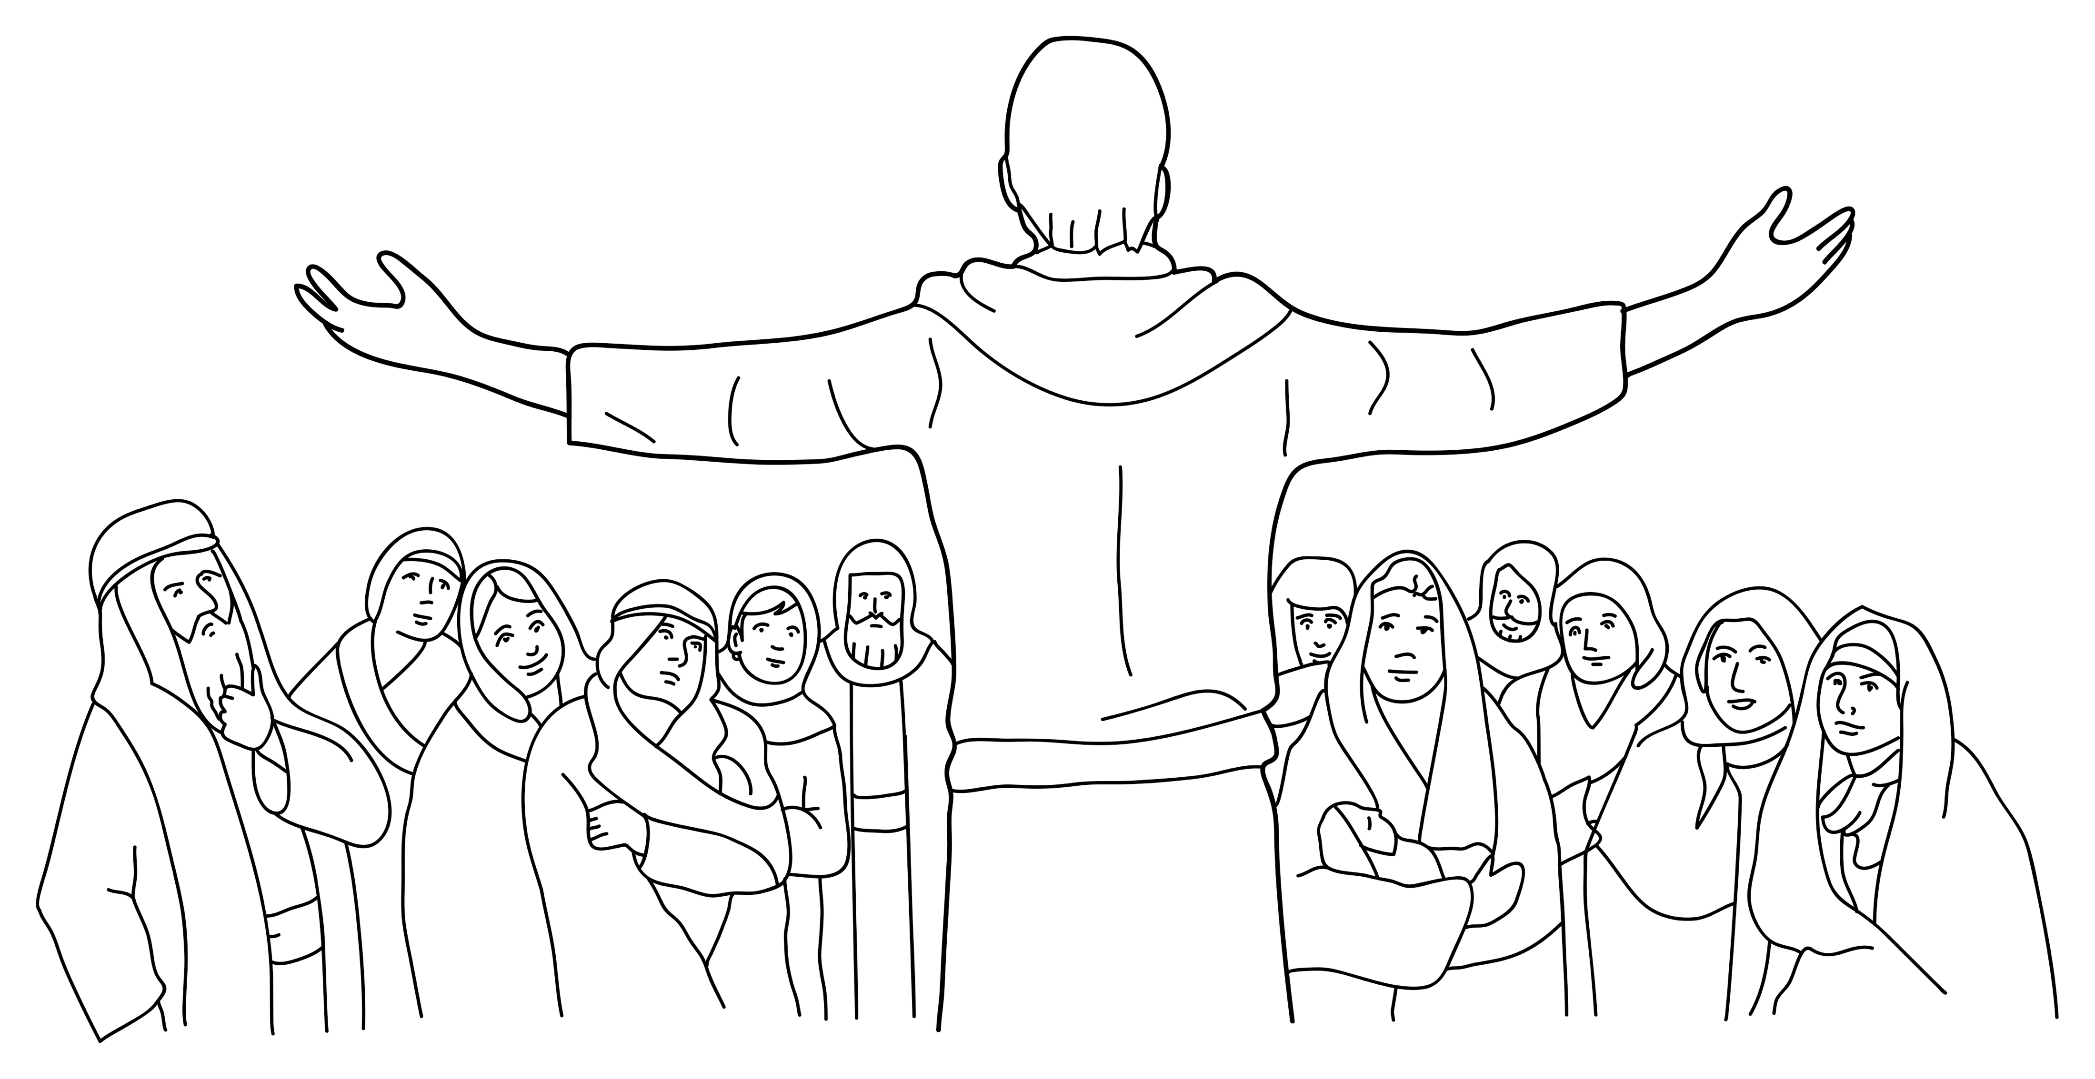
Love each other.
Notes:
Read for detail (continued)
Read the sentence aloud slowly.
Invite students to repeat the sentence after you.
Repeat several times to reinforce correct pronunciation.

Slide 31
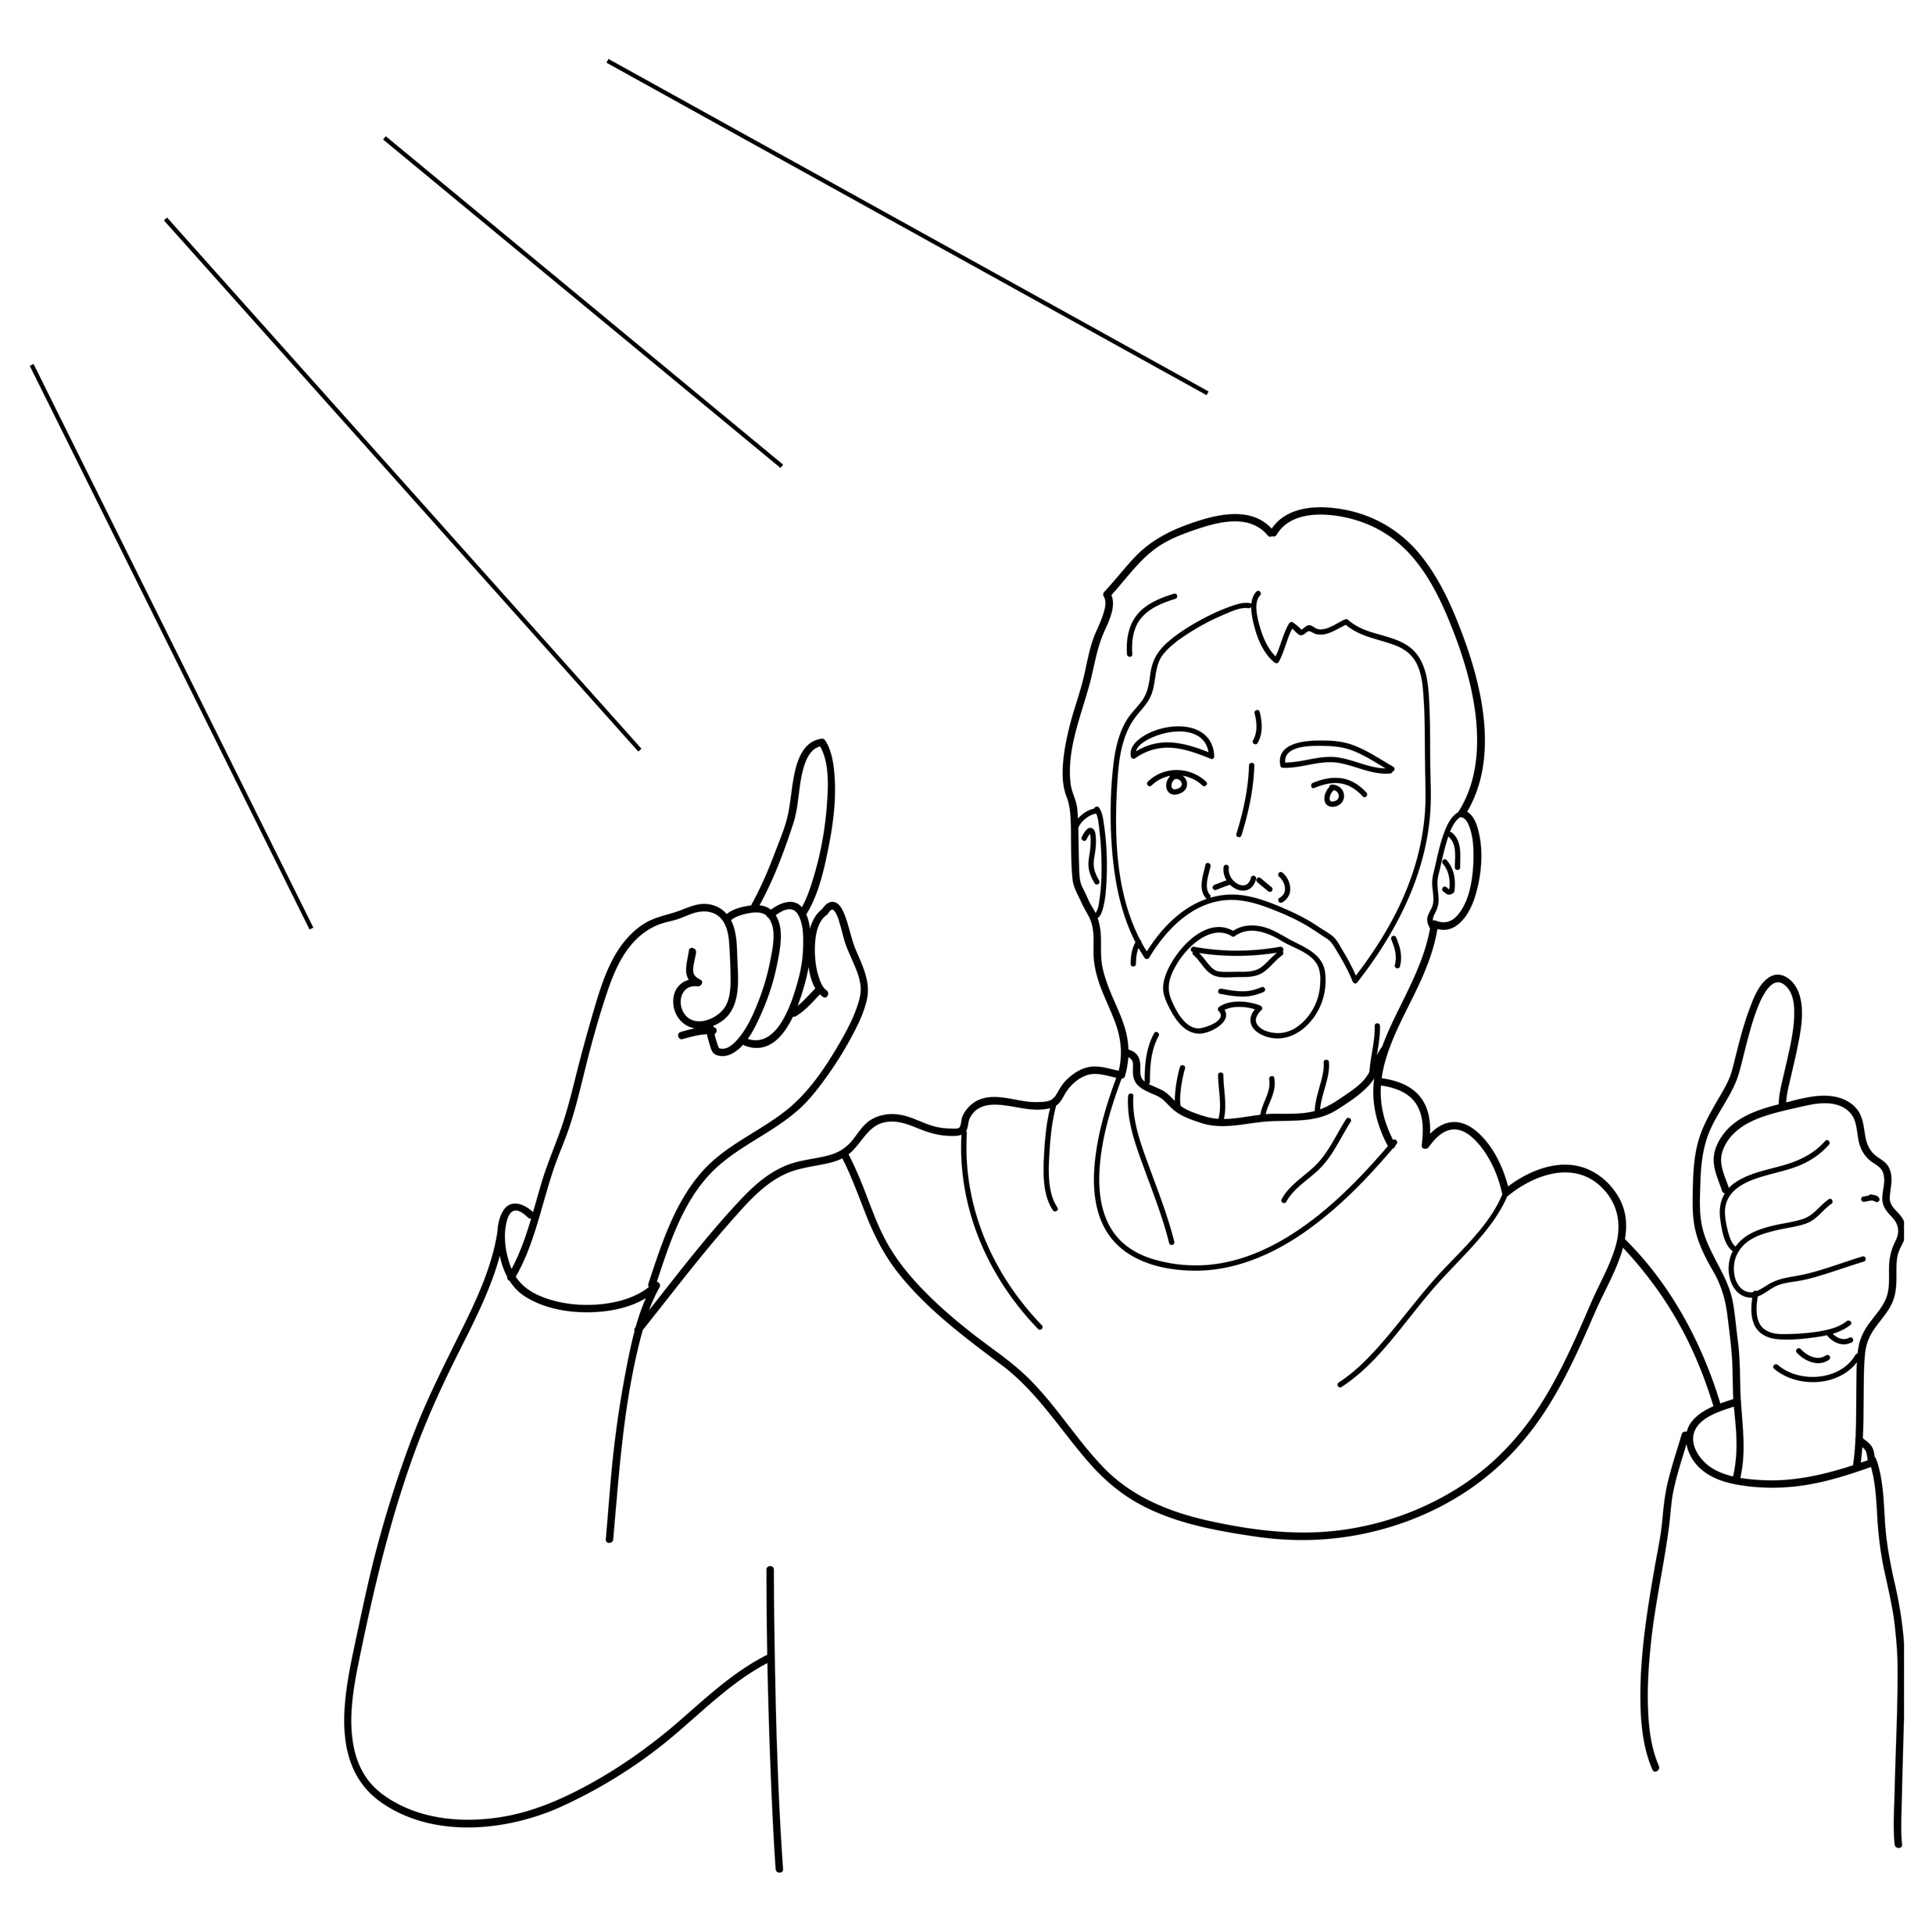
Obey my father.
Notes:
Read for detail (continued)
Read the sentence aloud slowly.
Invite students to repeat the sentence after you.
Repeat several times to reinforce correct pronunciation.

Slide 32
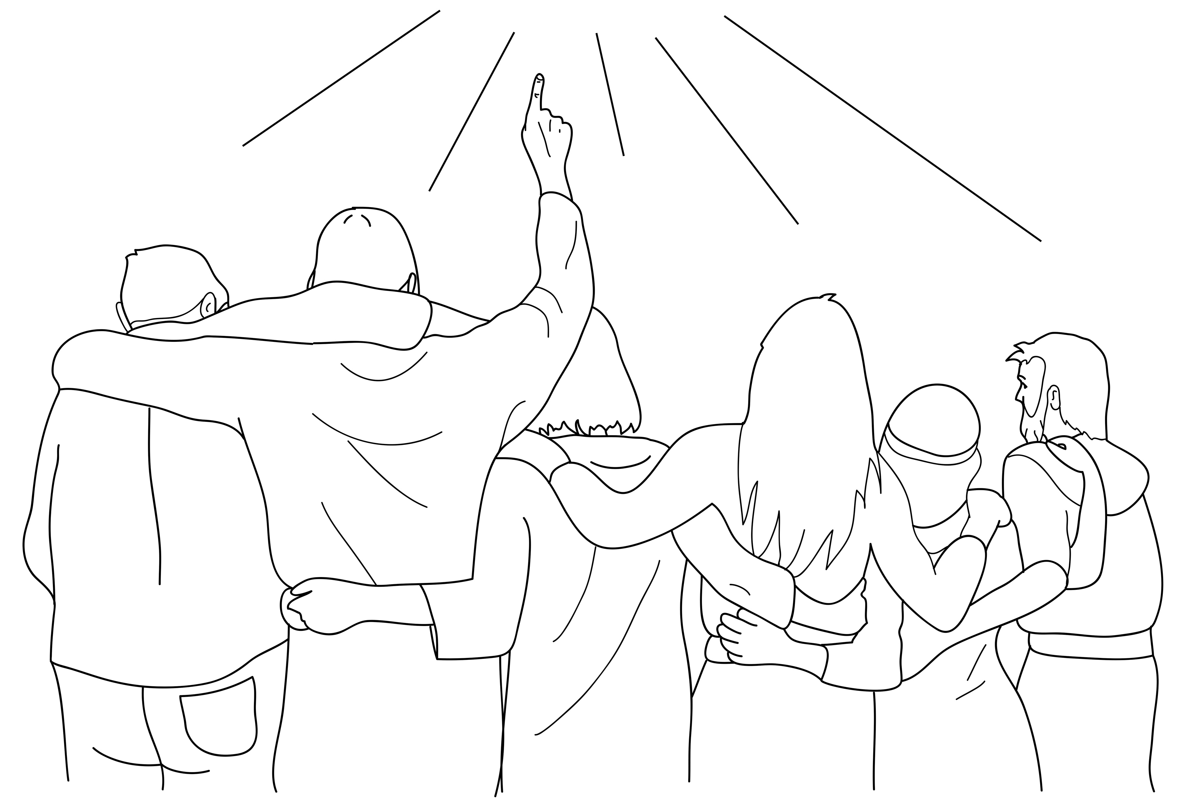
You are my friends if you obey.
Notes:
Read for detail (continued)
Read the sentence aloud slowly.
Invite students to repeat the sentence after you.
Repeat several times to reinforce correct pronunciation.

Slide 33
Notes:
Reinforce the language
[The activity on this slide and the 6 slides that follow replaces the activity in the lesson book in which students point to corresponding sketches.]
Invite students to say any words that they remember about this sketch.
Accept responses.

Slide 34
Notes:
Reinforce the language (continued)
Invite students to say any words that they remember about this sketch.
Accept responses.

Slide 35
Notes:
Reinforce the language (continued)
Invite students to say any words that they remember about this sketch.
Accept responses.

Slide 36
Notes:
Reinforce the language (continued)
Invite students to say any words that they remember about this sketch.
Accept responses.

Slide 37
Notes:
Reinforce the language (continued)
Invite students to say any words that they remember about this sketch.
Accept responses.

Slide 38
Notes:
Reinforce the language (continued)
Invite students to say any words that they remember about this sketch.
Accept responses.

Slide 39
Notes:
Reinforce the language (continued)
Invite students to say any words that they remember about this sketch.
Accept responses.

Slide 40

Notes:
Reinforce the language (continued)
NB This slide will at first appear blank in Slide Show mode.
Distribute RESOURCE 8.7 – Small sketches (if using) to pairs/groups. [Alternatively, complete this activity together verbally using the PowerPoint slides.]
Invite pairs/groups to sequence or try to remember the sketches in the correct order.
Click your mouse to display the sketches one at a time in the correct order.

Slide 41
Jesus said:
Notes:
Reinforce the language (continued)
Distribute RESOURCE 8.8 – Small sentence strips (if using) to pairs/groups.
Invite pairs/groups to match the sentence strips to the corresponding sketches (if using). More advanced students can sequence the sentence strips without looking at the sketches.
[Alternatively, complete this activity together verbally using the PowerPoint slides.]
Invite students to identify the sketch on the slide that corresponds to the sentence.
Click to display the arrow and confirm the correct response.

Slide 42
God is my father.
Notes:
Reinforce the language (continued)
Invite students to point to the sketch on the slide that corresponds to the sentence.
Click to display the arrow and confirm the correct response.

Slide 43
God loves me.
Notes:
Reinforce the language (continued)
Invite students to point to the sketch on the slide that corresponds to the sentence.
Click to display the arrow and confirm the correct response.

Slide 44
I love you.
Notes:
Reinforce the language (continued)
Invite students to point to the sketch on the slide that corresponds to the sentence.
Click to display the arrow and confirm the correct response.

Slide 45
Love each other.
Notes:
Reinforce the language (continued)
Invite students to point to the sketch on the slide that corresponds to the sentence.
Click to display the arrow and confirm the correct response.

Slide 46
Obey my father.
Notes:
Reinforce the language (continued)
Invite students to point to the sketch on the slide that corresponds to the sentence.
Click to display the arrow and confirm the correct response.

Slide 47
You are my friends if you obey.
Notes:
Reinforce the language (continued)
Invite students to point to the sketch on the slide that corresponds to the sentence.
Click to display the arrow and confirm the correct response.

Slide 48
1. _________ said:
Jesus
Notes:
Reinforce the language (continued)
Distribute RESOURCE 8.9 – Gap-fill worksheet (if using) to each student. [Alternatively, complete this activity together verbally using the PowerPoint slides.]
Encourage students to work together to complete the worksheet.
Click to reveal the missing word and check the answer together.

Slide 49
2. God is my __________.
father
Notes:
Reinforce the language (continued)
Click to reveal the missing word and check the answer together.

Slide 50
me
3. God loves __________.
Notes:
Reinforce the language (continued)
Click to reveal the missing word and check the answer together.

Slide 51
4. I love ________.
you
Notes:
Reinforce the language (continued)
Click to reveal the missing word and check the answer together.

Slide 52
Love
5. _________ each other.
Notes:
Reinforce the language (continued)
Click to reveal the missing word and check the answer together.

Slide 53
Obey
6. _________ my father.
Notes:
Reinforce the language (continued)
Click to reveal the missing word and check the answer together.

Slide 54
friends
7. You are my _________ if you obey.
Notes:
Reinforce the language (continued)
Click to reveal the missing word and check the answer together.

