Slide 1
Lesson 4
Bible Overview
Ten Bible-based English lessons
Beginner
Notes:
(Lesson 2 title page)

Slide 2
Lesson 4
PART 1
People who rescue
Notes:
(Part 1 title page)

Slide 3
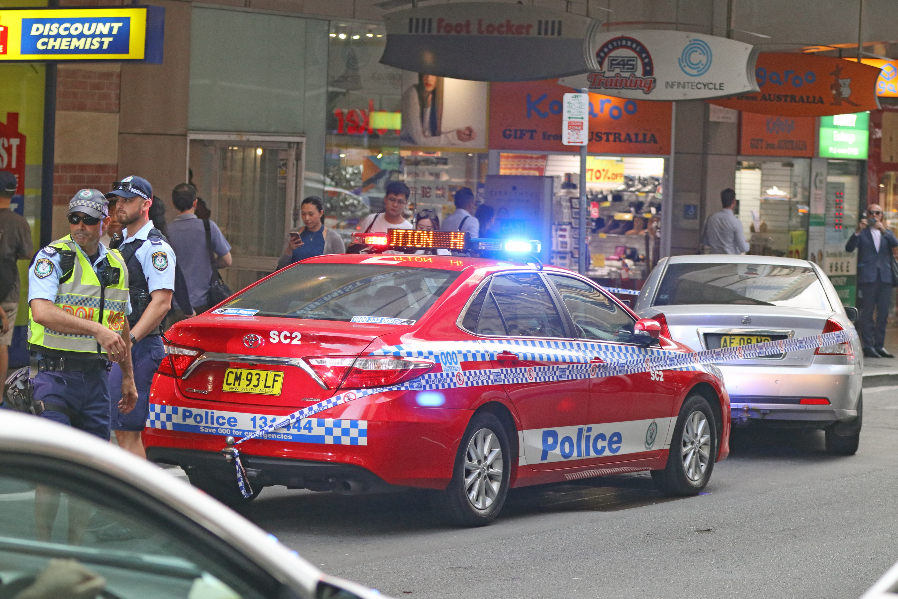
Notes:
Activate knowledge
[Slides 3–6 contain the photos from RESOURCE 4.1 – Four scenes.]
Ask ‘What can you see?
Write responses on the board (if using).

Slide 4
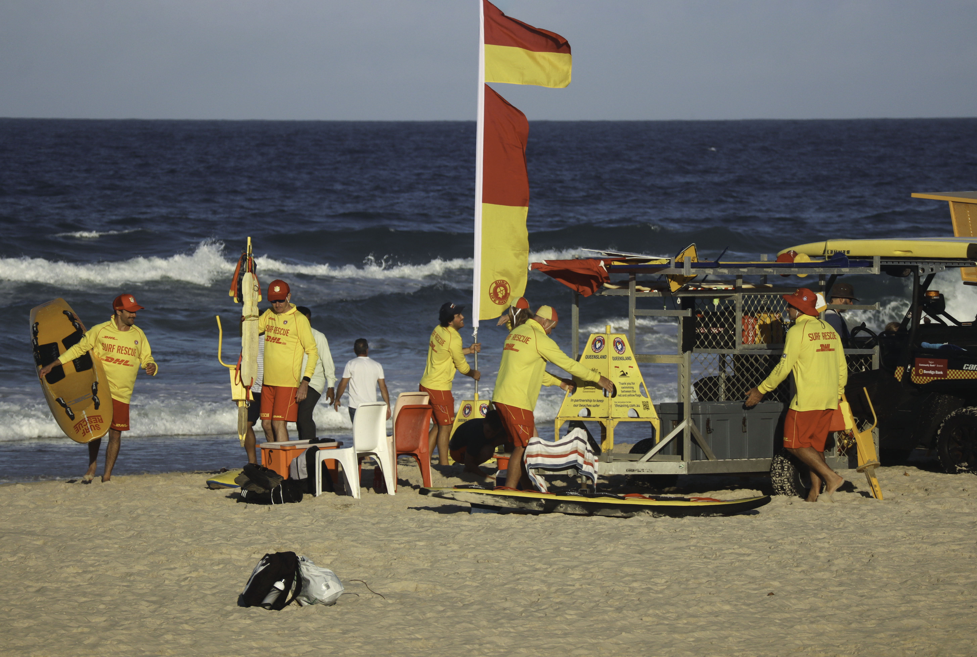
Notes:
Activate knowledge (continued)
Ask ‘What can you see?
Write responses on the board (if using).

Slide 5
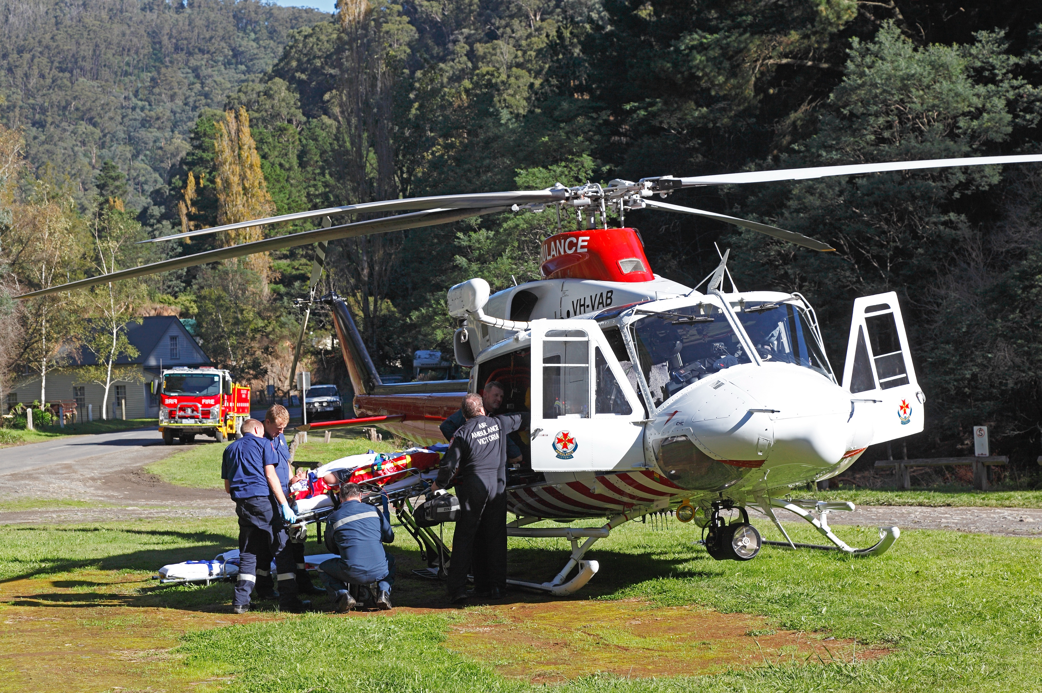
Notes:
Activate knowledge (continued)
Ask ‘What can you see?
Write responses on the board (if using).

Slide 6
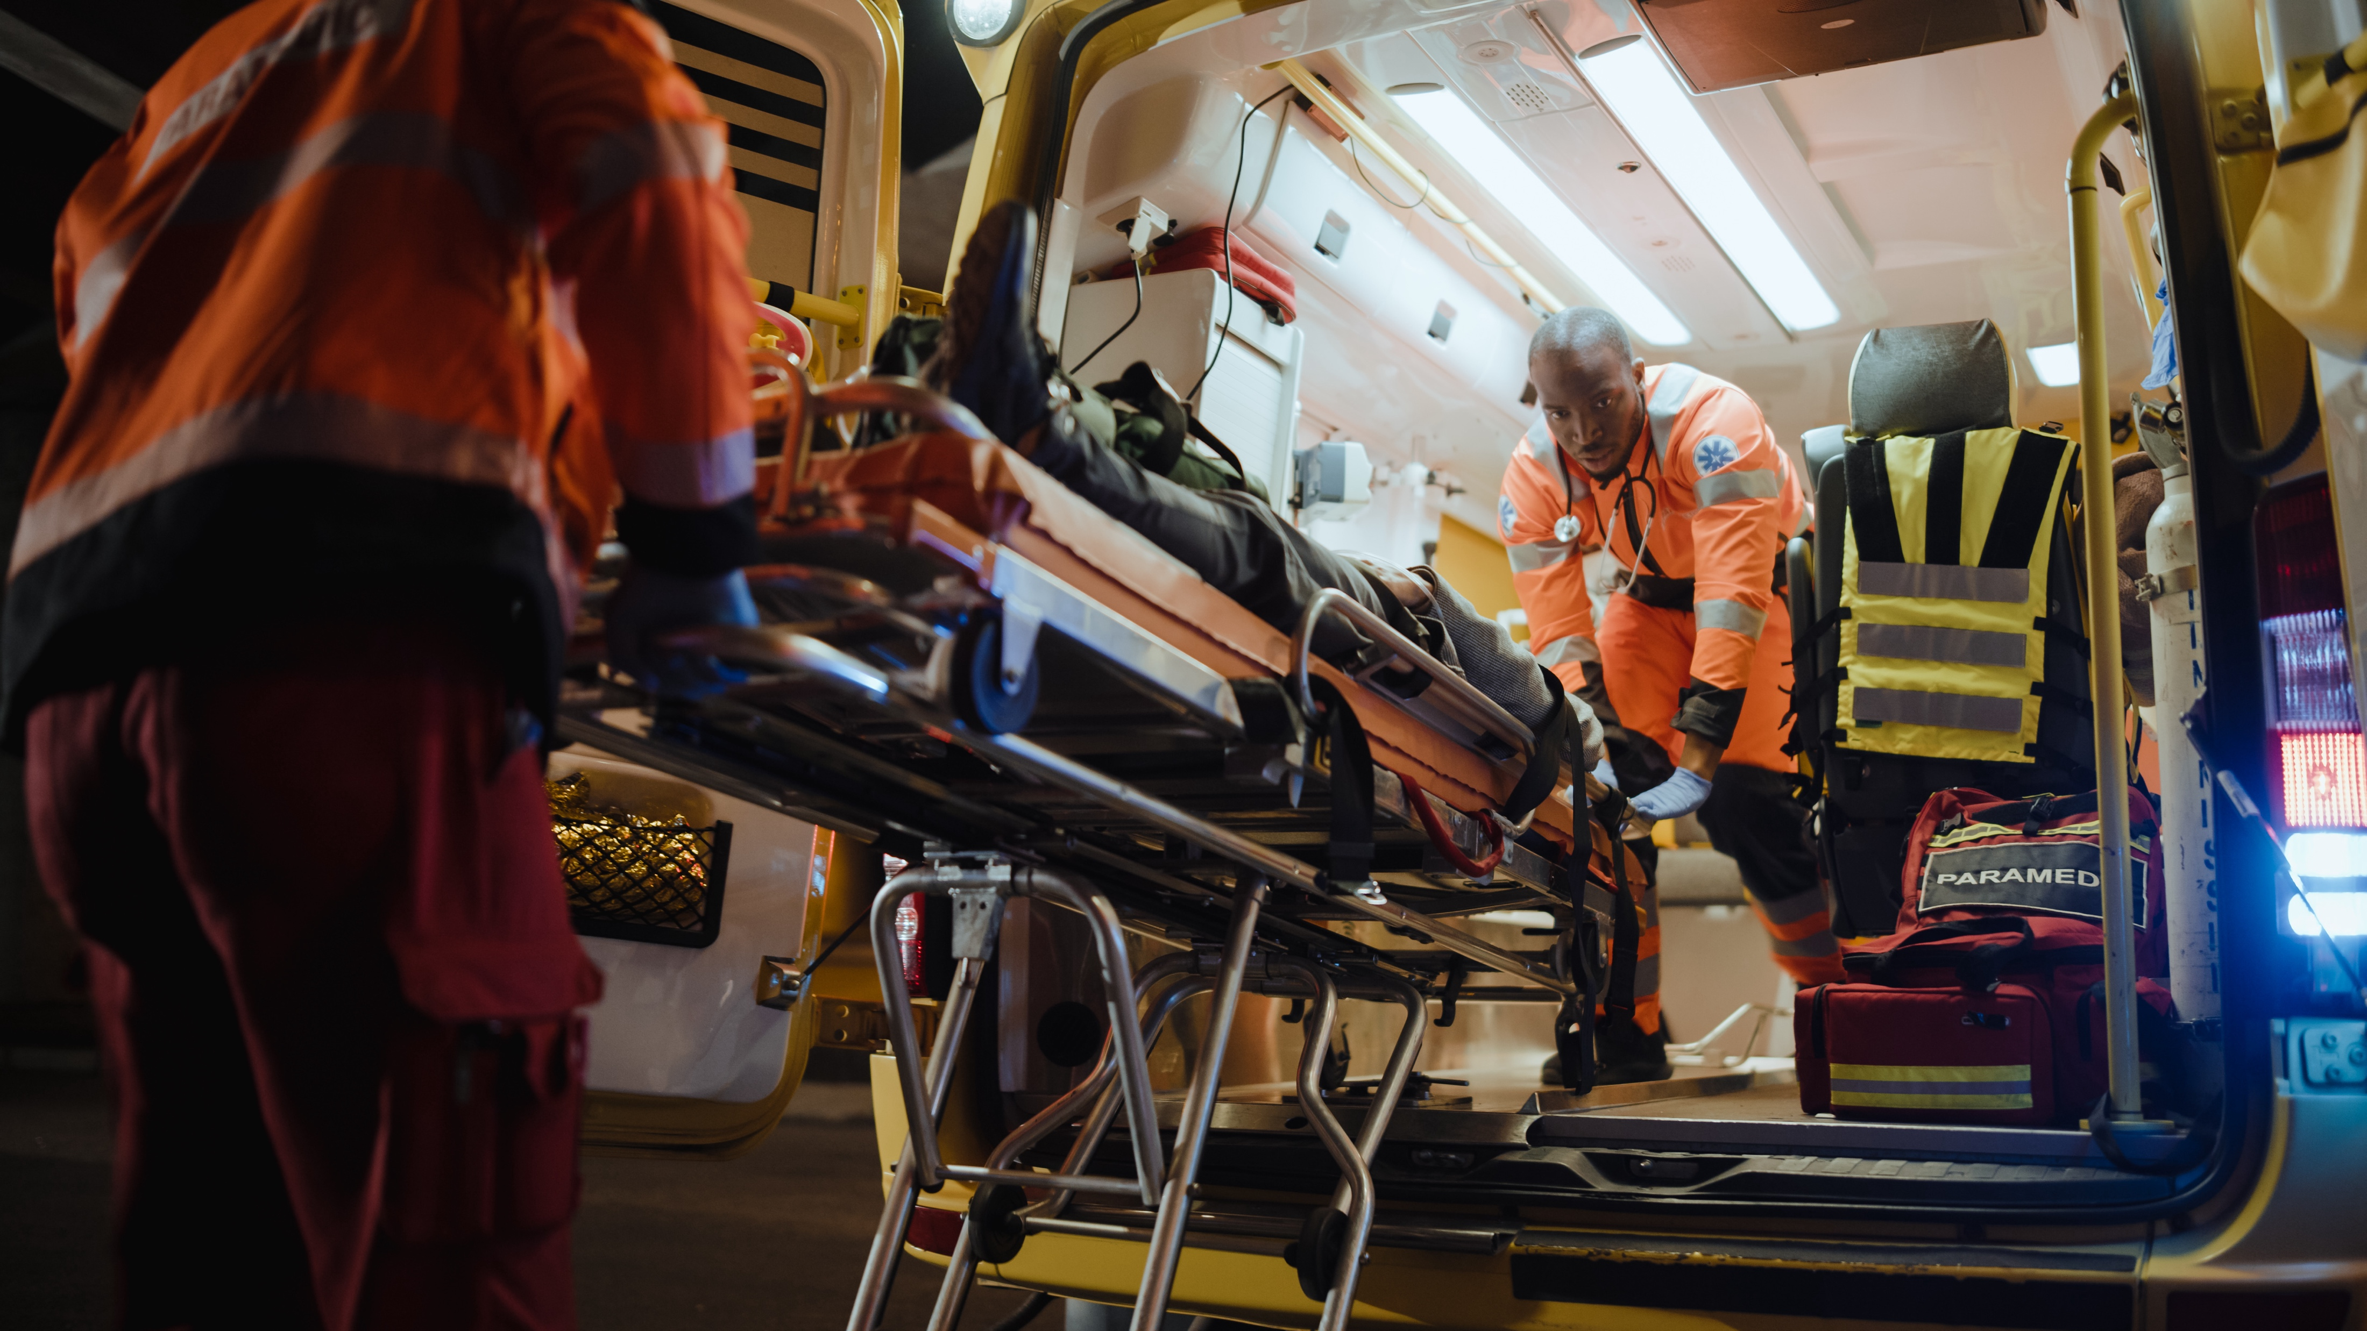
Notes:
Activate knowledge (continued)
Ask ‘What can you see?
Write responses on the board (if using).

Slide 7
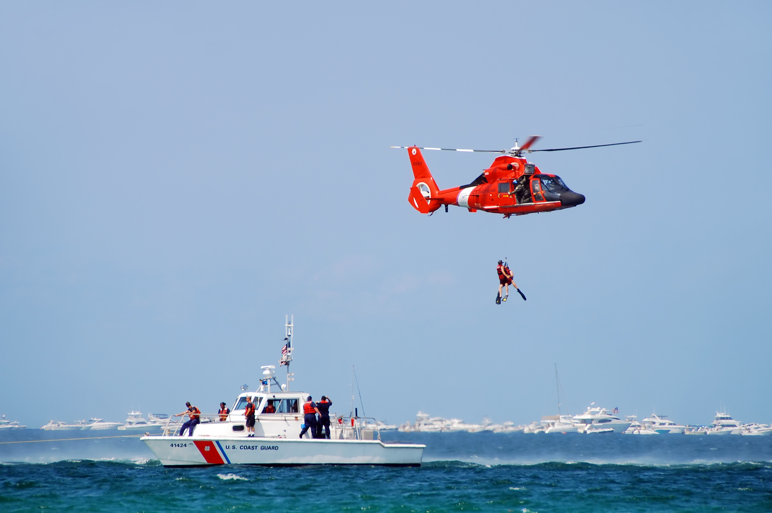
The koala was in danger.
The cat was in danger.
The sick person was in danger.
The fisherman was in danger.
The swimmer was in danger.
Notes:
Focus on language
Activity 1: Matching sentences to photos
[Slides 7–16 contain the pictures from RESOURCE 4.3 – Five photos. This slide will at first appear blank.]
Face-to-face lesson
Divide students into pairs.
Distribute one full set of cut-up sentences from RESOURCE 4.2 – Rescue sentences to each pair.
Click your mouse to display the first photo from RESOURCE 4.3 – Five photos on the slide.
Invite pairs to find the dark/purple sentence from RESOURCE 4.2 – Rescue sentences that matches the photo on the slide.
Click to reveal the answer.
Online lesson
Invite students to find the sentence that matches the photo.
Click your mouse to display the correct answer.

Slide 8
The lifesaver rescued her.
The fire officer rescued it.
The helicopter rescued him.
The police officer rescued it.
The ambulance officer rescued him.
Notes:
Focus on language (continued)
Activity 1: Matching sentences to photos (continued)
Face-to-face lesson
Say ‘The fisherman was in danger. What happened?’
Invite pairs to find the light/green sentence from RESOURCE 4.2 – Rescue sentences that correctly answers the question.
Click mouse to reveal correct answer.
Online lesson
Say ‘The fisherman was in danger. What happened?’
Accept responses.
Click mouse to reveal correct answer.

Slide 9
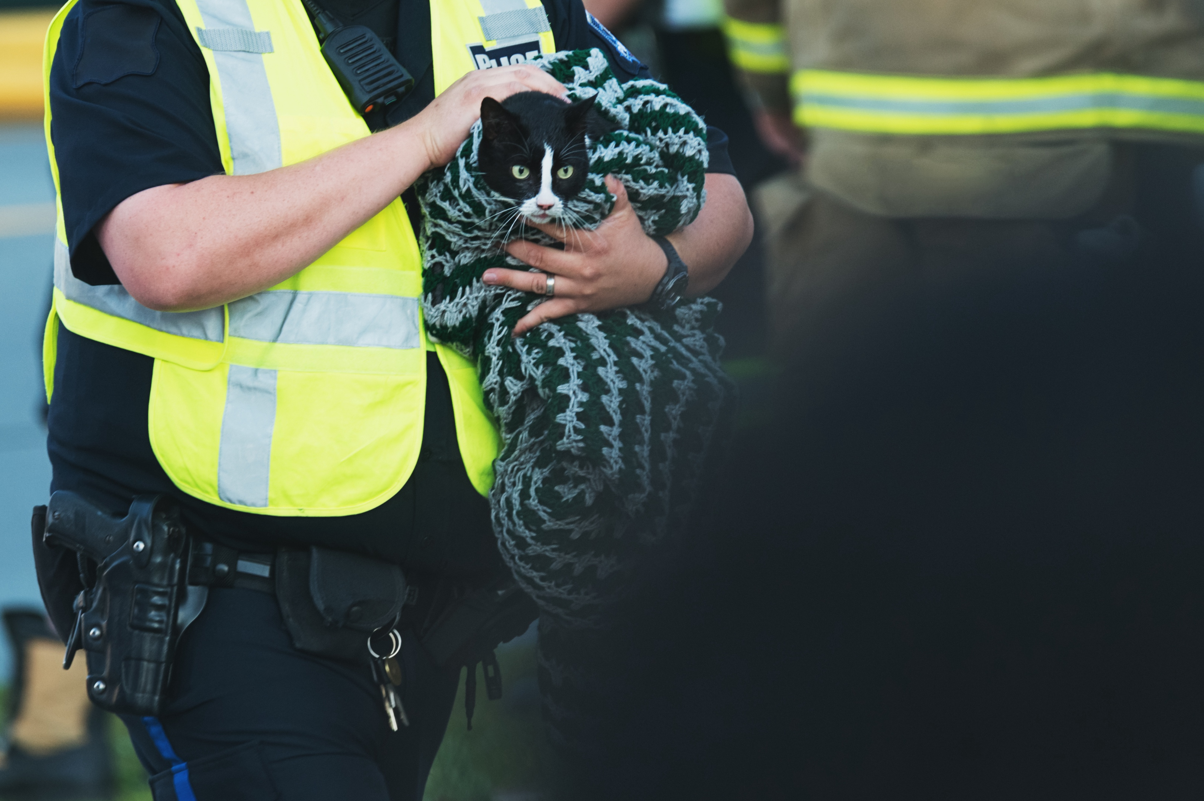
The koala was in danger.
The cat was in danger.
The sick person was in danger.
The fisherman was in danger.
The swimmer was in danger.
Notes:
Focus on language (continued)
Activity 1: Matching sentences to photos (continued)
Face-to-face lesson
Invite pairs to find the dark/purple sentence from RESOURCE 4.2 – Rescue sentences that matches the photo on the slide.
Click to reveal the answer.
Online lesson
Invite students to find the sentence that matches the photo.
Click your mouse to display the correct answer.

Slide 10
The lifesaver rescued her.
The fire officer rescued it.
The helicopter rescued him.
The police officer rescued it.
The ambulance officer rescued him.
Notes:
Focus on language (continued)
Activity 1: Matching sentences to photos (continued)
Face-to-face lesson
Say ‘The cat was in danger. What happened?’
Invite pairs to find the light/green sentence from RESOURCE 4.2 – Rescue sentences that correctly answers the question.
Click mouse to reveal correct answer.
Online lesson
Say ‘The cat was in danger. What happened?’
Accept responses.
Click mouse to reveal correct answer.

Slide 11
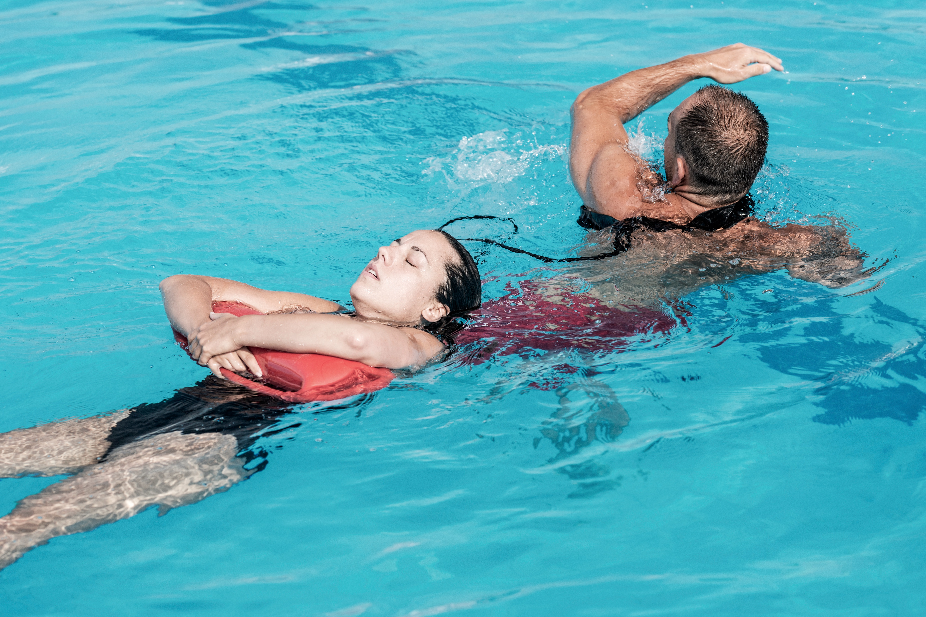
The koala was in danger.
The cat was in danger.
The sick person was in danger.
The fisherman was in danger.
The swimmer was in danger.
Notes:
Focus on language (continued)
Activity 1: Matching sentences to photos (continued)
Face-to-face lesson
Invite pairs to find the dark/purple sentence from RESOURCE 4.2 – Rescue sentences that matches the photo on the slide.
Click to reveal the answer.
Online lesson
Invite students to find the sentence that matches the photo.
Click your mouse to display the correct answer.

Slide 12
The lifesaver rescued her.
The fire officer rescued it.
The helicopter rescued him.
The police officer rescued it.
The ambulance officer rescued him.
Notes:
Focus on language (continued)
Activity 1: Matching sentences to photos (continued)
Face-to-face lesson
Say ‘The swimmer was in danger. What happened?’
Invite pairs to find the light/green sentence from RESOURCE 4.2 – Rescue sentences that correctly answers the question.
Click mouse to reveal correct answer.
Online lesson
Say ‘The swimmer was in danger. What happened?’
Accept responses.
Click mouse to reveal correct answer.

Slide 13
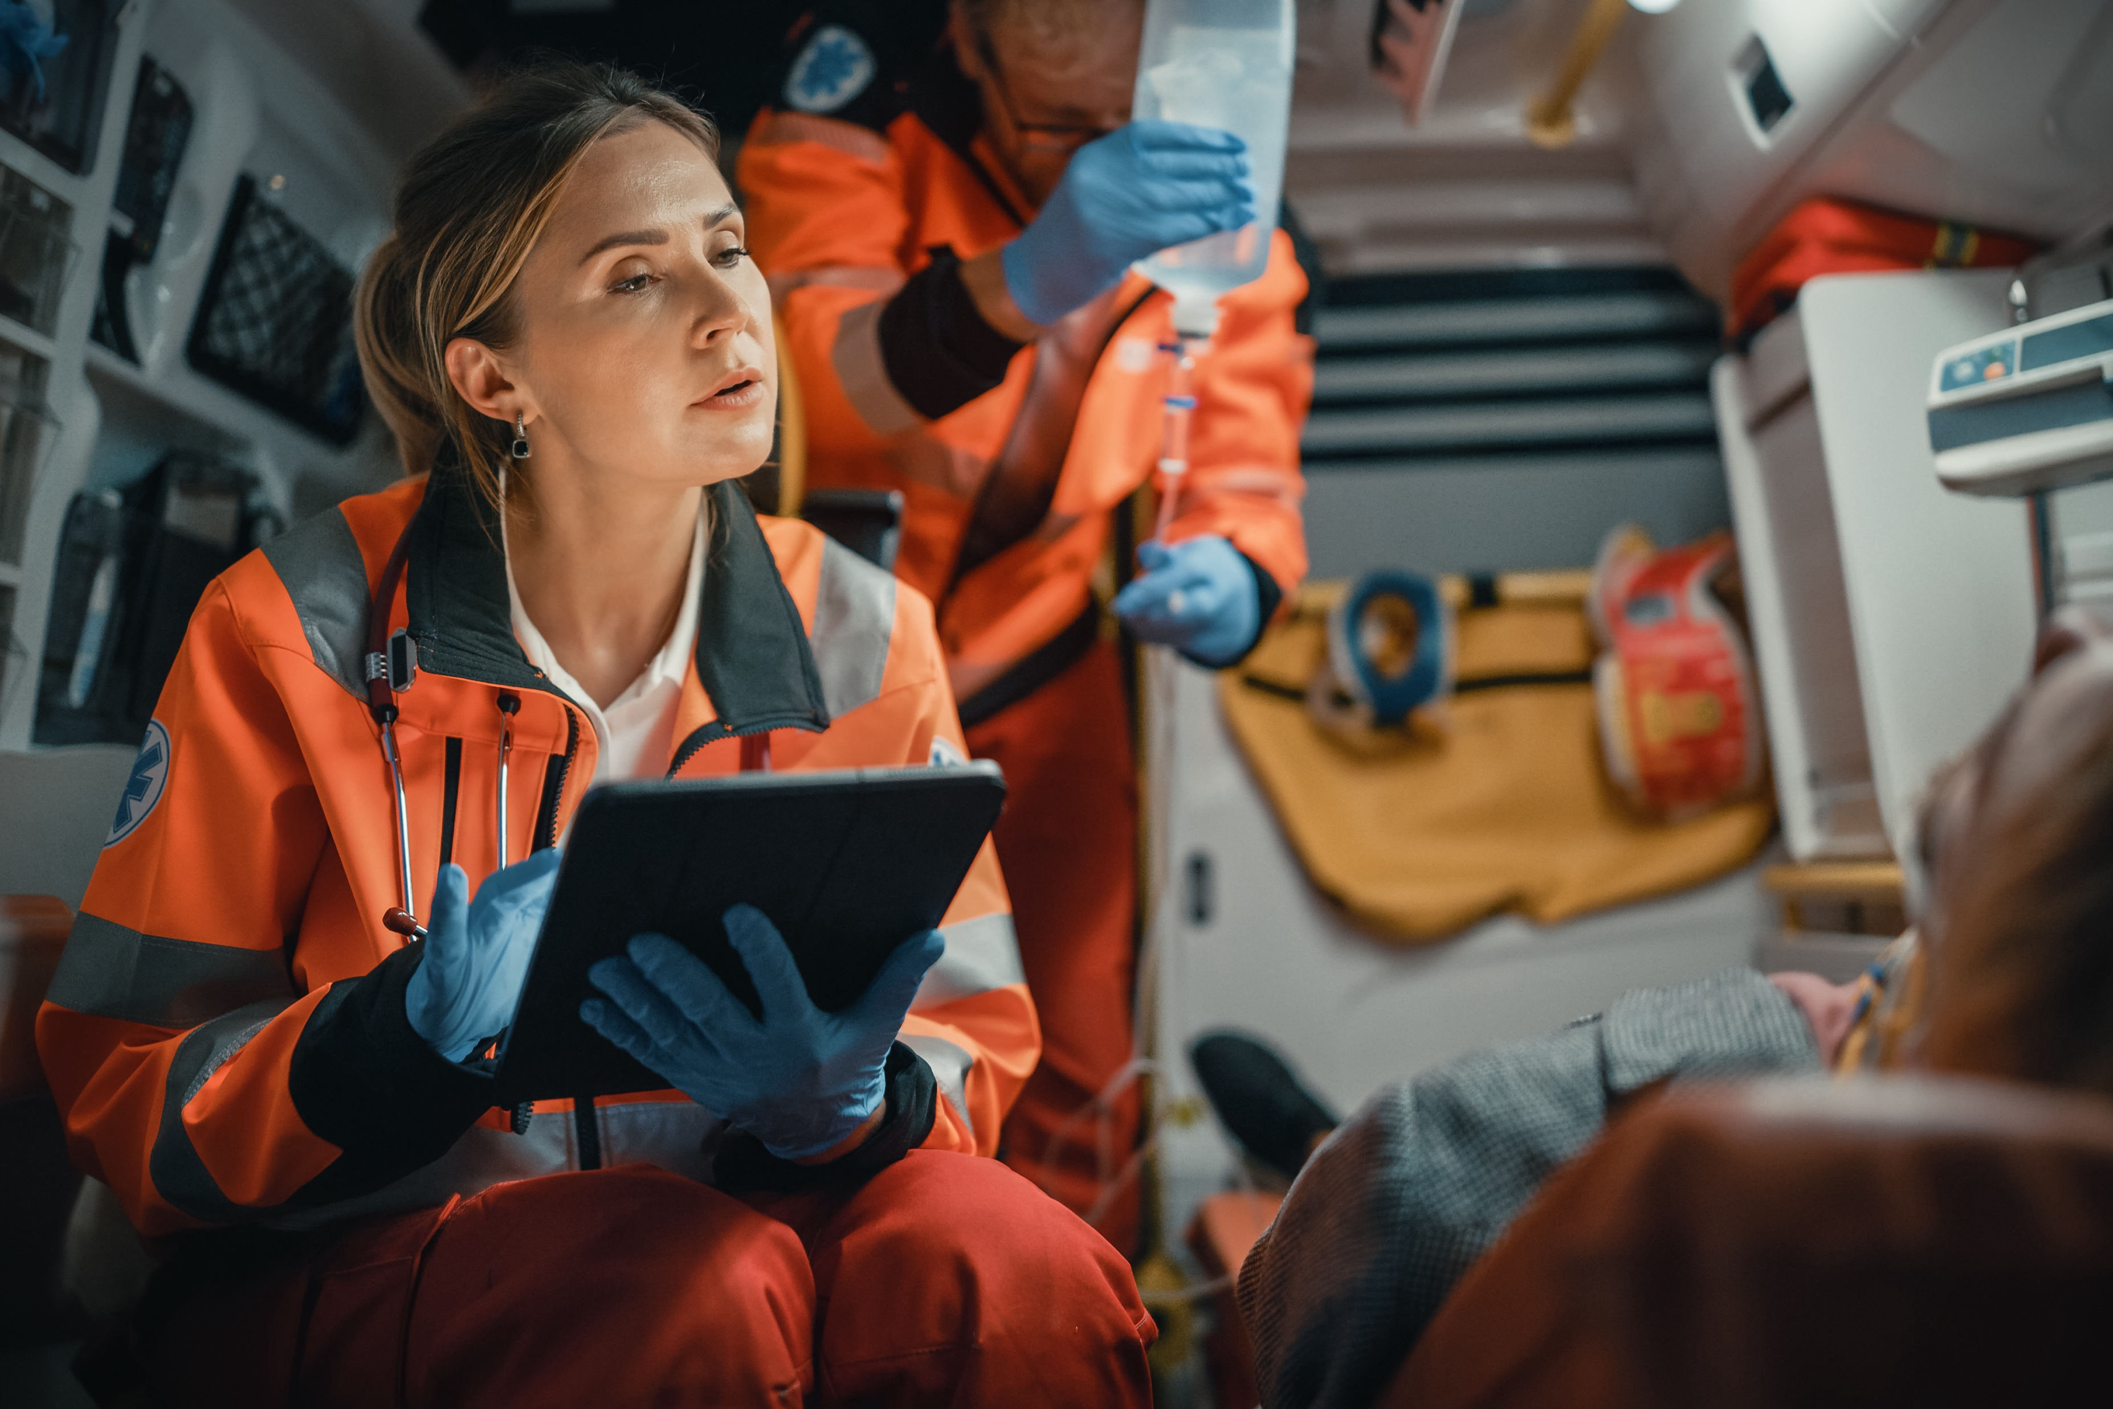
The koala was in danger.
The cat was in danger.
The sick person was in danger.
The fisherman was in danger.
The swimmer was in danger.
Notes:
Focus on language (continued)
Activity 1: Matching sentences to photos (continued)
Face-to-face lesson
Invite pairs to find the dark/purple sentence from RESOURCE 4.2 – Rescue sentences that matches the photo on the slide.
Click to reveal the answer.
Online lesson
Invite students to find the sentence that matches the photo.
Click your mouse to display the correct answer.

Slide 14
The lifesaver rescued her.
The fire officer rescued it.
The helicopter rescued him.
The police officer rescued it.
The ambulance officer rescued him.
Notes:
Focus on language (continued)
Activity 1: Matching sentences to photos (continued)
Face-to-face lesson
Say ‘The sick person was in danger. What happened?’
Invite pairs to find the light/green sentence from RESOURCE 4.2 – Rescue sentences that correctly answers the question.
Click mouse to reveal correct answer.
Online lesson
Say ‘The sick person was in danger. What happened?’
Accept responses.
Click mouse to reveal correct answer.

Slide 15
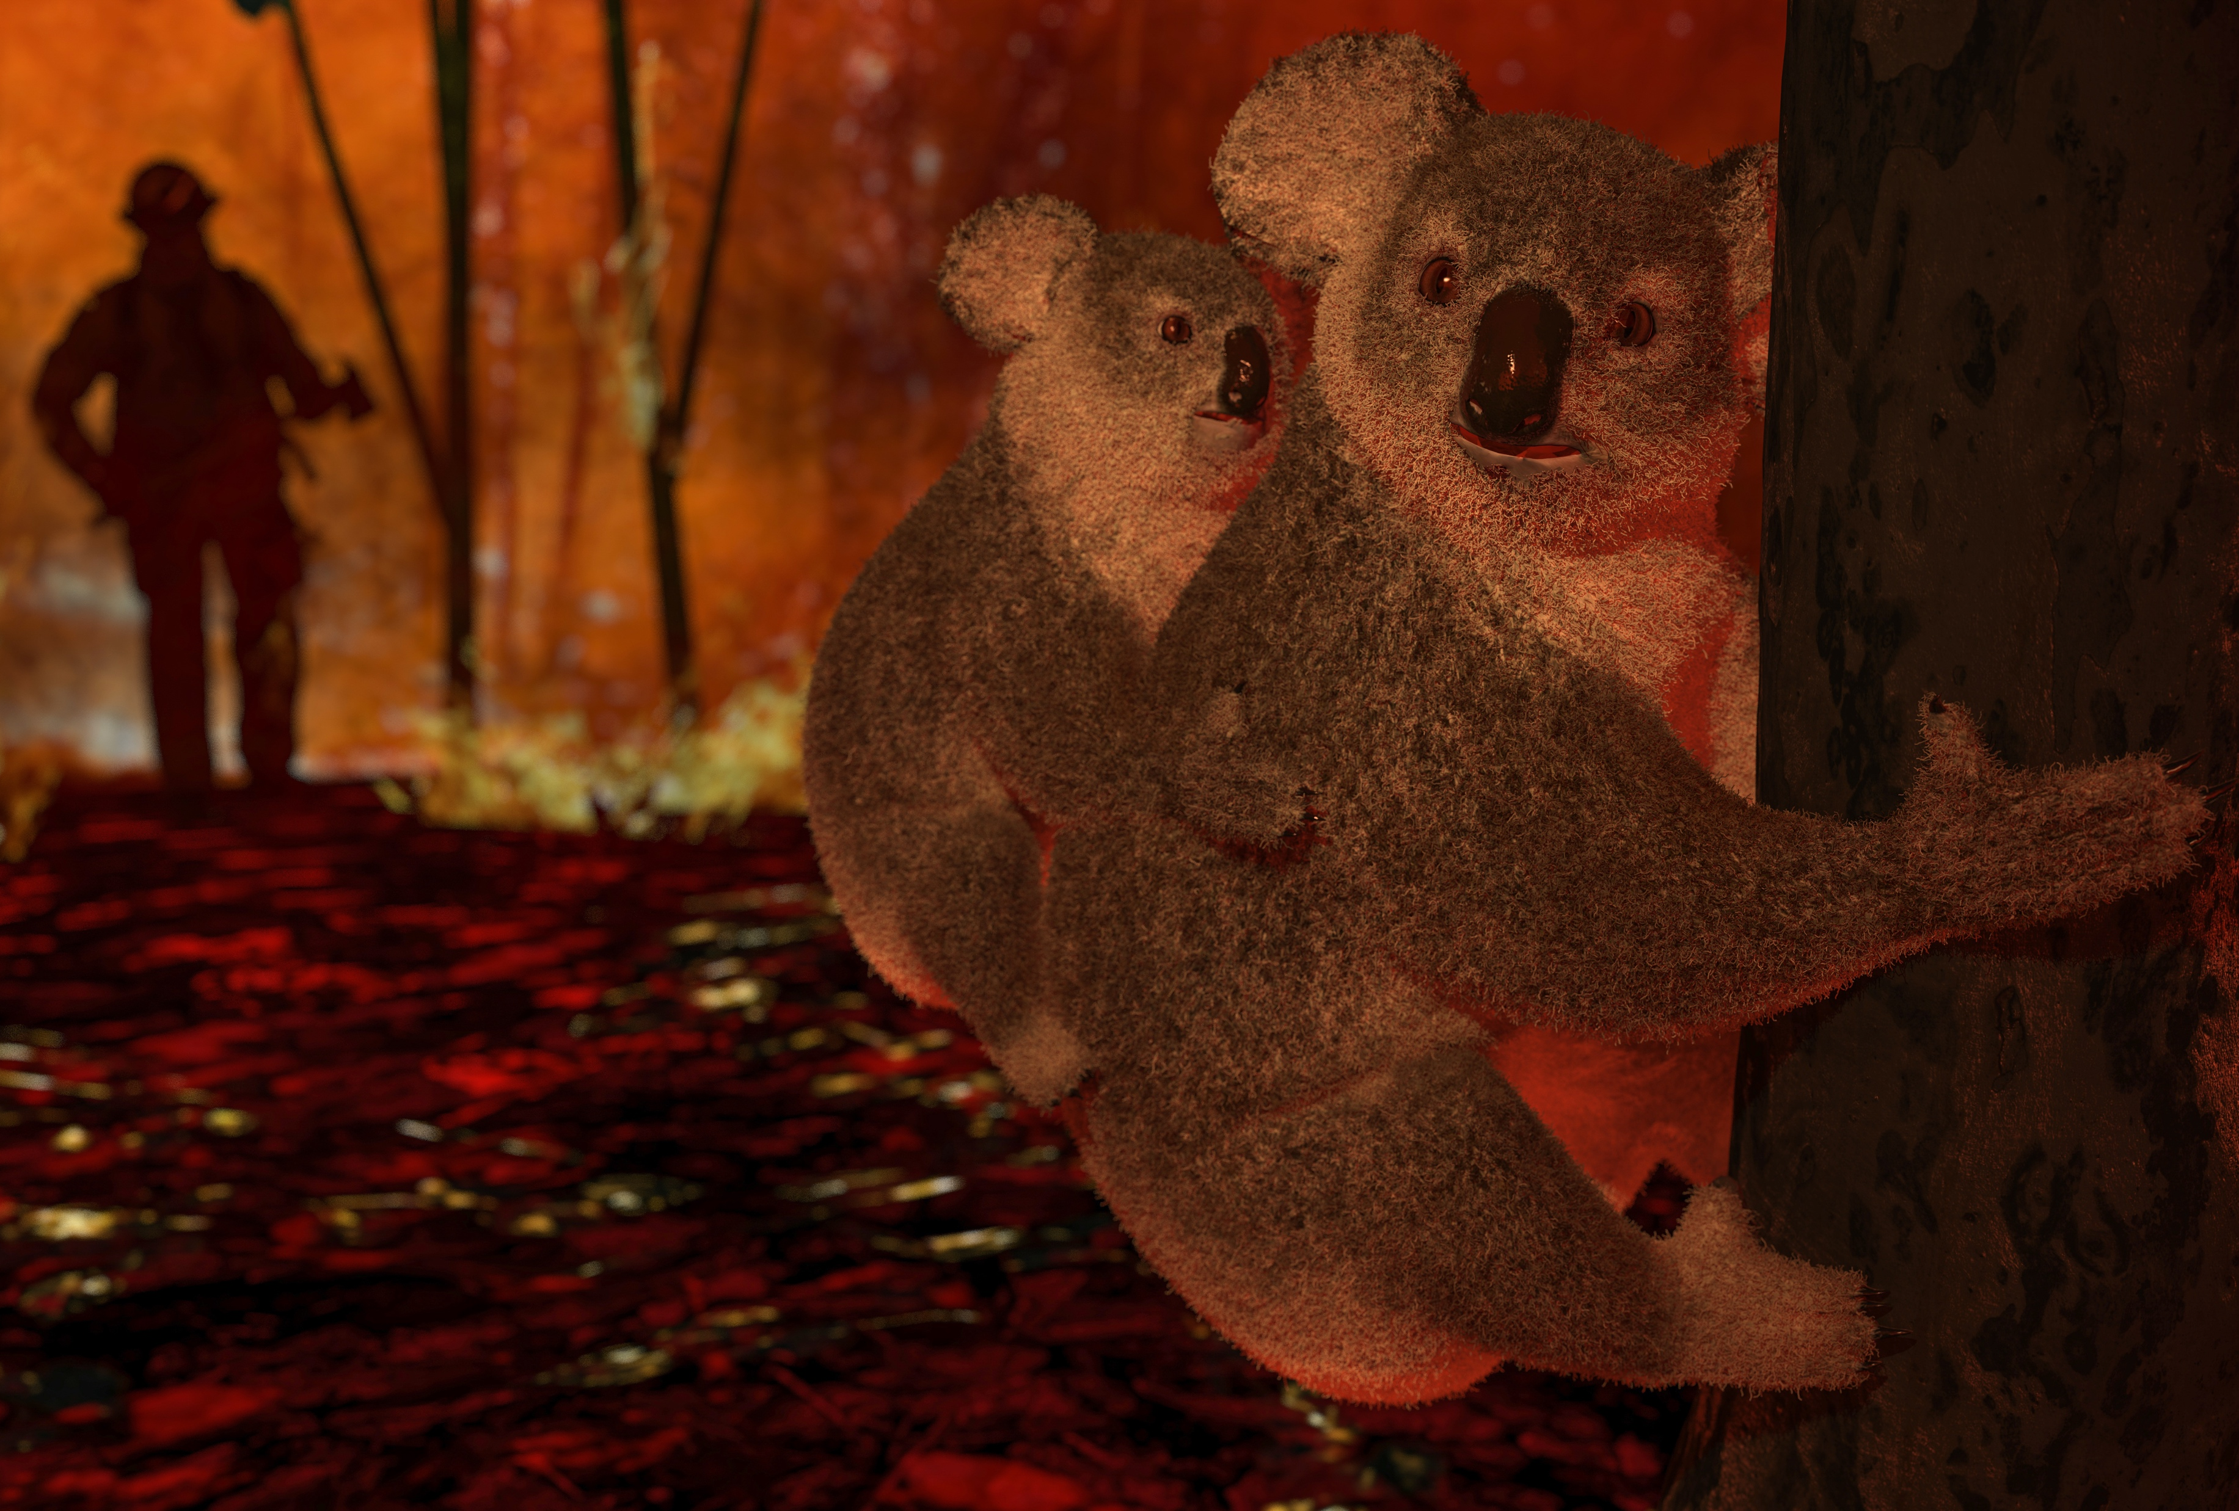
The koala was in danger.
The cat was in danger.
The sick person was in danger.
The fisherman was in danger.
The swimmer was in danger.
Notes:
Focus on language (continued)
Activity 1: Matching sentences to photos (continued)
Face-to-face lesson
Invite pairs to find the dark/purple sentence from RESOURCE 4.2 – Rescue sentences that matches the photo on the slide.
Click to reveal the answer.
Online lesson
Invite students to find the sentence that matches the photo.
Click your mouse to display the correct answer.

Slide 16
The lifesaver rescued her.
The fire officer rescued it.
The helicopter rescued him.
The police officer rescued it.
The ambulance officer rescued him.
Notes:
Focus on language (continued)
Activity 1: Matching sentences to photos (continued)
Face-to-face lesson
Say ‘The koala was in danger. What happened?’
Invite pairs to find the light/green sentence from RESOURCE 4.2 – Rescue sentences that correctly answers the question.
Click mouse to reveal correct answer.
Online lesson
Say ‘The koala was in danger. What happened?’
Accept responses.
Click mouse to reveal correct answer.

Slide 17
Lesson 4
PART 2
God rescues and restores his people
Exodus 3:4, 7–8a (before leaving Egypt); Exodus 19:4–8 (after leaving Egypt)
Notes:
(Part 2 title page)

Slide 18
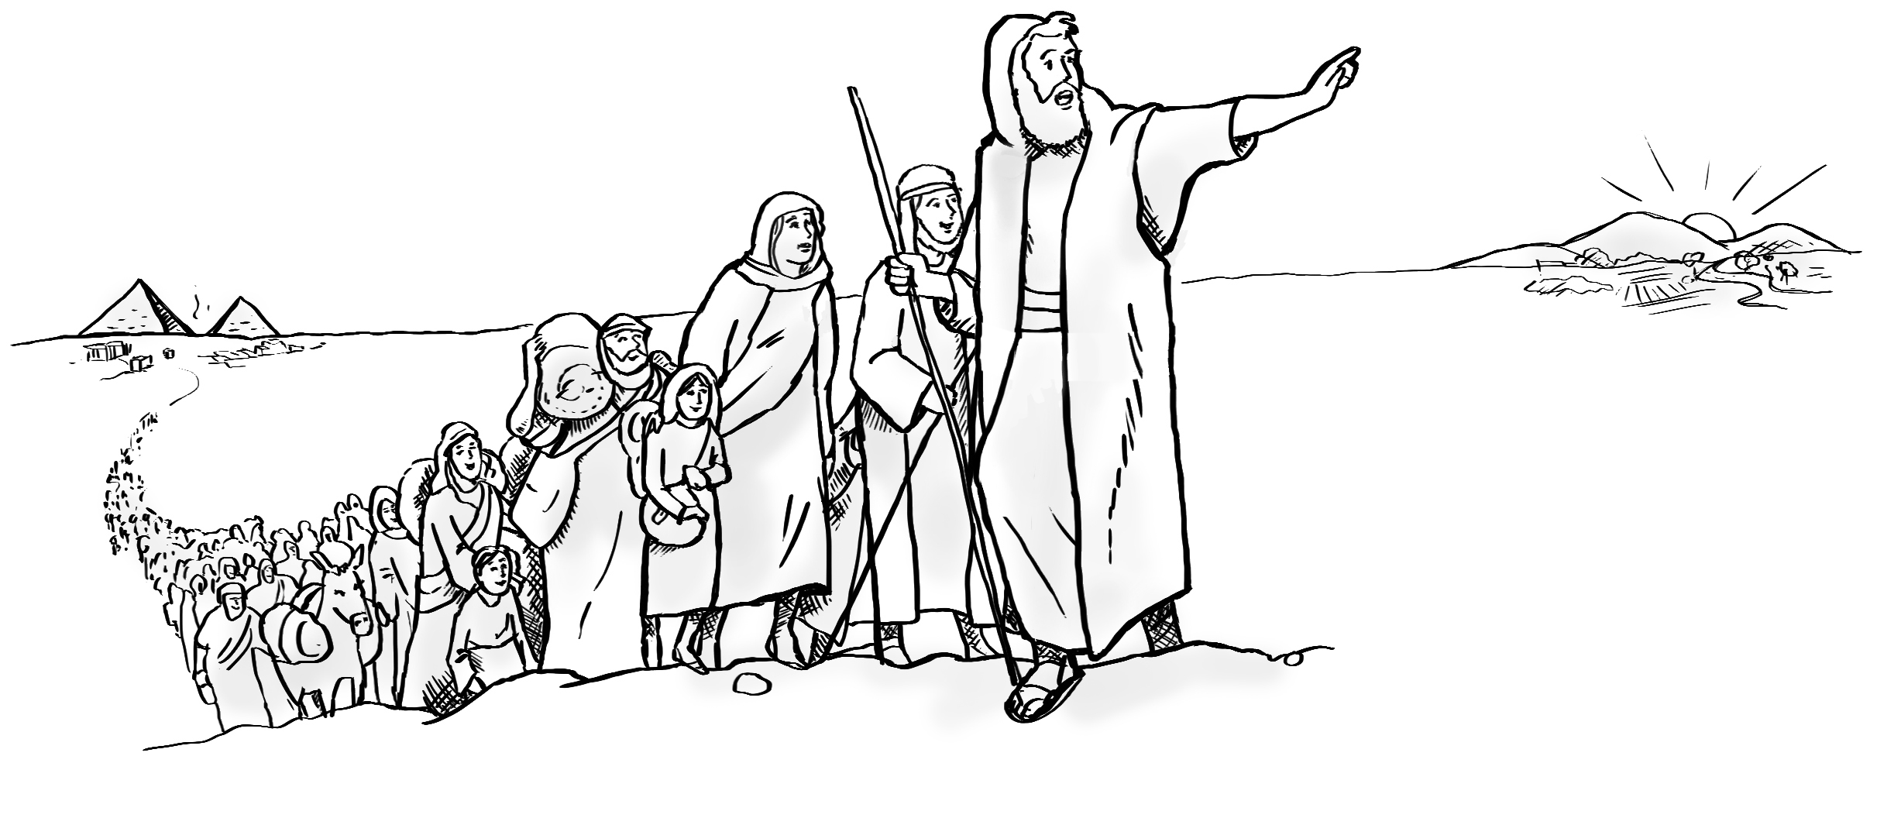
Notes:
Activate knowledge
[Slide contains RESOURCE 4.4 – Big idea sketch.]
Ask ‘What can you see?’
Write responses on the board (if using).

Slide 19

Notes:
Read for gist
Say ‘In the Bible story, God rescues his people.’
Distribute copies of Exodus 3:4, 7–8a; 19:4–8 in your students’ heart languages (if in the classroom). [Alternatively, if online, invite students to refer to the heart language texts they have been sent in advance.]
Give students a few minutes to read the text silently for context, then ask them to put it away for the rest of the lesson.

Slide 20
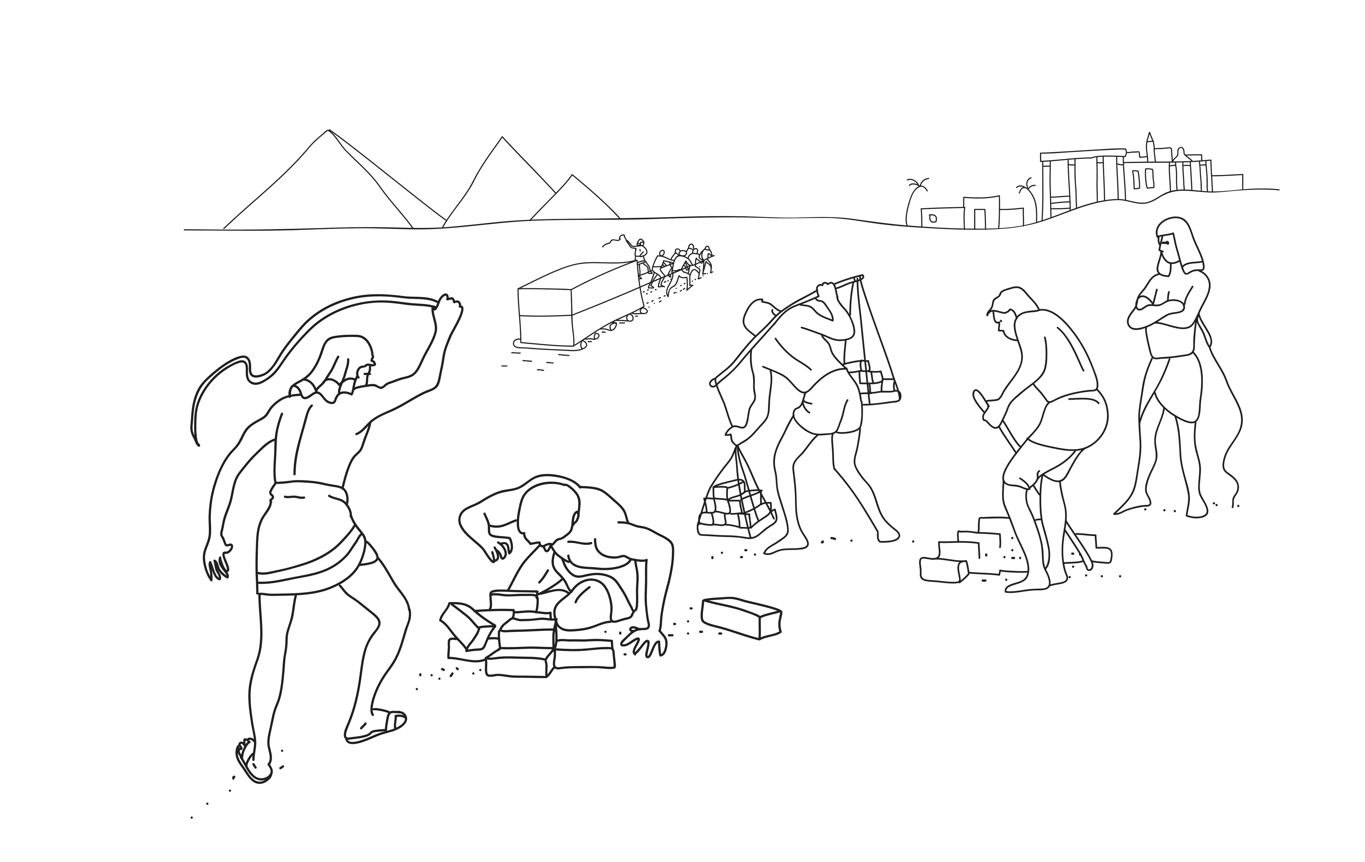
God saw people suffering in Egypt.
Notes:
Read for detail
[This slide and the 7 slides that follow contain RESOURCE 4.5 – Large sketches and RESOURCE 4.6 – Large sentences.]
Read the sentence on the slide aloud slowly.
Invite students to repeat the sentence after you.
Repeat several times to reinforce correct pronunciation.
Click through the presentation to display the remaining 7 sketches and sentences.

Slide 21
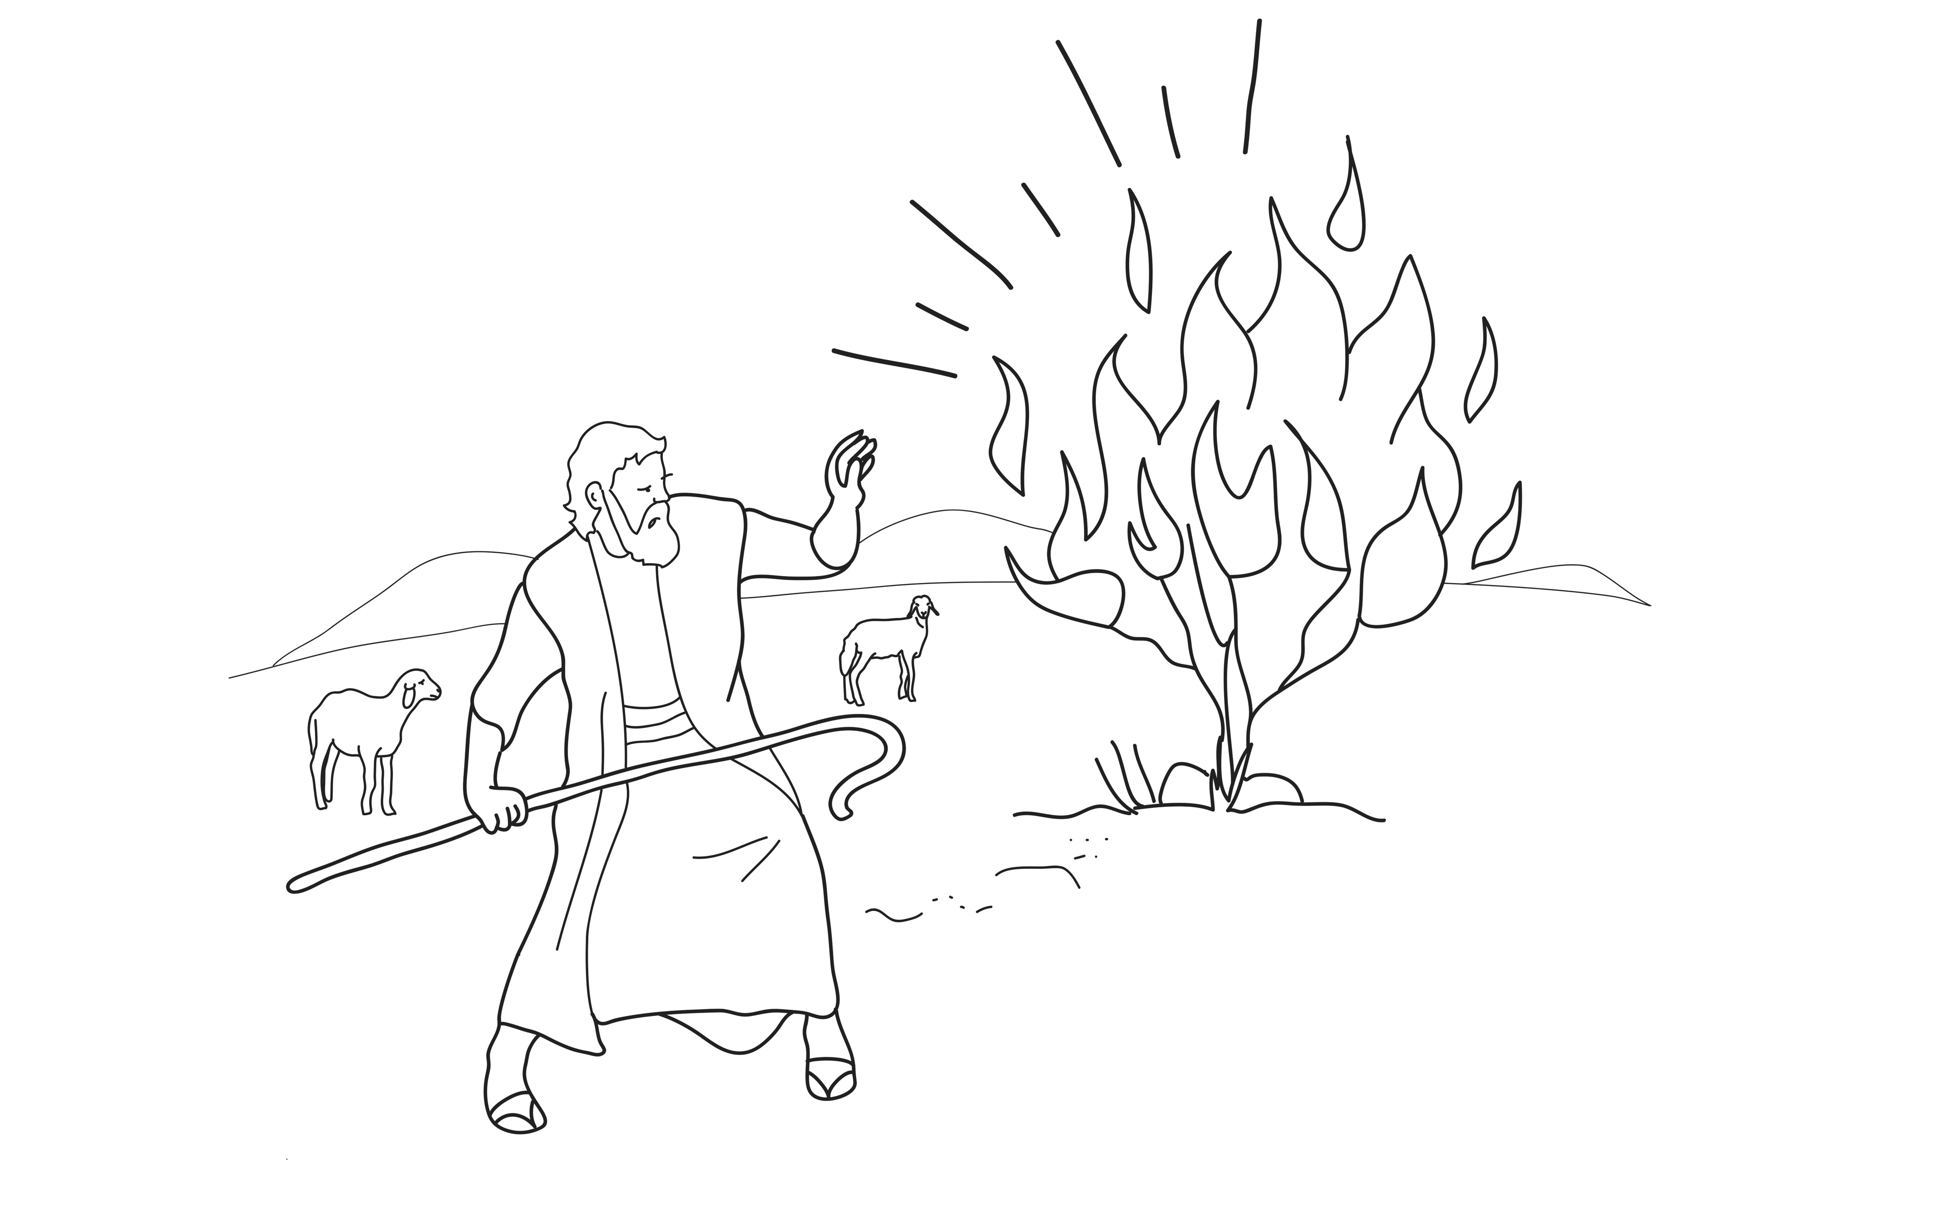
God spoke to Moses.
Notes:
Read for detail (continued)
Read the sentence aloud slowly.
Invite students to repeat the sentence after you.
Repeat several times to reinforce correct pronunciation.

Slide 22
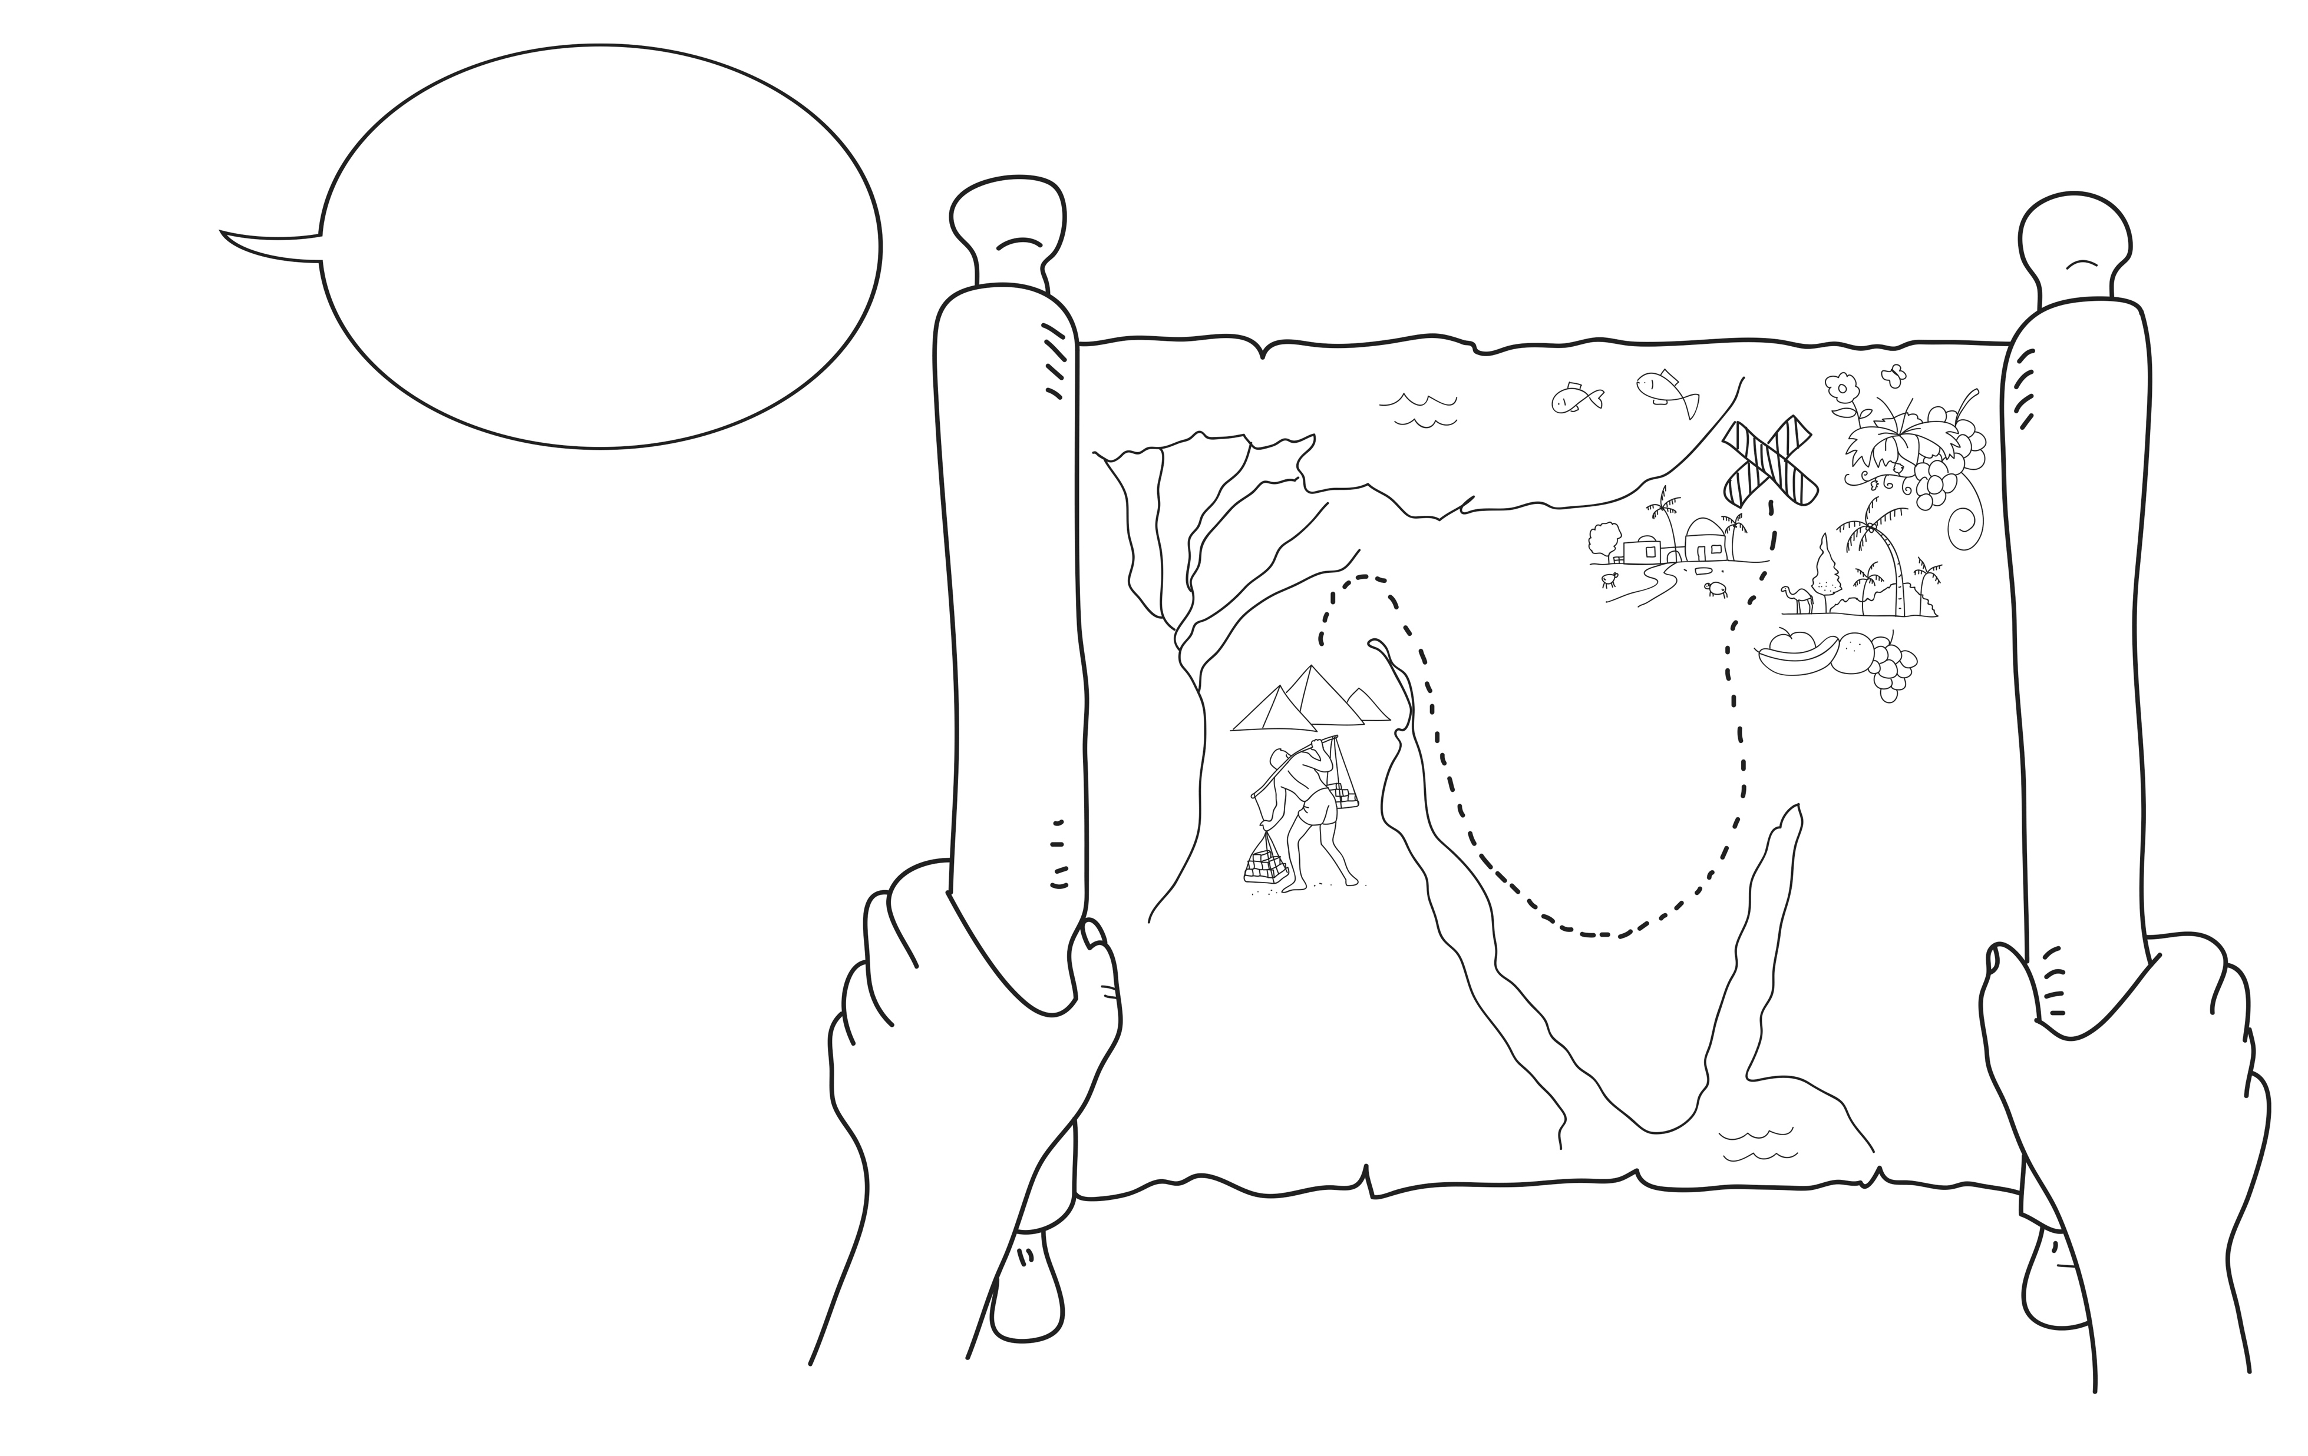
God said, ‘Lead my people out of
Egypt to a good land.’
Notes:
Read for detail (continued)
Read the sentence aloud slowly.
Invite students to repeat the sentence after you.
Repeat several times to reinforce correct pronunciation.

Slide 23
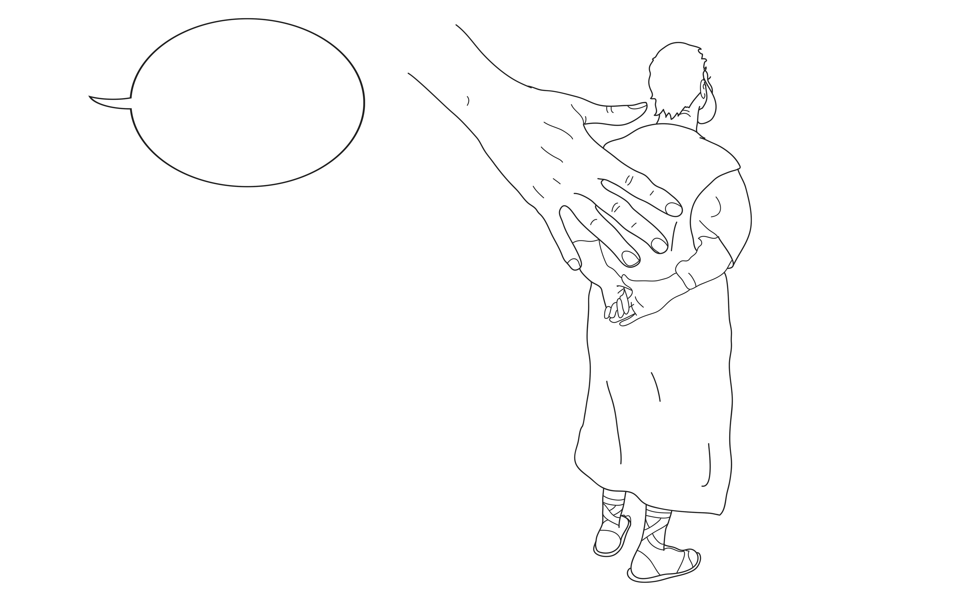
God said, ‘I will be with you.’
Notes:
Read for detail (continued)
Read the sentence aloud slowly.
Invite students to repeat the sentence after you.
Repeat several times to reinforce correct pronunciation.

Slide 24
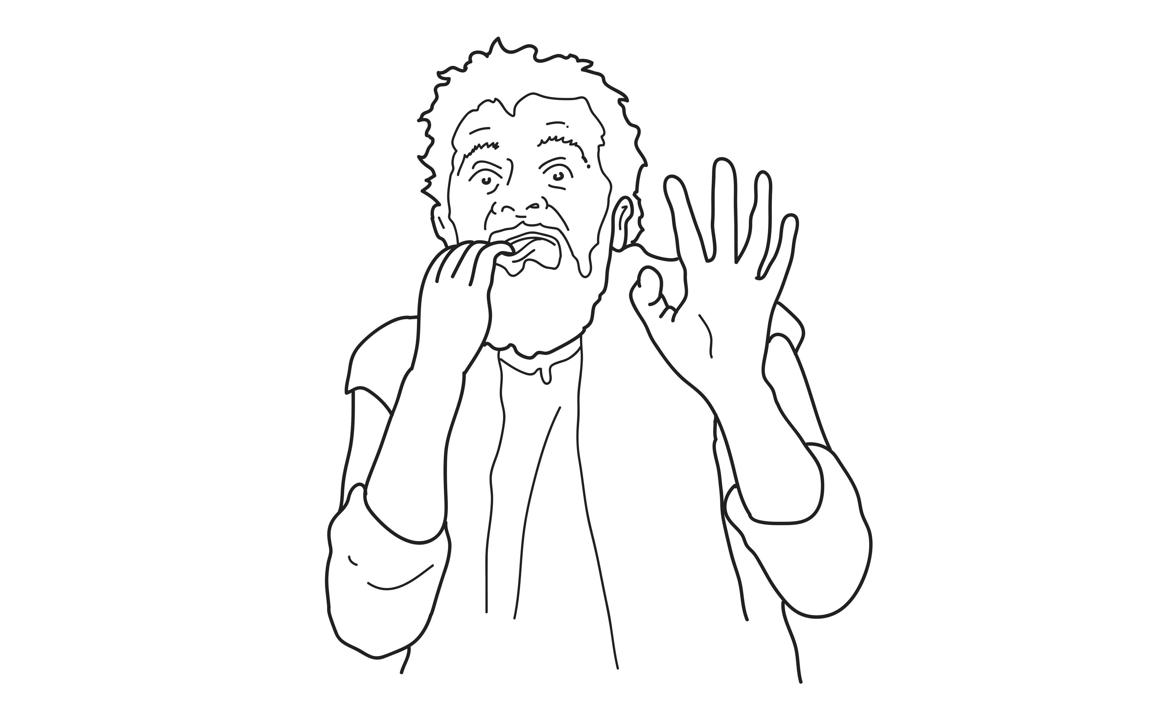
Moses was scared.
Notes:
Read for detail (continued)
Read the sentence aloud slowly.
Invite students to repeat the sentence after you.
Repeat several times to reinforce correct pronunciation.

Slide 25
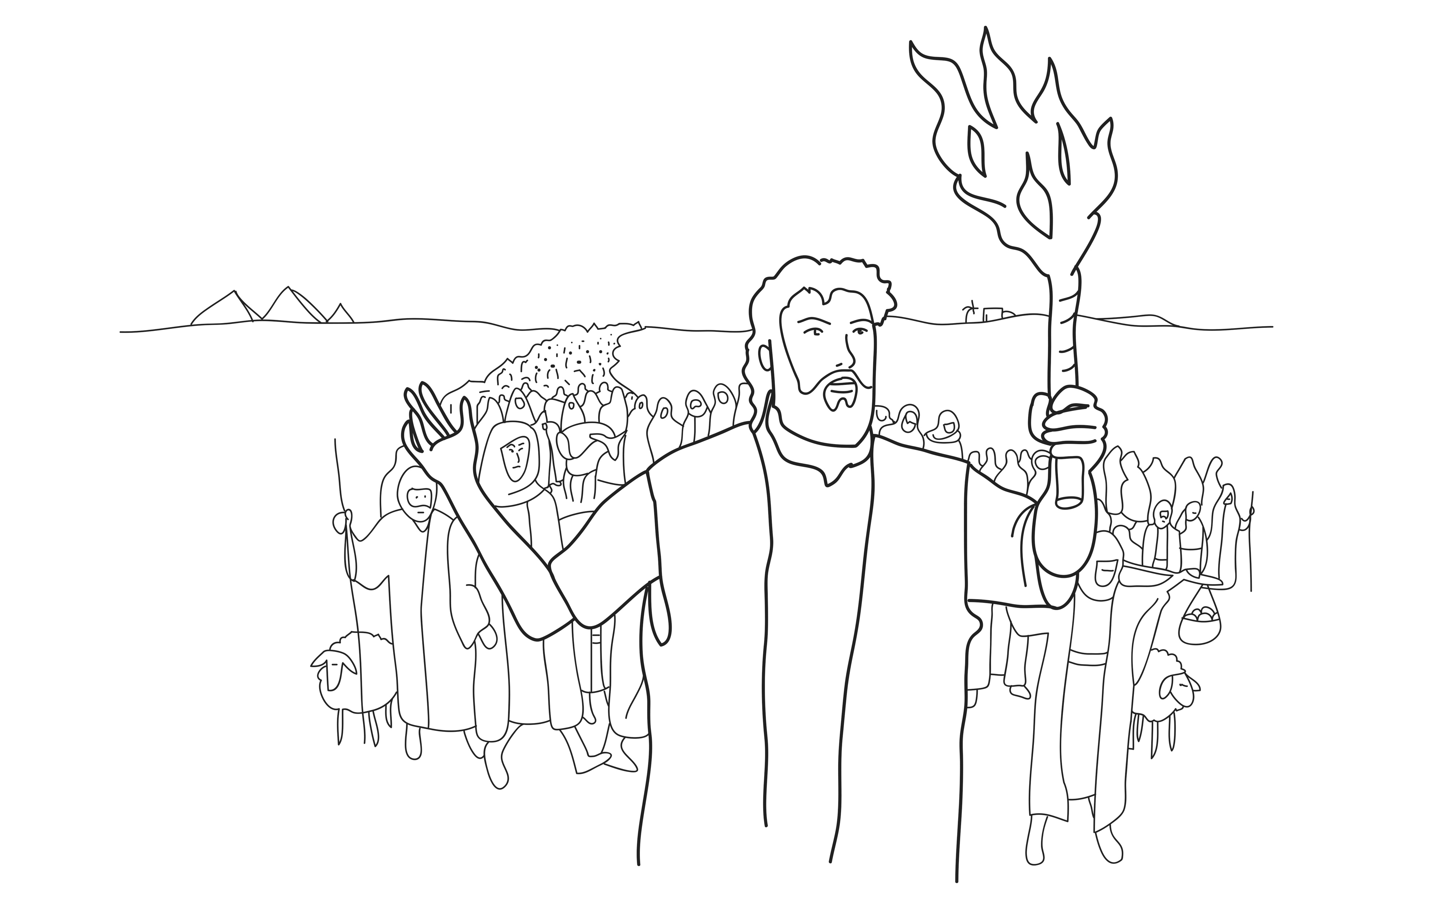
Moses obeyed God.
Notes:
Read for detail (continued)
Read the sentence aloud slowly.
Invite students to repeat the sentence after you.
Repeat several times to reinforce correct pronunciation.

Slide 26
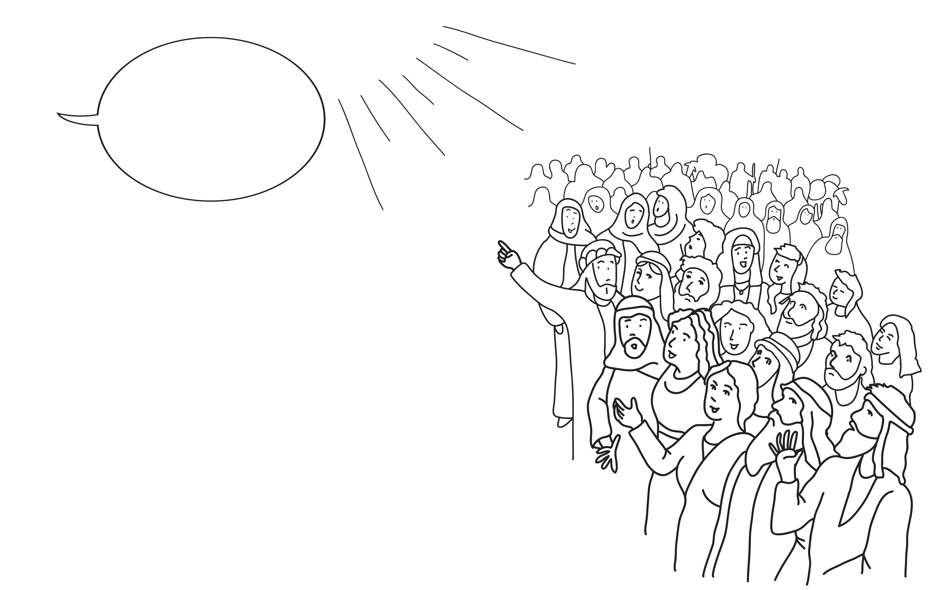
God said to the people, ‘You are special. Obey me.’
Notes:
Read for detail (continued)
Read the sentence aloud slowly.
Invite students to repeat the sentence after you.
Repeat several times to reinforce correct pronunciation.

Slide 27
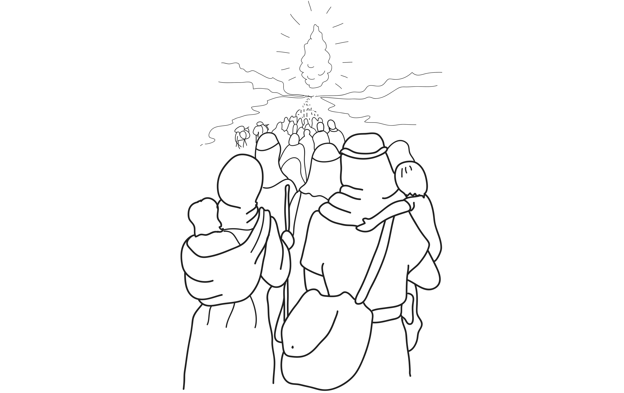
The people obeyed God.
Notes:
Read for detail (continued)
Read the sentence aloud slowly.
Invite students to repeat the sentence after you.
Repeat several times to reinforce correct pronunciation.

Slide 28
Notes:
Reinforce the language
[The activity on this slide and the 7 slides that follow replaces the activity in the lesson book in which students point to corresponding sketches.]
Invite students to say any words that they remember about this sketch.
Accept responses.

Slide 29
Notes:
Reinforce the language (continued)
Invite students to say any words that they remember about this sketch.
Accept responses.

Slide 30
Notes:
Reinforce the language (continued)
Invite students to say any words that they remember about this sketch.
Accept responses.

Slide 31
Notes:
Reinforce the language (continued)
Invite students to say any words that they remember about this sketch.
Accept responses.

Slide 32
Notes:
Reinforce the language (continued)
Invite students to say any words that they remember about this sketch.
Accept responses.

Slide 33
Notes:
Reinforce the language (continued)
Invite students to say any words that they remember about this sketch.
Accept responses.

Slide 34
Notes:
Reinforce the language (continued)
Invite students to say any words that they remember about this sketch.
Accept responses.

Slide 35
Notes:
Reinforce the language (continued)
Invite students to say any words that they remember about this sketch.
Accept responses.

Slide 36








Notes:
Reinforce the language (continued)
[This slide will at first appear blank in Slide Show mode.]
Distribute RESOURCE 4.7 – Small sketches (if using) to pairs/groups. [Alternatively, complete this activity together verbally using the PowerPoint slides.]
Invite pairs/groups to sequence or try to remember the sketches in the correct order.
Click your mouse to display the sketches one at a time in the correct order.

Slide 37
God saw people suffering in Egypt.
Notes:
Reinforce the language (continued)
Distribute RESOURCE 4.8 – Small sentence strips (if using) to pairs/groups.
Invite pairs/groups to match the sentence strips to the corresponding sketches (if using). More advanced students can sequence the sentence strips without looking at the sketches.
[Alternatively, complete this activity together verbally using the PowerPoint slides.]
Invite students to identify the sketch on the slide that corresponds to the sentence.
Click to display the arrow and confirm the correct response.

Slide 38
God spoke to Moses.
Notes:
Reinforce the language (continued)
Invite students to point to the sketch on the slide that corresponds to the sentence.
Click to display the arrow and confirm the correct response.

Slide 39
God said, ‘Lead my people out of
Egypt to a good land.’
Notes:
Reinforce the language (continued)
Invite students to point to the sketch on the slide that corresponds to the sentence.
Click to display the arrow and confirm the correct response.

Slide 40
God said, ‘I will be with you.’
Notes:
Reinforce the language (continued)
Invite students to point to the sketch on the slide that corresponds to the sentence.
Click to display the arrow and confirm the correct response.

Slide 41
Moses was scared.
Notes:
Reinforce the language (continued)
Invite students to point to the sketch on the slide that corresponds to the sentence.
Click to display the arrow and confirm the correct response.

Slide 42
Moses obeyed God.
Notes:
Reinforce the language (continued)
Invite students to point to the sketch on the slide that corresponds to the sentence.
Click to display the arrow and confirm the correct response.

Slide 43
God said to the people, ‘You are special. Obey me.’
Notes:
Reinforce the language (continued)
Invite students to point to the sketch on the slide that corresponds to the sentence.
Click to display the arrow and confirm the correct response.

Slide 44
The people obeyed God.
Notes:
Reinforce the language (continued)
Invite students to point to the sketch on the slide that corresponds to the sentence.
Click to display the arrow and confirm the correct response.

Slide 45
1. God ________ people suffering
in Egypt.
saw
Notes:
Reinforce the language (continued)
Distribute RESOURCE 4.9 – Gap-fill worksheet (if using) to each student. [Alternatively, complete this activity together verbally using the PowerPoint slides.]
Encourage students to work together to complete the worksheet.
Click to reveal the missing word and check the answer together.

Slide 46
2. God ________ to Moses.
spoke
Notes:
Reinforce the language (continued)
Click to reveal the missing word and check the answer together.

Slide 47
3. God said, ‘__________ my people out of Egypt to a good land.’
Lead
Notes:
Reinforce the language (continued)
Click to reveal the missing word and check the answer together.

Slide 48
with
4. God said, ‘I will be ________ you.
Notes:
Reinforce the language (continued)
Click to reveal the missing word and check the answer together.

Slide 49
scared
5. Moses was ________.
Notes:
Reinforce the language (continued)
Click to reveal the missing word and check the answer together.

Slide 50
obeyed
6. Moses _________God.
Notes:
Reinforce the language (continued)
Click to reveal the missing word and check the answer together.

Slide 51
7. God said to the people, ‘You are __________ . Obey me.’
special
Notes:
Reinforce the language (continued)
Click to reveal the missing word and check the answer together.

Slide 52
8. The people obeyed _________.
God
Notes:
Reinforce the language (continued)
Click to reveal the missing word and check the answer together.

