Slide 1
Lesson 10
Bible Overview
Ten Bible-based English lessons
Intermediate
Notes:
(Lesson 1 title page)

Slide 2
Lesson 10
PART 1
Future hopes and dreams
Notes:
(Part 1 title page)

Slide 3
a better world
Notes:
Activate knowledge
Invite students to brainstorm what ‘a better world’ would be like.
Accept and draw out responses.

Slide 4
sadness
joy
pain
comfort
wipe away
Notes:
Focus on language
[This activity replaces RESOURCE 10.1 – Worksheet.]
Model miming one of the words on the slide for the class to guess.
Invite a volunteer to choose a word from the slide without telling the class, and to mime it for the class to guess.
Continue until all words have been mimed and guessed.

Slide 5
What do you hope to do tomorrow? | What would your perfect day be like? | What are the most important things in life?
What do you hope to do next week? | What would a perfect world be like? | What do you hope to do when you retire?
What do you dream about doing one day? | What is a good friendship like? | What brings you comfort?
What are your hopes for your family? | Tell me about a time when someone comforted you. | Tell me about your dreams for the future.
What are your hopes for this year? | Tell me about a time when you were joyful. | Tell me about a good friend of yours.
Notes:
Undertake speaking tasks
[Slide contains questions from RESOURCE 10.2 – Question cards.]
Speaking task 1: Circle discussion
[If you are face-to-face and using the cards from RESOURCE 10.2 – Question cards, undertake this circle discussion activity as per the instructions in the lesson book. If not, use the following adapted activity.]
Divide students into pairs.
Invite students to take turns asking each other some questions from the slide.
Reallocate pairs every few minutes and repeat.

Slide 6
The perfect ruler would be …
Notes:
Undertake speaking tasks (continued)
Speaking task 2: Memory game
Clarify the meaning of the word ‘ruler’ (in this context: leader).
Explain that the word ‘would’ can be used when we are imagining something.
Form one large circle (if face-to-face) or ask for responses student by student.
Start the game by saying ‘The perfect ruler would be honest.’
Invite a helper or confident student to repeat your sentence and add a characteristic (e.g. The perfect ruler would be honest and kind).
Invite students to continue, adding a new characteristic each time (prompt if necessary: powerful, kind, compassionate, courageous, decisive, creative, confident, passionate, a good listener, etc.). You may need to explain that ‘and’ is only used before the last item in a list.
Speaking task 3: Sharing stories
Divide students into pairs.
Invite students to talk about a good ruler or leader.
Encourage students to ask each other questions.
Lead into Bible
Say ‘Our Bible time is about a good ruler in a good new world.’

Slide 7
Lesson 10
PART 2
Creation restored
Revelation 21:1, 3–5a
Notes:
(Part 2 title page)

Slide 8
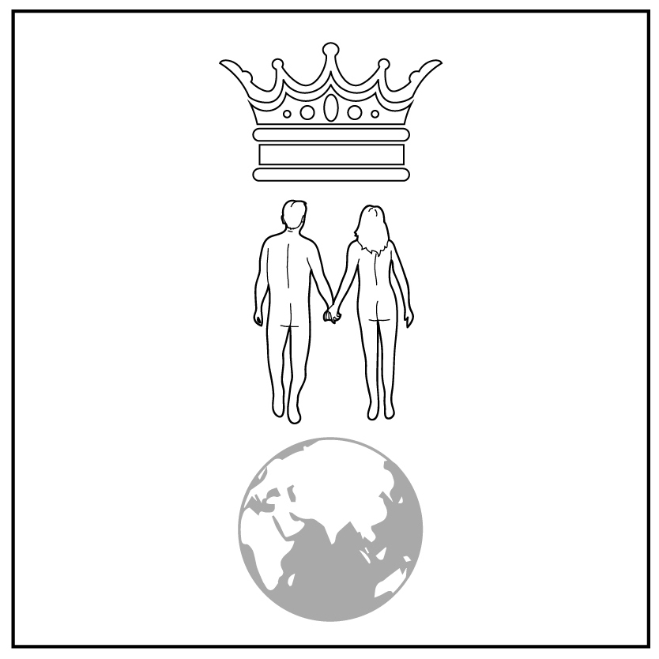

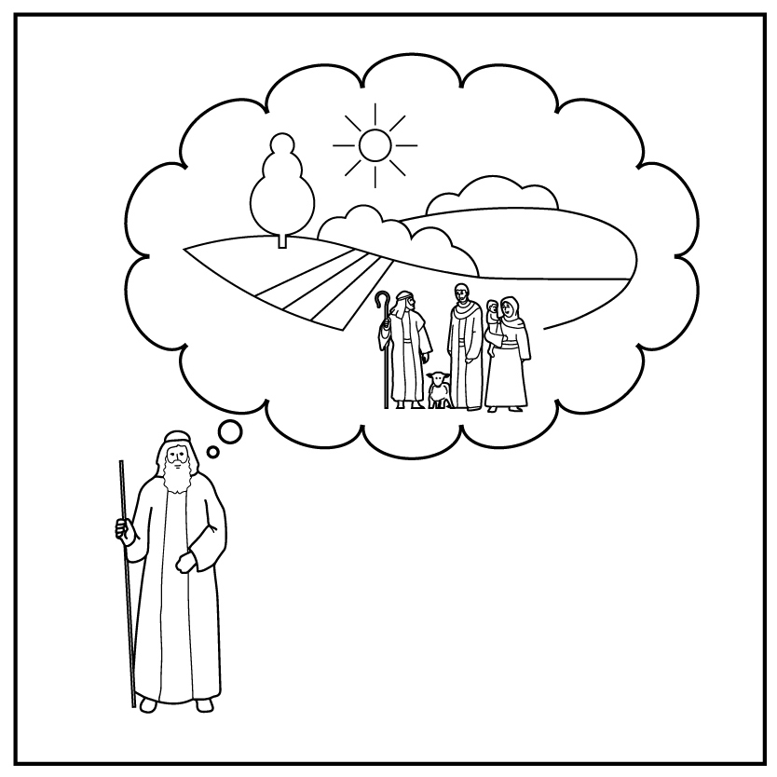
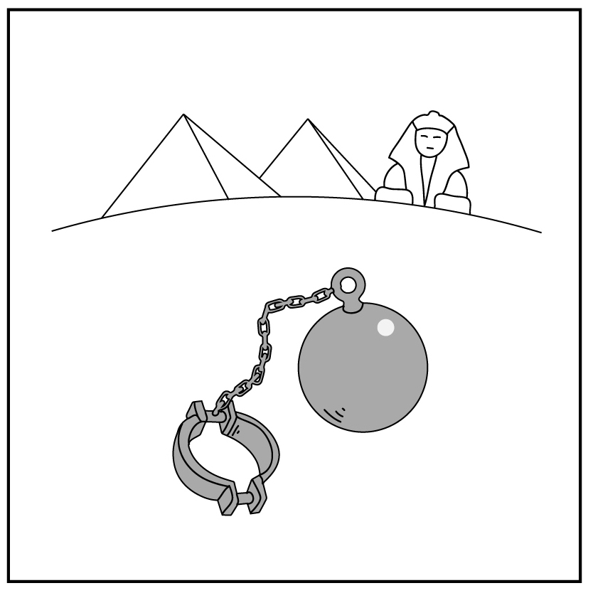
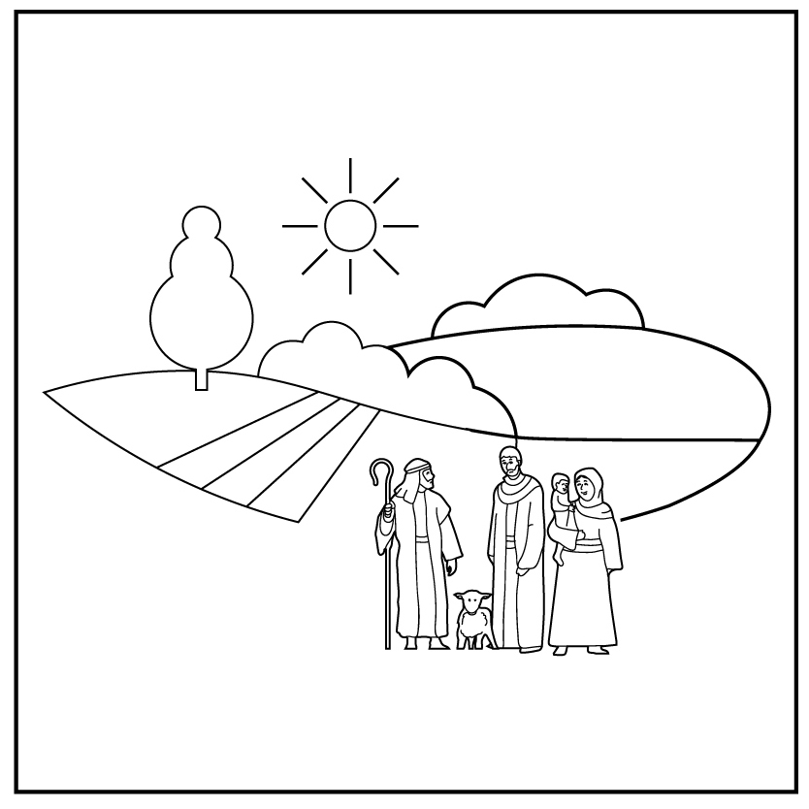
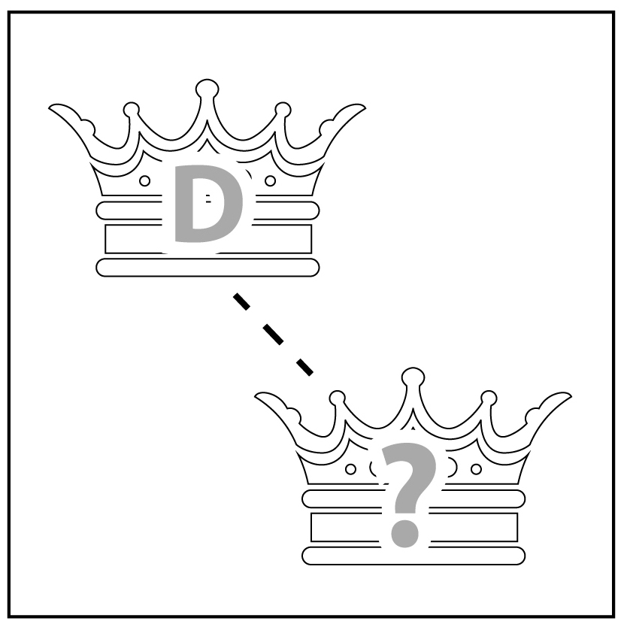
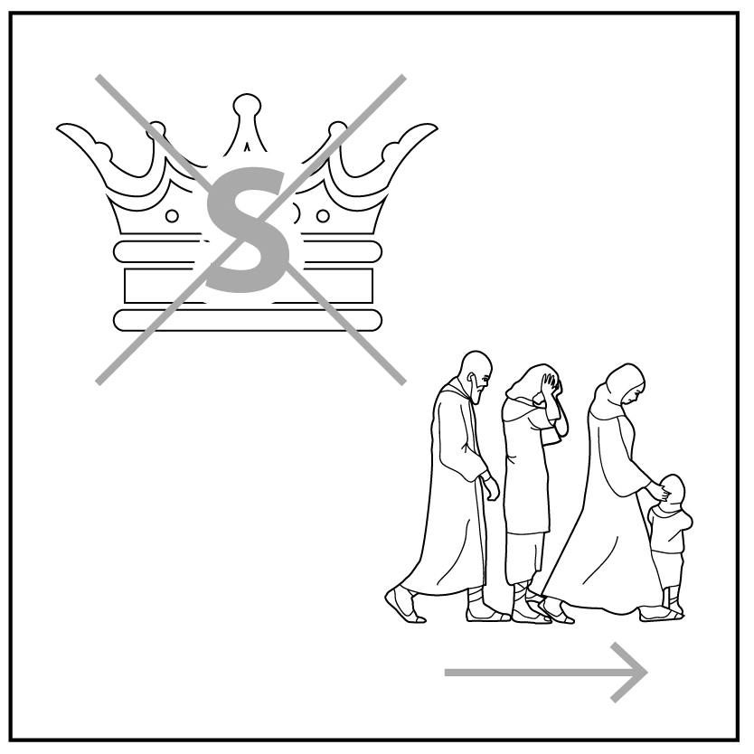


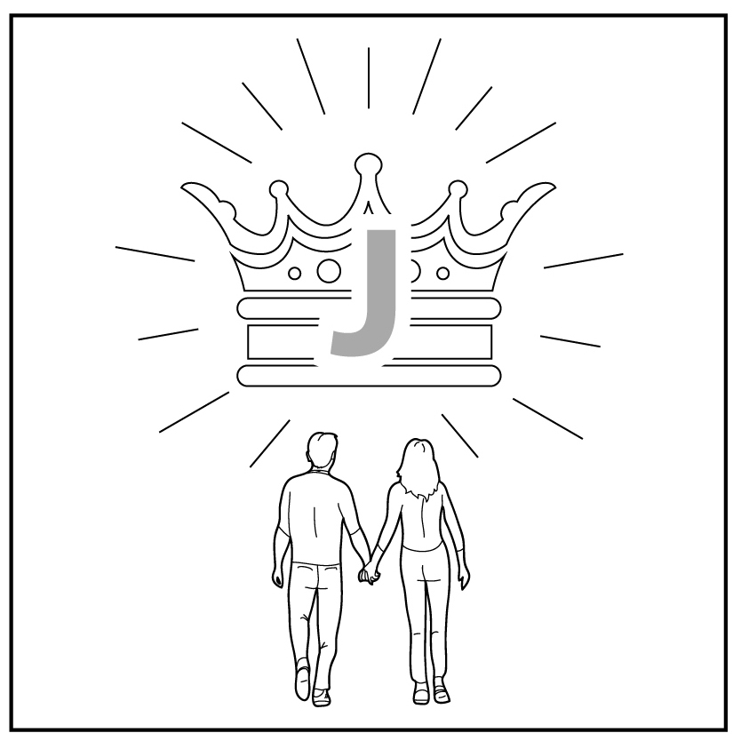
1
2
3
4a
4b
5
Creation
Rejection
Abraham
Egypt
Moses
King David
6
7
8
9
10
King Solomon
King Jesus
Jesus dies
Jesus raised
Notes:
Review previous lessons
[This slide contains the timeline with the icons from previous lessons inserted.]
Invite a volunteer to summarise the previous lessons as you point to each icon on the timeline. Prompt if necessary.
Icon 1: God made a good world, and he rules over it. God made people to be his friends and rule the world under him.
Icon 2: People rejected God’s rule and broke their friendship with him. God sent them out of the garden.
Icon 3: God chose a man and promised to bless his descendants with their own land under his rule. God promised to bless all people through them.
Icon 4a: Abram lived with his descendants in the land but during a famine they went to Egypt. After a long time, they became slaves in Egypt.
Icon 4b: God used Moses to rescue his people from slavery in Egypt and promised to give them their own land.
Icon 5: God gave the people a good king to rule them in their land. God promised that a descendant of King David would one day rule forever.
Icon 6: David’s son, King Solomon, disobeyed God. God took the kingdom from him and sent his people out of their land.
Icon 7: God’s promise to bless the world was fulfilled in King Jesus, a descendant of King David.
Icon 8: When Jesus died, he took our punishment for rejecting God so that we can be God’s friends instead of his enemies.
Icon 9: God raised Jesus from the dead and he rules forever. We can belong to Jesus’ kingdom by trusting and obeying him.

Slide 9
I am making everything new.
Notes:
Predict the content
Say ‘This is a statement from the Bible.’
Ask ‘Who do you think says this?’
Accept responses.
Ask ‘What do you think it means?’
Accept responses.

Slide 10
Revelation 21:1, 3–5a
I saw a new heaven and a new earth. The first heaven and the first earth were gone. I heard a loud voice from the throne. It said, ‘Look! God now makes his home with the people. He will live with them. They will be his people and he will be their God. He will wipe away every tear from their eyes. There will be no more death and no more sadness. There will be no more mourning or pain. The old way of things has finished.’ The one on the throne said, ‘I am making everything new!’ Then he said, ‘Write this down. You can trust these words. They are true.’
Revelation 21:1, 3–5a
I saw a new heaven and a new earth. The first heaven and the first earth were gone. I heard a loud voice from the throne. It said, ‘Look! God now makes his home with the people. He will live with them. They will be his people and he will be their God. He will wipe away every tear from their eyes. There will be no more death and no more sadness. There will be no more mourning or pain. The old way of things has finished.’ The one on the throne said, ‘I am making everything new!’ Then he said, ‘Write this down. You can trust these words. They are true.’
Notes:
Read and comprehend
(Optional: Invite students to read Revelation 21:1, 3–5a in their heart languages.)
[Slide contains RESOURCE 10.3 – Paraphrased Bible text. It will at first appear blank.]
Activity 1: Listen and describe
Say ‘The Bible text today is a vision that a man called John saw and wrote down.’
Invite students to close their eyes as you read the Bible text, and to imagine the place that is described.
Read the paraphrased Bible text aloud:
I saw a new heaven and a new earth. The first heaven and the first earth were gone. I heard a loud voice from the throne. It said, ‘Look! God now makes his home with the people. He will live with them. They will be his people and he will be their God. He will wipe away every tear from their eyes. There will be no more death and no more sadness. There will be no more mourning or pain. The old way of things has finished.’ The one on the throne said, ‘I am making everything new!’ Then he said, ‘Write this down. You can trust these words. They are true.’
Ask ‘What did you imagine as I read the text? What did you see in your mind?’
Accept responses and encourage discussion by asking questions.
Activity 2: Read and notice
Divide students into pairs.
Distribute RESOURCE 10.3 – Paraphrased Bible text to each student (if using).
Click to reveal the Bible text on the slide.
Invite students to read the passage aloud in their pairs, noting the word ‘will’ every time they read it.
Click to reveal the word ‘will’ in bold throughout the text on the slide.
Invite volunteers to read aloud the statements that include the word ‘will’.
Activity 3: Pair discussion
Say ‘If you could ask God questions about his new world, what would you ask him?’
Invite pairs to discuss this and share the questions they would have for God.

Slide 11
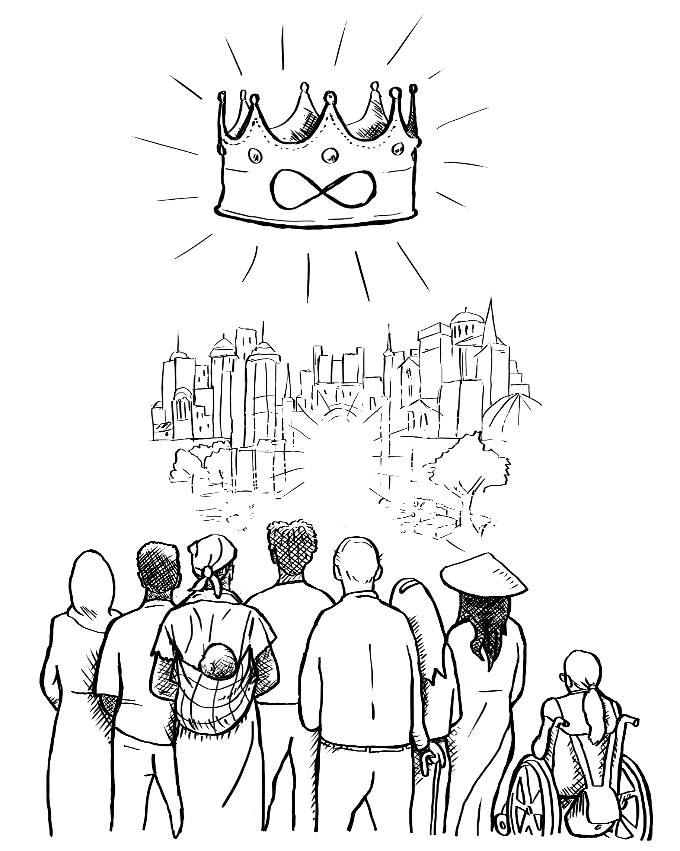
Notes:
Invite curiosity
[Slide contains RESOURCE 10.4 – Summary sketch. It will at first appear blank.]
Ask ‘Do you have any questions or comments about the story?’
Accept responses and discuss.
Student summary
Click to reveal the Summary sketch.
Invite a volunteer to summarise the Bible text in their own words.

Slide 12
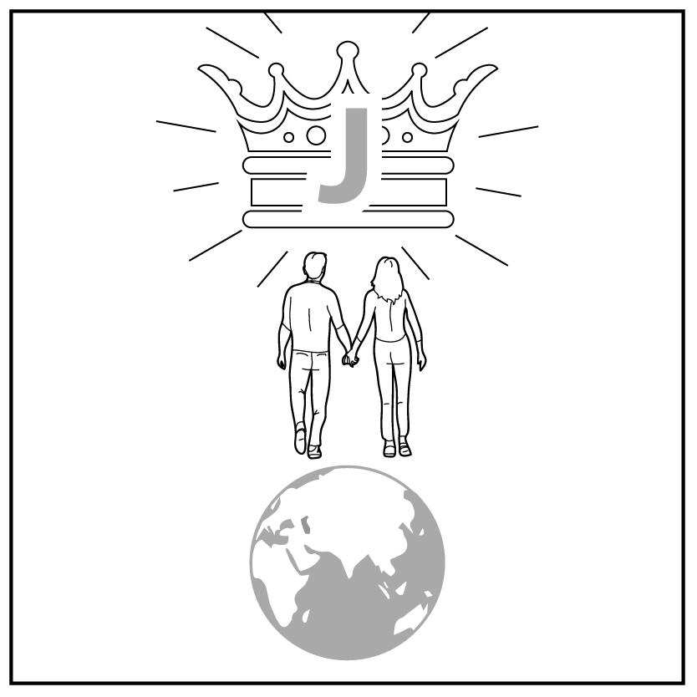
1
2
3
4a
4b
5
Creation
Rejection
Abraham
Egypt
Moses
King David
6
7
8
9
10
King Solomon
King Jesus
Jesus dies
Jesus raised
New creation
Notes:
Timeline and summary statement
[This slide at first contains the timeline with only the icons from the previous lessons already inserted.]
Click to reveal the icon for this lesson inserted in the timeline (RESOURCE 10.5 – Lesson 10 icon).
Say ‘Everyone who follows Jesus will live as friends with God, under his perfect rule in his new creation.’
An important question
Ask ‘What do you like most about this image of a new world?
Note: As this is the last lesson, you may wish to review the summary statements for the lesson series again.
Point to each icon and invite students to give a summary sentence. Prompt if necessary.
Icon 1: God made a good world, and he rules over it. God made people to be his friends and rule the world under him.
Icon 2: People rejected God’s rule and broke their friendship with him. God sent them out of the garden.
Icon 3: God chose a man and promised to bless his descendants with their own land under his rule. God promised to bless all people through them.
Icon 4a: Abram lived with his descendants in the land but during a famine they went to Egypt. After a long time, they became slaves in Egypt.
Icon 4b: God used Moses to rescue his people from slavery in Egypt and promised to give them their own land.
Icon 5: God gave the people a good king to rule them in their land. God promised that a descendant of King David would one day rule forever.
Icon 6: David’s son, King Solomon, disobeyed God. God took the kingdom from him and sent his people out of their land.
Icon 7: God’s promise to bless the world was fulfilled in King Jesus, a descendant of King David.
Icon 8: When Jesus died, he took our punishment for rejecting God so that we can be God’s friends instead of his enemies.
Icon 9: God raised Jesus from the dead and he rules forever. We can belong to Jesus’ kingdom by trusting and obeying him.
Icon 10: Everyone who follows Jesus will live as friends with God, under his perfect rule in his new creation.

