Slide 1
Lesson 7
Bible Overview
Ten Bible-based English lessons
Intermediate
Notes:
(Lesson 1 title page)

Slide 2
Lesson 7
PART 1
Great names in history
Notes:
(Part 1 title page)

Slide 3
great names in history
Notes:
Activate knowledge
[Slide will at first appear blank.]
Invite students to discuss the origin, meaning and significance of their names.
Focus on language
Click your mouse to reveal the ‘great names in history’ prompt on the slide.
Ask ‘Can you think of any great names in history?’
Write the names that students suggest in a list on the left side of the board (if using) until you have at least as many names on the board as students in your class. [Alternatively, if online, you could type the names into the chat function.]
Invite students to suggest what makes these people great and encourage discussion.
Ask ‘How many of these people are great because of the family they come from?’
Ask ‘How many of these people are great because of what they have done?’

Slide 4
What do all people, great or small,
have in common?
e.g. we were all babies,
we all make mistakes
Notes:
Undertake speaking tasks
[Slide will at first appear blank.]
Speaking task 1: Group sequencing
[This activity is not adapted for PowerPoint. If you cannot hand out strips, skip this activity and move to Speaking task 2 below.]
Distribute one blank strip to each student from RESOURCE 7.1 – Blank strips (if using).
Invite students to write one great name in history onto their strip.
Invite students to sequence the people from the greatest to the least as directed in the lesson book.
Speaking task 2: Pair discussion
Divide students into pairs.
Click your mouse to reveal the question for discussion on the slide.
Invite students to make a list with their partner of some things all people have in common.
Invite pairs to take turns sharing their lists with the class.

Slide 5
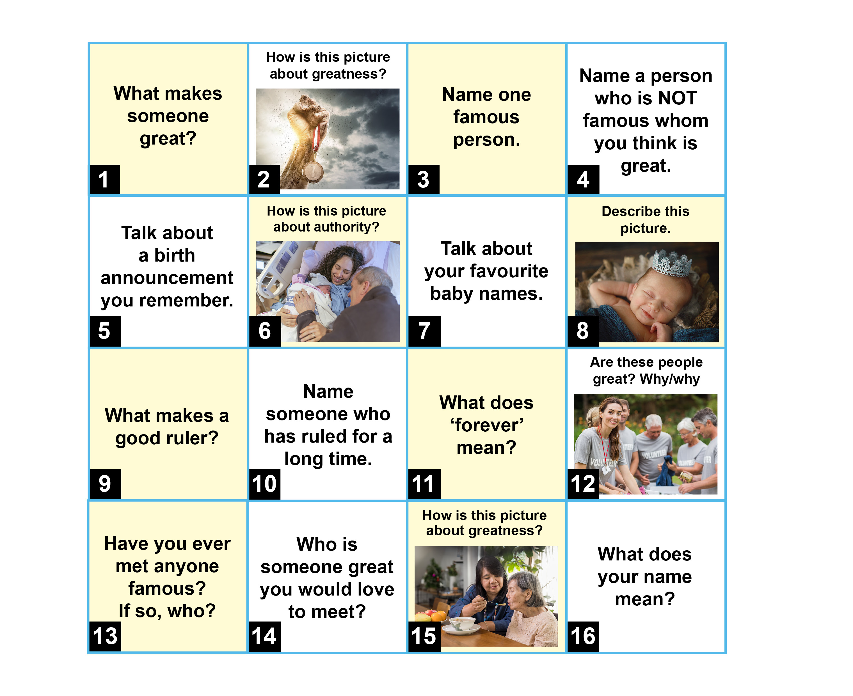
Notes:
Undertake speaking tasks (continued)
[Slide replaces RESOURCE 7.2 – Board game.]
Speaking task 3: Board game
[Note: This activity has been adapted for PowerPoint and is played differently from the board game in the lesson book. If you distribute RESOURCE 7.1 – Board game and play it in class, omit this PowerPoint activity.]
Divide students into small groups.
Distribute three dice to each group.
Invite students to play the game in their groups by taking turns to roll one, two or three dice, add up the total, and answer the question on the square with the corresponding number. (Alternatively, simply ask students to choose a square and answer the question on that square.)
Lead into Bible
Say ‘In our Bible time, God promises a baby who will be great because he will rule forever.’

Slide 6
Lesson 7
PART 2
The coming of God’s king
Luke 1:28–33
Notes:
(Part 2 title page)

Slide 7


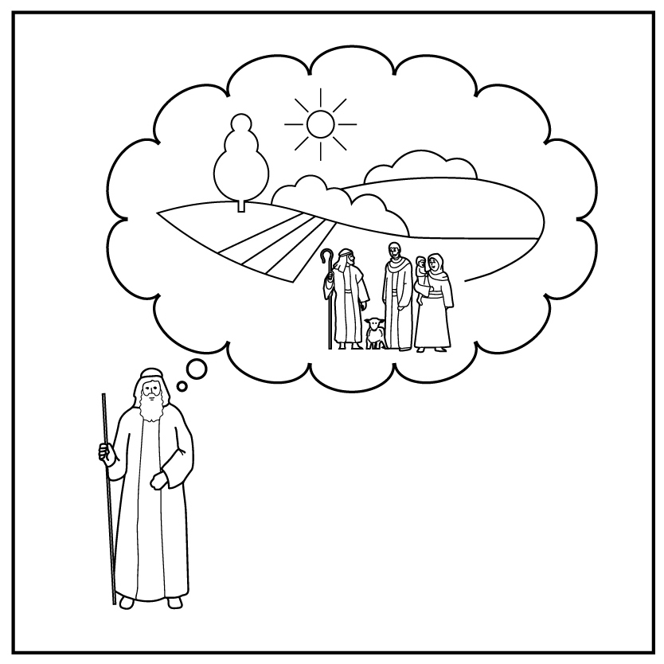
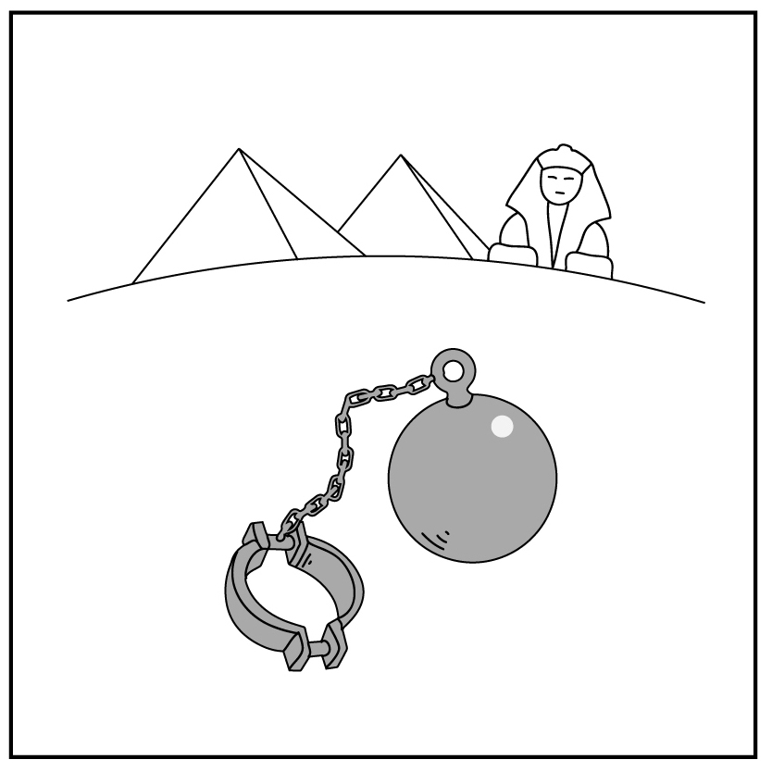
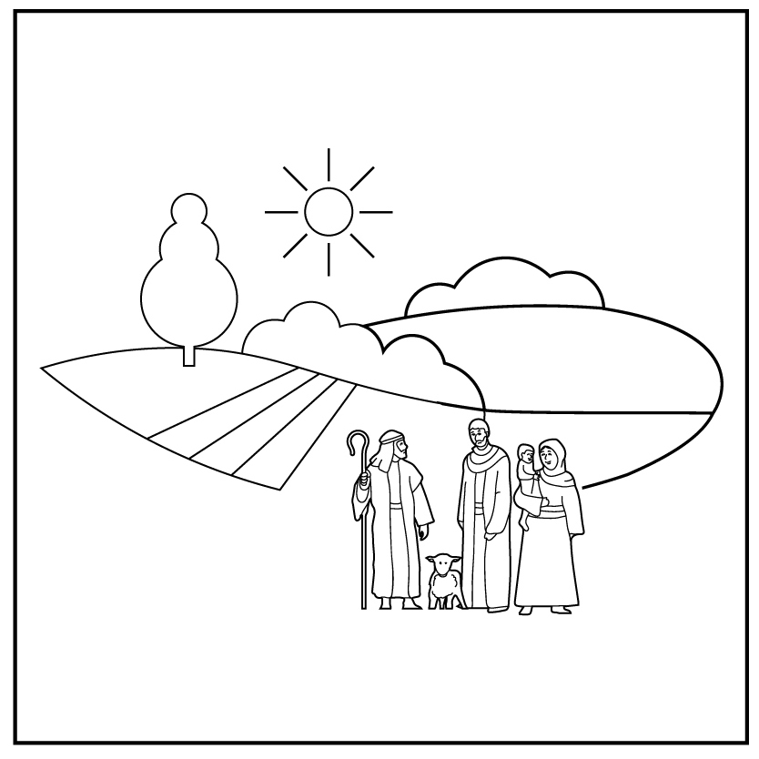
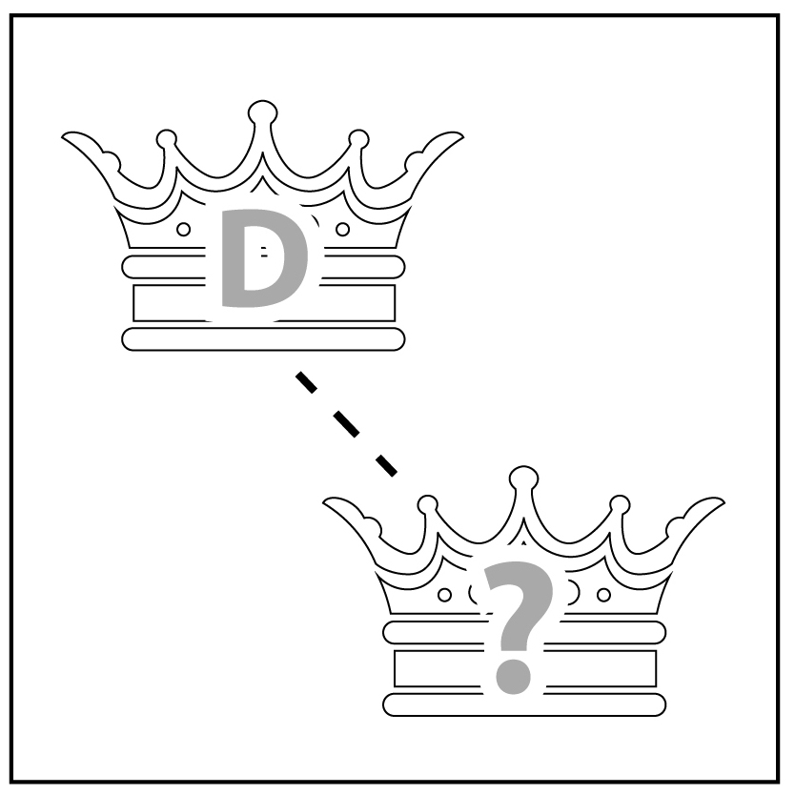
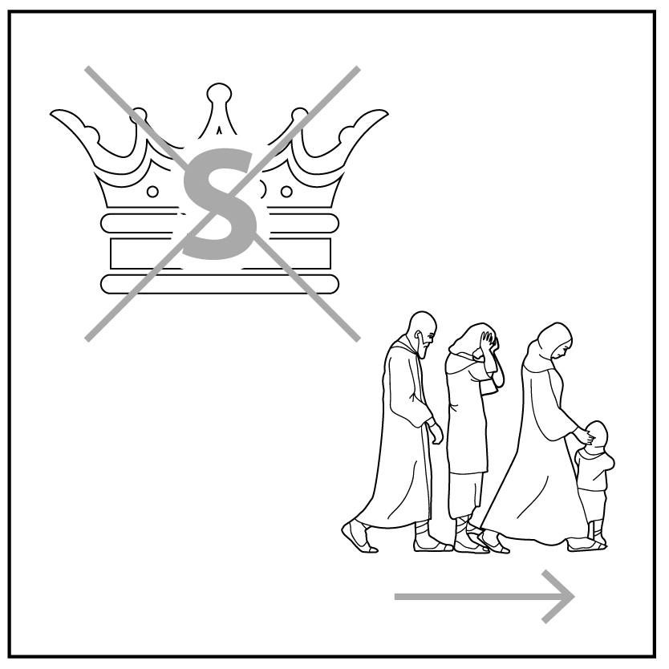
1
2
3
4a
4b
5
Creation
Rejection
Abraham
Egypt
Moses
King David
6
7
8
9
10
King Solomon
Notes:
Review previous lessons
[This slide contains the timeline with the icons from previous lessons inserted.]
Invite a volunteer to summarise the previous lessons as you point to each icon on the timeline. Prompt if necessary.
Icon 1: God made a good world, and he rules over it. God made people to be his friends and rule the world under him.
Icon 2: People rejected God’s rule and broke their friendship with him. God sent them out of the garden.
Icon 3: God chose a man and promised to bless his descendants with their own land under his rule. God promised to bless all people through them.
Icon 4a: Abram lived with his descendants in the land but during a famine they went to Egypt. After a long time, they became slaves in Egypt.
Icon 4b: God used Moses to rescue his people from slavery in Egypt and promised to give them their own land.
Icon 5: God gave the people a good king to rule them in their land. God promised that a descendant of King David would one day rule forever.
Icon 6: David’s son, King Solomon, disobeyed God. God took the kingdom from him and sent his people out of their land.

Slide 8
Mary
great
king
rule
son
forever
angel
afraid
Notes:
Predict the content
Read the words on the slide aloud.
Ask ‘What do you think the Bible story will be about?’
Encourage students to use as many of the words on the slide as possible in answer to this question.

Slide 9
Mary
The angel greeted­­­­ _______ and said, ‘The Lord has blessed you in a special way. He is with you.’
Mary was very upset by his words. She wondered what he meant.
But the angel said to her, ‘Do not be _______ , Mary. You will become pregnant and give birth to a son. You must call him _______ .
He will be _______ and will be called the Son of the Most High God.
God will make him a _______ like his father _______ from long ago.
He will rule _______ over his people. His kingdom will never ______.’
afraid
Jesus
great
king
David
forever
end
Notes:
Read and comprehend
(Optional: Invite students to read Luke 1:28–33 in their heart languages.)
Activity 1: Spoken gap-fill
Read the text on the slide slowly, pausing at each gap to prompt students to guess the missing content. Do not click to reveal answers until Activity 2 below is completed. Answers are provided below for your reference.
The angel greeted (pause) ­­­­_______ (Mary) and said, ‘The Lord has blessed you in a special way. He is with you.’
Mary was very upset by his words. She wondered what he meant. But the angel said to her, ‘Do not be (pause) _______ (afraid), Mary. You will become pregnant and give birth to a son. You must call him (pause) _______ (Jesus).
He will be (pause) _______ (great) and will be called the Son of the Most High God.
God will make him a (pause) _______ (king) like his father (pause) _______ (David) from long ago.
He will rule (pause) _______ (forever) over his people. His kingdom will never (pause) _______ (end).’
Activity 2: Written gap-fill
Distribute RESOURCE 7.3 – Gap-fill activity to each student (if using) and have students complete the activity as described in the lesson book.
Click your mouse to check the answers together one by one.
[Alternatively, if not using RESOURCE 7.3 – Gap-fill activity, read the text on the slide aloud, clicking to reveal the answers as you go.]
Invite students to note new words and phrases.
Clarify any new words and phrases.

Slide 10
Luke 1:28–33
The angel greeted Mary and said, ‘The Lord has blessed you in a special way. He is with you.’ Mary was very upset by his words. She wondered what he meant. But the angel said to her, ‘Do not be afraid, Mary. You will become pregnant and give birth to a son. You must call him Jesus. He will be great and will be called the Son of the Most High God. God will make him a king like his father David from long ago. He will rule forever over his people. His kingdom will never end.’
Notes:
Read and comprehend (continued)
[Slide contains RESOURCE 7.4 – Paraphrased Bible text.]
Activity 3: True or false
Distribute RESOURCE 7.4 – Paraphrased Bible text to each student (if using).
Invite students to read the text quietly to themselves.
Say the following statements, inviting students to respond with a thumbs up or thumbs down:
‘Mary was excited when the angel greeted her.’ (F – she was very upset)
‘Mary understood what the angel was saying.’ (F – Mary wondered what he meant)
‘The angel told Mary to fear God.’ (F – the angel said, ‘Do not be afraid’)
‘The angel told Mary she would have a son.’ (T)
‘The angel told Mary what her son’s name would be.’ (T – Jesus)
‘The angel told Mary that her son would also be God’s son.’ (T – Son of the Most High God)
‘The angel said that God would make her son a carpenter like Joseph.’ (F – make him a king)
‘Mary’s son will rule forever.’ (T)
‘His kingdom will never end.’ (T)

Slide 11
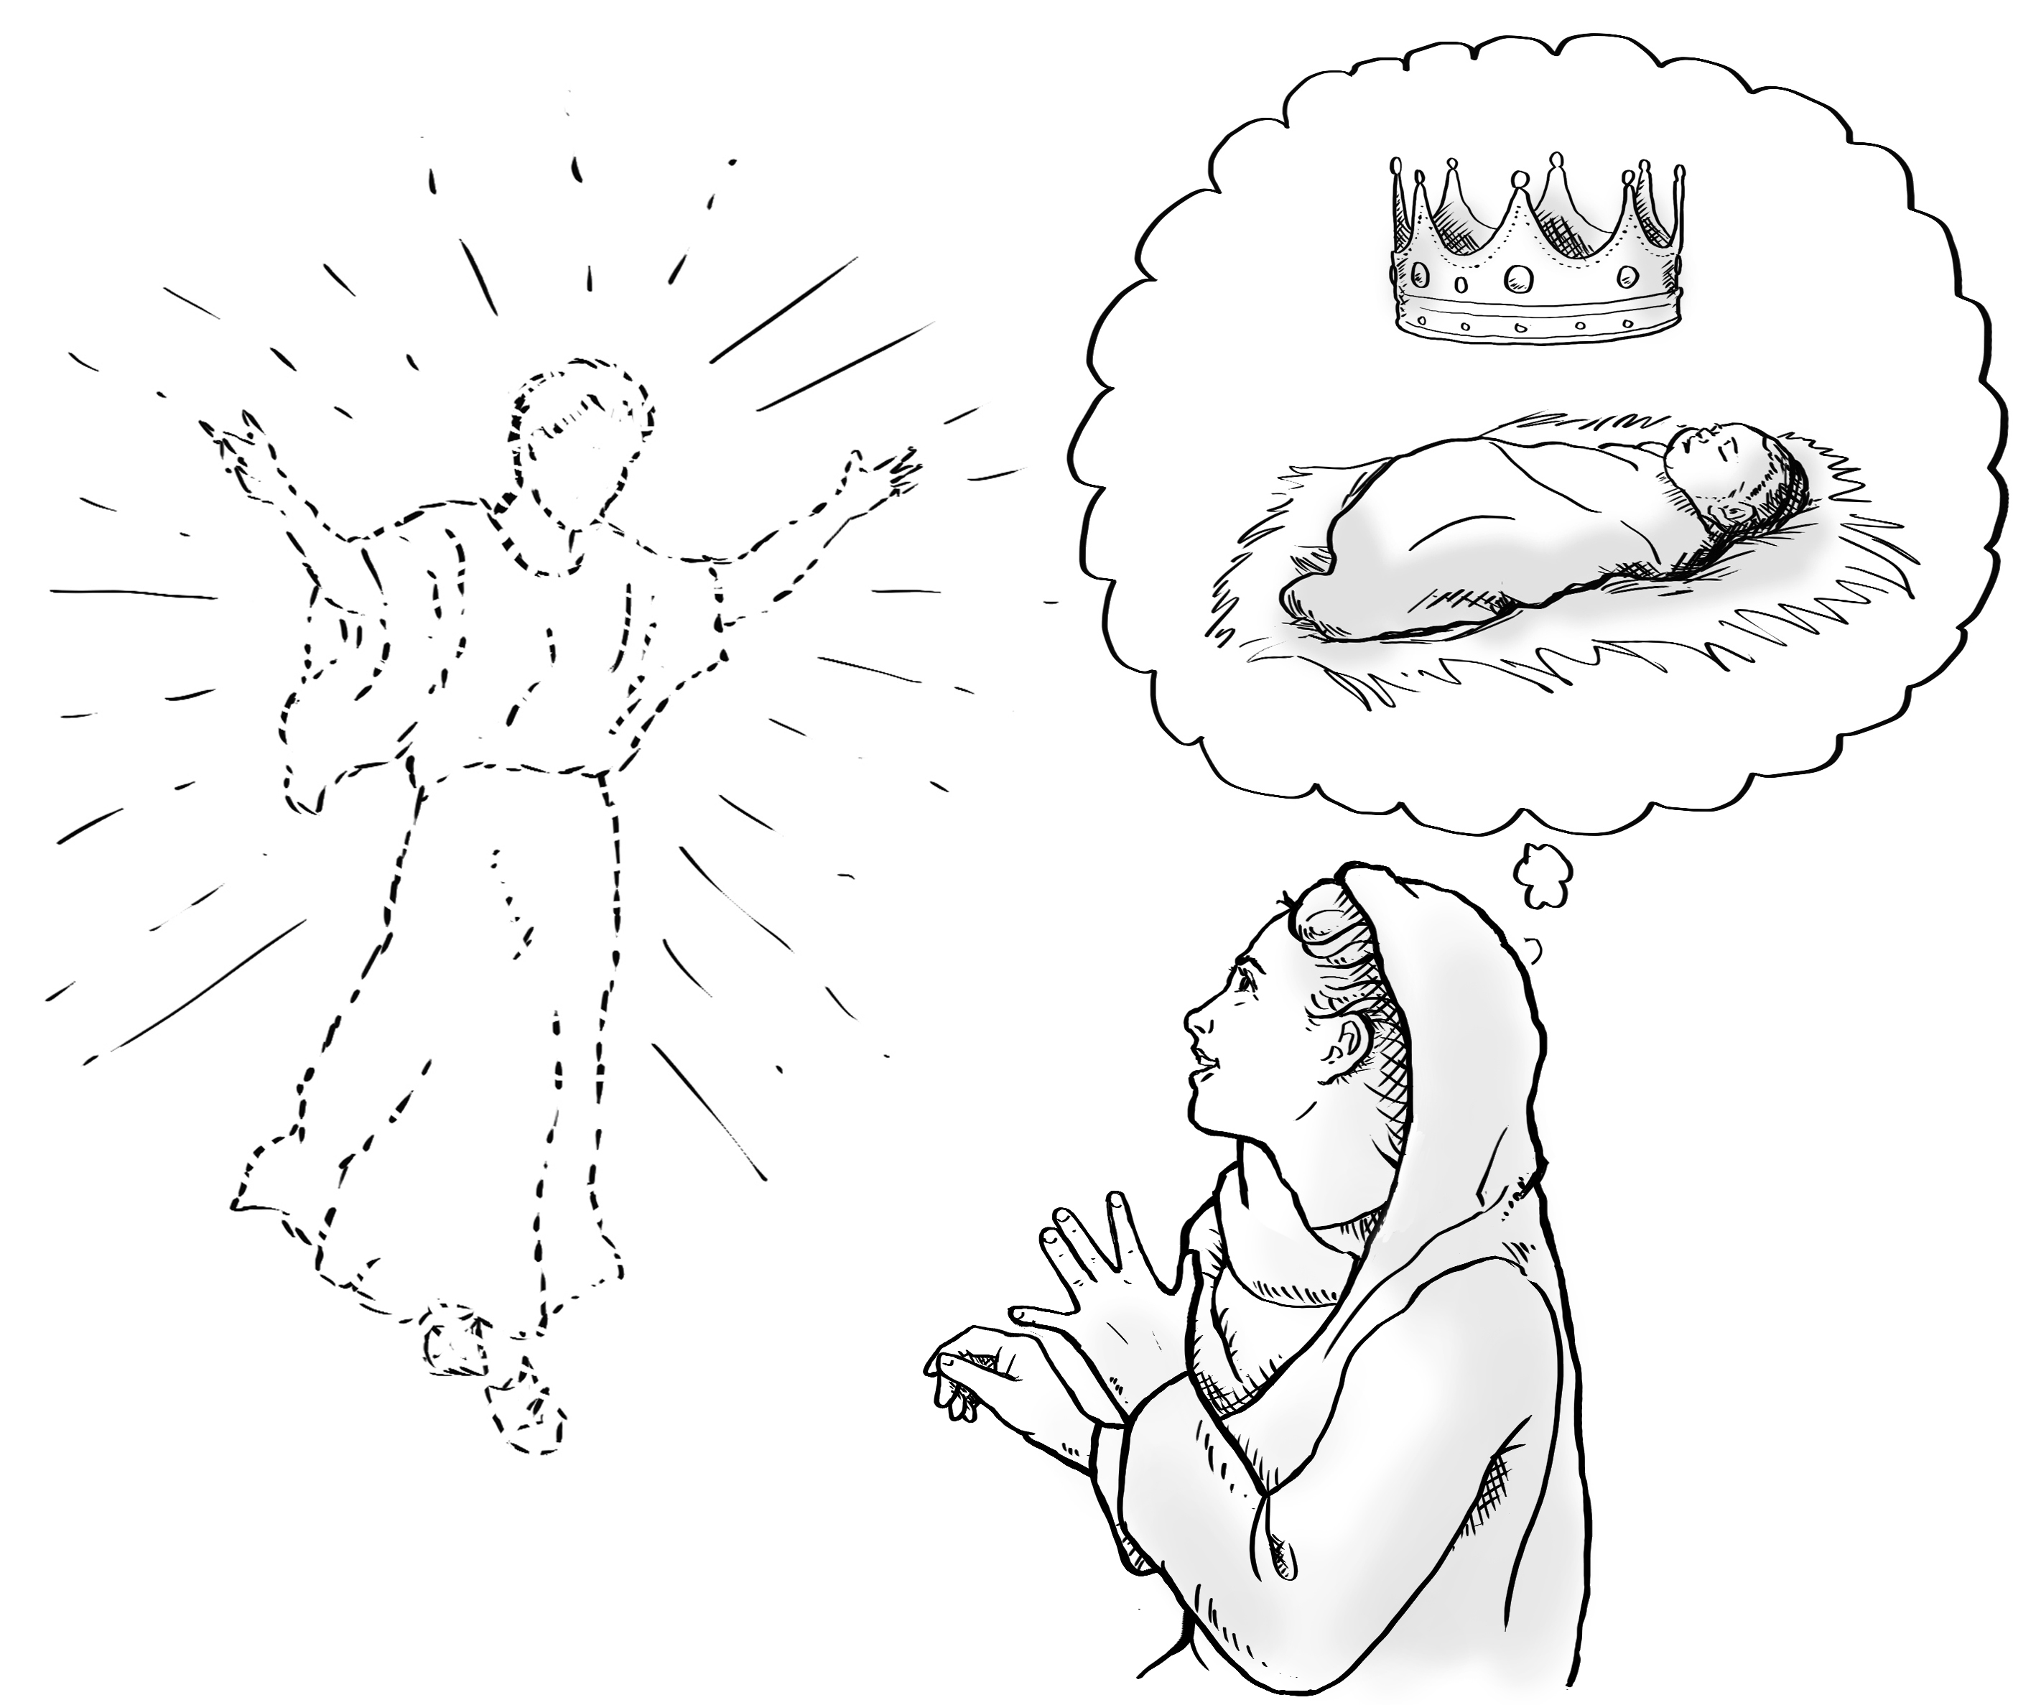
Notes:
Invite curiosity
[Slide contains RESOURCE 7.5 – Summary sketch. It will at first appear blank.]
Ask ‘Do you have any questions or comments about the story?’
Accept responses and discuss.
Student summary
Click to reveal the Summary sketch.
Invite a volunteer to summarise the Bible text in their own words.

Slide 12

1
2
3
4a
4b
5
Creation
Rejection
Abraham
Egypt
Moses
King David
6
7
8
9
10
King Solomon
King Jesus
Notes:
Timeline and summary statement
[This slide at first contains the timeline with only the icons from the previous lessons already inserted.]
Click to reveal the icon for this lesson inserted in the timeline (RESOURCE 7.6 – Lesson 7 icon).
Say ‘God’s promise to bless the world was fulfilled in King Jesus, a descendant of King David.’
An important question
Ask ‘How will God bless the world through Jesus?’

