Slide 1
Lesson 5
Bible Overview
Ten Bible-based English lessons
Intermediate
Notes:
(Lesson 1 title page)

Slide 2
Lesson 5
PART 1
Royalty
Notes:
(Part 1 title page)

Slide 3
Who is the leader of your home country?
What are three words to describe the leader of your country?
Does your home country have a king or a queen?
Notes:
Activate knowledge
[Slide replaces RESOURCE 5.1 – Student questionnaire.]
Divide students into pairs.
Invite students to ask each other the questions on the slide.
Invite students to share with the class what they learnt from their partners.

Slide 4
someone with authority over a group of people
people from a past generation in your family
people born after you in your family
a place ruled by a king or queen
ruler
ancestors
descendants
kingdom
Notes:
Focus on language
Invite the class to work together to define the four words on the slide.
Click to reveal the definitions one at a time.

Slide 5
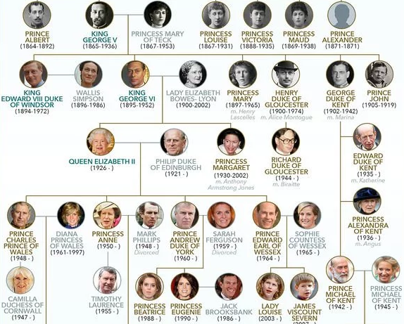
Notes:
Focus on language (continued)
[Slide contains a section of RESOURCE 5.2 – Royal family tree.]
Ask the following questions and allow time for students to respond:
‘When was Queen Elizabeth II born?’ (1926)
‘Name one of Queen Elizabeth’s ancestors.’ (accept multiple responses)
‘Name one of Queen Elizabeth’s descendants.’ (accept multiple responses)
‘Who was king before Queen Elizabeth?’ (King George VI)
‘When did he die?’ (1952)
‘Who are Queen Elizabeth’s children?’ (Prince Charles, Princess Anne, Prince Andrew, Prince Edward)

Slide 6
I see…
I think…
I wonder…
Notes:
Undertake speaking tasks
Speaking task 1: See, think, wonder
Demonstrate three sentences about the family tree. For example:
‘I see that Queen Elizabeth was born in 1926.’ (observation)
‘I think that Queen Victoria had a lot of children.’ (opinion)
‘I wonder how old Prince Charles will be if he becomes king.’ (question)
Invite students to look again at the family tree, and talk with the people around them about what they see, think and wonder (i.e. one observation, one opinion and one question).
Speaking task 2: Asking questions in pairs
Divide students into pairs.
Invite students to think of their own questions about the family tree and ask each other.

Slide 7
twice | her passport | Greek and Danish
Duke of Edinburgh | Cambridge University | ‘Your Majesty’ or ‘Ma’am’
vote | French | a truck driver and mechanic
Notes:
Undertake speaking tasks (continued)
[Slide replaces RESOURCE 5.3.1 – Royalty facts: answers and RESOURCE 5.3.1 – Royalty facts: question strips.]
Speaking task 3: Discussion about different rulers and their roles
Say ‘These are answers to questions about the British Monarchy. I will read the questions. Can you choose the correct answer?’
Read the questions/statements below, inviting students to choose the correct answer after each.
Define words and concepts as you go.
When she was 18, what was Elizabeth trained as in the Armed Services?
Where did Prince Charles study history?
What was the title of Queen Elizabeth’s husband?
The royal family are not allowed to do this.
What was Prince Philip’s ethnic background?
How many times a year does Queen Elizabeth celebrate her birthday?
How must the Queen be addressed?
The Queen of England never has to show this when she travels.
What language apart from English can Queen Elizabeth speak?
Lead into Bible
Say ‘Our Bible time is about a king and his descendant.’

Slide 8
Lesson 5
PART 2
A king for God’s people
2 Samuel 7:8–13
Notes:
(Part 2 title page)

Slide 9


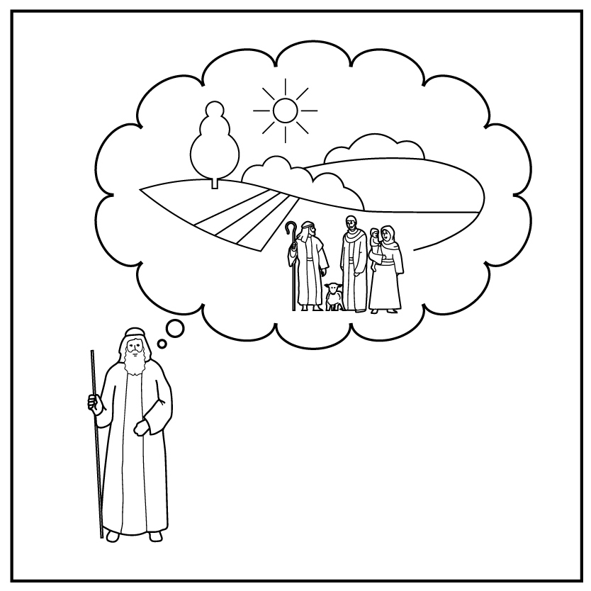
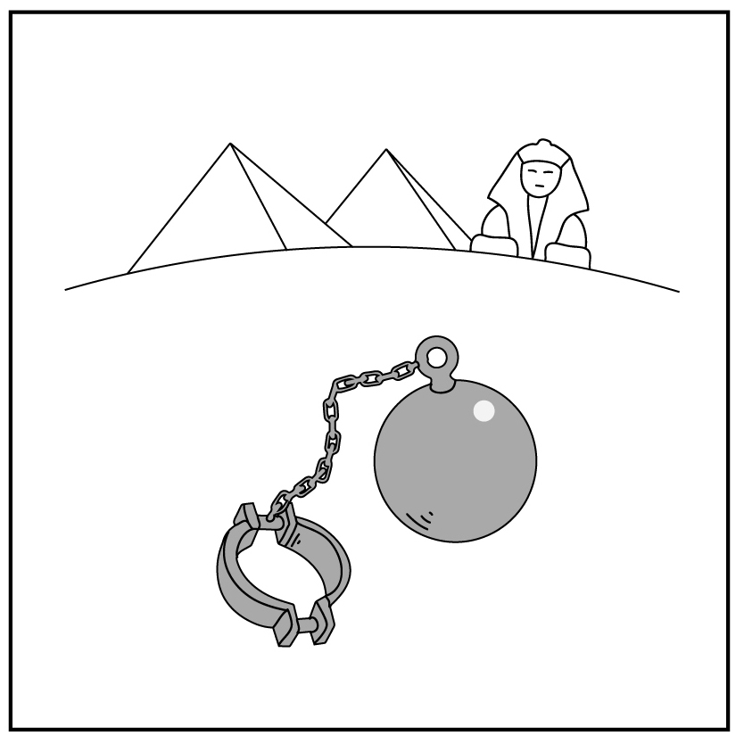
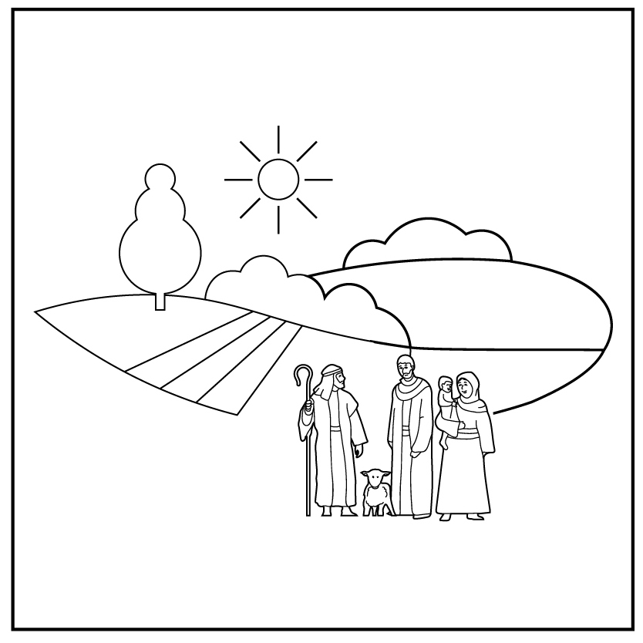
1
2
3
4a
4b
5
Creation
Rejection
Abraham
Egypt
Moses
6
7
8
9
10
Notes:
Review previous lessons
[Slide contains the timeline with the icons from previous lessons inserted.]
Invite a volunteer to summarise the previous lessons as you point to each icon on the timeline. Prompt if necessary.
Icon 1: God made a good world, and he rules over it. God made people to be his friends and rule the world under him.
Icon 2: People rejected God’s rule and broke their friendship with him. God sent them out of the garden.
Icon 3: God chose a man and promised to bless his descendants with their own land under his rule. God promised to bless all people through them.
Icon 4a: Abram lived with his descendants in the land but during a famine they went to Egypt. After a long time, they became slaves in Egypt.
Icon 4b: God used Moses to rescue his people from slavery in Egypt and promised to give them their own land.

Slide 10
The Lord said to a D v i d ‘I made you ruler over Israel.’
The Lord said to David ‘I made you ruler over Israel.’
I will give my people a place to live. I will put them in the land.
I will give my people a e p a c l to live. I will put them in the d n l a.
One day you will join your a c s e n t s r o who have e d i d.
One day you will join your ancestors who have died.
I will make one of your d s n c e t d a n e s king after you. I will establish his kingdom f e r o r v e.
I will make one of your descendants king after you.
I will establish his kingdom forever.
Notes:
Predict the content
Say ‘Today we learn about the king who God gave to his people’.
Ask ‘Who do you think God was talking to?’
Accept responses, prompting if necessary.
Click your mouse to reveal the unscrambled word (David).
Click your mouse again to reveal the next sentence with scrambled words in red.
Invite students to unscramble the red letters, prompting if necessary.
Repeat until all sentences have been revealed and all words unscrambled. Answers follow:
place; land
ancestors; died
descendants; forever

Slide 11
2 Samuel 7:8–13
Tell my servant David, ‘The Lord says, I made you ruler over Israel. I have been with you everywhere. I have destroyed your enemies. Now I will make your name great. I will give my people a place to live. I will put them in the land. They will have a home of their own. Their enemies will not persecute them anymore. One day your life will end, and you will join your ancestors who have died. Then I will make one of your descendants king after you. I will establish his kingdom forever.’
2 Samuel 7:8–13
Tell my servant David, ‘The Lord says, I made you ruler over Israel. I have been with you everywhere. I have destroyed your enemies. Now I will make your name great. I will give my people a place to live. I will put them in the land. They will have a home of their own. Their enemies will not persecute them anymore. One day your life will end, and you will join your ancestors who have died. Then I will make one of your descendants king after you. I will establish his kingdom forever.’
Notes:
Read and comprehend
(Optional: Invite students to read 2 Samuel 7:8–13 in their heart languages.)
[Slide contains RESOURCE 5.4 – Paraphrased Bible text.]
Activity 1: Read text
Distribute RESOURCE 5.4 – Paraphrased Bible text to each student (if using).
Read the text aloud, inviting students to read along and put their hands up every time they hear the word ‘will’.
Click to make the word ‘will’ bold throughout the text.
Invite students to read aloud the sentences in the text containing the word ‘will’.
Say ‘We use the word “will” in promises. God is making promises to David.’
Discuss the meaning of these promises as a class.
Activity 2: Remembering God’s promises
Say ‘Remember the promises God made to Abram. He promised to:
bless Abram’s descendants
give Abram’s descendants their own land
bless all people through them.’
Ask ‘How many of these promises are in this passage?’
Accept responses.
Ask ‘How can a kingdom last forever?’
Accept responses.
[The following activity is not adapted for PowerPoint. You may choose to do this activity if face-to-face. If not, skip the activity and move to the next slide.]
Activity 3: Pictionary
Invite students to play Pictionary as a class or in small groups. (Choose from the following words to give different students to draw for the group: King David, land, enemies, ancestors, descendants, king, kingdom, forever.)

Slide 12
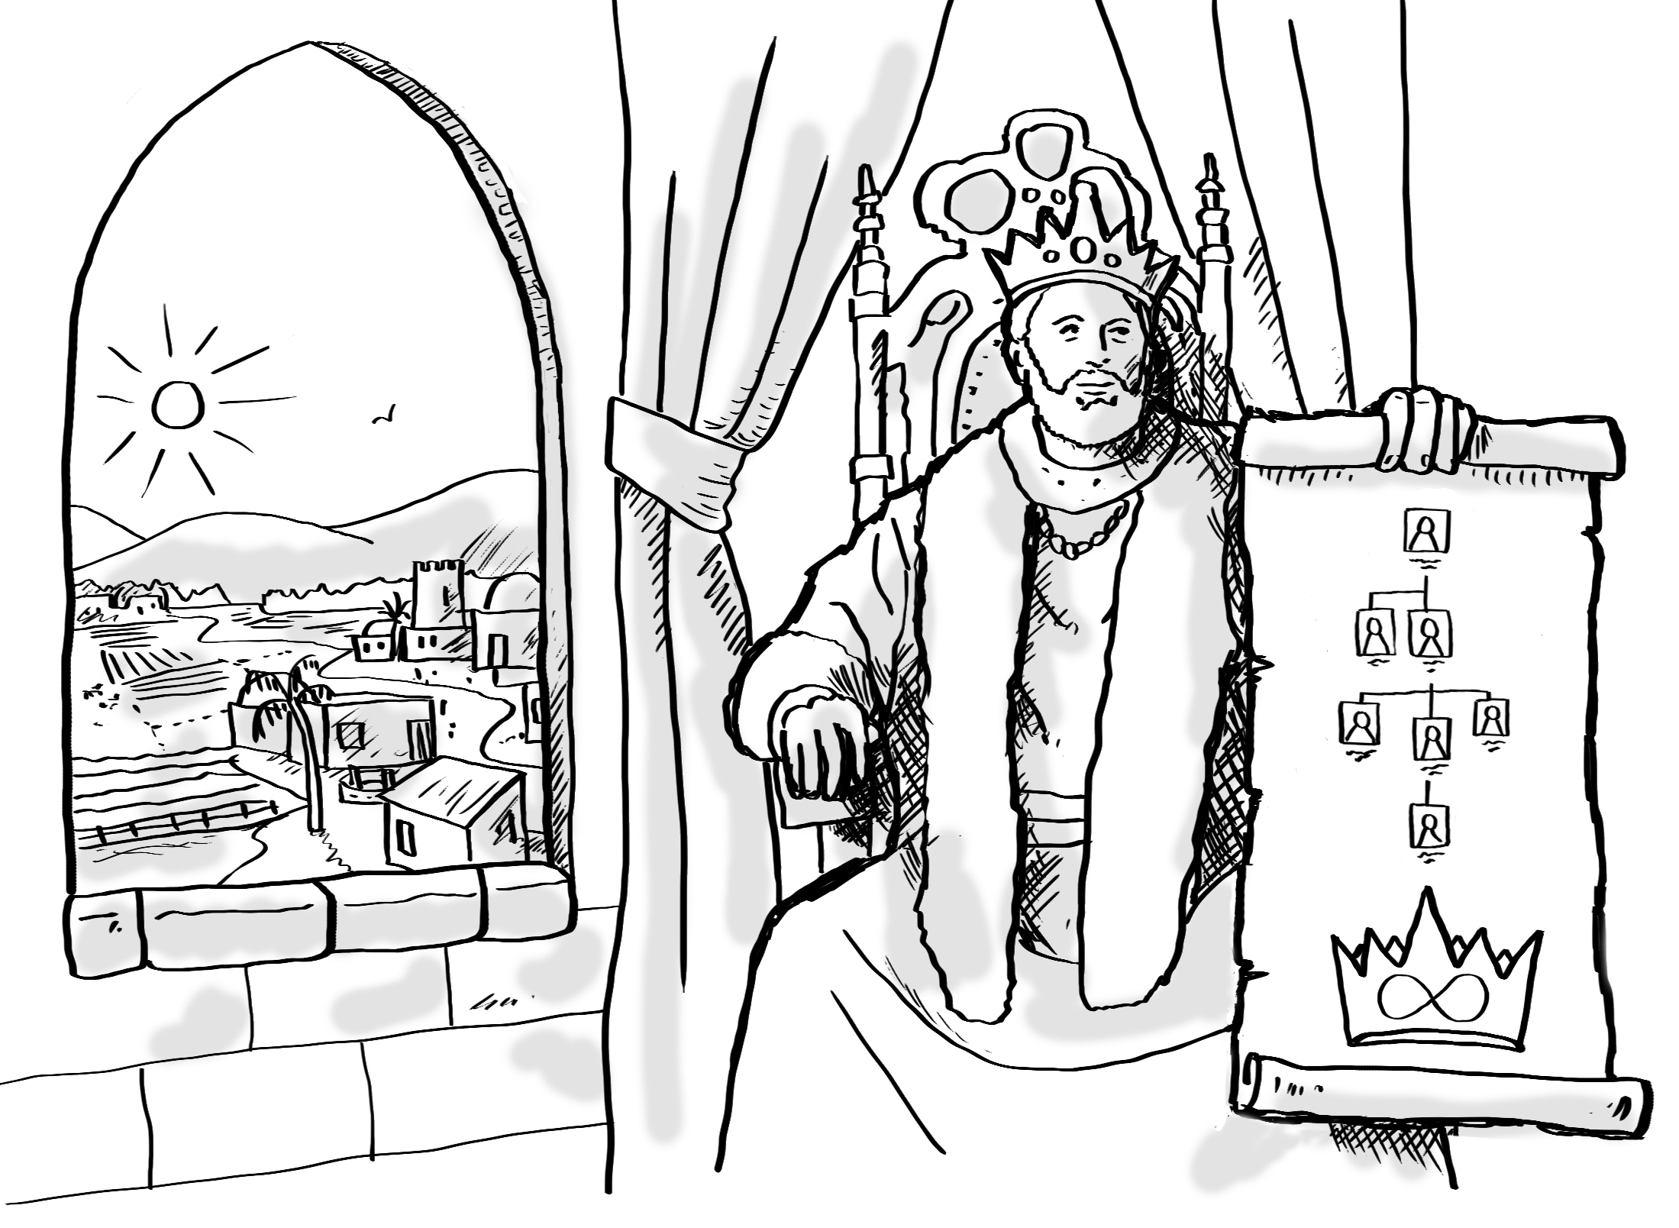
Notes:
Invite curiosity
[Slide contains RESOURCE 5.5 – Summary sketch. It will at first appear blank.]
Ask ‘Do you have any questions or comments about the story?’
Accept responses and discuss.
Student summary
Click to reveal the Summary sketch.
Invite a volunteer to summarise the Bible text in their own words.

Slide 13
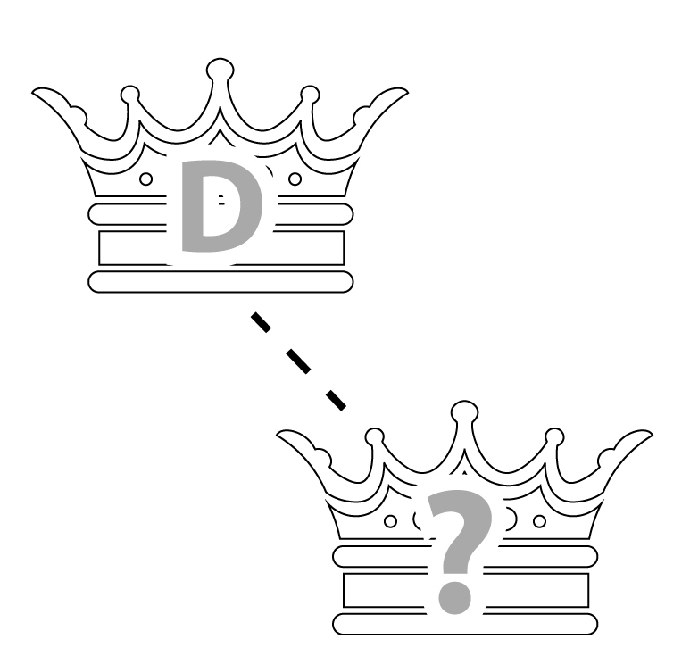
1
2
3
4a
4b
5
Creation
Rejection
Abraham
Egypt
Moses
King David
6
7
8
9
10
Notes:
Timeline and summary statement
[This slide at first contains the timeline with only the icons from the previous lessons already inserted.]
Click to reveal the icon for this lesson inserted in the timeline (RESOURCE 5.6 – Lesson 5 icon).
Say ‘God gave the people a good king to rule them in their land. God promised that a descendant of King David would one day rule forever.’
An important question
Ask ‘Who will this descendant be?’

