Slide 1
Lesson 3
Bible Overview
Ten Bible-based English lessons
Intermediate
Notes:
(Lesson 1 title page)

Slide 2
Lesson 3
PART 1
Journey to a new land
Notes:
(Part 1 title page)

Slide 3
Moving to a new country
Notes:
Activate knowledge
Invite volunteers to share about their decision to move from their home country.
(Note: Don’t name specific students. Not everyone will be ready to share about this.)
Ask ‘What did you know about Australia before you came?’

Slide 4
One night Sing and his father were outside looking at the stars. Sing’s father told him that tomorrow their family would leave their home and travel to a new place. They would say goodbye to friends and family because they would be going to a new land in a new country.
Sing felt uncertain, but his father told him to be brave. He said, ‘I will be with you, and I will show you where to go. We will travel together. One day this new land will be a blessing to our family, and we will also be a blessing to it.’
So that night, Sing and his family packed their most important possessions ready to travel from their home to a new land. Sing was nervous, but he loved and trusted his father, so he tried to be brave.
Notes:
Focus on language
[Slide contains RESOURCE 3.1 – Text: moving to a new country. Note: It will at first appear blank. Do not click to reveal the text until you are instructed to do so below.]
Say ‘I am going to read a story about someone who is moving to a new country. I will read it twice.’
Invite students to listen the first time and take notes as they listen again.
Read the following text aloud twice:
One night Sing and his father were outside looking at the stars. Sing’s father told him that tomorrow their family would leave their home and travel to a new place. They would say goodbye to friends and family because they would be going to a new land in a new country. Sing felt uncertain, but his father told him to be brave. He said, ‘I will be with you, and I will show you where to go. We will travel together. One day this new land will be a blessing to our family, and we will also be a blessing to it.’ So that night, Sing and his family packed their most important possessions ready to travel from their home to a new land. Sing was nervous, but he loved and trusted his father, so he tried to be brave.
Divide students into small groups.
Invite groups to work together to write a summary of the story.
Invite one group to read their summary aloud.
Invite others to add details and correct any content.
Click to reveal the text on the slide.
Invite students to read the text and note any new words.
Define new words as a class.
Brainstorm synonyms for the following words together as a class:
goodbye
possessions
blessings

Slide 5
One night Sing and his father were outside looking at the stars. Sing’s father told him that tomorrow their family would leave their home and travel to a new place. They would say goodbye to friends and family because they would be going to a new land in a new country.
Sing felt uncertain, but his father told him to be brave. He said, ‘I will be with you, and I will show you where to go. We will travel together. One day this new land will be a blessing to our family, and we will also be a blessing to it.’
So that night, Sing and his family packed their most important possessions ready to travel from their home to a new land. Sing was nervous, but he loved and trusted his father, so he tried to be brave.
1. questions
2. emotions
3. help to be brave
Notes:
Undertake speaking tasks
[Slide contains RESOURCE 3.1 – Text: moving to a new country.]
Speaking task 1: Brainstorming in groups
Divide students into three groups.
Click to reveal ‘1. questions’ on the slide.
Ask ‘What questions do you think Sing had about his new country?’
Invite group 1 to brainstorm some questions.
Click to reveal ‘2. emotions’ on the slide.
Say ‘Sing felt uncertain and nervous. What are some other emotions he might have felt?’
Invite group 2 to brainstorm the emotions people feel when they are moving to a new country.
Click to reveal ‘3. help to be brave’ on the slide.
Say ‘Sing’s father told him to be brave. What helps people to be brave when they are planning to move to a new country?’
Invite group 3 to brainstorm things that help people to be brave.
Allow time for groups to brainstorm and make notes.
Invite each group to share their answers with the class.
Invite the other groups to add to the answers given.

Slide 6
Name | Ping | Mahnaz | Lily
Age | 23 |  | 42
Lives with |  |  | Her husband and 2 children
Comes from |  | Iran
Came to Australia in | February 2020 |  | September 2010
Experience in |  | sales
Speaks | Mandarin and Cantonese |  | Vietnamese and French
63
Her 2 daughters
His 2 brothers
China
Vietnam
July 2003
hospitality
administration
Farsi
Notes:
Undertake speaking tasks (continued)
[Slide contains Part A of RESOURCE 3.2 – Three travellers information gap activity. If you are not able to distribute Part B of this resource, skip this activity and move to the next slide.]
Speaking task 2: Information gap activity
Distribute a copy of Part B of RESOURCE 3.2 – Three travellers information gap activity to each student (if using).
Ask specific students questions about the missing information (working cell by cell down each column, from left to right); e.g. ‘Who does Ping lived with?’
Accept responses and click to reveal the answer each time.

Slide 7
What did you notice when you
first came to Australia?
How did you feel when you
first came to Australia?
What have you learnt about Australia?
Notes:
Undertake speaking tasks (continued)
Speaking task 3: Sharing stories
Divide students into pairs.
Invite pairs to ask each other the questions on the slide.
Lead into Bible
Say ‘Our Bible time is about a man who is told to leave his country and take his family to a new land.’

Slide 8
Lesson 3
PART 2
God makes promises to Abram
Genesis 12:1–5
Notes:
(Part 2 title page)

Slide 9


1
2
3
4a
4b
5
Creation
Rejection
6
7
8
9
10
Notes:
Review previous lesson
[This slide contains the timeline with the icons from the previous lessons inserted.]
Invite a volunteer to summarise the previous lessons as you point to each icon on the timeline. Prompt if necessary.
Icon 1: God made a good world, and he rules over it. God made people to be his friends and rule the world under him.
Icon 2: People rejected God’s rule and broke their friendship with him. God sent them out of the garden.

Slide 10
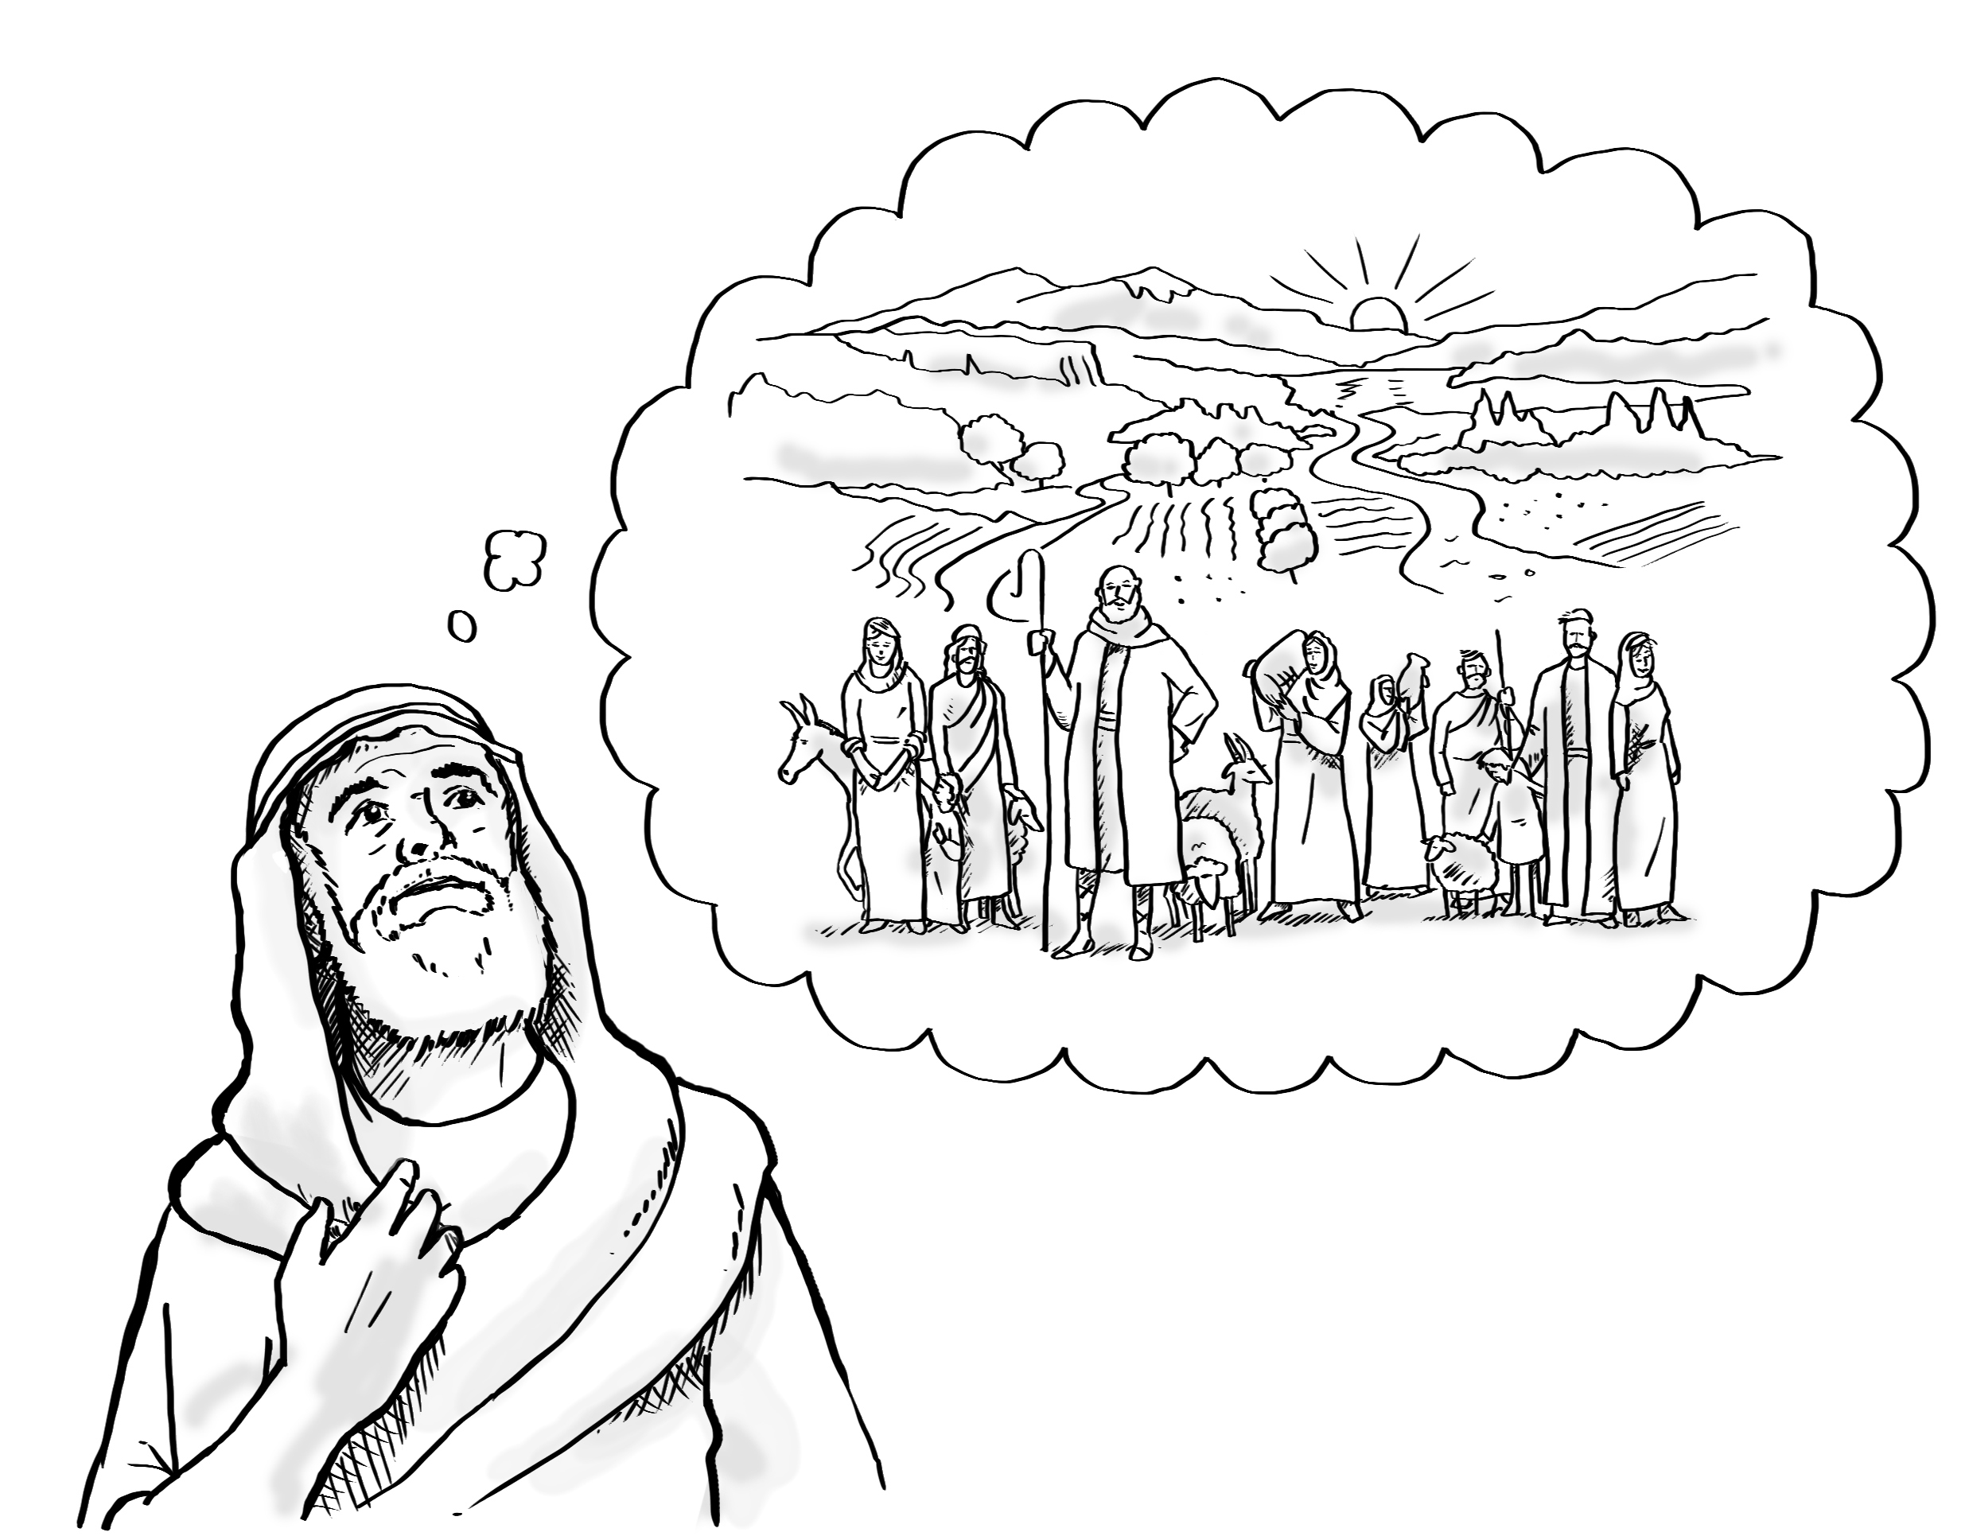
Notes:
Predict the content
[Slide contains RESOURCE 3.3 – Summary sketch.]
Ask ‘What do you think will happen in this Bible story?’
Accept responses.

Slide 11
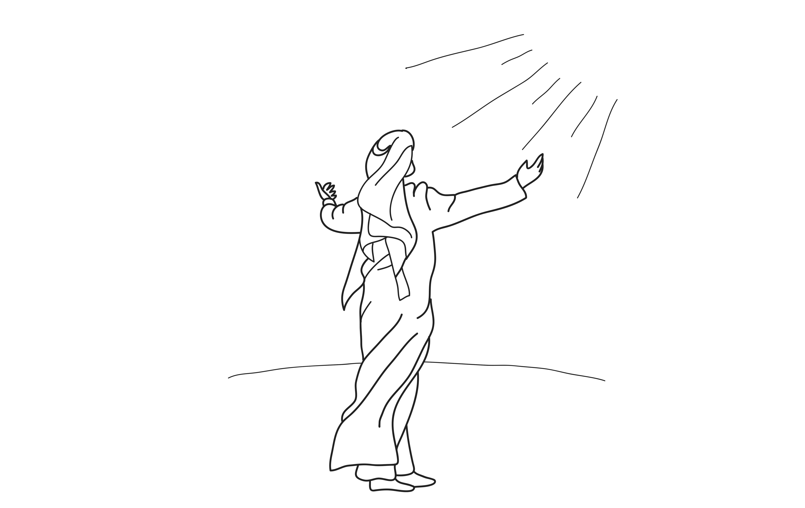
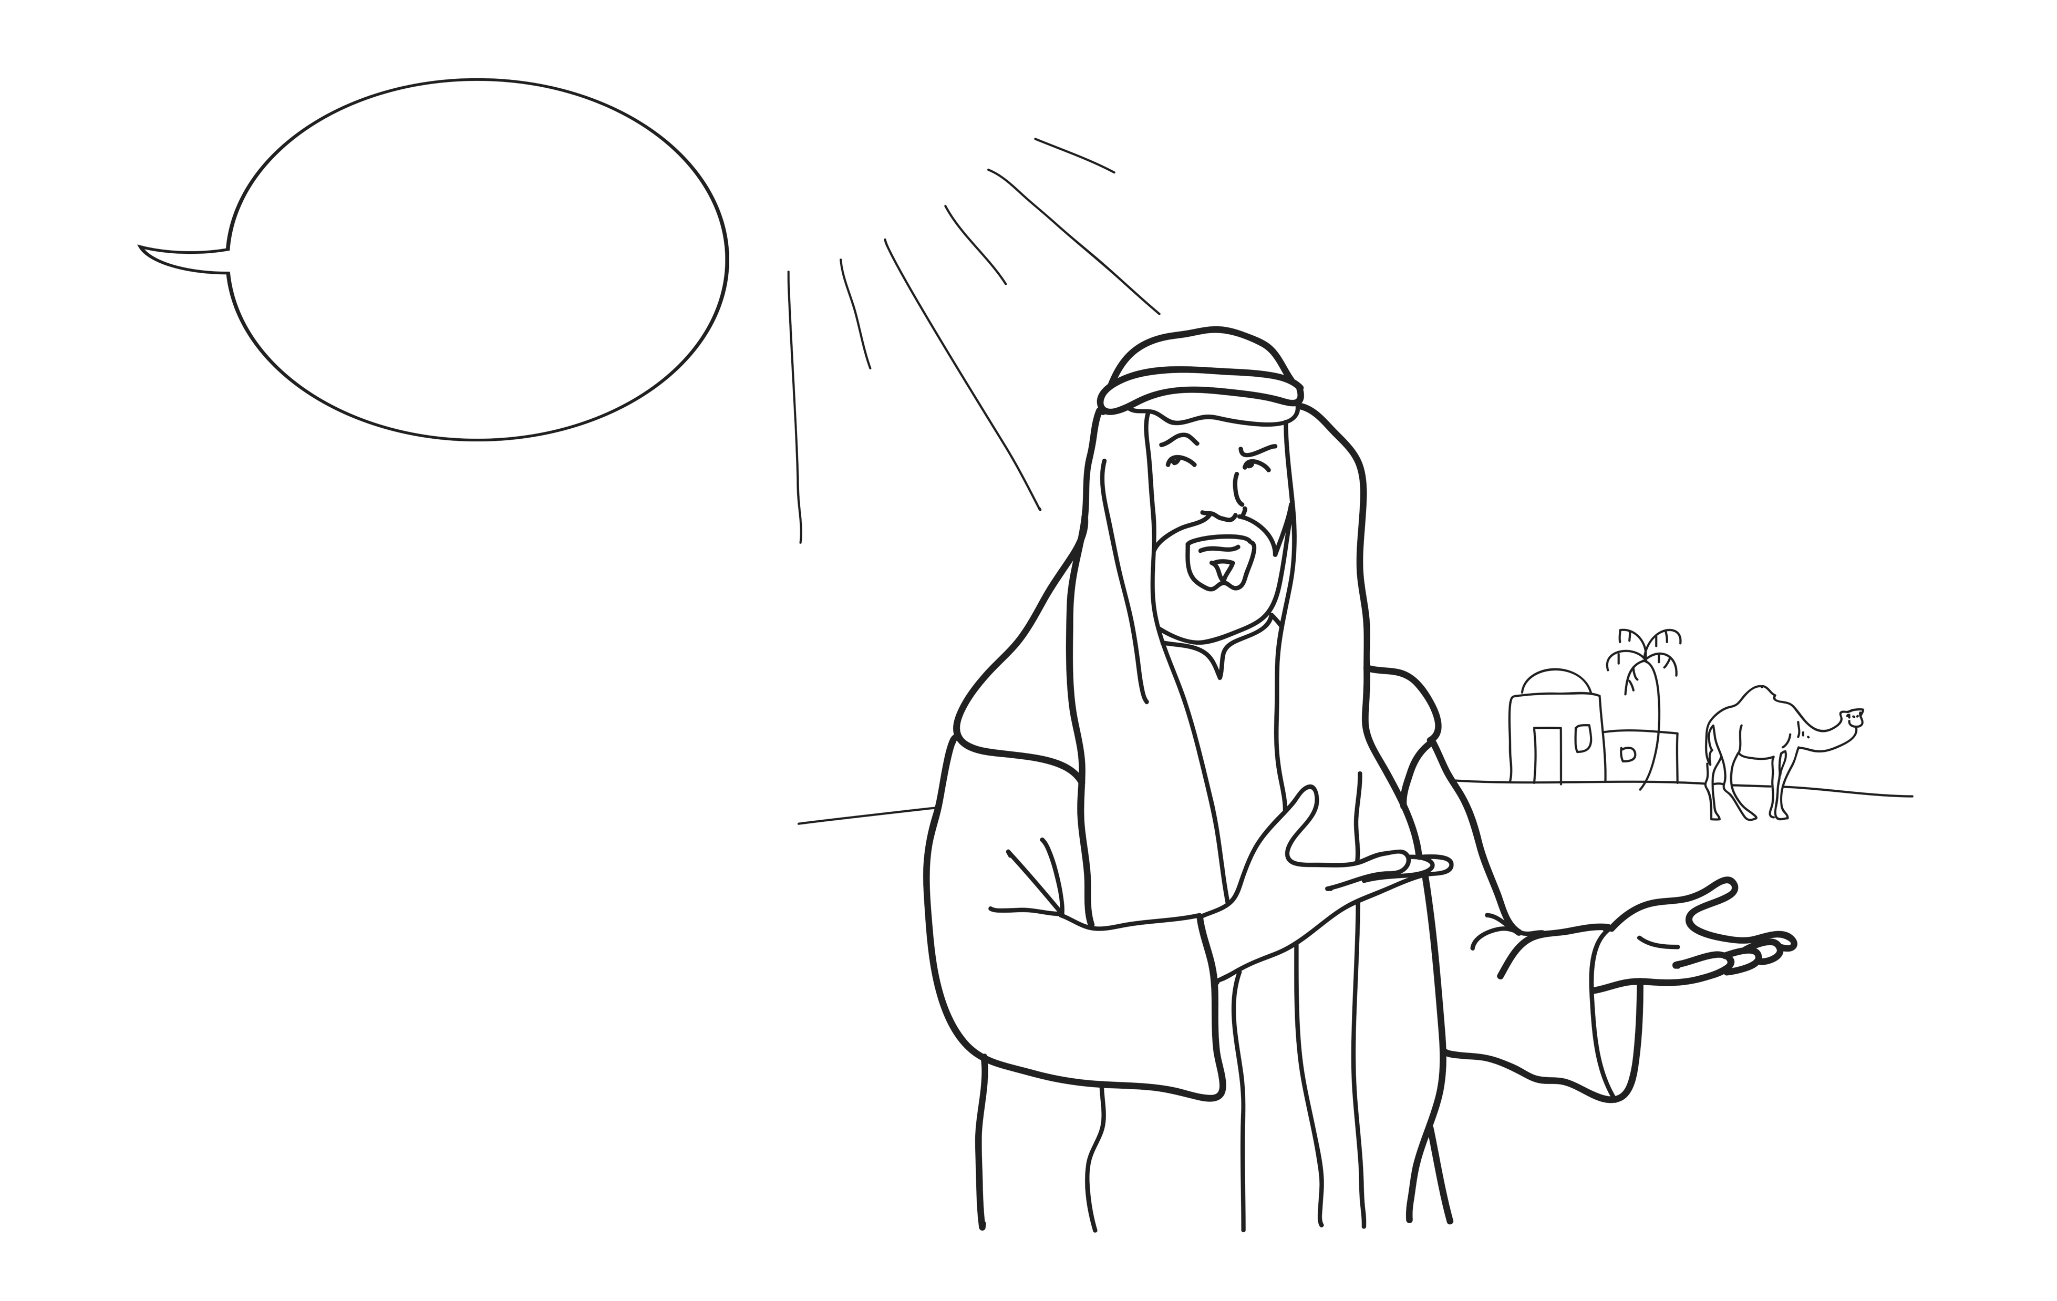
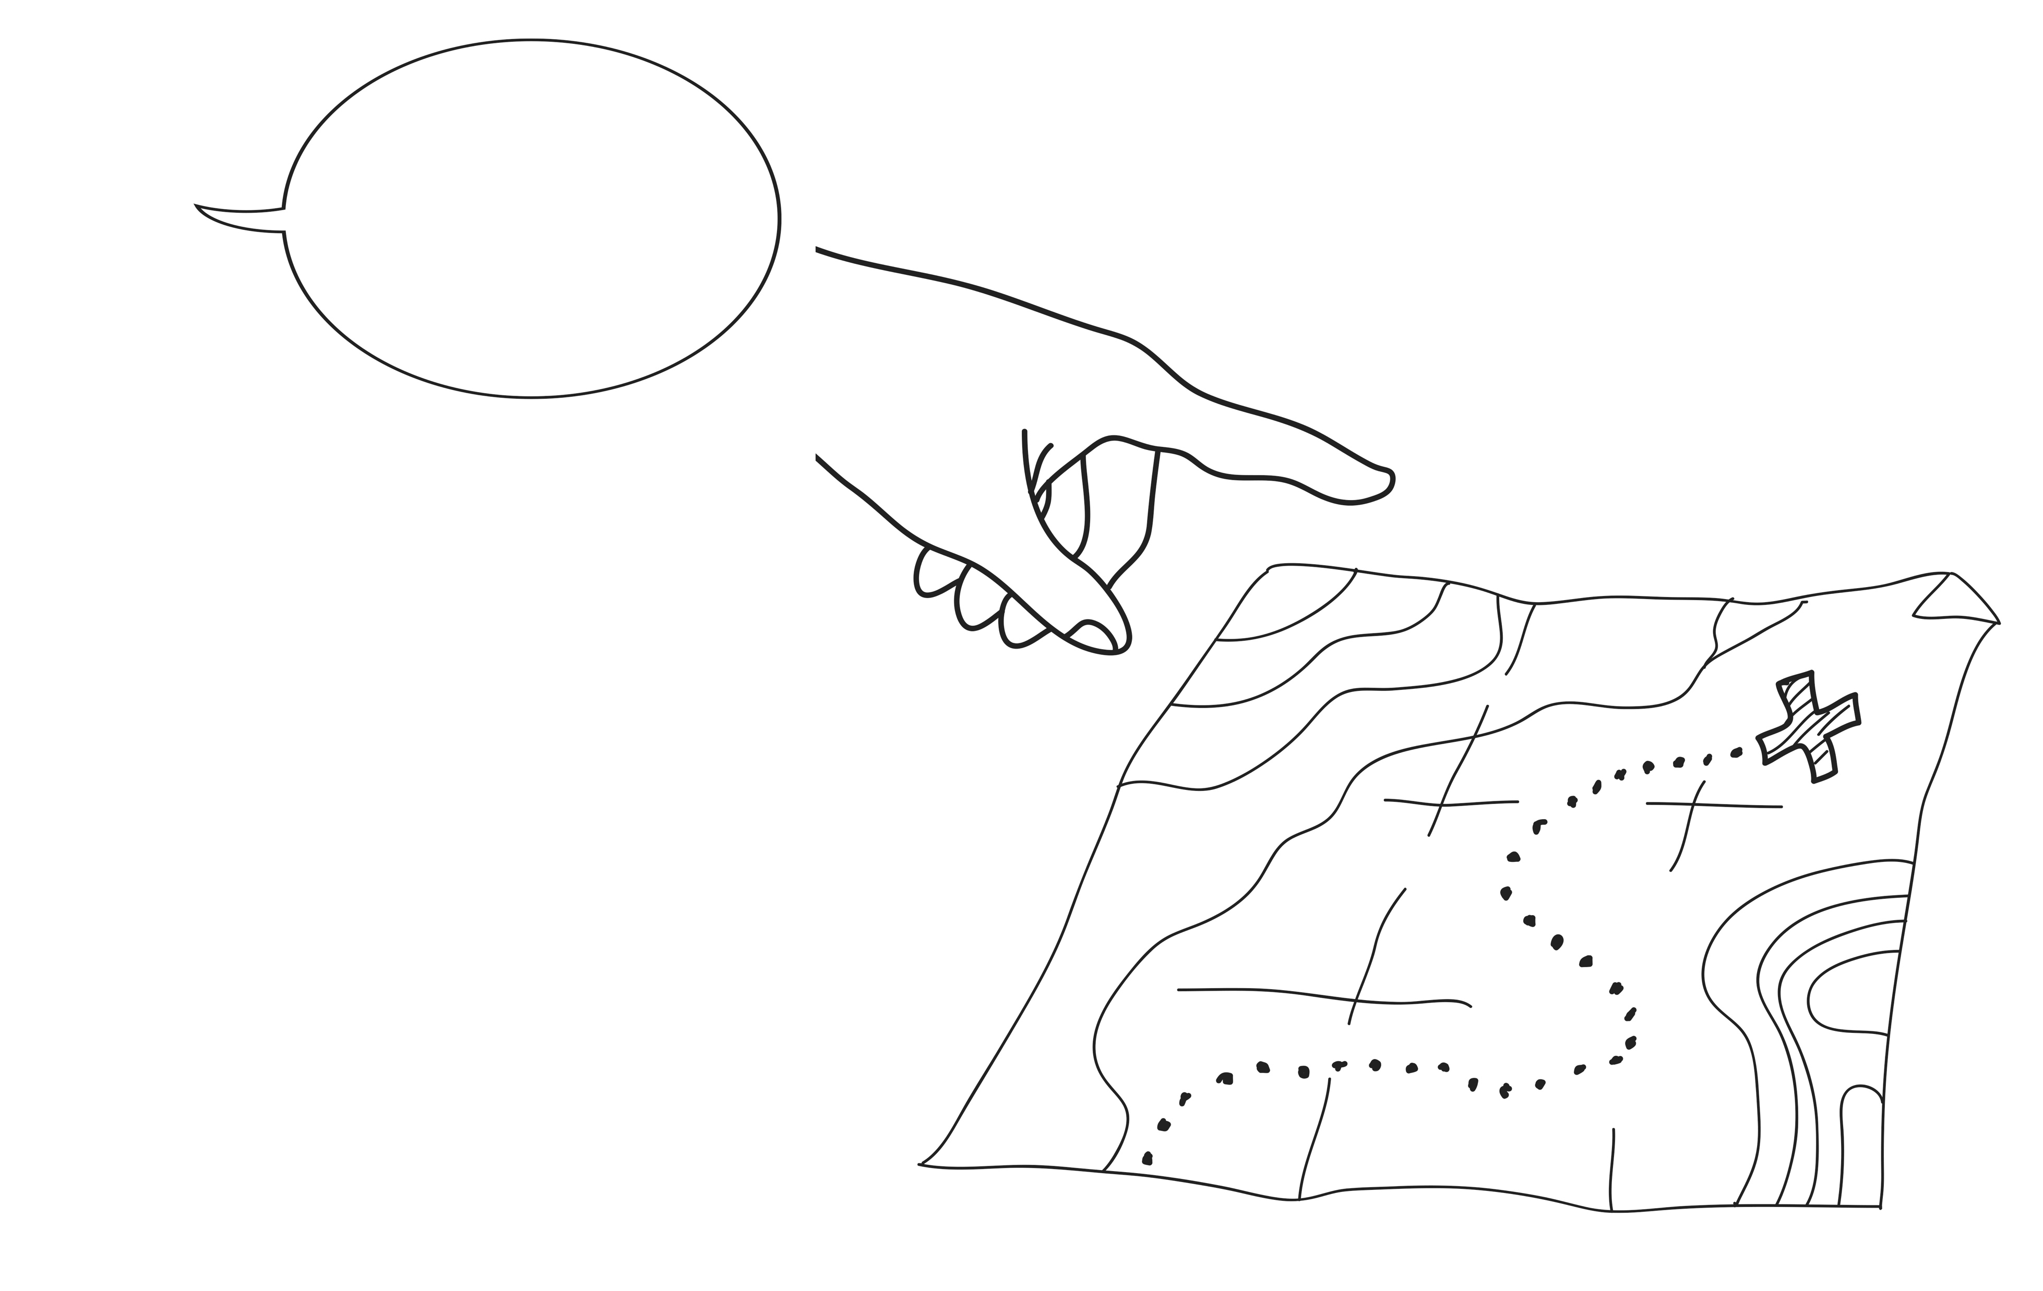
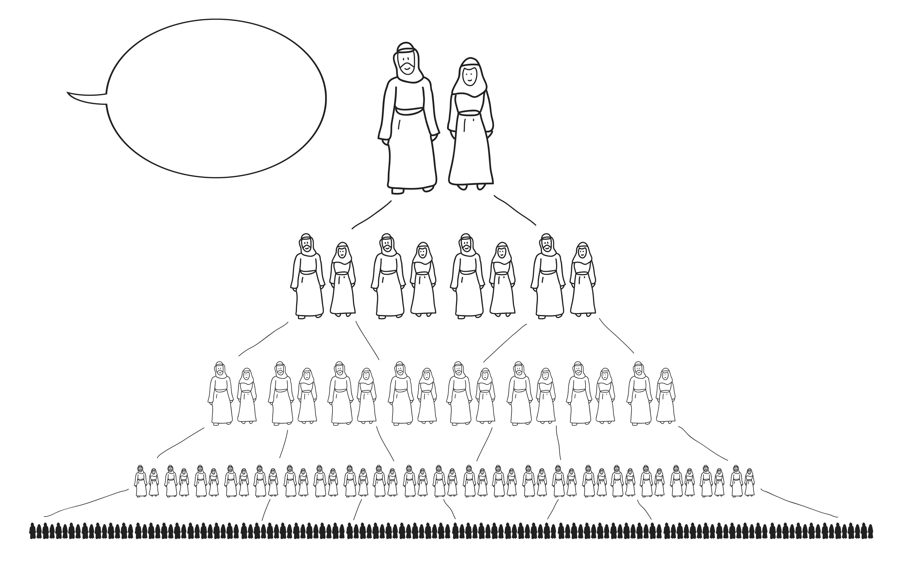
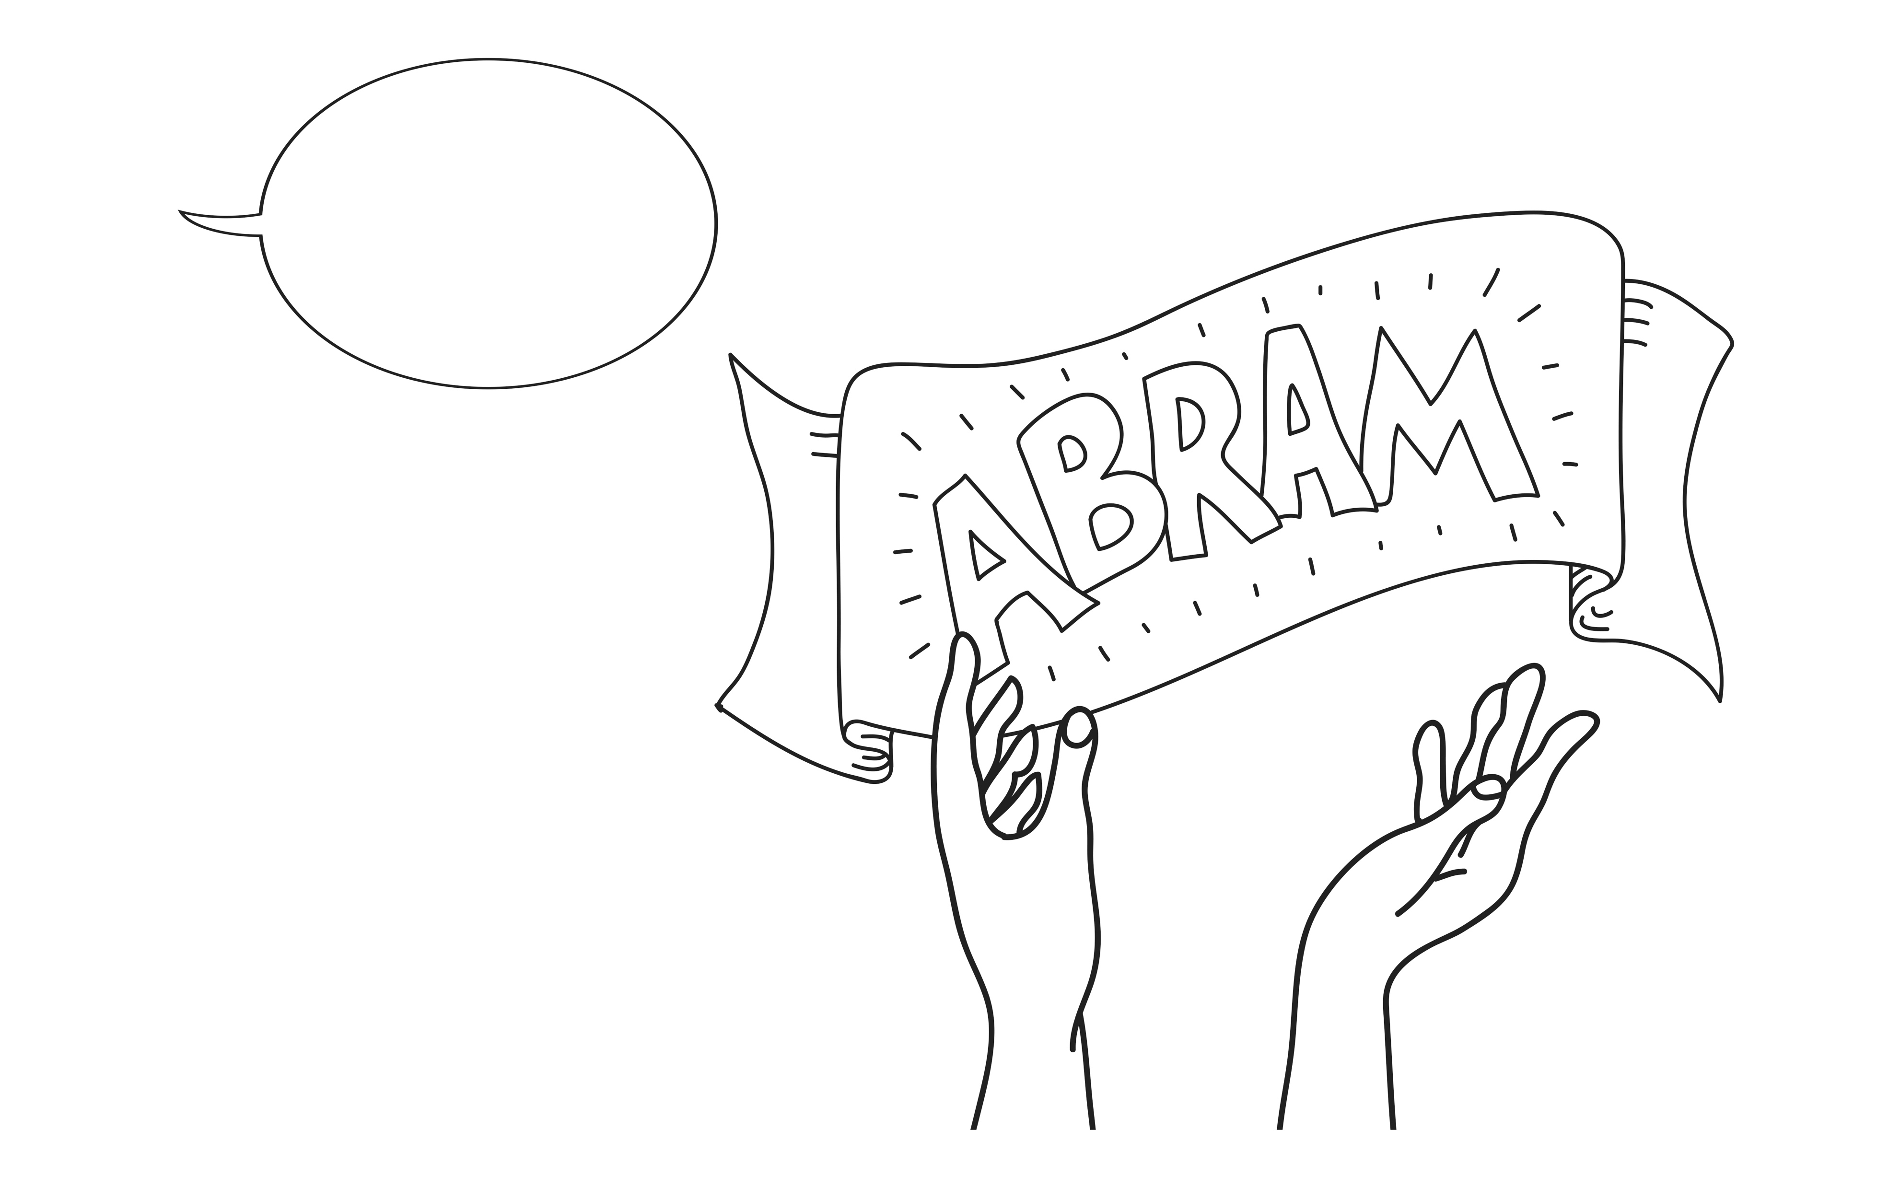
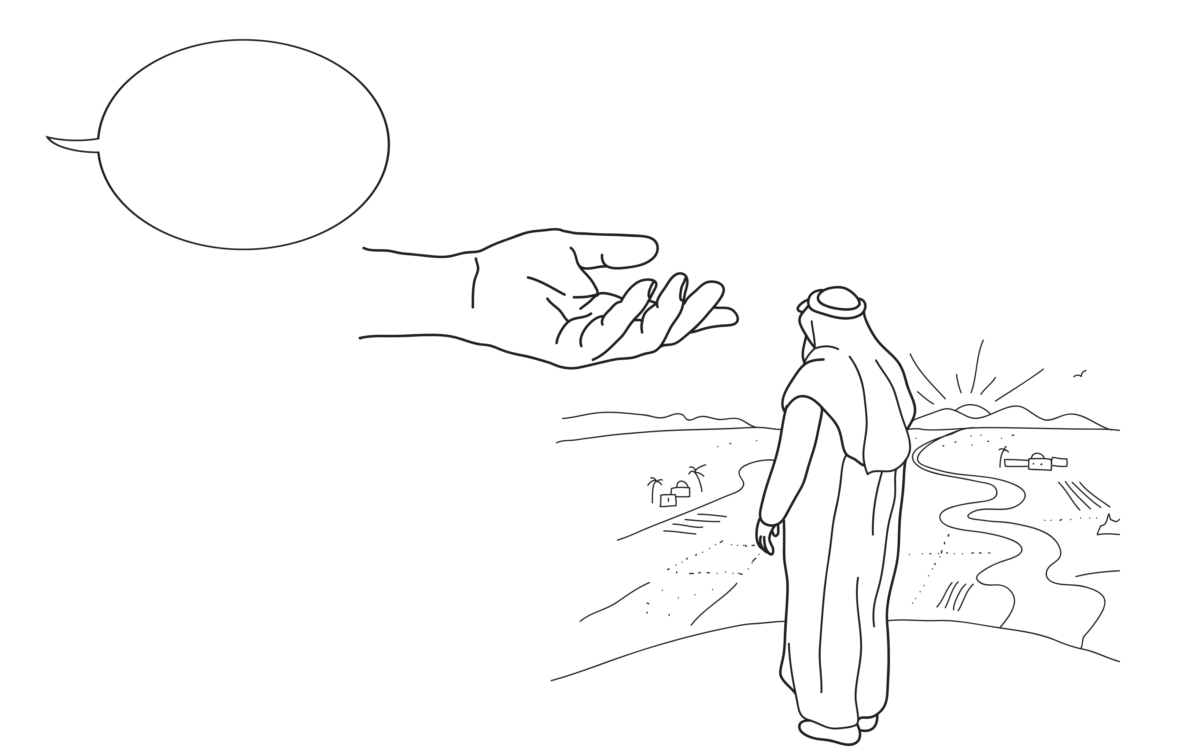
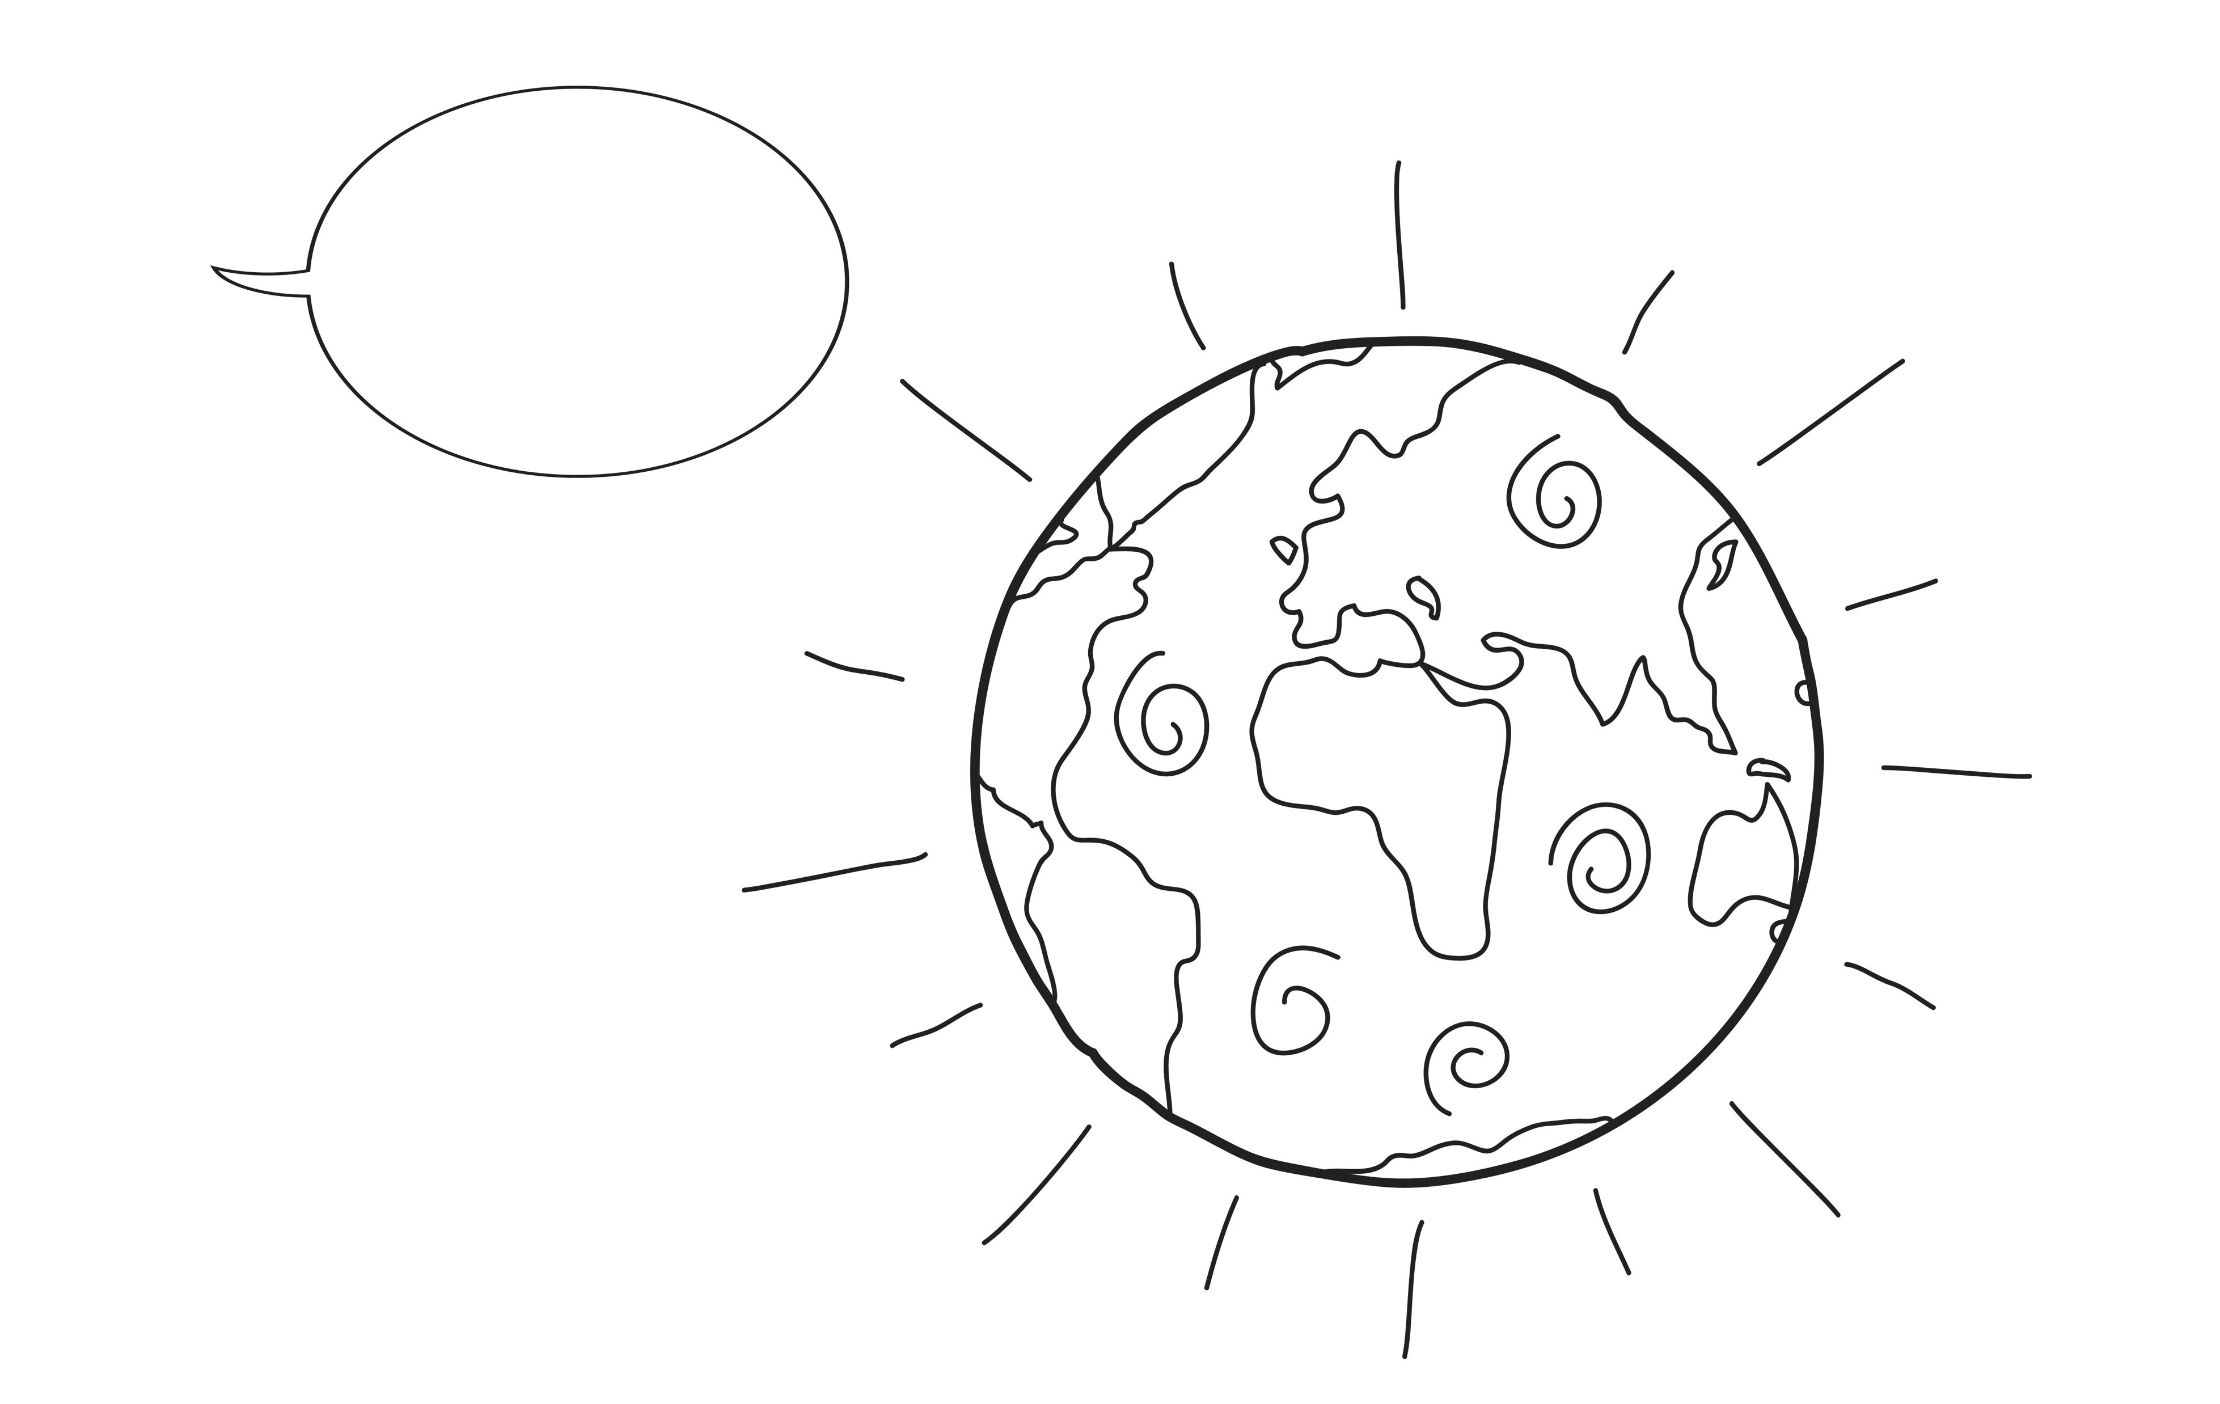
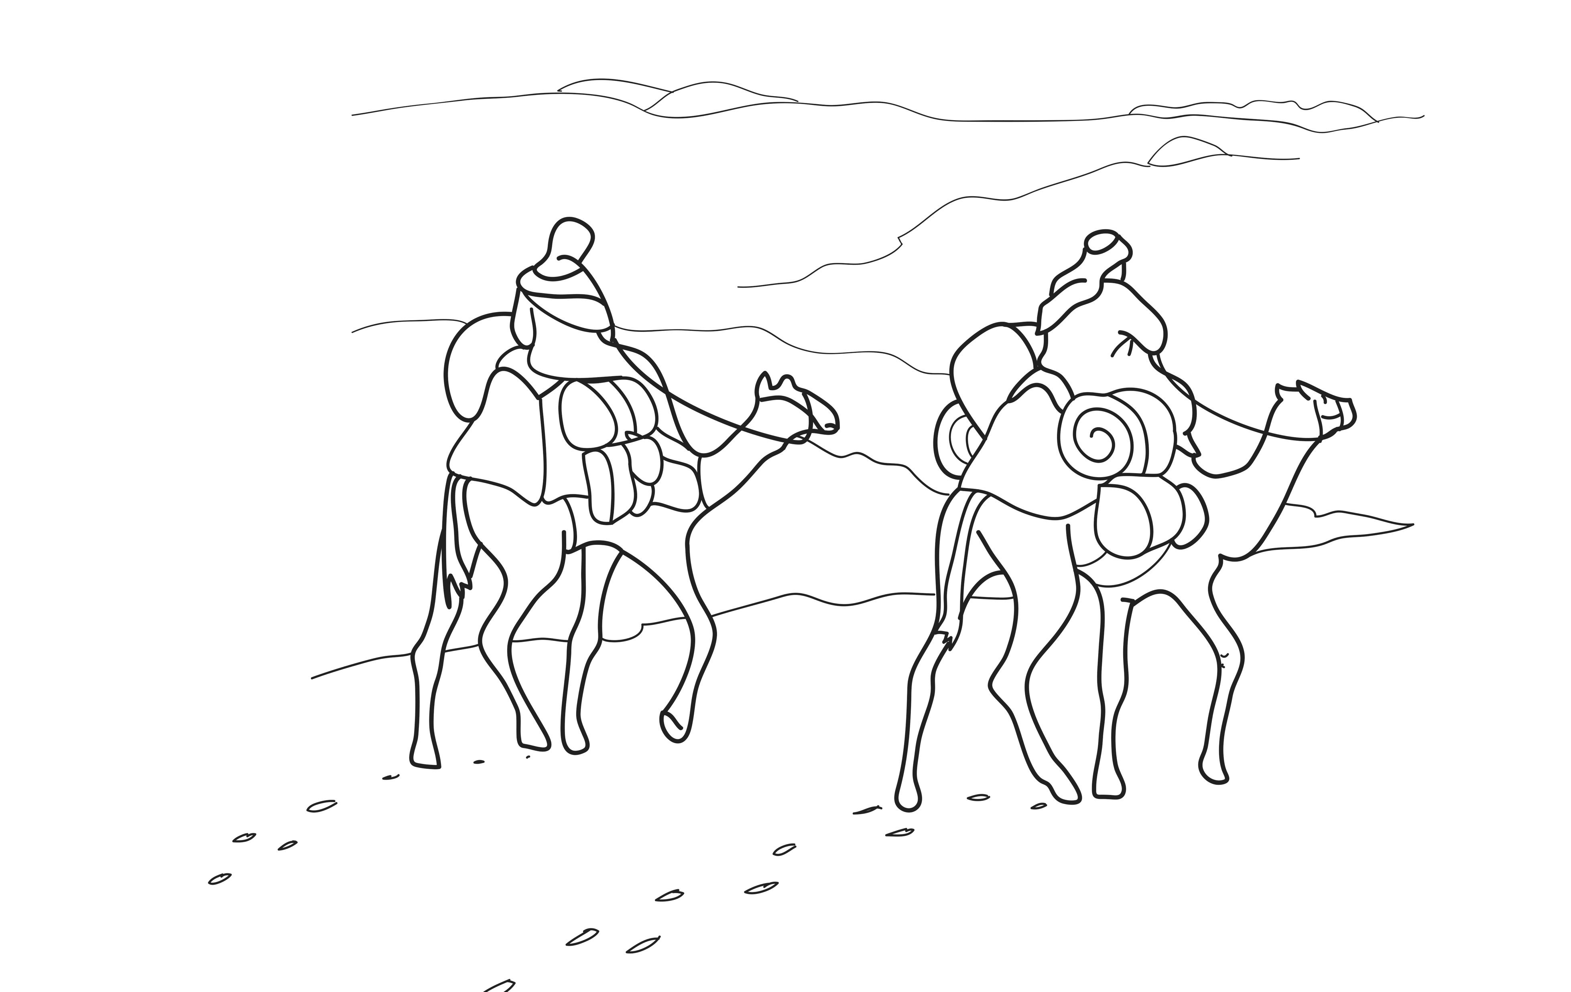
1
2
3
4
5
6
7
8
Notes:
Read and comprehend
(Optional: Invite students to read Genesis 12:1–5 in their heart languages.)
[Slide contains RESOURCE 3.4 – Picture sheet (8 sketches sequencing the Bible narrative).]
Activity 1: Captioning
Divide students into pairs.
Invite pairs to compose a story by writing a simple caption for each picture.
Invite pairs to share their stories.
Correct language and clarify new vocabulary.

Slide 12
Genesis 12:1–5
The Lord said to Abram, ‘Leave your country, your people and your family. Go to the land I will show you.
‘I will make you into a great nation.
I will bless you.
I will make your name great.
You will be a blessing to others.
I will bless people who bless you.
I will curse people who curse you.
All nations will be blessed because of you.’
So Abram did what the Lord told him. He took his wife Sarai and his nephew Lot. He took the people and all their possessions and travelled to Canaan.
Notes:
Read and comprehend (continued)
[Slide contains RESOURCE 3.5 – Paraphrased Bible text.]
Activity 2: Read the text
Distribute RESOURCE 3.5 – Paraphrased Bible text to each student (if using).
Read the text aloud while students follow along.
Invite students to note new words.
Define new words as a class.
Activity 3: Finding God’s promises in the text
Invite students to find and say the five promises in the text starting with I will.
Discuss the meaning of each promise.
Ask ‘What do you think “All nations will be blessed because of you” means?’
Accept responses, but don’t feel you need to answer the question yourself.

Slide 13
Notes:
Invite curiosity
[Slide will at first appear blank.]
Ask ‘Do you have any questions or comments about the story?’
Accept responses and discuss.
Student summary
Click to reveal the Summary sketch.
Invite a volunteer to summarise the Bible text in their own words.

Slide 14
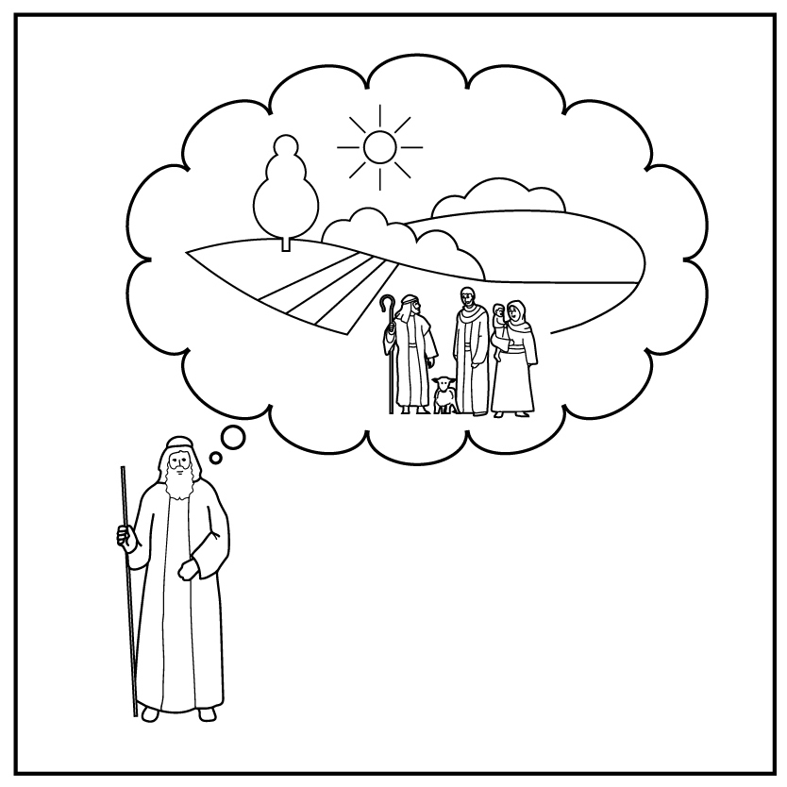
1
2
3
4a
4b
5
Creation
Rejection
Abraham
6
7
8
9
10
Notes:
Timeline and summary statement
[This slide at first contains the timeline with only the icons from the previous lessons already inserted.]
Click to reveal the icon for this lesson inserted in the timeline (RESOURCE 3.6 – Lesson 3 icon).
Say ‘God chose a man and promised to bless his descendants with their own land under his rule. God promised to bless all people through them.’
An important question
Ask ‘Will God keep his promises to Abraham of land, descendants and blessing?’

