Slide 1
Lesson 2
Bible Overview
Ten Bible-based English lessons
Intermediate
Notes:
(Lesson 1 title page)

Slide 2
Lesson 2
PART 1
Rules and consequences
Notes:
(Part 1 title page)

Slide 3
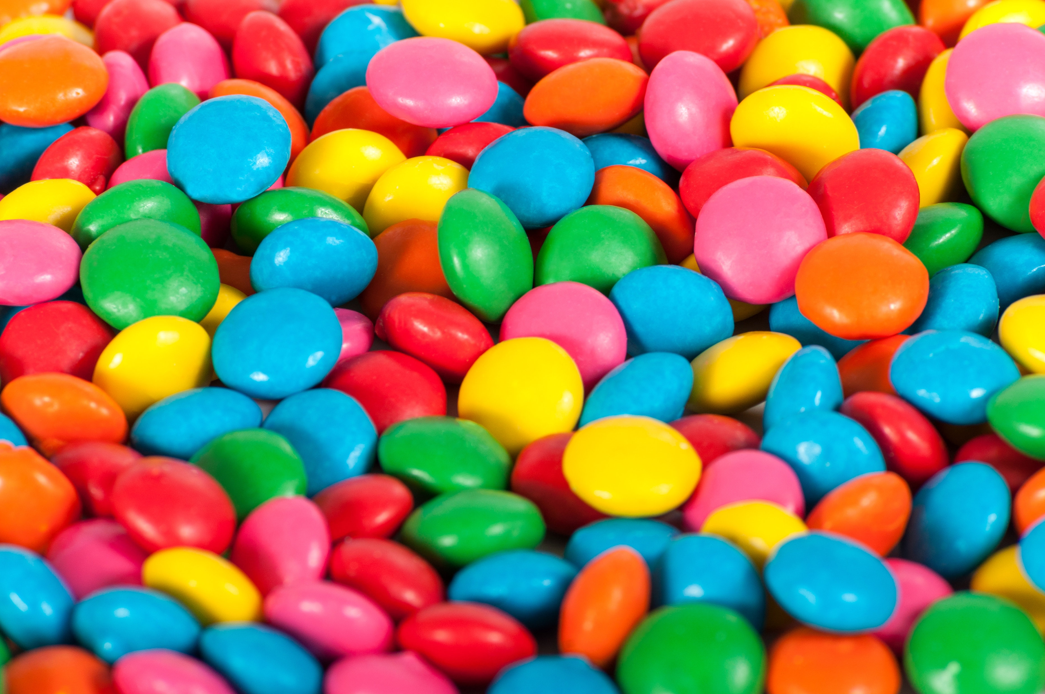
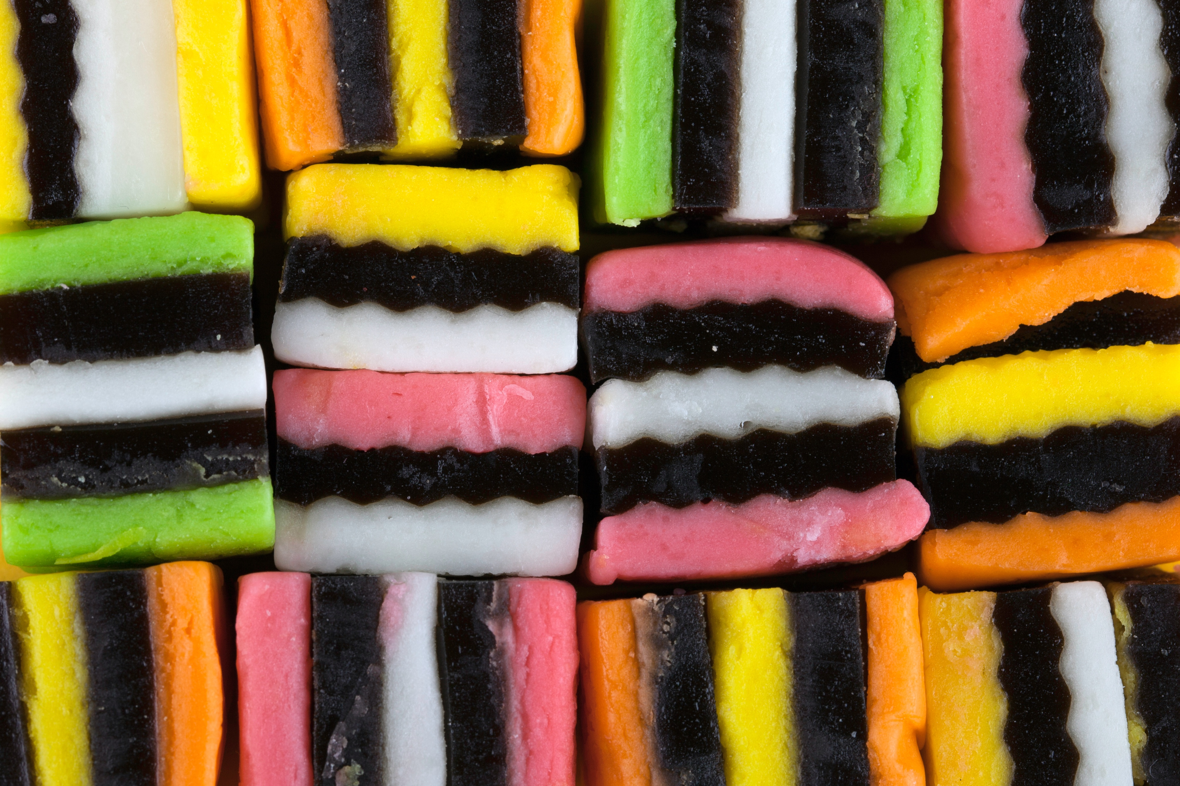

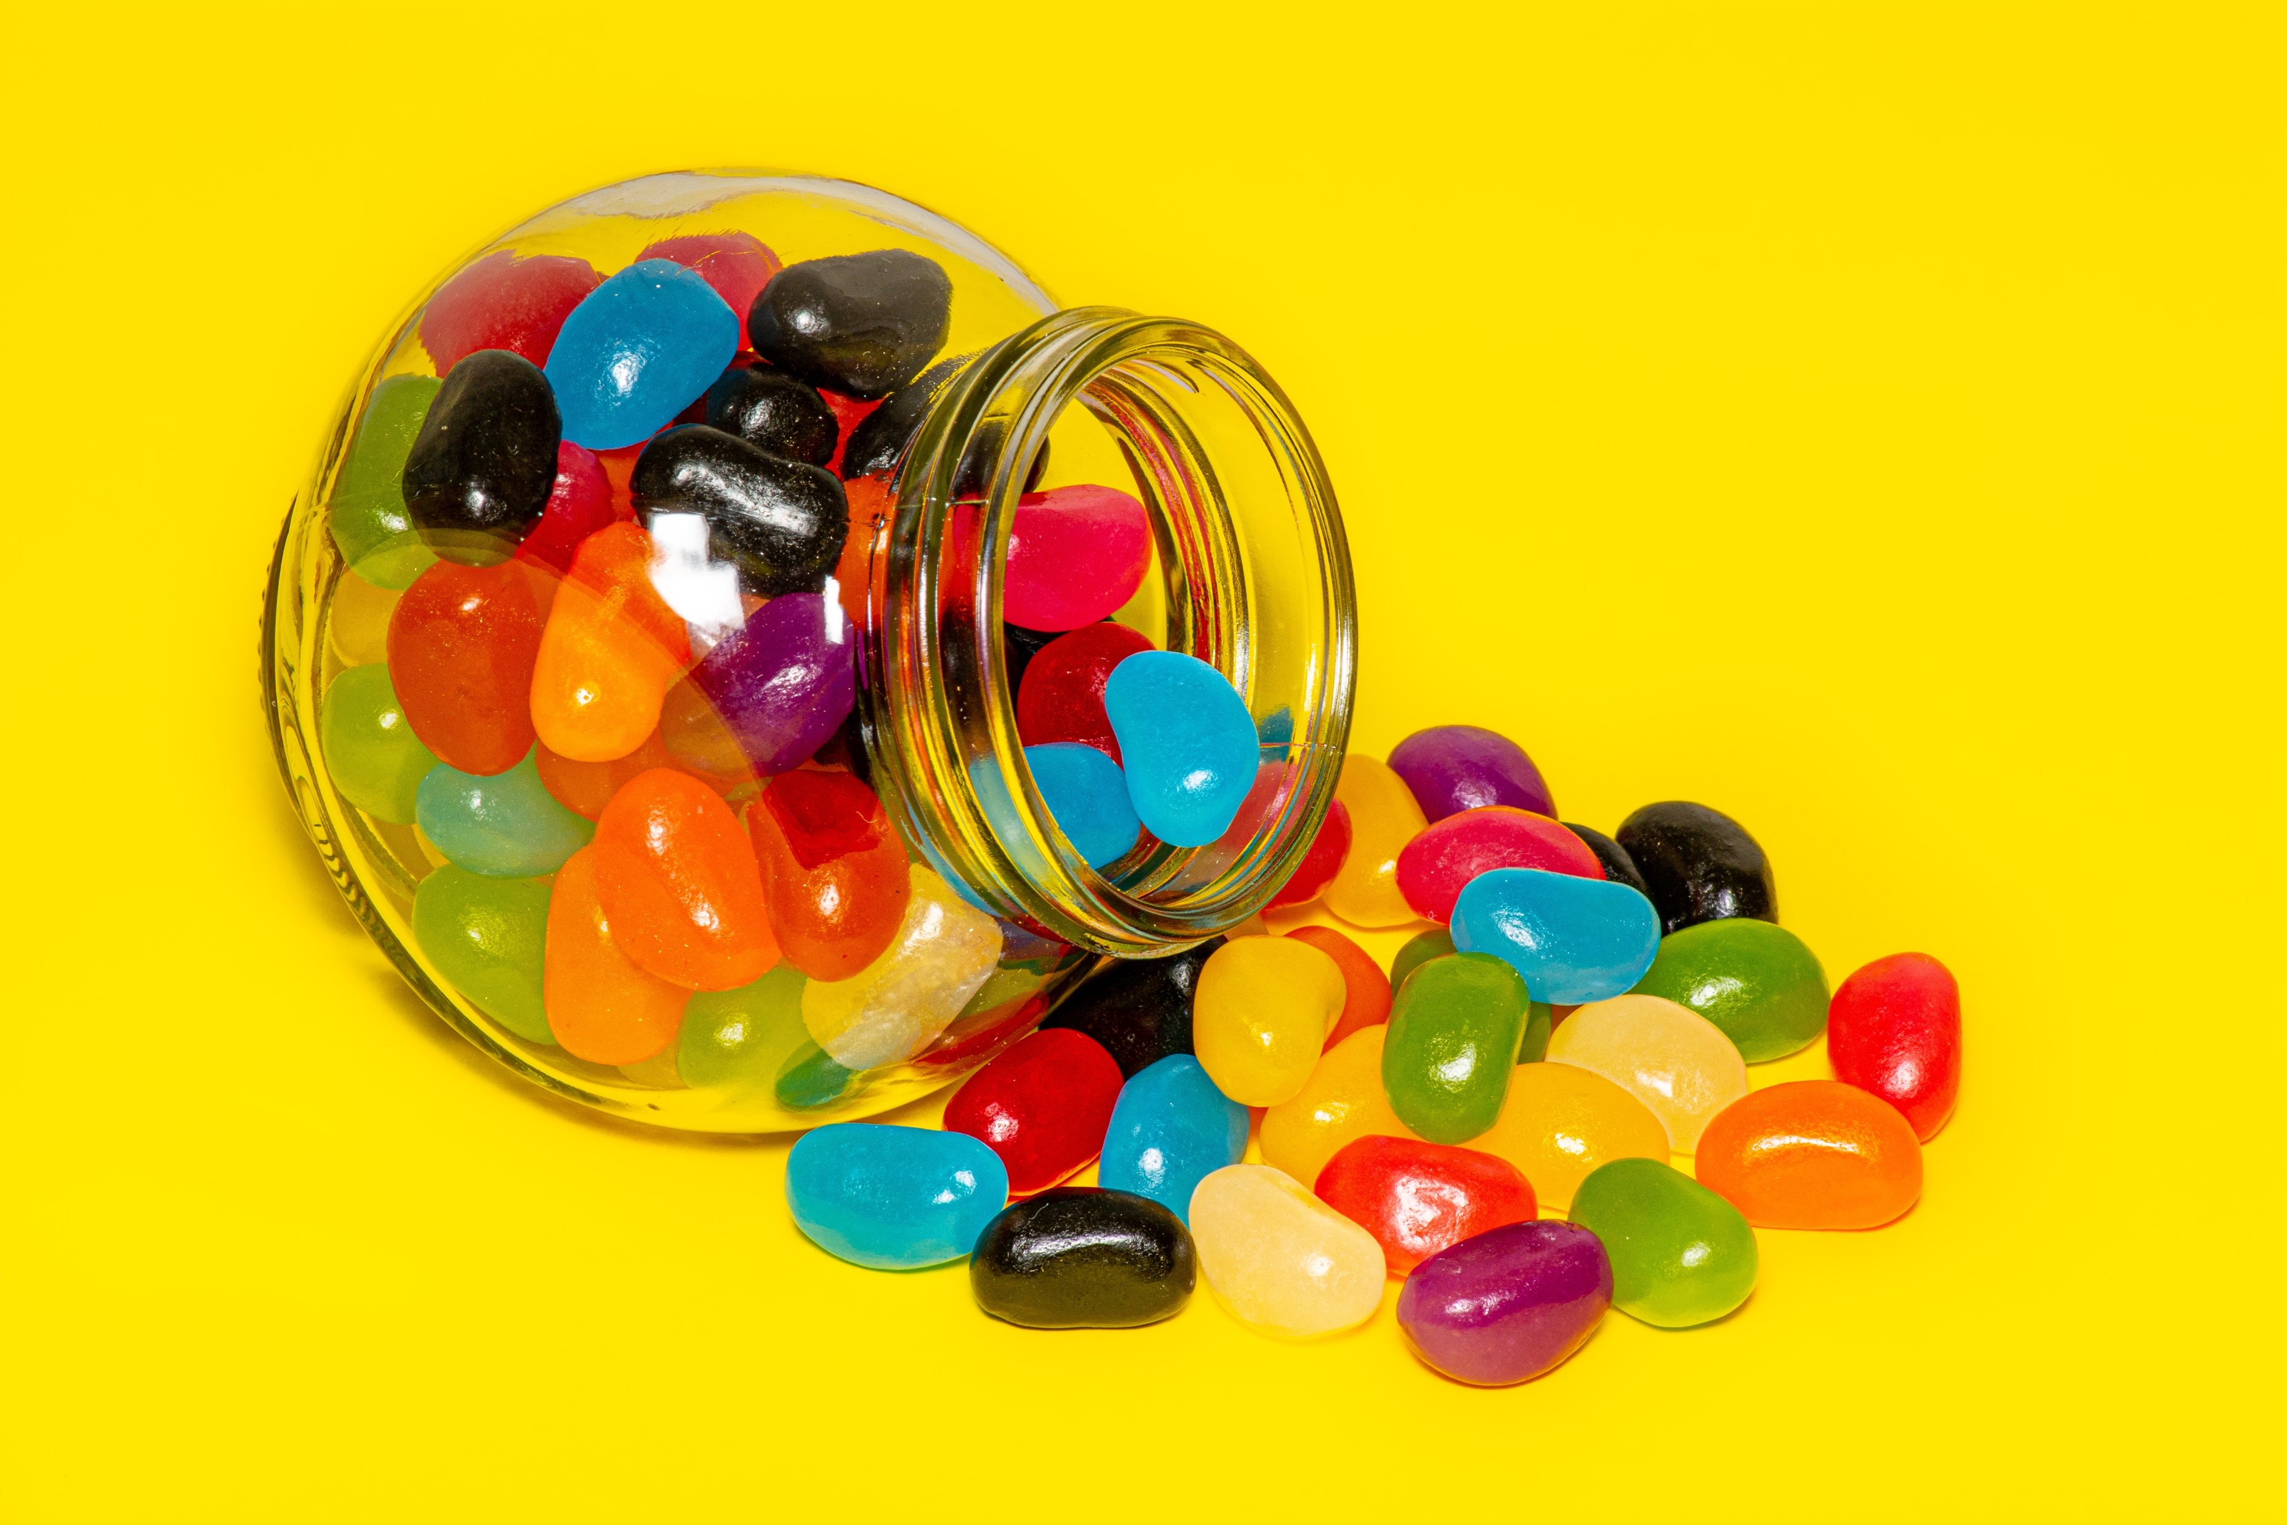
Notes:
Activate knowledge
[Slide contains 4 pictures from RESOURCE 2.1 – Lolly pictures.]
Invite students to tell you what they see in each picture.
Elicit the words lolly, lolly jar.

Slide 4
warn
touch
take
blame
punish
warned
touched
took
blamed
punished
Notes:
Focus on language
Clarify the meanings of the words listed on the slide through mime and discussion.
Invite students to give the past tense of each verb.
Click your mouse to reveal the past tense form of each verb one at a time.

Slide 5
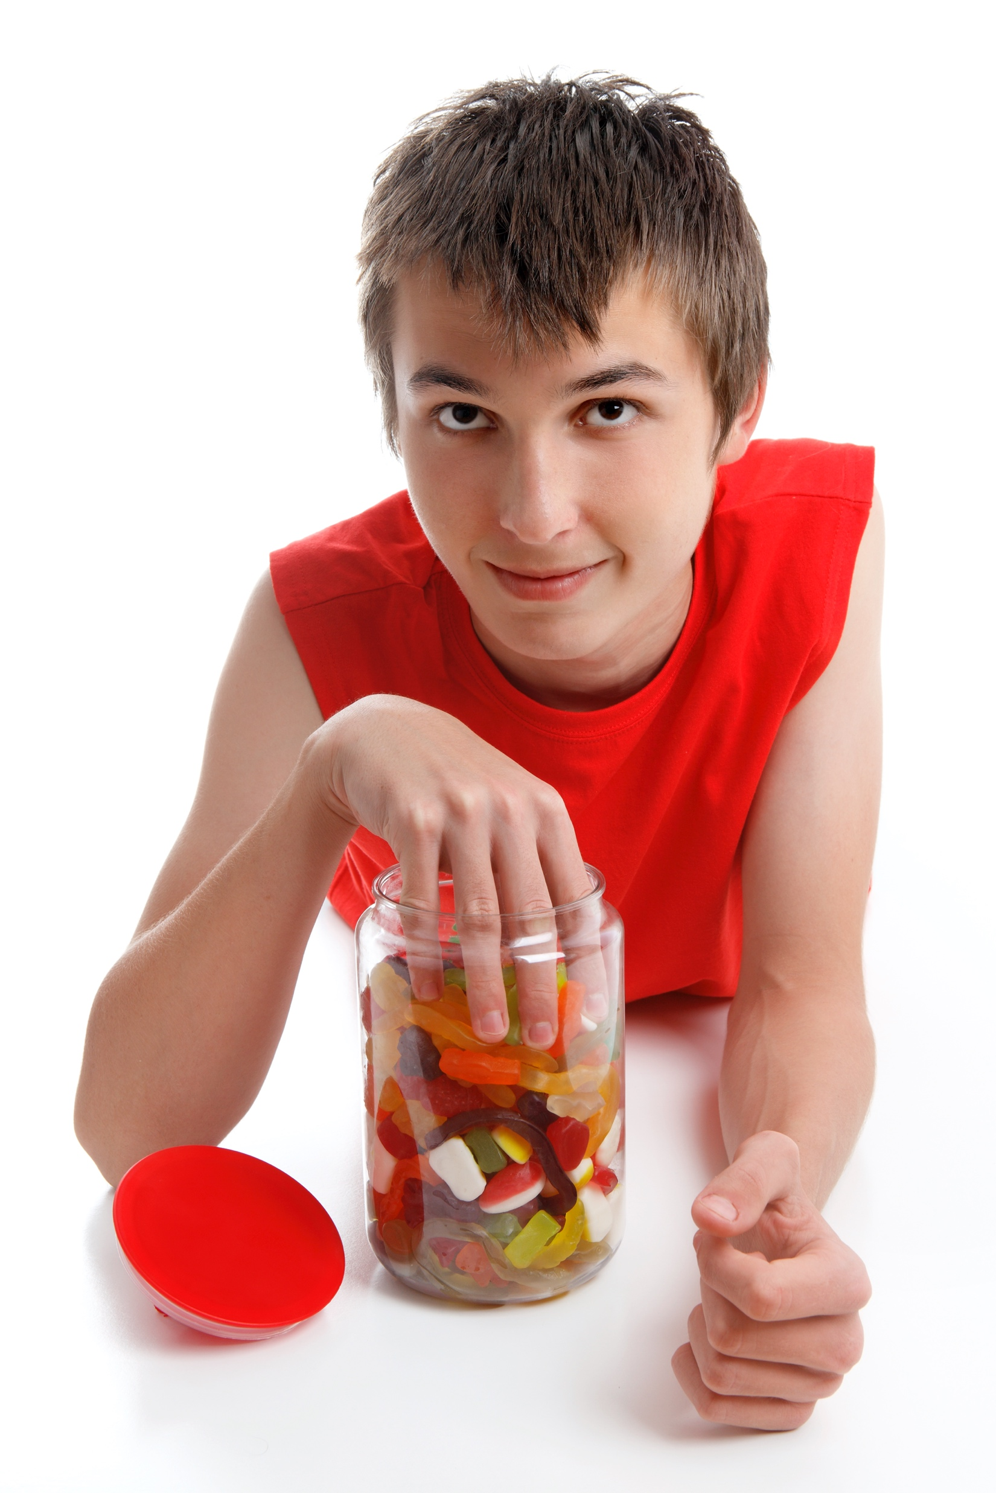
warned
touched
took
blamed
punished
Notes:
Focus on language (continued)
[Slide contains RESOURCE 2.2 - Picture of boy taking a lolly from a jar.]
Invite students to describe what they see.
Click to reveal the past tense verbs.
Divide students into small groups.
Invite groups to compose a story about the picture using the past tense forms of the verbs.
Invite groups to share their stories with the class.

Slide 6
Person 1: Who took the lolly from the lolly jar? [Name] took the lolly from the lolly jar.
Person 2: Who me?
Person 1: Yes you!
Person 2: Not me (shake head).
Person 1: Then who?
Person 2: [New name] took the lolly from the lolly jar.
Person 3: Who me?
Person 2: Yes you!
Person 3: Not me (shake head).
Person 2: Then who?
Person 3: [New name] took the lolly from the lolly jar.
Notes:
Undertake speaking tasks
[Slide contains RESOURCE 2.3 – Chant words.]
Speaking task 1: Play ‘Who stole the lolly from the lolly jar?’
Read the chant with a helper or confident student:
Teacher: Who took the lolly from the lolly jar? [Name of Helper 1] took the lolly from the lolly jar.
Helper 1: Who me?
Teacher: Yes you!
Helper 1: Not me (shake head).
Teacher: Then who?
Helper 1: [Name another helper or confident student] took the lolly from the lolly jar.
Helper 2: Who me?
Helper 1: Yes you!
Helper 2: Not me (shake head).
Helper 1: Then who?
Helper 2: [Name a confident student] took the lolly from the lolly jar.
Invite students to read through the chant in unison (everyone reading all the words).
Clap your hands to the rhythm of the chant and invite students to join you as they read the chant a few more times until they are confident.
Repeat the chant, now with students taking turns to say the different parts until all students have been accused of stealing the lolly and responded.

Slide 7
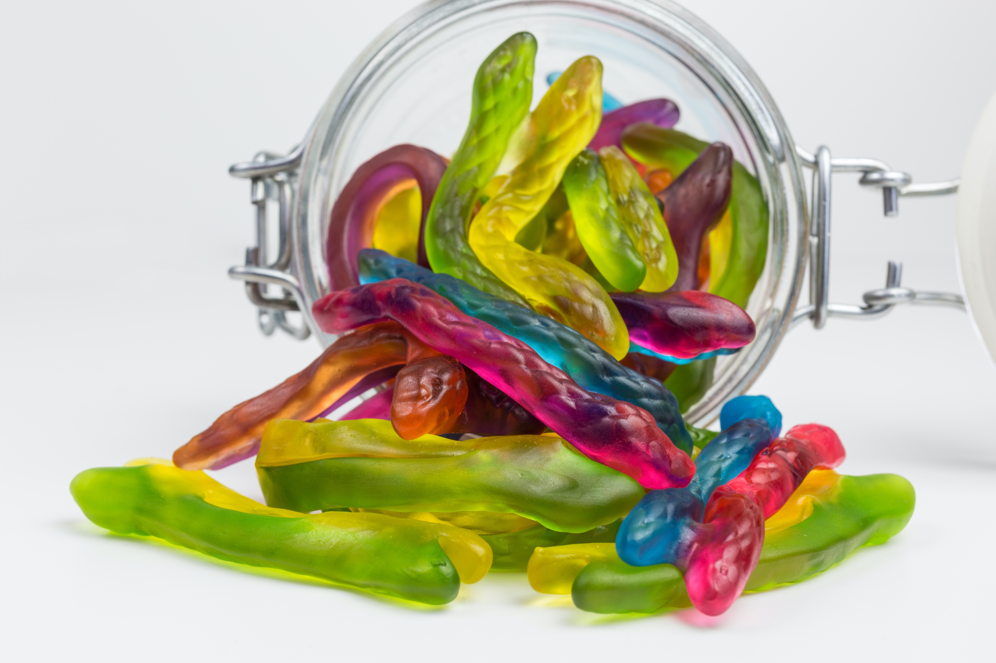
Notes:
Undertake speaking tasks (continued)
[Slide contains the remaining picture from RESOURCE 2.1 – Lolly pictures.]
Invite students to describe the picture.

Slide 8
Person 1: Who took the snake from the snake jar? [Name] took the snake from the snake jar.
Person 2: Who me?
Person 1: Yes you!
Person 2: Not me (shake head).
Person 1: Then who?
Person 2: [New name] took the snake from the snake jar.
Person 3: Who me?
Person 2: Yes you!
Person 3: Not me (shake head).
Person 2: Then who?
Person 3: [New name] took the snake from the snake jar.
Notes:
Undertake speaking tasks (continued)
Repeat the chant game. This time the word ‘lolly’ is replaced with the word ‘snake’ on the slide.

Slide 9
What are some good family rules?
Why are family rules important?
What should happen if family rules are broken?
Must children always understand their parents’ rules? Why/why not?
Notes:
Undertake speaking tasks (continued)
[Slide at first appears blank.]
Speaking task 2: Group discussion
Divide students into small groups.
Click to reveal the first question.
Invite groups to discuss their opinions.
Click to reveal the next question, and continue until all 4 questions have been discussed. (You may wish to invite groups to give feedback to the class.)

Slide 10
What are some good rules in a society?
Why are these rules important?
What should happen if these rules are broken?
Notes:
Undertake speaking tasks (continued)
[Slide contains RESOURCE 2.4 – Discussion questions.]
Speaking task 3: Pair discussion
Divide students into pairs.
Invite students to take turns asking the questions of their partners.
Invite students to share some of their partners’ answers with the class.
Clarify new words and expressions as they are shared.

Slide 11
Lesson 2
PART 2
People reject God
Genesis 3:1–6, 13–19, 23
Notes:
(Part 2 title page)

Slide 12

1
2
3
4a
4b
5
Creation
6
7
8
9
10
Notes:
Review previous lesson
[This slide contains the timeline with the icon from the previous lesson inserted.]
Invite a volunteer to summarise the previous lesson as you point to the icon on the timeline. Prompt if necessary.
Say ‘God made a good world, and he rules over it. God made people to be his friends and rule the world under him.’
Predict the content
Ask ‘Do you know what happens next?’
Accept responses.

Slide 13
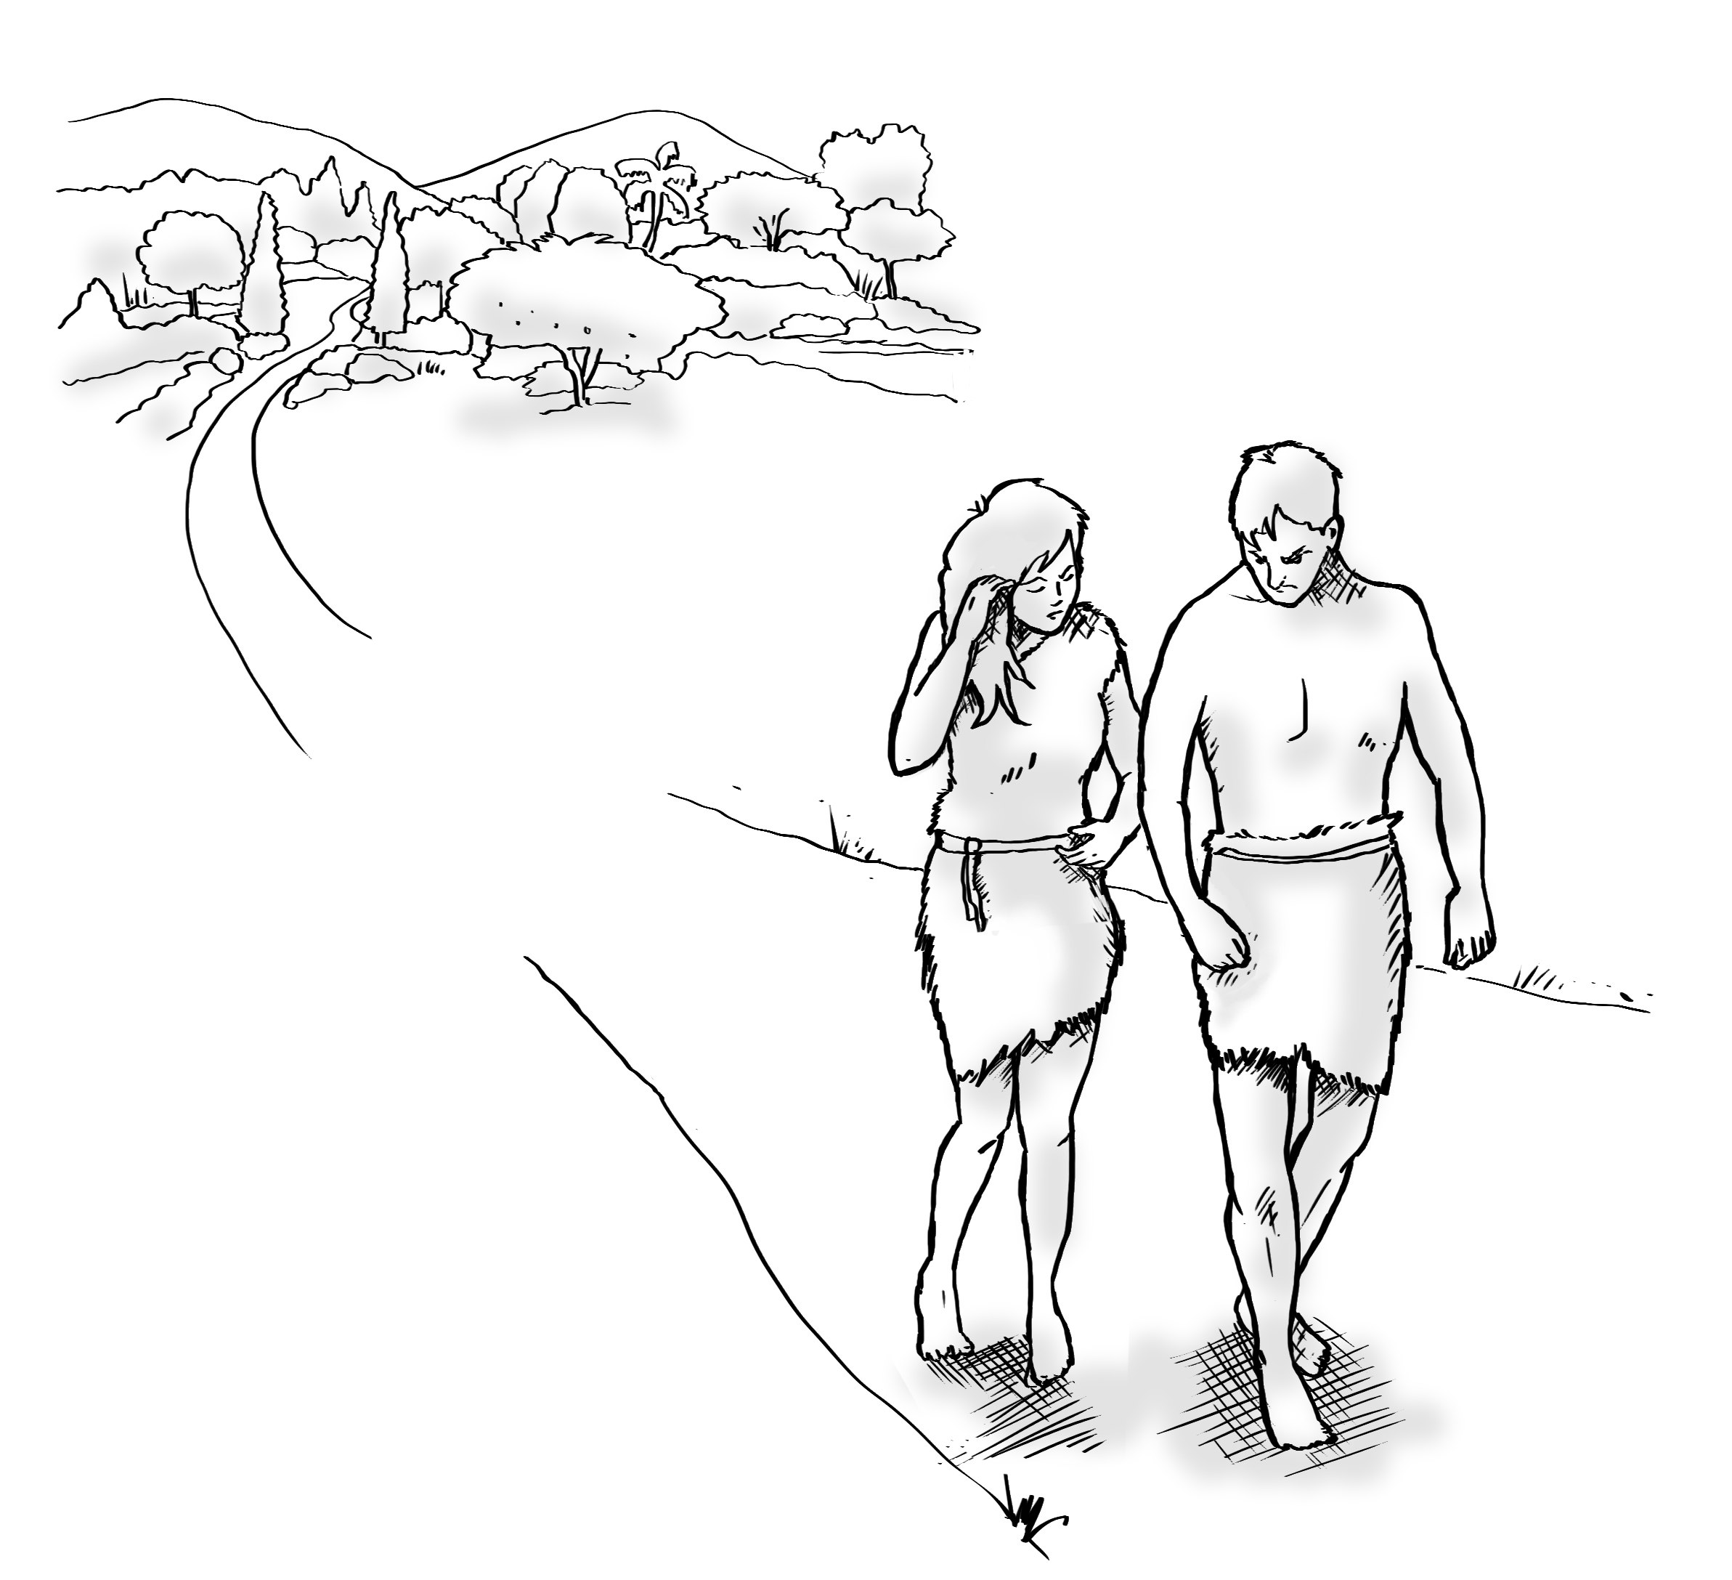
Notes:
Predict the content (continued)
[Slide contains RESOURCE 2.5 – Summary sketch.]
Ask ‘What do you see?’
Accept responses.

Slide 14
Genesis 3:1–6, 13–19, 23
The snake was craftier than any of the animals God had made. The snake said to the woman, ‘Did God really say, “You must not eat fruit from any tree in the garden”?’
The woman said, ‘We may eat fruit from the trees in the garden, but God said, ‘You must not eat fruit from the tree in the middle of the garden. Do not even touch it. If you do, you will die.’
‘You will not die,’ the snake said to the woman. The woman saw that the fruit was good to eat and look at, so she took some and ate it. She gave some to her husband and he ate it. God said, ‘You ate fruit from the tree I warned you not to eat from.’ The man blamed the woman. The woman blamed the snake.
God said to the snake, ‘I will curse you.’ God said to the woman, ‘You will be in great pain when you have children.’ God said to the man, ‘You will work hard all your life to produce the food you eat. You were made from the ground. You will return to it when you die.’
So God sent them out of the Garden of Eden.
Notes:
Read and comprehend
(Optional: Invite students to read Genesis 3:1–6, 13–19, 23 in their heart languages.)
[Slide will at first appear blank.]
Activity 1: Sequencing the text [or, if online, reading the text]
Read Genesis 3:1–6, 13–19, 23 aloud.
Invite students to share what they heard (words, phrases or ideas).
[This sequencing activity is not adapted for PowerPoint. Skip straight to ‘Click to display the Bible text’ below if teaching online.]
Divide students into pairs.
Distribute a set of strips from RESOURCE 2.6 – Text strips to each pair.
Invite pairs to order their strips. (Walk around the class and help as needed.)
Click to display the Bible text.
Distribute RESOURCE 2.7 – Paraphrased Bible text to each student (if using).
Invite pairs to read the text and note new words.
Invite students to share new words and define them as a class.

Slide 15
Genesis 3:1–6, 13–19, 23
The snake was craftier than any of the animals God had made. The snake said to the woman, ‘Did God really say, “You must not eat fruit from any tree in the garden”?’
The woman said, ‘We may eat fruit from the trees in the garden, but God said, ‘You must not eat fruit from the tree in the middle of the garden. Do not even touch it. If you do, you will die.’
‘You will not die,’ the snake said to the woman. The woman saw that the fruit was good to eat and look at, so she took some and ate it. She gave some to her husband and he ate it. God said, ‘You ate fruit from the tree I warned you not to eat from.’ The man blamed the woman. The woman blamed the snake.
God said to the snake, ‘I will curse you.’ God said to the woman, ‘You will be in great pain when you have children.’ God said to the man, ‘You will work hard all your life to produce the food you eat. You were made from the ground. You will return to it when you die.’
So God sent them out of the Garden of Eden.
Notes:
Read and comprehend (continued)
Activity 2: Composing and answering questions about the text
Invite each pair to write down three questions about the text.
Put two pairs together and invite them to ask their questions of each other.
Invite volunteers to ask one of their questions to the class and accept responses.

Slide 16
Genesis 3:1–6, 13–19, 23
The snake was craftier than any of the animals God had made. The snake said to the woman, ‘Did God really say, “You must not eat fruit from any tree in the garden”?’
The woman said, ‘We may eat fruit from the trees in the garden, but God said, ‘You must not eat fruit from the tree in the middle of the garden. Do not even touch it. If you do, you will die.’
‘You will not die,’ the snake said to the woman. The woman saw that the fruit was good to eat and look at, so she took some and ate it. She gave some to her husband and he ate it. God said, ‘You ate fruit from the tree I warned you not to eat from.’ The man blamed the woman. The woman blamed the snake.
God said to the snake, ‘I will curse you.’ God said to the woman, ‘You will be in great pain when you have children.’ God said to the man, ‘You will work hard all your life to produce the food you eat. You were made from the ground. You will return to it when you die.’
So God sent them out of the Garden of Eden.
Notes:
Read and comprehend (continued)
Activity 3: Class questions
Ask the following questions of the class and accept responses:
‘How would you summarise God’s instruction to Adam and Eve?’
‘Should God be allowed to give instructions? Why/Why not?’
‘How did Adam and Eve blame others?’

Slide 17
Notes:
Invite curiosity
[Slide will at first appear blank.]
Ask ‘Do you have any questions or comments about the story?’
Accept responses and discuss.
Student summary
Click to reveal the Summary sketch.
Invite a volunteer to summarise the Bible text in their own words.

Slide 18

1
2
3
4a
4b
5
Creation
Rejection
6
7
8
9
10
Notes:
Timeline and summary statement
[This slide at first contains the timeline with only the icon from the previous lesson already inserted.]
Click to reveal the icon for this lesson inserted in the timeline (RESOURCE 2.8 – Lesson 2 icon).
Say ‘People rejected God’s rule and broke their friendship with him. God sent them out of the garden.’
An important question
Say ‘After Adam and Eve leave the garden, things get worse. People keep disobeying God and more relationships are broken.’
Ask ‘What do you think God will do now?’

