Slide 1
Lesson 8
Bible Overview
Ten Bible-based English lessons
Intermediate
Notes:
(Lesson 1 title page)

Slide 2
Lesson 8
PART 1
A story of sacrifice
Notes:
(Part 1 title page)

Slide 3
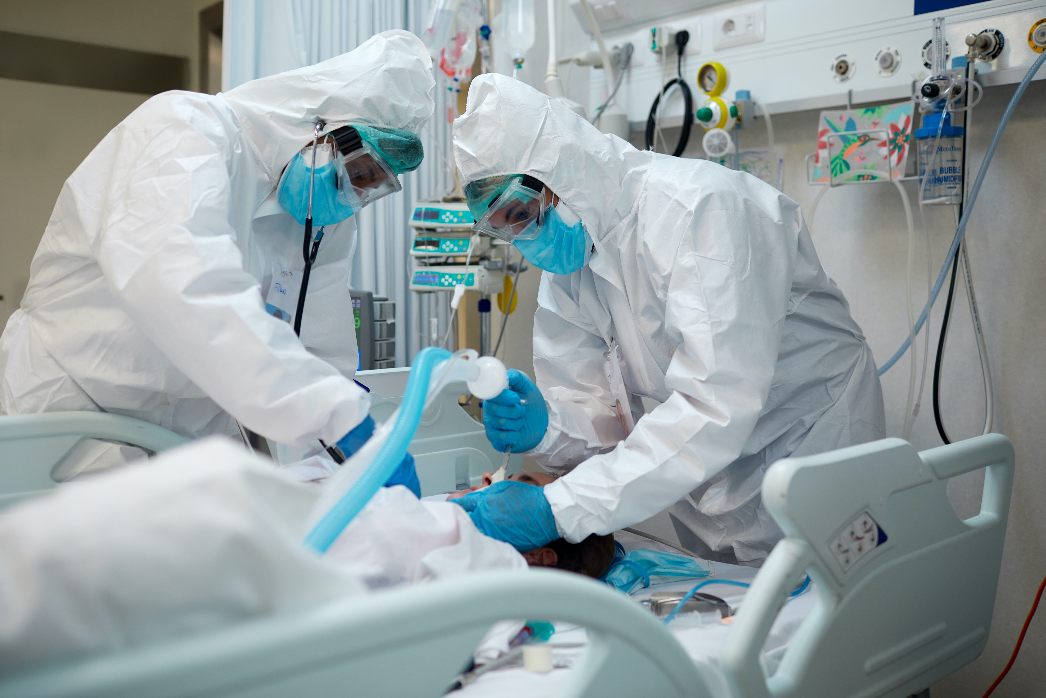
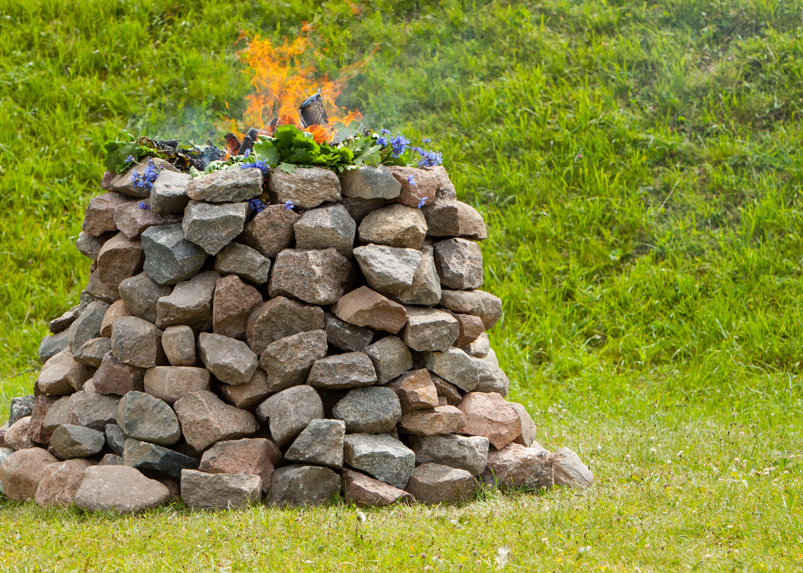

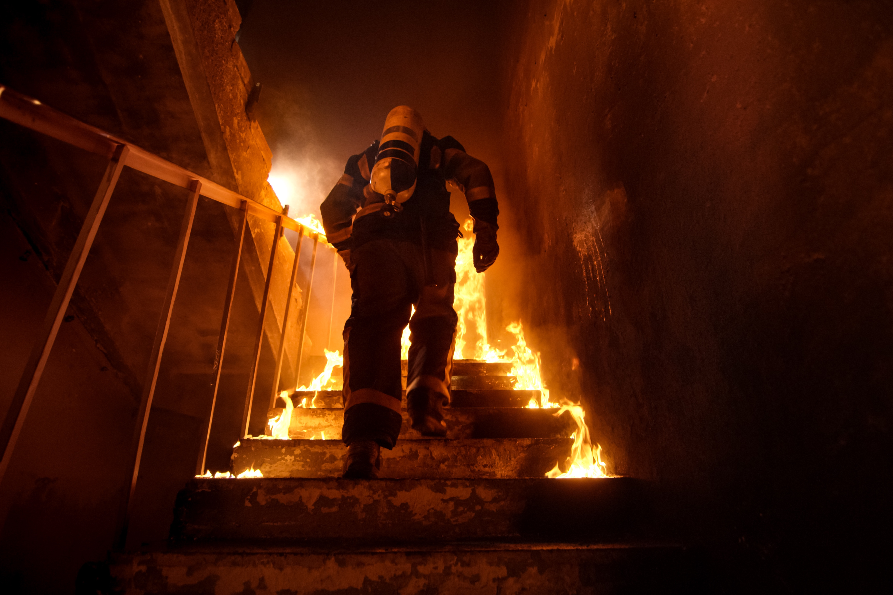
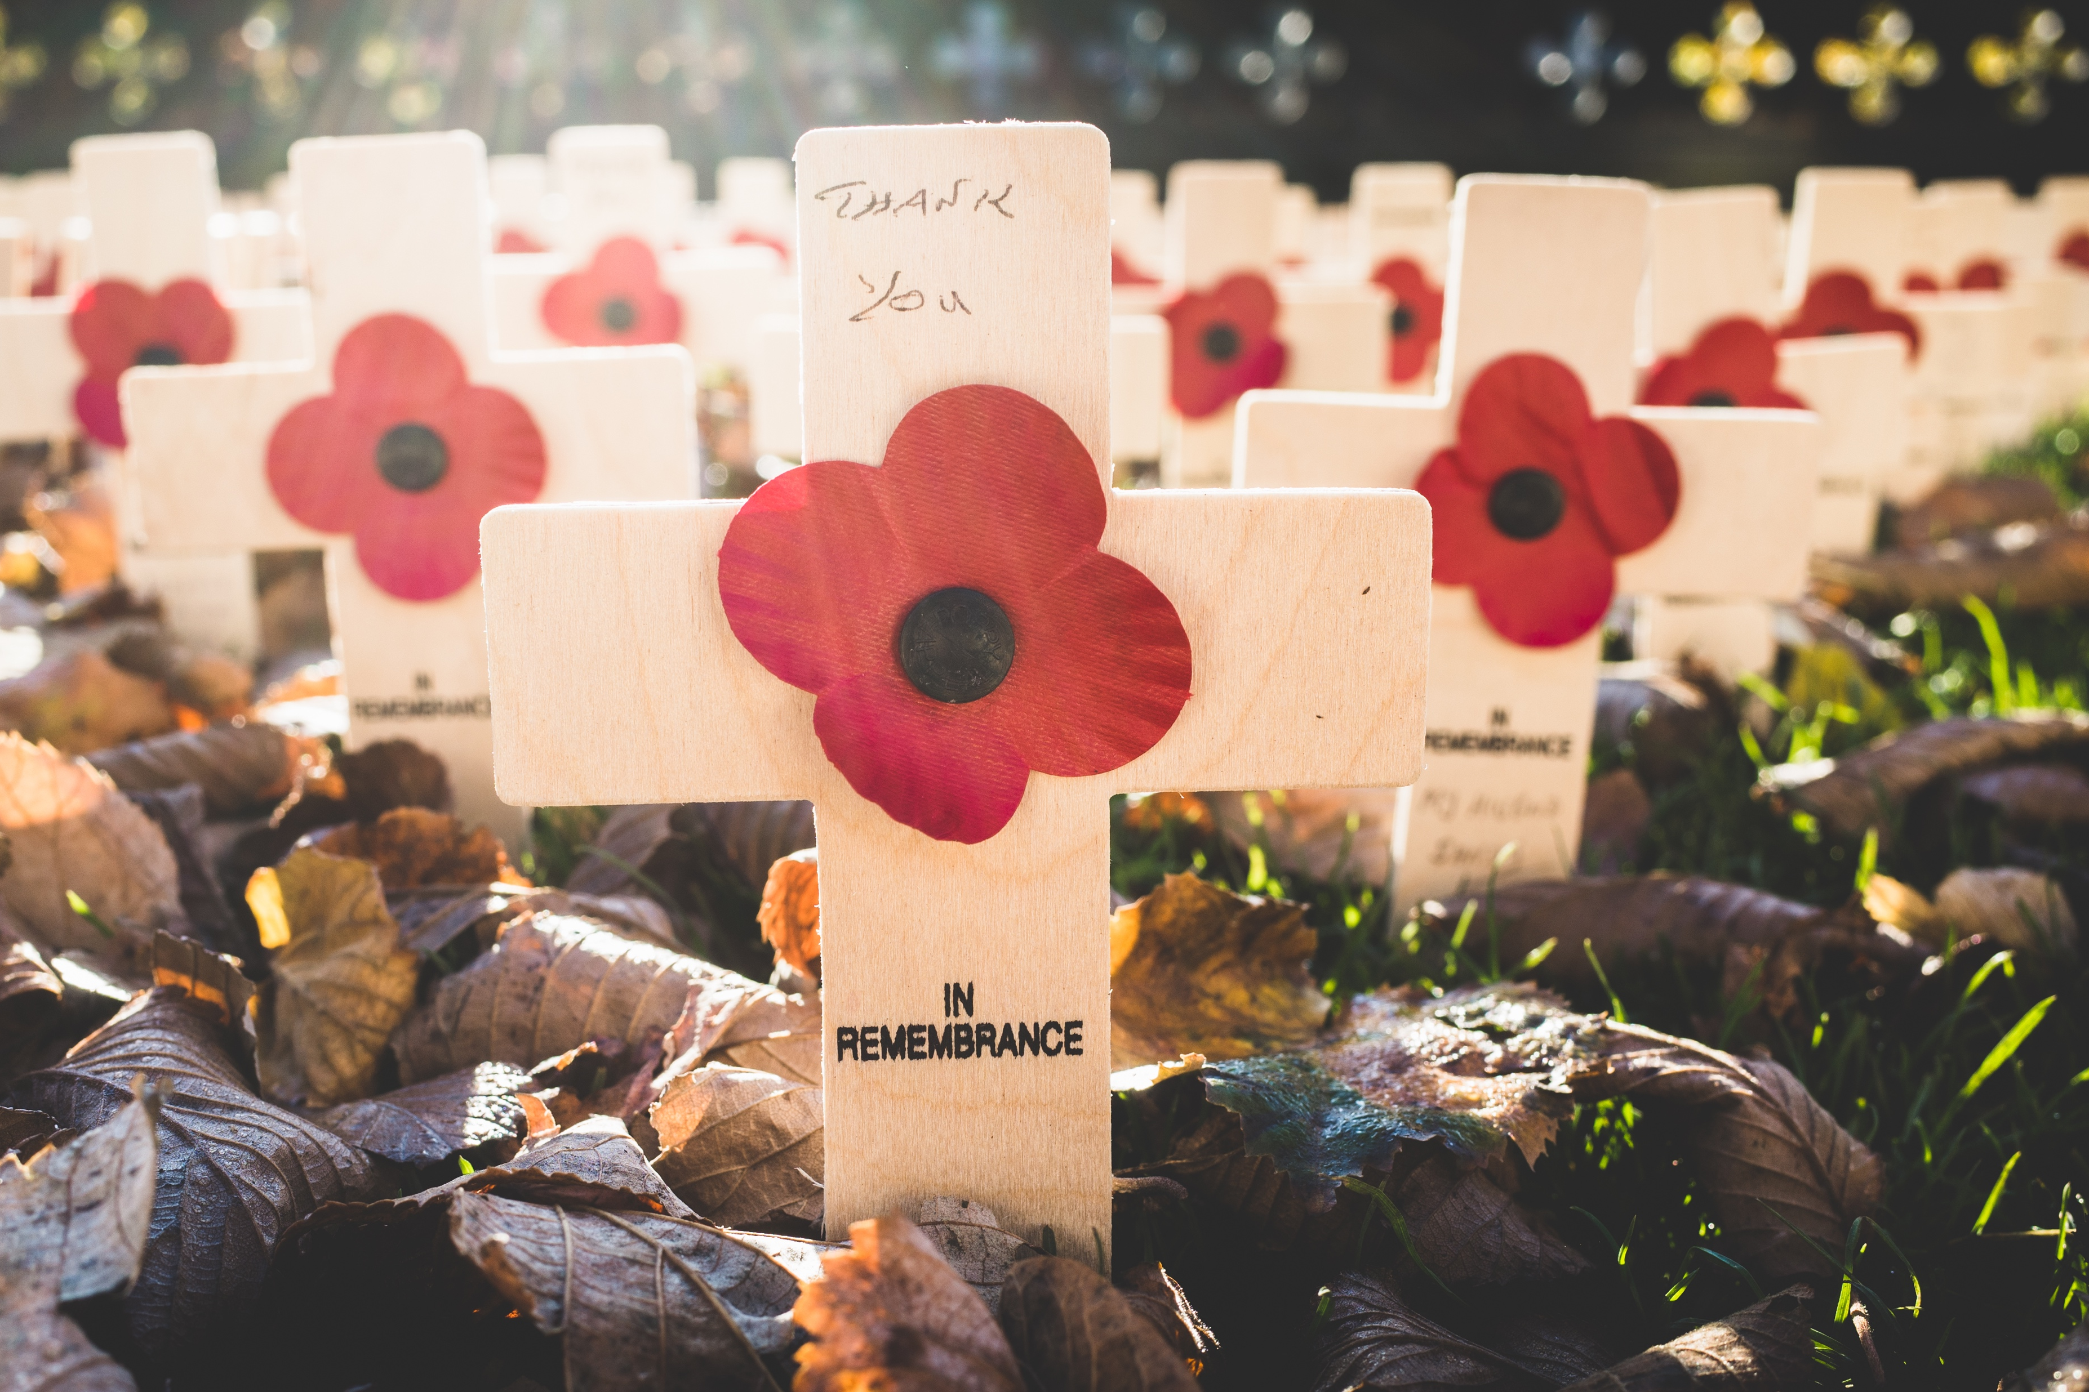
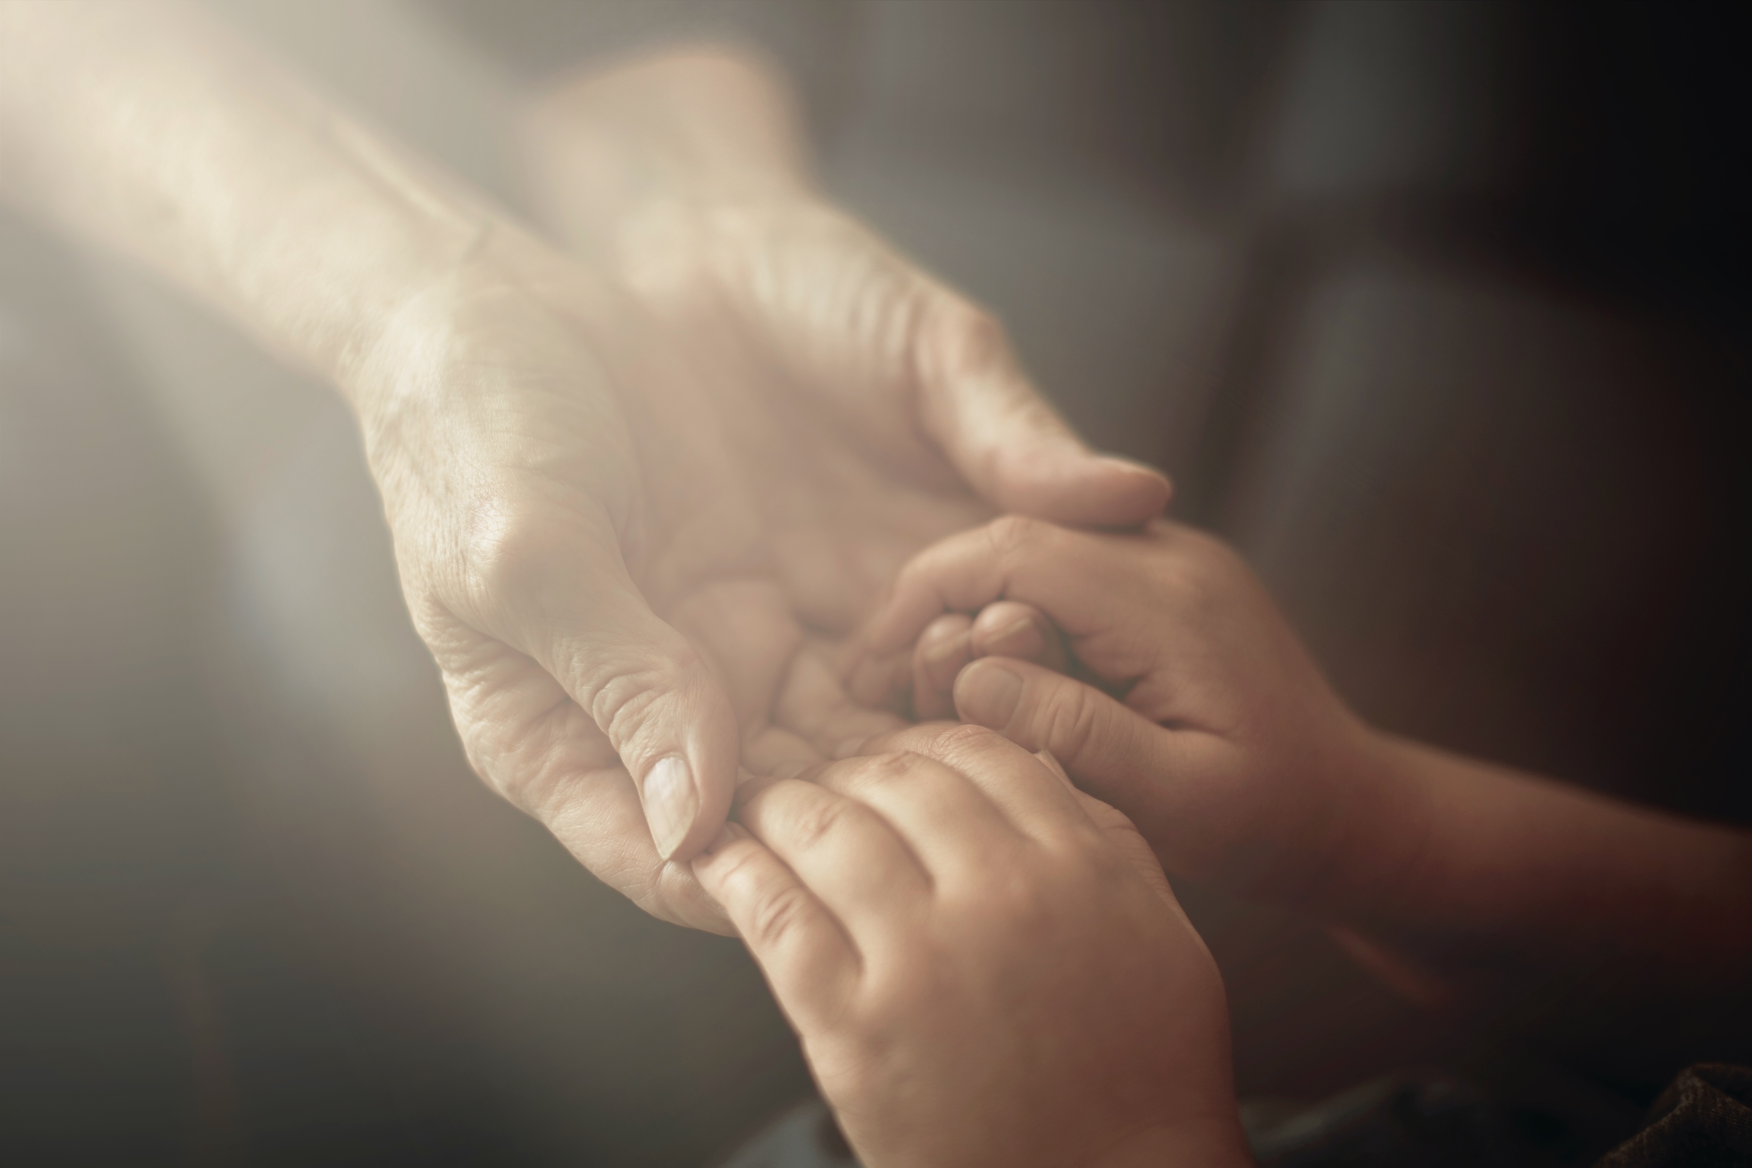
1
2
3
4
5
6
Notes:
Activate knowledge
[Slide contains pictures from RESOURCE 8.1 – Sacrifice pictures.]
Divide students into small groups.
Allocate a different picture to each group.
Invite groups to discuss what they see in their picture and what the picture illustrates about sacrifice (giving up something for someone else).
Invite groups to share their explanations with the class.

Slide 4
Cave Hero Tribute
After their rescue, 12 young footballers and their coach mourn the loss of Navy diver Saman Kunan who died rescuing them from an underwater cave.
About a week after their rescue, the boys were told about the former Navy Seal’s personal sacrifice for them. Kunan was part of a team of people who were willing to risk their safety to rescue the desperate boys and their coach from the cave. They were powerless. They were not able to save themselves after water flooded the exit to the cave.
The 38-year-old Navy diver delivered three oxygen tanks to the boys but lost consciousness on his return trip. His diving partner was unable to revive him. The boys were in tears when they found out about the man’s death on their behalf. They expressed thanks to Saman Kunan by bowing to his picture.
Notes:
Focus on language
[Slide contains RESOURCE 8.2 – Sacrifice text. It will at first appear blank.]
Divide students into small groups.
Tell students that you will read a text about sacrifice twice.
Invite students to listen the first time and take notes as they listen again.
Read the following text aloud twice:
Cave Hero Tribute
After their rescue, 12 young footballers and their coach mourn the loss of Navy diver Saman Kunan who died rescuing them from an underwater cave.
About a week after their rescue, the boys were told about the former Navy Seal’s personal sacrifice for them. Kunan was part of a team of people who were willing to risk their safety to rescue the desperate boys and their coach from the cave. They were powerless. They were not able to save themselves after water flooded the exit to the cave.
The 38-year-old Navy diver delivered three oxygen tanks to the boys but lost consciousness on his return trip. His diving partner was unable to revive him. The boys were in tears when they found out about the man’s death on their behalf. They expressed thanks to Saman Kunan by bowing to his picture.
Invite small groups to work together to write a summary of the information in the text.
Invite one group to read out their summary.
Invite others to add details and correct any content.
Click your mouse to show the text on the slide.
Divide students into pairs.
Invite students to read the text in pairs, noting new words.
Define any new words as a class.

Slide 5
If I found out that someone had died to rescue me, I would feel …
Notes:
Undertake speaking tasks
Speaking task 1: Complete the sentence
Divide students into pairs.
Invite pairs to create as many endings to the sentences as they can.
Invite pairs to share some of their sentences with the class.

Slide 6
Cave Hero Tribute
After their rescue, 12 young footballers and their coach mourn the loss of Navy diver Saman Kunan who died rescuing them from an underwater cave.
About a week after their rescue, the boys were told about the former Navy Seal’s personal sacrifice for them. Kunan was part of a team of people who were willing to risk their safety to rescue the desperate boys and their coach from the cave. They were powerless. They were not able to save themselves after water flooded the exit to the cave.
The 38-year-old Navy diver delivered three oxygen tanks to the boys but lost consciousness on his return trip. His diving partner was unable to revive him. The boys were in tears when they found out about the man’s death on their behalf. They expressed thanks to Saman Kunan by bowing to his picture.
Notes:
Undertake speaking tasks (continued)
[Slide at first appears blank.]
Speaking task 2: Retell from a different perspective
Say ‘I am going to retell the story from the perspective of the soccer coach.’
Retell the story using the following script as a suggestion:
‘How do we thank a man who gave his life for us? I could not save my team but Saman died for us. The boys cried when they found out about his death on their behalf. We will always be in debt to Saman.’
Click your mouse to show the original text on the slide.
Invite students to read it again aloud in their pairs.
Invite students to take turns retelling the story from the perspective of:
a. the boys; or
b. Saman Kunan’s wife.
Invite volunteers to share their perspectives with the class.

Slide 7
1
2
3
4
5
6
Notes:
Undertake speaking tasks (continued)
[Slide contains RESOURCE 8.3 – Sacrifice picture sheet.]
Speaking task 3: Share stories prompted by a picture
Divide students into pairs.
Model telling a short story from your life prompted by a picture on the sheet.
e.g. ‘My great uncle fought in World War I. He was injured and changed by the war. When he returned, he was awarded a Victoria Cross for bravery. He sacrificed his health and wellbeing for our country.’
Invite students to choose a picture that helps them share a story from their life about sacrifice. (Prompt by asking ‘Have you ever given something up for someone else?’ or ‘Has someone made sacrifices for you?’ or ‘Do you know someone who has made a big sacrifice for someone else?’)
Invite students to share stories in their pairs.
Lead into Bible
Say ‘In our Bible time a king dies for his enemies.’

Slide 8
Lesson 8
PART 2
Death of the king
Romans 5:6–9
Notes:
(Part 2 title page)

Slide 9
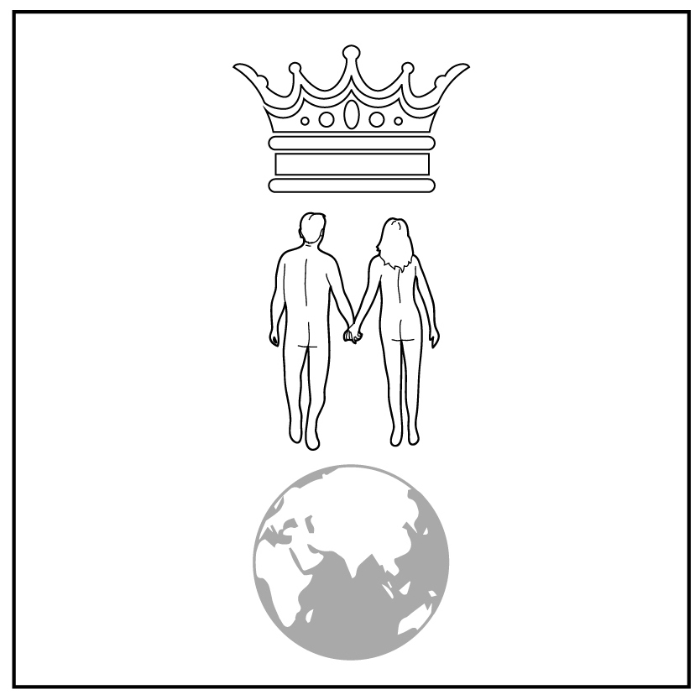
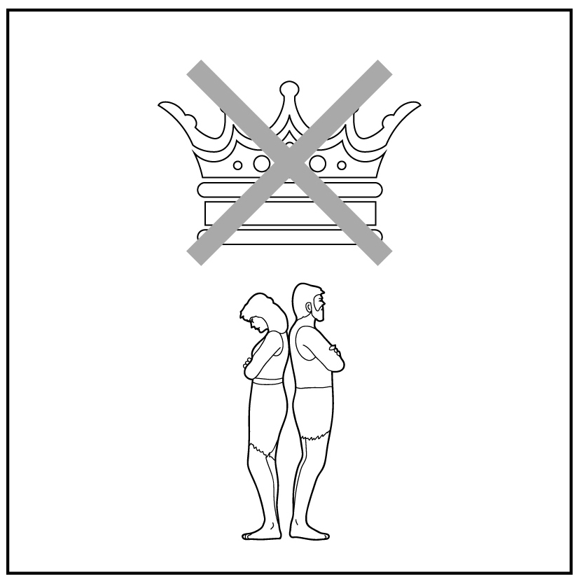
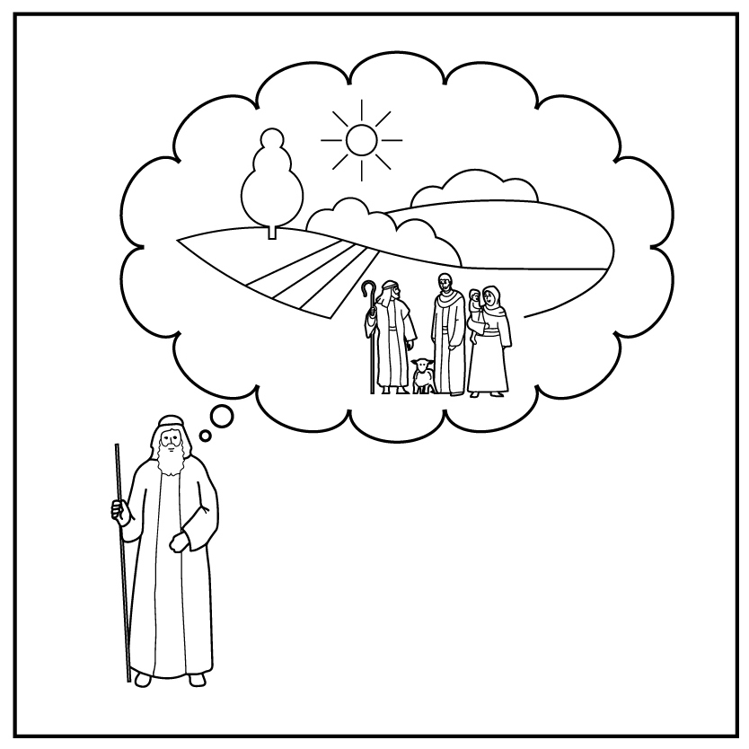
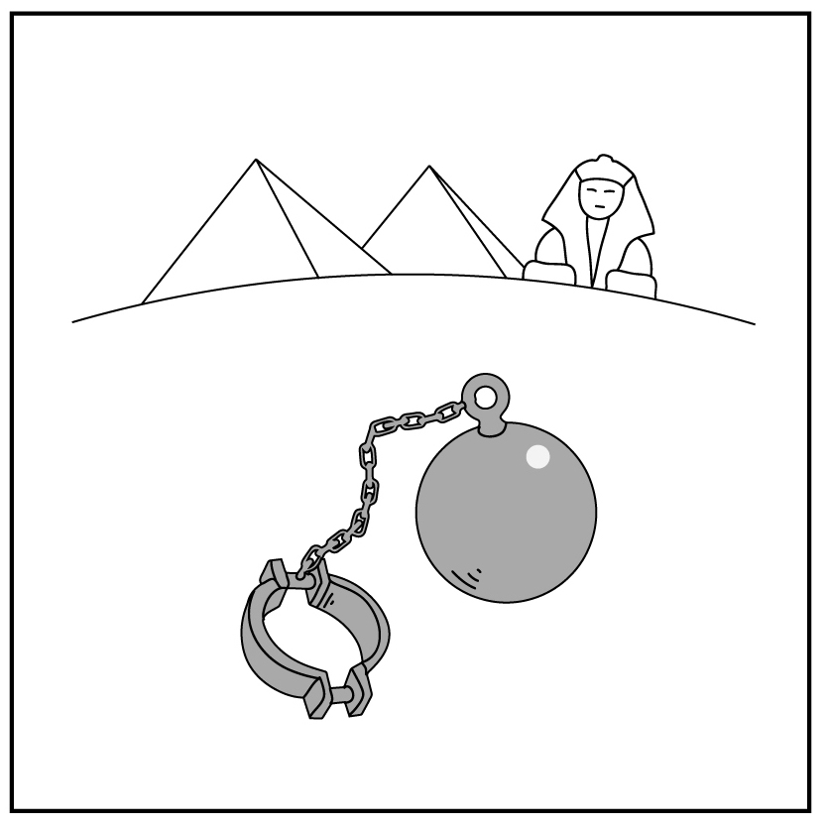
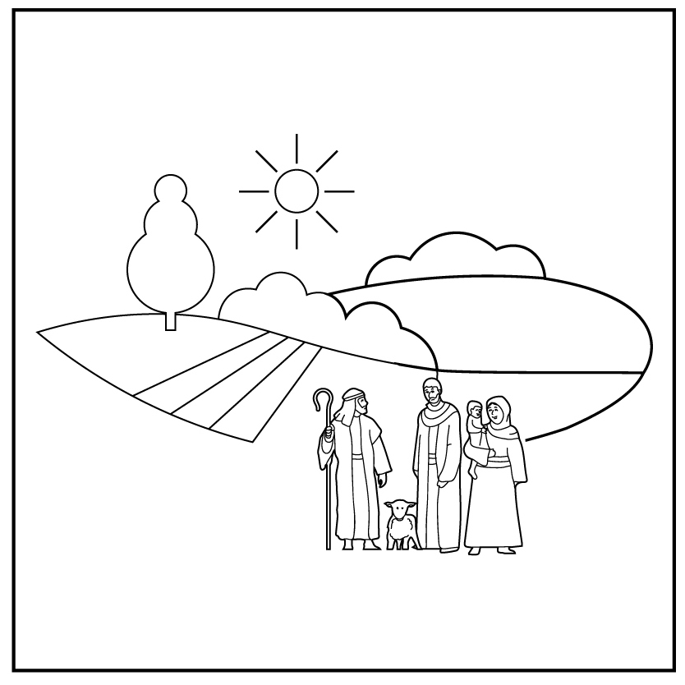
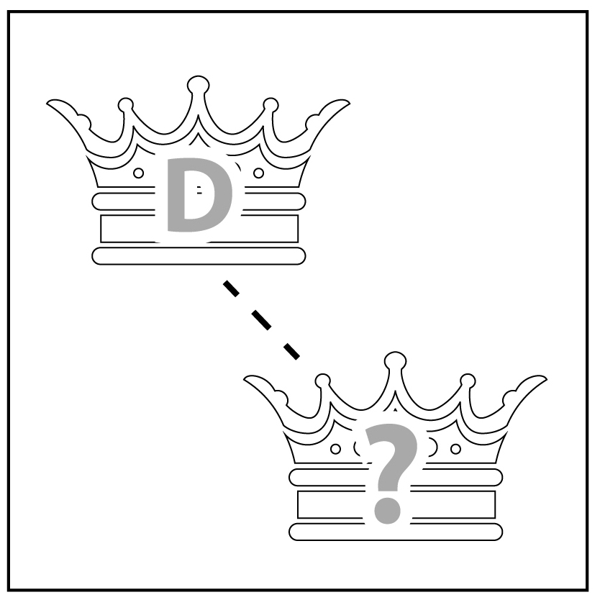
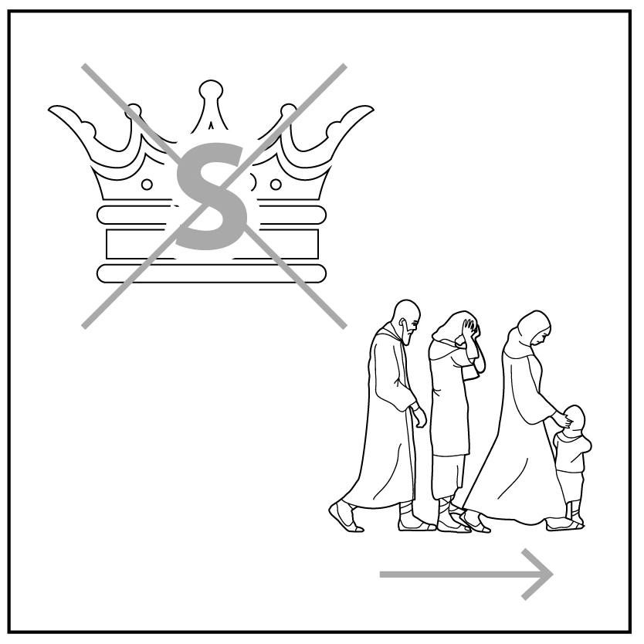

1
2
3
4a
4b
5
Creation
Rejection
Abraham
Egypt
Moses
King David
6
7
8
9
10
King Solomon
King Jesus
Notes:
Review previous lessons
[This slide contains the timeline with the icons from previous lessons inserted.]
Invite a volunteer to summarise the previous lessons as you point to each icon on the timeline. Prompt if necessary.
Icon 1: God made a good world, and he rules over it. God made people to be his friends and rule the world under him.
Icon 2: People rejected God’s rule and broke their friendship with him. God sent them out of the garden.
Icon 3: God chose a man and promised to bless his descendants with their own land under his rule. God promised to bless all people through them.
Icon 4a: Abram lived with his descendants in the land but during a famine they went to Egypt. After a long time, they became slaves in Egypt.
Icon 4b: God used Moses to rescue his people from slavery in Egypt and promised to give them their own land.
Icon 5: God gave the people a good king to rule them in their land. God promised that a descendant of King David would one day rule forever.
Icon 6: David’s son, King Solomon, disobeyed God. God took the kingdom from him and sent his people out of their land.
Icon 7: God’s promise to bless the world was fulfilled in King Jesus, a descendant of King David.

Slide 10
The king must die.
Notes:
Predict the content
Say ‘This is a sentence about the Bible text.’
Ask ‘What do you think the Bible text will be about?’
Accept responses.

Slide 11
Romans 5:6–9 (paraphrase)
This Bible paraphrase will be referred to later in the lesson.
At just the right time, Christ died for people who had not obeyed God.
He died for us when we were powerless. It is unusual for anyone to die
for someone else. Maybe someone would be willing to die for a good person. But God has shown us how much he loves us. Even when we
did not obey God, Christ died on our behalf.
Because Christ died on the cross, God accepts us. So we know that Christ will save us when God judges everyone. Because of Jesus, God will not be angry with us or punish us. While we were still God’s enemies, God’s Son died on our behalf. As a result, we became God’s friends.
Romans 5:6–9 (paraphrase)
This Bible paraphrase will be referred to later in the lesson.
At just the right time, Christ died for people who had not obeyed God.
He died for us when we were powerless. It is unusual for anyone to die
for someone else. Maybe someone would be willing to die for a good person. But God has shown us how much he loves us. Even when we
did not obey God, Christ died on our behalf.
Because Christ died on the cross, God accepts us. So we know that Christ will save us when God judges everyone. Because of Jesus, God will not be angry with us or punish us. While we were still God’s enemies, God’s Son died on our behalf. As a result, we became God’s friends.
Romans 5:6–9
At just the right time, Christ died for people who had not obeyed God.
He died for us when we were powerless. It is unusual for anyone to die
for someone else. Maybe someone would be willing to die for a good person. But God has shown us how much he loves us. Even when we
did not obey God, Christ died on our behalf.
Because Christ died on the cross, God accepts us. So we know that Christ will save us when God judges everyone. Because of Jesus, God will not be angry with us or punish us. While we were still God’s enemies, God’s Son died on our behalf. As a result, we became God’s friends.
Romans 5:6–9 (paraphrase)
This Bible paraphrase will be referred to later in the lesson.
At just the right time, Christ died for people who had not obeyed God.
He died for us when we were powerless. It is unusual for anyone to die
for someone else. Maybe someone would be willing to die for a good person. But God has shown us how much he loves us. Even when we
did not obey God, Christ died on our behalf.
Because Christ died on the cross, God accepts us. So we know that Christ will save us when God judges everyone. Because of Jesus, God will not be angry with us or punish us. While we were still God’s enemies, God’s Son died on our behalf. As a result, we became God’s friends.
Romans 5:6–9 (paraphrase)
This Bible paraphrase will be referred to later in the lesson.
At just the right time, Christ died for people who had not obeyed God.
He died for us when we were powerless. It is unusual for anyone to die
for someone else. Maybe someone would be willing to die for a good person. But God has shown us how much he loves us. Even when we
did not obey God, Christ died on our behalf.
Because Christ died on the cross, God accepts us. So we know that Christ will save us when God judges everyone. Because of Jesus, God will not be angry with us or punish us. While we were still God’s enemies, God’s Son died on our behalf. As a result, we became God’s friends.
Romans 5:6–9 (paraphrase)
This Bible paraphrase will be referred to later in the lesson.
At just the right time, Christ died for people who had not obeyed God.
He died for us when we were powerless. It is unusual for anyone to die
for someone else. Maybe someone would be willing to die for a good person. But God has shown us how much he loves us. Even when we
did not obey God, Christ died on our behalf.
Because Christ died on the cross, God accepts us. So we know that Christ will save us when God judges everyone. Because of Jesus, God will not be angry with us or punish us. While we were still God’s enemies, God’s Son died on our behalf. As a result, we became God’s friends.
Romans 5:6–9 (paraphrase)
This Bible paraphrase will be referred to later in the lesson.
At just the right time, Christ died for people who had not obeyed God.
He died for us when we were powerless. It is unusual for anyone to die
for someone else. Maybe someone would be willing to die for a good person. But God has shown us how much he loves us. Even when we
did not obey God, Christ died on our behalf.
Because Christ died on the cross, God accepts us. So we know that Christ will save us when God judges everyone. Because of Jesus, God will not be angry with us or punish us. While we were still God’s enemies, God’s Son died on our behalf. As a result, we became God’s friends.
Romans 5:6–9 (paraphrase)
This Bible paraphrase will be referred to later in the lesson.
At just the right time, Christ died for people who had not obeyed God.
He died for us when we were powerless. It is unusual for anyone to die
for someone else. Maybe someone would be willing to die for a good person. But God has shown us how much he loves us. Even when we
did not obey God, Christ died on our behalf.
Because Christ died on the cross, God accepts us. So we know that Christ will save us when God judges everyone. Because of Jesus, God will not be angry with us or punish us. While we were still God’s enemies, God’s Son died on our behalf. As a result, we became God’s friends.
Romans 5:6–9 (paraphrase)
This Bible paraphrase will be referred to later in the lesson.
At just the right time, Christ died for people who had not obeyed God.
He died for us when we were powerless. It is unusual for anyone to die
for someone else. Maybe someone would be willing to die for a good person. But God has shown us how much he loves us. Even when we
did not obey God, Christ died on our behalf.
Because Christ died on the cross, God accepts us. So we know that Christ will save us when God judges everyone. Because of Jesus, God will not be angry with us or punish us. While we were still God’s enemies, God’s Son died on our behalf. As a result, we became God’s friends.
Romans 5:6–9 (paraphrase)
This Bible paraphrase will be referred to later in the lesson.
At just the right time, Christ died for people who had not obeyed God.
He died for us when we were powerless. It is unusual for anyone to die
for someone else. Maybe someone would be willing to die for a good person. But God has shown us how much he loves us. Even when we
did not obey God, Christ died on our behalf.
Because Christ died on the cross, God accepts us. So we know that Christ will save us when God judges everyone. Because of Jesus, God will not be angry with us or punish us. While we were still God’s enemies, God’s Son died on our behalf. As a result, we became God’s friends.
Romans 5:6–9 (paraphrase)
This Bible paraphrase will be referred to later in the lesson.
At just the right time, Christ died for people who had not obeyed God.
He died for us when we were powerless. It is unusual for anyone to die
for someone else. Maybe someone would be willing to die for a good person. But God has shown us how much he loves us. Even when we
did not obey God, Christ died on our behalf.
Because Christ died on the cross, God accepts us. So we know that Christ will save us when God judges everyone. Because of Jesus, God will not be angry with us or punish us. While we were still God’s enemies, God’s Son died on our behalf. As a result, we became God’s friends.
Notes:
Read and comprehend
(Optional: Invite students to read Romans 5:6–9 in their heart languages.)
[Slide contains RESOURCE 8.4 – Paraphrased Bible text.]
Activity 1: Spoken gap-fill
Distribute RESOURCE 8.4 – Paraphrased Bible text to each student (if using).
Invite students to read the text quietly.
Read the following words aloud, inviting students to find them in the text:
friends
powerless
good
behalf
accepts
save
unusual
enemies
judges.
Click your mouse to reveal the words one by one, in the above order.
Define each word together as it appears.
Click your mouse to restore all text on the slide to black.
Read the text below slowly, pausing to prompt students to contribute the missing content:
At just the right time, Christ died for people who had not obeyed God. He died for us when we were (pause) _______ (powerless).
It is (pause) _______ (unusual) for anyone to die for someone else.
Maybe someone would be willing to die for a (pause) _______ (good) person.
But God has shown us how much he loves us. Even when we did not obey God, Christ died on our (pause) _______ (behalf).
Because Christ died on the cross, God (pause) _______ (accepts) us.
So we know that Christ will (pause) _______ (save) us when God (pause) _______ (judges) everyone.
Because of Jesus, God will not be angry with us or punish us.
While we were still God’s (pause) _______ (enemies), God’s Son died on our behalf. As a result, we became God’s (pause) _______ (friends).

Slide 12
Romans 5:6–9
At just the right time, Christ died for people who had not obeyed God.
He died for us when we were powerless. It is unusual for anyone to die for someone else. Maybe someone would be willing to die for a good person. But God has shown us how much he loves us. Even when we did not obey God, Christ died on our behalf.
Because Christ died on the cross, God accepts us. So we know that Christ will save us when God judges everyone. Because of Jesus, God will not be angry with us or punish us. While we were still God’s enemies, God’s Son died on our behalf. As a result, we became God’s friends.
Notes:
Read and comprehend (continued)
Activity 2: Vocabulary building
Say the verbs listed below one by one and invite the class to suggest:
a synonym/word(s) with a similar meaning
the past tense.
Words: die (a. decease, pass away; b. died), show (a. reveal; b. has shown/showed), obey (a. follow; b. obeyed), accept (a. welcome; b. accepted), save (a. rescue; b. saved), judge (a. condemn; b. judged).
Activity 3: True or false
Make the following statements, inviting students to respond with a thumbs up or thumbs down indicating true or false:
Jesus died for his friends. (F – he died for his enemies.)
If we try to be good, God will accept us. (F – he will accept us if we trust in Jesus.)
We can only hope that God will welcome us into heaven. (F – heaven is certain for those who trust Jesus.)
We can become friends with God because what Jesus has done, not because of what we do. (T)

Slide 13
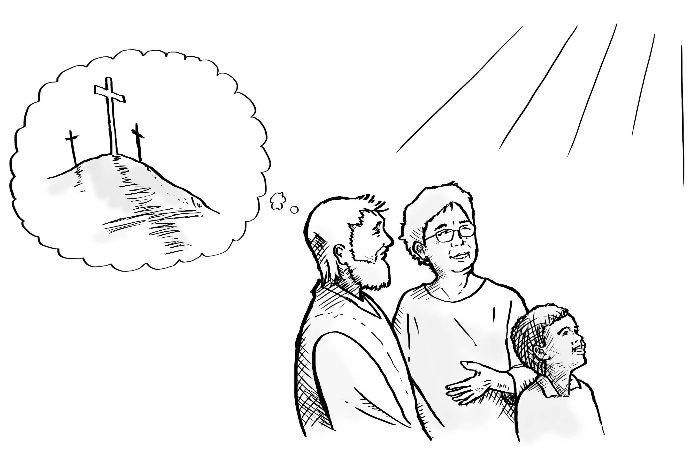
Notes:
Invite curiosity
[Slide contains RESOURCE 8.5 – Summary sketch. It will at first appear blank.]
Ask ‘Do you have any questions or comments about the story?’
Accept responses and discuss.
Student summary
Click to reveal the Summary sketch.
Invite a volunteer to summarise the Bible text in their own words.

Slide 14

1
2
3
4a
4b
5
Creation
Rejection
Abraham
Egypt
Moses
King David
6
7
8
9
10
King Solomon
King Jesus
Jesus dies
Notes:
Timeline and summary statement
[This slide at first contains the timeline with only the icons from the previous lessons already inserted.]
Click to reveal the icon for this lesson inserted in the timeline (RESOURCE 8.6 – Lesson 8 icon).
Say ‘When Jesus died, he took our punishment for rejecting God so that we can be God’s friends instead of his enemies.’
An important question
‘How was it possible for God to love his enemies?’

