Slide 1
Lesson 4
Bible Overview
Ten Bible-based English lessons
Intermediate
Notes:
(Lesson 1 title page)

Slide 2
Lesson 4
PART 1
A beach rescue
Notes:
(Part 1 title page)

Slide 3
the beach
Notes:
Activate knowledge
Invite students to each say one thing they know about the beach.
(Note: You may wish to go around the class a few times to generate more phrases and words.)

Slide 4
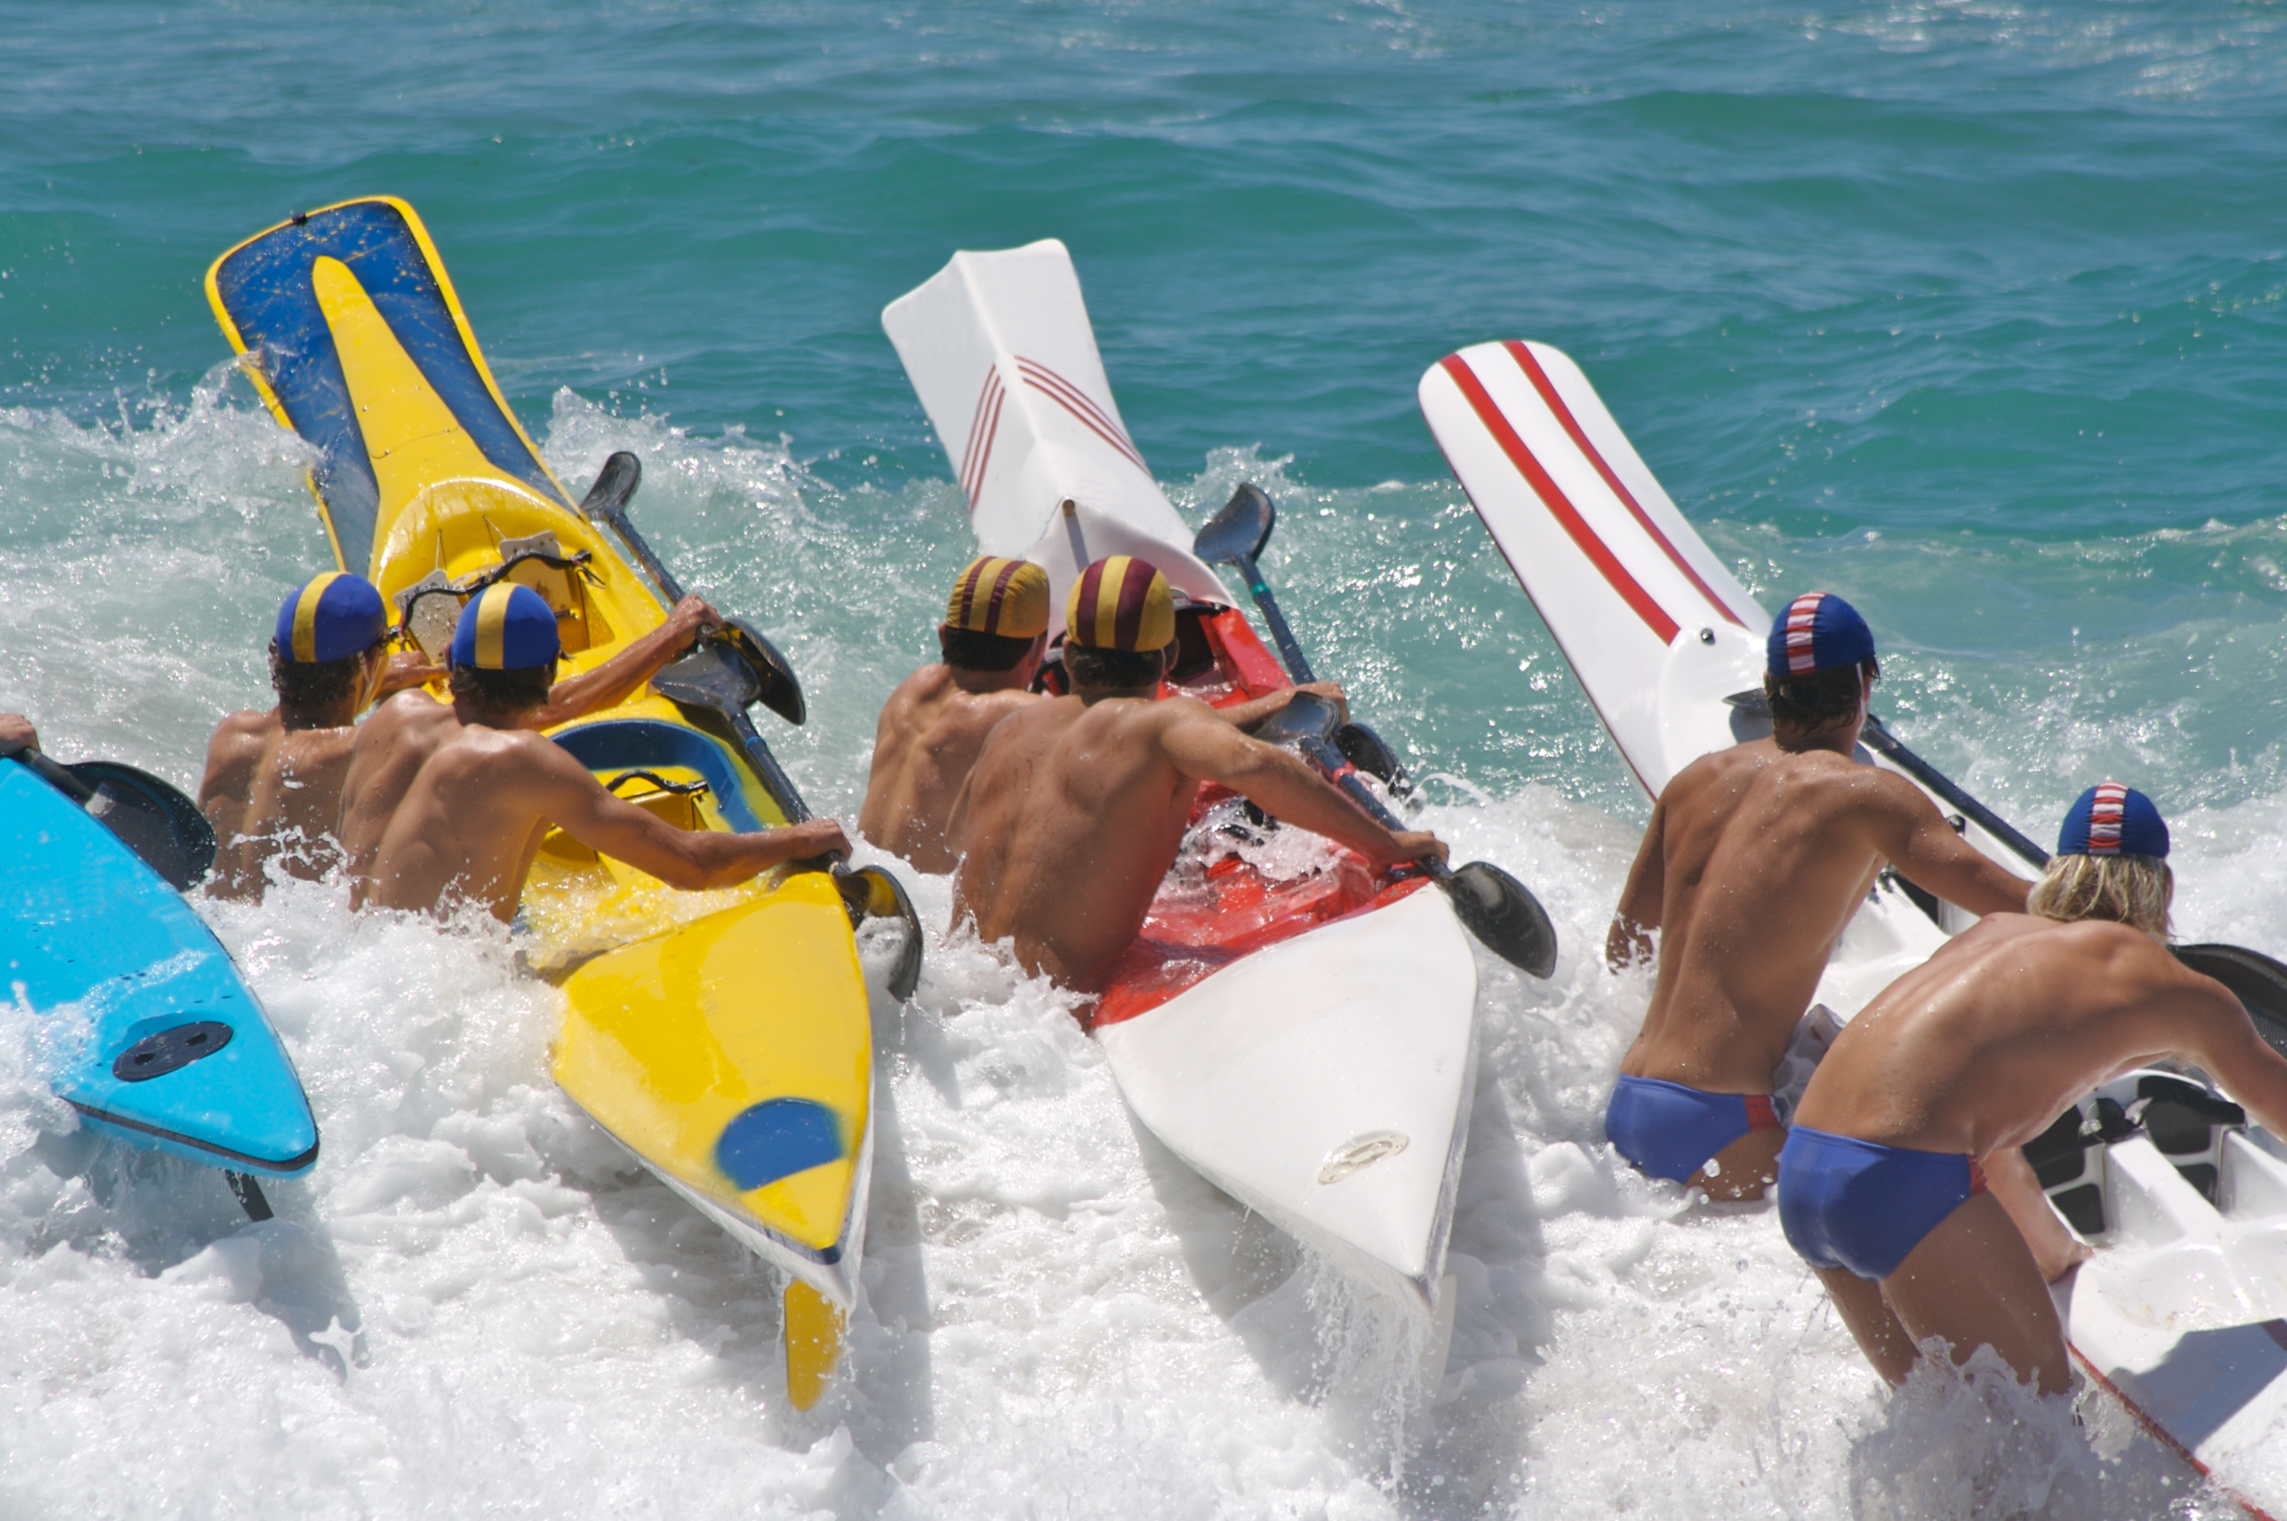
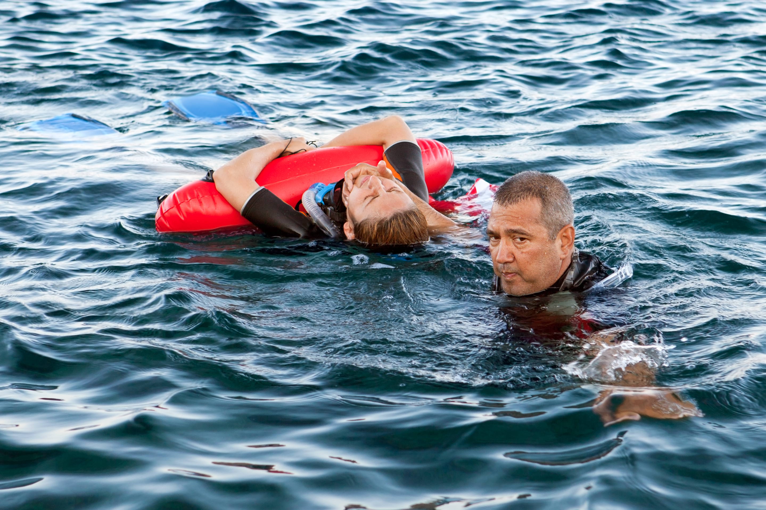
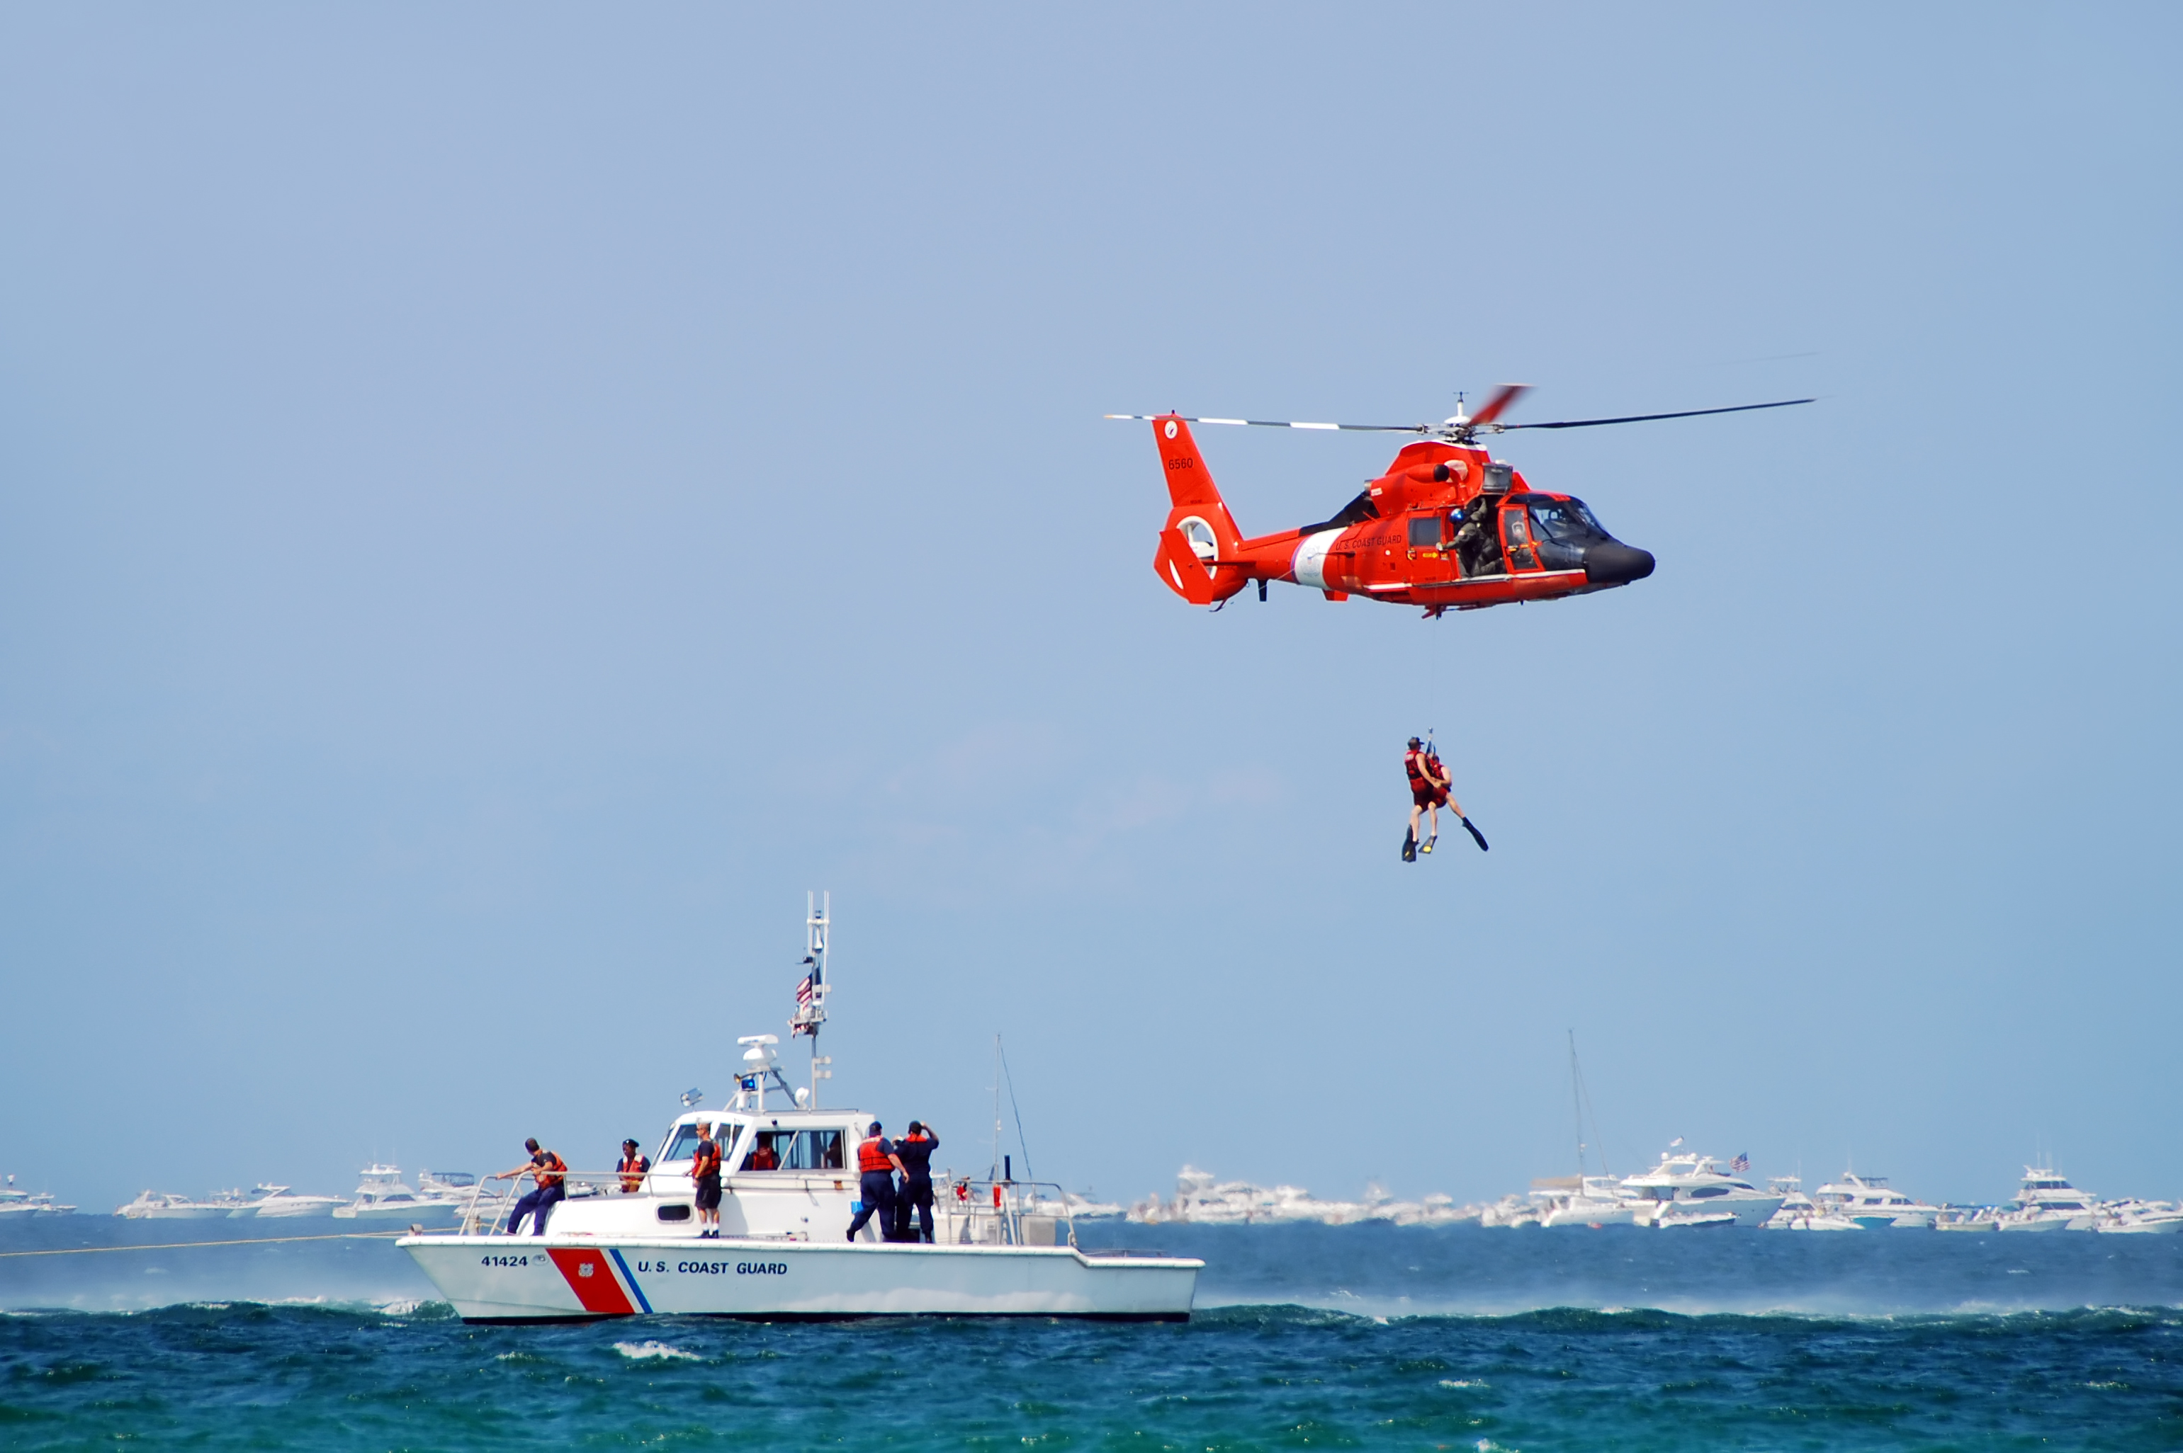
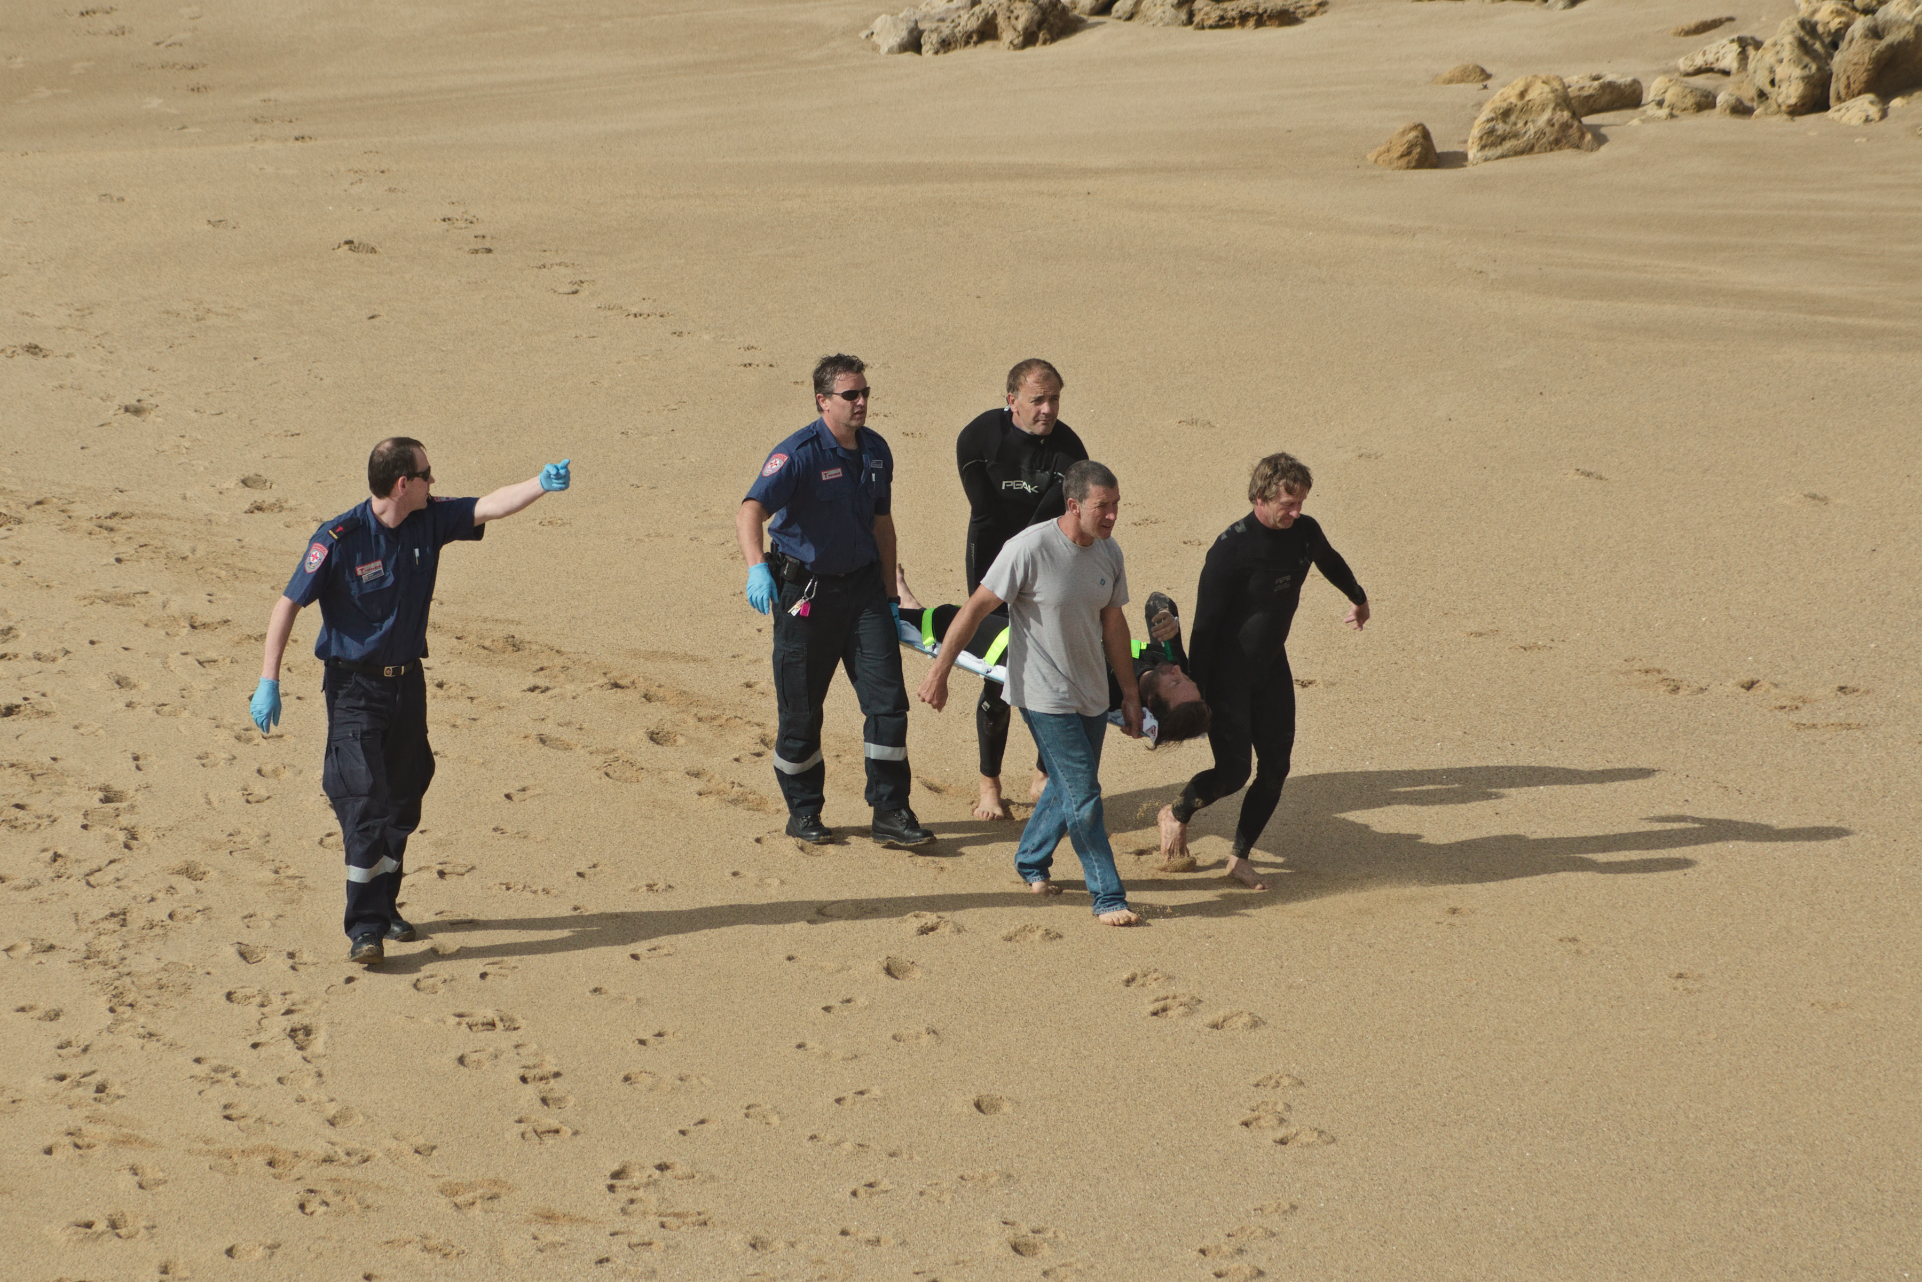
1
2
3
4
Notes:
Activate knowledge (continued)
[Slide contains RESOURCE 4.1 – Beach rescue pictures.]
Divide students into small groups.
Allocate a picture or pictures to each group without telling the other groups which picture(s) you have allocated.
Invite each group to discuss what they think is happening in the pictures picture(s) they have been allocated.
Invite a volunteer from each group to describe one of the pictures for the class to guess which one they are describing.

Slide 5
Sing and his family settled in Australia. Over time, they began to understand Australian culture better. They thought Australia was spacious and peaceful, but they would always remember and treasure their home country.
In Australia, they lived near the bush and the beach. They enjoyed the beach, but Sing’s dad was concerned because Sing was not a strong swimmer. One day in summer they learnt some very important lessons about being safe at the beach …
Notes:
Focus on language
[Slide contains RESOURCE 4.2 – Life in Australia text.]
Invite students to read the text quietly, noting words that are new to them.
Say the following words and invite students to find each word in the text and say the sentence the word is in:
settled
understand
culture
spacious
peaceful
treasure
bush
beach
concerned
safe
Define the meaning of the words using mime, synonyms and simple pictures on the board (if you have one).

Slide 6
settled treasure
understand bush
culture beach
spacious concerned
peaceful safe
Notes:
Focus on language (continued)
Read the text below slowly, inviting students to put their hands up when they hear each of the words on the slide. (If necessary, pause on the words in bold to prompt a response.)
Sing and his family settled in Australia. Over time, they began to understand Australian culture better. They thought Australia was spacious and peaceful, but they would always remember and treasure their home country. In Australia, they lived near the bush and the beach. They enjoyed the beach, but Sing’s dad was concerned because Sing was not a strong swimmer. One day in summer they learnt some very important lessons about being safe at the beach …

Slide 7
Wear a rash shirt and a hat
Apply sunscreen every 2 hours
Drink a lot of water
Obey the signs
Swim between the flags
Only swim at beaches patrolled by lifesavers
Raise your arm if you need help in the water
Never swim alone
Notes:
Undertake speaking tasks
[Slide contains Part A of RESOURCE 4.3 – Beach instructions and reasons. It will at first appear blank.]
Speaking task 1: Pair discussion
Divide students into pairs.
Invite students to brainstorm and list important instructions for staying safe at the beach.
Invite pairs to take turns sharing their instructions.
Click to reveal beach instructions from Part A of RESOURCE 4.3 – Beach instructions and reasons.
Speaking task 2: Matching instructions with reasons
Read each instruction aloud.
Ask ‘Why is this important?’
Accept responses.
Answers:
1. to protect you from the sun.
2. because it only protects your skin for 2 hours.
3. to avoid dehydration.
4. because they contain important safety information.
5. because this is where the lifesavers can see you.
6. because they rescue swimmers in trouble.
7. because this shows people you need help.
8. because there will be no-one to help you.

Slide 8
Sing’s dad said to Sing:
I am ________________ about you.
Be careful at the ________________.
I have seen many people in ________________ at the beach.
I have heard them ________________ for help.
Always swim between the ________________.
Always ________________ the safety signs.
If you need help in the water, raise your arm so that the lifeguard will see you and ________________ you.
Sing said to his father:
I will do ________________ that you have said.
trouble
save
concerned
beach
cry out
everything
flags
obey
concerned
beach
trouble
cry out
flags
obey
save
everything
Notes:
Undertake speaking tasks (continued)
[Slide replaces RESOURCE 4.4 – Gap-fill.]
Speaking task 3: Gap-fill
Invite one student at a time to read a sentence aloud inserting the correct word.
Click your mouse after each sentence to place the correct word in the gap.
Lead into Bible
Say ‘Our Bible time is about an important rescue.’

Slide 9
Lesson 4
PART 2
God rescues and restores his people
Exodus 3:4, 7–8a; 19:4–8
Notes:
(Part 2 title page)

Slide 10
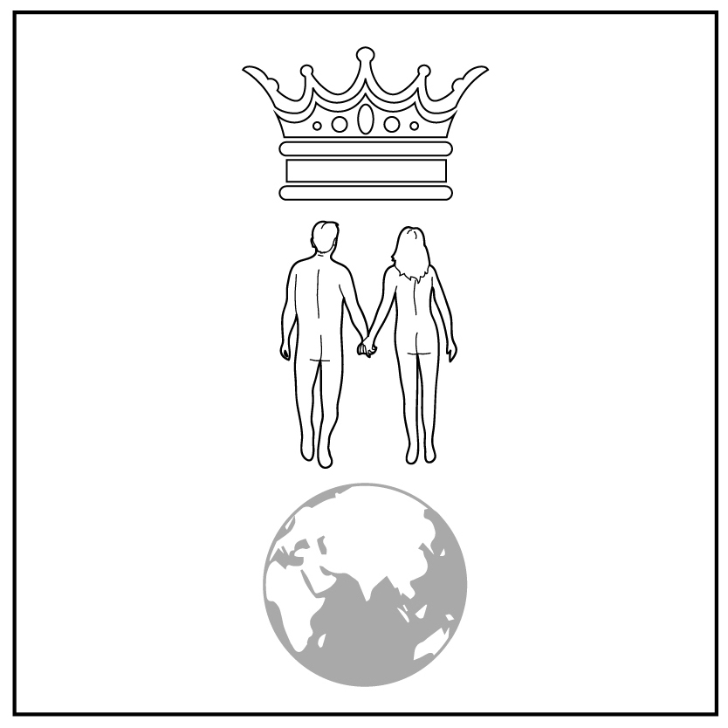
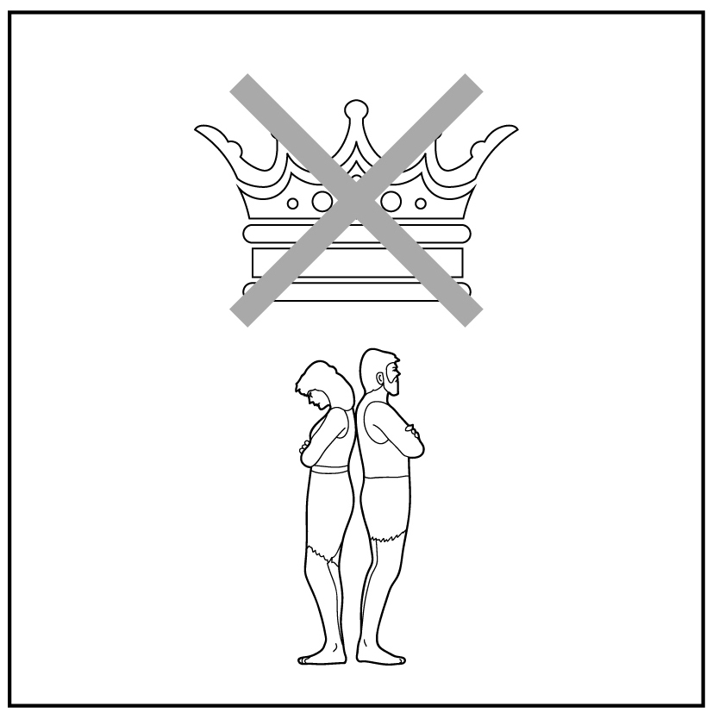
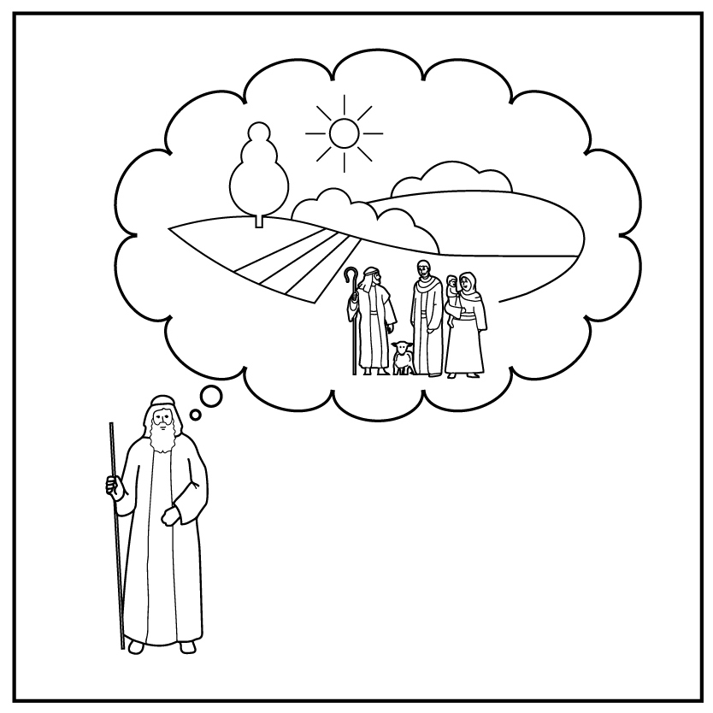
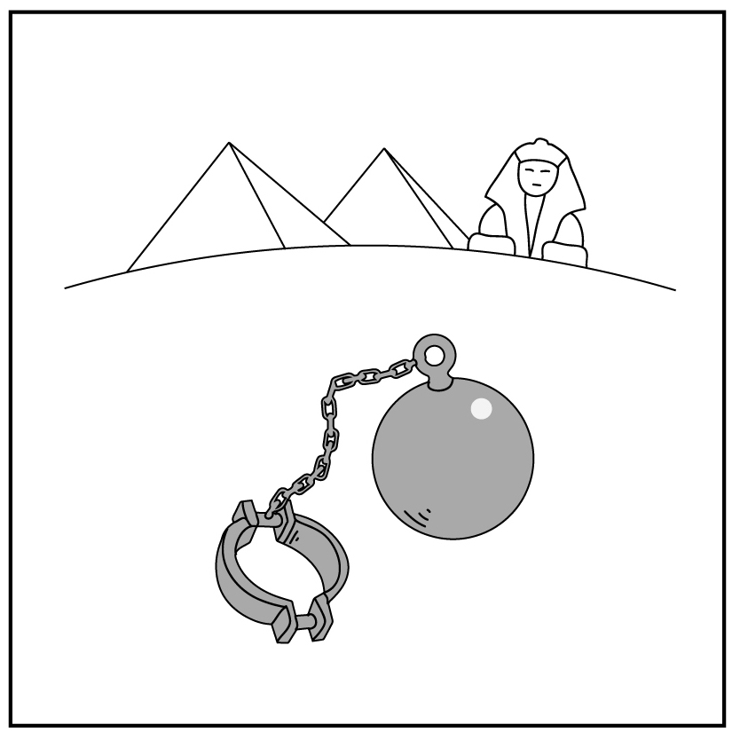
1
2
3
4a
4b
5
Creation
Rejection
Abraham
Egypt
6
7
8
9
10
Notes:
Review previous lesson
[This slide at first contains the timeline with only the icons from previous lessons inserted.]
Invite a volunteer to summarise the previous lessons as you point to each icon on the timeline. Prompt if necessary.
Icon 1: God made a good world, and he rules over it. God made people to be his friends and rule the world under him.
Icon 2: People rejected God’s rule and broke their friendship with him. God sent them out of the garden.
Icon 3: God chose a man and promised to bless his descendants with their own land under his rule. God promised to bless all people through them.
Say ‘In the text we will read today, Abram’s descendants are no longer in their land.’
Click to reveal Icon 4a inserted in the timeline (the first icon from RESOURCE 4.7 – Lesson 4 icons).
Say ‘Abram lived with his descendants in the land but during a famine they went to Egypt. After a long time, they became slaves in Egypt.’

Slide 11
God rescues his
people from Egypt
Notes:
Predict the content
Ask ‘What do you know about this story?’
(If necessary, prompt by asking ‘who, why, how, where’ questions, but don’t give answers at this stage.)
Accept responses.

Slide 12
Part A: Before leaving Egypt (Exodus 3:4, 7–8a)
God spoke to Moses from inside a burning bush. God said to Moses, ‘I have seen my people suffering in Egypt. I have heard them cry out from their slavery. I am concerned about their suffering. So I have come to save them from the Egyptians. I will bring them out of that land. I will bring them into a good land. It is a spacious land flowing with milk and honey.’
Part B: After leaving Egypt (Exodus 19:4–8)
God said, ‘You saw how I carried you out of Egypt and brought you to myself. Now obey me. If you do, you will be my special treasure.’
The people said, ‘We will do everything the Lord has said.’
Notes:
Read and comprehend
(Optional: Invite students to read Exodus 3:4, 7–8a; 19:4–8 in their heart languages.)
[Slide contains RESOURCE 4.5 – Paraphrased Bible text. It will at first appear blank. Do not click to reveal text until Activity 2 below.]
Activity 1: Listen to the text
Read the paraphrased text below aloud twice:
Part A: Before leaving Egypt (Exodus 3:4, 7–8a)
God spoke to Moses from inside a burning bush. God said to Moses, ‘I have seen my people suffering in Egypt. I have heard them cry out from their slavery. I am concerned about their suffering. So I have come to save them from the Egyptians. I will bring them out of that land. I will bring them into a good land. It is a spacious land flowing with milk and honey.’
Part B: After leaving Egypt (Exodus 19:4–8)
God said, ‘You saw how I carried you out of Egypt and brought you to myself. Now obey me. If you do, you will be my special treasure.’
The people said, ‘We will do everything the Lord has said.’
Ask ‘What did you hear?’
Accept responses.
Activity 2: Read and notice details
Click your mouse to reveal the paraphrased Bible text on the slide.
Invite students to read Part A quietly to themselves.
Ask:
What has God done? (I have …)
What will God do? (I will …)
Accept responses.
Invite students to read Part B quietly to themselves.
Ask:
What does God expect from his people?
What does God promise the people?
What do the people promise to do?
Accept responses.
[You may choose to do the following activity if you are face-to-face and have a whiteboard. If not, skip the activity and move to the next slide.]
Activity 3: Pictionary
Say ‘I am going to draw a picture of something in the story. Can you guess what it is?’
Invite students to guess what you are drawing on the board:
burning bush
treasure
spacious land flowing with milk and honey
land flowing with milk and honey
(Note: You could draw the first image and invite a volunteer to draw the next one.)
Discuss the meaning of the word-picture ‘flowing with milk and honey’ (abundant land).

Slide 13
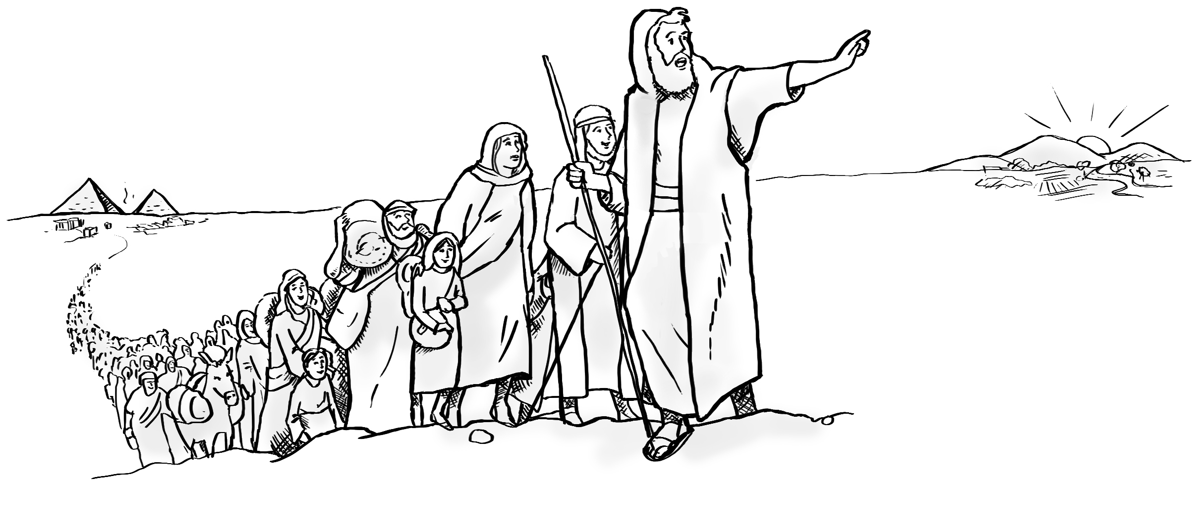
Notes:
Invite curiosity
[Slide contains RESOURCE 4.6 – Summary sketch. It will at first appear blank.]
Ask ‘Do you have any questions or comments about the story?’
Accept responses and discuss.
Student summary
Click to reveal the Summary sketch.
Invite a volunteer to summarise the Bible text in their own words.

Slide 14
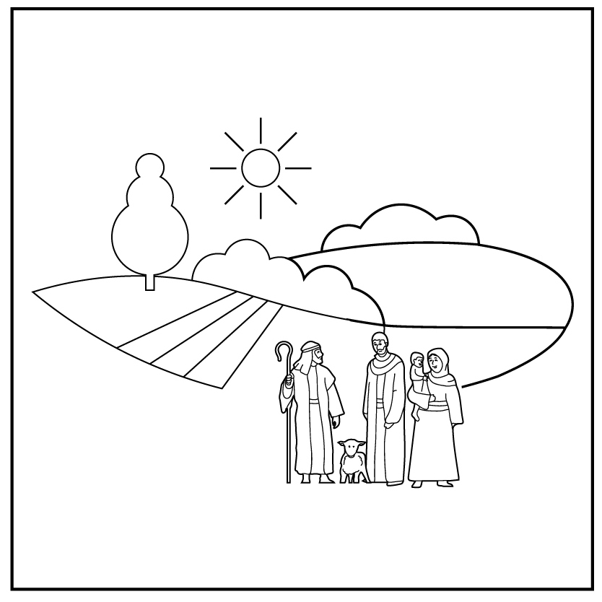
1
2
3
4a
4b
5
Creation
Rejection
Abraham
Egypt
Moses
6
7
8
9
10
Notes:
Timeline and summary statement
[This slide at first contains the timeline with only the icons from the previous lessons and Icon 4a already inserted.]
Click to reveal Icon 4b inserted in the timeline (the second icon from RESOURCE 4.7 – Lesson 4 icons).
Say ‘God used Moses to rescue his people from slavery in Egypt and promised to give them their own land.’
An important question
Ask ‘Will God continue to rule his people?’

