Slide 1
Lesson 1
Bible Overview
Ten Bible-based English lessons
Intermediate
Notes:
(Lesson 1 title page)

Slide 2
Lesson 1
PART 1
A good world
Notes:
(Part 1 title page)

Slide 3
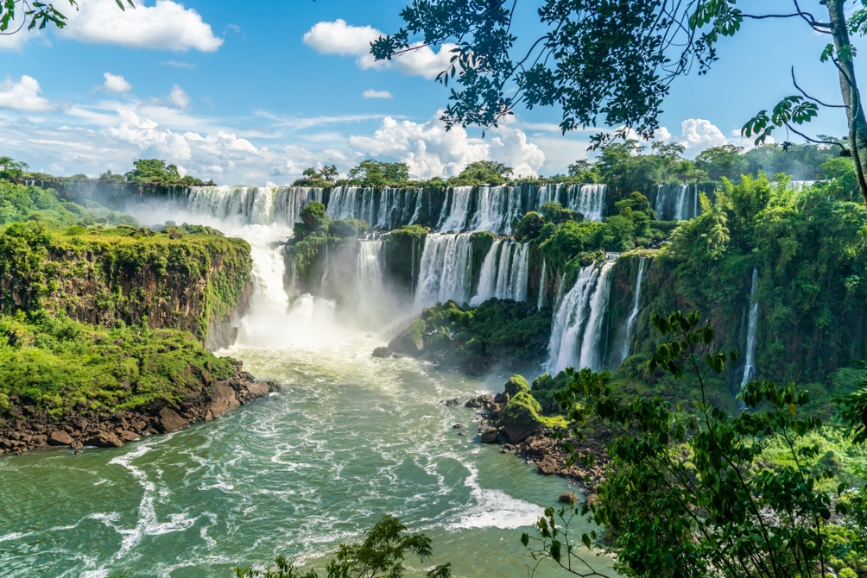
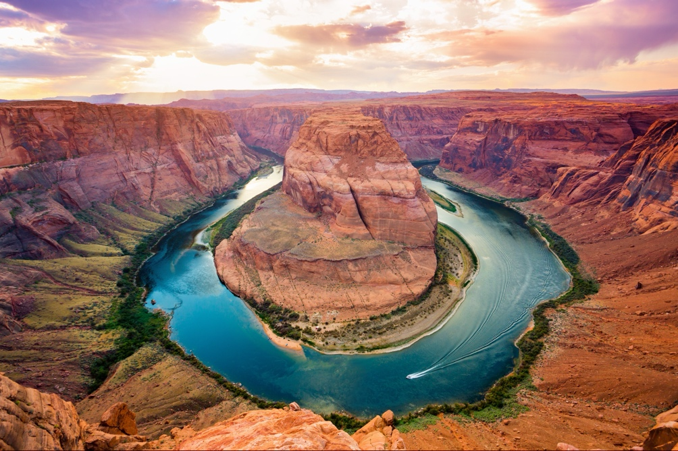
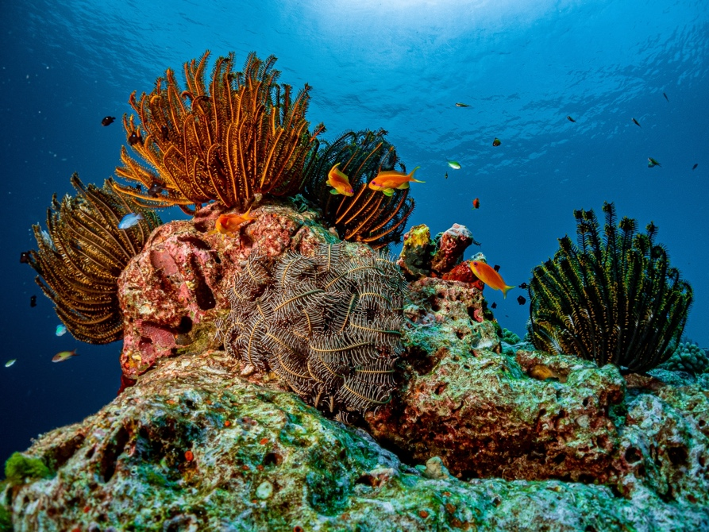
Iguazu Falls, Argentina
the Grand Canyon, USA
the Great Barrier Reef, Australia
Notes:
Activate knowledge
[Slide contains first three pictures from RESOURCE 1.1 – Nine natural wonders of the world picture set. It will at first appear blank.]
Invite students to show a picture of something from creation on their phone or device to the students around them.
Invite students to describe and discuss the pictures.
Invite students to share with the class about their favourite natural places.
Click to reveal the pictures on the slide.
Ask ‘What do you see?’(e.g. ‘I see water and trees.’).
Ask ‘What do you think? (e.g. ‘I think it is a famous waterfall.’).
Ask ‘What do you wonder? (e.g. ‘I wonder where it is.’).
Invite students to name the places on the slide. (Prompt with clues if necessary.)
Click to reveal the correct place names.
(Answers: 1. Iguazu Falls, Argentina; 2. the Grand Canyon, USA; 3. the Great Barrier Reef, Australia)

Slide 4
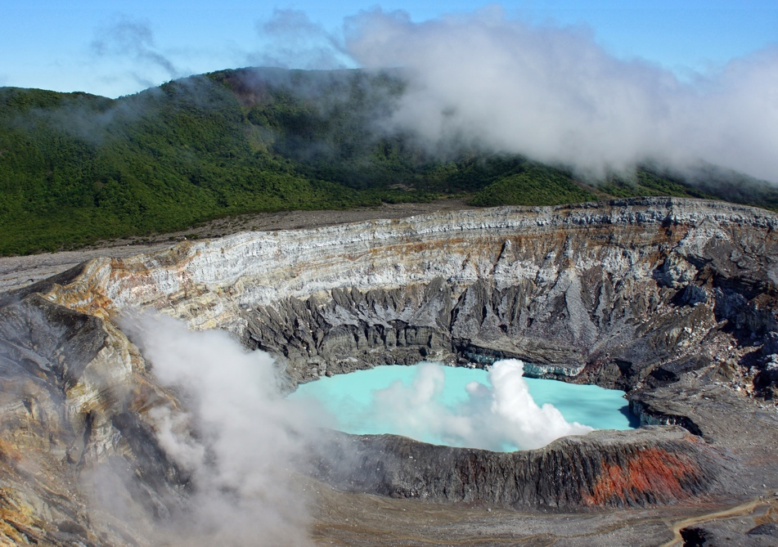
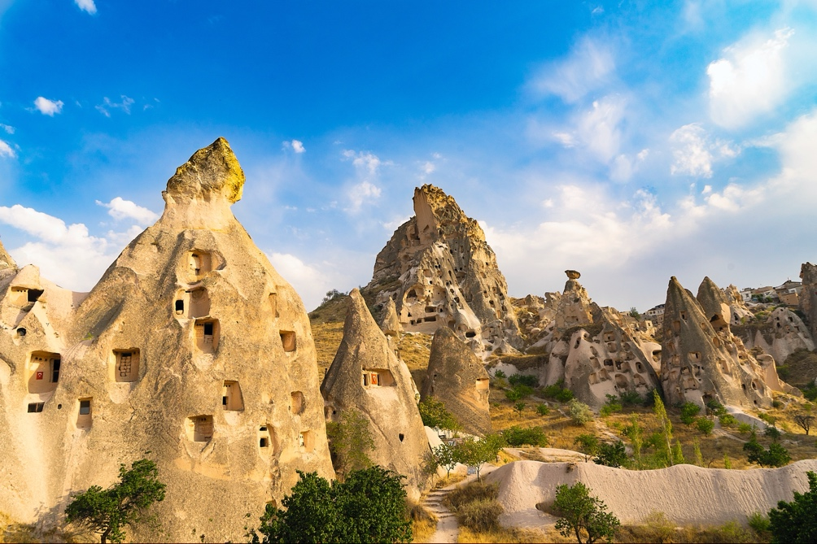
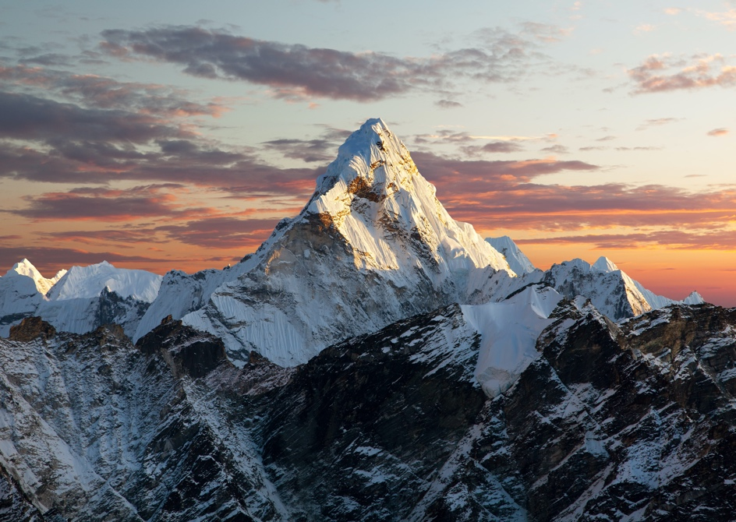
Poás Volcano, Costa Rica
Cappadocia, Turkey
Mount Everest, Nepal/Tibet
Notes:
Activate knowledge (continued)
[Slide contains the next three pictures from RESOURCE 1.1 – Nine natural wonders of the world picture set.]
Ask ‘What do you see?’
Ask ‘What do you think?’
Ask ‘What do you wonder?’
Invite students to name the places on the slide. (Prompt with clues if necessary.)
Click to reveal the correct place names.
(Answers: 4. Poás Volcano, Costa Rica; 5. Cappadocia, Turkey; 6. Mount Everest, Nepal/Tibet)

Slide 5
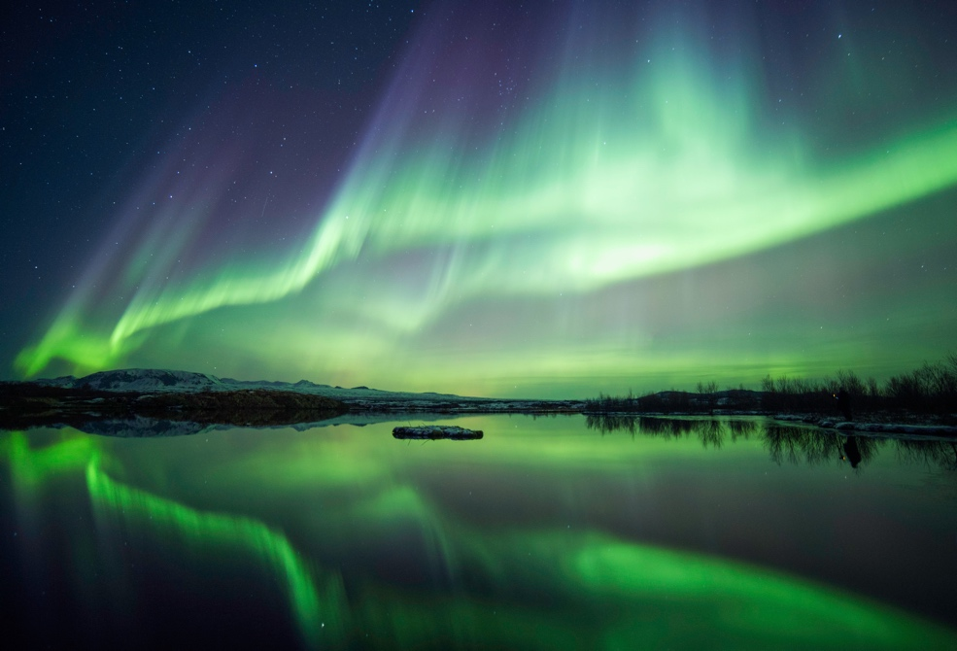
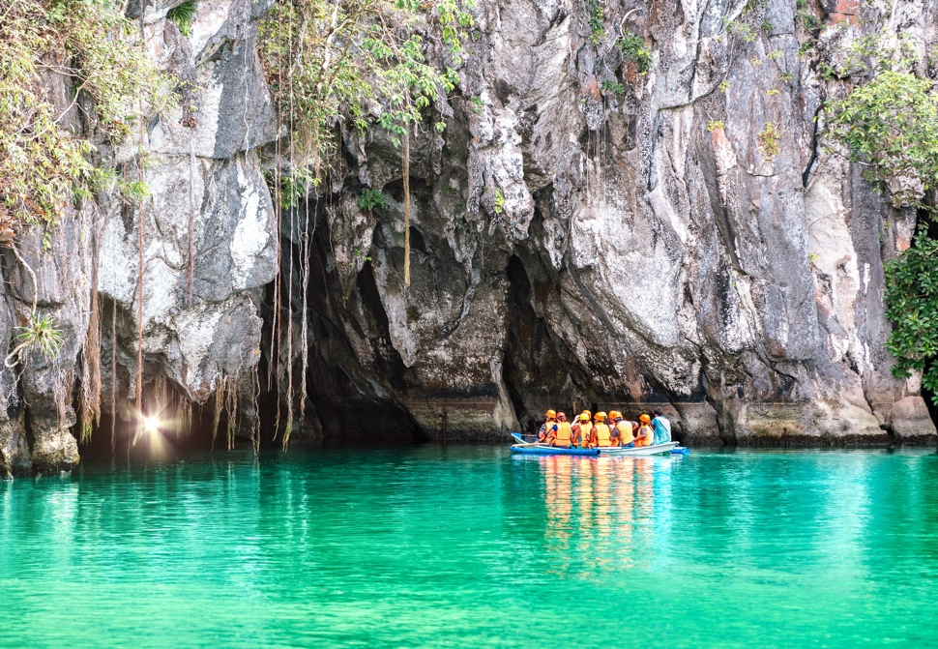
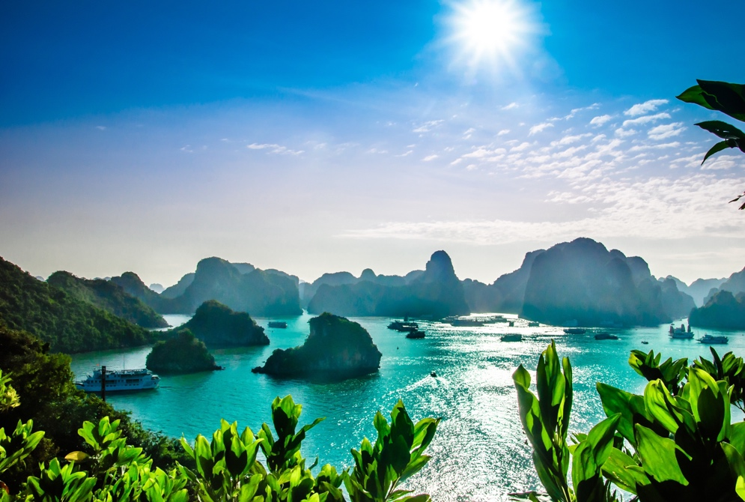
the northern lights/ aurora borealis, Iceland
Puerto Princesa Underground River, Philippines
Ha Long Bay, Vietnam
Notes:
Activate knowledge (continued)
[Slide contains the next three pictures from RESOURCE 1.1 – Nine natural wonders of the world picture set.]
Ask ‘What do you see?’
Ask ‘What do you think?’
Ask ‘What do you wonder?’
Invite students to name the places on the slide. (Prompt with clues if necessary.)
Click to reveal the correct place names.
(Answers: 7. the northern lights/ aurora borealis, Iceland; 8. Puerto Princesa Underground River, Philippines; 9. Ha Long Bay, Vietnam)

Slide 6


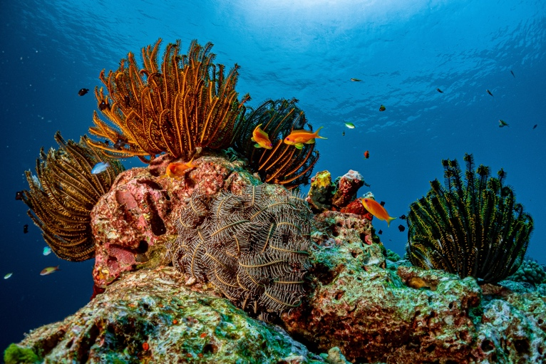
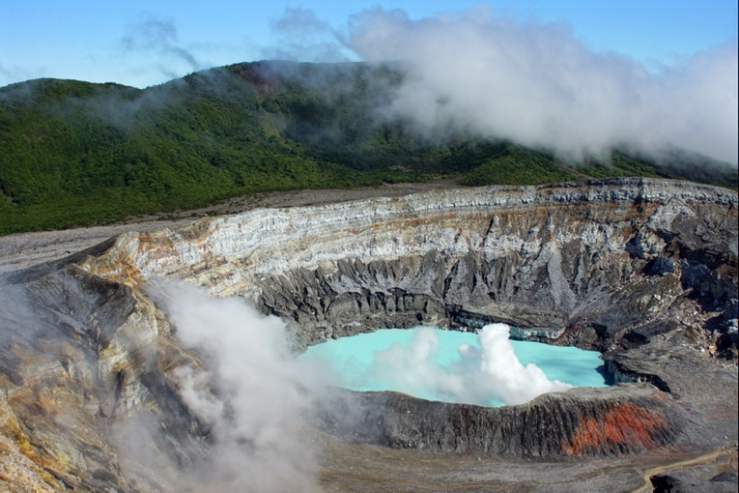

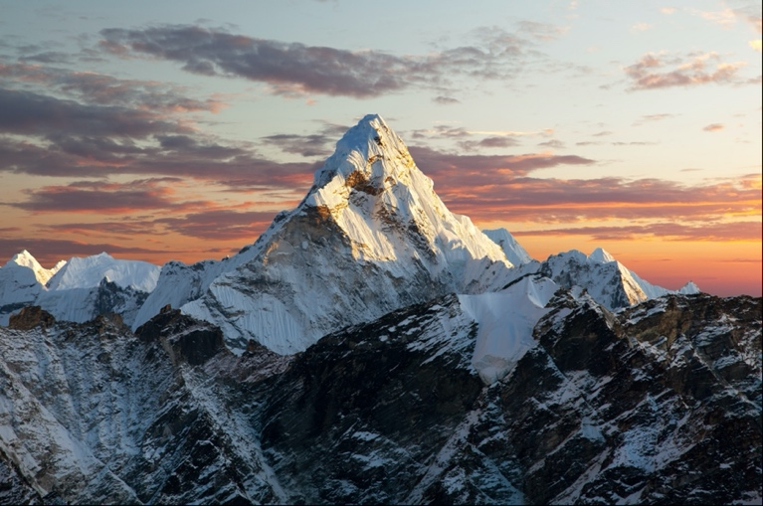
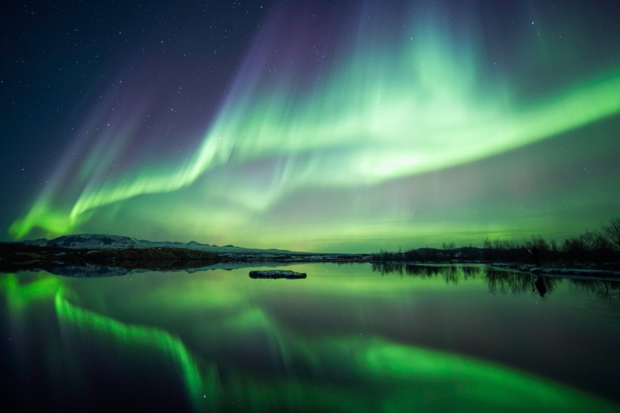
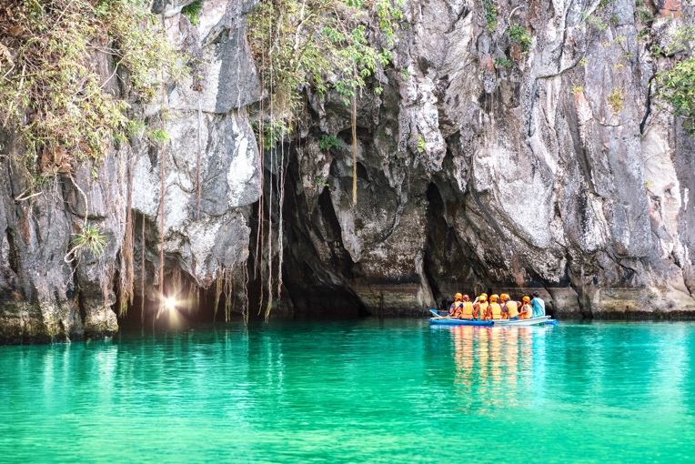

Notes:
Focus on language
[Slide contains all pictures from RESOURCE 1.1 – Nine natural wonders of the world picture set.]
Face-to-face lesson
Place RESOURCE 1.2 – Adjective cards face down on a table.
Turn over one card and model using the word in a sentence about something in one of the pictures (e.g. ‘The waterfall is breathtaking.’).
Invite students to take turns turning over the cards and using the word in a sentence about something in one of the pictures.
Clarify the meaning of the adjectives as you go.
Repeat this task until students have used each of the adjectives several times, and you are confident that they understand the word meanings.
Online lesson (or if not using cards)
Model using the adjective ‘breathtaking’ in a sentence about one of the pictures (e.g. ‘The waterfall is breathtaking.’).
Say the adjectives below one at a time, inviting students to use each word in a sentence about something in one of the pictures:
beautiful
peaceful
picturesque
colourful
spectacular
fascinating
stunning
incredible
unique
interesting
huge
lovely
amazing

Slide 7









1. Iguazu Falls, Argentina
2. the Grand Canyon, USA
3. the Great Barrier Reef, Australia
4. Poás Volcano, Costa Rica
5. Cappadocia, Turkey
6. Mount Everest, Nepal/Tibet
7. the northern lights/
aurora borealis, Iceland
8. Puerto Princesa Underground River, Philippines
9. Ha Long Bay, Vietnam
Notes:
Undertake speaking tasks
[Slide contains all pictures from RESOURCE 1.1 – Nine natural wonders of the world picture set.]
Speaking task 1: Group discussion about natural wonders
Divide the class into small groups.
Invite groups to talk about the places shown on the slide and share what they know about them.
Encourage students to look up information on their devices if they want to find out more.
After allowing time for group discussion:
Point to each picture one at a time, say its name and ask students to tell you what they know, without repeating something another student has said.

Slide 8



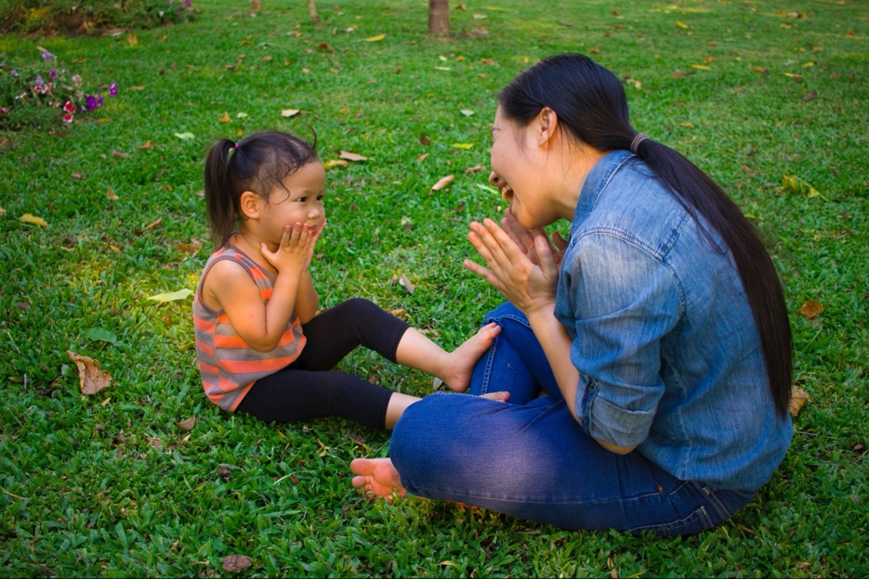

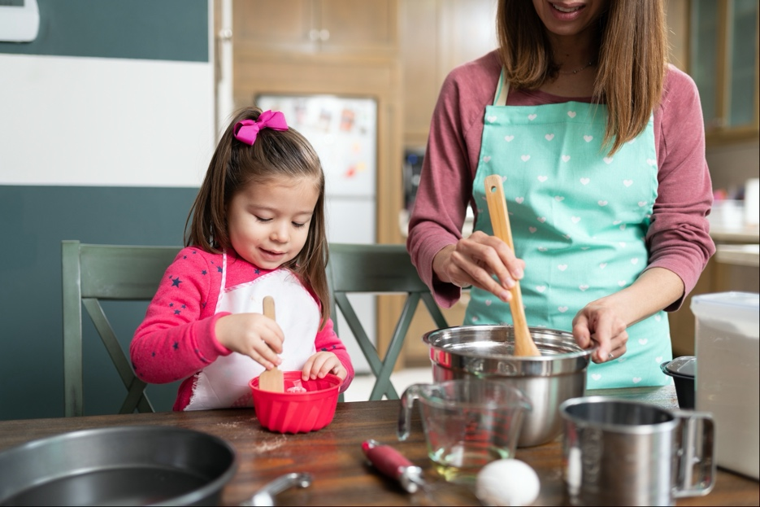
1
2
3
4
5
6
Notes:
Undertake speaking tasks (continued)
[Slide contains 6 of the 9 pictures from RESOURCE 1.3 – Family likeness picture set.]
Speaking task 2: Discussing family likeness
Say ‘Families are also a natural wonder.’
Describe one of the pictures and invite students to decide which one you are describing.
Invite volunteers to describe each of the other pictures for others to guess.
Divide students into pairs.
Invite pairs to brainstorm the ways parents and children can be alike (e.g. looks, personality, mannerisms, things they do).
Invite pairs to share their ideas with the class.

Slide 9
What are some
good family rules?
Notes:
Undertake speaking tasks (continued)
Speaking task 3: Brainstorming good family rules
Ask ‘What are some good family rules?’ (e.g. tell the truth; don’t hit other people).
Accept responses and remodel using correct English if necessary.
Ask ‘If you could only have one rule in your family, what would it be?’
Lead into Bible
Say ‘Our Bible time is about a creator, his creation and his one rule.’

Slide 10
Lesson 1
PART 2
God creates the world
Genesis 1:1, 26–31; 2:15–17
Notes:
(Part 2 title page)

Slide 11


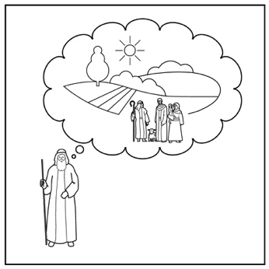
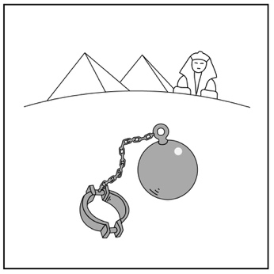
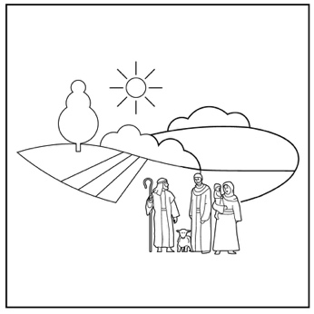
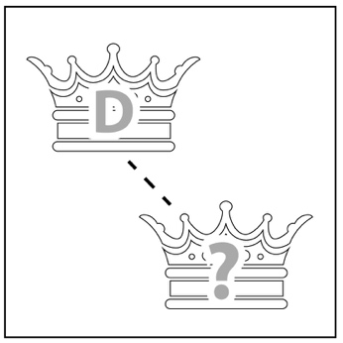
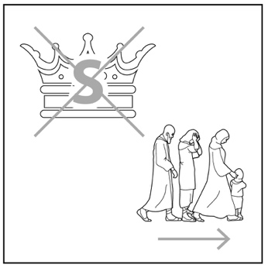


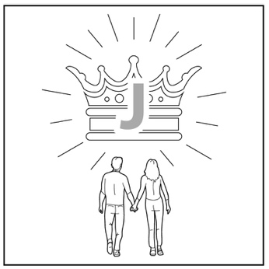

1
2
3
4a
4b
5
Creation
Rejection
Abraham
Egypt
Moses
King David
6
7
8
9
10
King Solomon
King Jesus
Jesus dies
Jesus raised
New creation
Notes:
Introduce the timeline
[Slide contains a completed timeline with icons placed in order of creation to new creation.]
Say ‘The Bible is one story with one author, and one main subject – Jesus.’
Move your finger or cursor along the timeline as you say ‘This term we’ll start at creation and read about God’s plans for his world throughout history and into the future. This story has changed the world and it has changed me. I’m looking forward to sharing it with you.’

Slide 12
creat…
create, created, creator, creative, creature
Notes:
Predict the content
[This slide will at first appear blank.]
Ask ‘What is the name we use for all of the animals, plants and people in our world?’
Introduce the word ‘creation’ if it isn’t volunteered.
Click to reveal the creat… word stem on the slide.
Invite students to suggest words beginning with the stem, prompting with clues if necessary (e.g. create, created, creator, creative, creature).
Click to reveal the words.
Define these words together.

Slide 13
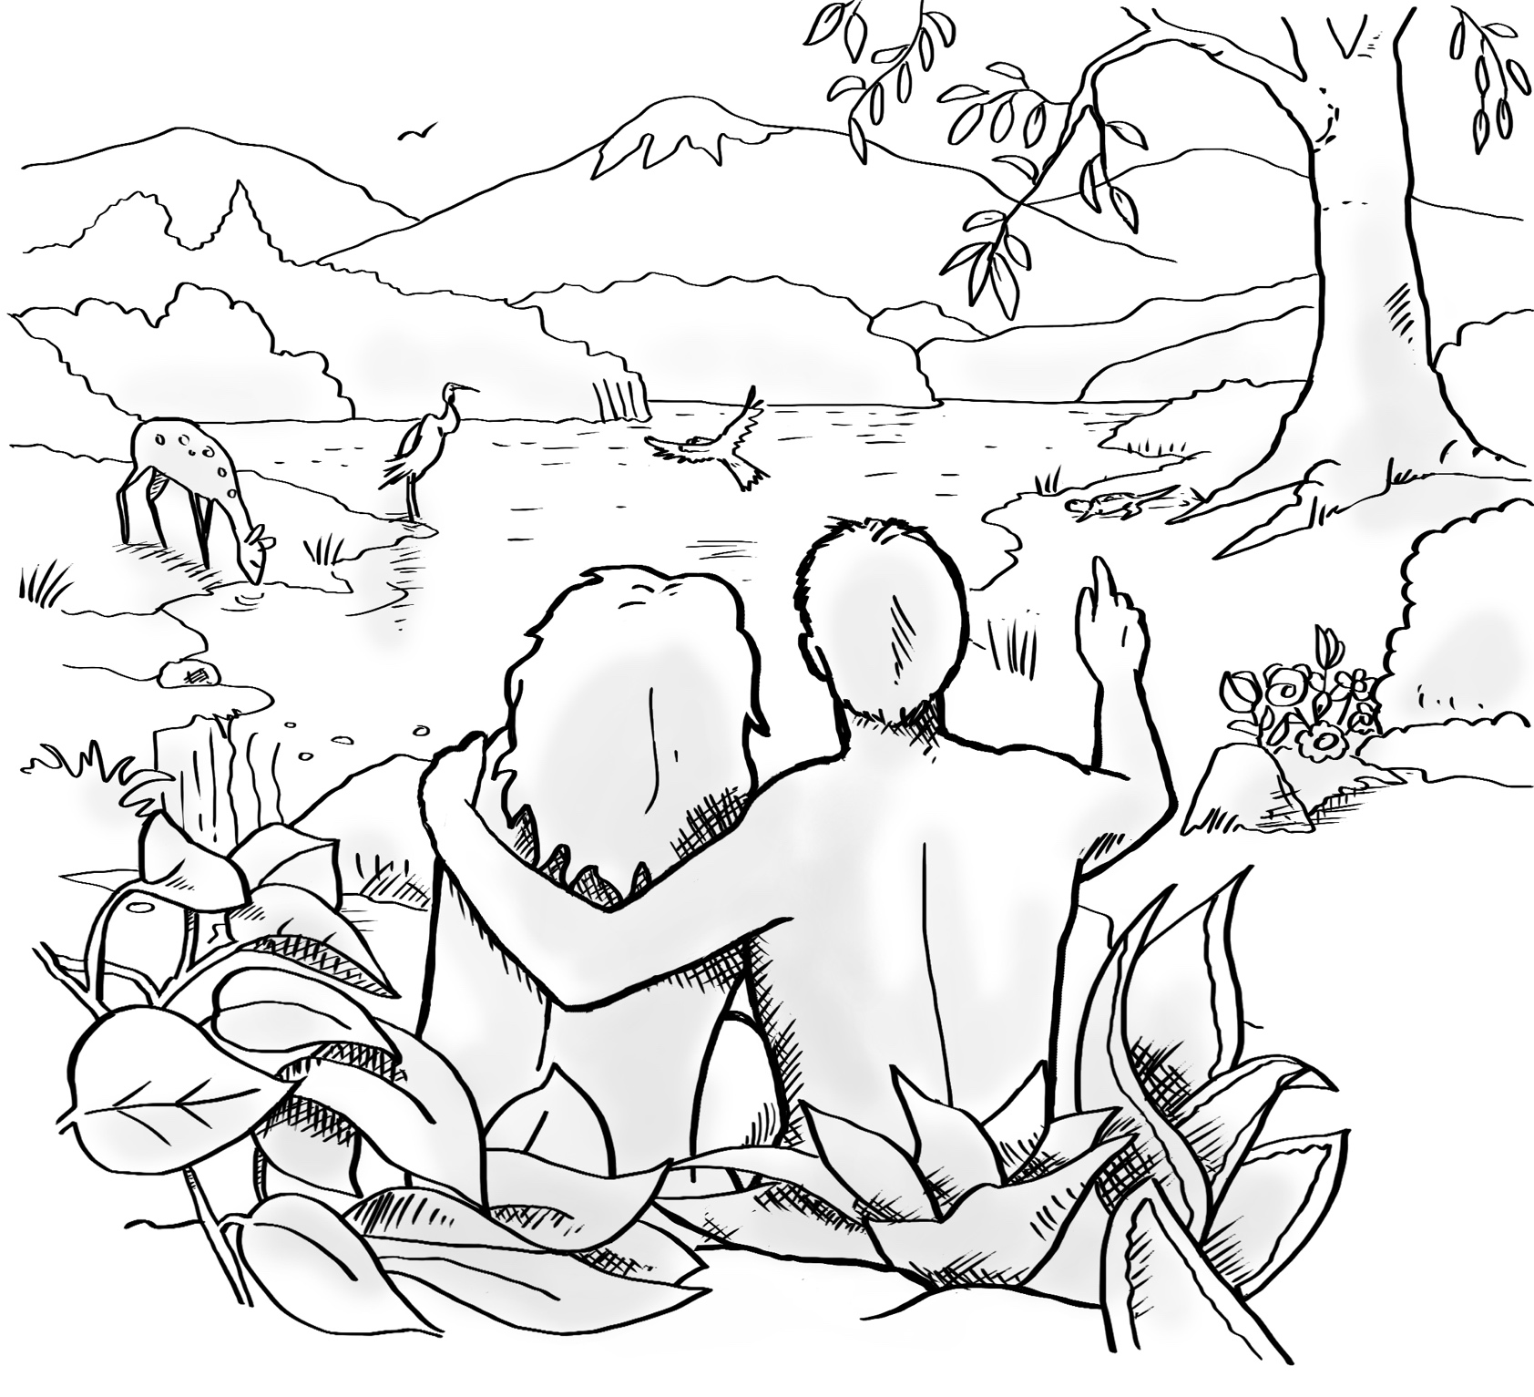
Notes:
Predict the content (continued)
[Slide contains RESOURCE 1.4 – Summary sketch.]
Ask ‘What do you think the Bible will say about how the world was made?’
Accept responses without correcting.

Slide 14
Genesis 1:1, 26–31; 2:15–17
In the beginning, God created the heavens and the earth.
God said, ‘Let us make humans so that they are like us. Let them rule over the fish in the sea, the birds in the sky, the wild animals, and the creatures that move along the ground.’ So God created human beings in his image. He created them to be like him. He created them male and female.
God blessed them. He told them to fill the earth and bring it under their control. God said, ‘I am giving you every plant on the earth for food.’
God saw everything he had made, and it was very good. There was evening, and there was morning. God put the man in the Garden of Eden to take care of it. God said, ‘You may eat fruit from any tree in the garden. But you must not eat fruit from the tree of the knowledge of good and evil. If you do, you will certainly die.’
Notes:
Read and comprehend
(Optional: Invite students to read Genesis 1:1, 26–31; 2:15–17 in their heart languages.)
[Slide contains RESOURCE 1.5 – Paraphrased Bible text.]
Activity 1: Read passage and define vocabulary
Read the Bible paraphrase aloud.
Distribute RESOURCE 1.5 – Paraphrased Bible text to each student (if using).
Divide students into pairs.
Invite pairs to read the text and note new words.
Clarify vocabulary as a class.
Ask ‘What did God think of the creation he had made?’
Accept responses. (It was very good.)

Slide 15
Made in God’s image
u
l
e
o
e
r
c
r
e
t
i
o
r _ _ _ _ v _ _ _ _ _ a _ _ _ n
t
a
e
c
a
e
o
c
r
e
t
i
o
_ _ k _ _ _ r _ _f _ _ _ a _ _ _ n
i
k
e
o
d
l _ _ _ G _ _
_ _ _ s _ f _ _ _ _ _ s _ _ _ _ _ _ h _ _ d
c
l
o
e
r
i
e
n
d
h
i
p
w
i
t
G
o
_ _ _ s _ f _ _ _ _ _ s _ _ _ _ _ _ h _ _ _ _ l _
c
l
o
e
r
i
e
n
d
h
i
p
w
i
t
p
e
o
p
e
Notes:
Read and comprehend (continued)
[Slide will at first appear with the heading only.]
Activity 2: Discuss ‘in his image’
Divide students into pairs.
Invite pairs to discuss what they think it means to be made in God’s image.
Invite pairs to share their thoughts with the class.
Click to display the first of the phrases on the slide, with only a few letters inserted. (Completed phrases are in ‘Answers’ below.)
Invite students to guess what the phrase is as you slowly click to reveal more letters.
Click again and continue for the remaining 4 phrases.
(Answers:
rule over creation
take care of creation
like God
close friendship with God
close friendship with people)
Discuss what each phrase means in small groups or as a class.

Slide 16
Genesis 1:1, 26–31; 2:15–17
In the beginning, God created the heavens and the earth.
God said, ‘Let us make humans so that they are like us. Let them rule over the fish in the sea, the birds in the sky, the wild animals, and the creatures that move along the ground.’ So God created human beings in his image. He created them to be like him. He created them male and female.
God blessed them. He told them to fill the earth and bring it under their control. God said, ‘I am giving you every plant on the earth for food.’
God saw everything he had made, and it was very good. There was evening, and there was morning. God put the man in the Garden of Eden to take care of it. God said, ‘You may eat fruit from any tree in the garden. But you must not eat fruit from the tree of the knowledge of good and evil. If you do, you will certainly die.’
Notes:
Read and comprehend (continued)
Activity 3: Giving opinions
Ask ‘What was the one rule God had for the man and the woman?’ (See text in bold on the slide.)
Note: ‘Rule’ is a noun here. You may wish to clarify the use of ‘rule’ as a verb and a noun with the following sentences:
Let the king rule over his people (v).
You must obey this rule (n).
Ask the following questions and invite students to share their opinions:
‘Is it okay for a creator to make rules about his or her creation? Why/why not?’
‘Is it okay for a parent to make rules that their children don’t like or understand? Why/why not?’

Slide 17
Notes:
Invite curiosity
[Slide will at first appear blank.]
Ask ‘Do you have any questions or comments about the story?’
Accept responses and discuss.
Student summary
Click to reveal the Summary sketch.
Invite a volunteer to summarise the Bible text in their own words.

Slide 18
1
2
3
4a
4b
5
Creation
6
7
8
9
10
Notes:
Timeline
[This slide contains the numbered outline from RESOURCE 1.6 – Timeline. It is blank at first.]
Say ‘This timeline goes from creation to new creation.’
Click to reveal the icon for this lesson inserted in the timeline (RESOURCE 1.7 – Lesson 1 icon).
Say ‘God made a good world and rules over it. God made people to be his friends and rule the world under him.’
An important question
Ask ‘Will this last?

