Slide 1
Lesson 1
Meet Jesus
Volume 1
Ten Bible-based English lessons
High Beginner
Notes:
(Lesson 1 title page)

Slide 2
Lesson 1
PART 1
Babies
Notes:
(Part 1 title page)

Slide 3
What can you see?
What can you feel?
Notes:
Activate knowledge
Display one or two baby items brought from home.
Invite students to feel the items and pass them to each other (if face-to-face).
Invite students to tell you what they can see and feel.
Write suggestions on the board (if using), correcting errors as you do this (e.g. It’s pink. It’s for a baby. It’s for the baby’s mouth. It’s soft.)

Slide 4
Babies
Notes:
Focus on language
Activity 1: Brainstorm
Divide students into groups of 3–4.
Give each group one A4 sheet of paper (if using). [Alternatively, complete this activity together verbally.]
Invite one student to act as the writer for the group.
Invite students to write as many words as they know that are related to babies.
List all of the groups’ words on the board (if using).

Slide 5
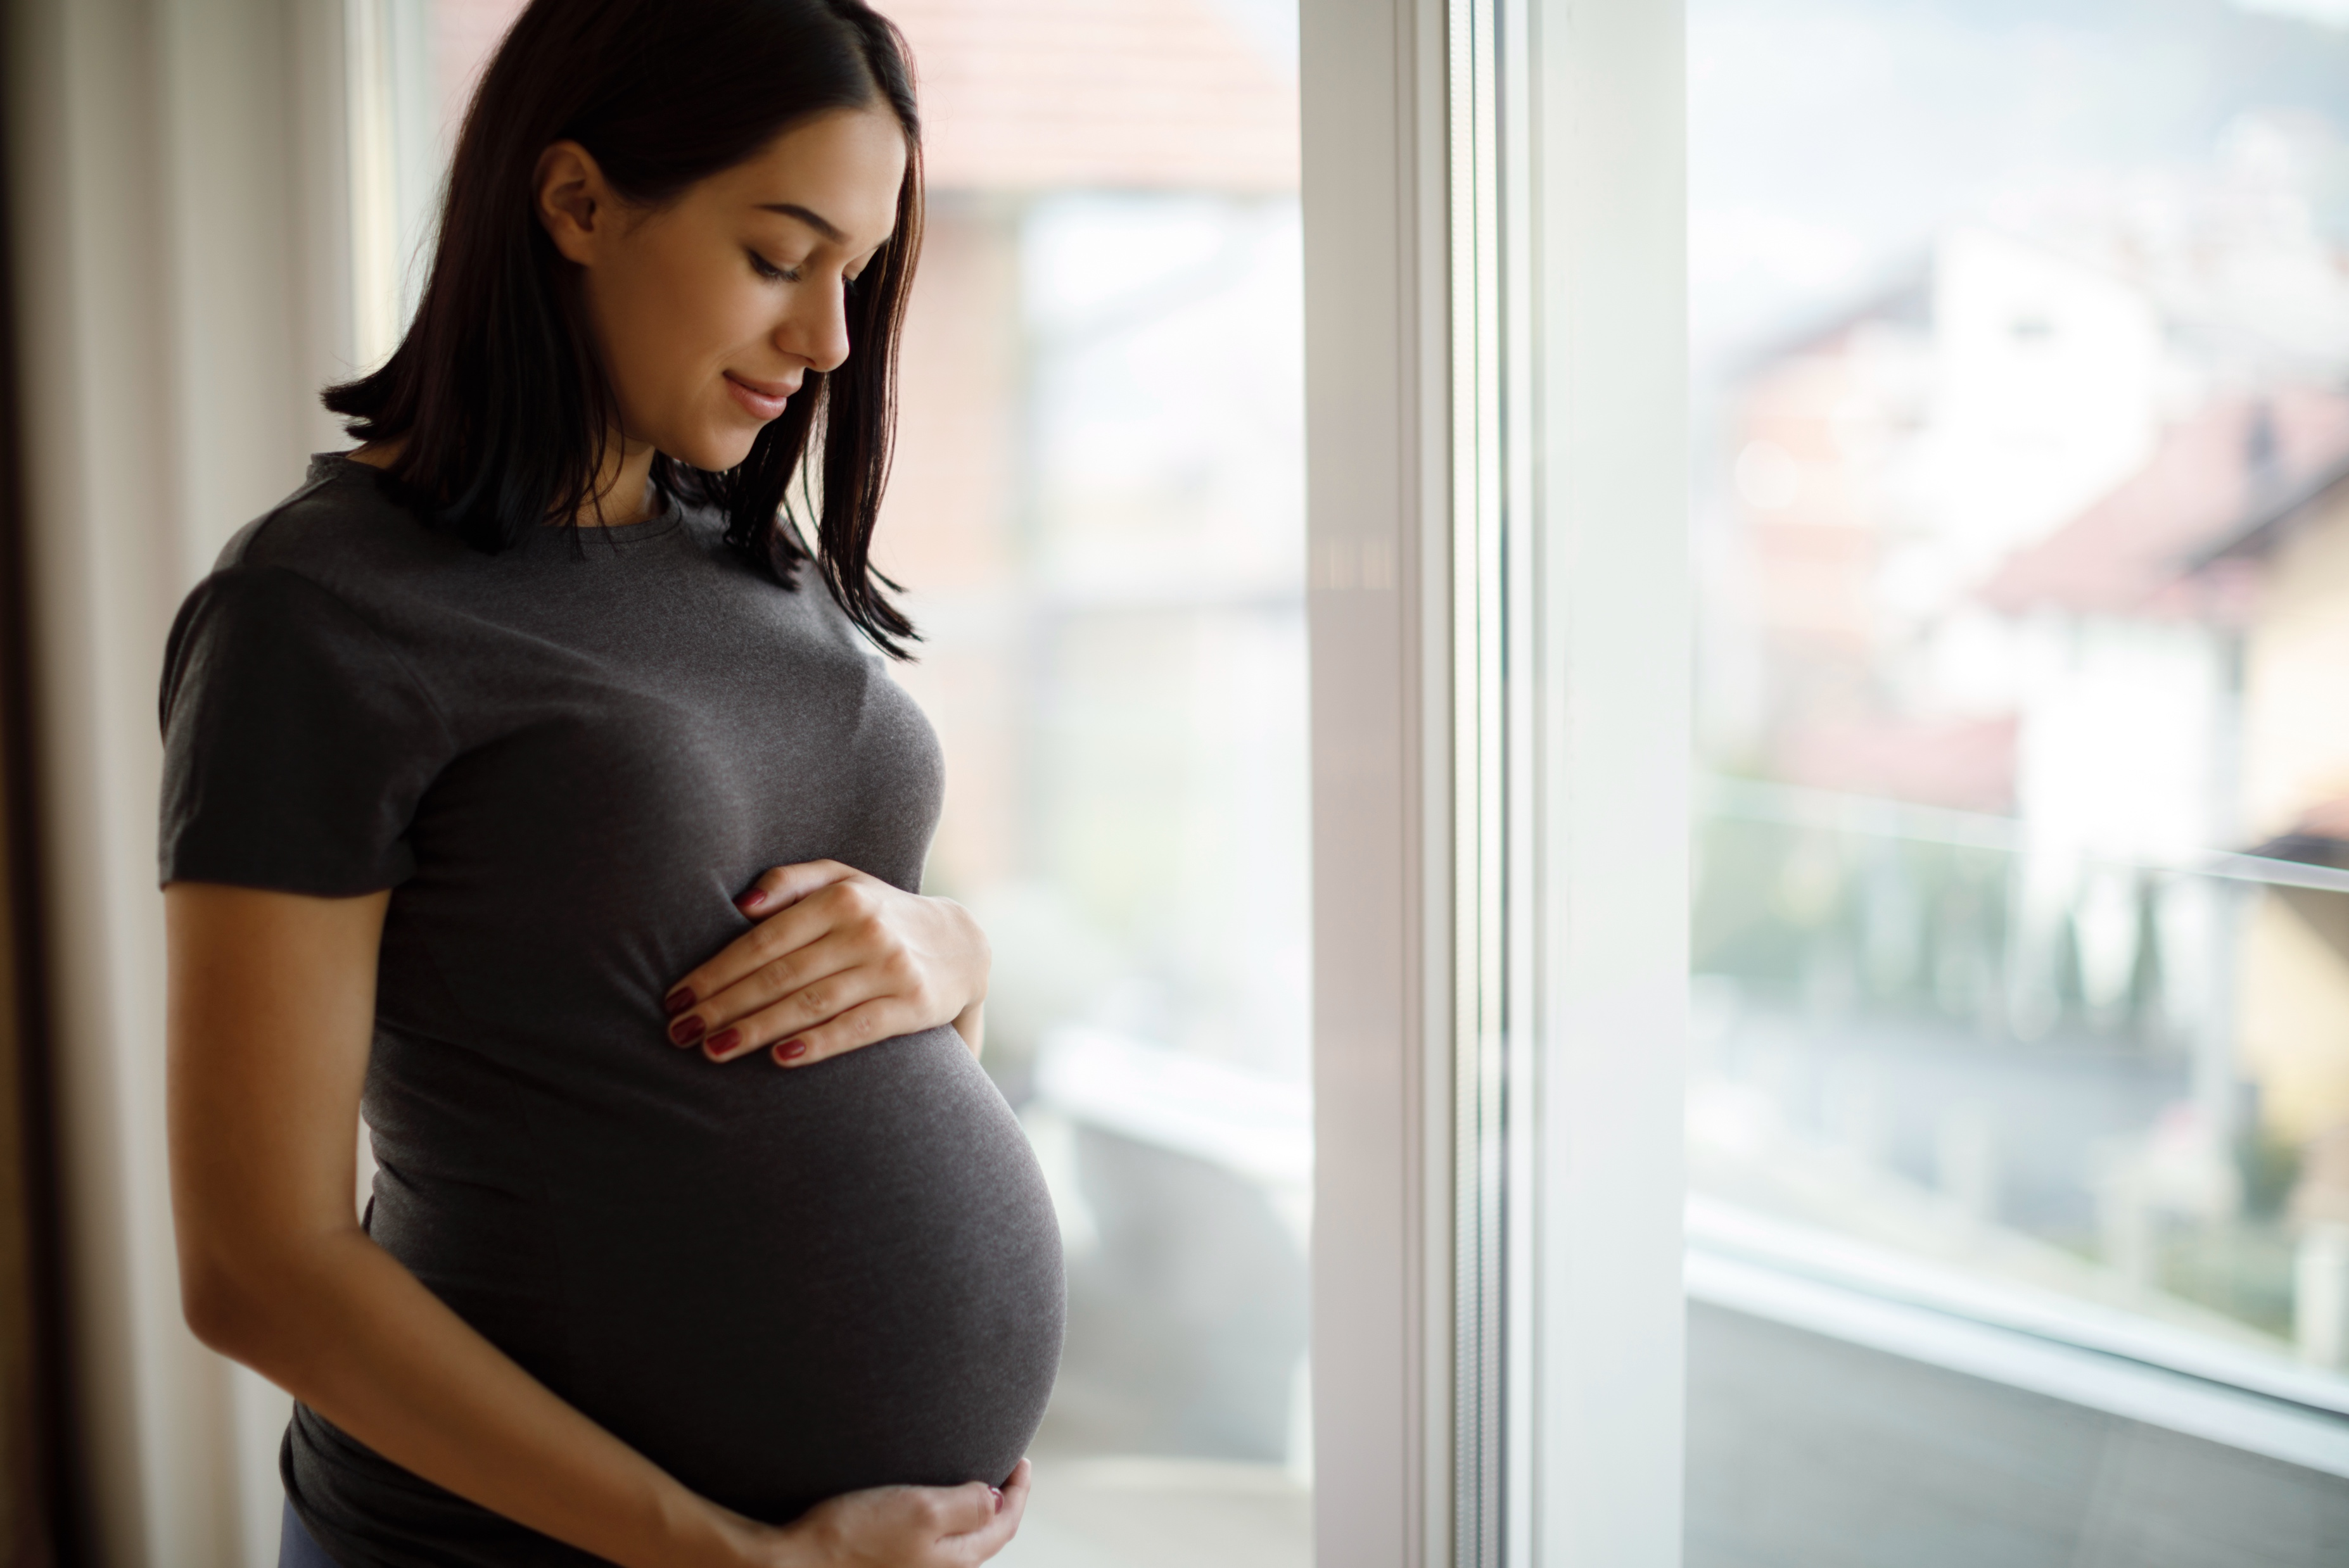
Put your hands
on your head
Stand on one foot
Notes:
Focus on language (continued)
Activity 2: Telling a birth story
[Slide contains RESOURCE 1.1.1 – Photo of pregnant woman.]
Ask ‘What can you see?’
Invite responses.
Say ‘She’s pregnant.’

Slide 6
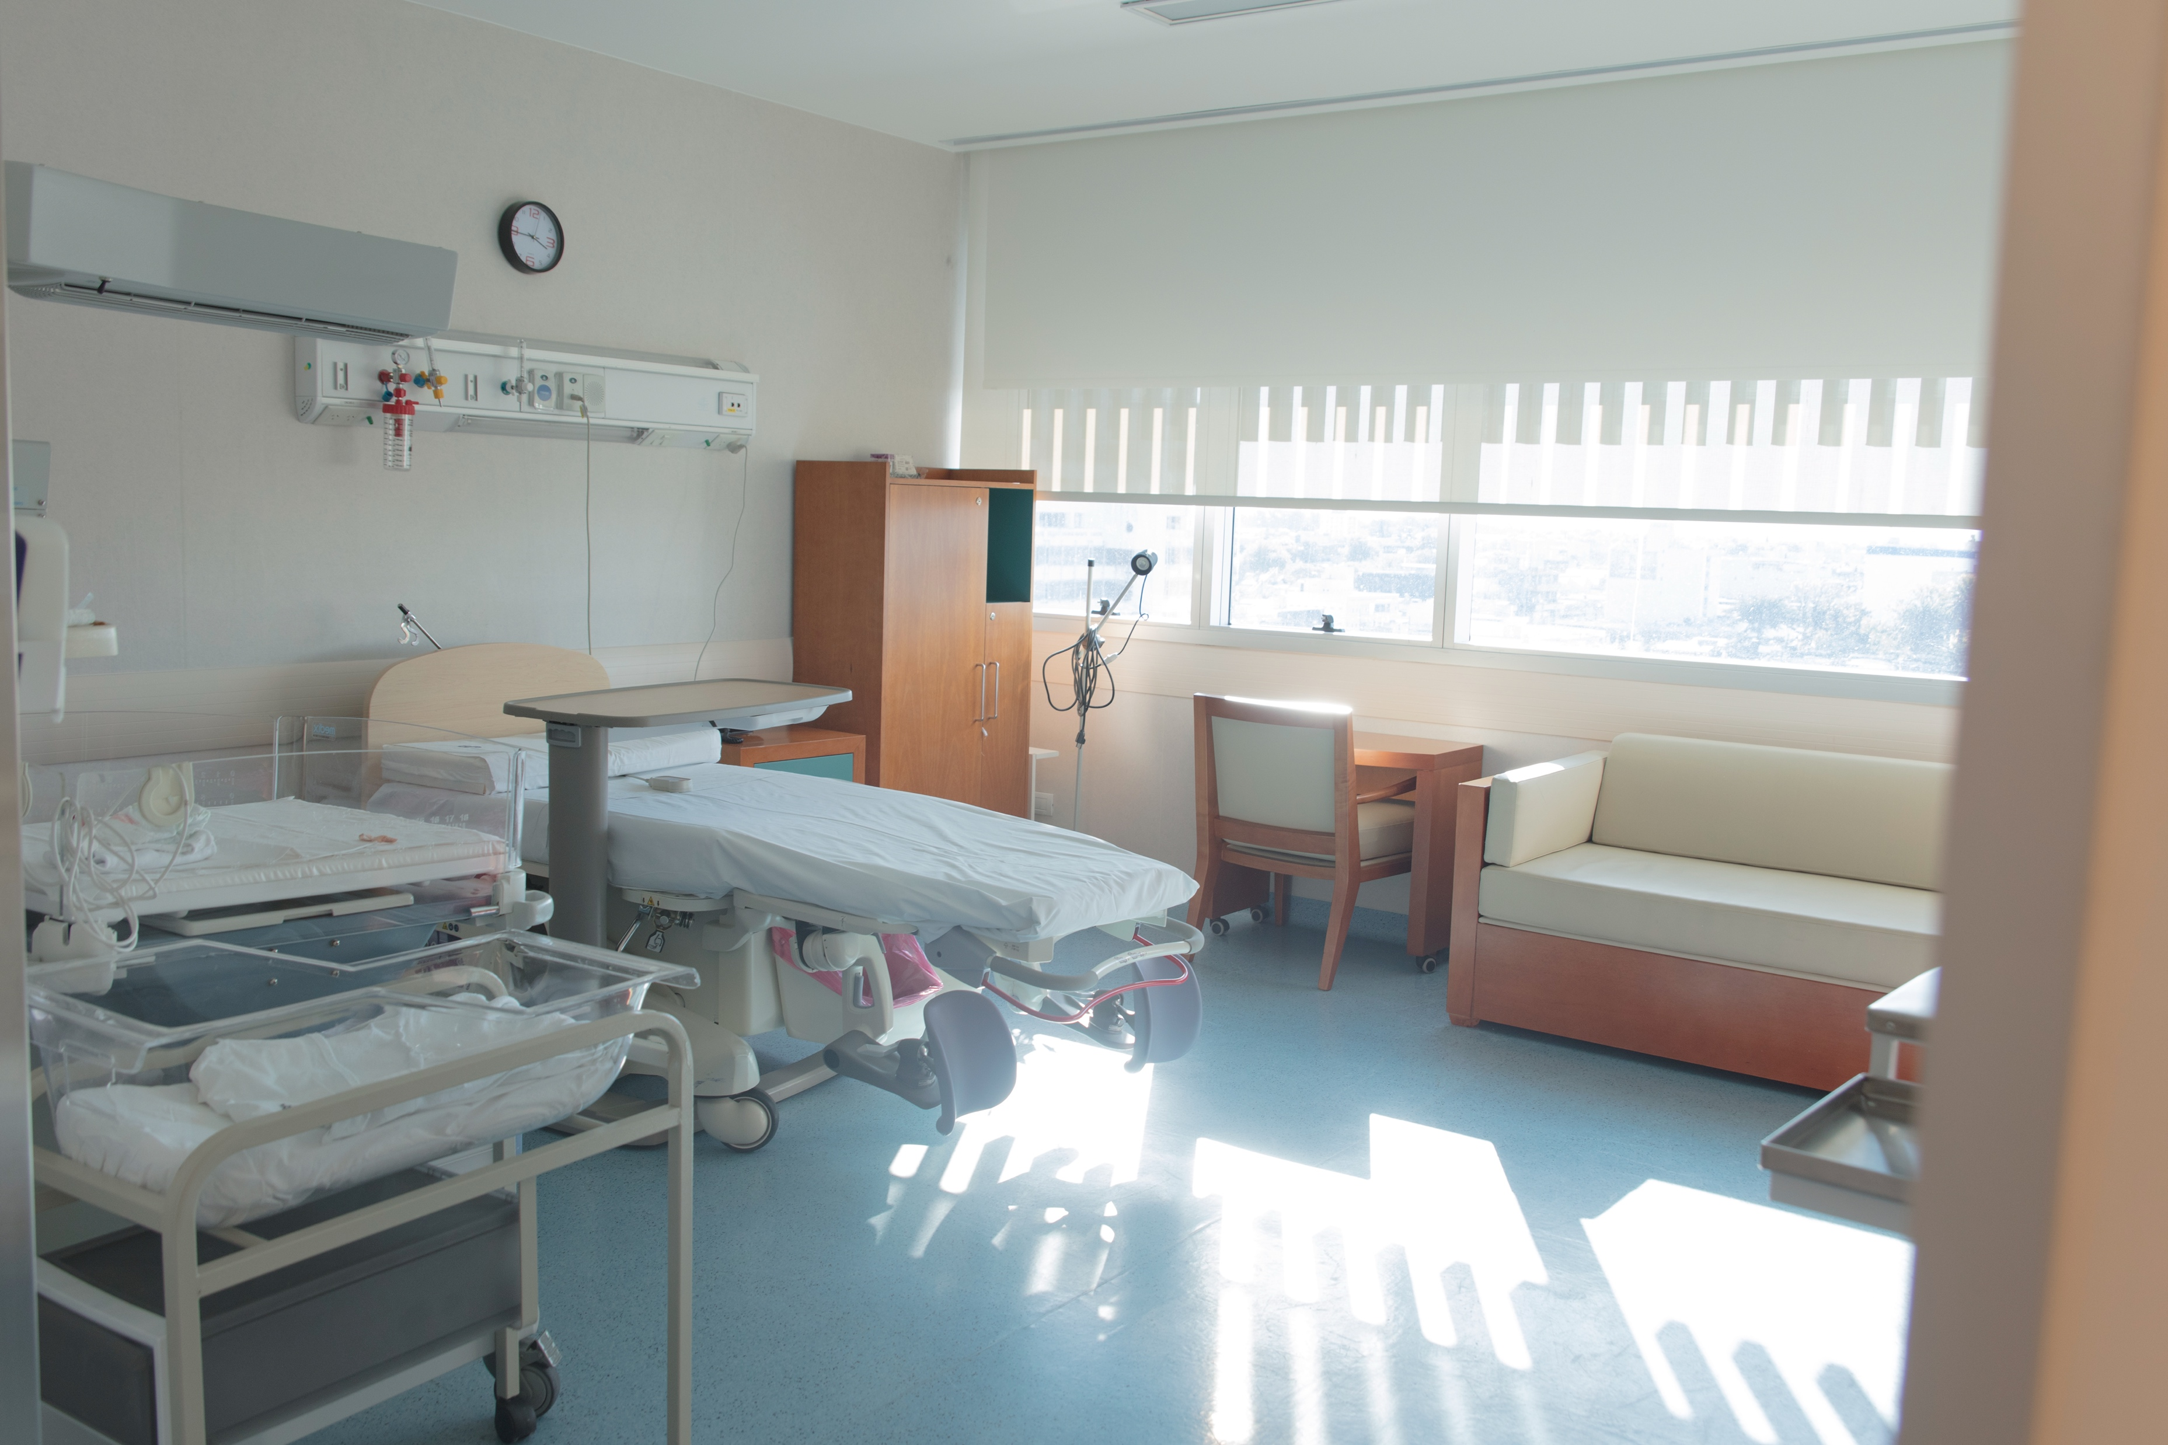
Put your hands
on your head
Stand on one foot
Notes:
Focus on language (continued)
Activity 2: Telling a birth story (continued)
[Slide contains RESOURCE 1.1.2 – Photo of hospital ward.]
Ask ‘What can you see?’
Invite responses.
Say ‘It’s in a hospital.’

Slide 7
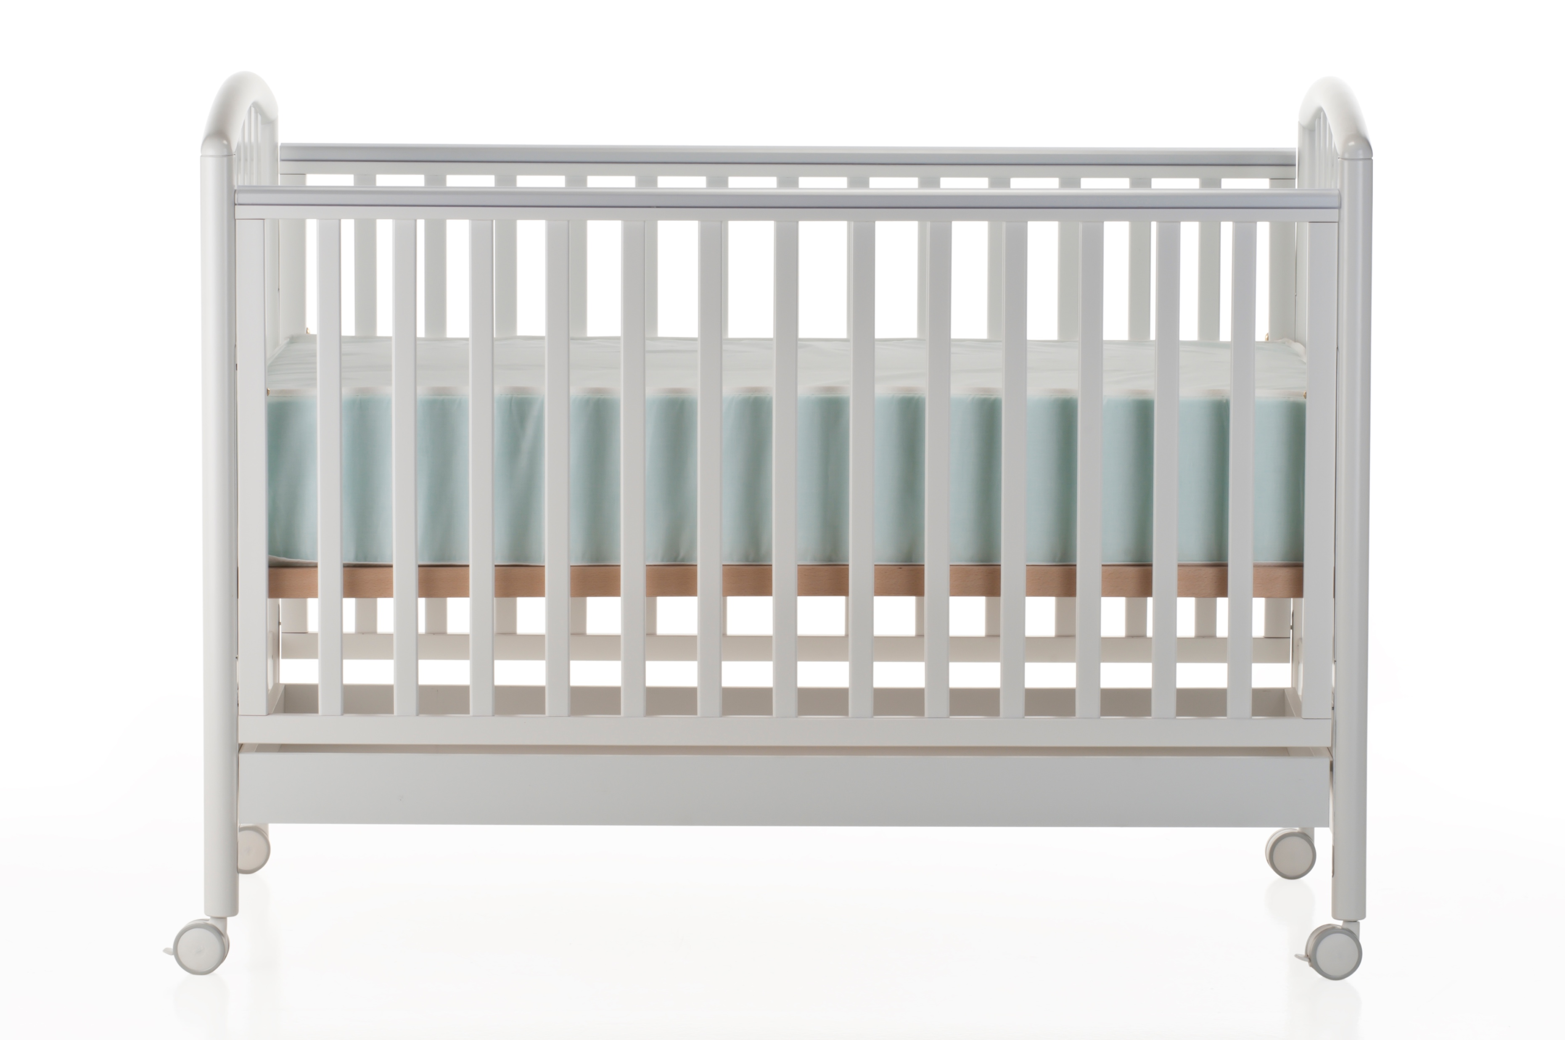
Put your hands
on your head
Stand on one foot
Notes:
Focus on language (continued)
Activity 2: Telling a birth story (continued)
[Slide contains RESOURCE 1.1.3 – Photo of cot.]
Ask ‘What can you see?’
Invite responses.
Say ‘It’s a cot.’

Slide 8
_________ was pregnant.
________ went to hospital.
_________ had a baby.
The baby’s name was _________.
_______ put ________ in a _________.
Notes:
Focus on language (continued)
Display this slide with underlined words below replaced with your own details or a helper’s details:
Sarah was pregnant.
Sarah went to hospital.
Sarah had a baby.
The baby’s name was Hamish.
Sarah put Hamish in a cot.
Model the following story using gestures/mime:
_________ was pregnant. (Gesture.)
_________ went to hospital. (You can display Slide 5 again at this point (RESOURCE 1.1.2 – Photo of hospital ward).)
_________ had a baby. (Rock your arms pretending to hold a baby.)
The baby’s name was ______________. (Point to the baby in your arms saying the name as you do this.)
_______________ put _____________ in a cot (You can display Slide 6 again at this point (RESOURCE 1.1.3 – Photo of cot).)
Repeat the story, inserting details relevant to a helper/student.
Distribute RESOURCE 1.2 – Birth story worksheet to each student.
Invite students to fill in the blanks for themselves or someone they know.
Divide students into groups of 3–4.
Invite students to share their stories with each other.

Slide 9
Lesson 1
PART 2
The birth of Jesus
Luke 2:1–12
Notes:
(Part 2 title page)

Slide 10

Notes:
Read for gist
Say ‘In the Bible story, the baby’s name is Jesus.’
Distribute copies of Luke 2:1–12 in your students’ heart languages (if in the classroom). [Alternatively, if online, invite students to refer to the heart language texts they have been sent in advance.]
Give students a few minutes to read the text silently for context, then ask them to put it away for the rest of the lesson.

Slide 11
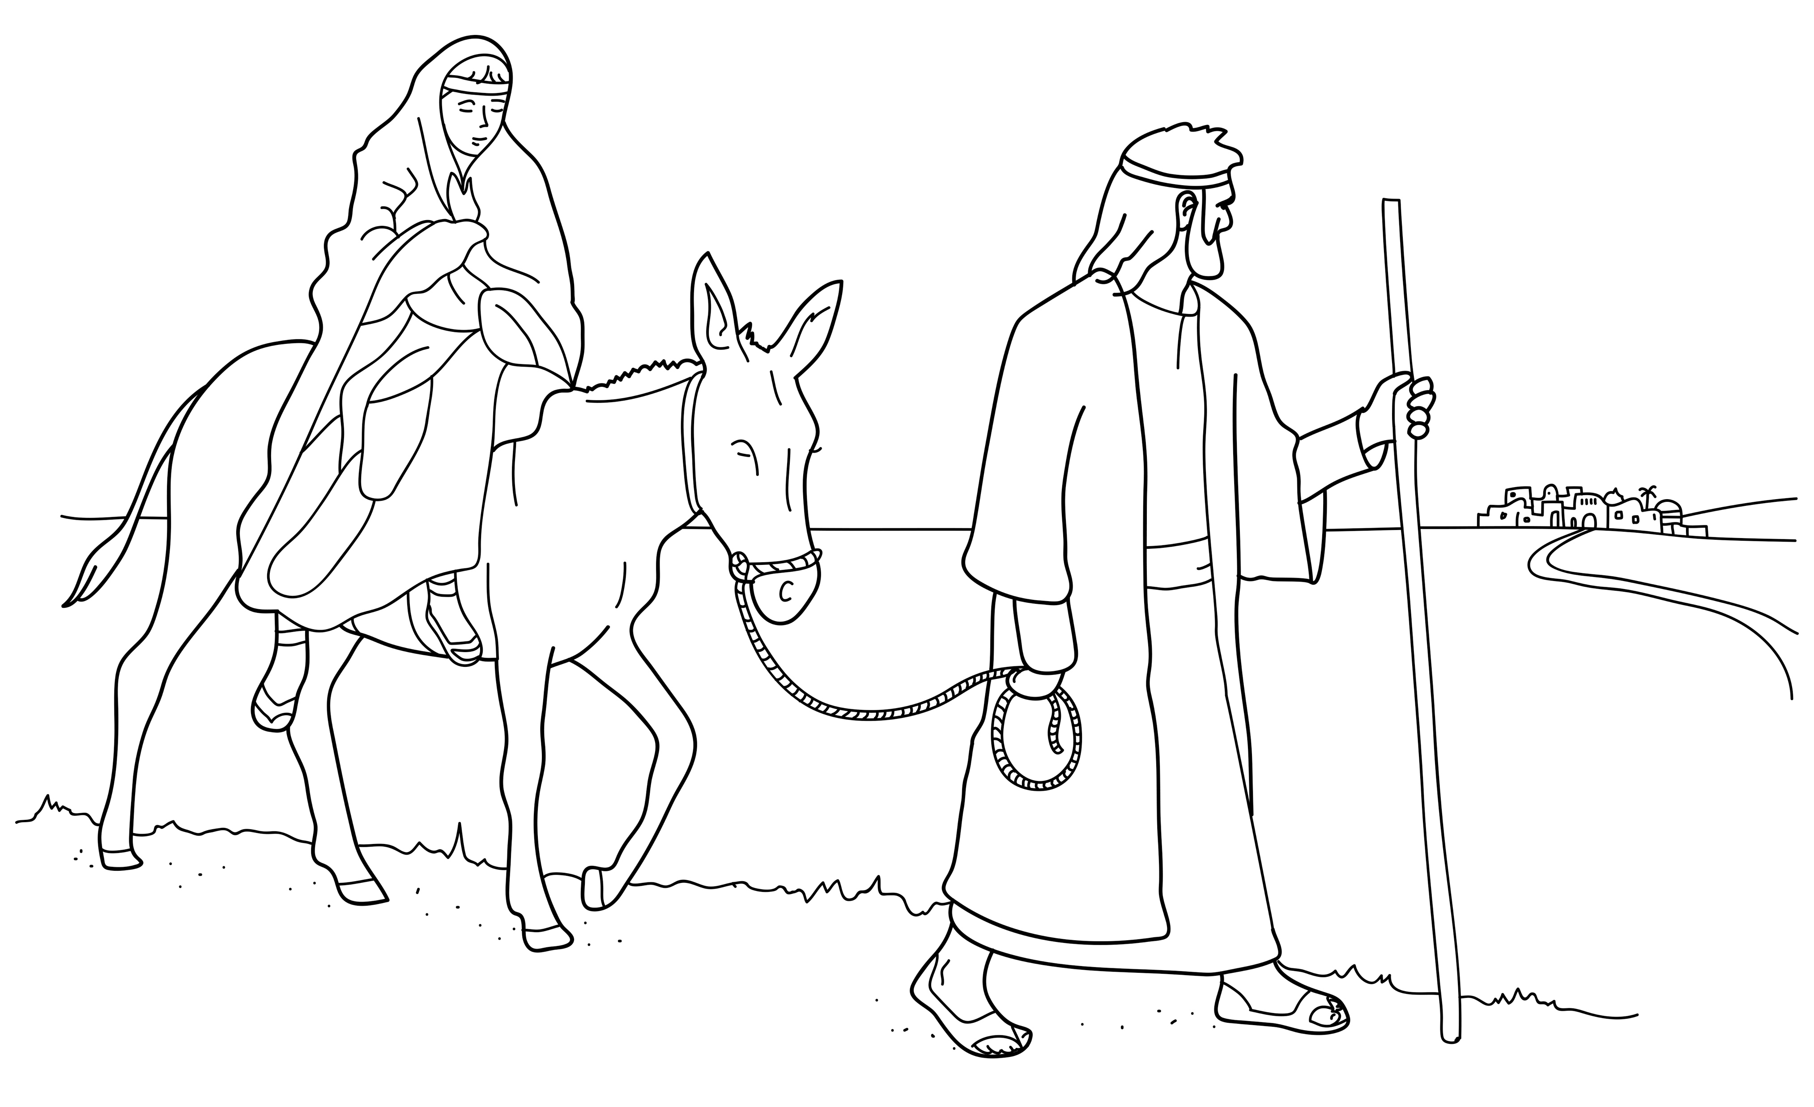
Mary and Joseph went to Bethlehem.
Notes:
Read for detail
[This slide and the 5 slides that follow contain RESOURCE 1.3 – Large sketches and RESOURCE 1.4 – Large sentences.]
Read the sentence on the slide aloud slowly.
Invite students to repeat the sentence after you.
Repeat several times to reinforce correct pronunciation.
Click through the presentation to display the remaining 5 sketches and sentences.

Slide 12
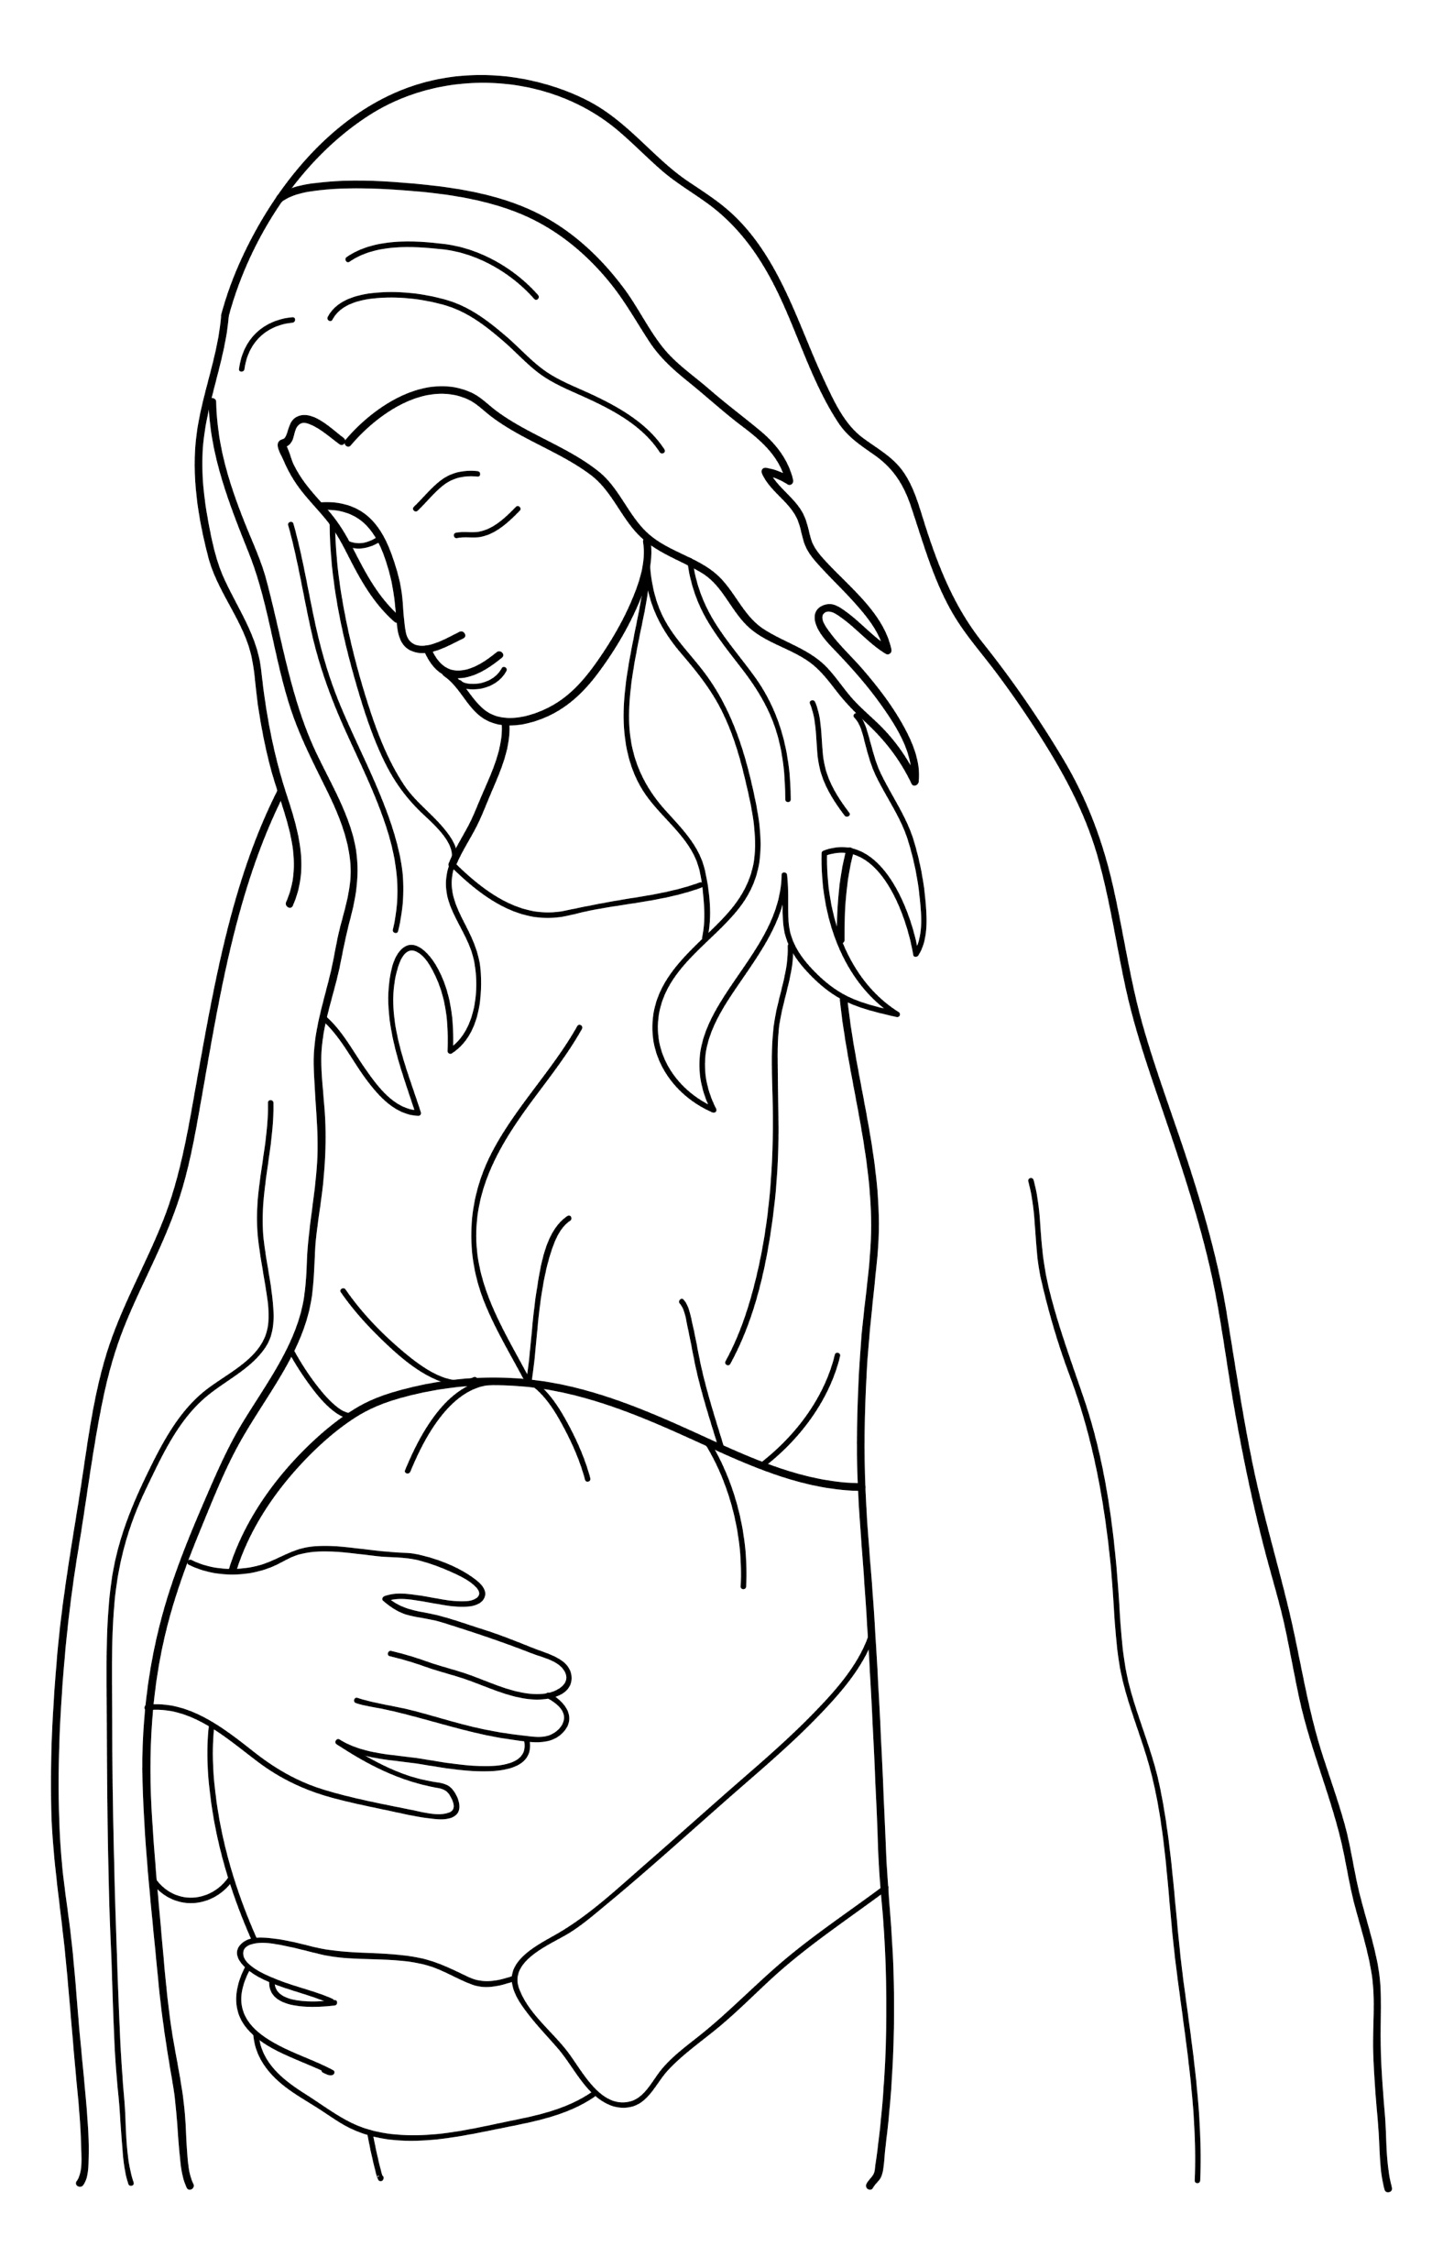
Mary was pregnant.
Notes:
Read for detail (continued)
Read the sentence aloud slowly.
Invite students to repeat the sentence after you.
Repeat several times to reinforce correct pronunciation.

Slide 13
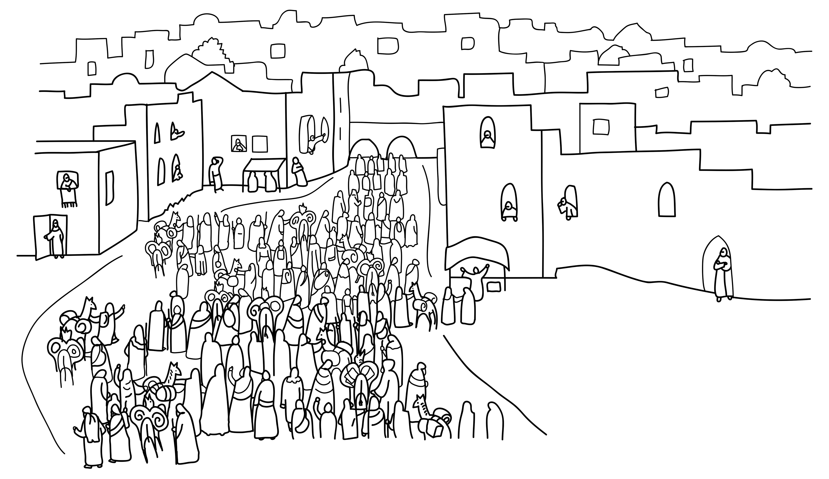
Bethlehem was crowded.
Notes:
Read for detail (continued)
Read the sentence aloud slowly.
Invite students to repeat the sentence after you.
Repeat several times to reinforce correct pronunciation.

Slide 14
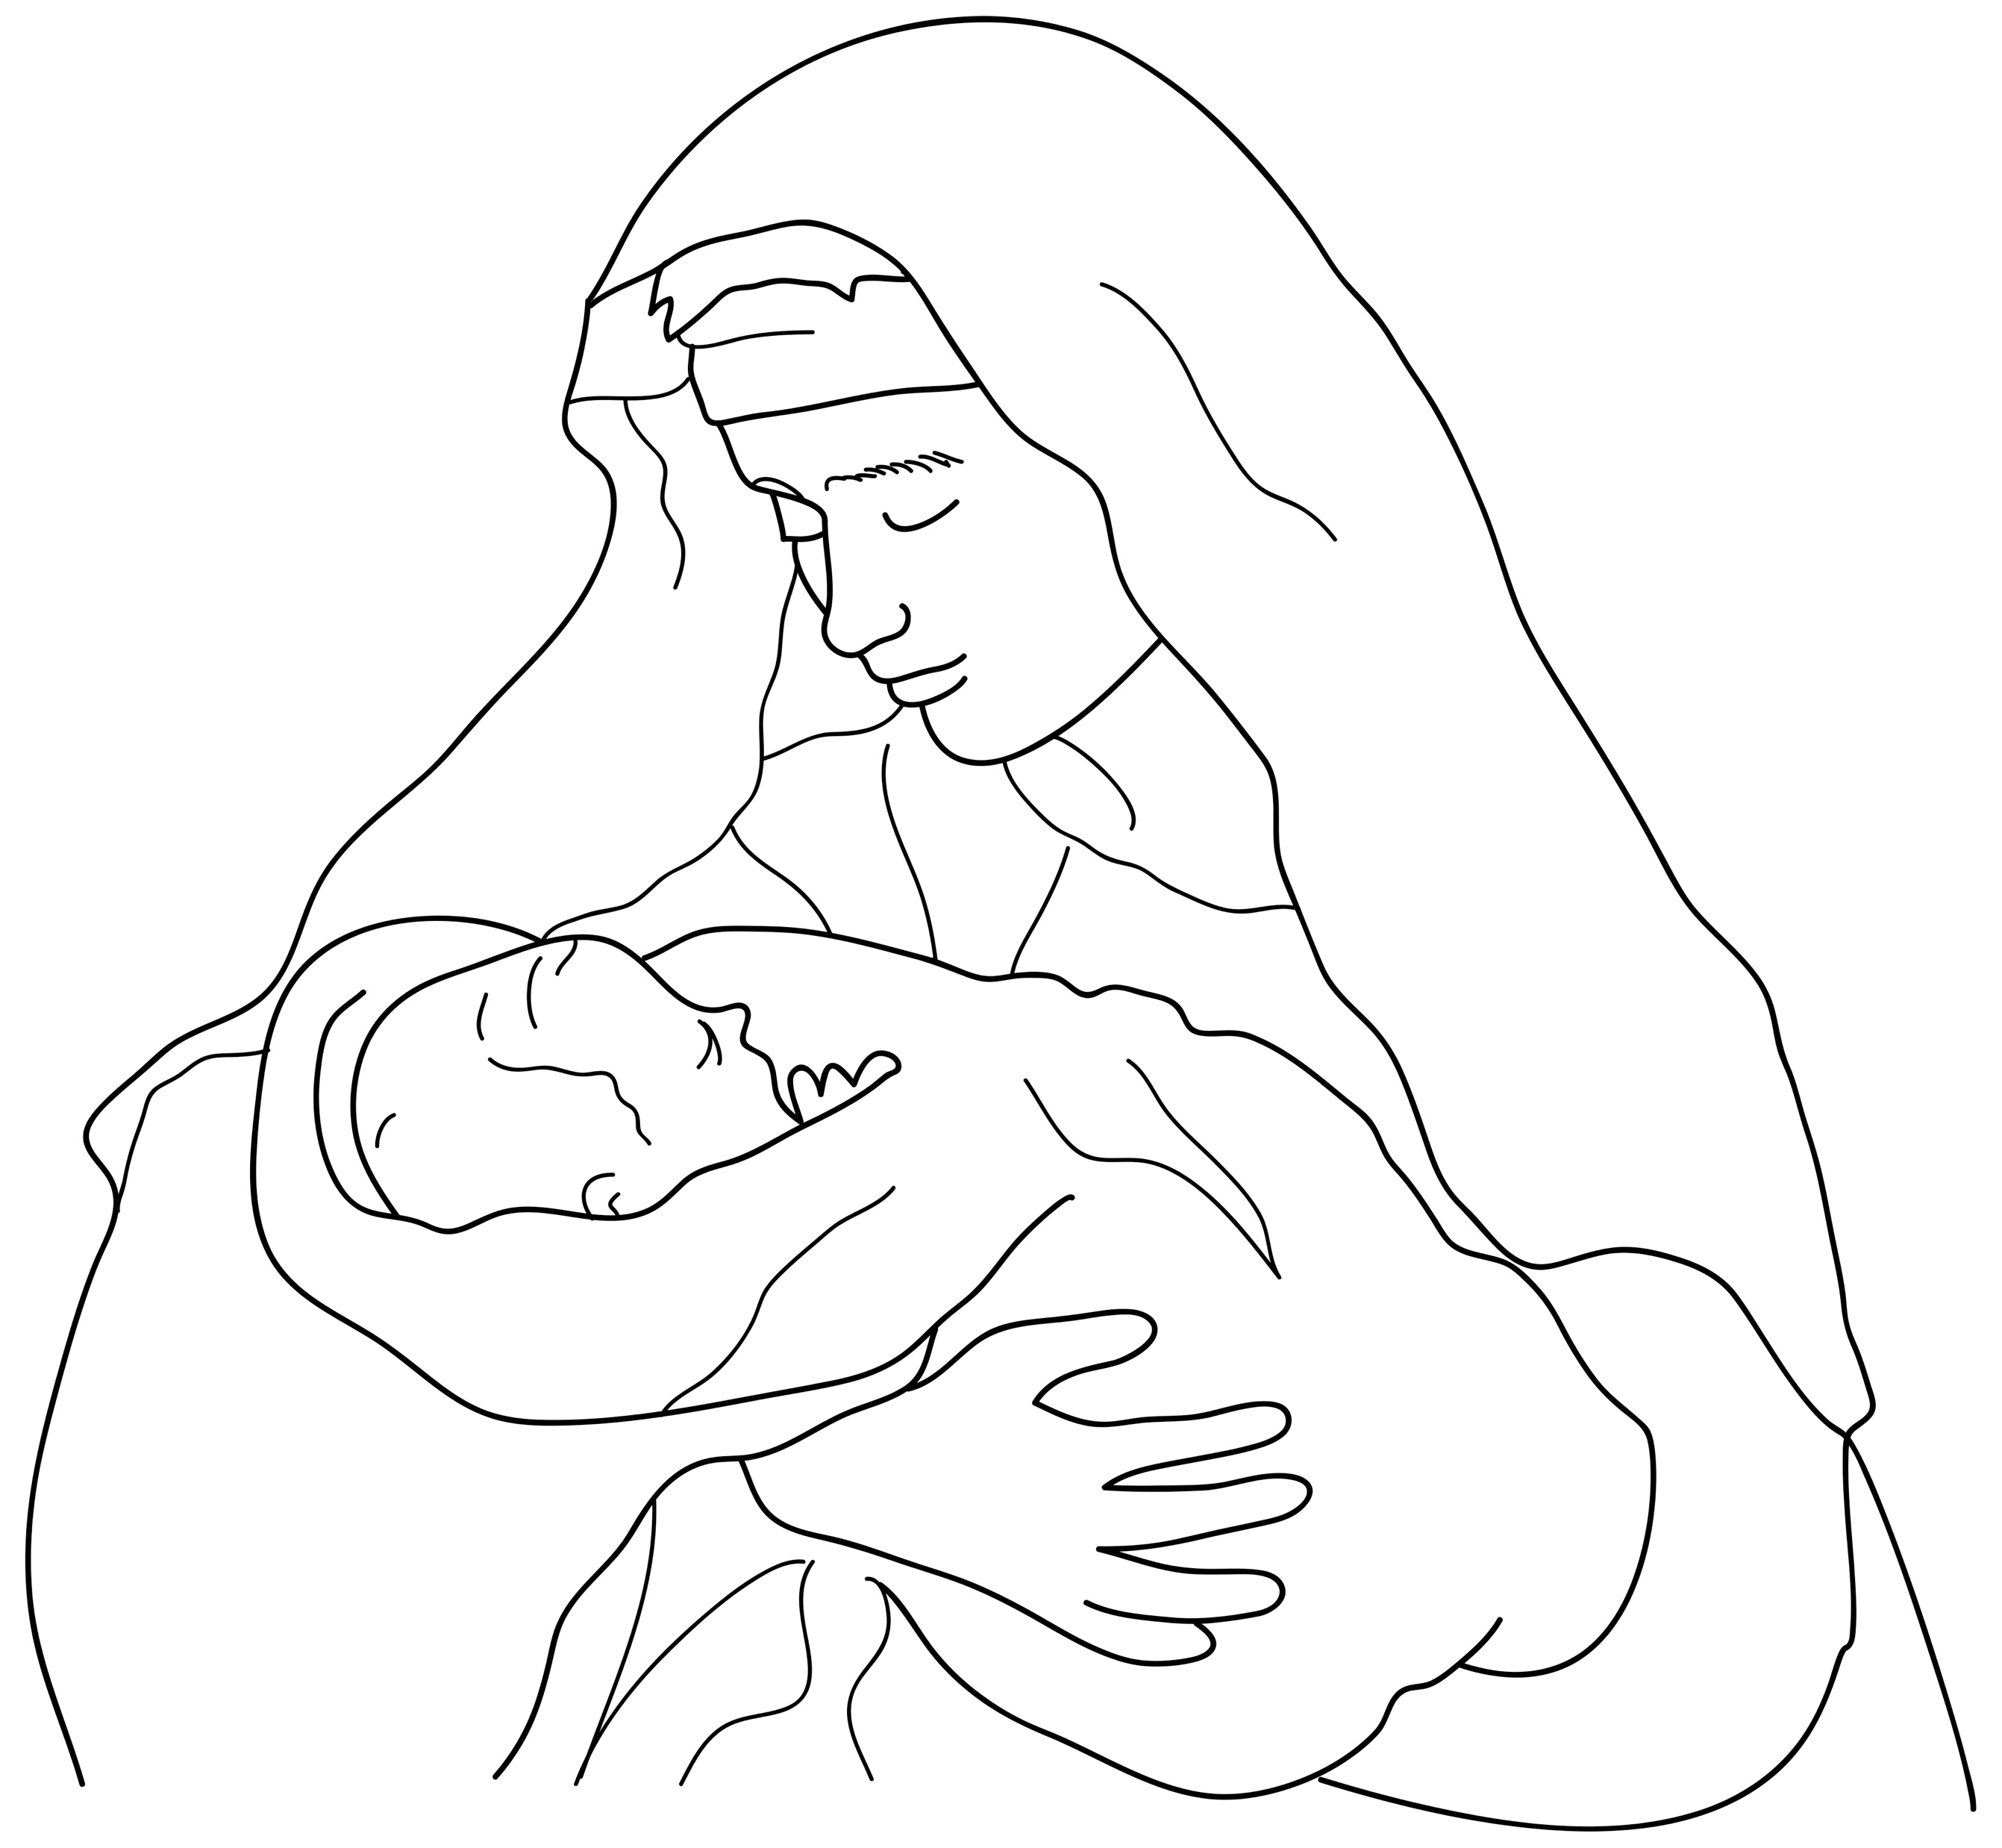
Mary had a baby.
Notes:
Read for detail (continued)
Read the sentence aloud slowly.
Invite students to repeat the sentence after you.
Repeat several times to reinforce correct pronunciation.

Slide 15
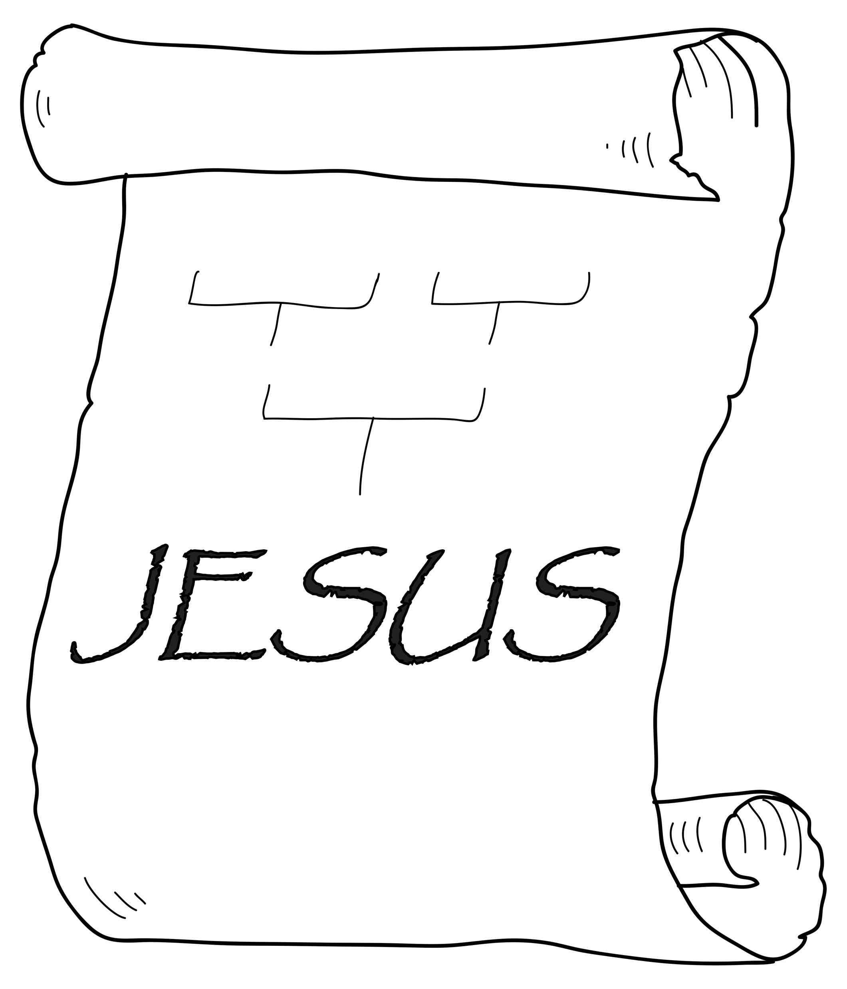
The baby’s name was Jesus.
Notes:
Read for detail (continued)
Read the sentence aloud slowly.
Invite students to repeat the sentence after you.
Repeat several times to reinforce correct pronunciation.

Slide 16
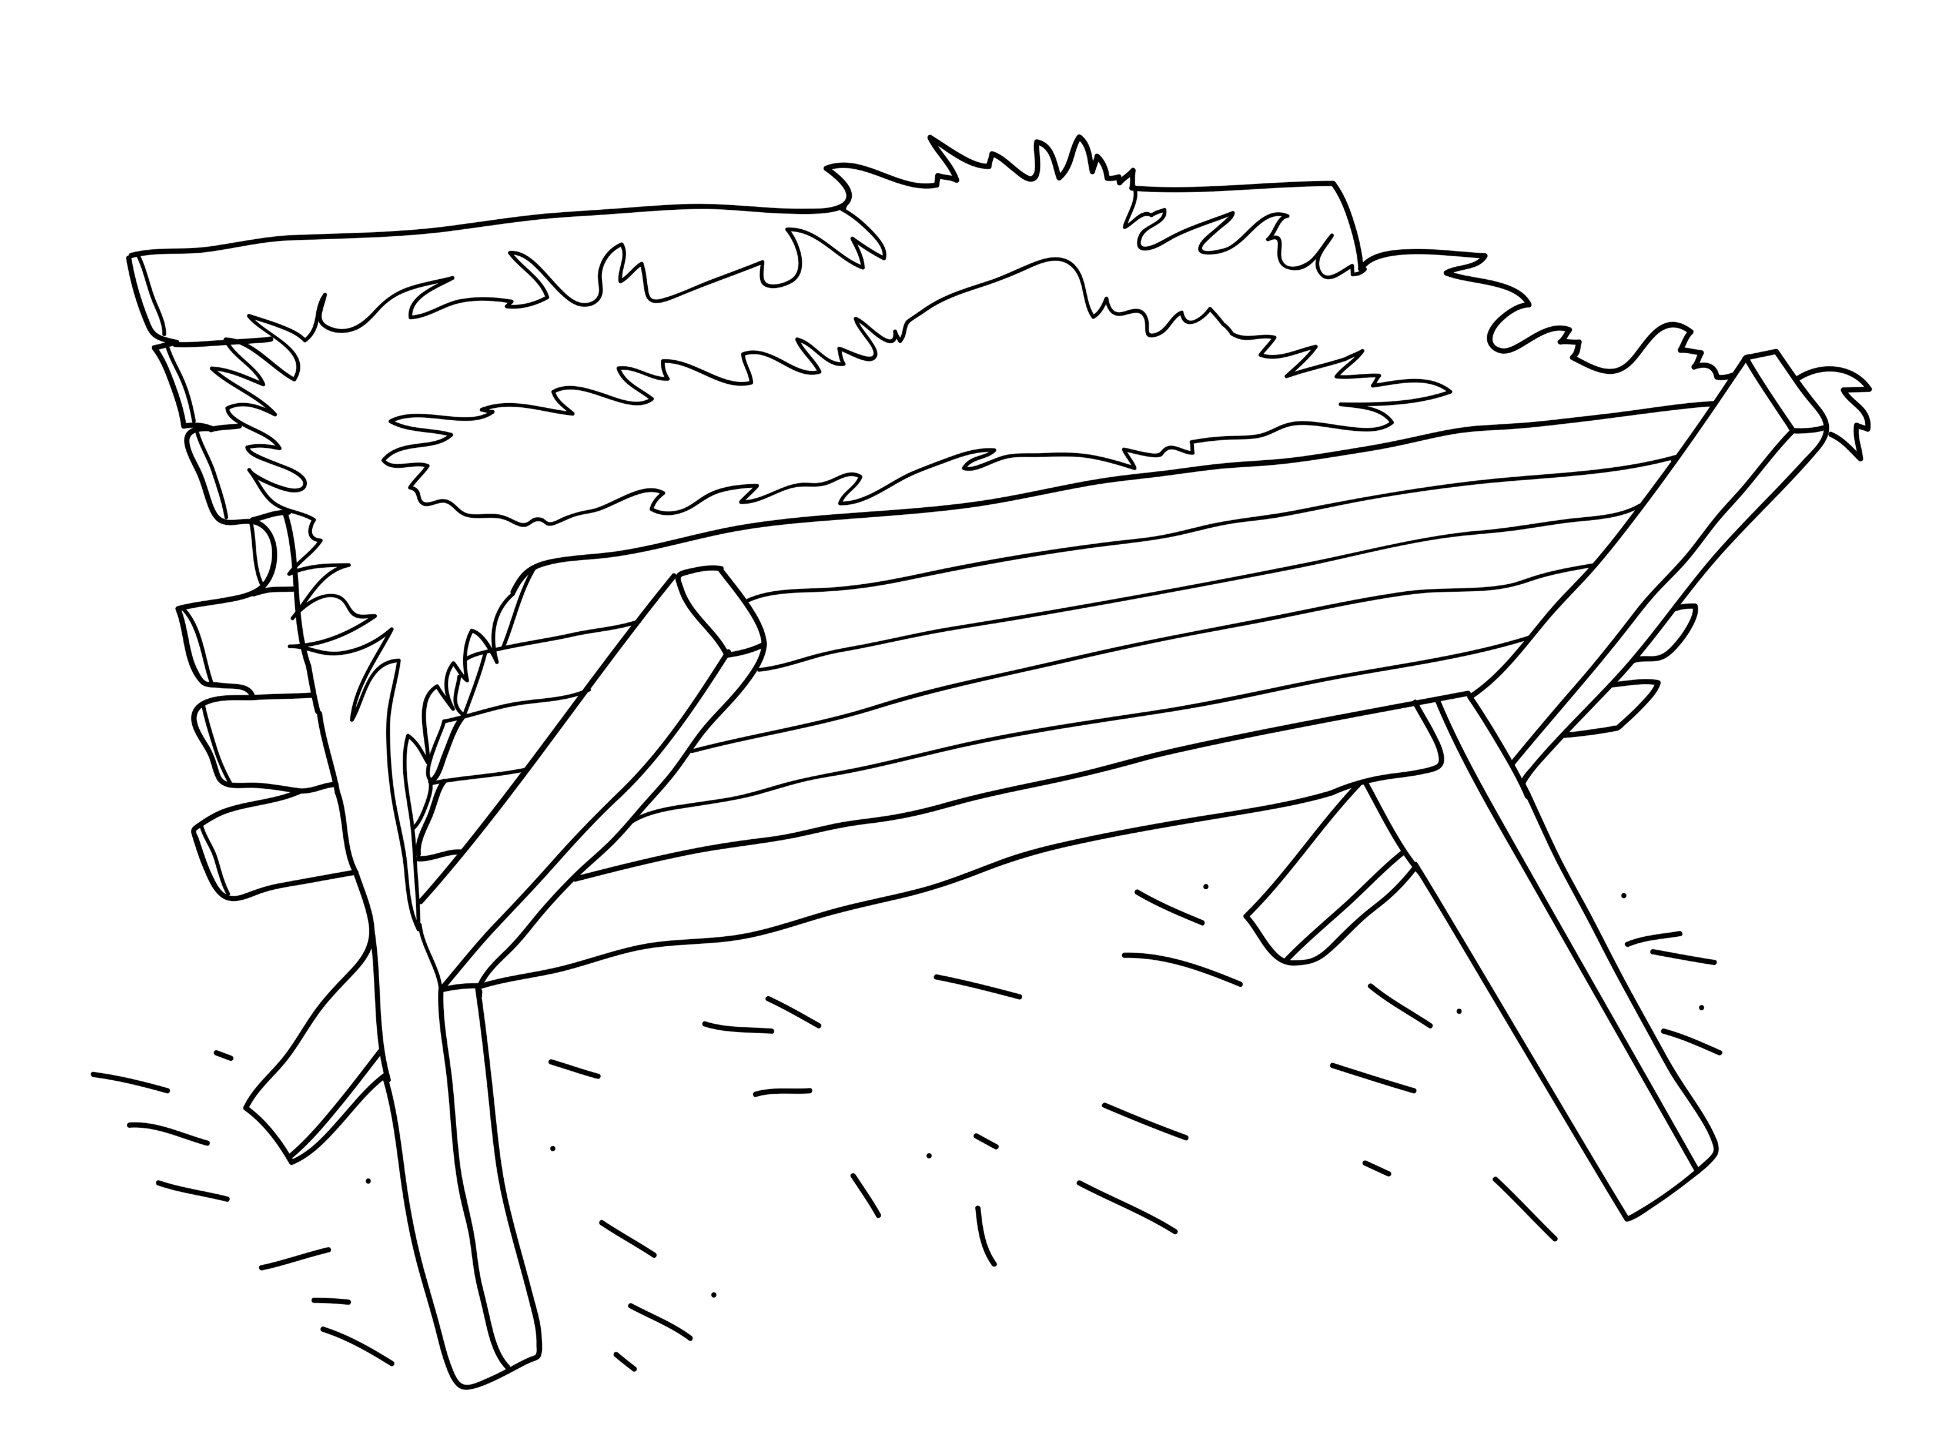
Mary put Jesus in a feeding box for animals.
Notes:
Read for detail (continued)
Read the sentence aloud slowly.
Invite students to repeat the sentence after you.
Repeat several times to reinforce correct pronunciation.

Slide 17
Notes:
Reinforce the language
[The activity on this slide and the 5 slides that follow replaces the activity in the lesson book in which students point to corresponding sketches.]
Invite students to say any words that they remember about this sketch.
Accept responses.

Slide 18
Notes:
Reinforce the language (continued)
Invite students to say any words that they remember about this sketch.
Accept responses.

Slide 19
Notes:
Reinforce the language (continued)
Invite students to say any words that they remember about this sketch.
Accept responses.

Slide 20
Notes:
Reinforce the language (continued)
Invite students to say any words that they remember about this sketch.
Accept responses.

Slide 21
Notes:
Reinforce the language (continued)
Invite students to say any words that they remember about this sketch.
Accept responses.

Slide 22
Notes:
Reinforce the language (continued)
Invite students to say any words that they remember about this sketch.
Accept responses.

Slide 23

Notes:
Reinforce the language (continued)
NB This slide will at first appear blank in Slide Show mode.
Distribute RESOURCE 1.5 – Small sketches (if using) to pairs/groups. [Alternatively, complete this activity together verbally using the PowerPoint slides.]
Invite pairs/groups to sequence or try to remember the sketches in the correct order.
Click your mouse to display the sketches one at a time in the correct order.

Slide 24
Mary and Joseph went to Bethlehem.
Notes:
Reinforce the language (continued)
Distribute RESOURCE 1.6 – Small sentence strips (if using) to pairs/groups.
Invite pairs/groups to match the sentence strips to the corresponding sketches (if using). More advanced students can sequence the sentence strips without looking at the sketches. [Alternatively, complete this activity together verbally using the PowerPoint slides.]
Invite students to identify the sketch on the slide that corresponds to the sentence.
Click to display the arrow and confirm the correct response.

Slide 25
Mary was pregnant.
Notes:
Reinforce the language (continued)
Invite students to point to the sketch on the slide that corresponds to the sentence.
Click to display the arrow and confirm the correct response.

Slide 26
Bethlehem was crowded.
Notes:
Reinforce the language (continued)
Invite students to point to the sketch on the slide that corresponds to the sentence.
Click to display the arrow and confirm the correct response.

Slide 27
Mary had a baby.
Notes:
Reinforce the language (continued)
Invite students to point to the sketch on the slide that corresponds to the sentence.
Click to display the arrow and confirm the correct response.

Slide 28
The baby’s name was Jesus.
Notes:
Reinforce the language (continued)
Invite students to point to the sketch on the slide that corresponds to the sentence.
Click to display the arrow and confirm the correct response.

Slide 29
Mary put Jesus in a feeding box for animals.
Notes:
Reinforce the language (continued)
Invite students to point to the sketch on the slide that corresponds to the sentence.
Click to display the arrow and confirm the correct response.

Slide 30
Mary
_________ and Joseph went
to Bethlehem.
Notes:
Reinforce the language (continued)
Distribute RESOURCE 1.7 – Gap-fill worksheet (if using) to each student. [Alternatively, complete this activity together verbally using the PowerPoint slides.]
Encourage students to work together to complete the worksheet.
Click to reveal the missing word and check the answer together.

Slide 31
2. Mary was __________.
pregnant.
Notes:
Reinforce the language (continued)
Click to reveal the missing word and check the answer together.

Slide 32
3. Bethlehem was __________.
crowded
Notes:
Reinforce the language (continued)
Click to reveal the missing word and check the answer together.

Slide 33
4. Mary had a _________.
baby
Notes:
Reinforce the language (continued)
Click to reveal the missing word and check the answer together.

Slide 34
5. The baby’s
_______ was Jesus
name
Notes:
Reinforce the language (continued)
Click to reveal the missing word and check the answer together.

Slide 35
6. Mary put _________ in a
feeding box for animals.
Jesus
Notes:
Reinforce the language (continued)
Click to reveal the missing word and check the answer together.

