Slide 1
Lesson 2
Meet Jesus
Volume 1
Ten Bible-based English lessons
High Beginner
Notes:
(Lesson 2 title page)

Slide 2
Lesson 2
PART 1
Pointing
Notes:
(Part 1 title page)

Slide 3
Point to _______
Notes:
Activate knowledge
Say ‘Point to the table.’
Invite students to respond to the command by pointing.
Repeat for several items such as body parts, people in the room, objects and features of the room (e.g. your head, the teacher, the window, the bathroom).
Ensure that all students point correctly before giving the next command.

Slide 4
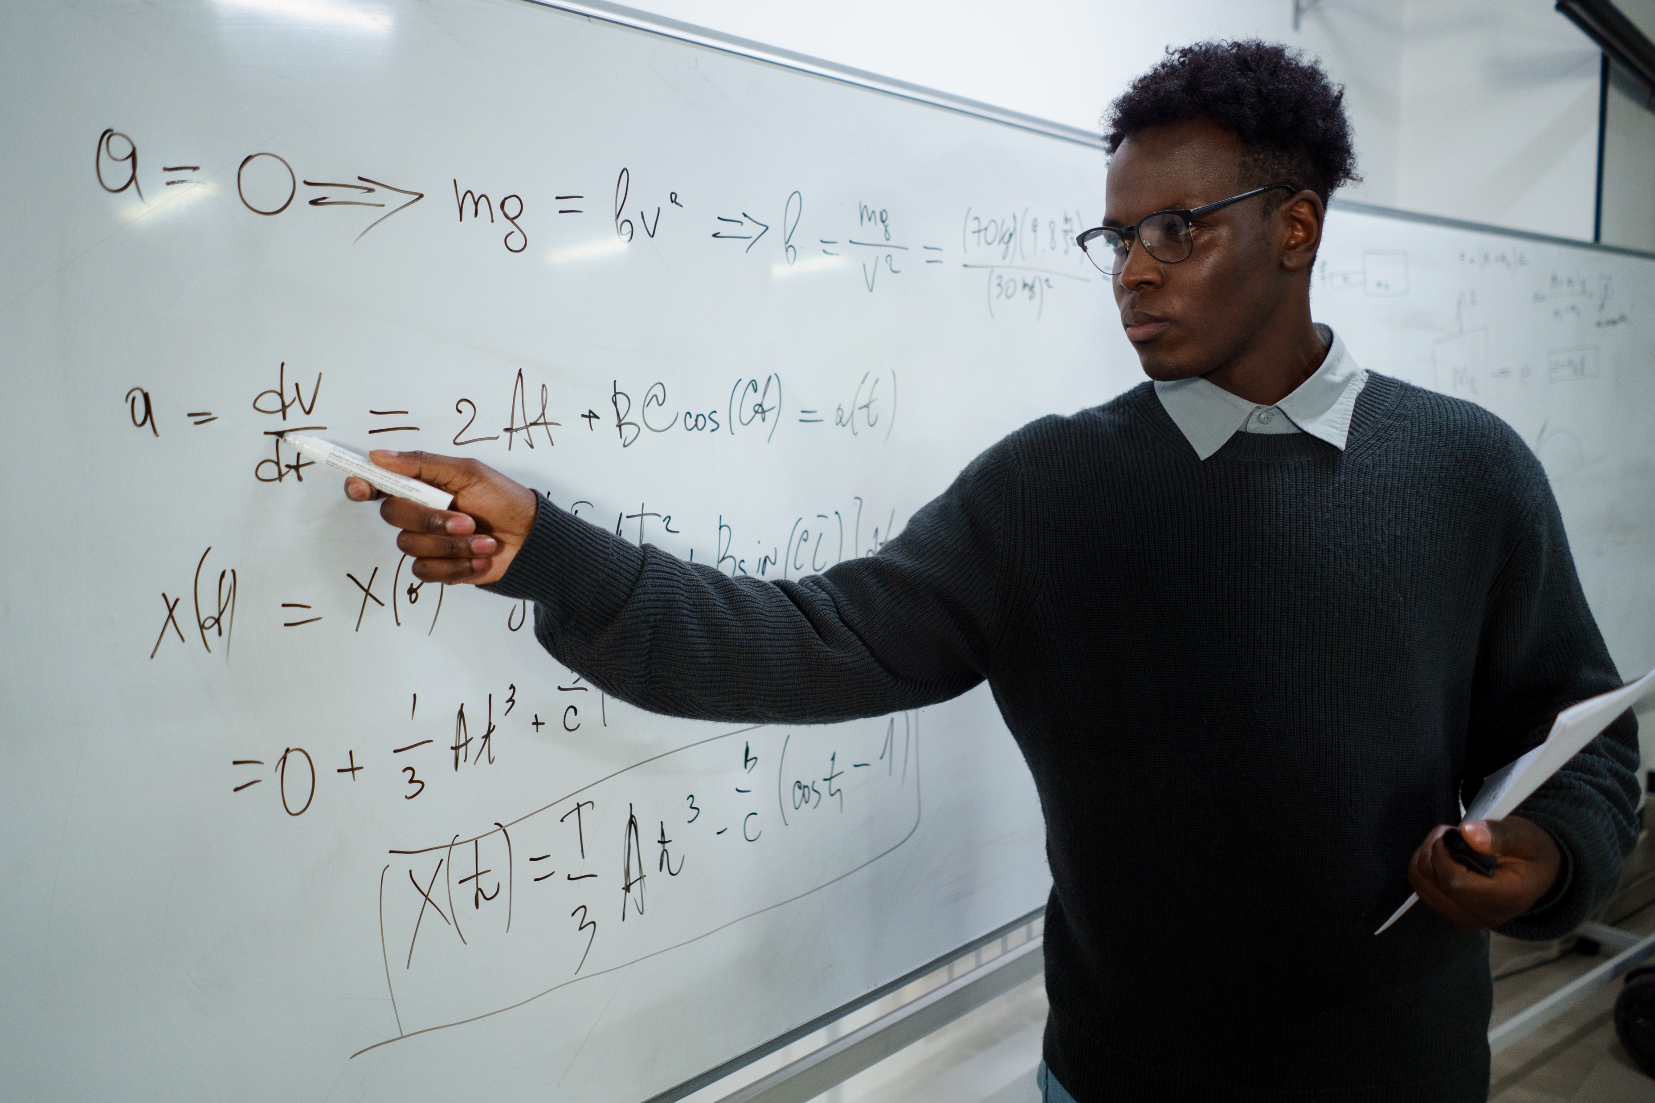
_____________ is / are pointing to _________________ .
The teacher
the whiteboard
Notes:
Focus on language
[Slides 4–11 contain RESOURCE 2.1 – Eight photos.]
Activity 1: Completing the sentence
Invite students to guess the words that belong on the blank lines on the slide.
Click to display The teacher and the whiteboard on the blank lines.
Invite students to say the sentence as you point to the words, ensuring correct pronunciation as you do this.

Slide 5
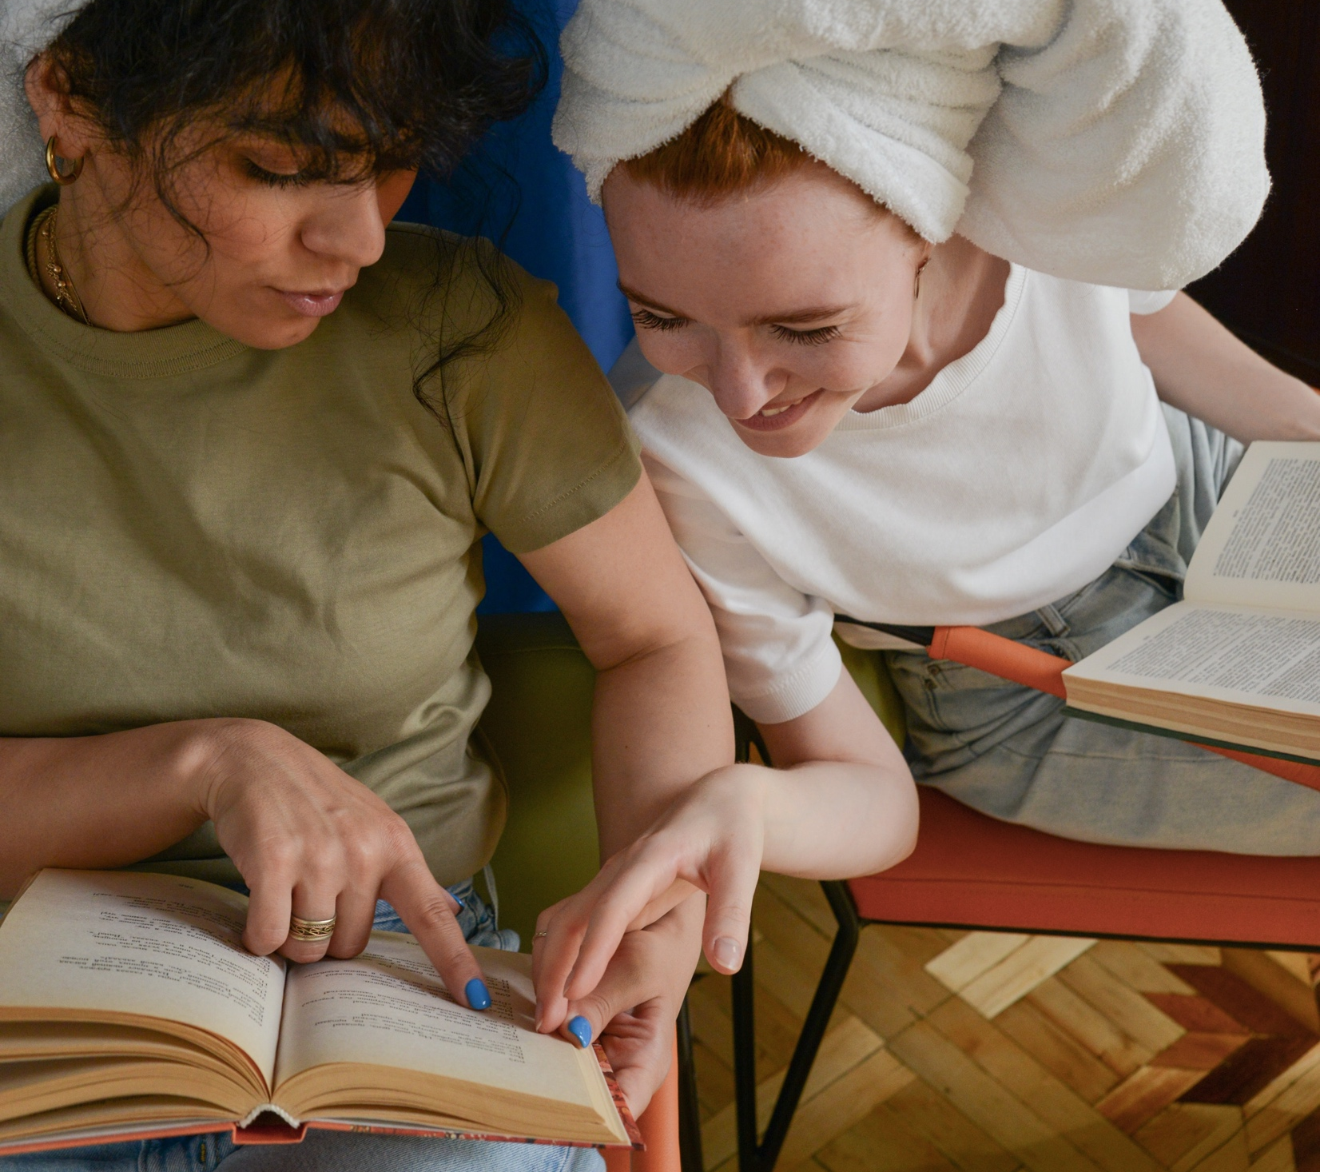
_____________ is / are pointing to _________________ .
The women
the book
Notes:
Focus on language (continued)
Activity 1: Completing the sentence (continued)
Invite students to guess the words that belong on the blank lines on the slide.
Click to display The women and the book on the blank lines.
Invite students to say the sentence as you point to the words, ensuring correct pronunciation as you do this.

Slide 6
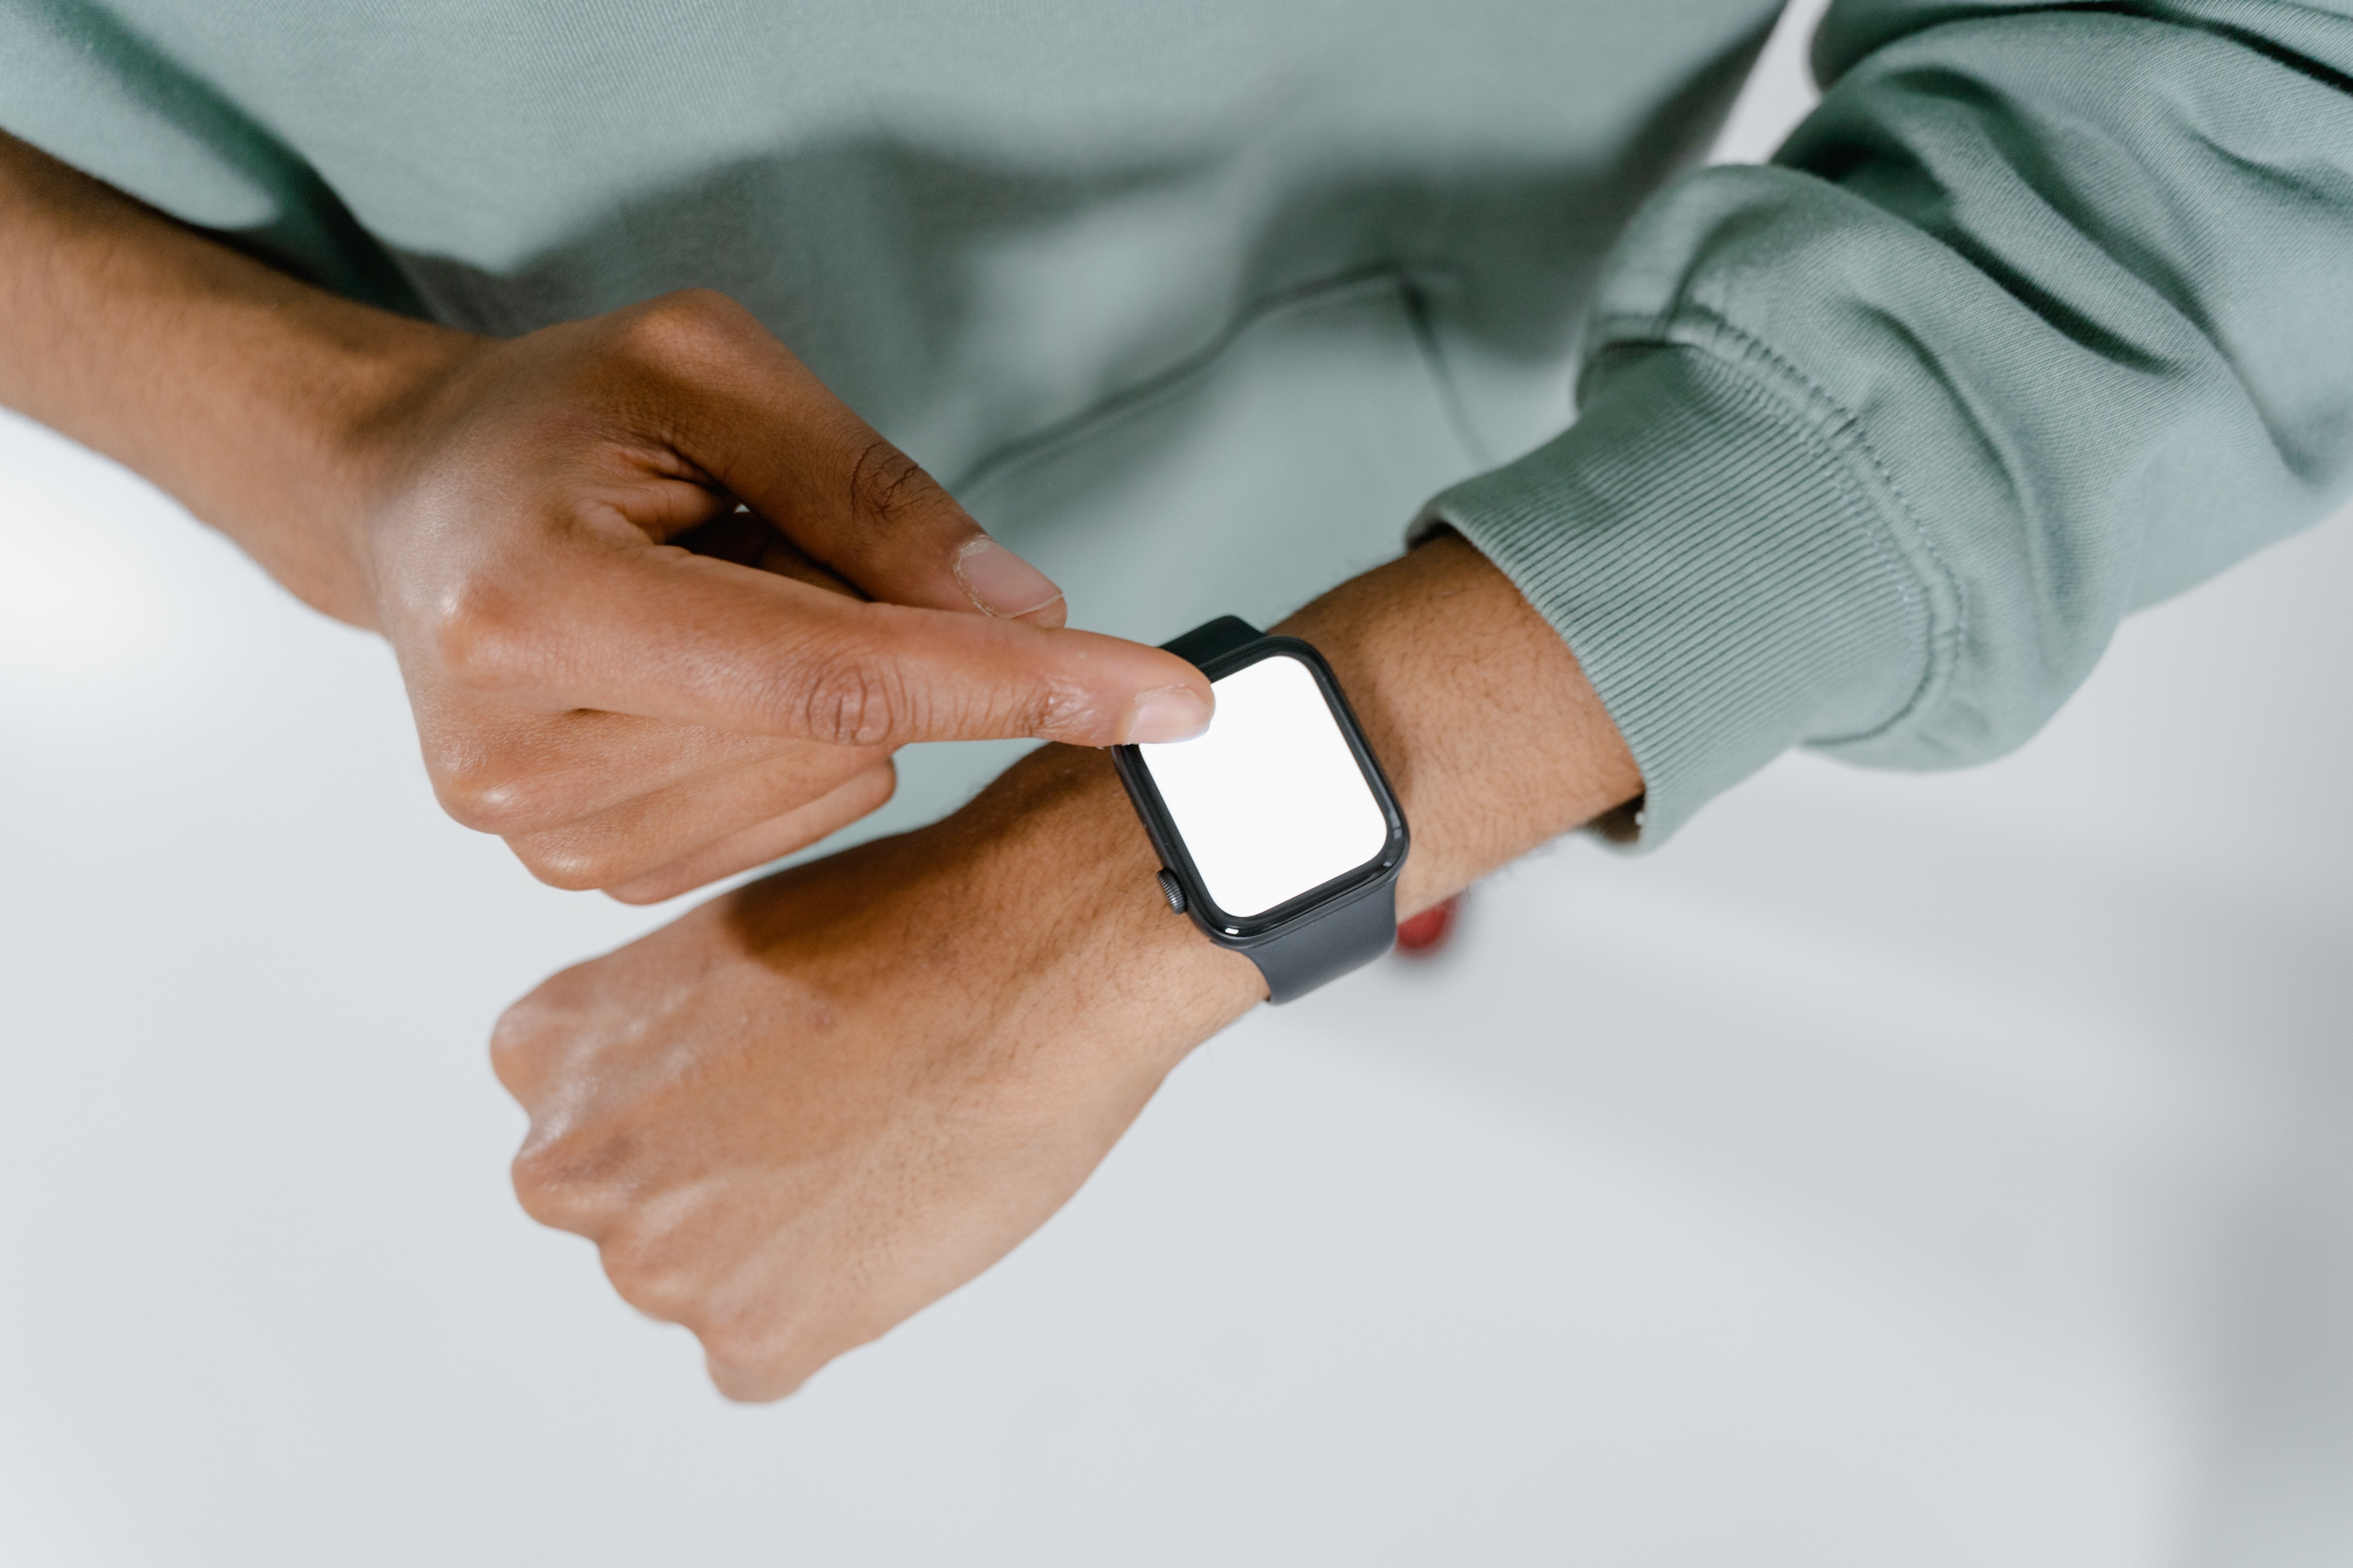
_____________ is / are pointing to _________________ .
The man
the watch
Notes:
Focus on language (continued)
Activity 1: Completing the sentence (continued)
Invite students to guess the words that belong on the blank lines on the slide.
Click to display The man and the watch on the blank lines.
Invite students to say the sentence as you point to the words, ensuring correct pronunciation as you do this.

Slide 7

the mountains
_____________ is / are pointing to _________________ .
The boys
Notes:
Focus on language (continued)
Activity 1: Completing the sentence (continued)
Invite students to guess the words that belong on the blank lines on the slide.
Click to display The boys and the mountains on the blank lines.
Invite students to say the sentence as you point to the words, ensuring correct pronunciation as you do this.

Slide 8

The pen
_____________ is / are pointing to _________________ .
the computer
Notes:
Focus on language (continued)
Activity 1: Completing the sentence (continued)
Invite students to guess the words that belong on the blank lines on the slide.
Click to display The pen and the computer on the blank lines.
Invite students to say the sentence as you point to the words, ensuring correct pronunciation as you do this.

Slide 9
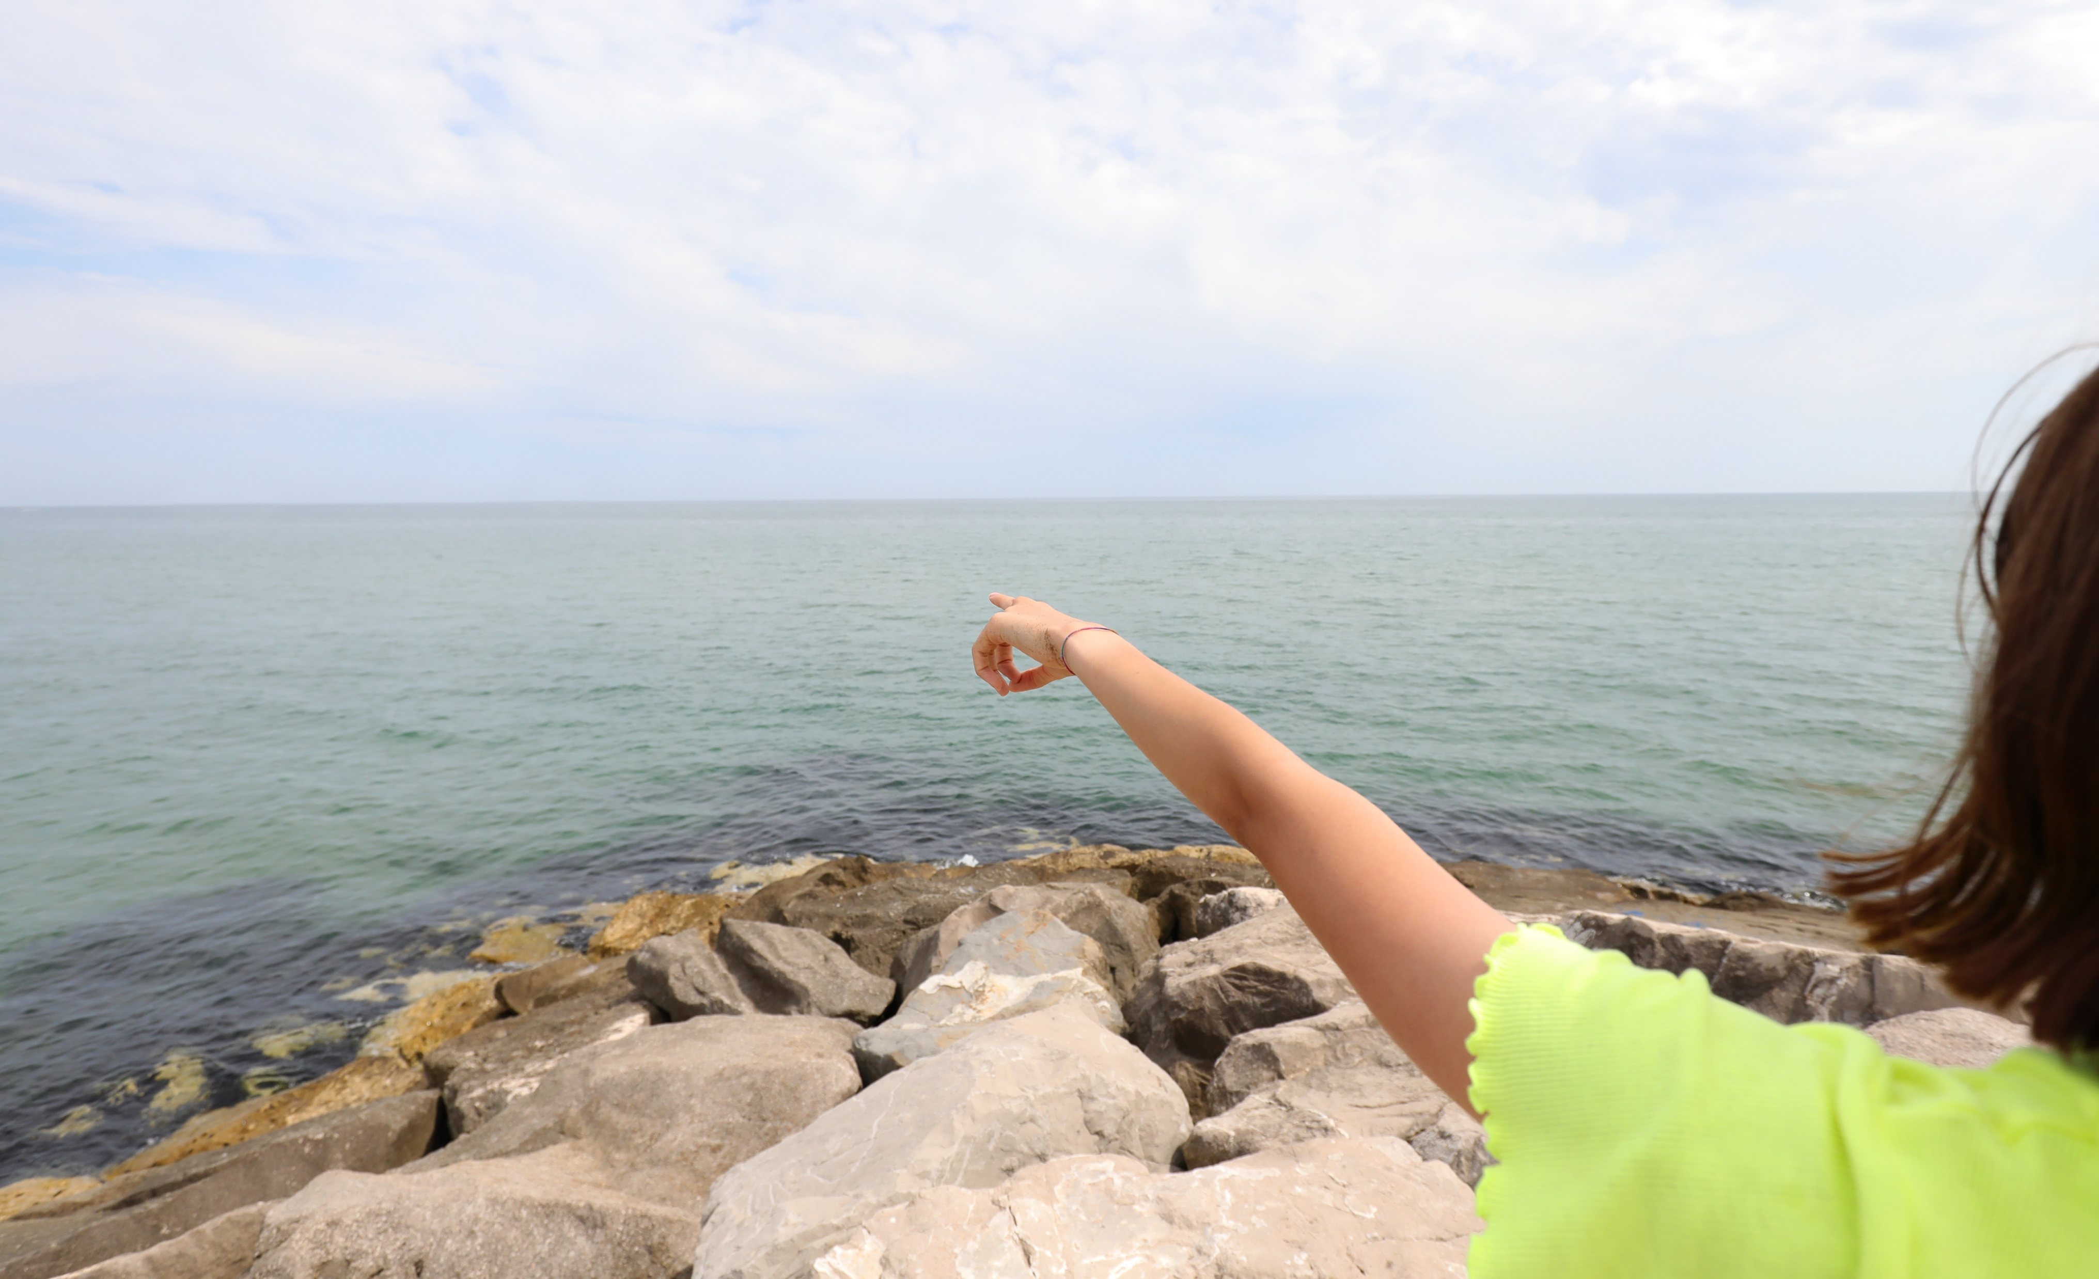
The girl
the water
_____________ is / are pointing to _________________ .
Notes:
Focus on language (continued)
Activity 1: Completing the sentence (continued)
Invite students to guess the words that belong on the blank lines on the slide.
Click to display The girl and the water on the blank lines.
Invite students to say the sentence as you point to the words, ensuring correct pronunciation as you do this.

Slide 10

_____________ is / are pointing to _________________ .
The finger
the clock
Notes:
Focus on language (continued)
Activity 1: Completing the sentence (continued)
Invite students to guess the words that belong on the blank lines on the slide.
Click to display The finger and the clock on the blank lines.
Invite students to say the sentence as you point to the words, ensuring correct pronunciation as you do this.

Slide 11
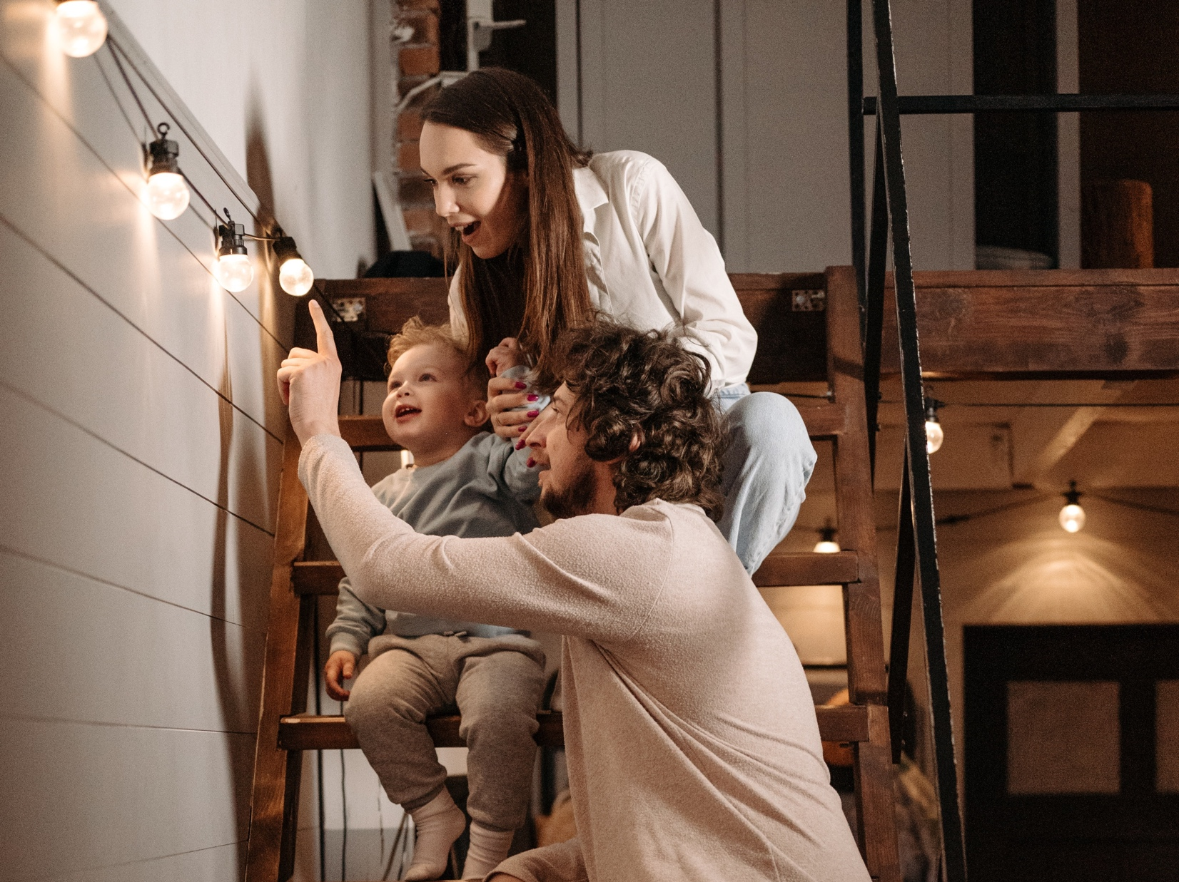
The father
the light
_____________ is / are pointing to _________________ .
Notes:
Focus on language (continued)
Activity 1: Completing the sentence (continued)
Invite students to guess the words that belong on the blank lines on the slide.
Click to display The father and the light on the blank lines.
Invite students to say the sentence as you point to the words, ensuring correct pronunciation as you do this.

Slide 12
The teacher / the / pointing to / whiteboard. / is
The teacher
is
pointing to
the
whiteboard.
Notes:
Focus on language (continued)
Activity 1: Completing the sentence (continued)
Distribute RESOURCE 2.2 – Sentence unscramble worksheet to each student (if using). [Alternatively, complete this activity together verbally using the PowerPoint slides.]
Invite students to work together to complete the worksheet.
Check answers together by clicking to reveal the correct sentences on slides 12–19.

Slide 13
the book. / The women / are / pointing to
The women
are
pointing to
the book.
Notes:
Focus on language (continued)
Activity 1: Completing the sentence (continued)
Click to reveal the correct sentence.

Slide 14
pointing to / is / the watch. / The man
is
pointing to
the watch.
The man
Notes:
Focus on language (continued)
Activity 1: Completing the sentence (continued)
Click to reveal the correct sentence.

Slide 15
boys / The / to the / mountains. / are pointing
boys
are pointing
to the
mountains.
The
Notes:
Focus on language (continued)
Activity 1: Completing the sentence (continued)
Click to reveal the correct sentence.

Slide 16
pen is / the computer. / pointing to / The
pen is
pointing to
the computer.
The
Notes:
Focus on language (continued)
Activity 1: Completing the sentence (continued)
Click to reveal the correct sentence.

Slide 17
to / The girl / pointing / is / the water.
is
The girl
pointing
to
the water.
Notes:
Focus on language (continued)
Activity 1: Completing the sentence (continued)
Click to reveal the correct sentence.

Slide 18
pointing to / the clock. / The hand is
The hand is
pointing to
the clock.
Notes:
Focus on language (continued)
Activity 1: Completing the sentence (continued)
Click to reveal the correct sentence.

Slide 19
is pointing / light. / to the / The father
The father
is pointing
to the
light.
Notes:
Focus on language (continued)
Activity 1: Completing the sentence (continued)
Click to reveal the correct sentence.

Slide 20
teacher
What is/are the ______________ pointing to?
(Student A)
The __________ is/are pointing to the ____________.
(Student B)
teacher
whiteboard
Notes:
Focus on language (continued)
Activity 2: Speaking practice
Ask ‘What is the teacher pointing to?’
Invite responses.
Say ‘The teacher is pointing to the whiteboard.’
Divide students into pairs.
Nominate Student A and Student B in each pair.
Invite students to practise the dialogue on this slide and slides 21–27.
Check answers together by clicking to reveal the correct words.

Slide 21
women
What is/are the ______________ pointing to?
The __________ is/are pointing to the ____________.
women
book
Notes:
Focus on language (continued)
Activity 2: Speaking practice (continued)
Invite students to practise the dialogue on the slide.
Check answers together by clicking to reveal the correct words.

Slide 22
man
What is/are the ______________ pointing to?
The __________ is/are pointing to the ____________.
man
clock
Notes:
Focus on language (continued)
Activity 2: Speaking practice (continued)
Invite students to practise the dialogue on the slide.
Check answers together by clicking to reveal the correct words.

Slide 23
boys
What is/are the ______________ pointing to?
The __________ is/are pointing to the ____________.
boys
mountains
Notes:
Focus on language (continued)
Activity 2: Speaking practice (continued)
Invite students to practise the dialogue on the slide.
Check answers together by clicking to reveal the correct words.

Slide 24
pen
What is/are the ______________ pointing to?
The __________ is/are pointing to the ____________.
pen
computer
Notes:
Focus on language (continued)
Activity 2: Speaking practice (continued)
Invite students to practise the dialogue on the slide.
Check answers together by clicking to reveal the correct words.

Slide 25
woman
What is/are the ______________ pointing to?
The __________ is/are pointing to the ____________.
woman
water
Notes:
Focus on language (continued)
Activity 2: Speaking practice (continued)
Invite students to practise the dialogue on the slide.
Check answers together by clicking to reveal the correct words.

Slide 26
finger
What is/are the ______________ pointing to?
The __________ is/are pointing to the ____________.
finger
clock
Notes:
Focus on language (continued)
Activity 2: Speaking practice (continued)
Invite students to practise the dialogue on the slide.
Check answers together by clicking to reveal the correct words.

Slide 27
father
What is/are the ______________ pointing to?
The __________ is/are pointing to the ____________.
father
light
Notes:
Focus on language (continued)
Activity 2: Speaking practice (continued)
Invite students to practise the dialogue on the slide.
Check answers together by clicking to reveal the correct words.
Swap student roles and repeat slides 20–27.

Slide 28
What’s in the bag?
Notes:
Focus on language (continued)
Activity 3: What’s in the bag?
[NB If online, skip this activity and go straight to the next slide.]
Hold up the cloth bag/pillowcase from home with the star concealed in it.
Create interest by passing the bag from student to student.
Invite students to feel the contents of the bag without speaking.
Invite students to describe what the item feels like.
Invite students to guess what the hidden item is.
Write suggestions on the board (if using).

Slide 29
big
bigger
biggest
Notes:
Focus on language (continued)
Activity 4: Comparing stars
[This slide contains RESOURCE 2.3 – Stars.]
Point to the first star, already displayed on the left of the slide.
Say ‘It’s a big star.’
Invite students to repeat after you.
Click to display the next (bigger) star.
Say ‘It’s a bigger star.’
Invite students to repeat after you.
Click to display the third (biggest) star.
Say ‘It’s the biggest star.’
Invite students to repeat after you.

Slide 30
long
longer
longest
Notes:
Focus on language (continued)
Activity 4: Comparing stars (continued)
Distribute RESOURCE 2.4 – Describing worksheet to each student (if using). [Alternatively, complete this activity together verbally using the PowerPoint slides.]
Invite students to work together to complete the worksheet. (Note: students may need your help with the words marked with asterisks on the worksheet.)
Click to reveal the correct words.

Slide 31
small
smaller
smallest
Notes:
Focus on language (continued)
Activity 4: Comparing stars (continued)
Click to reveal the correct words.

Slide 32
loud
louder
loudest
Notes:
Focus on language (continued)
Activity 4: Comparing stars (continued)
Click to reveal the correct words.

Slide 33
old
older
oldest
Notes:
Focus on language (continued)
Activity 4: Comparing stars (continued)
Click to reveal the correct words.

Slide 34
short
shorter
shortest
Notes:
Focus on language (continued)
Activity 4: Comparing stars (continued)
Click to reveal the correct words.

Slide 35
tall
taller
tallest
Notes:
Focus on language (continued)
Activity 4: Comparing stars (continued)
Click to reveal the correct words.

Slide 36
new
newer
newest
Notes:
Focus on language (continued)
Activity 4: Comparing stars (continued)
Click to reveal the correct words.

Slide 37
bad
worse
worst
Notes:
Focus on language (continued)
Activity 4: Comparing stars (continued)
Click to reveal the correct words.

Slide 38
Lesson 2
PART 2
The visit of the wise men
Matthew 2:1–12
Notes:
(Part 2 title page)

Slide 39

Notes:
Read for gist
Say ‘In the Bible story, a star points to Jesus.’
Distribute copies of Matthew 2:1–12 in your students’ heart languages (if in the classroom). [Alternatively, if online, invite students to refer to the heart language texts they have been sent in advance.]
Give students a few minutes to read the text silently for context, then ask them to put it away for the rest of the lesson.

Slide 40
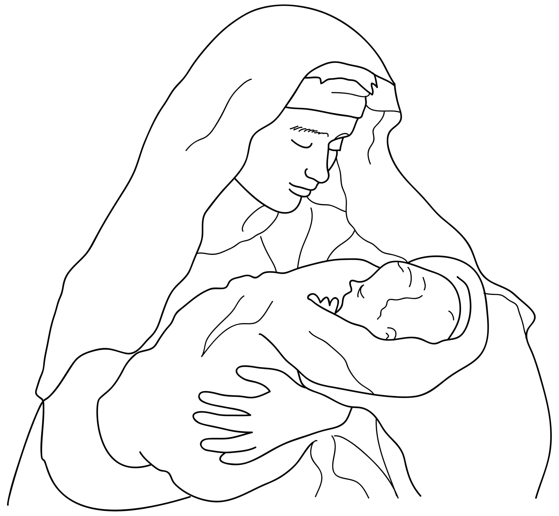
Jesus was born.
Notes:
Read for detail
[This slide and the 5 slides that follow contain RESOURCE 2.5 – Large sketches and RESOURCE 2.6 – Large sentences.]
Read the sentence on the slide aloud slowly.
Invite students to repeat the sentence after you.
Repeat several times to reinforce correct pronunciation.
Click through the presentation to display the remaining 5 sketches and sentences.

Slide 41
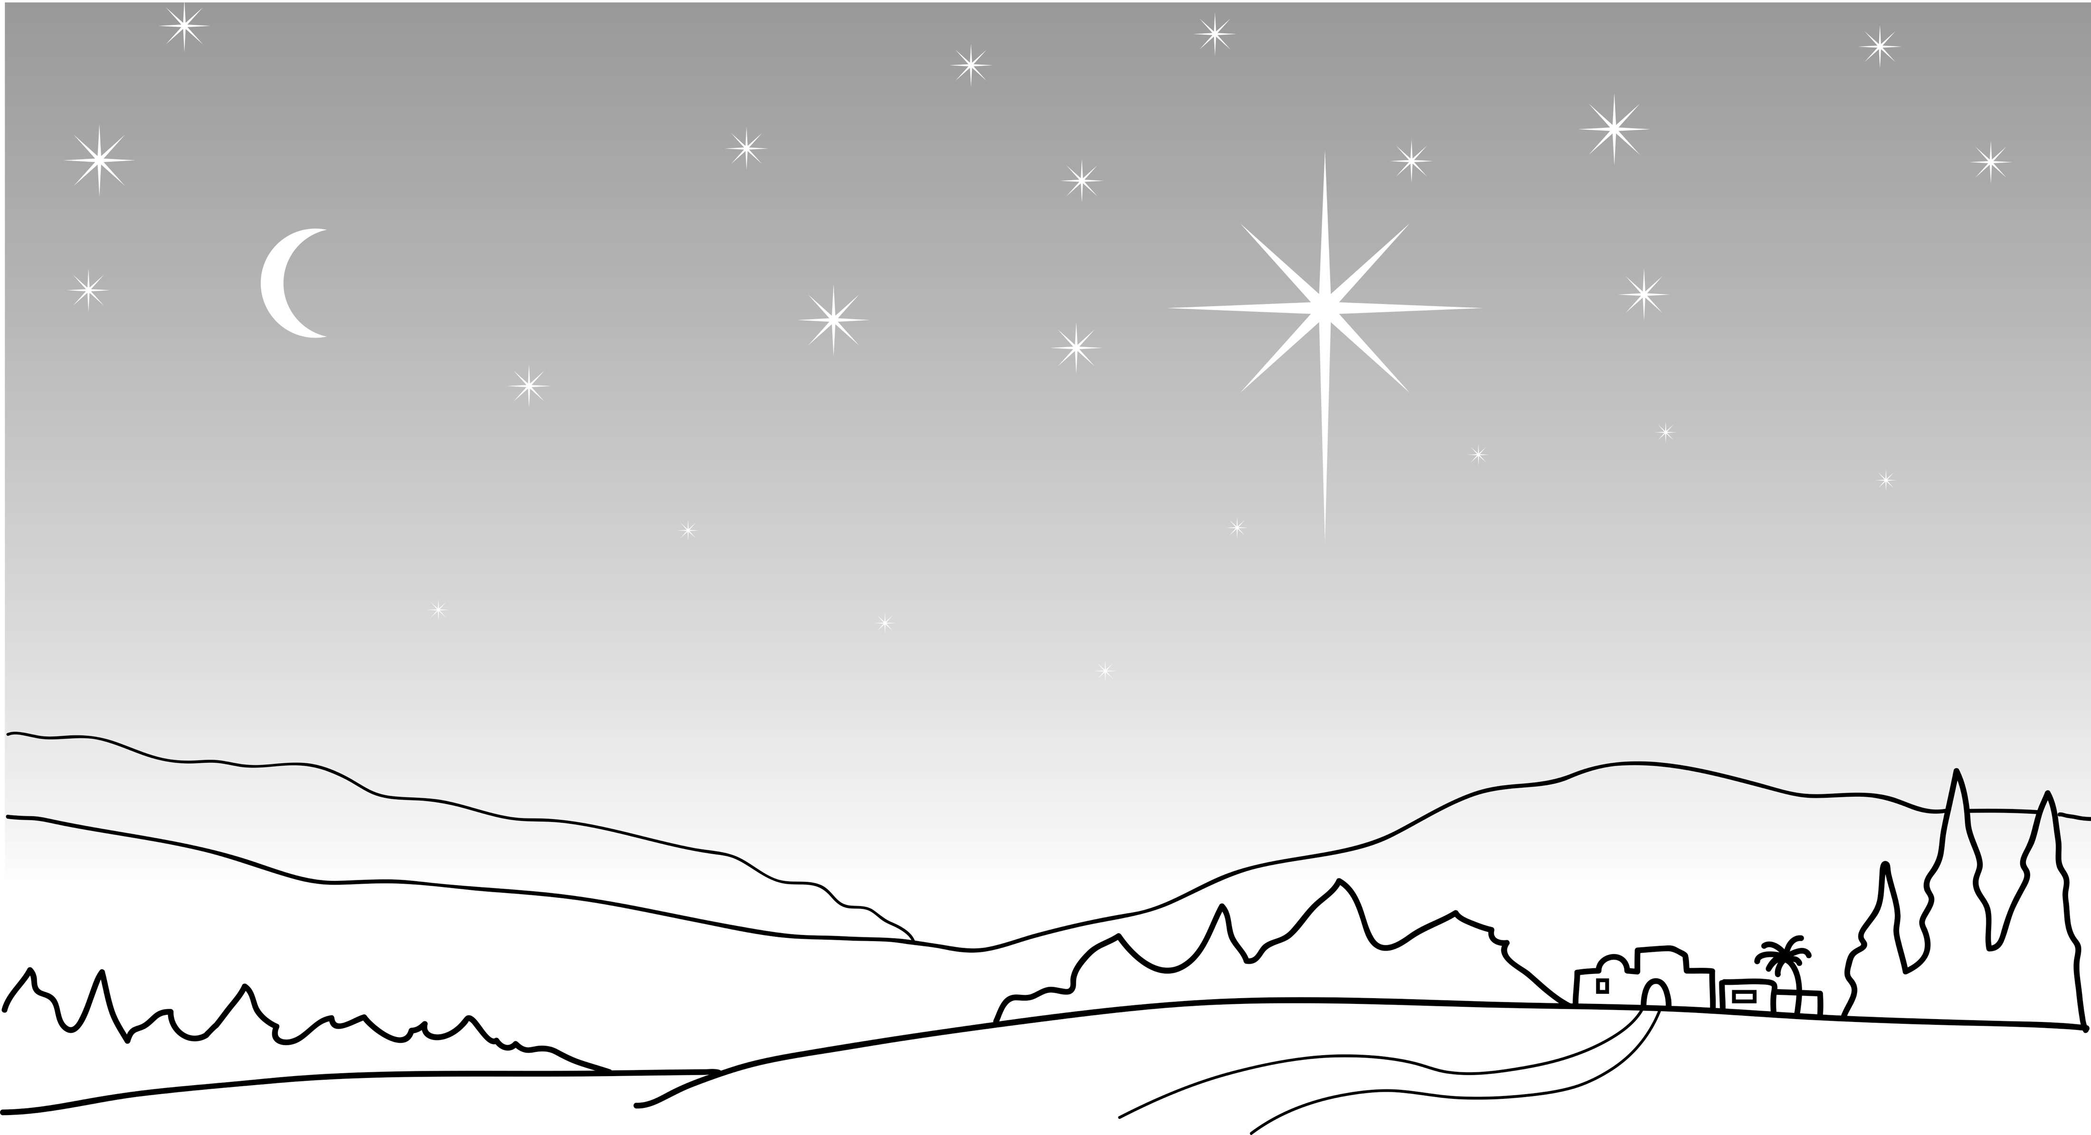
God created a special star.
Notes:
Read for detail (continued)
Read the sentence aloud slowly.
Invite students to repeat the sentence after you.
Repeat several times to reinforce correct pronunciation.

Slide 42
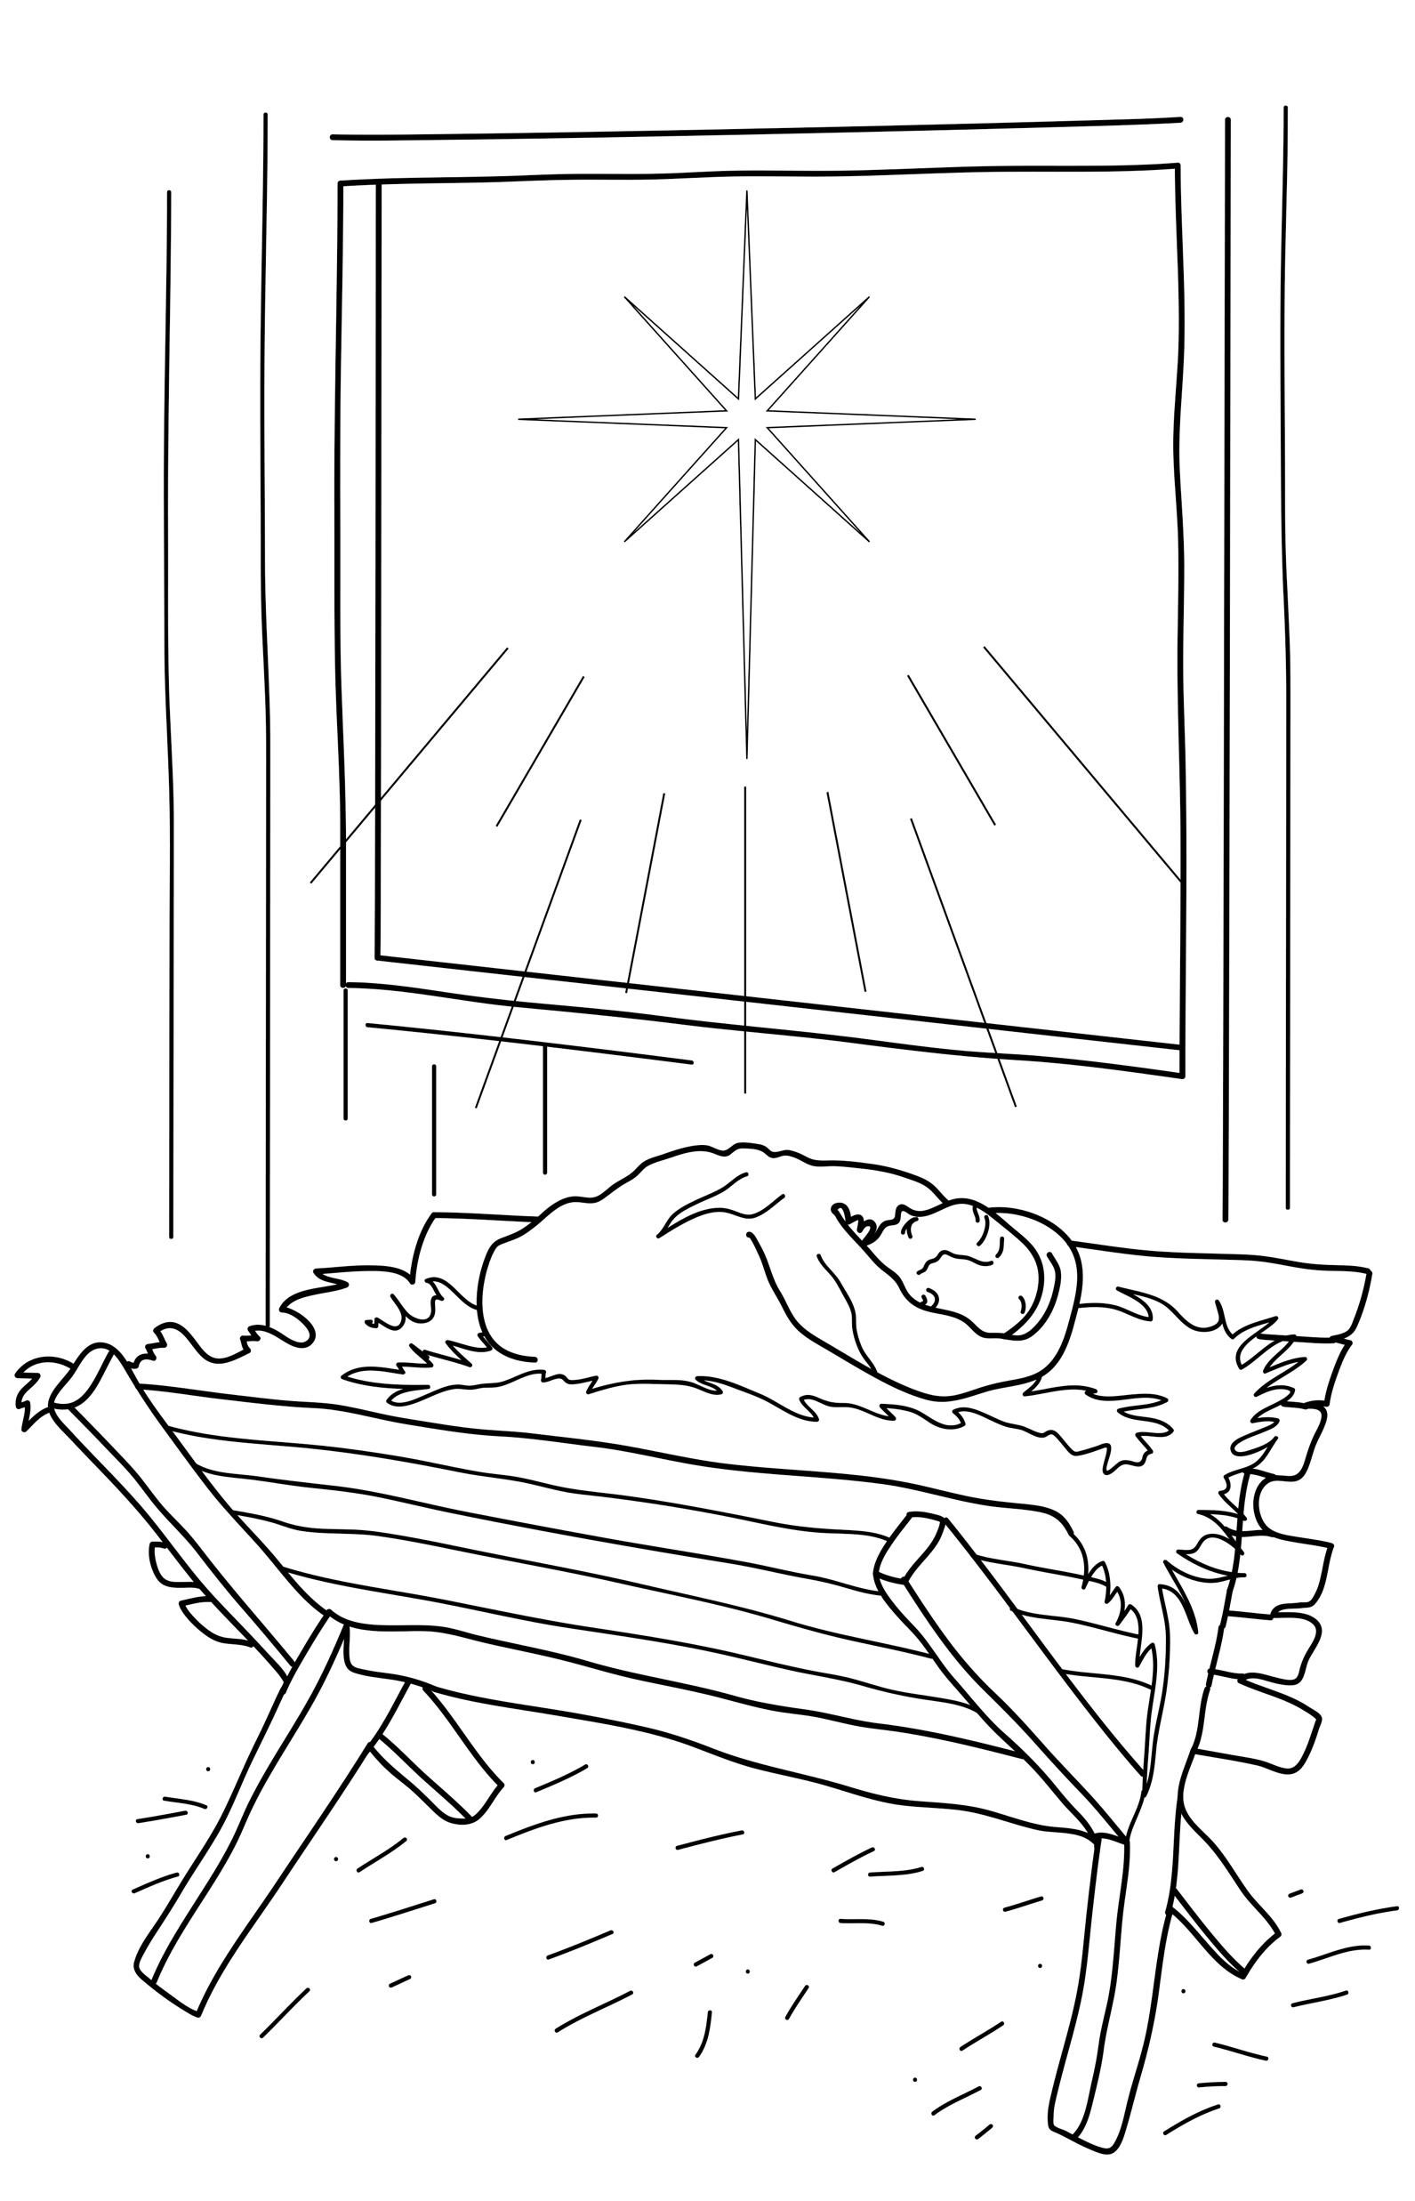
The star pointed to Jesus.
Notes:
Read for detail (continued)
Read the sentence aloud slowly.
Invite students to repeat the sentence after you.
Repeat several times to reinforce correct pronunciation.

Slide 43
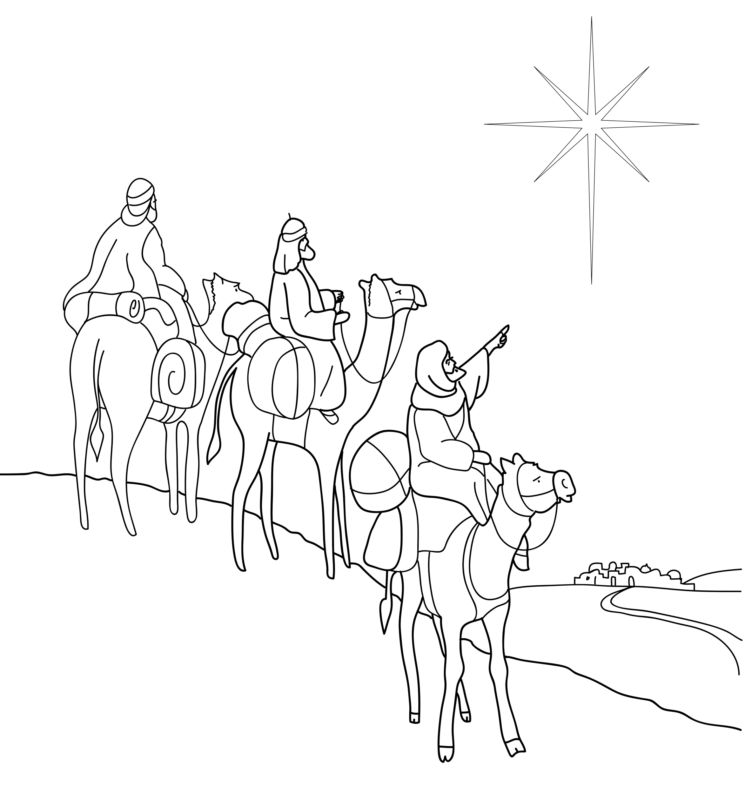
Wise men followed the star.
Notes:
Read for detail (continued)
Read the sentence aloud slowly.
Invite students to repeat the sentence after you.
Repeat several times to reinforce correct pronunciation.

Slide 44
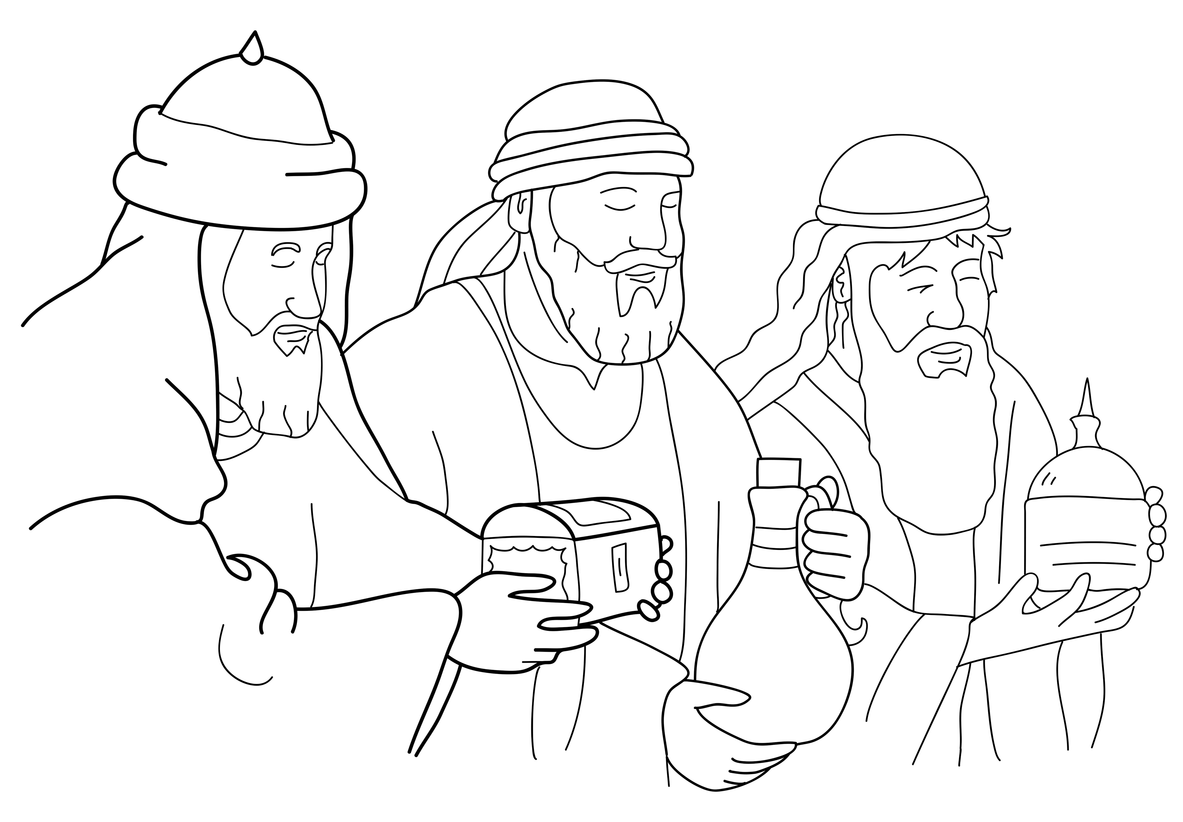
Wise men gave Jesus gifts.
Notes:
Read for detail (continued)
Read the sentence aloud slowly.
Invite students to repeat the sentence after you.
Repeat several times to reinforce correct pronunciation.

Slide 45
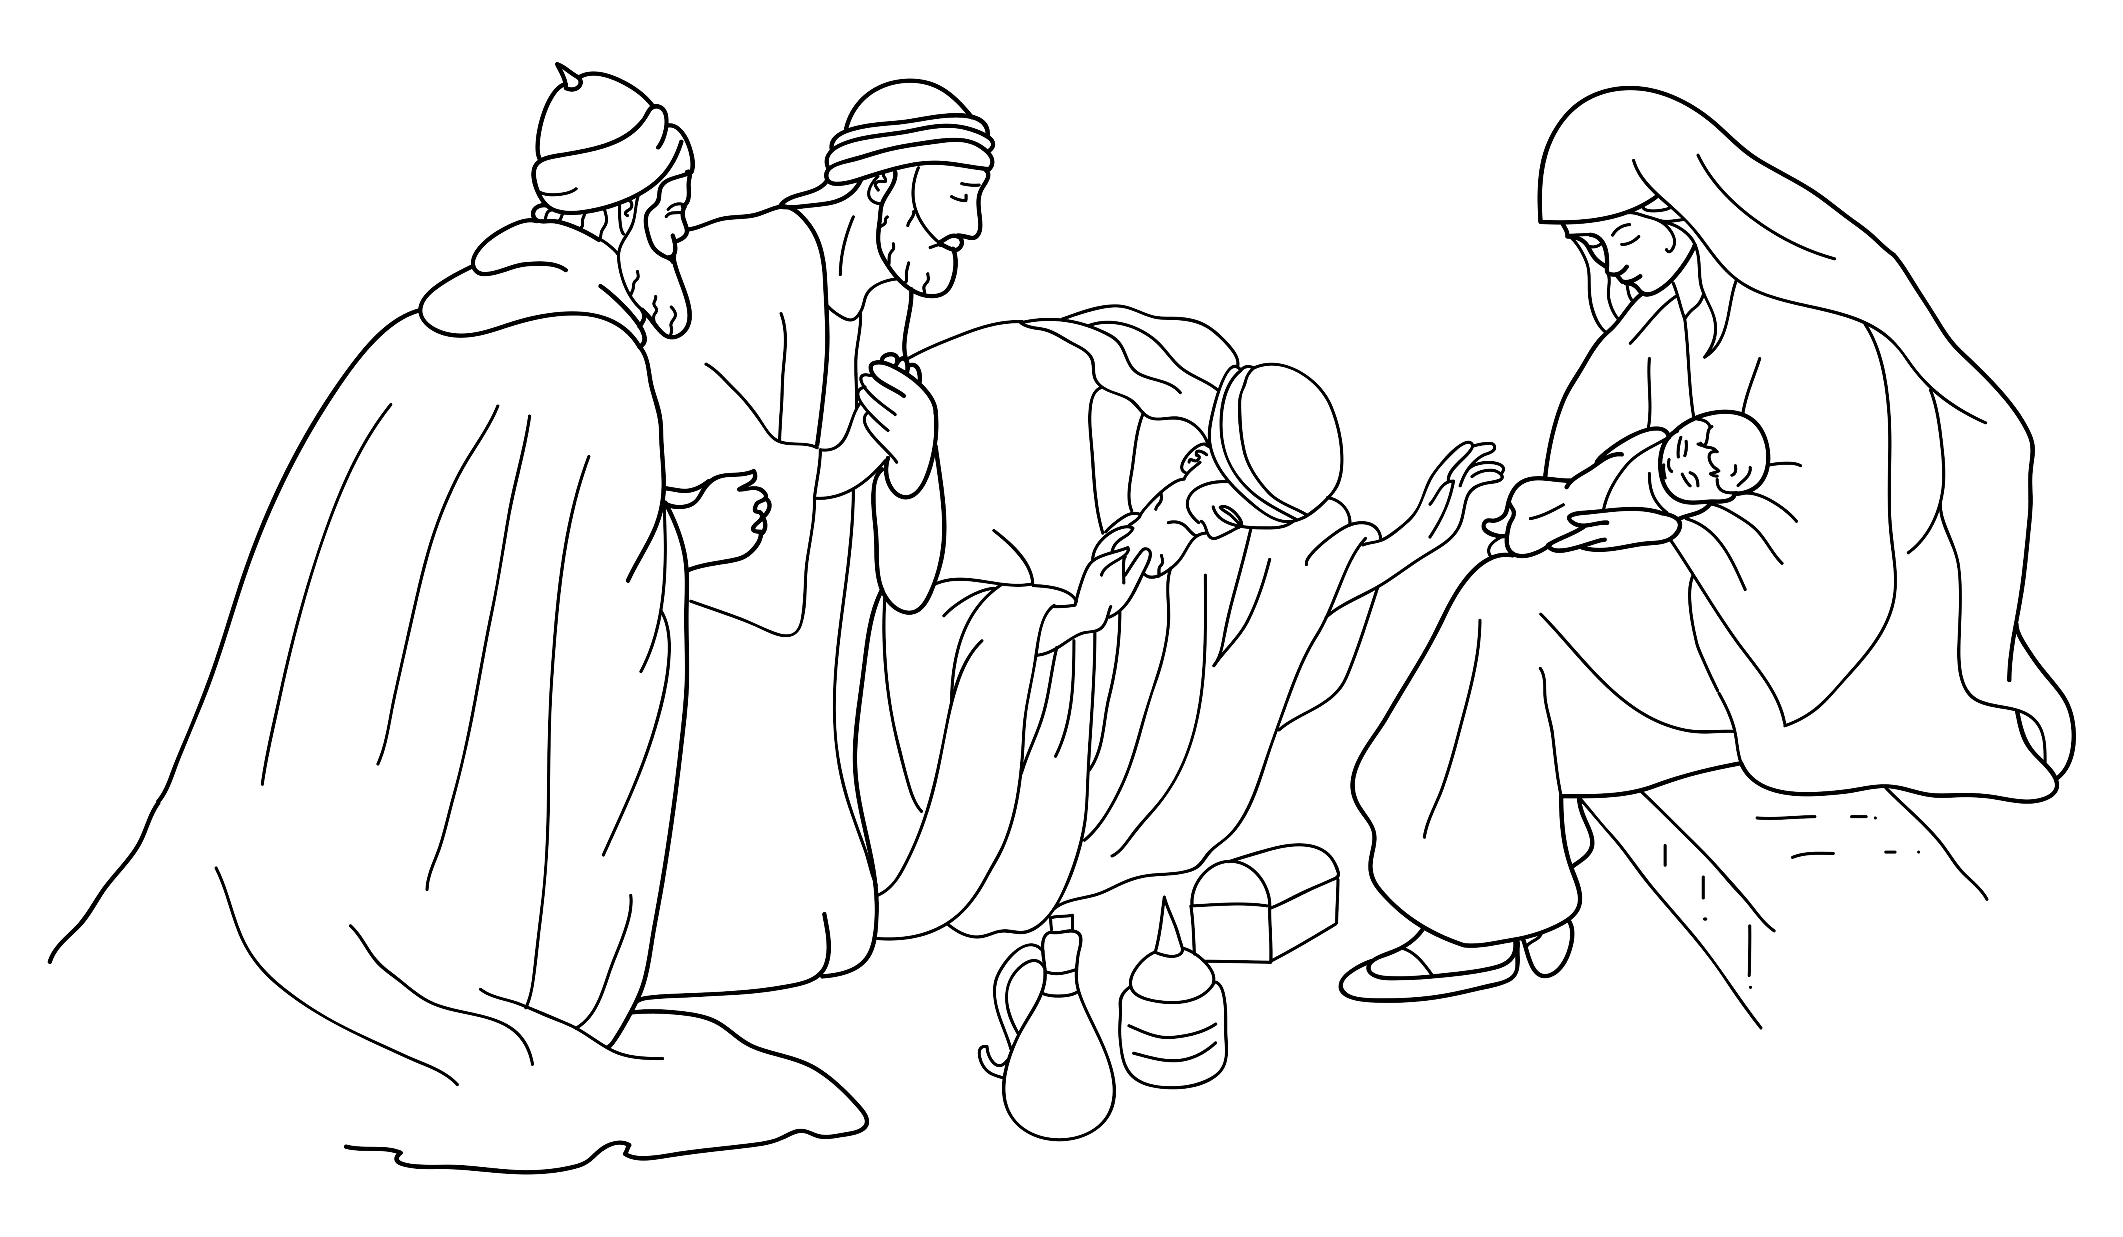
Wise men worshipped Jesus.
Notes:
Read for detail (continued)
Read the sentence aloud slowly.
Invite students to repeat the sentence after you.
Repeat several times to reinforce correct pronunciation.

Slide 46
Notes:
Reinforce the language
[The activity on this slide and the 5 slides that follow replaces the activity in the lesson book in which students point to corresponding sketches.]
Invite students to say any words that they remember about this sketch.
Accept responses.

Slide 47
Notes:
Reinforce the language (continued)
Invite students to say any words that they remember about this sketch.
Accept responses.

Slide 48
Notes:
Reinforce the language (continued)
Invite students to say any words that they remember about this sketch.
Accept responses.

Slide 49
Notes:
Reinforce the language (continued)
Invite students to say any words that they remember about this sketch.
Accept responses.

Slide 50
Notes:
Reinforce the language (continued)
Invite students to say any words that they remember about this sketch.
Accept responses.

Slide 51
Notes:
Reinforce the language (continued)
Invite students to say any words that they remember about this sketch.
Accept responses.

Slide 52
Notes:
Reinforce the language (continued)
NB This slide will at first appear blank in Slide Show mode.
Distribute RESOURCE 2.7 – Small sketches (if using) to pairs/groups. [Alternatively, complete this activity together verbally using the PowerPoint slides.]
Invite pairs/groups to sequence or try to remember the sketches in the correct order.
Click your mouse to display the sketches one at a time in the correct order.

Slide 53
Jesus was born.
Notes:
Reinforce the language (continued)
Distribute RESOURCE 2.8 – Small sentence strips (if using) to pairs/groups.
Invite pairs/groups to match the sentence strips to the corresponding sketches (if using). More advanced students can sequence the sentence strips without looking at the sketches.
[Alternatively, complete this activity together verbally using the PowerPoint slides.]
Invite students to identify the sketch on the slide that corresponds to the sentence.
Click to display the arrow and confirm the correct response.

Slide 54
God created a special star.
Notes:
Reinforce the language (continued)
Invite students to point to the sketch on the slide that corresponds to the sentence.
Click to display the arrow and confirm the correct response.

Slide 55
The star pointed to Jesus.
Notes:
Reinforce the language (continued)
Invite students to point to the sketch on the slide that corresponds to the sentence.
Click to display the arrow and confirm the correct response.

Slide 56
Wise men followed the star.
Notes:
Reinforce the language (continued)
Invite students to point to the sketch on the slide that corresponds to the sentence.
Click to display the arrow and confirm the correct response.

Slide 57
Wise men gave Jesus gifts.
Notes:
Reinforce the language (continued)
Invite students to point to the sketch on the slide that corresponds to the sentence.
Click to display the arrow and confirm the correct response.

Slide 58
Wise men worshipped Jesus.
Notes:
Reinforce the language (continued)
Invite students to point to the sketch on the slide that corresponds to the sentence.
Click to display the arrow and confirm the correct response.

Slide 59
1. ________ was born.
Jesus
Notes:
Reinforce the language (continued)
Distribute RESOURCE 2.9 – Gap-fill worksheet (if using) to each student. [Alternatively, complete this activity together verbally using the PowerPoint slides.]
Encourage students to work together to complete the worksheet.
Click to reveal the missing word and check the answer together.

Slide 60
2. God created a special ________.
star
Notes:
Reinforce the language (continued)
Click to reveal the missing word and check the answer together.

Slide 61
pointed
3. The star ________ to Jesus.
Notes:
Reinforce the language (continued)
Click to reveal the missing word and check the answer together.

Slide 62
4. Wise men _________ the star.
followed
Notes:
Reinforce the language (continued)
Click to reveal the missing word and check the answer together.

Slide 63
gifts
5. Wise men gave Jesus _______.
Notes:
Reinforce the language (continued)
Click to reveal the missing word and check the answer together.

Slide 64
worshipped
6. Wise men _____________ Jesus.
Notes:
Reinforce the language (continued)
Click to reveal the missing word and check the answer together.

