Slide 1
Skills for Success, 4th edition
Stella Cottrell

Slide 2
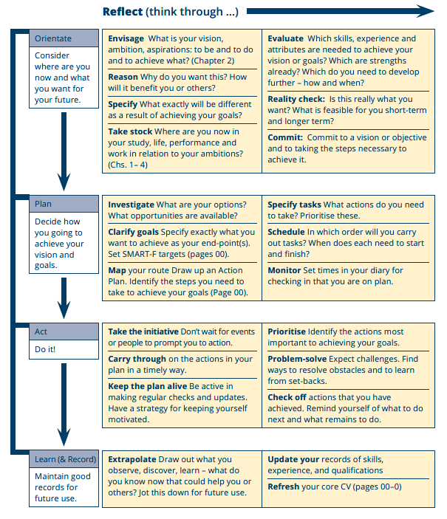
PDP as a process (p.6)

Slide 3
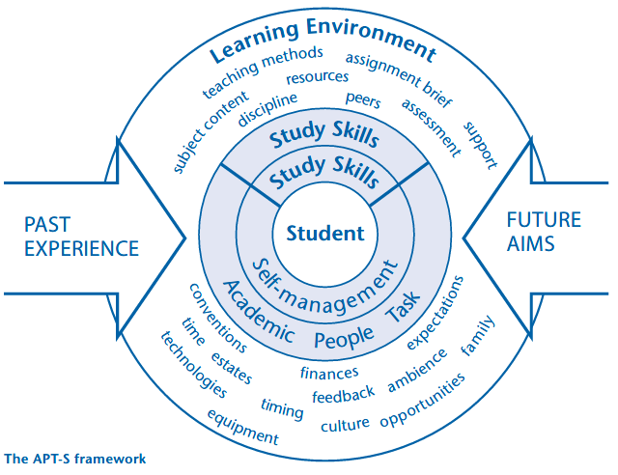
APT-S framework in a learning environment

Slide 4
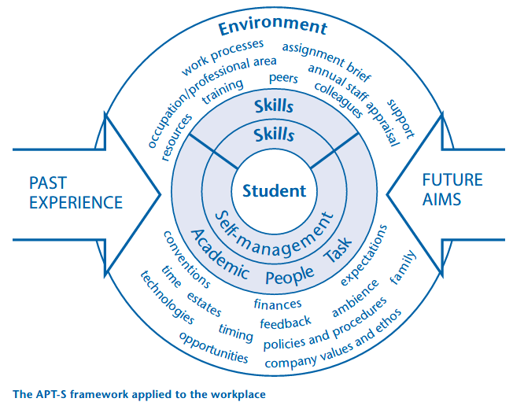
APT-S framework in a workplace environment

Slide 5
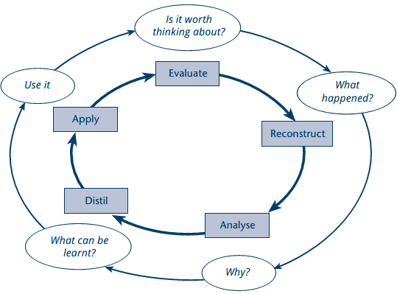
Core model for reflection

Slide 6
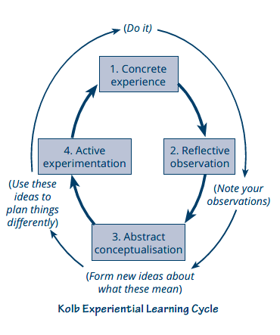
Kolb Experiential Learning Cycle

Slide 7
Boud, Keogh and Walker (1985) reflective model

Slide 8
What is reflection?
Making sense of experience
Standing back
Repetition
Deeper honesty
Weighing up
Clarity
Understanding
Making judgements

Slide 9
Personal performance and SHAPES
Skills | Habits | Attitudes | Preferences | Experiences | Strategies

Slide 10
Aspects of self-management
Self-management
Self-responsibility
Self-care
Intra-personal skills
Initiative
Organisation

Slide 11
Eight levels: motivators and inhibitors

Slide 12
Habit-shaper from The Macmillan Student Planner

Slide 13
The Tuckman team formation model

Slide 14
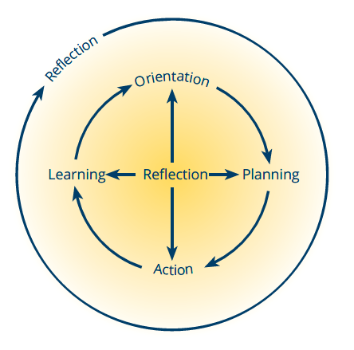
The OPAL strategy diagram

Slide 15
The OPAL strategy and reflection

Slide 16
SMART-F targets
SMART-F stands for:
Specific
Measurable
Achievable
Realistic
Time-bound
Flexible
Skills for Success, p.207.

Slide 17
Action plan
Action Plan
Vision/longer term Goal(s): |  |  |  |  |  | To be achieved by (year and/ or month):
(1) | Interim goal (1) (write opposite) |  |  | Start by: | End by: | Evidence that this is completed | Done 
 | Actions to take (to achieve interim goal 1) |  |  | Start by: | End by: | Evidence that this is completed | Done 
 | 1
 | 2
 | 3
 | 4
 | 5

