Slide 1
Your logo
State the date and occasion of the pitch. Page numbers are also recommended.

Slide 2
Problem
Describe the problem that your startup is solving.
Be precise. Use pictures or other visual elements to make your point. If your market is dominated by existing solutions, show why they are insufficient.

Slide 3
Solution
What is your solution?
Boil it down so that everyone understands your approach on one slide!

Slide 4
Product
Show and explain your product or what you have built so far. Also showing a MVP adds value.

Slide 5
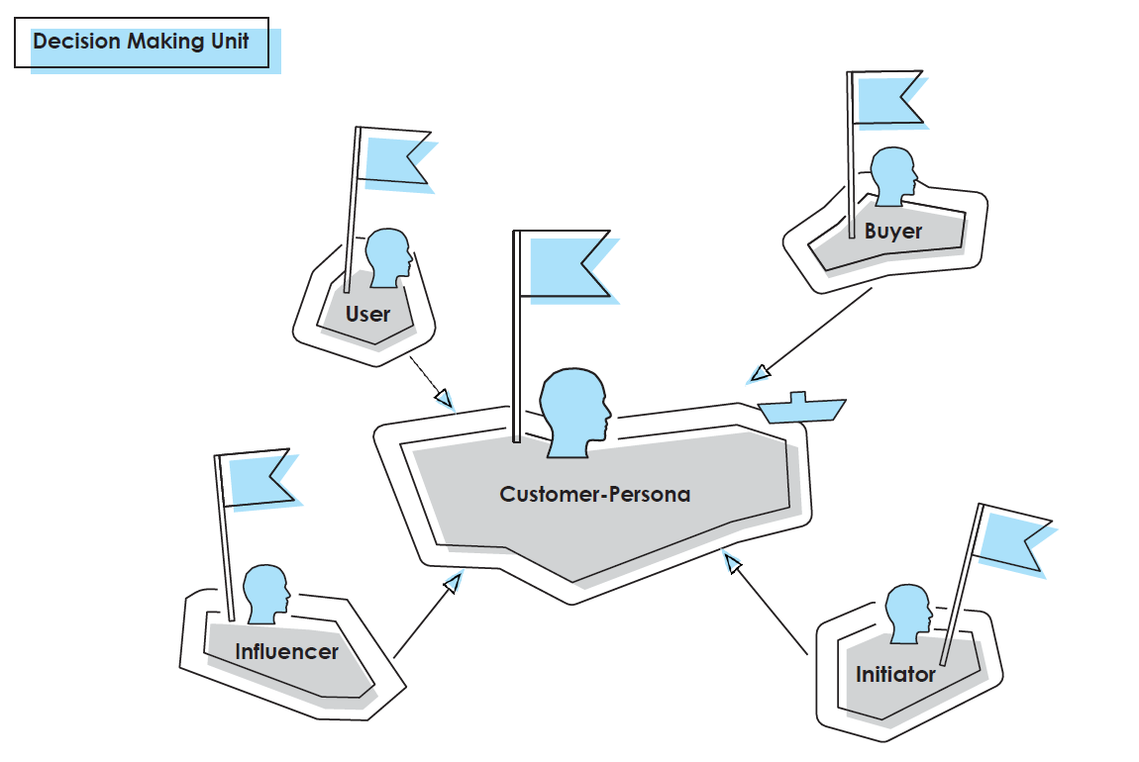
Customers and/or User
Describe, who suffers the most from the problem you try to solve.
If you have users and customers, identify and describe both groups. Already hint what potential lies in that customer group and show, how you get them! If you already have prominent customers – drop some logos.

Slide 6
(Go-to-)Market
It‘s best when you show that the market you adress is big, growing, and has an international scope.
Also be sure to know the market you address in terms of characeristics, developments in the near future and any legal regulations. Show how you want to capture it.
Size & Growth
Int. Scope
Entry Steps
Step 1...
XXMrd. €
Step 2...
Step 3...
X Mrd. €
X Mrd. €
Adressable markets
Segment 1...
Segment 2...
Active markets
*Sources

Slide 7
Competition & USP
Show your value propositions (VP) and compare it to your competitors. Ideally, you have more VP’s than the others. Name your USP and/or unfair advantage.
Companies addressing similar markets
Competitor 1
Competitor 2
Competitor 3
Your Venture
Value Propositions 1
X
√
√
√
Value Propositions 2
√
√
X
√
Put some logos here.
Value Propositions 3
√
X
X
√
Value Propositions 4
X
X
√
√
Value Propositions 5
X
X
X
√
Your USP

Slide 8
Team
Show why you are the best team to bring this venture to success!
Also, you can show some logos of companys that you have worked with or where you have studied.
In case, you have already an advisor or even a whole board, name it!
Founders Team
Picture
Picture
Picture
Name 1
Name 2
Name 3
Role in company
Role in company
Role in company
Advisory Board
Picture
Picture
Picture
Picture
Advisor 1
Advisor 2
Advisor 3
Advisor 4
Role / Corrent occupation
Role / Corrent occupation
Role / Corrent occupation
Role / Corrent occupation
Role as advisor
Role as advisor
Role as advisor
Role as advisor

Slide 9
Business Model
How do you earn money?
Who is paying how much for what? Use visualizations, value chains or process steps to make your revenue streams accessible.
Process
Revenue Stream
Step 1: Customer Acquisition
$
Referral Program
14% Conversion Rate
Step 5: Customer Care
Step 2: Customer Sign-up
84% Retention
Service Fee
Product Hardware
Automated Execution
Lock-In Effect
XX Month Standard Deal
Avg. Deal Duration XX Month
XX EUR Margin
Low Entry Barrier
Service Oriented Package Deals
Step 4: Service On-Boarding
Step 3:
Product Delivery

Slide 10
Traction
If you have already achieved something – share it. Choose 3-4 meaningful KPIs and provide a breakdown, if necessary.
Mai 2017
Juni 2017
Juli 2017
August 2017
Sept. 2017
Okt. 2017
98k €
45k €
22k €
5k €
REV
EBIT
FCF
REV
EBIT
FCF
REV
EBIT
FCF
REV
EBIT
FCF
REV
EBIT
FCF
REV
EBIT
FCF
Acc. Working Capital
EBIT
Earnings before Interest and Taxes
REV
Revenue
FCF
Free Cash Flow

Slide 11
Unit Economics
Show that you understand your Unit Economics.
Break each unit down to CM3 and demonstrate that you are ready to scale.
Sept. 2017
Oct. 2017
Lifetime Value
CLV
-43%
CLV Formula depending on business model
-47%
XXX € x XXX Jahre*
57%
55%
53%
53%
51%
47%
XXX €
REV
COGS
CM1
OPS
CM2
CAC
CM3
REV
COGS
CM1
OPS
CM2
CAC
CM3
*Lifespan calculated as: LS = 1/(1-Retention Rate)

Slide 12
Achievements & Roadmap
Show what you have achieved so far and what you plan on doing next.
This should signal the upside potential and builds the bridge to the investment opportunity.
Achievements
Next steps
Short description of achievement 1.
Next step 1.
Short description of achievement 2.
Next step 2.
Short description of achievement 3.
Next step 3.
Good investors invest in upside potential not downside protection!

Slide 13
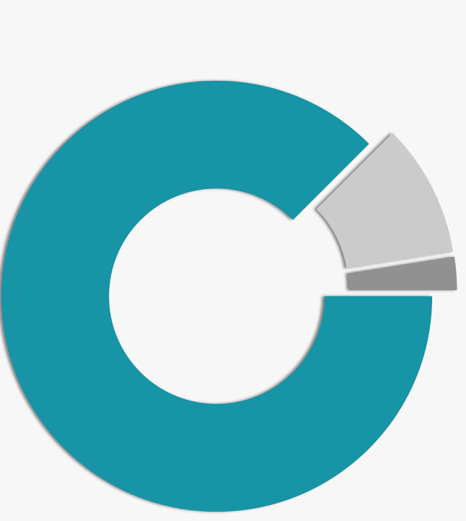
Investment & Deal
How are your shares distributed so far?
Seed Investment:
Share how much money was raised so far. What have you achieved with this investment?
87,5% Founders
10% Seed Investors
Current financing round:
Show the cornerstones of the current financing round. How much money are you looking for? How much has already been committed? Don‘t talk about valuation here!
2,5% ESOP*
Use of funds:
Provide a good description of your use of funds. What will you spend the money for? What are quantifyable milestones that you would like to reach?
*Employee Stock Ownership Plan

Slide 14
DON‘T FORGET YOUR NAME AND CONTACT DETAILS
MOBILE PHONE NUMBER
EMAIL ADDRESS (LINK)
WEBSITE (LINK)

Slide 15
APPENDIX
Use the APPENDIX for detailed explanations,
financial fact sheets, IP protection excerpts,
additional product descriptions and screenshots,
etc.

