Slide 1
Do presidential election debates still matter?
A.N. Example
©Ursula hackett, under exclusive licence to Macmillan education limited

Slide 2
Arguments
1. Election debates have always ‘mattered’ in sense 1, but not in sense 2
2. Election debates matter less in sense 3 over time
3. Election debates matter more in sense 4 over time
Sense 1 = candidates care about them and work hard to prepare
Sense 2 = sway people’s actual votes
Sense 3 = increase citizen political knowledge
Sense 4 = create media coverage and elite discussion

Slide 3
Key concepts: definition
Presidential election debates (pretty straightforward) – single sentence here
‘Matter’ - that’s the tricky one!
Dan Weaver & Dan Drew (1991, 1995, 2006 etc.) look at a variety of ways debates could matter
Julia Fox and colleagues (2007) consider hype and substance of coverage
Benoit, Hansen & Verser (2010): analysis of debate effects

Slide 4
Key concepts: ambiguities and clarification
‘Matter’ is the key. Possible definitions:
Increase general political knowledge amongst viewers
Voting intention: sway people’s choice of candidate
Priming: affect what issues are salient in people’s minds
Framing: Change the issue that most matters to people
Likelihood of voting – increase participation
Matter to whom? Who watches? Who pays attention?
Benoit, Hansen & Verser (2010): General campaign debates increase issue knowledge and issue salience. Debates can have an agenda-setting effect. Debates can alter perceptions of the candidates' personality, but they do not exert a significant effect on perceptions of the candidates' competence (leadership ability). Debates can affect vote preference.

Slide 5
Unexamined assumptions
STILL matter → implies that the debates ONCE DID matter but NO LONGER DO. Is that assumption likely to be true?
Why might it be true?
Greater captive television audience during pre-cable period. More discussion of substantive issues? Less aggressive partisanship, segmented media environment. Less flashy debates in the past. Alternative determinants of voting choice (money in politics, partisanship etc.)
Why might it be false?
More information now available. Candidates getting better at doing debates. The fact they still bother to take part.
Or even: debates have NEVER mattered.
Partisanship always trumped debates as a determinant of voting choice.

Slide 6
Measurement
‘Matter’:
Survey research. Who watches?
Experimental research. Exposing people to clips.
How long-term are the effects of the debates?
Difficulties with measurement. Selection on DV!

Slide 7
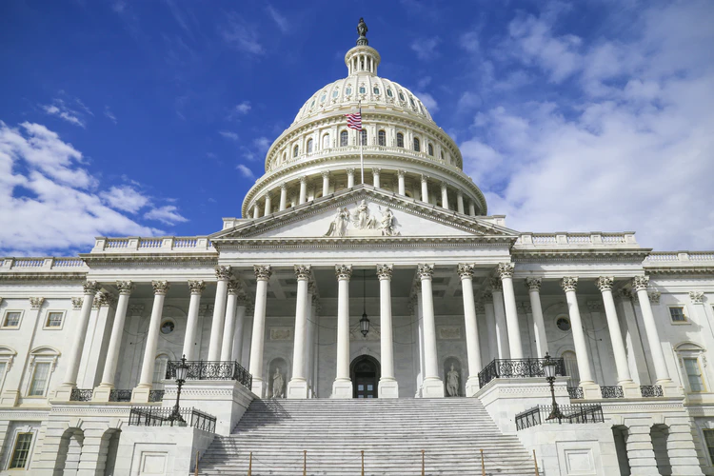
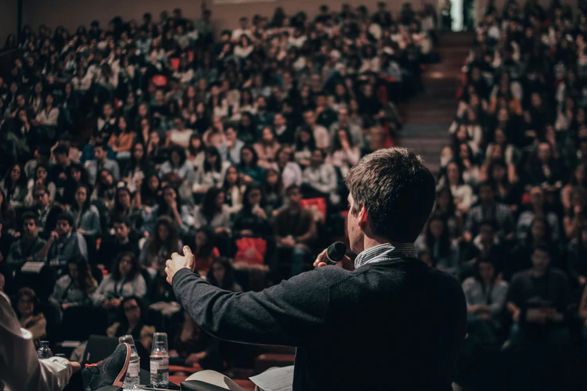
Empirical evidence
Requires an historical comparison. Compare situation where effects are MOST likely (perhaps open contests) to situation where effects is LEAST likely (closed contests)

Slide 8
Conclusion
Implications for democracy: important for candidates to speak. Inform citizens in their vote choice. Open competition for people’s votes.
Implications for money and politics. Huge expense involved in putting these things on.
Implications for media studies and politics. Increasingly fragmented media environment. Social media and traditional televised debates. A chance to see the candidates slug it out in an open forum.

