Slide 1
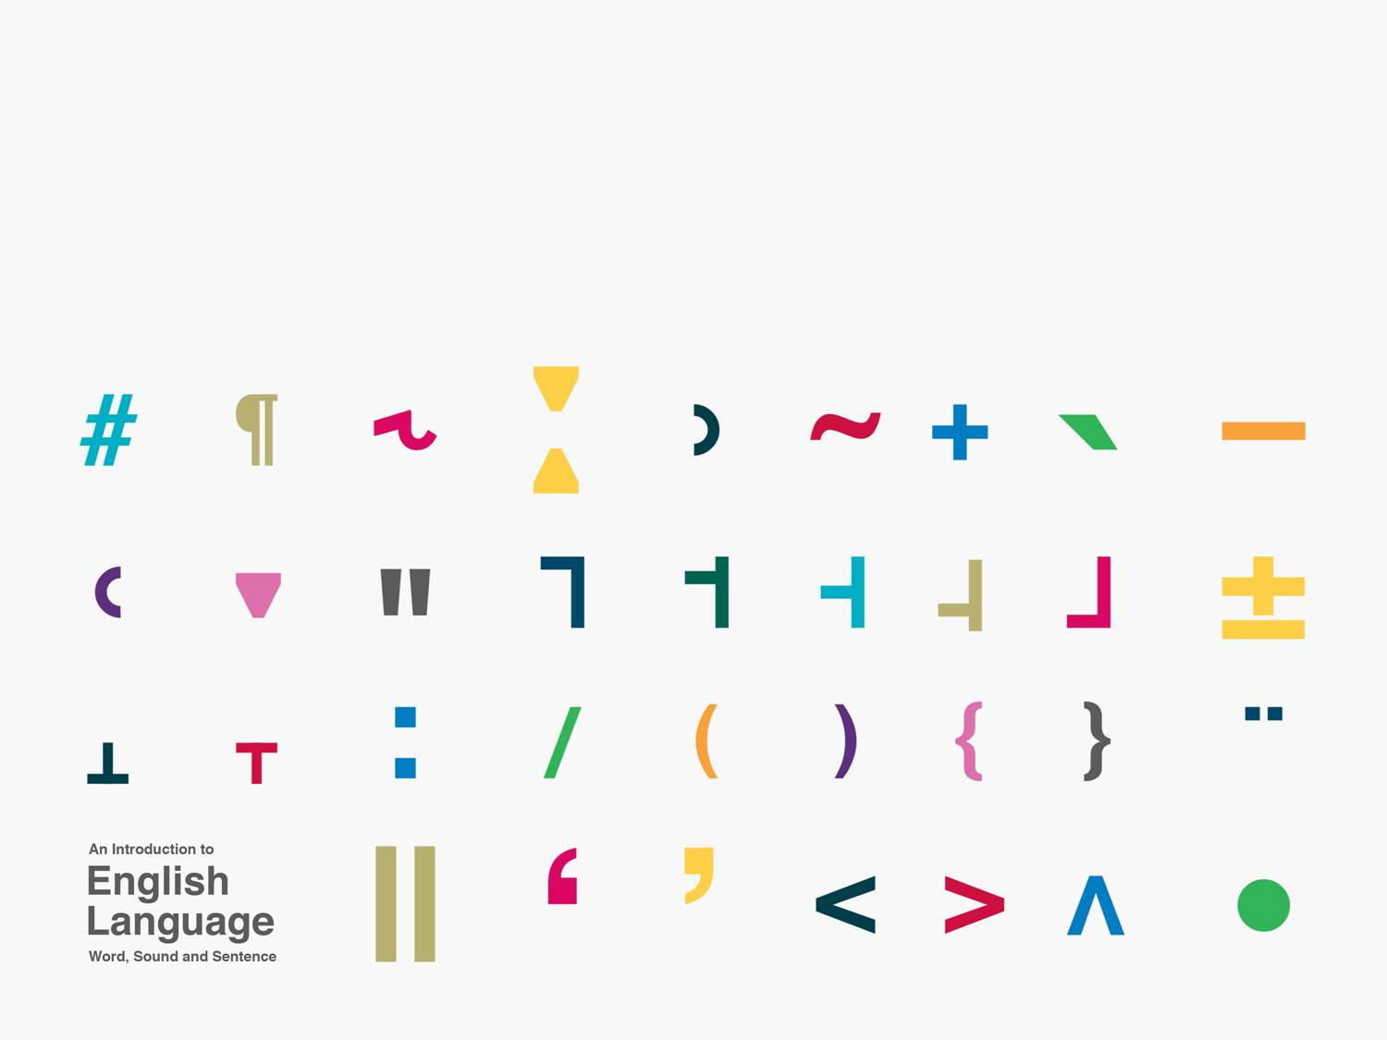
Properties of human language
Kuiper and Allan Chapter 1.1-1.3

Slide 2
Language is a code

Slide 3
Human language is a code
symbols
syntax of symbols
system

Slide 4
An elementary code: traffic lights

Slide 5
Symbols
red stop
amber prepare to stop
green proceed

Slide 6
Syntax of symbols
linear sequence
lights show one at a time
sequence is rule governed
breakdowns show the stability of the system

Slide 7
System
closed system
interdependence of meanings
red and green have opposite meanings

