Slide 1
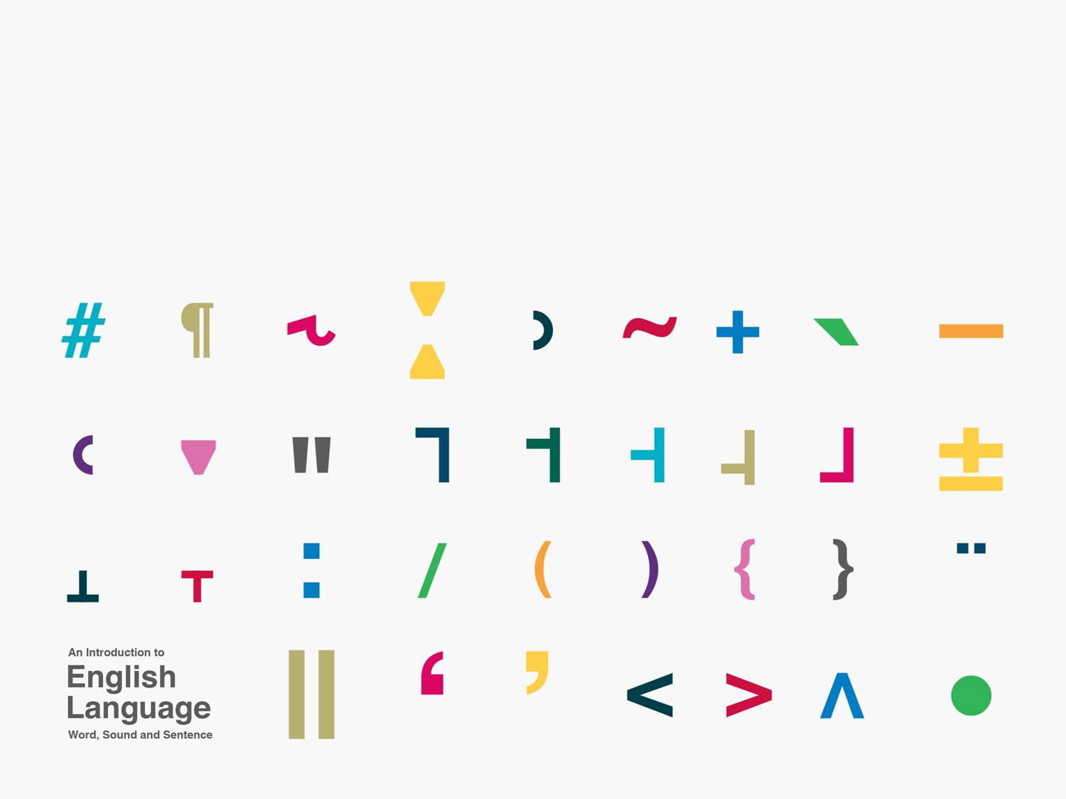
Pragmatics
Kuiper and Allan Chapter 9

Slide 2
Introduction
Semantics
Semantics is usually divided into two domains:
  Lexical semantics which deals with the meaning of words.
  Formal semantics which deals with the meaning of grammar/syntax.
    What is the difference between
      Joanne greeted Marcia.
      and
      Marcia greeted Joanne.

Slide 3
Compositionality
If a sentence means literally what it says then the meaning of the sentence is the effect of taking
  the meanings of the words
    and
  the meaning of the syntax
    and
  combining them in rule governed ways.

Slide 4
Pragmatics
But when you utter anything at a specific time, in a specific place to specific audience the compositional meaning of a sentence is not all there is to the meaning of the utterance.
For instance, the meaning of a pronoun changes depending on who is speaking and who they are speaking to.

Slide 5
Narrow and wide pragmatics
The English tradition is narrower than the Continental tradition.
English pragmatics deals with local contexts and the way assumptions about that context creates meaning for an utterance.
Continental pragmatics includes more context which in most Anglo-American pragmatics is regarded as sociolinguistics.
We will look at only some areas of pragmatics
  because it is a very large domain
  but we want to get a glimpse of what is beyond the language system

Slide 6
Linguistic theories
Advanced linguistics is full of theories; of morphology, phonology, syntax etc., i.e. the material of sections 1, 2 and 3.
In Kuiper and Allan we have been as atheoretical as we can.
But in Chapter 9 we will explore one theory of pragmatics, namely relevance theory.
Why?
  To get you used to the idea that linguistics is a science and sciences deal in theories.

