Slide 1
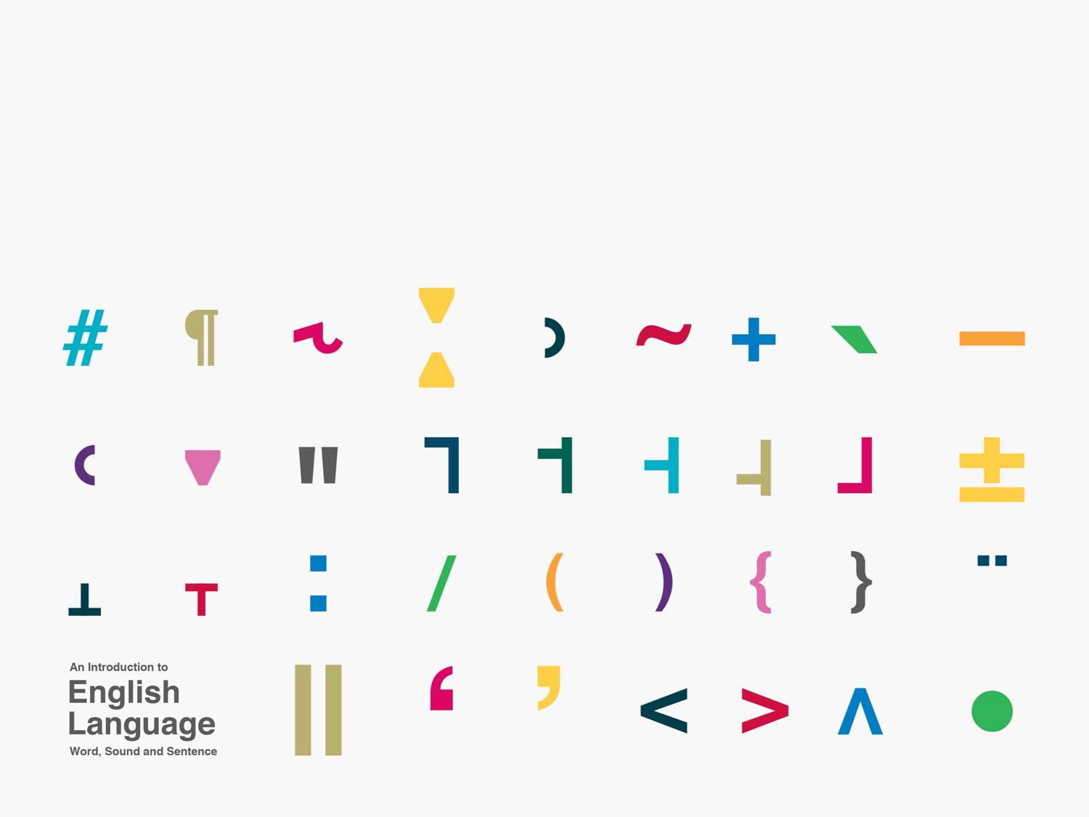
Simple clauses and their functional constituents
Functional constituents perform particular grammatical and semantic roles.
Kuiper and Allan Chapter 7.2

Slide 2
Subject and predicate
Who is doing what?
Data
  a. The dogs played in the park.
  b. Some elephants were chewing the acacia trees.
  c. The film crew left the location for lunch.
  d. Sandra didn't like the neighbours.
  e. The building looked unstable.
  f. A journey up the Nile might take three months.

Slide 3
Subject
is who or what is performing the action of the verb or what has the property denoted by the verb.
  a. the dogs
  b. some elephants
  c. the film crew
  d. Sandra
  e. the building
  f. a journey up the Nile
inflectional agreement between subject and verb

Slide 4
Predicate
is what the subject is doing or what property it has.
  a. played in the park.
  b. were chewing the acacia trees.
  c. left the location for lunch.
  d. didn't like the neighbours.
  e. looked unstable.
  f. might take three months.

Slide 5
Exercise
Find the subjects of the following sentences.
  a. Peter joins the Navy tomorrow.
  b. The greatest magician of all time performs here next week.
  c. On Saturday morning three monkeys escaped from the zoo.
  d. They hate performing.
  e. That Lionel saw the escape interests the police.

Slide 6
Clauses, predicates and VPs
Simple subject and predicate structures are called clauses.
Predicates have the structure of a VP.

