Slide 1
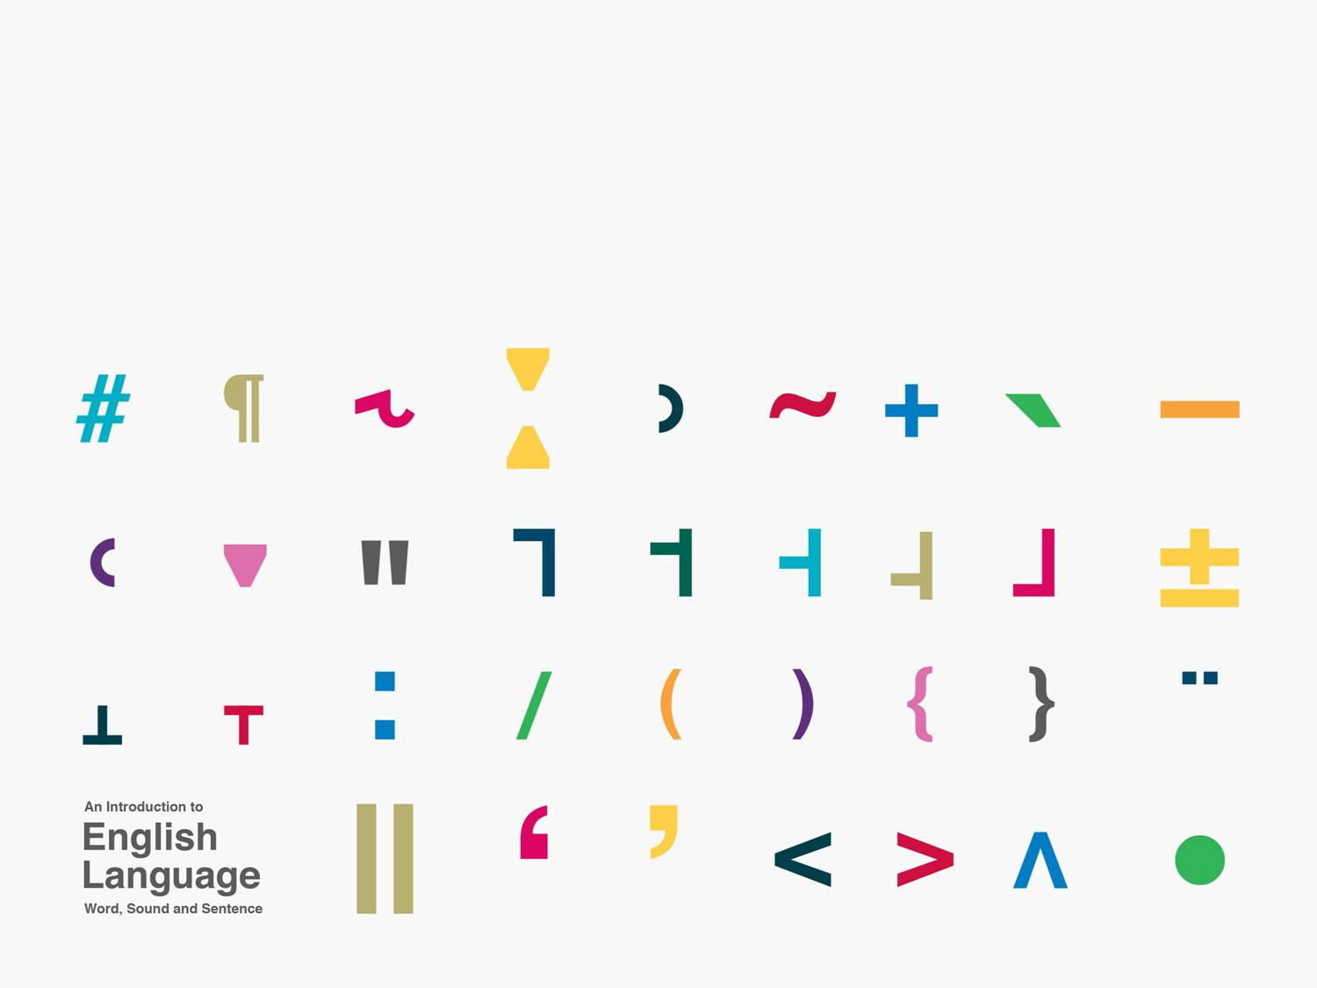
Syntactic relatedness
Kuiper and Allan Chapter 8.2-8.3

Slide 2
Questions
yes/no
  Answer to these is either yes or no.
Wh
  Answer to these is some functional constituent of the clause, e.g.
    subject
    object
    adverbial

Slide 3
Yes/no questions
Data
  1.a. John is eating.
  1.b Is John eating?
  2.a Geraldine has dined.
  2.b Has Geraldine dined?
  3.a Pauline might come.
  3.b Might Pauline come?
What is the relationship between the declarative form and the interrogative form?

Slide 4
Movement
There appear to be syntactic rules which relate an extraction site to a landing site.
These rules are often termed transformations.
In yes/no questions the first auxiliary verb appears to be moved to the left of the subject.

Slide 5
Yes/no questions
More data
  1.a Ethne writes letters.
  1.b Does Ethne write letters?
  2.a Thomas skates on thin ice.
  2.b Does Thomas skate on thin ice?
What has moved and what are the extraction and landing sites here?

Slide 6
Tense movement
In yes/no questions tense is moved from the first auxiliary position to a position to the left of the subject.
It takes with it any auxiliary verb it may be attached to.
It cannot take with it any lexical verb it is attached to.

Slide 7
WH questions
Data
  1.a When is Marcia coming?
  1.b Marcia is coming tomorrow.
  2.a What has Marcel brought?
  2.b Marcel has brought the wine.
  3.a Where will we eat tomorrow?
  3.b We will eat outside tomorrow.
What is the relationship between the interrogative and declarative forms?

Slide 8
WH movement
WH questions seem to be formed by tense movement.
& the movement of a WH phrase (including an interrogative pronoun) to the left of the subject.
Data
  1.a What has the cat caught?
  1.b *What has the cat caught the bird?
  2.a The cat was purring.
  2.b *What was the cat purring?

Slide 9
Application
'When I say, therefore, that Mycroft has better powers of observation than I, you may take it that I am speaking the exact and literal truth.'
'Is he your junior?'
'Seven years my senior.'
'How comes it that he is unknown?'
'Oh, he is very well known in his own circle.'
'Where, then?'
‘Well, in the Diogenes Club, for example.'
I had never heard of this institution, and my face must have proclaimed as much, for Sherlock Holmes pulled out his watch.
from The Greek Interpreter
by Sir Arthur Conan Doyle

Slide 10
Relative clauses
Data
  [NP the person [S' whom [S I met yesterday]]]
Relative clauses are introduced by relative pronouns which are WH words.
Relative pronouns have been moved.
No tense movement.

