Slide 1
Articulatory phonetics
the study of how speech sounds are produced
Kuiper and Allan Chapter 4.2.2

Slide 2
The Organs of Speech
Speech is produced by a variety of organs also used for other purposes.
lungs
windpipe (trachea)
vocal cords
mouth & nose

Slide 3
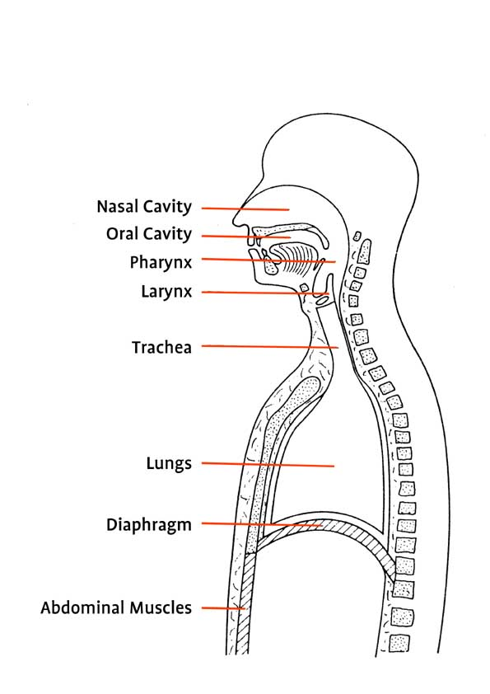
The Organs of Speech

Slide 4
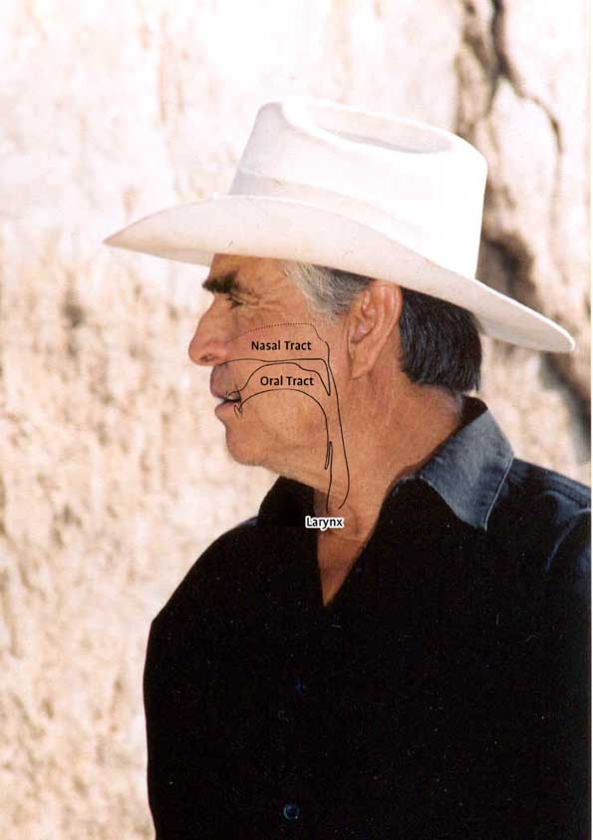
The Upper Vocal Tract

Slide 5
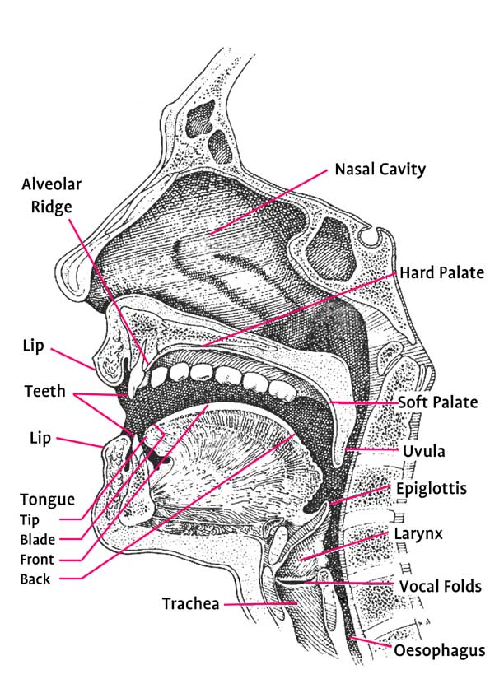
The Upper Vocal Tract

Slide 6
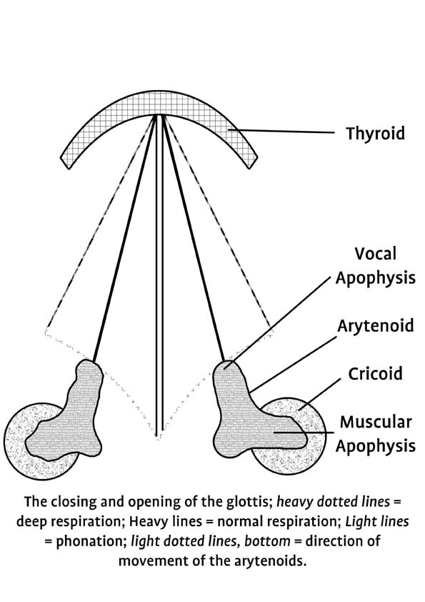
The Larynx

