Slide 1
Speech production
Kuiper and Allan Chapter 4.2.2

Slide 2
Three phases of speech production
initiation
  How is the airstream created?
phonation
  How is the larynx involved in creating speech sounds?
articulation
  How does the vocal tract modify the airstream and sound created with it?

Slide 3
Initiation
The air stream for speech in English is created by the diaphragm and intercostal muscles placing pressure on the lungs thus forcing air out of the lungs.
a pulmonic egressive airstream

Slide 4
Phonation
the primary function of the vocal cords
  a valve
open position
closed position
position for voicing
definition: glottis
  the opening between the vocal cords.

Slide 5
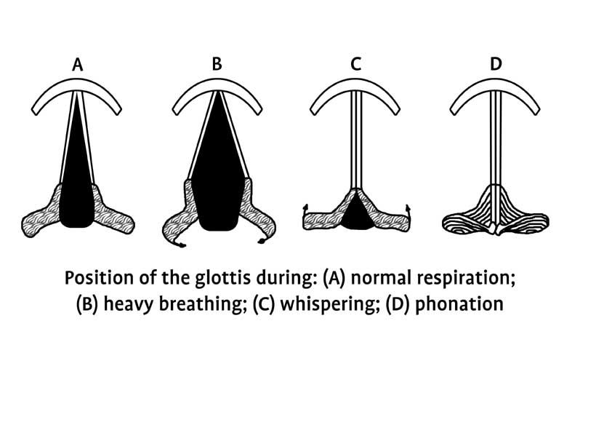
Positions of the vocal cords

Slide 6
Voicing
How can you tell whether your vocal cords are vibrating?
  Hold the front of the larynx.
  Feel for the vibration.
  Listen for a ‘note’.

Slide 7
Exercise
Which of the underlined sounds is voiced?
  see
  pie
  bays
  soya
  leaf
  shout

