Slide 1
Consonant articulation
Kuiper and Allan Chapter 4.2.2

Slide 2
Articulation
The lips and the tongue can obstruct the passage of the air in the vocal tract creating various speech sounds.
The tongue and lips are active articulators.
The roof of the mouth is a passive articulator.

Slide 3
Place of articulation
The obstruction to the air is always at a location.
  labial (lips only)
  labio-dental (lips & teeth)
  dental (tongue & teeth)
  alveolar (tongue & alveolar ridge)
  post-alveolar (tongue & just behind the alveolar ridge)
  palatal (tongue & palate)
  velar (tongue & soft palate)

Slide 4
Manner of articulation
There are different ways of obstructing the air:
  oral vs nasal
  stop
  fricative
  approximant
  affricate
  trills, taps and flaps
  central vs lateral

Slide 5
Nasal vs Oral
The soft palate is a valve that can block off the passage of air to the nasal cavity.
Oral sounds are produced with air flowing out of the mouth.
Nasal sounds are produced with the air flowing out of the nose because the oral cavity is blocked and the velum is lowered.

Slide 6
Stop
The oral cavity is completely blocked.
Nasal consonants must be stops, e.g. [m].
three stages in the case of plosives:
  onset
  hold
  release
plosive consonants, e.g. [t]

Slide 7
Fricative
Blockage is not total; enough for audible friction to result from the narrow opening, e.g. [s].

Slide 8
Approximant
Vocal tract is narrowed but just not enough to create audible friction, e.g. [j].
two types:
  liquid, [l r]
  glide, [j w]

Slide 9
Affricate
a slow release stop, i.e. a plosive onset followed by a fricative release, e.g.[dZ] in judge

Slide 10
Trills, taps and flaps
momentary contact between active and passive articulators,
  e.g. Scots r is a trill
  e.g. American English t in butter is a tap

Slide 11
Central vs lateral
the route of the airstream past the tongue:
  round the side(s), lateral, e.g. [l]
  through the middle, central, e.g. sh in shelf

Slide 12
Three term labels for consonants
voicing: yes or no
place of articulation
manner of articulation
  [b] is a voiced bilabial stop

Slide 13
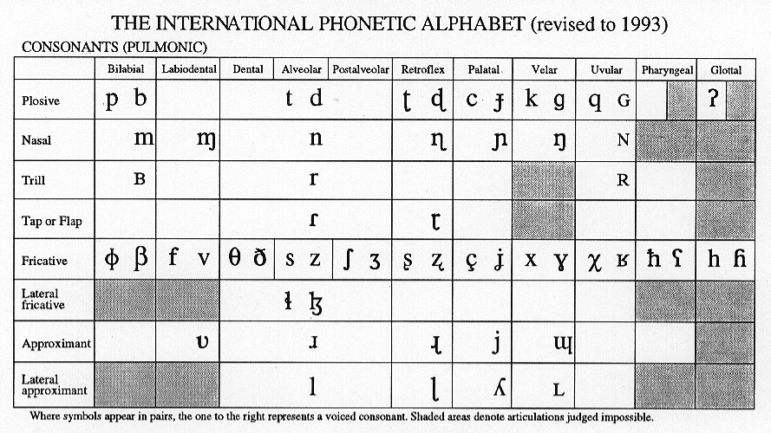
IPA consonant chart

Slide 14
Exercise
Give three term labels for the following three consonants:
  [m]
  [t]
  [l]

