Slide 1
Vowel articulation
Kuiper and Allan Chapter 4.2.3

Slide 2
Vowels
no obstruction in the airway
All English vowels are voiced.
The shape of the oral tract is modified by:
  the position of the tongue
  the shape of the lips.

Slide 3
Tongue position
from close to the roof of the mouth (high) to as low as possible (low)
retracted (back)
not retracted (front)

Slide 4
The Vowel Quadrilateral
front
central
back
high
mid
low

Slide 5
Cardinal vowels
arbitrary auditory reference points
  invented by Daniel Jones
8 points on the vowel quadrilateral
can only be learned by listening to them

Slide 6
Cardinal vowels
1 [i]
[u] 8
2 [e]
[o] 7
3 [E]
[ç] 6
4 [a]
[A] 5

Slide 7
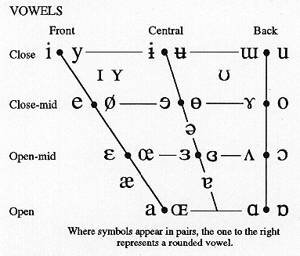
IPA vowel chart

Slide 8
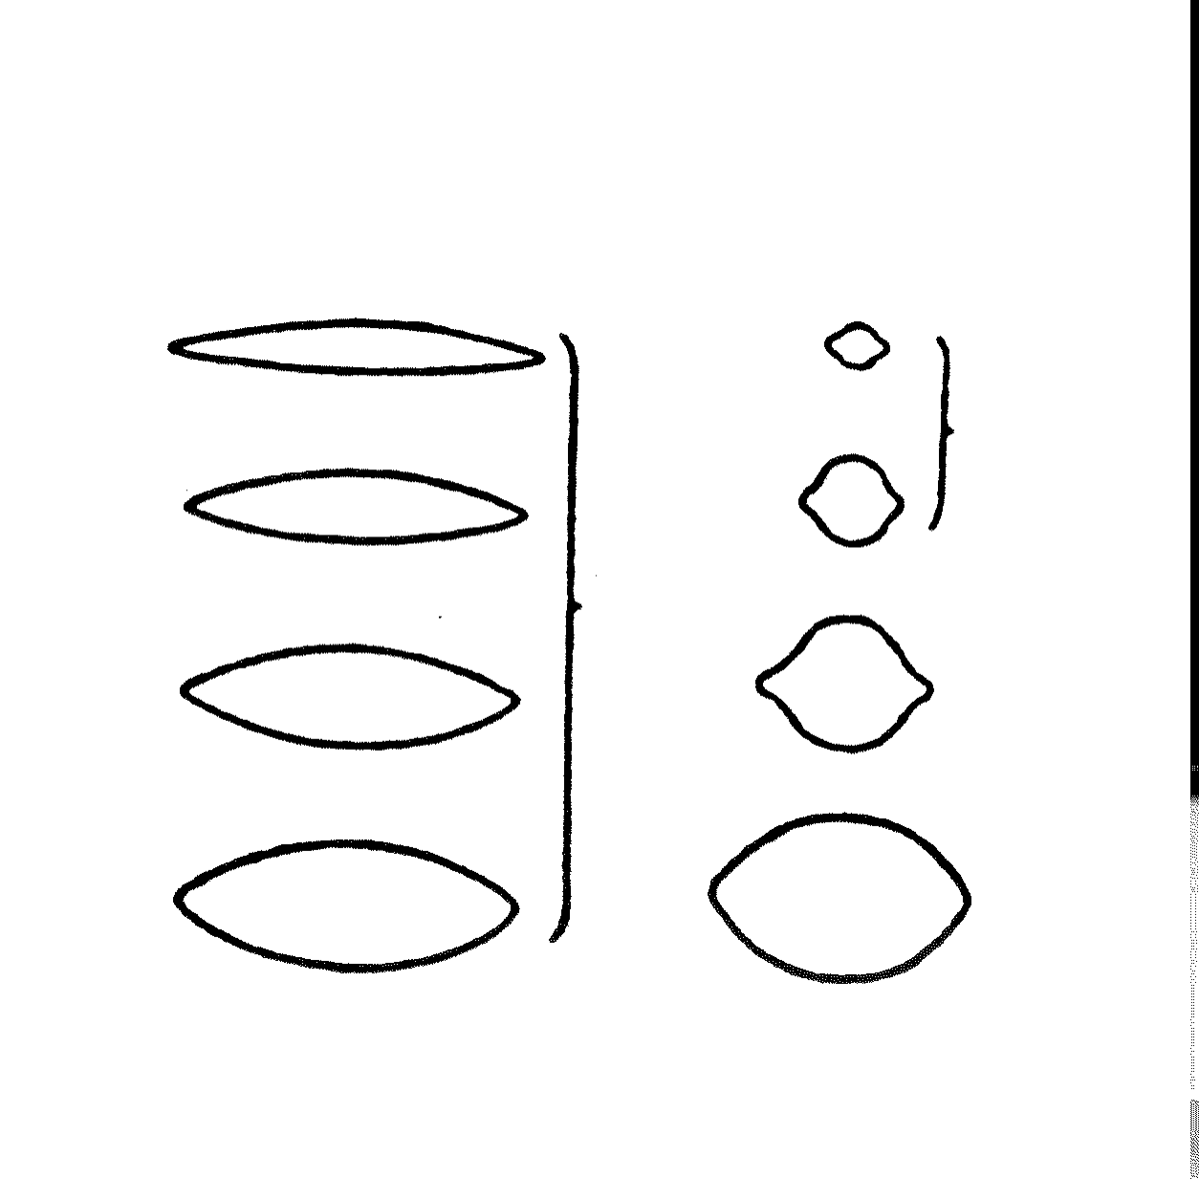
Lip position
rounded
unrounded

Slide 9
Monophthongs and diphthongs
Vowels can stay relative unchanged during their production, monophthongs.
  a in car
Vowels can alter during their production, diphthongs.
  i in hi

Slide 10
Long and short vowels
Some vowels in English are inherently of a shorter duration.
  i in kit
Some are inherently longer.
  ee in feet

Slide 11
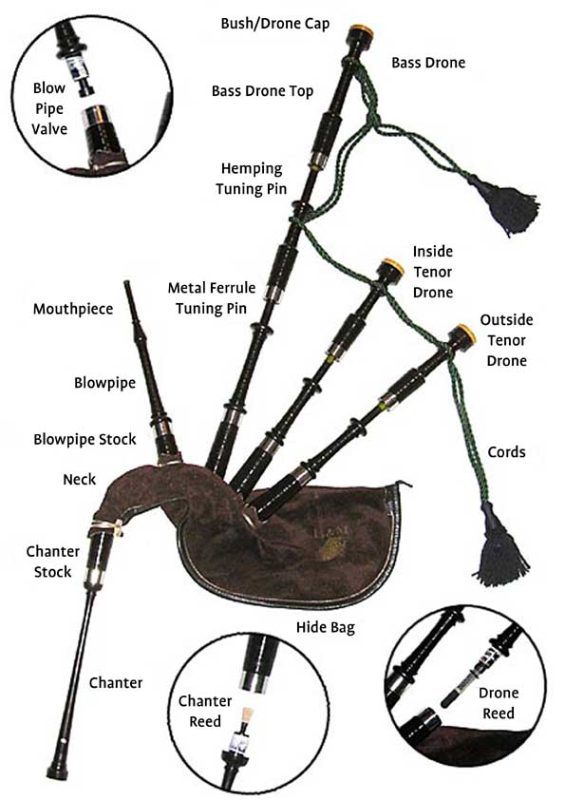
The real bagpipes

Slide 12
The human bagpipes

