Slide 1
Allophonic processes
Kuiper and Allan Chapter 5.4

Slide 2
Some allophonic processes
aspiration
  increasing your puff
assimilation
  becoming like the neighbours
elision
  getting lost
insertion
  adding bits

Slide 3
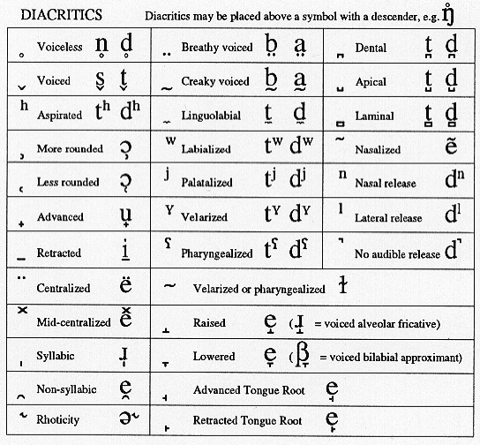
IPA diacritics chart

Slide 4
Aspiration
All voiceless stops are aspirated in initial position in stressed syllables.
/p t k/ ---> [pH tH kH] / . ___ V
[+stress]
(Note this process applies not to one phoneme but a class of phonemes having particular features, i.e. they are voiceless oral stops.)

Slide 5
Assimilation
Assimilation takes place when a sound takes on a phonetic property of one of the surrounding sounds.
There are a number of different kinds:
  place
  voice
  nasalization
  lip attitude
  fusion

Slide 6
Direction of assimilation
progressive (or perseverative)
  A sound segment takes on a phonetic property of a sound segment coming before it.
regressive (or anticipatory)
  A sound segment takes on a phonetic property of a sound segment coming after it.

Slide 7
Place assimilation
How do you normally pronounce uncomfortable?
  Note that the /n/ is pronounced [N].
  Its place of articulation is velar. Why?
  Because the following consonant is velar.
  The nasal consonant has assimilated its place of articulation.

Slide 8
Exercise
How is the final consonant pronounced in the following words?
  hurts
  heads
  looks
  lags
  Is it voiced or voiceless?
  Why?

Slide 9
Voicing assimilation
Sound segments can take on the voicing characteristics of their neighbours.
  voicing
    cads
  devoicing
    crush

Slide 10
Nasalization
Vowels before nasals are often partly nasalized, i.e. the velum is lowered.
  /lo‚N /
Rule:
~
  V ---> V / ___ N
  a vowel becomes nasalized before a nasal consonant.

Slide 11
Fusion
Two sound segments donate phonetic properties one to another creating a third segment and disappearing themselves.
  e.g. education
  /edju˘keiS´n/ becomes [edZu˘keiS´n] by fusing the /d/ and /j/ to become [dZ].

Slide 12
Exercise
Pronounce the following words as you might normally.
Are there are segments which you would omit in normal conversation?
  handsome
  windmill
  handkerchief
  mostly

Slide 13
Elision
In connected speech whole sound segments (both consonants and vowels) may be elided.

Slide 14
Exercise
How might children pronounce the following words?
  athlete
  film

Slide 15
Insertion
(epenthesis)
Into some sound sequences speakers may insert a vowel or consonant.

Slide 16
Summary
There can be a considerable distance between the underlying phonological representation of a word and how it is realized in speech.
Many processes may be involved.

