Slide 1
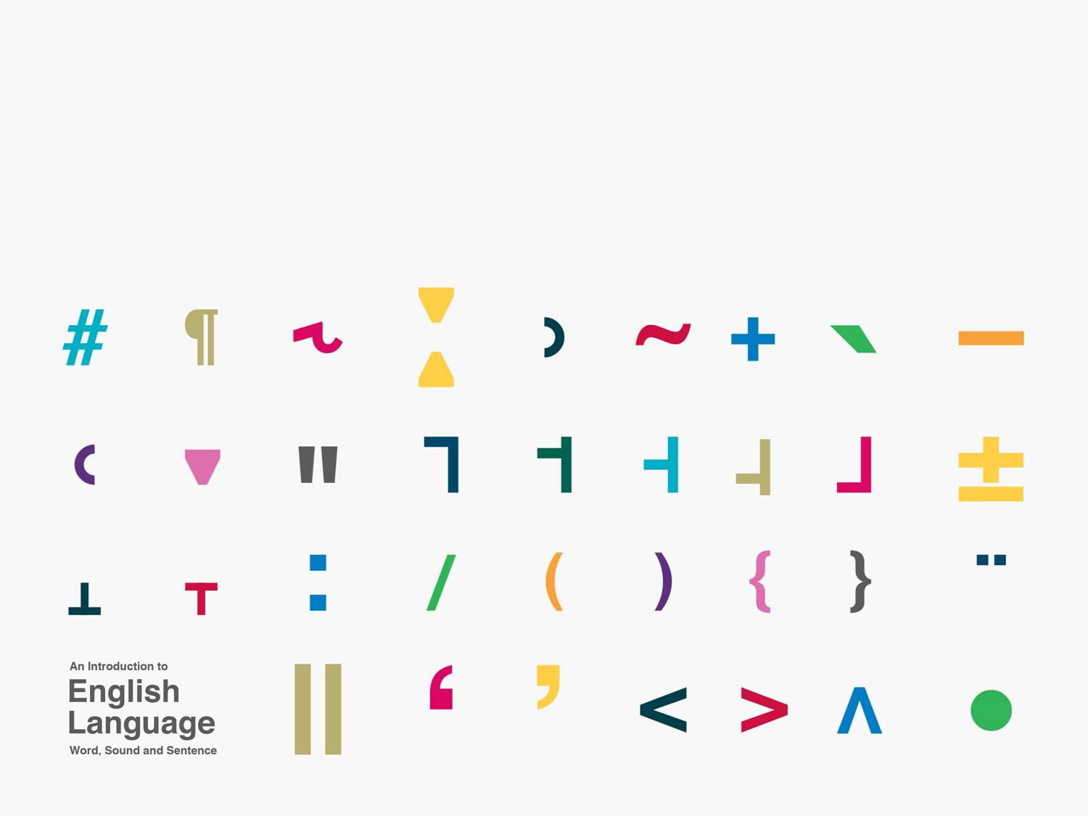
Non-Segmental Phonology
sounds other than sound segments
Kuiper and Allan Chapter 6

Slide 2
Sub areas of non-segmental phonology
Syllables (Kuiper an Allan, 6.1)
Suprasegmentals (Kuiper and Allan, 6.2)
  pitch
  intonation
Stress (Kuiper and Allan, 6.3)

Slide 3
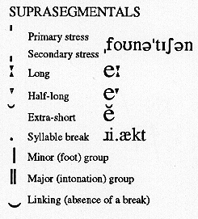
IPA suprasegmental chart

Slide 4
Exercise
Transcribe the words below phonemically and place a syllable marker (a low dot) between the syllables:
  technical
  lengthen
  industry

Slide 5
Answers
/tek.nI.k´l/
/leN.P´n/
/êIn.d´.stri/
  or
/êIn.d´s.tri/

Slide 6
Syllables
Native speakers have intuitions about where syllable boundaries are.
The number of syllables in a word is connected with the number of vowels.
Consonants are at syllable boundaries.
Sometimes a consonant can belong to either of two adjoining syllables.

Slide 7
Syllable structure and phonotactics
Acceptable consonant clusters (initially or finally in a syllable) are determined by the phonotactics of the language.
  /skr/ is a permissible syllable initial consonant cluster in English.
  /sbl/ is not.

Slide 8
Exercises
1. Why are the following syllable divisions bad?
  o.bscure
  infi.ltration
  unp.rete.ntious
2. Why are the following, optional syllable boundaries?
  re.tri.bu.tion vs ret.rib.u.tion

Slide 9
Ambisyllabic consonants
can belong to either the end of one or beginning of the next adjacent syllables.
  su(s)tain

