Slide 1
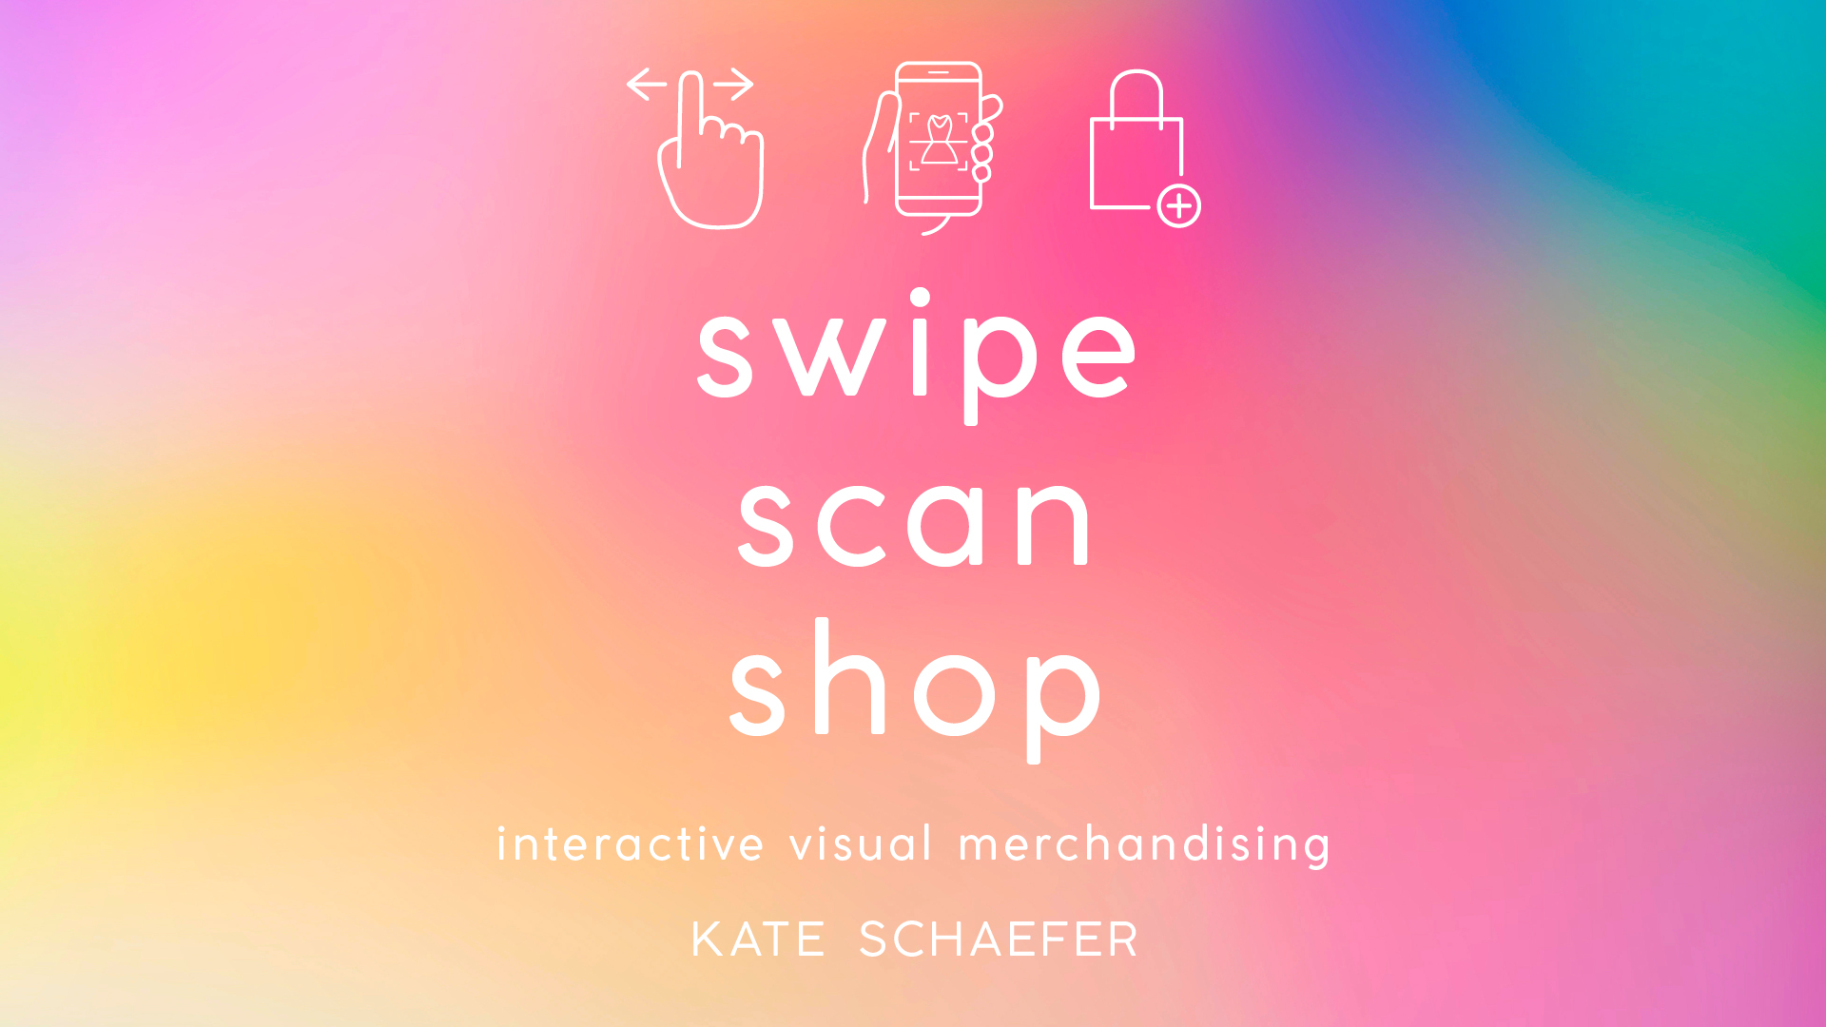

Slide 2
Store planning and design
CHAPTER 4

Slide 3
Store planning and design
Effective utilization of space, through floor plans and space management, make a store a shoppable environment
Interior elements such as fixtures, lighting and mannequins enhance the physical store layout
A shoppable environment keeps customers in the store as long as possible

Slide 4
What is store planning?
Store planning focuses on the physical space
Visual merchandising focuses on the display of products
Space allocation, store layout, floor and wall coverings, fixture types
Utilize elements to maximize sales per square foot
Experiential retail, showrooming, and pop-up shops are affecting the way sales floor are utilized

Slide 5
Store planning considerations
Retailers work to create a space that shoppers can easily navigate, find product, complete their purchase in a hassle-free manner
Store design + customer flow = improved shopping experiences
Important considerations:
Number of floors
Use of aisles; aisle width and length
Type of fixture
Mannequins or dress forms
Lighting
Additional fixtures
In-store experiences
Brand aesthetic

Slide 6
“Effective store design is an essential building block in garnering strong relationships with customers. Design touches every aspect of the retail experience. It narrates the brand and product story, it educates customers, it inspires and entertains, and it leads customers to make a purchase. Retailers that place a high importance on design innovation are the ones that will thrive.” Walter Miranda, Harbor Retail, CEO

Slide 7
What to expect: store interiors
Utilization of square footage to sell product and positively impact the customer experience
Accessibility and product engagement results in increased purchases
Store layout should subtly guide customers through the store
Exposing customers to sellable merchandise, keeping them engaged in the experience, and inspiring purchases
Cohesive branding: the entire shopping experience should reinforce brand messaging
Color, font, brand personality

Slide 8
Store interiors
Provides customers with a transition area
Allows shoppers to get acclimated to the store
Ensures merchandise is not overlooked as customers transition from exterior to interior space
Sets the tone for the rest of the store environment
Understanding traffic flow influences product placement
Majority of customers turn to the right
How does that affect merchandising strategies?
On-trend product, compelling merchandise displays, and interactive experiences capture shoppers’ attention and entice them to continue exploring the store

Slide 9
Store layouts
There are 5 most commonly used store layouts found at brick and mortar retailers:
Grid: Aisles of merchandise that direct customers through a methodical pattern. (i.e. Grocery stores and convenience stores)
Herringbone: Similar to the grid pattern, but aisles are shorter. Oftentimes there is a display featured at the end of some of the aisles
Loop: Guides shoppers around a closed loop (also referred to as a racetrack). Offers a predictable traffic flow, directing customers past all the merchandise, leading them from store entrance directly to the check-out.
Free-flow: Fixtures are not placed in a methodical way; store planning and merchandising teams can be creative in fixture placement. Often used by upscale retailers who have limited merchandise and lower inventory levels.
Forced path: Walls, doors and fixtures create a pre-determined route all shoppers have to take (i.e. Ikea)
Retailers can use a combination of these layouts, pending square footage and product assortment.
For example, Nordstrom uses different store layouts to differentiate from one department to the next.

Slide 10
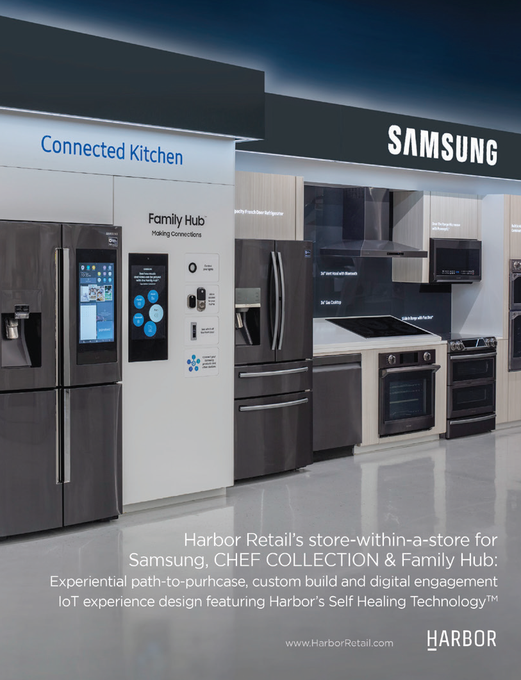
Company spotlight: Harbor Retail
Retail design company that integrates physical design with digital engagements
Retail environments are integrated and immersive
Focus on harmonic retail: online and offline experiences interact, enrich and react upon one another to create a living, harmonized brand expression throughout the customer journey
Uses e-commerce as the foundation, integrating apps, email, social media, print collateral, special events, etc.

Slide 11
Square footage vs. selling space
What is the difference?
Square footage: Overall size of the store
Selling space: Amount of space that is dedicated to displaying product
Areas of the floor where there are fixtures, tables, seating areas
Selling space now includes in-store experiences, both physical and digital
Impacts sales per square foot, which has historically been used to gauge how efficiently a retailers is utilizing their space
There is not currently a metric to determine the value of social media experiences as oftentimes interactions result in future sales

Slide 12
Square footage vs. selling space
Retailers are increasingly finding ways to incorporate charging stations for mobile devices in-store.
Why is this necessary?
Shoppers are becoming increasingly reliant on mobile devices while they shop
Retailers are offering social media moments for shoppers in-store, requiring the use of a mobile device
Keeps customers in-store longer while they wait for devices to charge
Secure charging stations allow shoppers to venture around the store while their devices charge, resulting in increased exposure to products and services

Slide 13
Why is the integration of digital technologies in the brick and mortar retail environment important?
Eighty-five percent said the store environment is an important feature when shopping.
Ninety-five percent of shoppers want to be left alone when shopping.
In-store tech offerings that fulfill customer service needs (price scanner, apps that provide promotional information) are much more important to shoppers than dressing room tech, mobile payment, and in-store events.
Thirty percent of respondents ranked free in-store Wi-Fi as an important store feature (the rate was much higher among younger shoppers who rely more heavily on their social networks while they shop).
Thirty-seven percent think tech-enhanced dressing rooms are important in clothing stores.
Sixty-five percent of shoppers said that the “buy online, pick up in-store” option is important when buying apparel.
Forty-two percent of Millennial and 38 percent of Gen Z respondents identified “reserve online and try on in-store” as important elements for apparel purchases.
Thirty-four percent ranked receiving promotional and sales information directly via smartphone when entering a store important.
Seventy-six percent rated an in-store app that provides personal recommendations as important.
Nearly 70 percent of Gen Z and 63 percent of Millennials use social media to share pictures and gather opinions from friends and family before they buy
Thirty percent said the ability to pay a sales associate from anywhere in the store is important.

Slide 14
Multi-store retailers: Creating a cohesive space
How do multi-store retailers create consistent and cohesive displays and store layouts in multiple locations?
Mock-up space: Physical space where displays are installed and product is placed; acts as a corporate directive
Allows merchandisers, buyers, and design teams to assess product placement, assign fixtures and create compelling sales floors
Virtual planograms: Software programs and virtual reality technology can recreate the physical showroom for multi-store directives

Slide 15
Digital resources: Software programs and CAD programs
Retailers create digitally rendered corporate directives for store layouts and installations
Outline seasonal themes, trends, fixtures, signage, and display guidelines
Ensure all locations across the company present a cohesive visual aesthetic
Digital renderings allow merchandising and store design teams to work more efficiently
Cloud-based communications allow users to work in real-time for planning, reviewing, edits and changes

Slide 16
Digital resources: Software programs and CAD programs
There are many different digital resources available to retailers and brands. The size and scale as well as company needs impact which resource(s) will be used. Here are a few programs widely used across the industry:
MockShop
Part of Visual Retailing platform
Allows users to create virtual 3D mockups
Ability to input store-specific fixtures and inventory to accommodate seasonal buys and themes
Creates planograms and visual guidelines for stores to follow
Virtual fixtures can be moved around for different store locations and updated based on inventory levels
Virtual floorplan allows retailers to evaluate and assess product placement and traffic flow
Retail Smart
Team of retail planning experts provide recommendations to optimize space on the sales floor
Software program helps create planograms and evaluates merchandising strategies
Breaks down the sales floor by category and department
Offers 3D experience for three-dimensional store models, including audio and video components

Slide 17
Industry trade events
Trade shows allow retailers and brands to learn about new opportunities, partnerships and collaborations for their brand
Some of the biggest trade shows for visual merchandisers include:
RetailX
NeoCon
EuroShop

Slide 18
RetailX
Educates retailers on how to integrate bricks and clicks into retail business models
Trade show that brings together GlobalShop, RFID Journal LIVE! Retail and Internet Retailer Conference and Exhibition (IRCE)
GlobalShop
Introduces emerging trends in store design, planning, construction, and visual merchandising
Internet Retailer Conference and Exhibition
World’s largest e-commerce event
RFID Journal LIVE! Retail
Focuses on how radio frequency identification (RFID) impacts store operations, merchandising strategies, and back-end systems

Slide 19
NeoCon
Tradeshow targeting industry professionals working in commercial design
Educates attendees on creating a functional and aesthetically pleasing commercial environment
Features products in categories such as furniture, fabrics, flooring, interior finishes, and technology
Seminars and presentations educate guests on design trends, busines-to-business needs, and business-to-consumer needs

Slide 20
EuroShop
World’s largest trade fair for the retail industry
Held every 3 years
Encompasses different facets of the retail industry, such as retail marketing, retail technology, event marketing, lighting, store design, and visual merchandising

Slide 21
Company spotlight: Visual retailing
Assists brands with a comprehensive retail plan, including store planning, visual merchandising, and retail execution
Offers a suite of products:
MockShop: Creates 3D mockups of stores, including store-specific fixtures and inventory
ShopShape: Cloud-based communication tool for corporate teams and store level merchandisers
Style Shoots: Photography system that provides all-in-one tools for content production for photo and video

Slide 22
Key terms
EuroShop
Forced path layout
Free-flow
Grid
Herringbone
Loop
NeoCon
Retail X
Selling space
Square footage
Store planning
Transition area

Slide 23
Critical thinking: The application process
After completing the chapter readings, reflect on the information and experiences shared. Apply what you learned to future retail experiences:
How should retailers prioritize their integration of technologies in the brick-and-mortar shopping experiences?
What does the integration of digital technologies mean for store planning and store design?
How should (or shouldn’t) existing and emerging digital technologies be integrated into store design?

